Slide 1
HNFS setup improvements
SM, 21/4/2020

Slide 2
Where to improve
Cameras (SNR, resolution)
Scintillator & optics (resolution, light yield)
Sample (SNR)

Slide 3
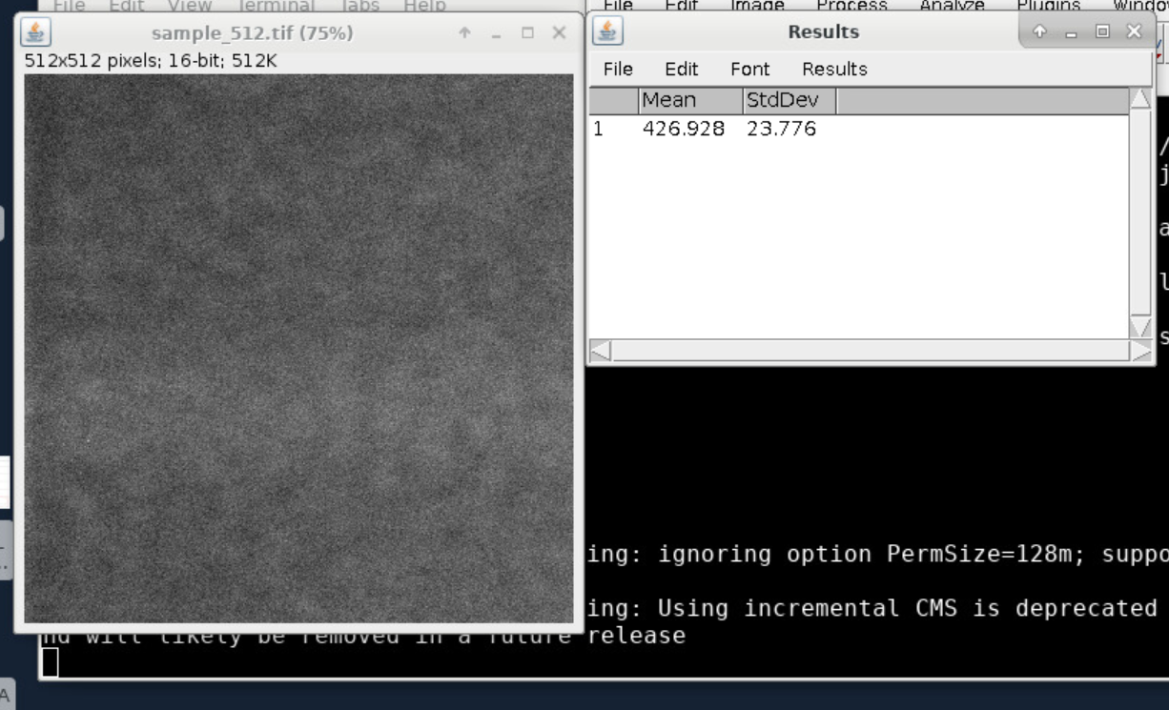
Camera
In October 2018: e- well occupied at 426/2**12 = 10% for 50 ms exposure time.

Slide 4
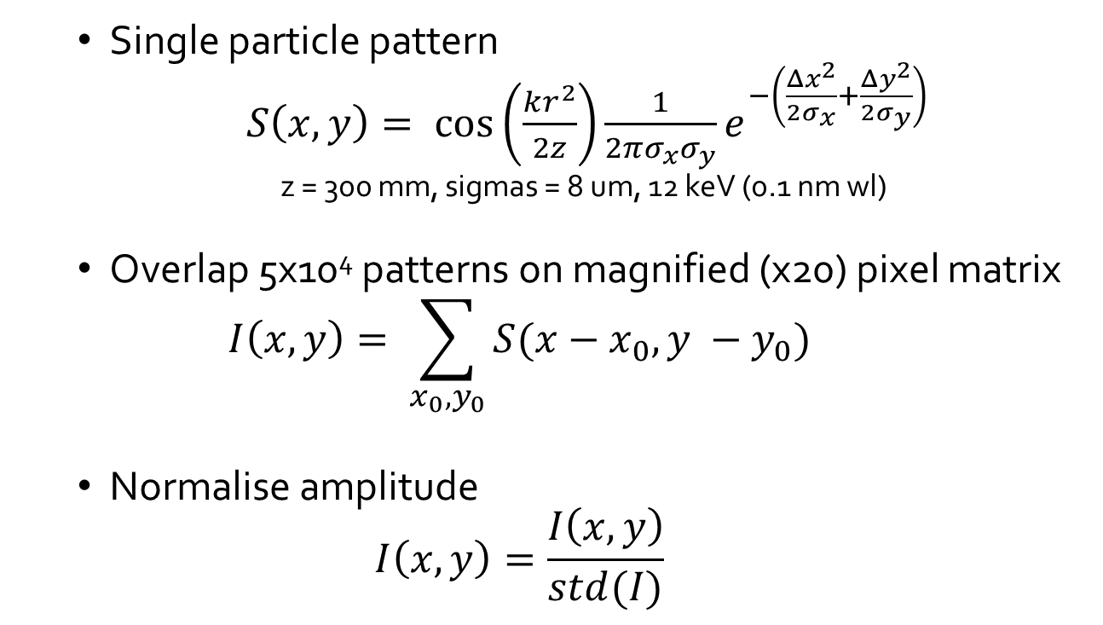
Camera – signal simulation
  Single particle pattern
  $S\left(x,y\right)= \cos\left(\frac{kr^{2}}{2z}\right)\frac{1}{2πσ_{x}σ_{y}}e^{−\left(\frac{Δx^{2}}{2σ_{x}}+\frac{Δy^{2}}{2σ_{y}}\right)}$
  z = 300 mm, sigmas = 8 um, 12 keV (0.1 nm wl)
  Overlap 5x10⁴ patterns on magnified (x20) pixel matrix
  $$I\left(x,y\right)= \sum_{x_{0},y_{0}}{S(x−x_{0},y −y_{0})}$$
  Normalise amplitude
  $$I\left(x,y\right)=\frac{I\left(x,y\right)}{std(I)}$$

Slide 5
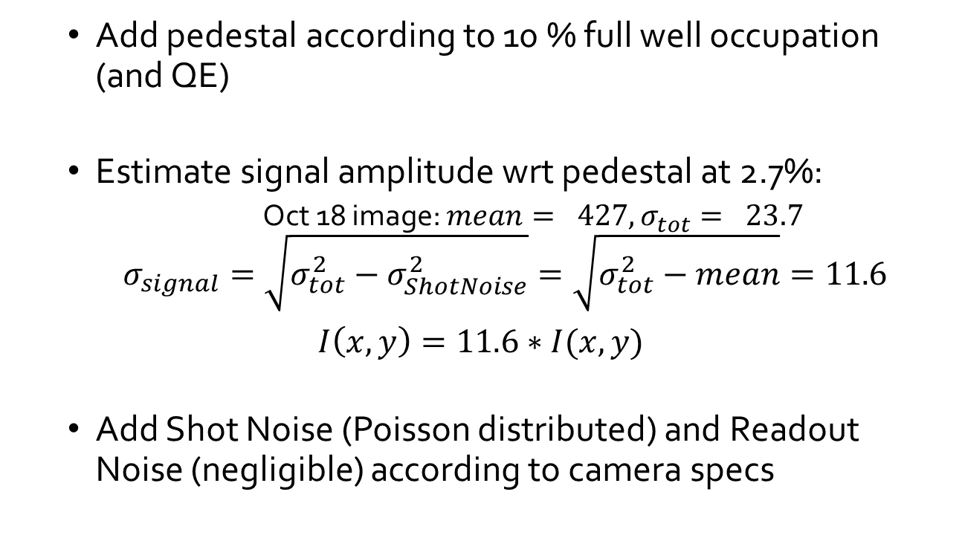
Camera – signal simulation
  Add pedestal according to 10 % full well occupation (and QE)
  Estimate signal amplitude wrt pedestal at 2.7%:
    Oct 18 image: $mean= 427, σ_{tot}= 23.7$
    $$σ_{signal}=\sqrt{σ_{tot}^{2}−σ_{ShotNoise}^{2}}=\sqrt{σ_{tot}^{2}−mean}=11.6$$
$I\left(x,y\right)=11.6∗I(x,y)$
  Add Shot Noise (Poisson distributed) and Readout Noise (negligible) according to camera specs

Slide 6
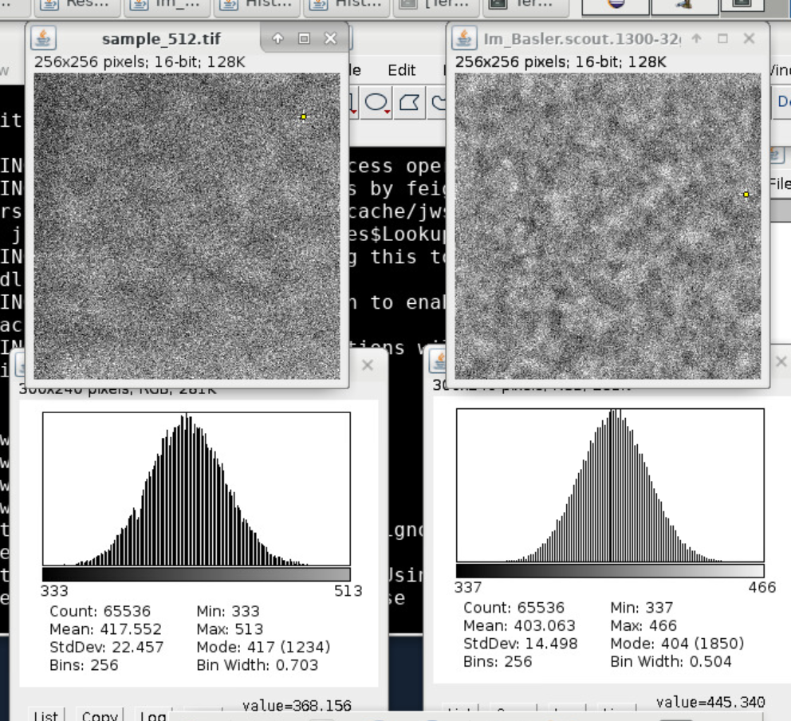
Camera – signal simulation
Measured
Simulated

Slide 7
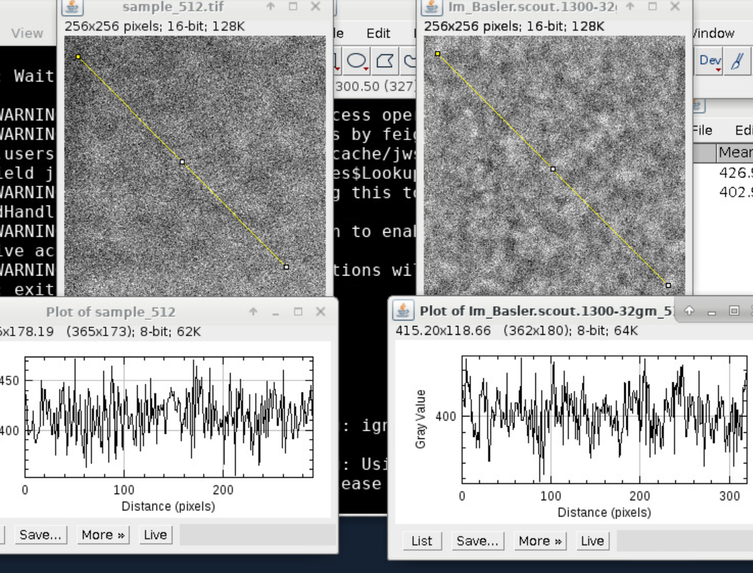
Camera – signal simulation
Measured
Simulated

Slide 8
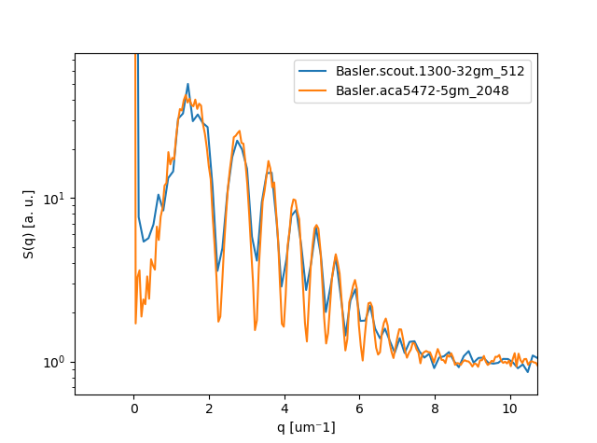
Camera - comparison
Use procedure to compare Basler Scout and Basler Ace based on specs (QE, full well capacity, pixel size, sensor size, dark noise) with equivalent photon flux.
FW occupation:
10% B. scout
4% B. Ace
difference due to smaller pixel size / larger sensor

Slide 9
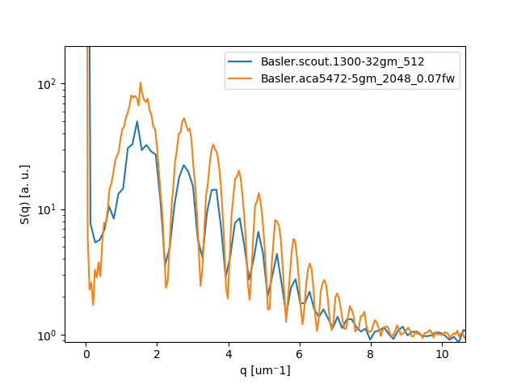
Camera - comparison
Different camera does not help much if SNR is not increased. Here comparison of present setup (blue) with Basler ace and 2x signal (orange)

Slide 10
Camera - summary
SNR is limited by shot noise, readout noise negligible.
Imperative to increase signal, better camera does not help
Smaller pixels / larger sensor size improves sp. resolution
…but what about YAG + optics resolution?

Slide 11
YAG + optics
Considerations based on paper: T. Martin et al.“Recent developments in X-ray imaging with micrometer spatial resolution”, J. Synchrotron Rad. 13, 180–194 (2006)

Slide 12
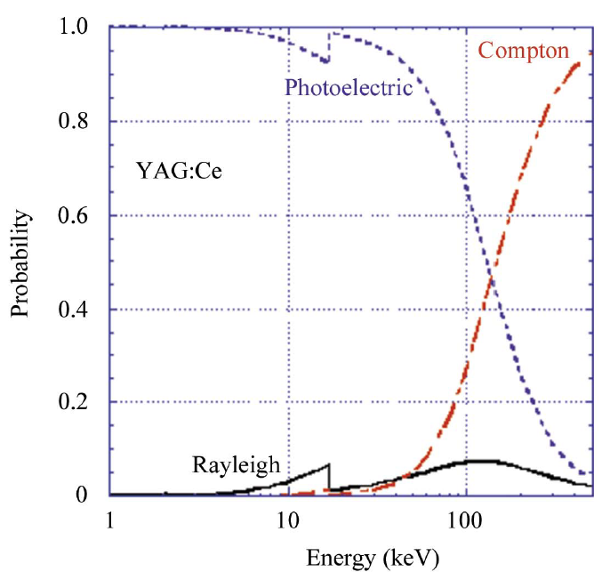
YAG
Spatial resolution in scintillator limited by:
  Photoelectric effect (absorption of X ray photon, isotropic re-emission of K band electron that causes fluorescence)
  Scattering of X rays photons (Rayleight, compton)
Ph. effect is dominant up to approx. 100 keV

Slide 13
Optics
However:
“…high spatial resolution is [thus] not limited by the scintillator but by the resolving power of the optics, i.e. in particular of the microscope objective.”

Slide 14
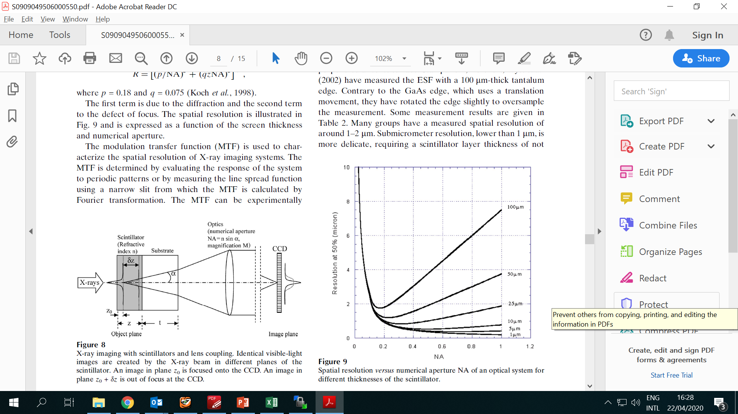
Optics
Spatial resolution affected by
  depth of field (δz)
  diffraction (λ)
  spherical aberrations (t)

Slide 15
Optics
Thicker YAG does not improve light collection: limited by depth of field (in our case a few um).
For 100 um thick YAG, 0.4 NA objective, resolution is approx. 3 um
Thinner YAG => less spherical aberrations.

Slide 16
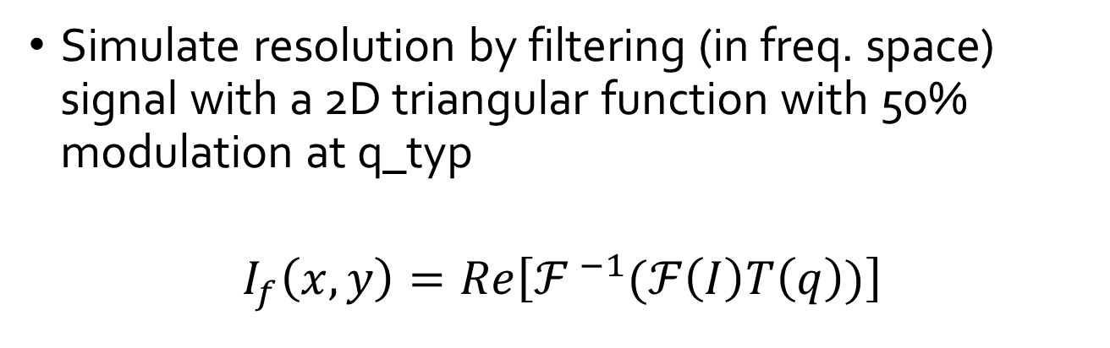
Optics
Simulate resolution by filtering (in freq. space) signal with a 2D triangular function with 50% modulation at q_typ
$$I_{f}\left(x,y\right)=Re\left[{ℱ }^{−1}(ℱ\left(I\right)T\left(q\right))\right]$$
I
1
0.5
0
q_{typ} = 2p/Res
q

Slide 17
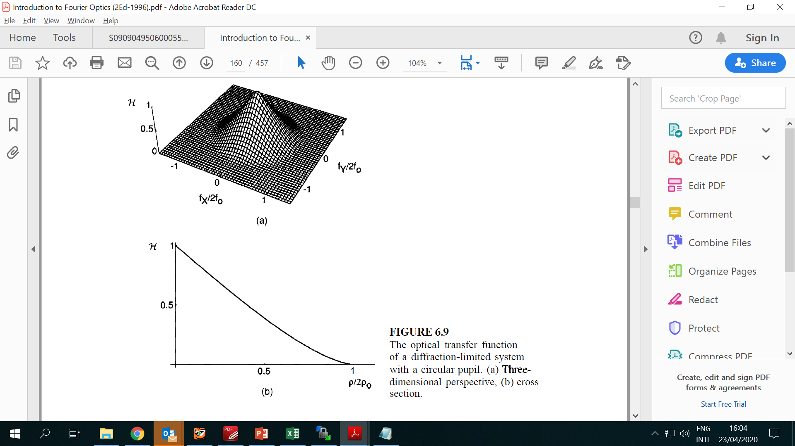
Optics
From Introduction to Fourier optics (Goodman)

Slide 18
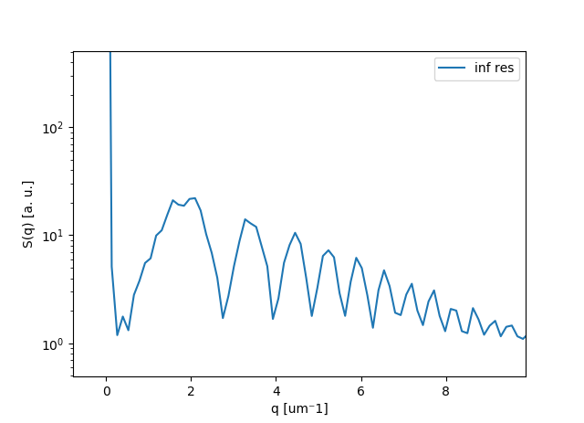
Optics
Present system, infinite resolution

Slide 19
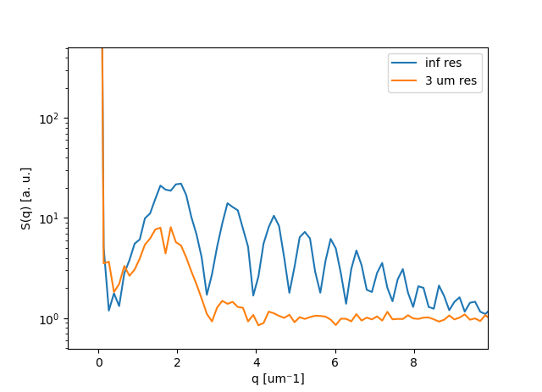
Optics
Present system, inf vs 3 um resolution

Slide 20
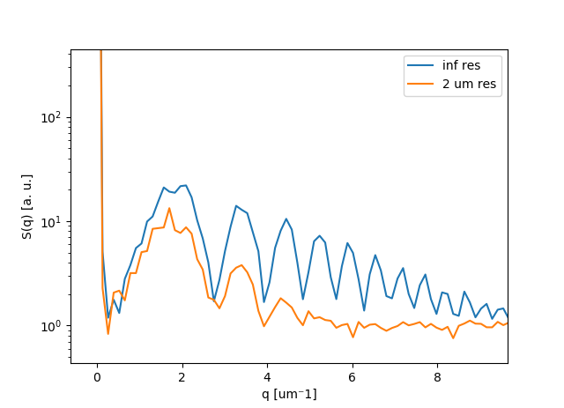
Optics
Present system, inf vs 2 um resolution. Qualitatively it looks similar to experimental data

Slide 21
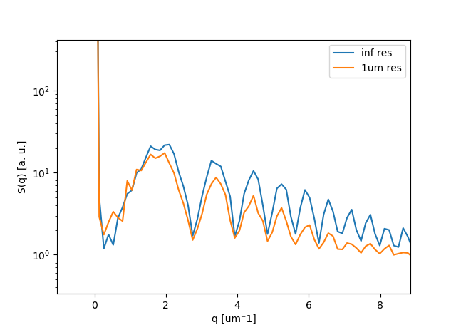
Optics
Present system, inf vs 1 um resolution

Slide 22
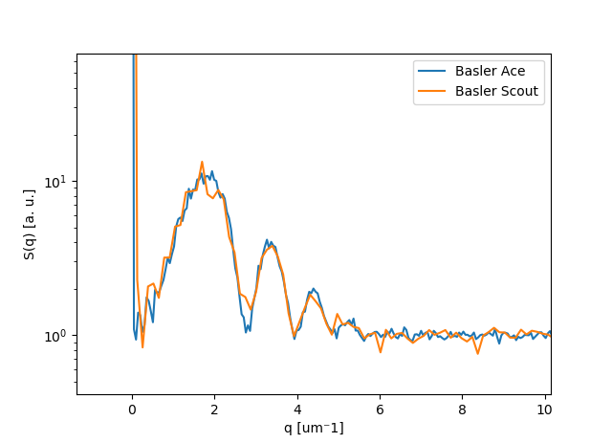
Optics
At 2 um resolution, changing camera (smaller pix) does not have a major impact

Slide 23
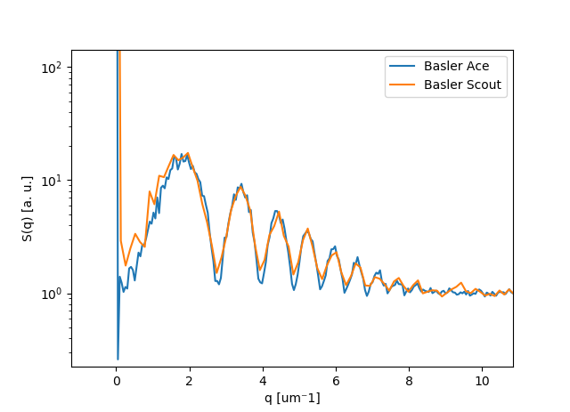
Optics
At 1 um resolution, changing camera starts to make sense

Slide 24
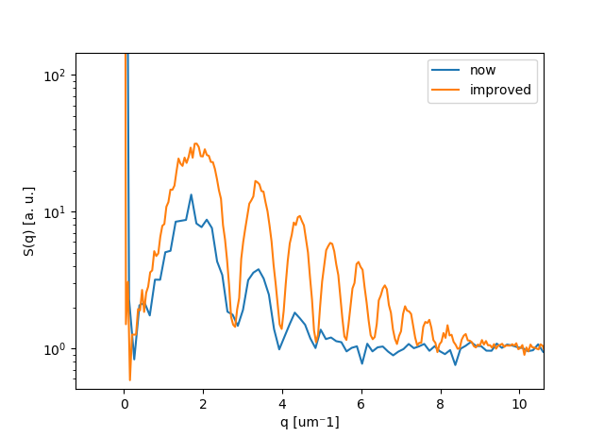
Conclusion
Ways to improve quality of data:
  Increase signal: try to increase thickness of cuvette / capillary
  Increase resolution: thinner YAG (50 um? less?)
  If resolution is increased: change camera (Basler Ace)
2x signal
2x resolution
Basler Ace camera

