Slide 1

Unit 1
Magnets for circular accelerators: the arc
Ezio Todesco
European Organization for Nuclear Research (CERN)
Lectures based on USPAS courses in 2009-2015 with P. Ferracin, H. Felice, S. Prestemon
and on University of Milano Bicocca courses in 2016-2018
Thanks to L. Bottura and G. de Rijk for proposing and supporting this initiative
All the units will use International System (meter, kilo, second, ampere) unless specified

Slide 2
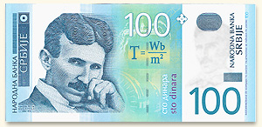
FOREWORD
The science (or the art …) of superconducting magnets is a exciting, fancy and dirty mixture of physics, engineering, and chemistry
  Chemistry and material science: the quest for superconducting materials with better performances
  Quantum physics: the key mechanisms of superconductivity and superfluidity
  Classical electrodynamics: magnet design
  Mechanical engineering: support structures
  Electrical engineering: powering of the magnets and their protection
  Cryogenics: keep them cool …
The cost optimization is a key element
  Keep them cheap …

Slide 3
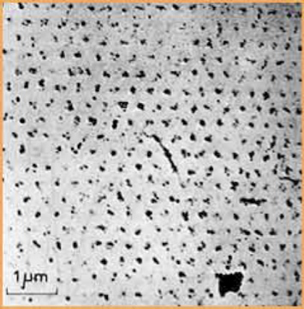
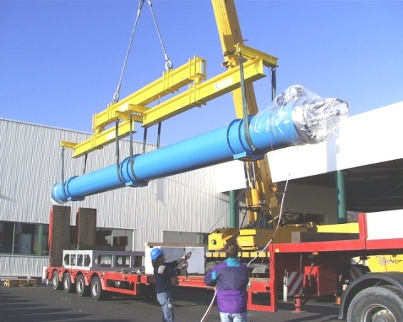
FOREWORD
An example of the variety of the issues to be taken into account
  The field of the LHC dipoles (8.3 T) is related to the critical field of Niobium-Titanium (Nb-Ti), which is determined by the microscopic quantum properties of the material
  The length of the LHC dipoles (15 m) has been determined by the maximal dimensions of (regular) trucks allowed on European roads
This makes the subject complex, challenging and complete for any physicist or engineer who has the chance of working in this field
Quantized fluxoids penetrating a superconductor used in accelerator magnets
A 15m truck unloading a 27 tons LHC dipole

Slide 4
AIM OF THE LECTURES
Superconducting magnets for particle accelerators are a vaste domain
These lectures will be especially focused on magnets for colliders, with a special eye on the CERN high energy infrastructures
  The Large Hadron Collider, 27 km tunnel with 8 T magnets based on Nb-Ti (CERN-2004-0039, the blue book)
  The HL-LHC, upgrade in luminosity of the LHC – ongoing project with installation foreseen in 2025 (CERN-2017-007)
  We will give some examples for the studies related to FCC (Future Circular Colliders)
    A 100 TeV collider based on a 16 T Nb₃Sn dipole in a 100 km tunnel (CERN-ACC-2018-058)
    A ∼30 TeV collider based on 16 T Nb₃Sn dipole in the LHC tunnel (also known as HE-LHC) (CERN-ACC-2018-059)

Slide 5
A SUMMARY OF THE TOOLS
Estimating order of magnitudes
  Can be done just thinking, no need of paper
Back-of-the-envelope
  Based on simple analytical formulas, can be done on a sheet of paper and with a pocket calculator
Analytical tools
  More complex formulas, but still analytical, that can be implemented on a worksheet (Excel type)
  Allow a fast sensitive analysis
Simple self-made codes (100-1000 lines)
  Equations need integration, or optimization problem needs iterative procedures, that can be coded
  Difficulty: you have to write the code
Complex codes (10k lines)
  Finite elements codes (ROXIE ANSYS) or multiphysics (COMSOL, …)
  Difficulty: you have to write the input and understand the output

Slide 6
AIM OF THE LECTURES
A good physicist/engineer should have a toolbox available to solve the challenges
  According to the type of problem, be sure to use the right tool
    Don’t spend hours with a screwdriver if you need a hammer …
  Don’t be afraid of be imprecise, if you are aware of the level of your imprecision – go in successuve steps of approximation
Aim of the lectures
  Cover the main physics and the main equations of magnet design, bringing the partecipants up to the « aware » use of complex codes like ANSYS, ROXIE or COMSOL
    We will not deal with complex codes
  Many things can be done analytically!
    The analytical approach has the advantage of allowing a fast sensitive analysis
    Not easy to find in the literature

Slide 7
AIM OF THE LECTURES
Estimating order of magnitudes
  Can be done just thinking, no need of paper
Back-of-the-envelope
  Based on simple analytical formulas, can be done on a sheet of paper and with a pocket calculator
Analytical tools
  More complex formulas, but still analytical, that can be implemented on a worksheet (Excel type)
  Allow a fast sensitive analysis
Simple self-made codes (100-1000 lines)
  Equations need integration, or optimization problem needs iterative procedures, that can be coded
  Difficulty: you have to write the code
Complex codes (10k lines)
  Finite elements codes (ROXIE ANSYS) or multiphysics (COMSOL, …)
  Difficulty: you have to write the input and understand the output
We will focus on these tools

Slide 8
PLAN OF THE LECTURES
Part 1 – From beam dynamics to magnet specifications
  Unit 1: the energy of a synchrotron and the magnets in the arcs
  Unit 1.2: the luminosity in a collider and the interaction region magnets
Part 2 – Principles of electromagnets
Part 3 – Basics of superconductivity
Part 4 – Magnet design
  Each unit lasting approximately 90 minutes
  Additional units with exercises could be envisaged

Slide 9
RULE OF THE LECTURES
Lectures are carried out in the early European morning to allow participation from Eurasia
Please register for each unit, so we have an idea of the attendance
  Put also your institute
When entering vidyo, please use your name and surname
  Please, not email of initials …
During the lecture mute the microphone
Questions
  I will stop from time to time to open for questions
  When you make questions, please switch camera on
Lectures will be registered, but this should not limit the possibility to put questions (even naïve, wrong, or stupid) – we are here to learn

Slide 10
Unit 1
Magnets for circular accelerators: the arc
Ezio Todesco
European Organization for Nuclear Research (CERN)
Lectures based on USPAS courses in 2009-2015 with P. Ferracin, H. Felice, S. Prestemon
and on University of Milano Bicocca courses in 2016-2018
Thanks to L. Bottura and G. de Rijk for proposing and supporting this initiative
All the units will use International System (meter, kilo, second, ampere) unless specified

Slide 11
CONTENTS
Principles of synchrotron
How to keep particles on a circular orbit
  Relation between energy, dipolar field, machine length
The beam size and principles of focusing
  Aperture requirements for arc dipoles and arc quadrupoles
  Gradient requirements for arc quadrupoles
Some examples
Conclusions

Slide 12
PRINCIPLES OF A SYNCHROTRON
Electro-magnetic field accelerates particles
Magnetic field steers the particles in a ∼circular orbit
  Driving particles in the same accelerating structure several times
  Particle accelerated → energy increased → magnetic field increased (“synchro”) to keep the particles on the same orbit of curvature ρ
Limits to the increase in energy
  The maximum field of the dipoles (proton machines)
    This is why high field magnets are important to get high energies!
    Paradox: B does not accelerate but limits the energy
  The synchrotron radiation due to bending trajectories (electron machines) – ignored in these lectures
Constant

Slide 13
PRINCIPLES OF A SYNCHROTRON
Colliders: two beams with opposite momentum collide
  This doubles the energy !
  One pipe if particles collide their antiparticles (LEP, Tevatron)
  Otherwise, two pipes (ISR, RHIC, HERA, LHC)

Slide 14
PRINCIPLES OF A SYNCHROTRON
The arcs: region where the beam is bent
  Dipoles for bending
  Quadrupoles for focusing
  Correctors
Long straight sections (LSS)
  Interaction regions (IR) where the experiments are housed
    Quadrupoles for strong focusing in interaction point
    Dipoles for beam crossing in two-ring machines
  Regions for other services
    Beam injection (dipole kickers)
    Accelerating structure (RF cavities)
    Beam dump (dipole kickers)
    Beam cleaning (collimators)
LHC: 27.6 km of tunnel, 20.5 km in the arcs, 7.2 km in the insertions
A schematic view of a synchrotron
The lay-out of the LHC

Slide 15
CONTENTS
Principles of synchrotron
How to keep particles on a circular orbit
  Relation between energy, dipolar field, machine length
The beam size and principles of focusing
  Aperture requirements for arc dipoles and arc quadrupoles
  Gradient requirements for arc quadrupoles
Some examples
Conclusions

Slide 16
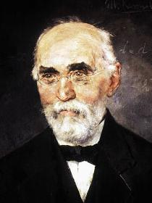
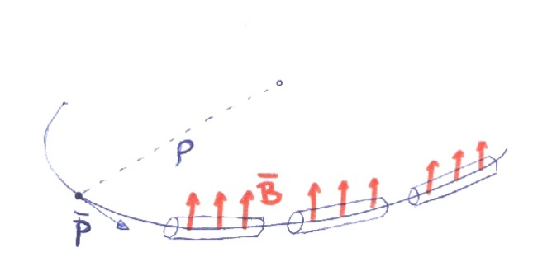
HOW TO KEEP PARTICLES ON A CIRCLE
Kinematics of circular motion
Relativistic dynamics
Lorentz (?) force
Putting all together
  Hyp. 1 - longitudinal acceleration<<transverse acceleration
Hendrik Antoon Lorentz, Dutch
(18 July 1853 – 4 February 1928), painted by Menso Kamerlingh Onnes, brother of Heinke

Slide 17
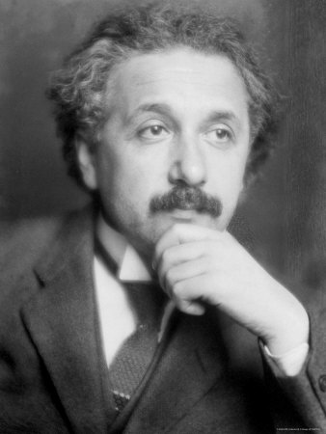
A DIGRESSION ON “RELATIVISTIC MASS”
Note: in several books
  The mass is called the rest mass
  A new relativistic mass is defined
  So that the momentum is still defined as
  This is why you see in several texts that accelerating corresponds to increase the mass (?)
    This is a rather controversial intepretation of the formalism
    Einstein was not in favour of it – I will follow his advice
“It is not good to introduce the concept of the mass of a moving body for which no clear definition
can be given. It is better to introduce no other mass concept than the ’rest mass’ m. Instead of introducing
M it is better to mention the expression for the momentum and energy of a body in motion.”
— Albert Einstein in letter to Lincoln Barnett, 19 June 1948 (quote from L. B. Okun (1989), p. 42^{[1]}
    Other authors against this concept
  "The concept of "relativistic mass" is subject to misunderstanding. That's why we don't use it. First, it applies the name mass - belonging to the magnitude of a 4-vector - to a very different concept, the time component of a 4-vector. Second, it makes increase of energy of an object with velocity or momentum appear to be connected with some change in internal structure of the object. In reality, the increase of energy with velocity originates not in the object but in the geometric properties of spacetime itself."^{[18]}
  E. F. Taylor, J. A. Wheeler (1992), Spacetime Physics, second edition, New York: W.H. Freeman and Company, ISBN 0-7167-2327-1
Albert Einstein, German
(14 March 1879 – 18 April 1955)

Slide 18
RELATION BETWEEN
GAMMA, VELOCITY AND ENERGY
What are the ranges of velocity obtained in particle accelerators?
  From 10⁻⁴ to 10⁻¹¹ from the speed of light !
    Please note e⁻ in LEP (100 GeV) go faster than p⁺ in LHC (7 TeV)
    This happens since 7000/100 < 2000, ie the ratio between p and e mass

Slide 19

HOW TO KEEP PARTICLES ON A CIRCLE
Preservation of 4-momentum
  Rest energy
  Hyp. 2 Ultra-relativistic regime
  Using practical units for particle with charge as electron, one has
  magnetic field in Tesla …
    Remember 1 eV=1.602×10⁻¹⁹ J
    Remember 1 e= 1.602×10⁻¹⁹ C

Slide 20
ALL YOU HAVE TO KNOW
ABOUT TAYLOR SERIES
For small ε, one has
Example
  α=1 is trivial
  α=2 is a bit less trivial
  For ε=0.01 (1+0.01)²=1.0201 1+2×0.01+ .. = 1.02+ …
  What is neglected? Order of ε², so my result is precise up to 0.0001
Application to relativity
  We find Newton: energy is mv²/2

Slide 21
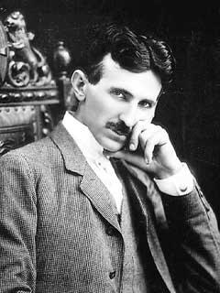
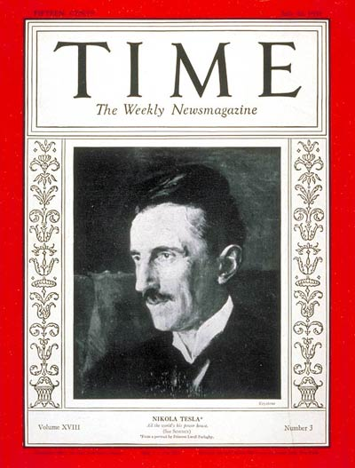
TESLA DIGRESSION
Nikolai Tesla (10 July 1856 - 7 January 1943)
  Born at midnight during an electrical storm in Smiljan
  near Gospić (now Croatia)
  Son of an orthodox priest
  A national hero in Serbia
Career
  Polytechnic in Gratz (Austria) and Prague
  Emigrated in the States in 1884
  Electrical engineer
  Inventor of the alternating current induction motor (1887)
  Author of 250 patents
Miscellaneous
  Strongly against marriage
  Considered sex as a waste of vital energy
Tesla, man of the year

Slide 22
HOW TO KEEP PARTICLES ON A CIRCLE
Relation momentum-magnetic field-orbit radius

Slide 23
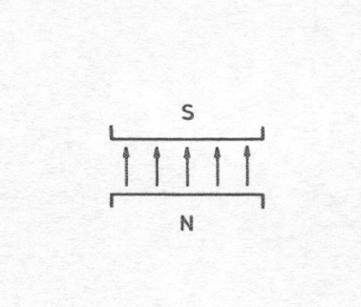
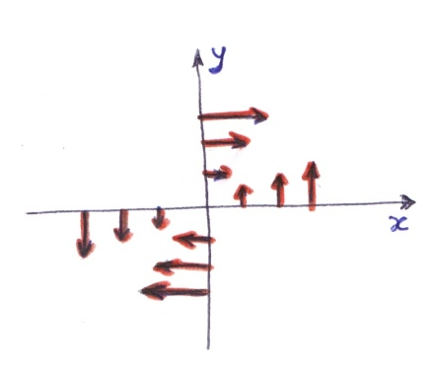
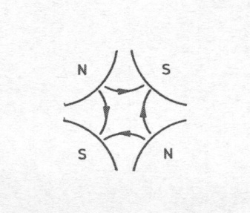
HOW TO KEEP PARTICLES ON A CIRCLE
The magnet that we need should provide a constant (over the space) magnetic field, to be increased with time to follow the particle acceleration
  This is done by dipoles
As the particle can deviate from the orbit, one needs a linear force to bring it back (like a spring)
  We will show in the next section that this is given by quadrupoles

Slide 24
CONTENTS
Principles of synchrotron
How to keep particles on a circular orbit
  Relation between energy, dipolar field, machine length
The beam size and principles of focusing
  Aperture requirements for arc dipoles and arc quadrupoles
  Gradient requirements for arc quadrupoles
Some examples
Conclusions

Slide 25
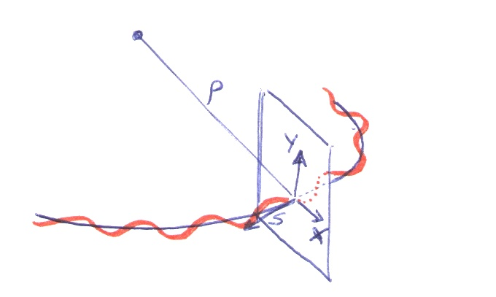

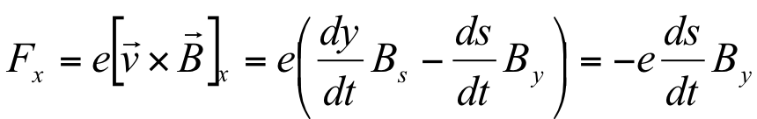
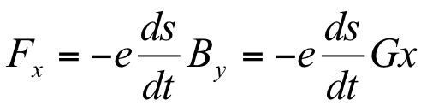
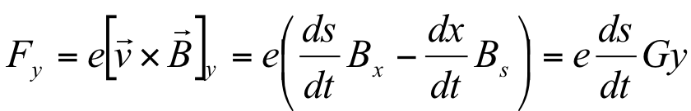
SIZE OF THE BEAM AND FOCUSING
The force necessary to stabilize linear motion is provided by the quadrupoles
  Quadrupoles provide a field which is proportional to the transverse deviation from the orbit, acting like a spring
  Let us write the electromagnetic force

Slide 26
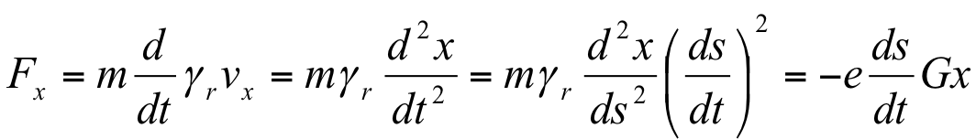
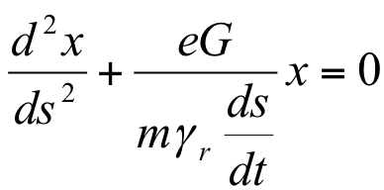
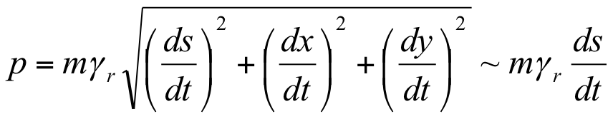
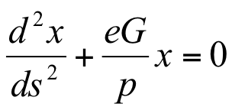
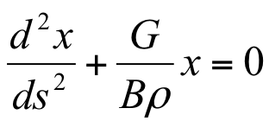
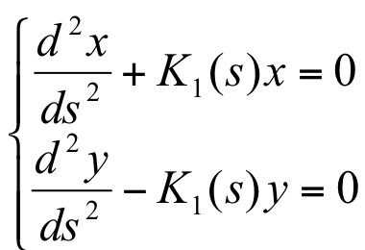
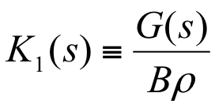
SIZE OF THE BEAM AND FOCUSING
The motion equation read
And therefore
Since the momentum is manly carried in the longitudinal direction
One has
And finally defining the gradient K

Slide 27
SIZE OF THE BEAM
In this way the motion equation in the transverse space is similar to a harmonic oscillator
  where the force depends on time …
  Solution: a oscillator whose amplitude and frequency are modulated
  We write the amplitude as a s-dependent part (beta function) plus an invariant along the ring
  The invariant is inverse proportional to the energy – so one can define a new invariant, also independent of the energy

Slide 28
SIZE OF THE BEAM
Size of the beam is given by
  ε: emittance invariant along the ring, invariant from ring to ring
    This is a property of the injectors!
  Beam energy: the larger the energy, the smaller the beam
  β is the beta function [m], giving the envelope of the beam along the ring (the so-called optics)

Slide 29
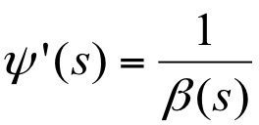
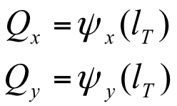
BEAM OSCILLATIONS
It may appear strange to use a square root
The big advantage of using a square root is that there is a relation between the beta function and the phase advance
  Large beta fuction, small phase advance
  Small beta function, large phase advance
The tune is the phase advance over the ring

Slide 30
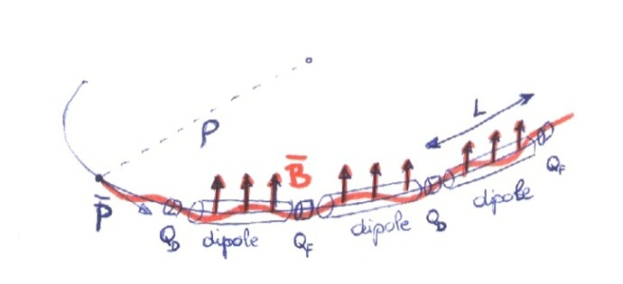
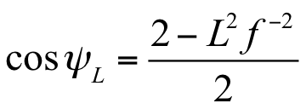
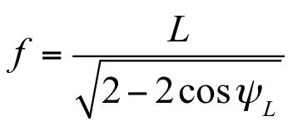
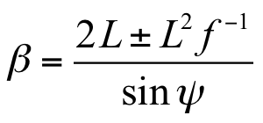
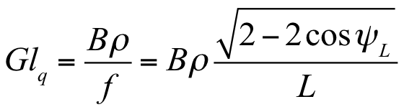
SIZE OF THE BEAM
A bit more insight on beta functions
  A typical structure is the FODO cell:
  alternating quadrupoles spaced by length L
  of similar gradient, with focal length f
    One can prove that this gives stable solutions in both transverse planes
    … and that the phase advance per cell Ψ_{L} the focusing length f and the beta function are related to
Cell length 2L

Slide 31
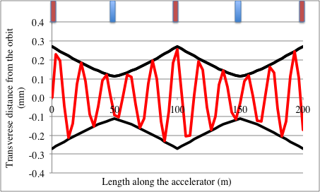
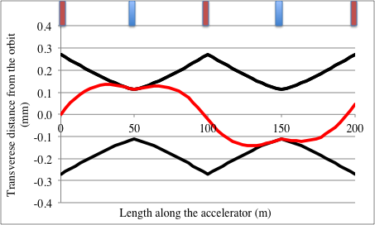
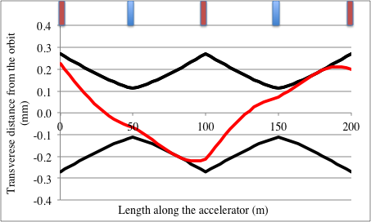
SIZE OF THE BEAM
A bit more insight on orbit shape
  The orbits of the particle oscillate within the envelope of the beta function
  In reality, the phase advance is 90 degrees so the orbit is rather like this (two cases shown with different starting points

Slide 32
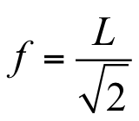
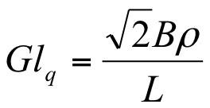
SIZE OF THE BEAM
A bit more insight on beta functions
  The phase advance usually is set to ∼integer have a periodicity
    Example of a 90° phase advance, i.e. one complete transverse oscillation after s=8L, ie eight quadrupoles
    One can prove that for 90° cells
  ☺ The larger L, the less quads you need
  ☺ The larger L, the lower integrated gradient
  ☹ The larger L, the larger the beam
Cell legth 2L

Slide 33
SIZE OF THE BEAM
Example of the LHC:
  L=50 m, β_{f} =170 m, β_{d} =30 m
  The beta functions are in meters
  they are related, but not equal to the beam size
  Pay attention ! β_{f} =170 m does not mean that the beam size is 170 m !!
  It is not easy to “feel” the dimension of a beta function
Radius of the beam in the arc (1 sigma)
  LHC: ε_{n} =3.75 10⁻⁶ m rad
    High field E=7 TeV, γ=7460, σ=0.29 mm
    Injection E=450 GeV, γ=480, σ=1.2 mm
  LHC requirement: beam is cut around 6σ=7 mm – radius of arc magnets aperture is 28 mm, i.e. about a factor four larger

Slide 34
FOCUSING
Focusing in a FODO cell
  Thin lens approximation: focusing strength in a 90° FODO cell is
  The focusing strength is related to K₁
  and to the quadrupole length ℓ_{q}
  and the quadrupole gradient is
  LHC: at high field B=8.33 T, ρ=2801 m, L=50 m, G ℓ_{q}=660 T
  Case of 60° phase advance: linear dependence on L, different constants
    It looks interesting: same beam size, 30% less focusing required

Slide 35
CONTENTS
Principles of synchrotron
How to keep particles on a circular orbit
  Relation between energy, dipolar field, machine length
The beam size and principles of focusing
  Aperture requirements for arc dipoles and arc quadrupoles
  Gradient requirements for arc quadrupoles
Some examples
Conclusions

Slide 36
FIRST EXAMPLE: LHC
The Large Hadron Collider
  E=7000 GeV
  Nb-Ti magnets, dipole field B=8.3 T, 14.3 m long
    Total (magnetic) length of dipoles 1232×14.3=17.6 km
  Cell semilength L=50 m
    Beta function in the focusing quad β_{f} =170 m
    Filling factor 14.3×3/50=86%
  27.6 km of tunnel, 20.5 km in the arcs, 7.2 km in the insertions
  Emittance ε=3.75×10⁻⁶m rad
  Injection energy 450 GeV, γ=480
    Beam size σ=0.0012 m (at injection)
    Coil aperture of 0.056 m (coil-to-coil)

Slide 37
FIRST EXAMPLE: LHC
LHC arc quadrupoles
  56 mm aperture, Nb-Ti, gradient of 220 T/m
    Corresponds to 220×0.028=6.2 T field on the bore
    One could do 10-20% better but not more
  LHC cell phase advance of 90 degrees
  Integrated gradient of 660 T required, with 3.0-m-long quadrupoles
    Note that these are approximated formulas, LHC quadrupole length is 3.15 m
  Therefore, over a cell whose length is 2L = 100 m we have
    Six 14.3-m-long dipoles → total 86 m (86%)
    Two 3-m-long quadrupoles → total 6 m (6%)
    Plus interconnections and correctors

Slide 38
SECOND EXAMPLE: HE-LHC
A higher energy collider in the LHC tunnel (HE-LHC)
  Assume a 16 T dipole available
  Which energy ? First easy answer, assume same filling factor as LHC, we just scale the energy with the field
    E=7.0/8.33*16 = 13.45 TeV
  If we assume the same injection energy, and the same cell semilength, we obtain the same aperture of 56 mm
  What about the quadrupoles ? We need
  Now B nearly doubles, so integrated gradient becomes 1270 T (it was 660 T for the LHC)
  Since Nb₃Sn cannot do more than 300 T/m in 56 mm aperture (we will see this much later), we will have 4.2 m long quadrupoles
    We lose 2.5% in the filling factor (need 2.5 meters more for two quadrupole in 100 m cell) → the energy shall be not 13.45, but 13.11 TeV

Slide 39
SECOND EXAMPLE: HE-LHC
A higher energy collider in the LHC tunnel (HE-LHC)
  What about if we want to save on the cost of the quadrupoles and make them in Nb-Ti ?
  1270 T of integrated gradient is done with 5.7 m long quadrupoles giving 220 T/m
  Now with respect to the LHC we lose 2.6 m per quadrupole, 5.2 m per cell, i.e. 5% in filling factor → energy will be 12.77 TeV instead of 13.44 TeV
    … unless I can increase the dipole field by 5%, i.e. going from 16 T to 16.8 T – but this looks difficult with Nb₃Sn …

Slide 40
SECOND EXAMPLE: HE-LHC
A higher energy collider in the LHC tunnel (HE-LHC)
  I could also work on the cell length – let us have a cell with L=100, then I just need 630 T of integrated gradient
  So I can use cheaper Nb-Ti with 220 T/m – I could even reuse LHC quadrupoles
  But the peak beta function will double to 320 m
  And I could probably need more aperture – not the double, since it depends with a square root – but to be verified
  … and the optimization goes on…

Slide 41
THIRD EXAMPLE: FCC
A 100 km, 100 TeV collider with 16 T magnets (FCC)
  E=50,000 GeV
  Nb-Ti magnets, dipole field B=16 T
    Curvature radius 10.4 km
    Total length of dipoles L_{d}=65.4 km – looks reasonable for 100 km tunnel
  Cell semilength L=100 m
    Better to increase theLHC value otherwise quadrupole needs will become huge
    Beta function in the focusing quad β_{f} =340 m
  Emittance ε=3.75×10⁻⁶m rad
  Injection energy 1 TeV GeV
    Beta has doubled, but I also double gamma so the aperture is the same as in the LHC

Slide 42
THIRD EXAMPLE: FCC
FCC arc quadrupoles
  We need 2350 T of integrated gradient
  Even with Nb₃Sn quadrupoles, we have 300 T/m and 7.8 m long
  Since we increased the cell length, we have only one quadrupole per 100 m, and therefore quadrupole uses 7.8% of the cell length
Summarizing
  65.4 km of 4573 dipoles (14.3 m long)
  200 m long cell, 1 quadrupole every 6 dipoles: total 762 quadrupoles, occupying 6.0 km
  Interconnection and correctors: 1 m per magnet → 6 km more
  Total length of the arcs: 77 km, the rest for insertions (topic of next unit)

Slide 43
CONCLUSIONS
Equation for a synchrotron
  And for a ultrarelativistic proton/electron one has
More energy?
  Either brute force (longer collider)
  Or technological development (higher magnetic field)
Speed world record is not of LHC, but of LEP
Do not use relativistic mass
  Fast particles do not get fatter
approximation

Slide 44
CONCLUSIONS
Equation for the transverse particle motion
  Like an pendulum, but frequency and amplitude vary along the accelerator
  Alternating sign quadrupoles guarantee stability of oscillations
Aperture requirement is given by
  More energy requires less aperture
  More beta requires more aperture
Essential parameter: spacing between quadrupoles L
  L=50 m in the LHC
  This gives the amplitude of oscillations and the requirements for magnet aperture
  The function beta is proportional to quadrupole spacing
  For a 90 degrees cell
approximation

Slide 45
CONCLUSIONS
The integrated gradient of the quadrupole is inverse proportional to the quadrupole spacing L
The lattice design implies a balance between
  Large spacing L: less quadrupoles in number and in strength, more space for dipoles but larger aperture magnets
  Small spacing L: more quadrupoles in number and in strength, less space for dipoles, but smaller aperture
approximation

Slide 46
REFERENCES
  Beam dynamics - arcs
    P. Schmuser, et al, Ch. 9.
    F. Asner, Ch. 8.
    K. Steffen, “Basic course of accelerator optics”, CERN 85-19, pg 25-63.
    J. Rossbach, P. Schmuser, “Basic course of accelerator optics”, CERN 94-01, pg 17-79.

Slide 47
ACKNOWLEDGEMENTS
    J. P. Kouthcouk, M. Giovannozzi, W. Scandale for discussions on beam dynamics and optics
    www.wikipedia.org for most of the pictures

Slide 48
FLOWCHART FOR MAGNET PARAMETERS

Slide 49
FLOWCHART FOR MAGNET PARAMETERS

Slide 50
FLOWCHART FOR MAGNET PARAMETERS
Input 1. Collision energy E_{c}
  Gives a relation between the dipole magnetic field B and the total length of the dipoles L_{d}
Technology constraint 1. Dipole magnetic field B
    Does not depend on magnet aperture
    B_{t} <2 T for iron magnets
    B_{t} <13 T for Nb-Ti superconducting magnets (10 T in practice)
    B_{t} <25 T for Nb₃Sn superconducting magnets (16 T in practice)
Output 1. Length of the dipole part
        Length in m, B in T, energy in GeV

Slide 51
FLOWCHART FOR MAGNET PARAMETERS

Slide 52
FLOWCHART FOR MAGNET PARAMETERS
Input 2. Injection energy E_{i}
  Determines the relativistic factor, that affect the beam size
Constraint 2. Normalized beam emittance ε
  Determined by the beam properties of the injectors
Semi-cell length L
  This is a free parameter that can be used to optimize
  Determines the beta functions
Output 2. Aperture of the arc magnets (also determined by field errors and beam stability)
  Size of the beam at injection
  Magnet aperture (diameter)

Slide 53
FLOWCHART FOR MAGNET PARAMETERS

Slide 54
FLOWCHART FOR MAGNET PARAMETERS
Technology constraint 1. Quadrupole magnetic field vs aperture
Output 3. Gradient of the quadrupoles
Semi-cell length L
  Also determines the focusing, i.e. the integrated gradient
Output 4. Length of the quadrupoles

Slide 55
FLOWCHART FOR MAGNET PARAMETERS
Output 5. Number of semi-cells and arc length
  Number of semi-cells = number of quadrupoles = n_{q}
  Length of the arc L_{a}

