Slide 1
Muon System Properties of recent Collider Experiments
An Inventory
Burkhard Schmidt
12.04.2010
Please note that the presentation is not yet complete.
Only CMS has been looked at so far

Slide 2
Overview
Muon Systems considered:
  LHC experiments:
    CMS, ATLAS and LHCb
  Experiments at B-factories
    Babar and Belle
  To be included as well:
    ILC experiments ILD and SiD
Properties of Interest:
  Main design features
    Number of stations, thickness of hadron absorber
  Expected background rates
    Have direct impact on technology choices
  Spatial- and Time-resolutions
    Strongly related to the main purposes of a muon system, such as Muon ID, Muon momentum measurement, Muon triggering
    Have a strong impact on the technology choices

Slide 3
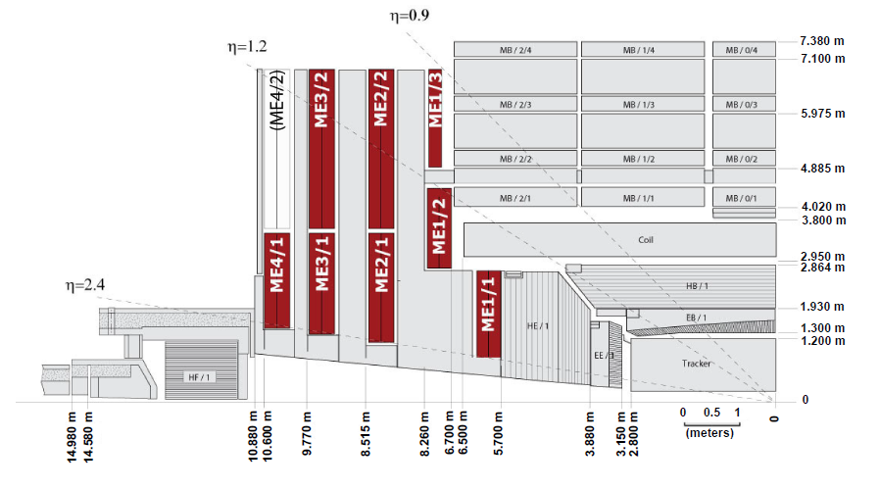
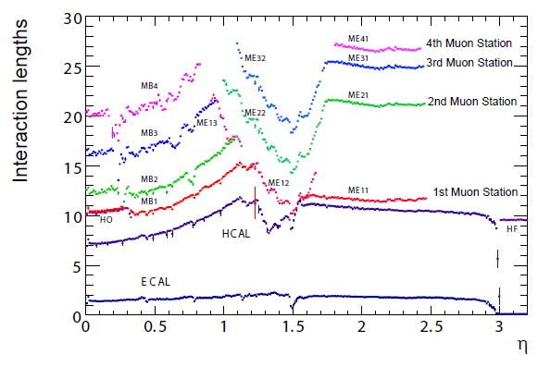
A closer look at CMS:
Thickness of the Hadron Absorber

Slide 4
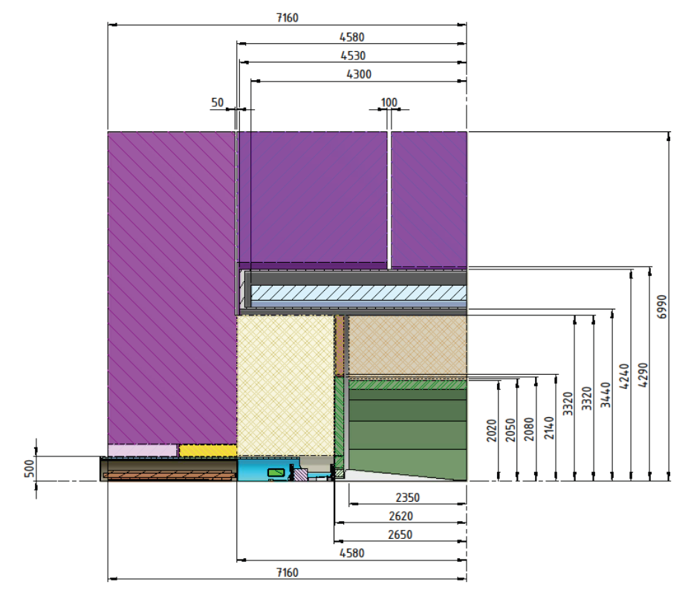

Comparison CMS - ILD
Huge difference in
absorber depth and
space for instrumentation
→ To be looked into

Slide 5
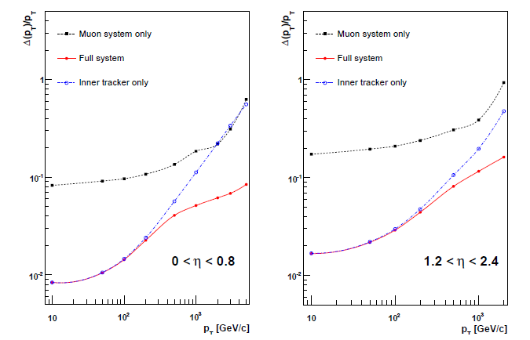
Momentum resolution

Slide 6
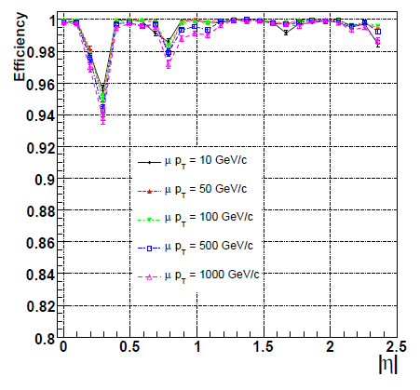
Other characteristics
→ To be completed

