Slide 1
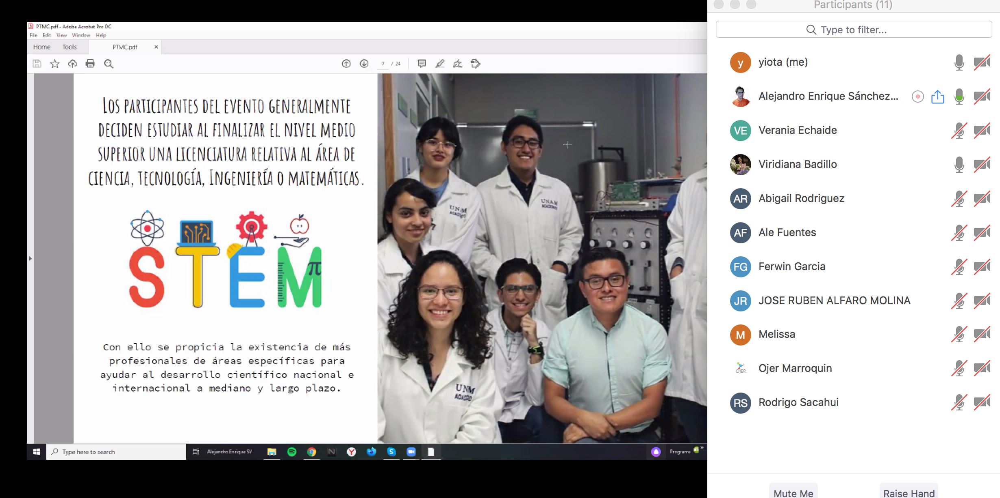
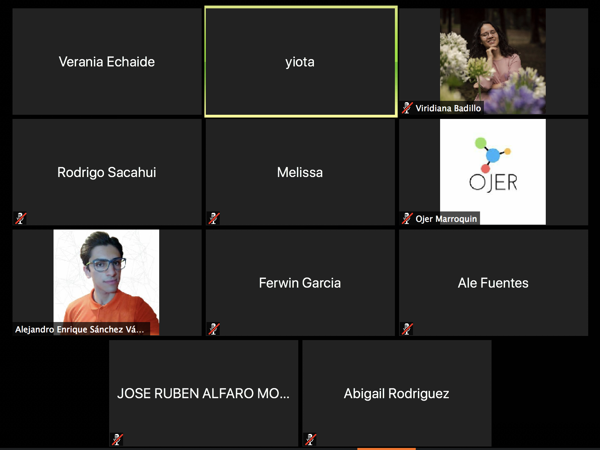
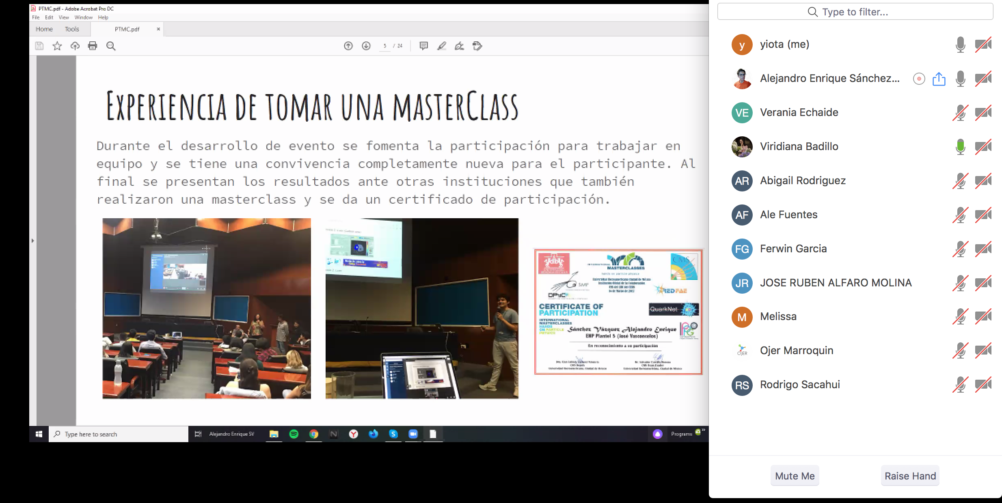
PTMC Online Tutorials to New Countries
in Latinoamerica
After the 2 March PTMC in MXC
plans on the spot for 22 May 2020, BUT….
Online tutorials on zoom by UNAM tutors:
Itzel Viridiana González Badillo
Alejandro Enrique Sánchez Vázquez
Guatemala, Honduras, Mexico, YF
From Students becoming Tutors
Moderation, support center

Slide 2
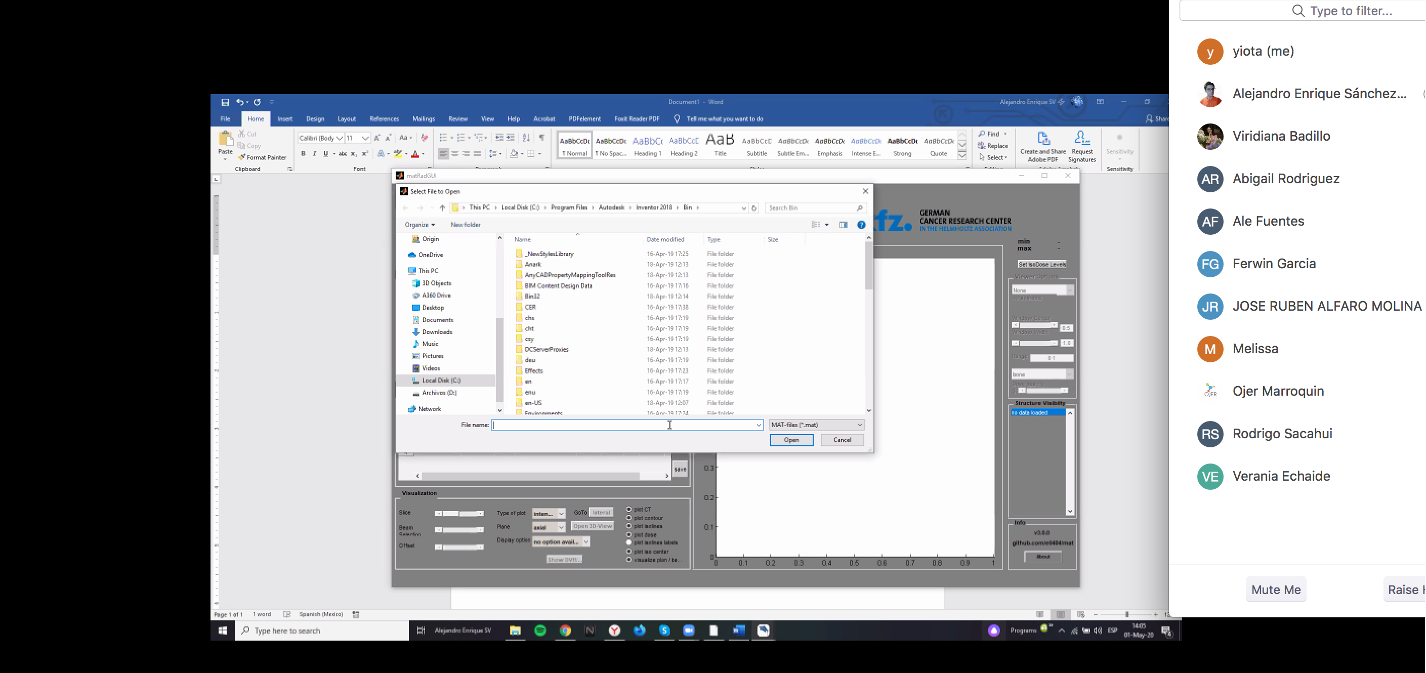
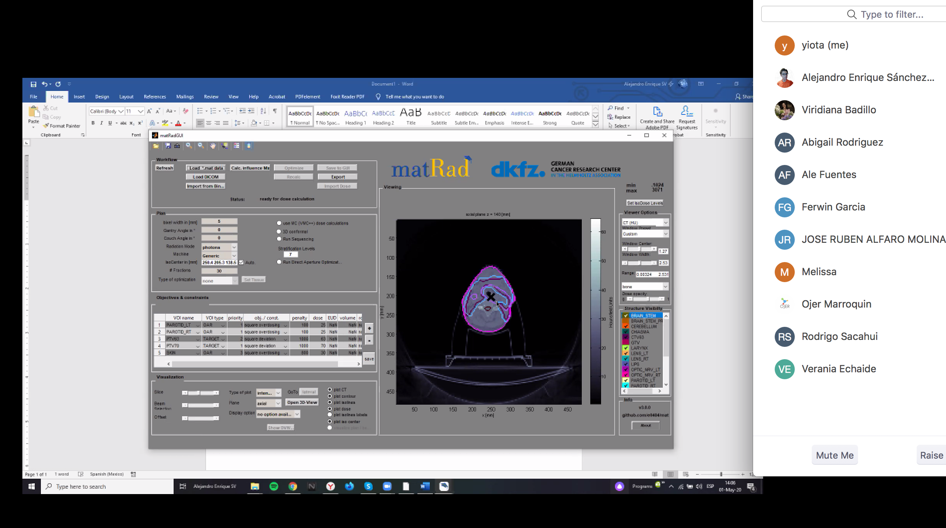
PTMC Online Tutorials
Test recording: Spanish and English
Important: material in spanish
Tested even via a mobile phone:
act from the mobile phone of Viri on the screen of Alejandro
https://drive.google.com/drive/folders/1u7okYFTllFmiWLj_uLN0PDedyGk9DJtE
Plan to also target:
- under-privileged areas in mexico/other cities
- female students
Challenges: PC, laptops, accessibility, language….
To come: Venezuela, Costa Rica, El Salvador, Chile…
Important: personal support for new-comers
Some availability of funding would help

