Slide 1
Management and Protection of Linac4 LEBT settings
R. Scrivens, 06/05/2020
Machine Protection Panel

Slide 2
Table of Contents
Introduction
Layout of the LEBT
Operation Scenarios to Cover
Function Specification
Roles
Settings
Summary

Slide 3
Introduction
Transmission of the Linac4 RFQ (measured from LEBT BCT to first MEBT BCT) is in the range of 70% with the present source/LEBT/RFQ combination.
It is very strongly dependent on LEBT settings.
When settings are changed, losses occur in the LEBT, or in the RFQ.
We have to tolerate some losses in the RFQ – the objective is to avoid that they are increased losses occur unnecessarily, nor maintained for a long period.
This is a summary of the specification EDMS L4-CIB-ES-0007 .

Slide 4
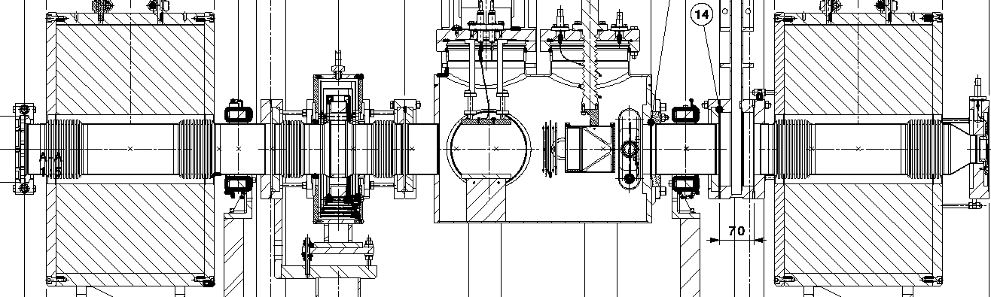
Layout of the LEBT
Source
RFQ
Solenoid
Steerer
Pre-chopper
Steerer
Solenoid
BCT
Beam-Stopper

Slide 5
Operation Scenarios
More than one operational scenario:
  Standard operation MODE1.
    Requires best transmission to deliver 25mA out of the RFQ.
    Pulse length of beam is varied by the pre-chopper (and chopper).
    Beam settings to RFQ are for maximum transmission (25mA), and static.
    Autopilot varies the source intensity (via source RF).
  Low transmission mode (7-8mA out of RFQ) MODE2.
    Source intensity lowered to minimum (limitation to ignite and maintain a plasma).
    Beam settings to RFQ lose beam in the LEBT. The settings are static.
    Autopilot should be disabled.
  Machine Development for source/LEBT/RFQ MODE3.
    E.g. attempting higher currents and different settings.
    This mode would only be used if justified.

Slide 6
Function Specification - Flow Diagram
MODE1 SETTINGS
SOLENOID111_MIN
SOLENOID121_MAX
…
PULSE_LENGTH_MAX
RF_POWER_MAX
BEAM_CURRENT_MAX
OPERATION_MODE
[MODE1, MODE2, MODE3]
CMW communication
Virtual settings - MCS
RESET [TRUE/FALSE]
Virtual settings
Equipment device aqns
MODE2 SETTINGS
SOLENOID111_MIN
SOLENOID121_MAX
…
PULSE_LENGTH_MAX
RF_POWER_MAX
BEAM_CURRENT_MAX
SIS / UCAP
Logic
Published Acquisitions
LSA Machine Critical Settings
CHOPPERS BIS
SIS Input
Beam disposed in LEBT
MODE3 SETTINGS
SOLENOID111_MIN
SOLENOID121_MAX
…
PULSE_LENGTH_MAX
RF_POWER_MAX
BEAM_CURRENT_MAX
DEVICE ACQUISITIONS
BEAM_STOPPERs
SOLENOID111_AQN
…
PULSE_LENGTH
RF_POWER

Slide 7
Functional Specification - Logic Description
Acquire all Settings Parameters and Acquisitions.
If beam stopper is IN, do nothing (beam permit is True).
Check if acquisitions out of range (OOR) for the given mode?
=> increment bad-pulse-counter.
If bad-pulse-counter > max – stop the next pulse using the BIS.
Bad-pulse-counter -> 0 once per hour, if beam is not stopped.
Increment life-time-counter
If life-time-counter > max – stop the next pulse using the BIS.
If counter reset requested: bad-pulse-counter or life-time-counter -> 0.
In a mode switch, all counters will be set to 0.

Slide 8
Who has control (RBAC/MCS)?
 | RBAC /MCS
Min / Max Settings | MCS for Linac Supervisors
Operation Mode | MCS for Linac Supervisors
Reset Counters | No RBAC - Operator
UCAP Node Configuration | RBAC role for Linac4

Slide 9
Settings
The following tables give the proposed values for the min/max settings.

Slide 10
Mode1 Operation
Mode 1 _ OP | Window | Central Value | Comment
solenoidLEBT111_Mode1_Min/Max | +/-0.5 A | 86.4
solenoidLEBT121_Mode1_Min/Max | +/-0.5 A | 107.7
steererLEBTH111_Mode1_Min/Max | +/-0.5 A | TBC | Central value to be set after 3MeV beam tests.
steererLEBTV111_Mode1_Min/Max | +/-0.5 A | TBC | Central value to be set after 3MeV beam tests.
steererLEBTH121_Mode1_Min/Max | +/-0.5 A | TBC | Central value to be set after 3MeV beam tests.
steererLEBTV121_Mode1_Min/Max | +/-0.5 A | TBC | Central value to be set after 3MeV beam tests.
einzelLens_Mode1_Min/Max | +/-1050.0 V | 29000.0
 | Value
tailclipperTime_Mode1_Max | 276.0e6 ns |  | i.e. 1ms pulse
rfPower_Mode1_Max | 50000 |  | W
watchDogLowLossMinTrans_Mode1_Min | 65 |  | %
lifetime_Mode1_Max | 100000000 (100M) |  | (>3 years)
beamCurrentLEBT | -45.0 mA

Slide 11
Mode2 Low Intensity
Mode 2 __ LOW INTENSITY | Window | Central Value | Comment
solenoidLEBT111_Mode2_Min/Max | +/-0.5 | 62.25
solenoidLEBT121_Mode2_Min/Max | +/-0.5 | 115.0
steererLEBTH111_Mode2_Min/Max | +/-0.5 | TBC | Central value to be set after 3MeV beam tests.
steererLEBTV111_Mode2_Min/Max | +/-0.5 | TBC | Central value to be set after 3MeV beam tests.
steererLEBTH121_Mode2_Min/Max | +/-0.5 | TBC | Central value to be set after 3MeV beam tests.
steererLEBTV121_Mode2_Min/Max | +/-0.5 | TBC | Central value to be set after 3MeV beam tests.
einzelLens_Mode2_Min/Max | +/-1050.0 | 29000.0
 | Value
tailclipperTime_Mode2_Max | 275.1e6 |  | i.e. 0.1 ms pulse
rfPower_Mode2_Max | 30000 |  | W
watchDogLowLossMinTrans_Mode2_Min | 35 |  | %
lifetime_Mode2_Max | 3000 |  | (1 hour)
beamCurrentLEBT | -25.0

Slide 12
Mode 3 Machine Development
Mode 3 __ MD | Window | Central Value | Comment
solenoidLEBT111_Mode3_Min/Max | +/-0.1 | 0.0
solenoidLEBT121_Mode3_Min/Max | +/-0.1 | 0.0
steererLEBTH111_Mode3_Min/Max | +/-0.1 | 0.0
steererLEBTV111_Mode3_Min/Max | +/-0.1 | 0.0
steererLEBTH121_Mode3_Min/Max | +/-0.1 | 0.0
steererLEBTV121_Mode3_Min/Max | +/-0.1 | 0.0
einzelLens_Mode3_Min/Max | +/-0.1 | 0.0
 | Value
tailclipperTime_Mode3_Max | 275.0e6 |  | i.e. 0 ms pulse
rfPower_Mode3_Max | 30000 |  | W
watchDogLowLossMinTrans_Mode3_Min | 100 |  | %
lifetime_Mode3_Max | 1 |  | (1 hour)
beamCurrentLEBT_Mode3_Min | -45.0

Slide 13
Settings
In the previous tables, the “windows” in Mode1 and Mode2 are to be considered critical, and changes should be documented with an update to the specification.
Central values can be updated by Linac4 Supervisors, and should include and entry in the logbook.
All values will be reassessed during the start of Linac4 operation.
The Mode3 MD settings: These are to be adjusted for any MD, depending on the objective. The settings in the table are default values that will be programmed at the beginning, and will not allow beam.

Slide 14
Closing Remarks
Specification surveys upstream of the RFQ.
Settings for will be protected through Machine Critical Parameters.
Specification written up in EDMS L4-CIB-ES-0007 (In Work).
Tibor will explain more on the implementation.

