Slide 1





A new gas-jet setup for laser spectroscopy of transfermium elements
*S. Nothhelfer, M. Block, A. Claessens, P. Chhetri, R. Ferrer, S. Kraemer, M. Laatiaoui, S. Raeder, J. Romans, F. Schneider, P. Van Duppen, M. Verlinde, E. Verstraelen, Th. Walther

Slide 2
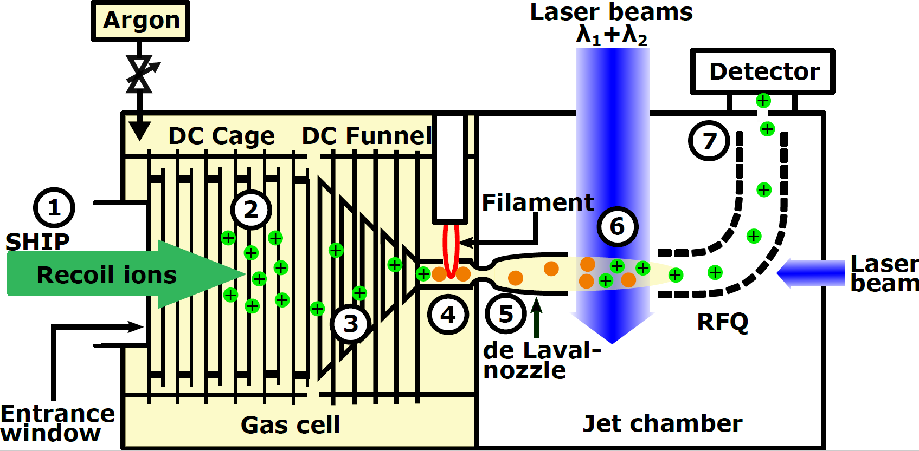
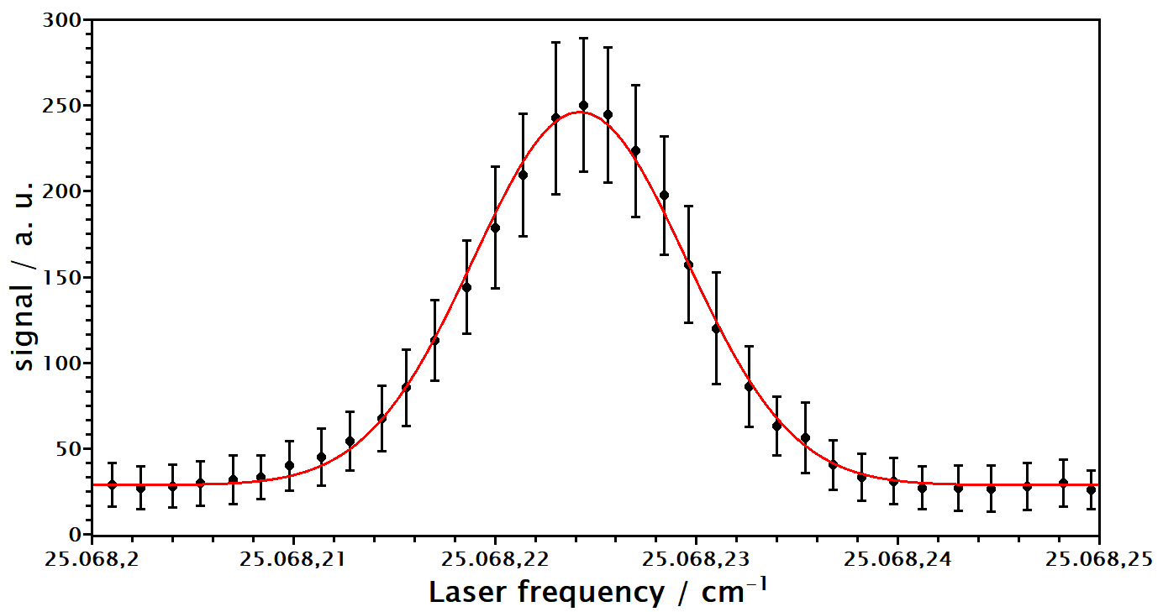
Working principle of the gas-jet @ GSI / HIM
²⁵³No
Master thesis start: 09.2018
PhD thesis start: 15.05.2019
~ 80 mbar Argon
~ 2.5·10^{–2} mbar
S. Raeder et al., Nuclear Inst. And Methods in Physics Research B 463 (2020), 272-276
~ 400 MHz on ¹⁷⁴Yb

Slide 3
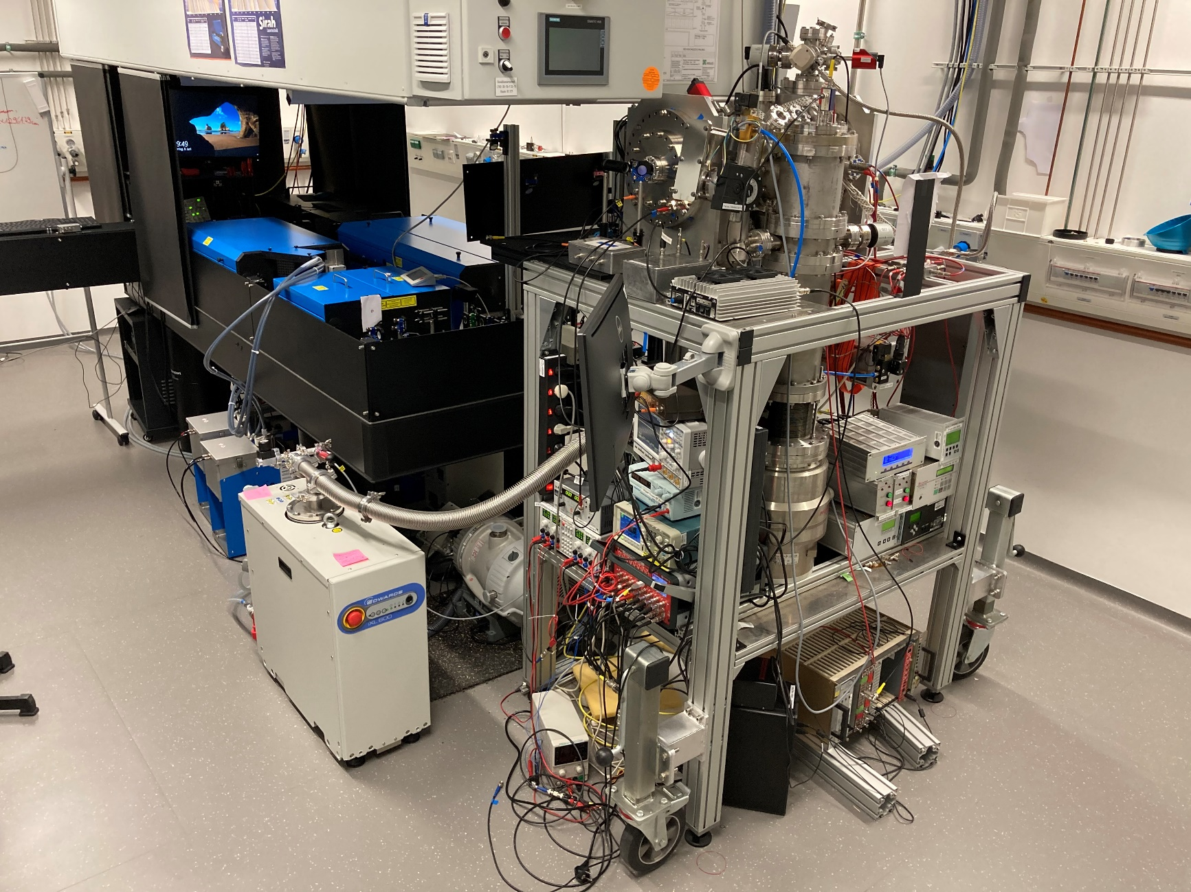
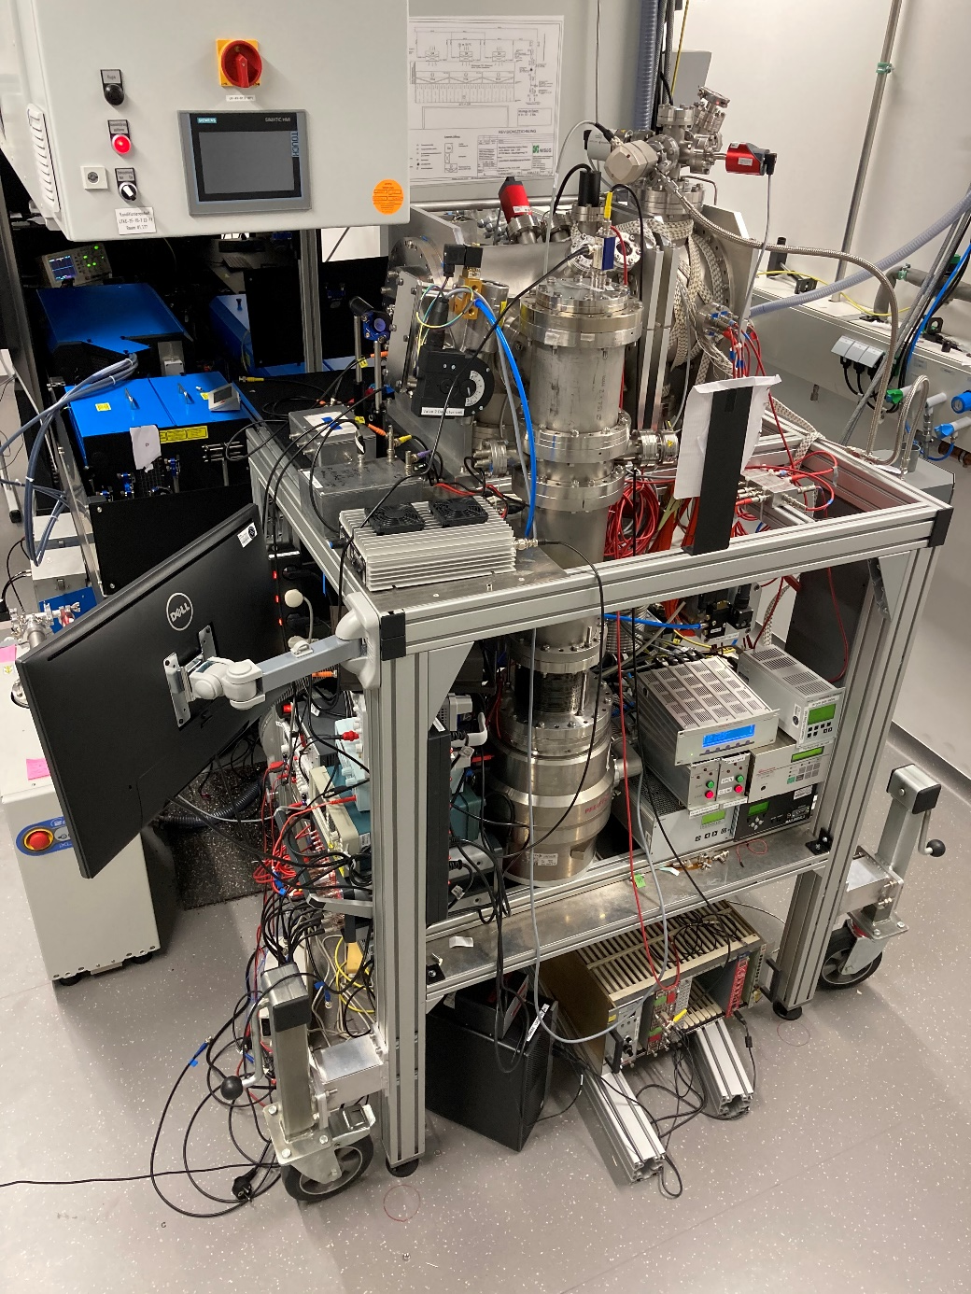
Pictures

