Slide 1
tomography at the SPS
G. Papotti
acks: S. Albright, E. Chapochnikova, J. F. Comblin, H. Damerau, F. Follin, G. Kotzian, M. Jaussi, A. Lasheen

Slide 2
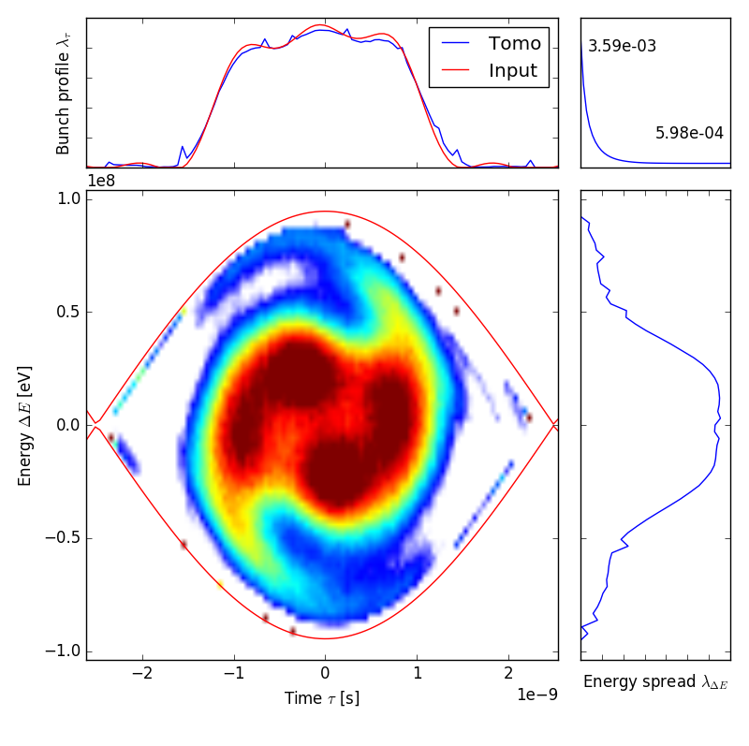
history
2007: studies in RF-BR (T. B., H.D., S. H.)
  “Longitudinal Tomographic Reconstruction of LHC-type Bunches in the SPS”
  conclusion: … “Avoiding the long coaxial cables from the SPS tunnel to the surface is a crucial issue”
2017: A. Lasheen at LIU-SPS BD WG
    includes more references
  setup for MD profile acquisitions
  offline analysis via traditional Fortran code
  conclusion: useful for core, tails are tricky
A.L. LIU-SPS BD WG 13/07/2017
Notes:
https://indico.cern.ch/event/644449/

Slide 3
motivation
reconstruction of injected bunches
measure voltage and phase for 800 MHz
200 MHz voltage calibration
slip stacking setup an optimization
…

Slide 4
main system components
hardware
  wall current monitor for beam profiles (APWL, bw < 3 GHz)
  fibre optic link (fibre, transmitter, receiver)
  extension of sampling pit, including remotely controlled variable attenuators
digitization of profiles (ADC)
trigger devices
  synchronize to cycle and RF
software
options | MD-like setup | towards an op. tool
hardware | APWL + MD f.o. | APWL + dedicated f.o.
ADC | high speed scope | Acqiris DC222
synch | DTU + VTU | CTR + VTU
software layers | dedicated scripts for analysis | ABWLM (FESA class) + J.F.C.’s GUI

Slide 5
towards an operational tool - software
reuse ABWLM FESA class + J.F.C.’s GUI
  FESA class to be expanded to publish profiles à la Oasis (G.P., M.J.)
    already does burst of acquisitions (“MD mode”)
  J.F.C.’s GUI to be extended for use at SPS
    already widespread use, option for Fortran and C++/Python implementations
    timeline: after beam at the PSB
  Fabio’s “OP Bunch Length” GUI to remain
    minor changes for sharing hardware with J.F.C.’s GUI
      e.g. PPM “who’s using me” field/property in FESA

Slide 6
towards an operational tool - hardware
additional variable attenuators being built
  development for LIU SPS LLRF
main issue: ABWLM currently on coaxial cable
  fibres (tunnel to BA3 Faraday Cage) are pulled and available
missing: fibre optic transmitter and receiver
  procurement of new wideband tx and rx not straightforward
    operational equipment obsolete
    commercial successor not in spec
  lack of manpower
    progress on “best effort” basis only

Slide 7
longer term view
CO-SRC and RF-FB to procure and integrate new, fast digitisers
  Acqiris/Keysight digitizers are at commercial end-of-life
    presently used for SPS BQM, LHC BQMs, ABWLM, SPS MR, PS & PSB tomos, …
  joint efforts
possibly eventually decouple tomo from ABWLM
  requires doubling of hardware (fibre optic tx and rx, ADC)
multiple tomography within one cycle
  ABWLM FESA class to handle multiburst by end of LS2

Slide 8
summary and matters for discussion
for 2021 startup
  first operational experience, reuse what is available
  required
    variable, remotely controlled attenuators
    fibre optic tx and rx
for later (2022?)
  separate tomography and bunch length measurement
  required
    reuse attenuators and fibre optic tx and rx (buy/make 2x now)
      assume fibres are pulled
    APWL signals: combiners (?)
    digitiser procurement (BE-CO-SRC + BE-RF-FB)

