Slide 1
COVID19 Supercomputing consortium overview
Discussion for Supercomputing Response.org
29 April 2020

Slide 2
AGENDA
PROGRAM OVERVIEW
OBSERVATIONS
A DEEPER LOOK
CONCLOUSION

Slide 3
Primary Sites
  ORNL, LLNL, NERSC, TACC, SDSC, NCSA, PSC, NASA AMES, AWS, MSFT
37 Projects with new entries daily
50% Apply AI/ML or HPC*AI/ML
Most PIs are US based
  Nepal 1, Porto 1, India 1
NV is offering technical support to each team
  Outreach completed with 80% to date
covid19
consortium
Summary

Slide 4
PI | Project
Bryan M Wong, UC Riverside | Harnessing Large-Scale Quantum-Based DFTB Calculations for a More Accurate Assessment of COVID-19 Inhibitors and Their Binding Dynamics
Olexandr Isayev, Carnegie Mellon University | Assisting SARS-CoV-2 computational drug discovery efforts with artificial intelligence (AI) and AI-accelerated quantum mechanics
Arvind Ramanathan, Argonne National Laboratory (Part of Rick Stevens Ask) | Artificial intelligence driven integrative biology for accelerating therapeutic discovery against SARS-CoV-2
Guowei Wei, Michigan State University | AI-based repositioning of existing drugs for COVID-19
Viktor Stolc, NASA Ames Research Center | Whole genome analysis using the NASA Ames supercomputer to define risk groups for severe pulmonary disease associated with COVID-19 and other illnesses
Gerardo Cisneros, University of North Texas | Using MD and QM/MM to improve drug candidates for nCoV-19 targets
Mahmoud Moradi, University of Arkansas | Conformational free energy landscapes of SARS coronavirus spike glycoproteins
Jeremy Smith, University of Tennessee, Knoxville | Rapid antiviral drug discovery for SARS-CoV-2: AutoDock and MD Sim
Aaron Morris, PostEra | PostEra: COVID MoonShot
Thomas Cheatham, University of Utah | Ensemble-based simulation and analysis workflow for design of novel peptidic inhibitors of COVID-19 main protease
Stratos Davlos, Innoplexus | COVID-19 novel molecule generation with reinforced learning
Ahmet Yildiz, University of California, Berkeley | Exploring binding and fusion mechanism of SARS-CoV-2 spike glycoprotein using molecular dynamics simulations
Wei Li, Children's National Medical Centre | Target Identification for Broad Antiviral Therapy using Functional Genetic Screening Datasets
Debsindhu Bhowmik, Oak Ridge National Laboratory | Discovering molecular targets of the human coronavirus with HPC and AI
Yang Zhang, University of Michigan | Request computing resource for de novo protein therapeutics design simulations to treat the COVID-19 disease

Slide 5
PI | Project
Bo Liang, Emory University | Characterization and structures of the SARS-CoV-2 polymerase and its complex with RNA or potential inhibitors
Chia-en Chang, University of California, Riverside | iterative information from computational and experimental investigation can efficiently discover new lead compounds and assist drug design targeting papainlike protease of SARS-CoV-2.
Zach Shahn, IBM | Allocation of Scarce Resources During the COVID-19 Pandemic
Pete Riley, Predictive Science Inc | Forecasting COVID-19 transmission in the USA using DICE (Dynamics of Interacting Communty Epidemics)
Padilla-Sanchez, Victor, Catholic University of America | SARS-CoV-2 structural analysis and insights on antibody engineering in silico
Dustin Machi, U of Virginia | HPC Support for COVID-19 Response
Mark Flynn, LANL | Incidence of SARS-CoV-2 in SRA metagenomic samples
Kevin Esvelt, MIT | Designing virus-specific sACE2 mimics for competitive inhibition of SARS-CoV-2
Oscar Bastidas, U of Minnesota | Modeling the Dynamic Behavior of Surface Spike Glycoprotein of COVID19 Coronavirus and Designing Biomimetic Therapeutic Compounds
Ou, Shujun Iowa Sate | The evolutionary history of SARS-CoV-2
Rath, Soumya National Institute of Technology Warangal | Dependence of Structure and Dynamics of SARS-CoV-2 on Temperature and Humidity in the Atmosphere
Michael Feig, Michigan State | High Accuracy Modeling of SARS-CoV-2 Membrane Proteins via Machine Learning and Physics-Based Refinement
Stephan Irle, ORNL | Quantum Mechanics-based Refinement of SARS-CoV-2 Inhibitors from Classical Docking
Numan Oezguen, Baylor College of Medicine | Dynamics of SARS-CoV2 spike protein RBD and core S2 domains
Cesar de la Fuente, UPenn | Effects of genetic variants of human ACE2 protein on SARS-CoV-2 spike protein binding

Slide 6
PI | Project
David Wright, Kuano.ai (start-up?). Inspire | Drug-repurposing for Covid-19 with 3D-aware machine learning
Gomez-Bombarelli, Rafael | COVID-19: RNA-seq analysis to identify potential biomarkers indicative of disease severity
Beheshti, Afshin, NASA | Physical Models of COVID-19 Related Proteins
Ken Dill, SUNY Stony Brook, | A Dynamic Structural Model of the SARS-CoV-2 Main Protease to Guide Drug Design and Repurposing
Jennifer Klein, UW-LaCrosse | Dissecting inhibitor impacts on viral RNA polymerase and fidelity control of RNA synthesis in SARS-CoV-2
Jin Yu, UC-Irvine | A drug discovery project against the main protease of COVID-19
Maria Ramos, University of Porto | Computer Simulation of COVID-19 Spread in Nepal
Bishesh Khanal, Nepal Applied Mathematics and Informatics Institute for Research | Drug-repurposing for Covid-19 with 3D-aware machine learning

Slide 7
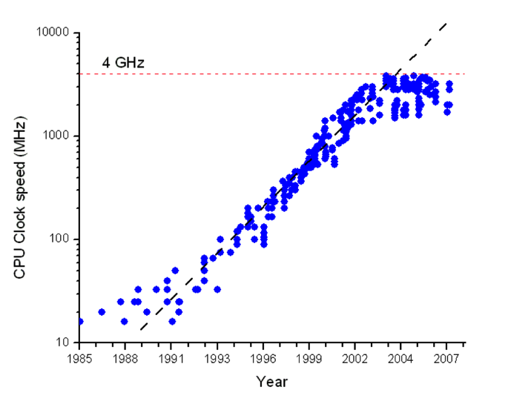
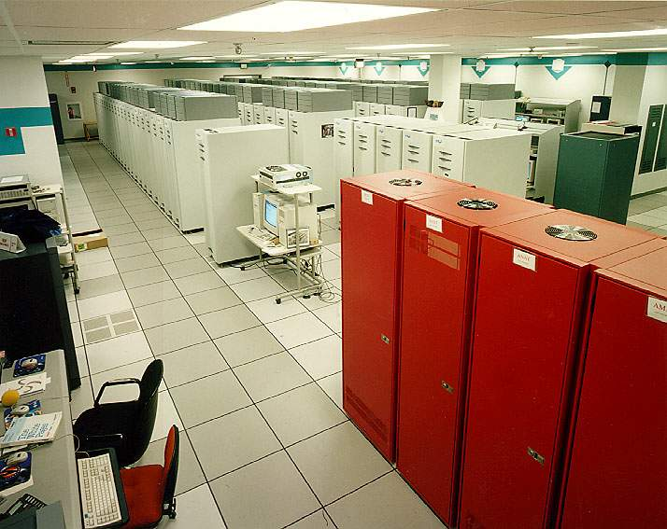
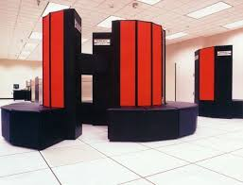
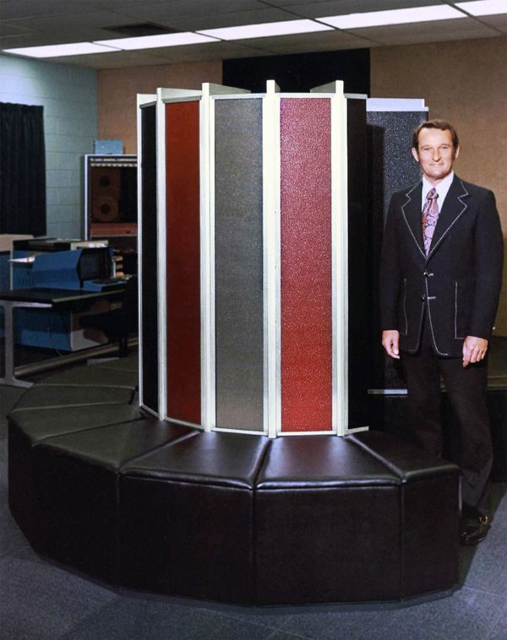
The Evolution of HPC Systems
We Want to GO Here
We Are Here
ASCI RED
CRAY XMP
G Bell, History of Supercomputers, LLNL, April 2013
CRAY 1

Slide 8
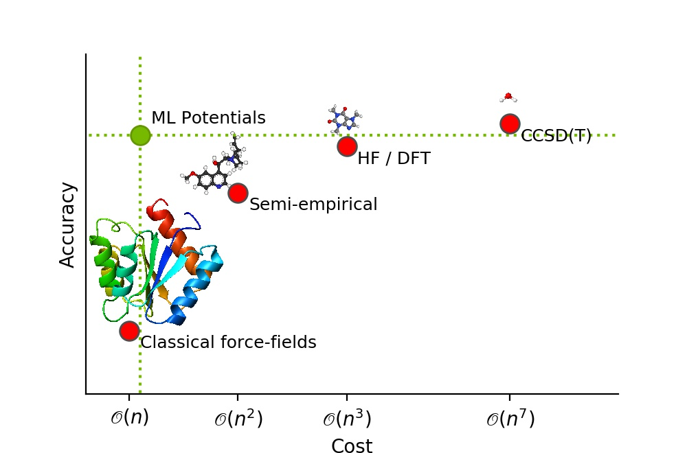
ACCURACY- Compute COST TRADE-OFF

Slide 9
Deeper discussion
PI | Site | Description | Key Points
Converrged
Jeremy Smith ORNL | SUMMIT | In silico to In Vitro Autodock, Gromacs | Combine (restrained T-REMD) simulations with virtual high-throughput screening in an ensemble docking campaign to identify well-characterized drugs
Arvind Ramanathan ANL | SUMMIT | AI Steering with AMBER and Autodock | Adaptive conformational sampling using molecular dynamics (MD) simulations, and building all-atom models for the entire viral envelope
Olexandr Isayev CMU, UFLA | Bridges | TorchANI steering AMBER with RDKit and Openeye | Creating a library of screened candidates using AI and MD and docking
Debsindhu Bhowmik (ORNL) | SUMMIT | Adaptive Drug Discovery VAE + NAMD + scikit | Application of molecular phylogenetics combining MD and AI simulation and combinatoric search
Large Scale Conventional MD Models
Chia-en Chang UC Riverside | COMET | Optimized long time scale AMBER | 500,000 Atoms for usec simulation time
Rommie Amaro | Frontera | Large Scale MD with NAMD | Currently 2Mn Atoms usec scale. Goal is 200Mn Atoms usec

Slide 10

Common approach
MD
Conventional
Model
AI /ML
Model
How data is shared through the discovery pipeline
?

Slide 11
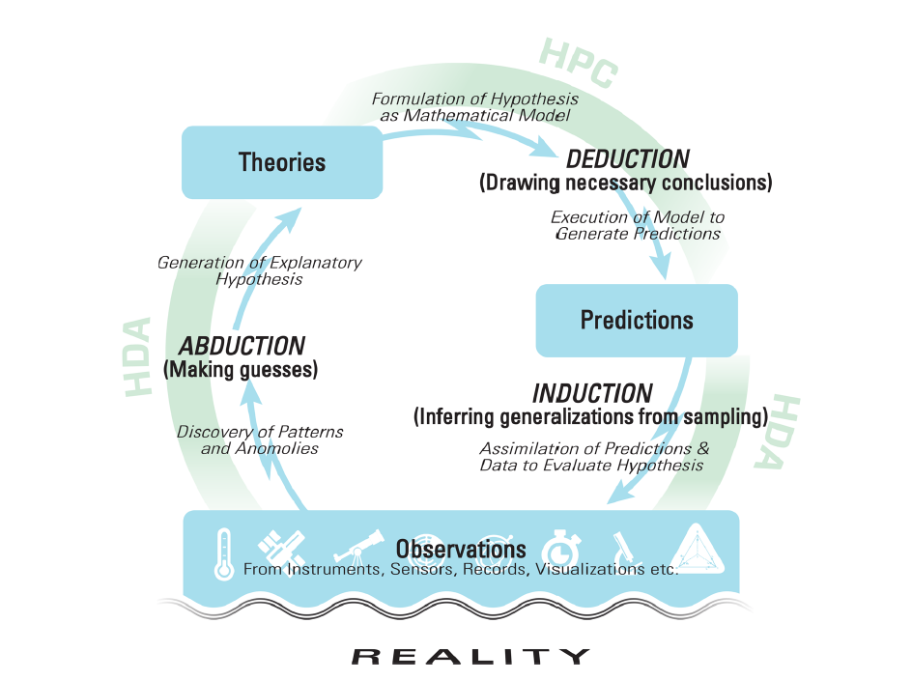
Converged HPC*AI system
BIG DATA AND EXTREME-SCALE COMPUTING: PATHWAYS TO CONVERGENCE
Tech Report No. ICL-UT-17-08

Slide 12
