Slide 1
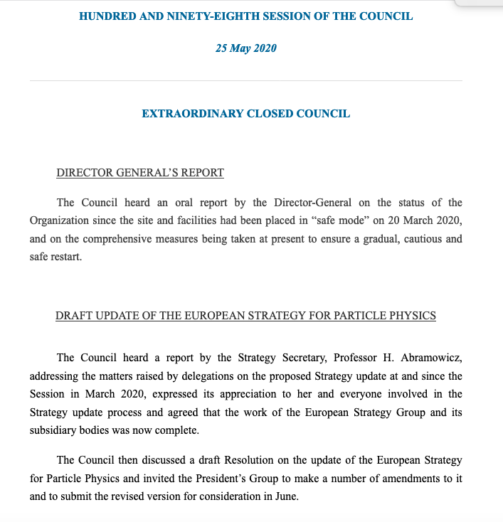
EPSSU
APP contributions to EPPSU:
  Written Input from APPEC;
  PPG work (S. Bentvelsen Marco Zito)
  In Granada Symposium in May 2019
  In Briefing Book (e-Print: 1910.11775).
  Overall many APP scientific inputs!
APPEC Chair observer in ESG and invited to Restricted Council Sessions.
Active member in ESG-WG3 (relation of CERN with other bodies), WG1 (social and career aspects), WG5 (public engagement, education, communication) WG4 (knowledge &Technology Transfer).
Participated to Bad Honnef week to draft the strategy document in Jan 2019.
After January APPEC was blind to the process...(not invited to restricted Council or ESG)
ESG work concluded officially on May 25.
A draft Resolution on the EPPSU is being discussed.
Document will become public after June 19 Council meeting.
Any comment on the porcess?
GA meeting, 5 June 2020

Slide 2
APPEC procedure for roadmap implementation on 0nubb decay
  SAC charged a panel (led by Silvia Pascoli) with mandate to describe the status of major experimental efforts in Europe also in relation to international context and synergy with other fields (such as for DM direct detection).
  Panel’s document sent to SAC on Jun. 17 and S. Pascoli presented the document at the SAC Jun. 18-19 meeting.
  Comments from SAC received on July 4 and implemented
  Document released in the archive on Oct. 19 in https://arxiv.org/pdf/1910.04688.pdf
  APPEC sponsored the Community meeting (https://indico.cern.ch/event/832454/, London, Oct 31, 2019 (LOC R. Sakyaan, S. Pascoli)
  Process in APPEC newsletter https://www.appec.org/news/neutrinoless-double-beta-decay-report-from-the-appec-committee
  On SAC Nov 26 meeting, SAC endorsed 6 recommendations of the panel and and concluded (from minutes):
    We endorse the scientific review carried out by the committee to summarize the main European efforts in neutrino less double beta decay.
    We encourage the community to explore convergence towards 2-3 technologies with the potential to be scaled up to the ton scale (and beyond).
    We strongly endorse the importance of neutrinoless double beta decay searches. There should be at least two large experimental programmes globally, and at least one hosted in Europe.
    This evaluation should be updated in 4 years, reflecting what is learned in the meantime from technology demonstrations, what we learn about normal vs. inverted hierarchy from neutrino oscillation experiments, and the international funding situation.
    We endorse R&D towards new technologies to reach the normal hierarchy and for new physics searches.

Slide 3
APPEC procedure for roadmap implementation on 0nubb decay
  At Meeting Dec. 2-3, 2019, GA agreed on the SAC recommendations (from minutes):
    APPEC-GA endorses the scientific review carried out by the committee to summarize the main European efforts in neutrinoless double beta decay.
    APPEC-GA encourages the community to explore convergence towards 2-3 technologies with the potential to be scaled up to the ton-scale (and beyond).
    APPEC-GA strongly endorses the importance of neutrinoless double beta decay searches. There should be at least two large experimental programmes globally, and at least one hosted in Europe.
    This evaluation should be updated in 3-4 years, reflecting what is learned in the meantime from technology demonstrations, what we learn about normal vs. inverted hierarchy from neutrino oscillation experiments, and the international funding situation.
    APPEC-GA endorses R&D towards new technologies to reach the normal hierarchy and for new physics searches.
    APPEC-GA endorsed the panel recommended for a more active coordination role from the largest of the underground laboratories.
  Chair organise follow-up to develop a common EU view and contact DOE
  New version of document approved by SAC and GA in the archive in Feb. 2020.
  April 21 Chair message to T. Hallmann summarising the process and also responding to NUSAC comments on being the document too ‘eurocentric’ (no nEXO community able to escalate at national funding able today in Europe and strong US participation in CUPID and LEGEND experiments at CDR level of advancement as well as liquid and gaseous noble gas needing more coordination with DOE)
  Response on June 1: the main thing to report is that at present, R&D continues on the most promising “front-runners” for technologies to be considered for a ton-scale DBD measurement (LEGEND-1000, nEXO, CUPID, NEXT).
  Latifa Eloudhiri, Jehanne Gillo in charge for plans on an international meeting (in June to August 2020) to discuss possible sites for a ton-scale experiment that might have major participation from the U.S. and its international partners. Request to identify interested parties from APPEC side.

Slide 4
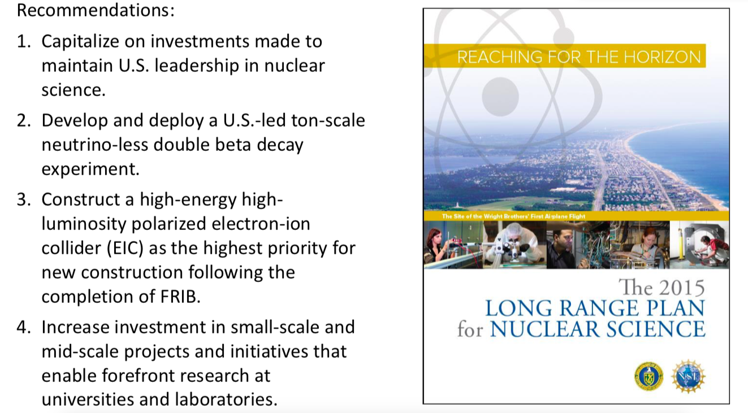
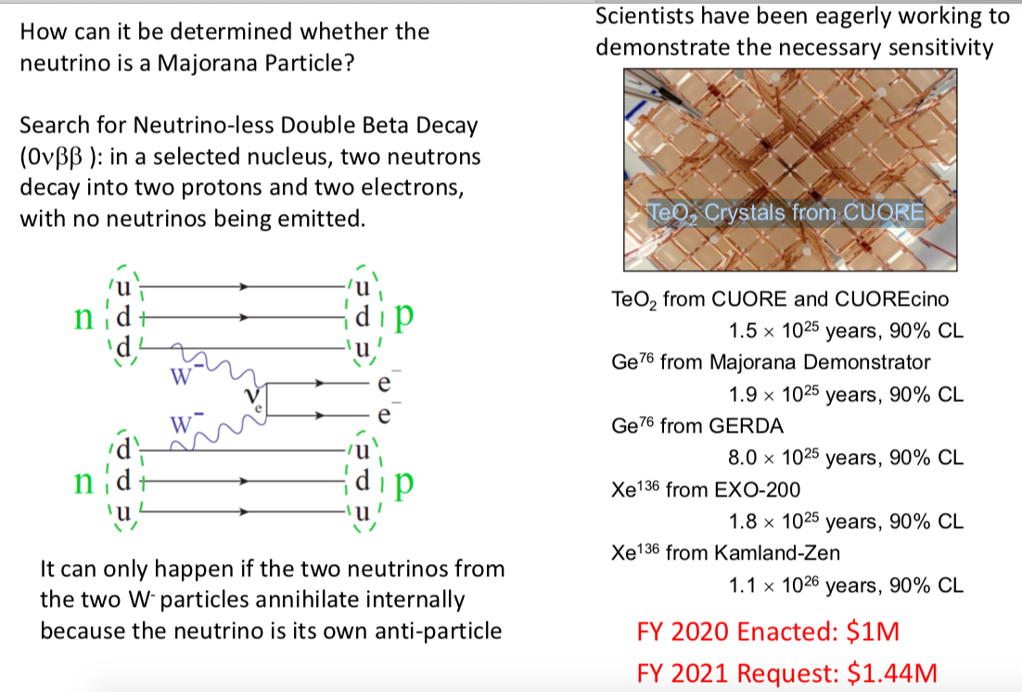
Neutrinoless double beta decay in US
Recommendations of 2015 long range plan:
DOE proceedings: down selection of site (SNO Lab in pole position) and down selection of a ton-scale US-led experiment with international participation and another project.
Discussions on 0nubb decay in WG9 of IUPAP on Nuclear Physics (David Hertzog NSAC Chair and Nigel Smith in charge of low-E neutrinos). WG10 (ApPIC, Chair Natalie Roe, not active since 2018) on APP…should be in continuous dialogue with APIF of Global Science Forum and advice it. WG11 is GWIC.
Berrie Giebels (IN2P3) APPEC representative in Snowmass 2021 process (Division of Particle and Fields chair Young-Kee Kim, see https://snowmass21.org)
Tim Hallman: https://science.osti.gov/-/media/np/nsac/pdf/202003/Hallman_NSAC_DOE_NP_Report_03022020.pdf?la=en&hash=CAD6F18ADB69357FFB964E764A23817D59DEC40A
Notes:
16 countries, 18 members, 5 observers

Slide 5
For discussion
1) International Meeting: will EC agencies coordinate before a meeting or let US take the lead without a clear path?
  - send a list of representatives of agencies of involved countries and delegated scientists from experiments with leading roles in APPEC (G, IT, Fr, UK, Russia, PL, CH, CzR);
  - align agencies APPEC agencies first in Eu for an effective participation in a dedicated virtual meeting in the next few weeks;
2) The 0nubb decay panel recommended more active coordination role from the largest of the underground laboratories. The DM panel has echoed this request which find large consensus from communities: network of EC labs represented by a legal agency, eg an ERIC European Laboratory of Underground Science
3) Revive discussion with ApPIC and APIF. We need an international forum of APP Agencies!

