Slide 1
Report of the General Secretary (and Joint Secretariat)
Job de Kleuver et al.
General Assembly Meeting – 5 June 2020
1

Slide 2
General Assembly composition
Poland: Accession document signed in April
Leszek Roszkowski represents Poland
NuPECC: Marek Lewitowicz (observer)

Slide 3
Activities since last GA meeting (Job)
JS meetings in March and May (via Zoom)
Preparatory meetings for Town Meeting
Renewal SAC composition
SAC meeting in May (Zoom)
Preparations GA meeting today and December meeting
Finalising accession Poland
Contacts with FNRS (Belgium) about APPEC membership
Several GW and ET related activities and contacts

Slide 4
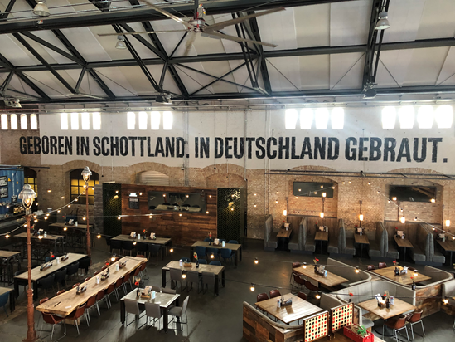
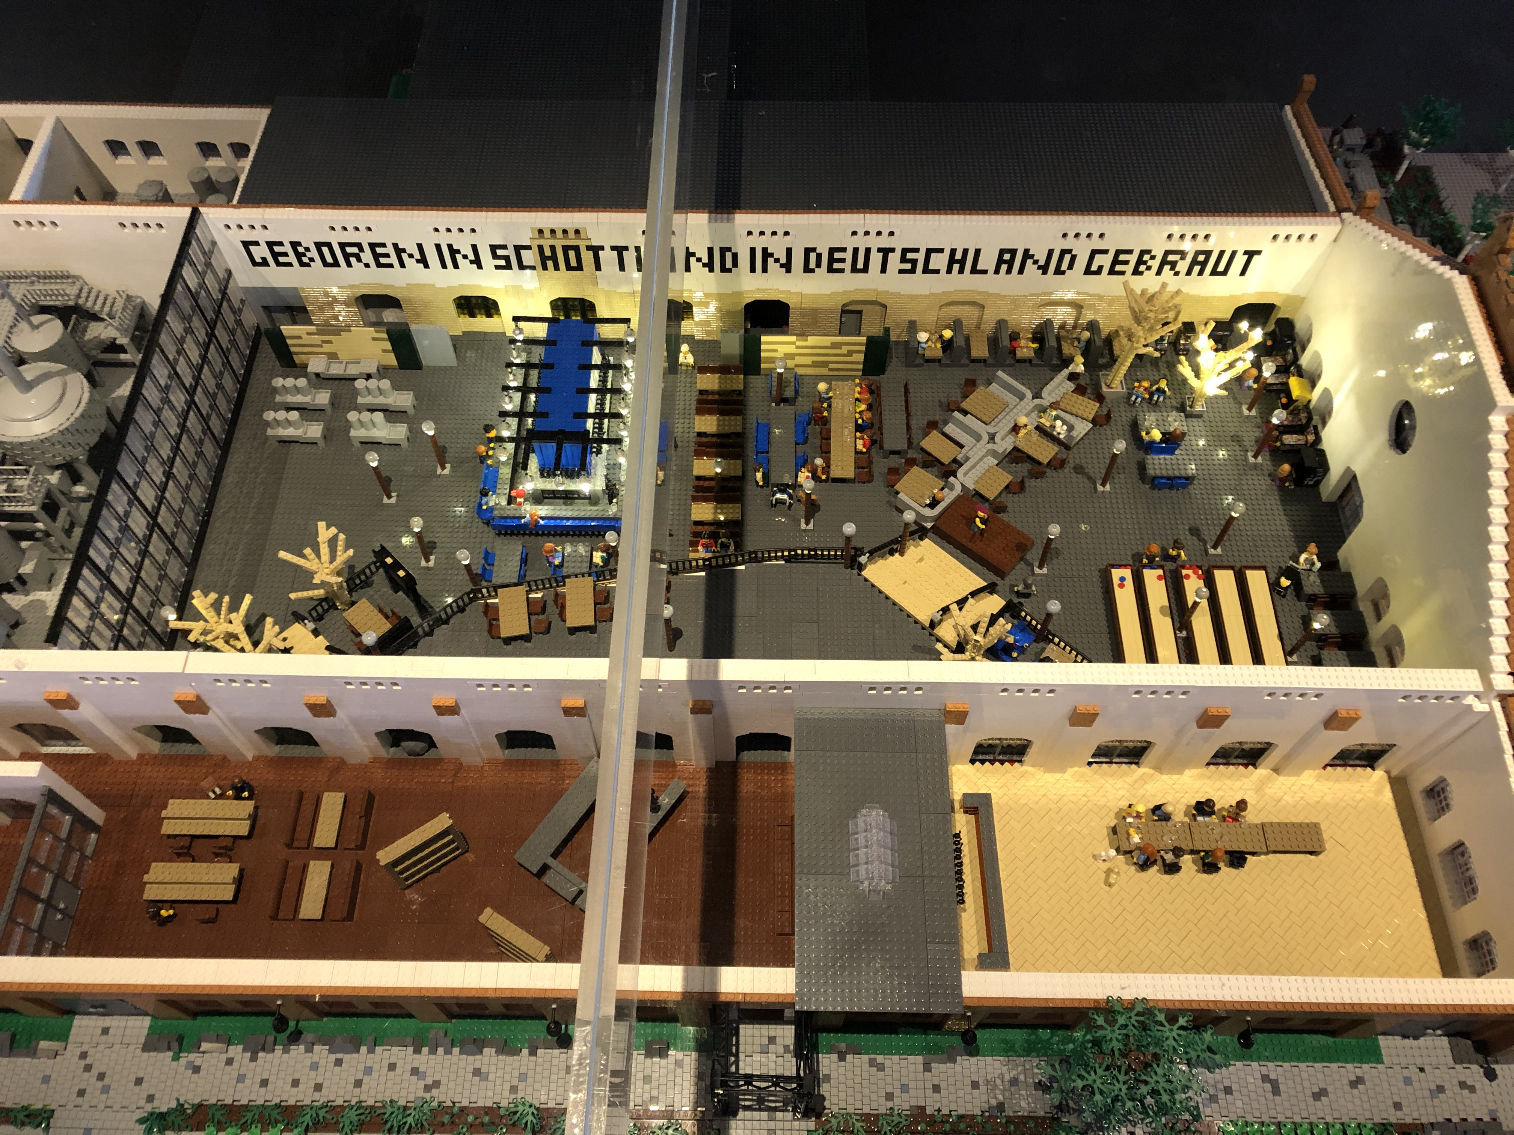
APPEC Town Meeting postponed until Fall 2021
Exciting venue in Berlin
First ideas programme and format
SAC actions on going
Excellent moment to celebrate

Slide 5
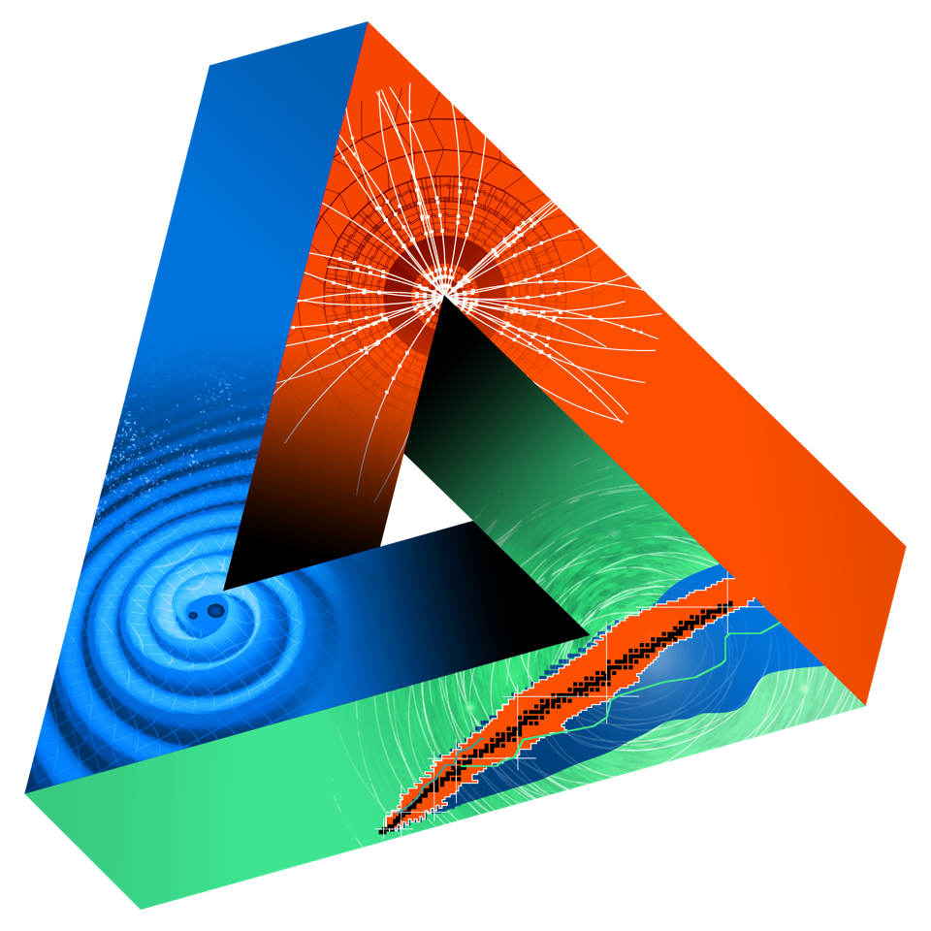
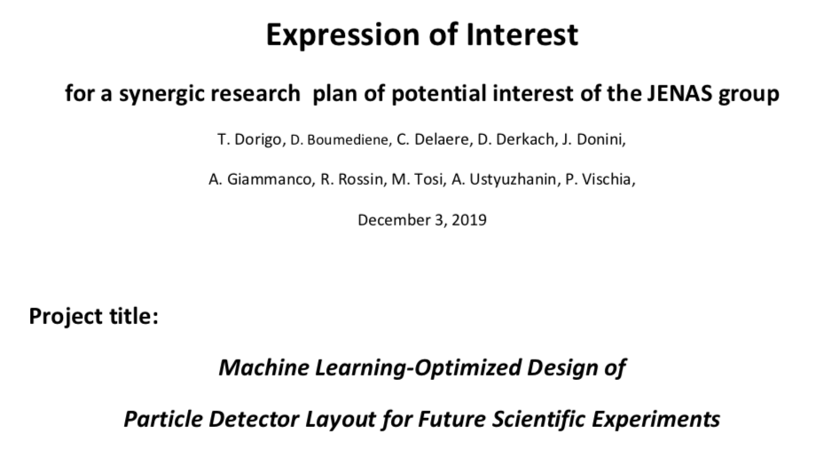
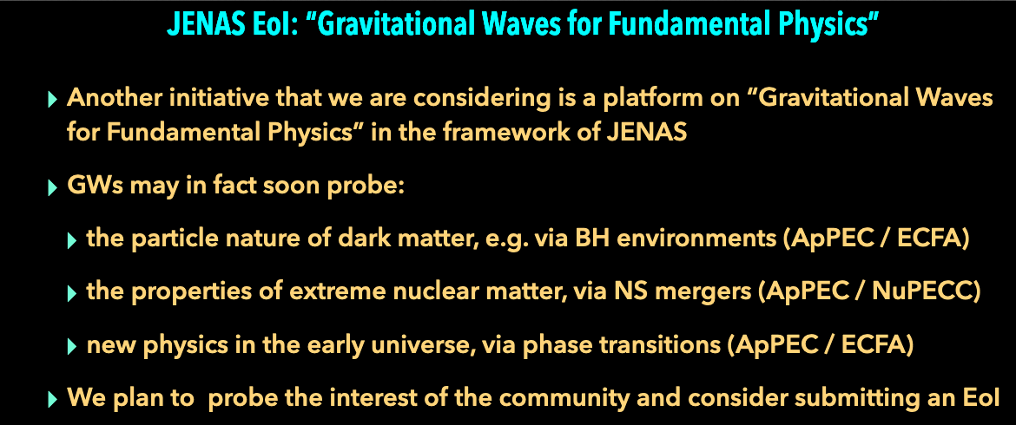
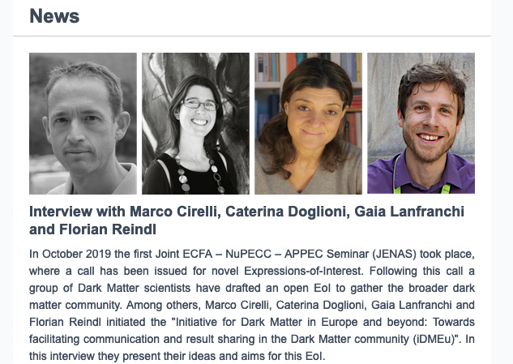
APPEC-ECFA-NuPECC activities
2 EoIs received and 1 in preparation within EuCAPT!
6 panel members: ML Jurgen Brunner (CPPM, KM3NeT, IceCube),Elena Cuoco (Virgo, EGO), DM: F. Calore (Theory/Pheno, LAPTh), U. Oberlack (Mainz, XENON) GW TomeK Bulik (Warsaw U,, Virgo,CTA), J.van den Brand
Led by Tetyana Galatyuk (Prof at TU Darmstadt, from the nuclear physics / accelerator community) and Paolo Pani (Ass. Prof. in Rome, from the GW / Fundamental Physics community).

Slide 6
Proposal to GA
APPEC could provide the communities proposing the EoIs with opportunities for a one-time spending sum of 10kEuro. Short proposals for motivations on spending on specific items would be encouraged from the EoI proponents and then scrutinized by the panel, who would issue a recommendation to APPEC GA on which items to finance between the following items:
Workshops, kick-off meetings
Schools, Cycles of seminars
Developments of Web tools, Citizen Science items from a company or Institute covered by APPEC…
Officer professional science writer in a company or institute involved in APPEC…to support in an EC network proposal submission.
At the moment, the position of ECFA is that ECFA does not have a direct budget to function but that in-kind contributions are possible. Once the panel enters in the discussion with the EoI promoters, under the option that joint work can happen between the three communities, the chair would then be available to explore in the ECFA community and Institutes might become interested to contribute in-kind for hosting meetings, workshops, schools.
The position of NuPECC is that they can support the EoI process with very limited funds (few k€) but this kind of support for any action is done after consideration (usually at their plenary meetings) of a well-defined project. It is desirable also that the full process leads to EC applications.

Slide 7
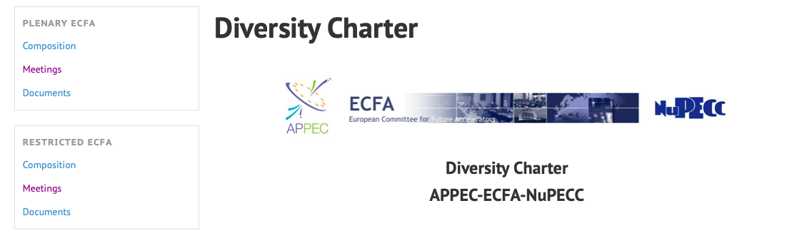
Launch of the Diversity Charter @ JENAS 2019
http://ecfa.web.cern.ch/content/diversity-charter
Prepared letters to
- to sponsor it at conferences
- send request of endorsement to main experiments and to respond to Survey or send data in other form.

Slide 8
ASTRONET Roadmap
The ASTRONET Science Vision and Infrastructure Roadmap were published in 2007 and 2008 respectively and presented a strategic plan for the development of European Astronomy.
A requirement was to have a light-touch update of these midway through the term. The Science Vision was updated in 2013 and the conclusions were fed into the Roadmap update. This was completed following the outcome of the ESA decisions on the latest missions. The community has been involved through a variety of processes and the final version of the update has been endorsed by the ASTRONET Executive.
ASTRONET was created by a group of European funding agencies in order to establish a strategic planning mechanism for all of European astronomy. It covers the whole astronomical domain, from the Sun and Solar System to the limits of the observable Universe, and from radioastronomy to gamma-rays and particles, on the ground as well as in space; but also theory and computing, outreach, training and recruitment of the vital human resources.
ASTRONET aims to engage all astronomical communities and relevant funding agencies on the new map of Europe in 2020
http://www.astronet-eu.org/
http://www.astronet-eu.org/sites/default/files/astronet_ir_final_word_doc_for_printing_with_logo.pdf

Slide 9
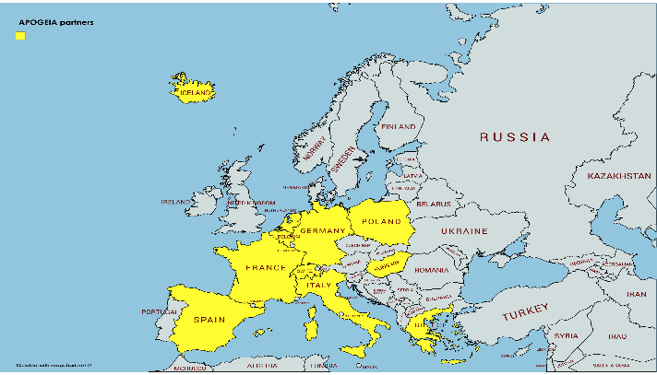
APOGEIA
AstroParticle Observatories and Geoscience Infrastructure Activities
Deliverable 1: a synergy roadmap of Astroparticle Observatories and Geoscience Infrastructures
Deliverable 2: Characterisation of next generation sites (ET and KMT but also undergrounds labs, deep ocean/lake/ice)
Integrated Activity: Networking, Infrastructure Access and Joint Research Activities
+ Art and Science (T. Saraceno et al.)
Budget 5 M€
Support by APPEC, GEO-8 and Academia Europeae

Slide 10
Joint Research Activities
Sensors at the Astro-Geo Interface.
  Gravimetry and Gradiometry sensors , Optical clock sensors
  Network Synchronisation and time distribution.
  Early warning systems and Gravity Signal.
Site Characterisation and Monitoring.
  Characterization and monitoring of current and next generation sites.
  Mobile sensor networks.
  Fiber Distributed Antenna systems for seismology and monitoring of deep ocean sites.
Muon Radiography and Atmospheric monitoring.
  Volcanology & Geoscience, Underground targets and site characterization .
  Muons and the Ozone at the Antarctica
Data analytics and Machine Learning.
  Early warning and Machine Learning, Characterization Classification of noise and signals sources in seismic and infrasound sensors networks.
  Activities identification from seismic signals, Newtonian Noise and Deep Learning.
  Muon radiography and Machine Learning.
Theoretical studies at the interface.
  Earth tomography with neutrinos and seismic data
  Fluid-kinetic dynamics in astrophysical plasmas and geoscience
  Astro-Seismology of compact objects: modeling and data analysis methods
  Astoparticles and Heliosphere/Magnetosphere/Ionosphere
30

Slide 11
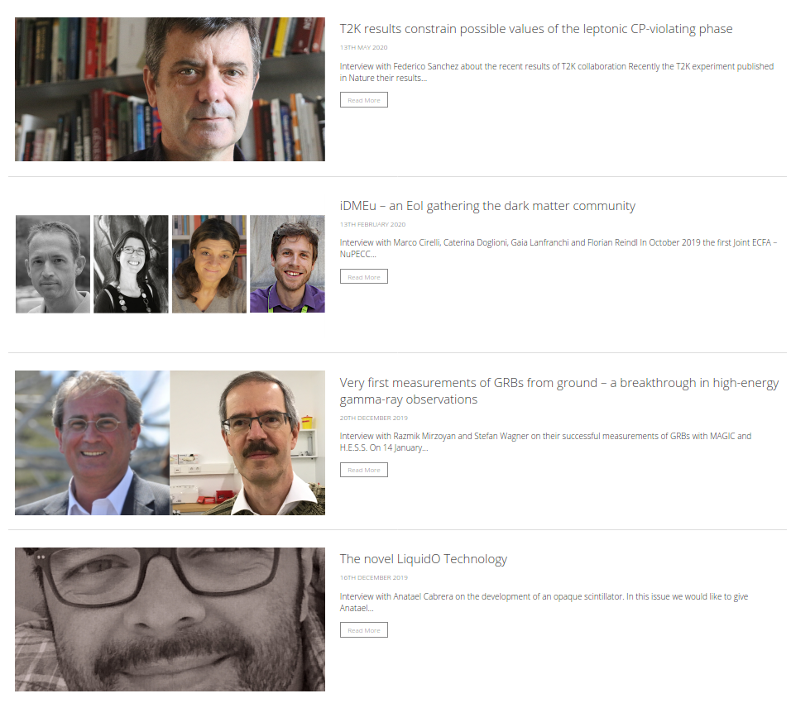
Communication and Outreach
Activities are ongoing
Website up and running
  Hacker attack on website in February
    Redirection to suspicious websites
    Fixed and better protection implemented
News, Newsletter, Interviews
Announcement of Events
  Testing different Calendar extensions for website
Irregular Twitter usage
Participation in IPPOG and EPPCN meetings

Slide 12
Common fund 2019 status
The call for funds for 2019 was sent to participating institutes end of September 2019.
Still some contributions are missing:
CNRS and STFC each € 5000 €, Greece and Hungary each € 2000.
The financial year 2019 ended with a balance of € 73,019.14
In 2020 by now, following costs were paid: € 2,462.20

Slide 13
Meeting and Budget plan 2020
Meeting | Location | Jan | Feb | Mar | April | May | June | July | Aug | Sep | Oct | Nov | Dec | Cost / €
APPEC JS-meeting | Zoom |  |  | X |  |  |  |  |  |  |  |  |  | -
APPEC JS-meeting | Zoom |  |  |  |  | X |  |  |  |  |  |  |  | -
APPEC SAC-meeting | Zoom |  |  |  |  | X |  |  |  |  |  |  |  | -
APPEC GA-meeting | Zoom |  |  |  |  |  | X |  |  |  |  |  |  | -
APPEC JS meeting | Zoom |  |  |  |  |  |  | X |  |  |  |  |  | -
ERICE International School of Cosmic Ray Astrophysics | ERICE |  |  |  |  |  |  |  | X |  |  |  |  | 3.000,00
APPEC JS meeting | Zoom |  |  |  |  |  |  |  |  | X |  |  |  | -
DM direct search comm. Meeting | Zoom? |  |  |  |  |  |  |  |  | X |  |  |  | -
APPEC SAC-workingmeeting | Zoom |  |  |  |  |  |  |  |  | X |  |  |  | -
APPEC SAC-meeting | Zoom |  |  |  |  |  |  |  |  |  |  | X |  | -
APPEC JS meeting | Zoom |  |  |  |  |  |  |  |  |  |  | X |  | -
APPEC GA-meeting | Rome/Zoom |  |  |  |  |  |  |  |  |  |  |  | X | 1.000,00
 |  |  |  |  |  |  |  |  |  |  |  |  |  | 4.000,00
Budget 2020
Meetings | 4.000,00
EuCAPT | 10.000,00
Town Meeting 21 | 20.000,00
Communication | 20.000,00
Costs Webserver | 1.300,00
Total | 54.300,00
Due to Corona pandemic almost all meetings are remote or postponed

Slide 14
APPEC Technology Forum: Robotics and operation of detectors in a harsh environment (Ivan)
Venue: Czech Technical University in Prague, Prague, Czech Republic
Date: June 1 – 2, 2021
Aim: In person meeting with 60-70 people (including SME industry) with a few major speaker presentations
Topics: Robotics in medical applications and in Covid-19 era, Robotics in space Robotics underground
Web site: https://indico.utef.cvut.cz/indico/event/20/overview

