Slide 1






ATF 2021 in Prague
Ivan Štekl
Institute of Experimental and Applied Physics, Czech Technical University in Prague
Technology Forum 2021: organized by APPEC, NuPECC, ECFA, CTU in Prague (2 research institutes – IEAP, CIIRC), NRPI
Date: June 1-2. 2021 (it was changed due to covid-19)
Venue: CTU in Prague (2 possibilities – CIIRC or IEAP CTU)

Slide 2
Scientific Committee:
Beniamino Di Girolamo (chair, CERN), Teresa Montaruli (APPEC), Hanna Franberg (NuPECC/GANIL), Corrado Gargiulo (ECFA), Václav Hlaváč (CIIRC, CTU in Prague),
Jiří Hůlka (NRPI), Ivan Štekl (IEAP, CTU in Prague), Enrico Chesta (CERN, Knowledge Transfer Group)
Organizing Committee:
Ivan Štekl (IEAP, CTU in Prague), Maroš Petro (IEAP, CTU in Prague), Aneta Chaloupková (IEAP, CTU in Prague), Martina Vanišová (IEAP, CTU in Prague), Daniel Seifert (CIIRC, CTU in Prague), Ivan Hupka (NRPI)
Topics:
1. Robotics, electronics and detectors in medical applications (including Covid-19 era)
2. Robotics, electronics and detectors in space
3. Robotics, electronics and detectors in underground, high energy physics and nuclear reactors.
Indico page:
https://indico.utef.cvut.cz/indico/event/20/overview
Some remarks (opened for discussion):
a) ≤ 50-60 participants
b) Participation of technology companies in ATF subjects
c) Student session (the possibility for selected students to present their activities in ATF subjects)
d) Poster session ???

Slide 3
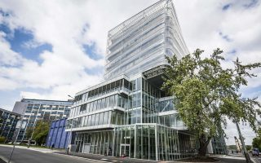
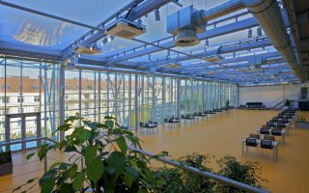
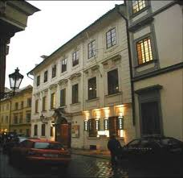
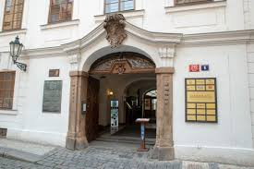

Venue No 1: Respirium conference room in the CIIRC (10 minutes from Prague´s
castle) (https://www.ciirc.cvut.cz/about/ciirc-ctu-building/)
Venue No 2: Conference center of IEAP CTU, Bethlem palace (3 minutes from
Charles bridge)
Special stamp
of the Czech Post
18.4.1869: Czech Polytechnical School in Prague, and Deutsche Technische Hochschule in Prag.

Slide 4
A) Research subjects in IEAP CTU:
LHC at CERN – ATLAS (shielding, ATLAS TPX – radiation field measurement, luminosity monitoring, data processing), MoEDAL
Neutrino physics – ββ decay (⁸²Se SuperNEMO, ⁷⁶Ge LEGEND); atmospheric neutrinos (Baikal-GVD); reactor antineutrinos
Detection of dark matter – experiment PICO in SNOLAB (Canada)
Detection of high-energy cosmic rays – Timepix detectors on ISS, NASA; on ESA satellite Proba-V and RISESAT, Japan)
Applications – pixel and strip detectors, imaging, biomedicine, study of material…..
B) Research subjects in CIIRC CTU:
Automatic control and optimization; robotics; artificial intelligence; computer graphics;
computer vision and machine learning; designing software systems; designing decision
and diagnostic systems and their applications in medicine, energy transport, including
smart homes and smart cities. Technology transfer to industry. Industry 4.0.
C) Research subjects in NRPI:
Radiation protection; support of state supervision in radiation protection; operating the Radiation Monitoring Network in the Czech Republic including Early Warning System and atmospheric contamination monitoring; operating the mobile team for radiation accidents and emergency events; Radon R&D; radiation protection assessments for medical exposure…
Close link with ATF conference subjects

Slide 5

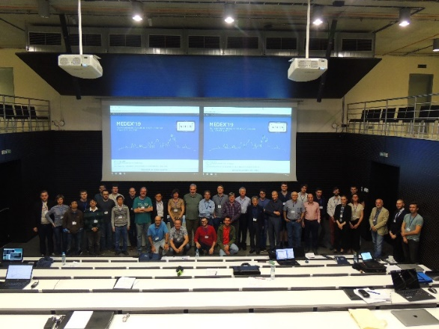
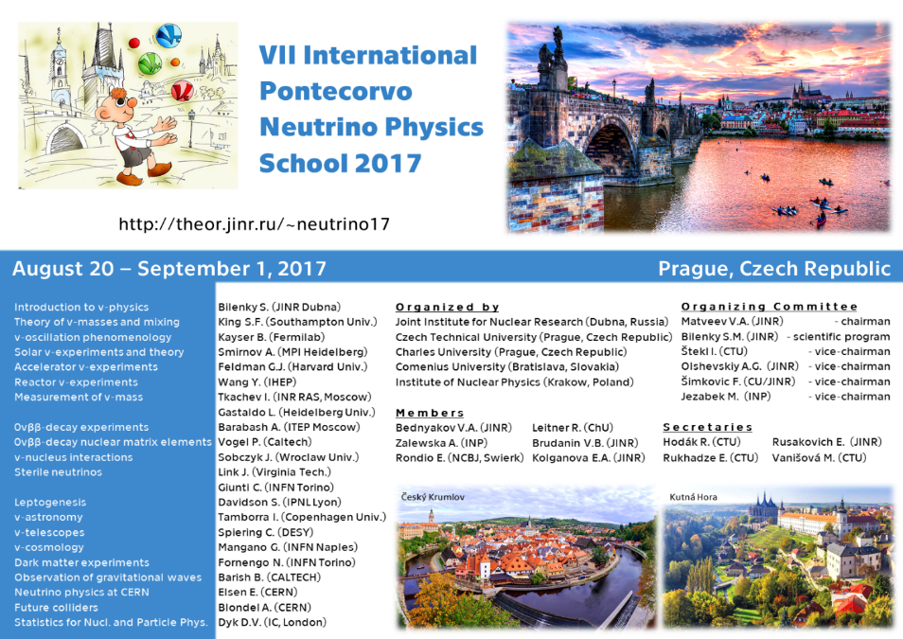
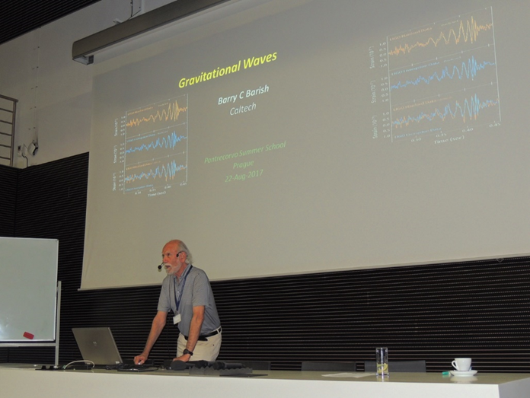
Selected conferences or summer schools organized by IEAP CTU:
1) Conferences MEDEX (Matrix Elements for the Double beta decay Experiments)
Organizers: O. Civitarese (Univ. La Plata), J. Suhonen (Univ. Jyvaskyla), I. Štekl (IEAP CTU); R. Hodák (IEAP CTU) – every two years
MEDEX´19: Prague, 27-31 May, 2019 (50 participants), venue = National Technical Library
See https://indico.utef.cvut.cz/indico/event/15/overview
Proceedings published in AIP
2) 2017: the VII Pontecorvo Neutrino Physics School at IEAP CTU
2019: the VIII Pontecorvo Neutrino Physics School to be held in Hotel International, Sinaia
mountain resort, Romania, September 1 - September 10, 2019; 22 lecturers; number of students
80
See http://theor.jinr.ru/~neutrino19/
Nobel price winner B. Barish, during his lecture in ν school (2017)

Slide 6
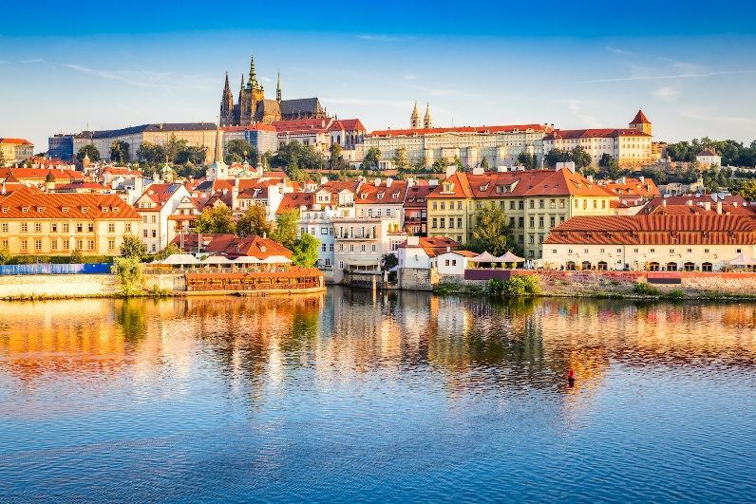
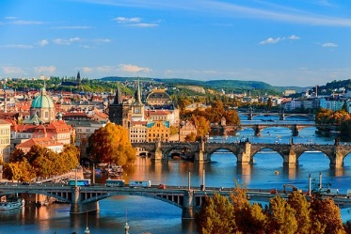
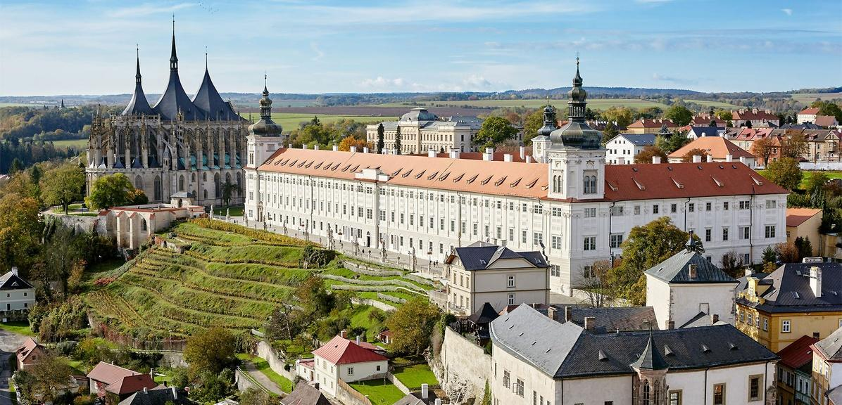
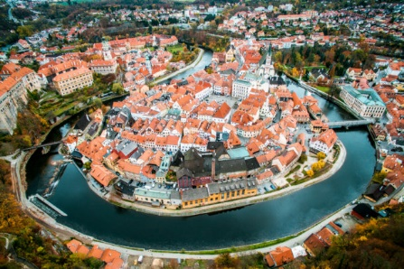
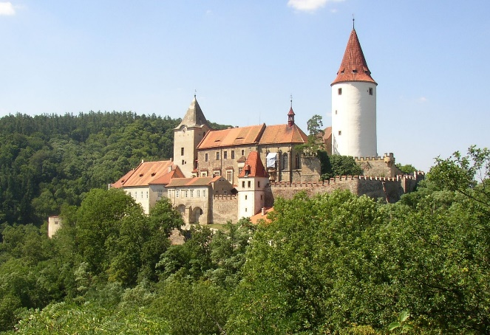
Prague advertisement and other cities (for excursion): Cesky Krumlov, Kutna Hora,
castle Krivokrat……

Slide 7
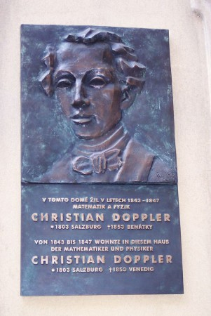
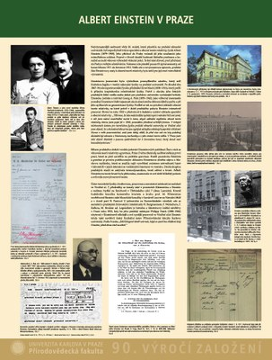
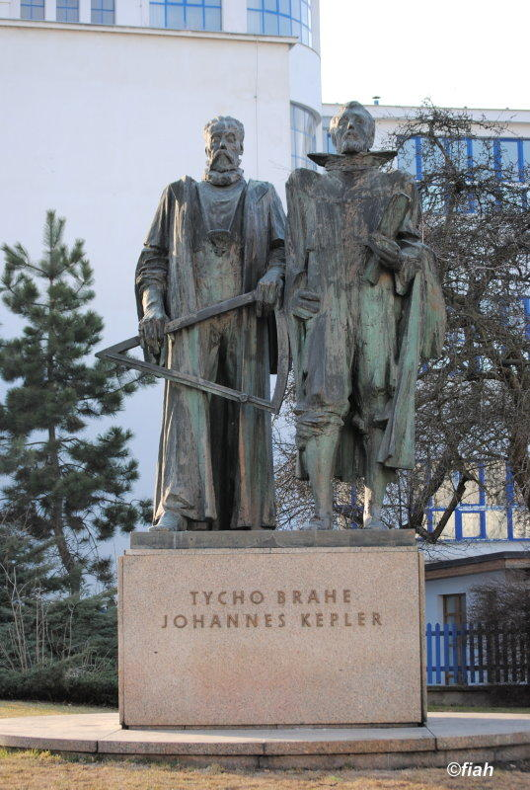
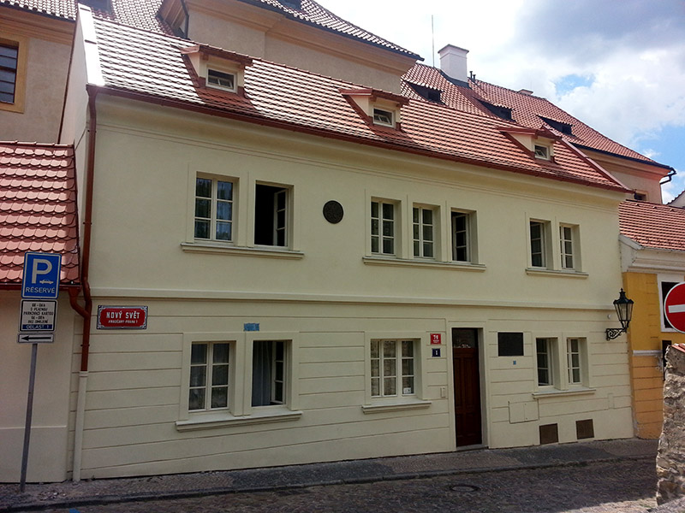
Conclusion:
- IEAP, CIIRC CTU, NRPI are ready to participate in ATF 2021 organization
- Offering interesting conference venue (possibility to select – modern or old)
- Needed infrastructure in Prague
- High level of Czech science, education and industry
- Very good connections of Prague with many airports
- Attractive location
WELCOME in PRAGUE

