Slide 1

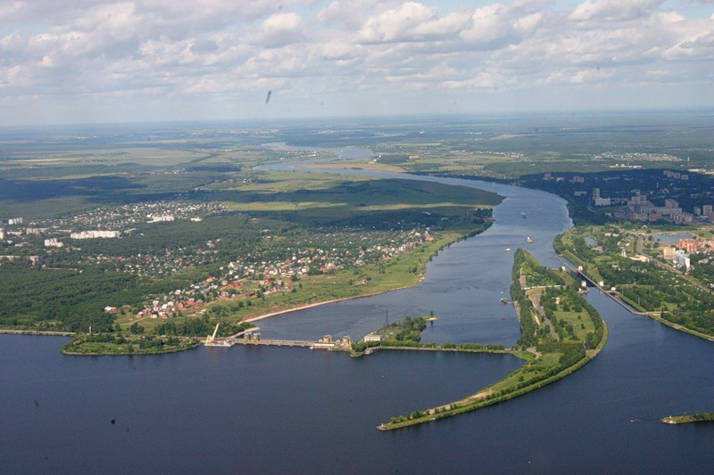
Challenges of the Project
V. Kekelidze, G. Trubnikov
Joint Institute for Nuclear Research
NICA
r. Volga
Ice Cream seminar, CERN
June 16, 2020

Slide 2
Strong interactions play a central role in particle physics and are well described by QCD, but questions remain :
  long-distance phenomena, for example, confinement;
  collective behaviour in extreme conditions,
  at high temperature, or high density;
  reliable predictions in nonperturbative mode.
is it possible to describe phenomena on the border of low and high
energies from the first principles of QCD?
how fast moving quarks and gluons are grouped
in colour-singlet hadrons?
QCD lattice calculations predict the transition of matter
in quark-gluon plasma (QGP),
in which partons are not confinement and chiral symmetry is restored.

Slide 3
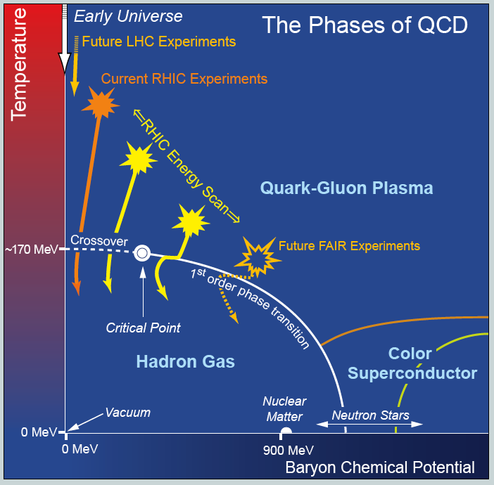





Lattice QCD
LHC
NICA
NICA
2 10¹² K
nuclei
baryonic density ρ / ρ₀
0 1 ρ₀ = 0,16 fm⁻³

Slide 4
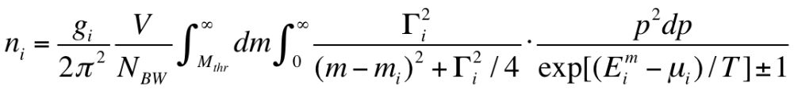
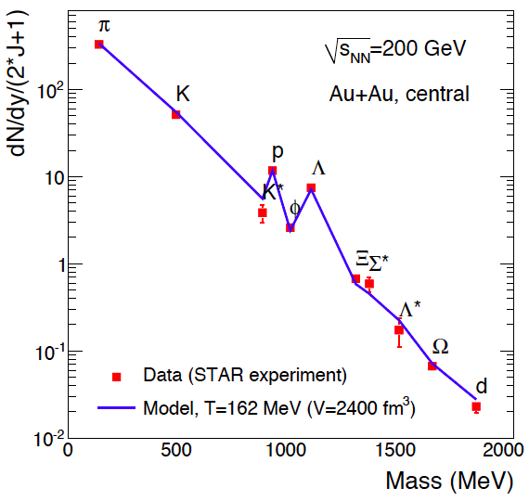
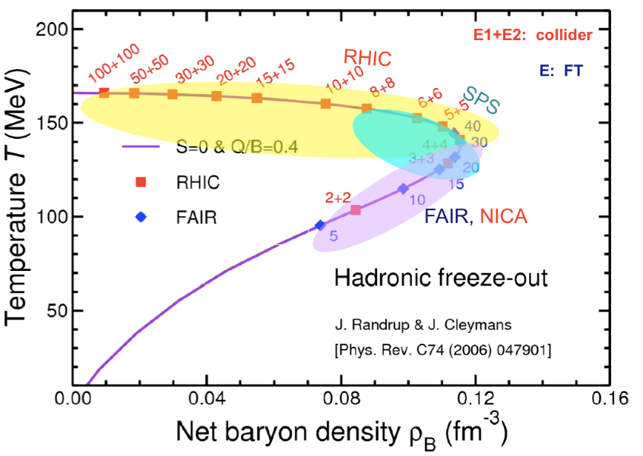
Thermal / Statistical model
(no dynamics)
  The system is described by the Grand canonical ensemble
  of non-interacting hadron gas in equilibrium (thermal & chemical)
  with min number of parameters T, μ_{Β} (V – scale)
particle yeild
freeze-out conditions
Au+Au BNL
max ρ_{Β}: √S_{NN} = 5 -10 GeV

Slide 5
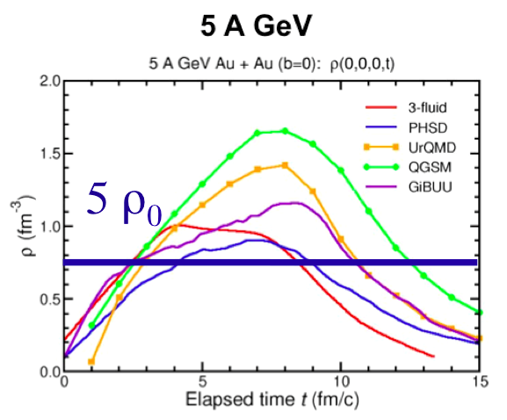
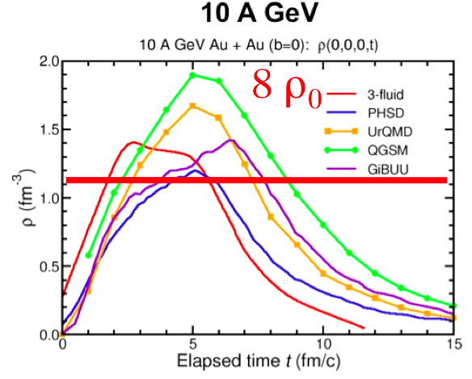
Net Baryonic density to be reached
in Au + Au collisions
Hydrodynamical models:
conservation laws + equation of state; assumption of local thermal and chemical equilibrium (simplified dynamics)
Transport models:
based on transport theory of relativistic quantum many-body systems;
actual solutions: Monte Carlo simulations with a large number
of test-particles (full dynamics)
I.C. Arsene at al.,
Phys. Rev. C75 (2007) 24902.

Slide 6
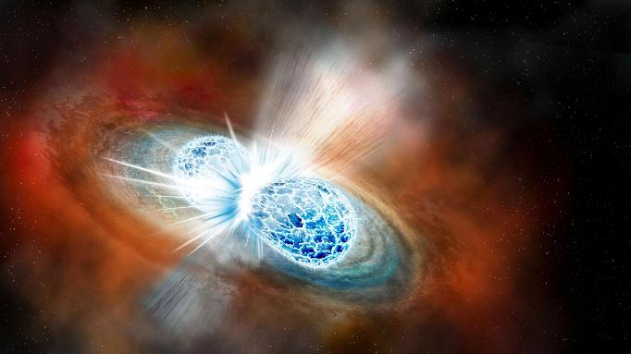
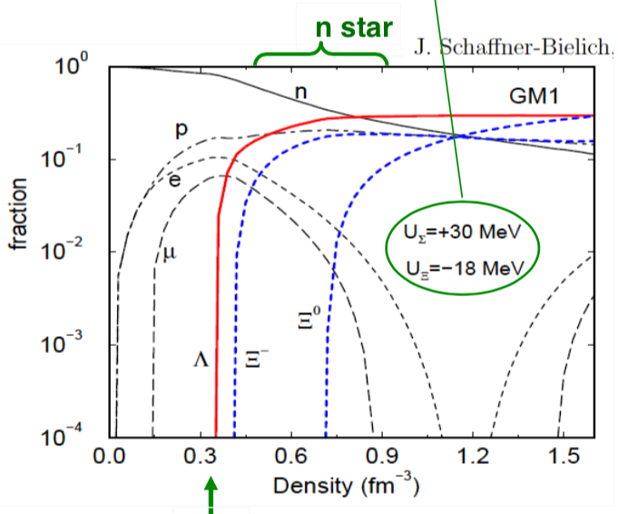
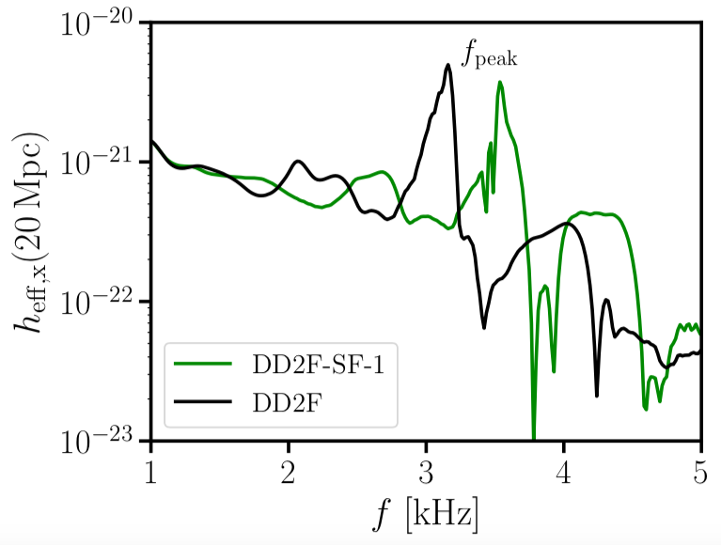
Similarity of Stellar Objects & Heavy Ion Collisions
Neutron Star Merger
appearance of strangeness changes EOS,
depends on strangeness-nucleon interaction
1st OPT:
gravitational waves from mergers
f [kHz]
2ρ₀
5ρ₀
10ρ₀
Bauswein et. al.,
arXiv:1809.01116

Slide 7

Main goals: to obtain new data on
hot and dense baryonic matter:
- is there a first-order phase transition?
- is there a critical point?
nucleon spin structure
- how the spin of proton/neutron is composed
modernization of JINR accelerator complex – Nuclotron
construction of Collider NICA providing collisions of
- relativistic ions from p to Au at energies √ S_{NN}= 4-11 GeV, L=10²⁷cm⁻²s⁻¹
- polarized p and d up to energy √S = 27 GeV (p), L=10³²cm⁻²s⁻¹
construction of three detectors: Baryonic Matter @ Nuclotron (BM@N),
Multi Purpose Detector (MPD) and Spin Physics Detector (SPD)

Slide 8
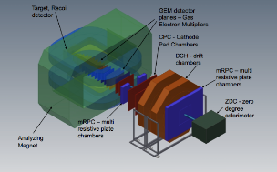
Structure of the Accelerator Complex
Linac HILac (3.2MeV/u)
KRION
Booster (25 Tm)
storage of
(2 ÷ 4)×10⁹ ions,
acceleration
up to 600 MeV/u;
electron cooling
Ion sources
Linac LU-20(5MeV/u)
Fixed Target Area
BM@N
started data taking in 2018
Stripping (80%) ¹⁹⁷Au³¹⁺ => ¹⁹⁷Au⁷⁹⁺
Nuclotron (45 Tm)
injection bunch
~ 2×10⁹ ions
acceleration up to
1 - 4.5 GeV/u
SPD
Two SC collider rings
~ 2 x 22 injection cycles
22 bunches per ring
MPD

Slide 9
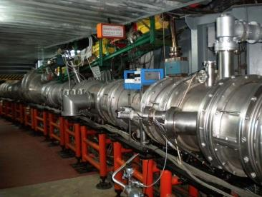
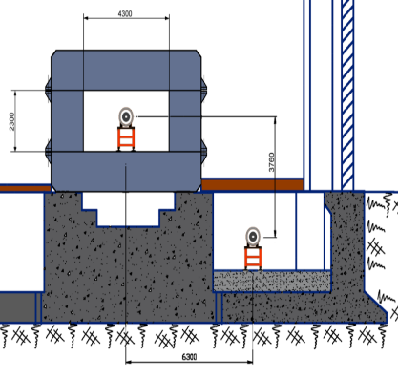
NUCLOTRON
put in operation in 1993
modernized in 2010-2015
BOOSTER
to be put in operation
in 2020
Type | SC synchrotron
particles | p, d, nuclei
max. kin. energy, GeV/u | 12.07 ( p); 5.62 ( d) 4.38 (Au)
injection energy, MeV/u | 5 ( p, d) 570-685 (Au)
magn. rigidity, Tm | 25 – 43.25
circumference, m | 251.52
vacuum, Torr | 10⁻⁹
intensity, Au /pulse | 1 10⁹
 | value
ion species | A/Z < 3
max. energy, MeV/u | 600
injection energy, MeV/u | 3.2
magnetic rigidity, T m | 1.6 – 25.0
circumference, m | 210.96
vacuum, Tor | 10⁻¹¹
intensity, Au /p | 1.5 10⁹
RF region,MHz | 0.5 -2.53
BOOSTER
NUCLOTRON

Slide 10
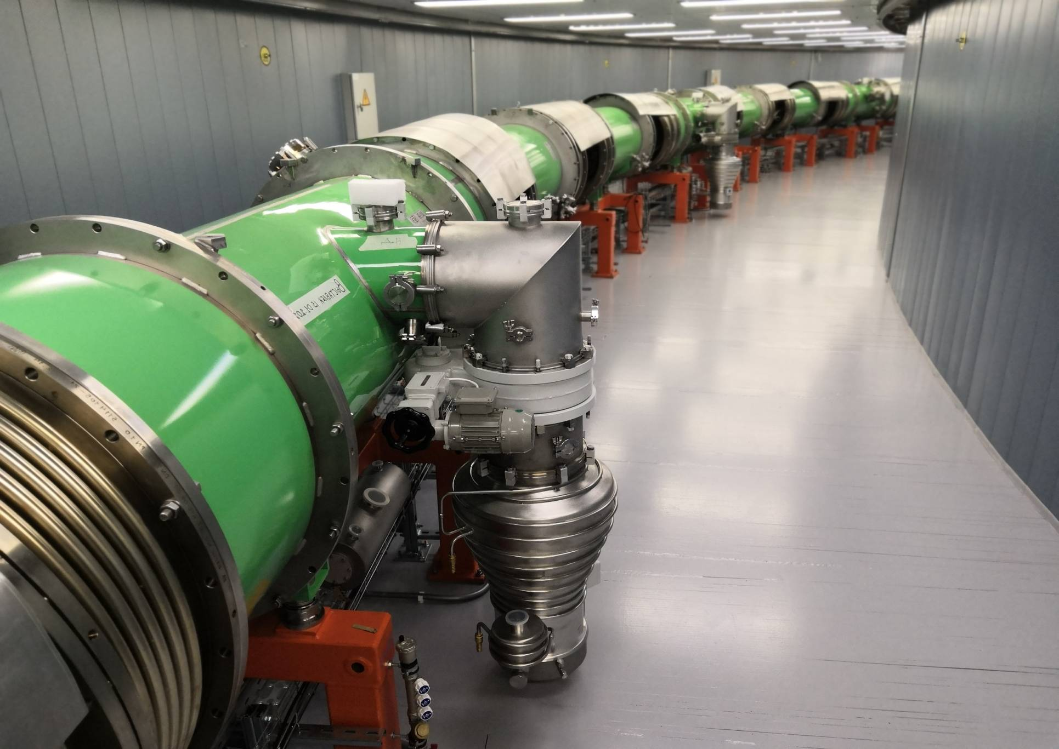
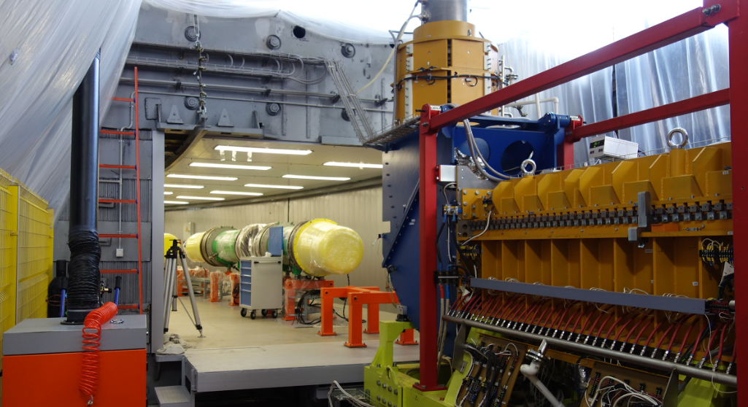
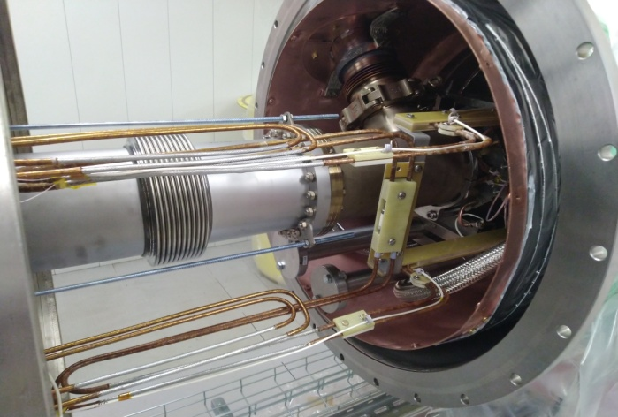
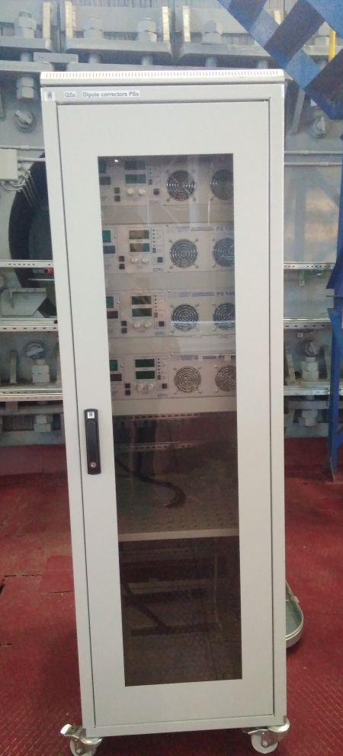
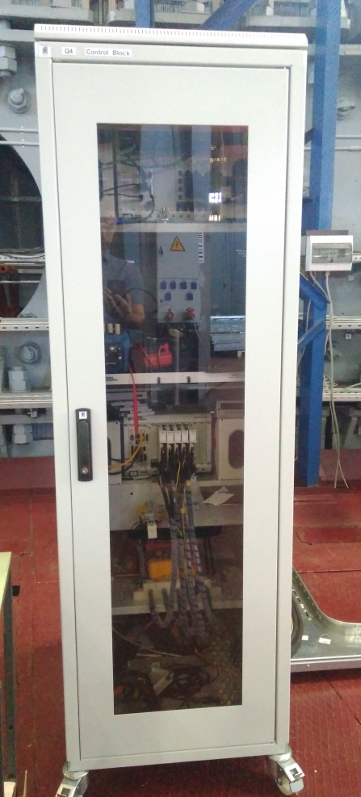
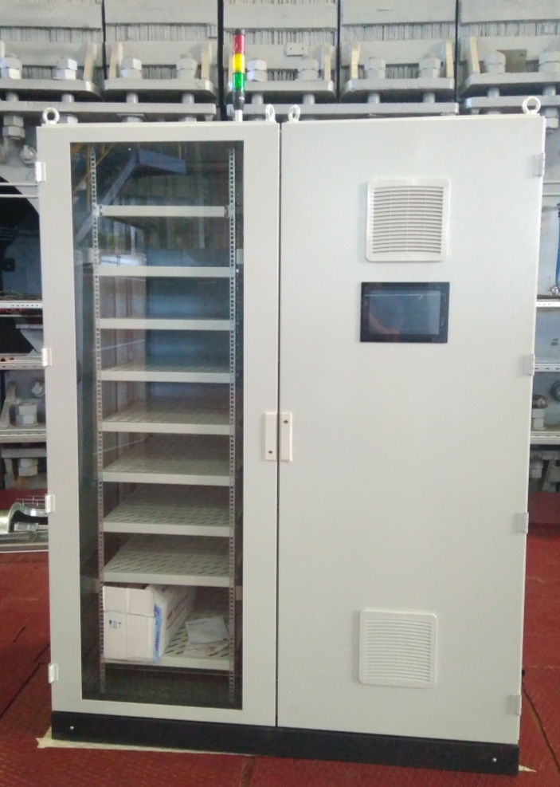
Booster: assembly to be completed in August 2020
The Green machine is under
technical commissioning
100% magnets installed & aligned
90% magnets connections
100% LHe system assembled,
80% LN2 system assembled
25% Vacuum system assembled
1/8 Beam pipe assembling & testing
Diagnostics & control systems
              beam diagnostic - 90%
              monitoring & control - 90%
              vacuum chamber automatic control - 30%
ECS - installed
& tested (BINP)
В. Кекелидзе, КПП ОИЯИ
10
10
Notes:
.

Slide 11
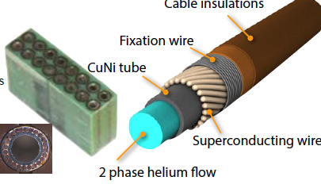
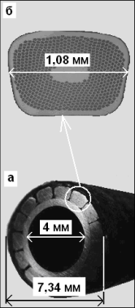
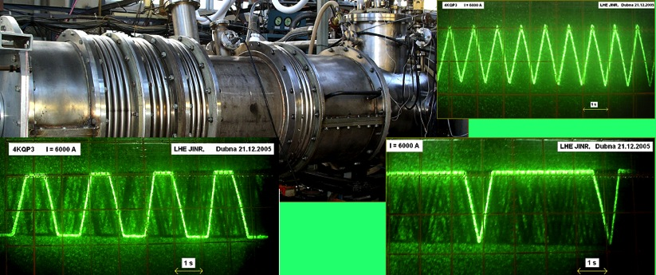
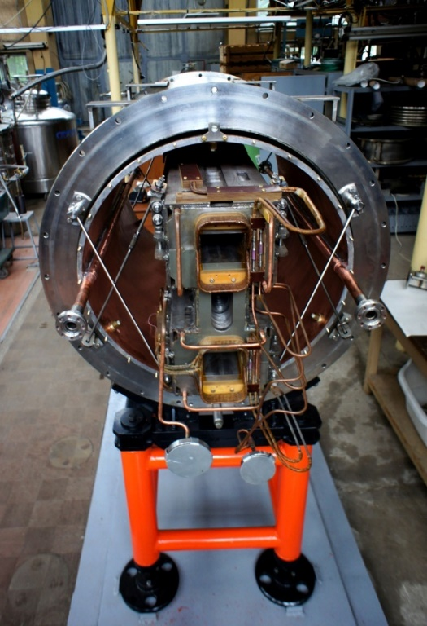
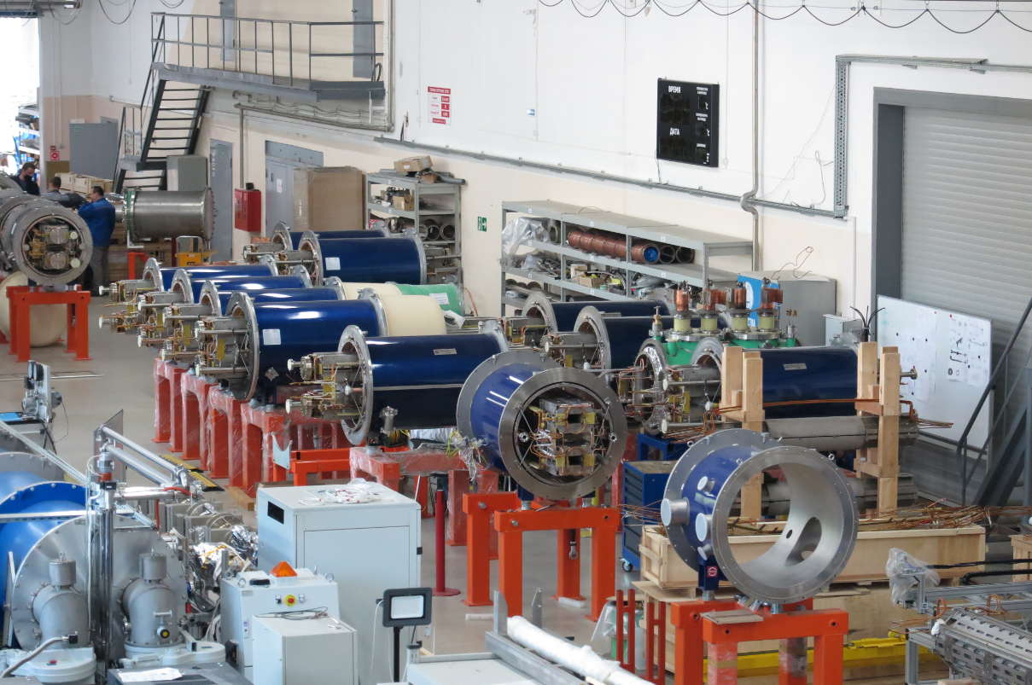
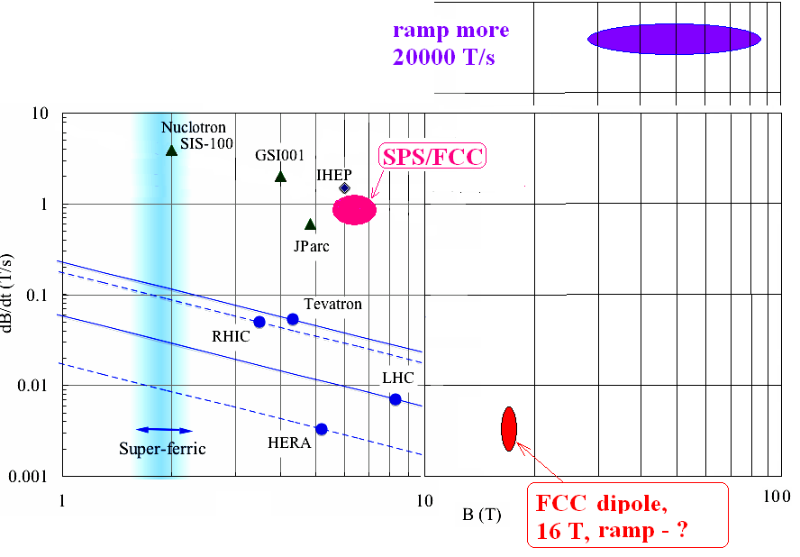
Challenge # 1: Unique SC magnets Nuclotron type
(from fast-cycling mode to long plateau @ high field)
“Nuclotron type” magnets:
hollow SC cable
two phase He flow @ 4,5K
NICA Booster & Collider, FAIR SIS-100, HIAF:
B ~2T, I=10–17 kA, ramp rate – up to 4T/s@1Hz, stored energy ~0.4MJ
factory for SC magnet
production was put in operation in 2016
Collider “twin” SC dipole

Slide 12
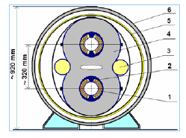
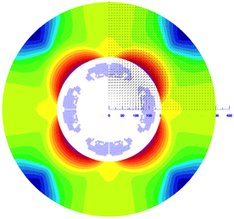
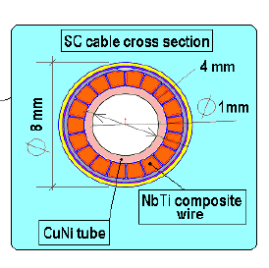
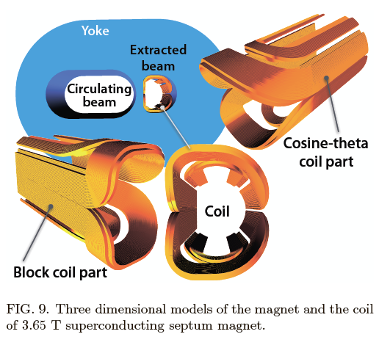
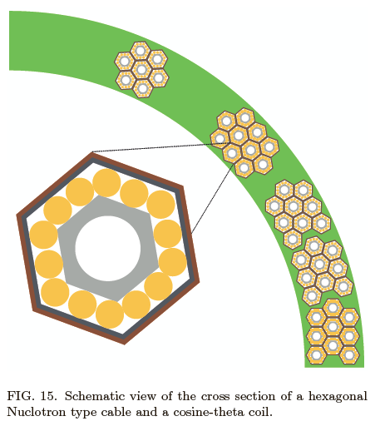
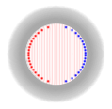
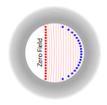
Very near future: fast (up to 4 T/s) ramped 4-6T dipoles and large aperture quadrupoles (FFL). Perspective -> 50 GeV (p)
- Aperture: 100 - 110 mm;
- Single layer coil (12-14 turns)
- NbTi cable made of
keystone wires;
- The cold mass limited
to the coil and collar;
- The yoke at T = 50 - 80 K.
- Two-phase Helium flow (mass flow rate of 2 g/s);
- Operating current ~ 30 kA. HTSC current-leads (1st gen.) used @ 77K.
Field quality - by yoke boundary profile and the coil turns azimuth position
    cos-theta
    cut cos-theta
JINR+GSI common efforts to increase current density of the cable, coil, to construct high field septum magnet reaching 8T - alternative to the Rutherford cable magnet.

Slide 13
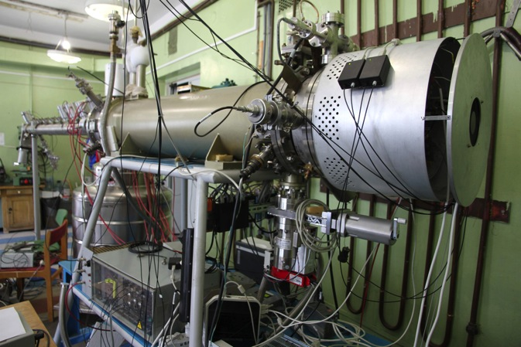
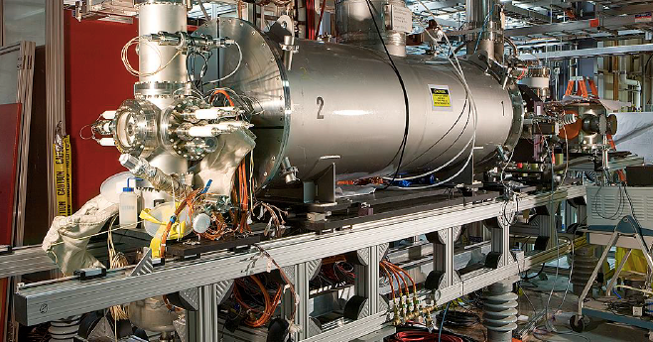
Challenge #2: Intense Heavy ion sources ESIS/EBIS type
JINR Krion-6T (ESIS) for NICA
B = 6 (5.4) T !!!
Ee = 25 keV
J_el (design) = 1000 A/cm²
Au³⁰⁺³²⁺ : 2.5*10⁹ ppp,
t_{ion} = 20 ms @ 50 Hz.
Frequency 0.6 – 10 Hz
Au (32+):
2.3*10⁹ ions/pp@5Hz
I_e = (7 –10) A
L_trap = 188 cm
E_e = (20 –24) kV
J_e= (300–500) A/cm2
BNL 5T EBIS (for RHIC and NSRL)

Slide 14
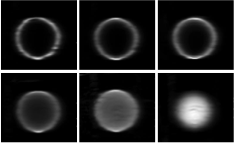
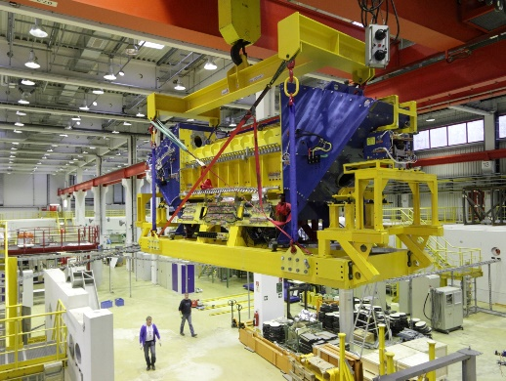
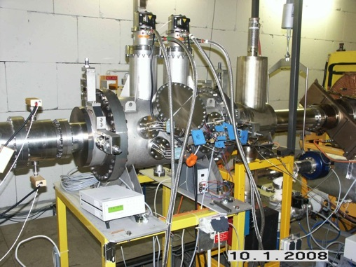
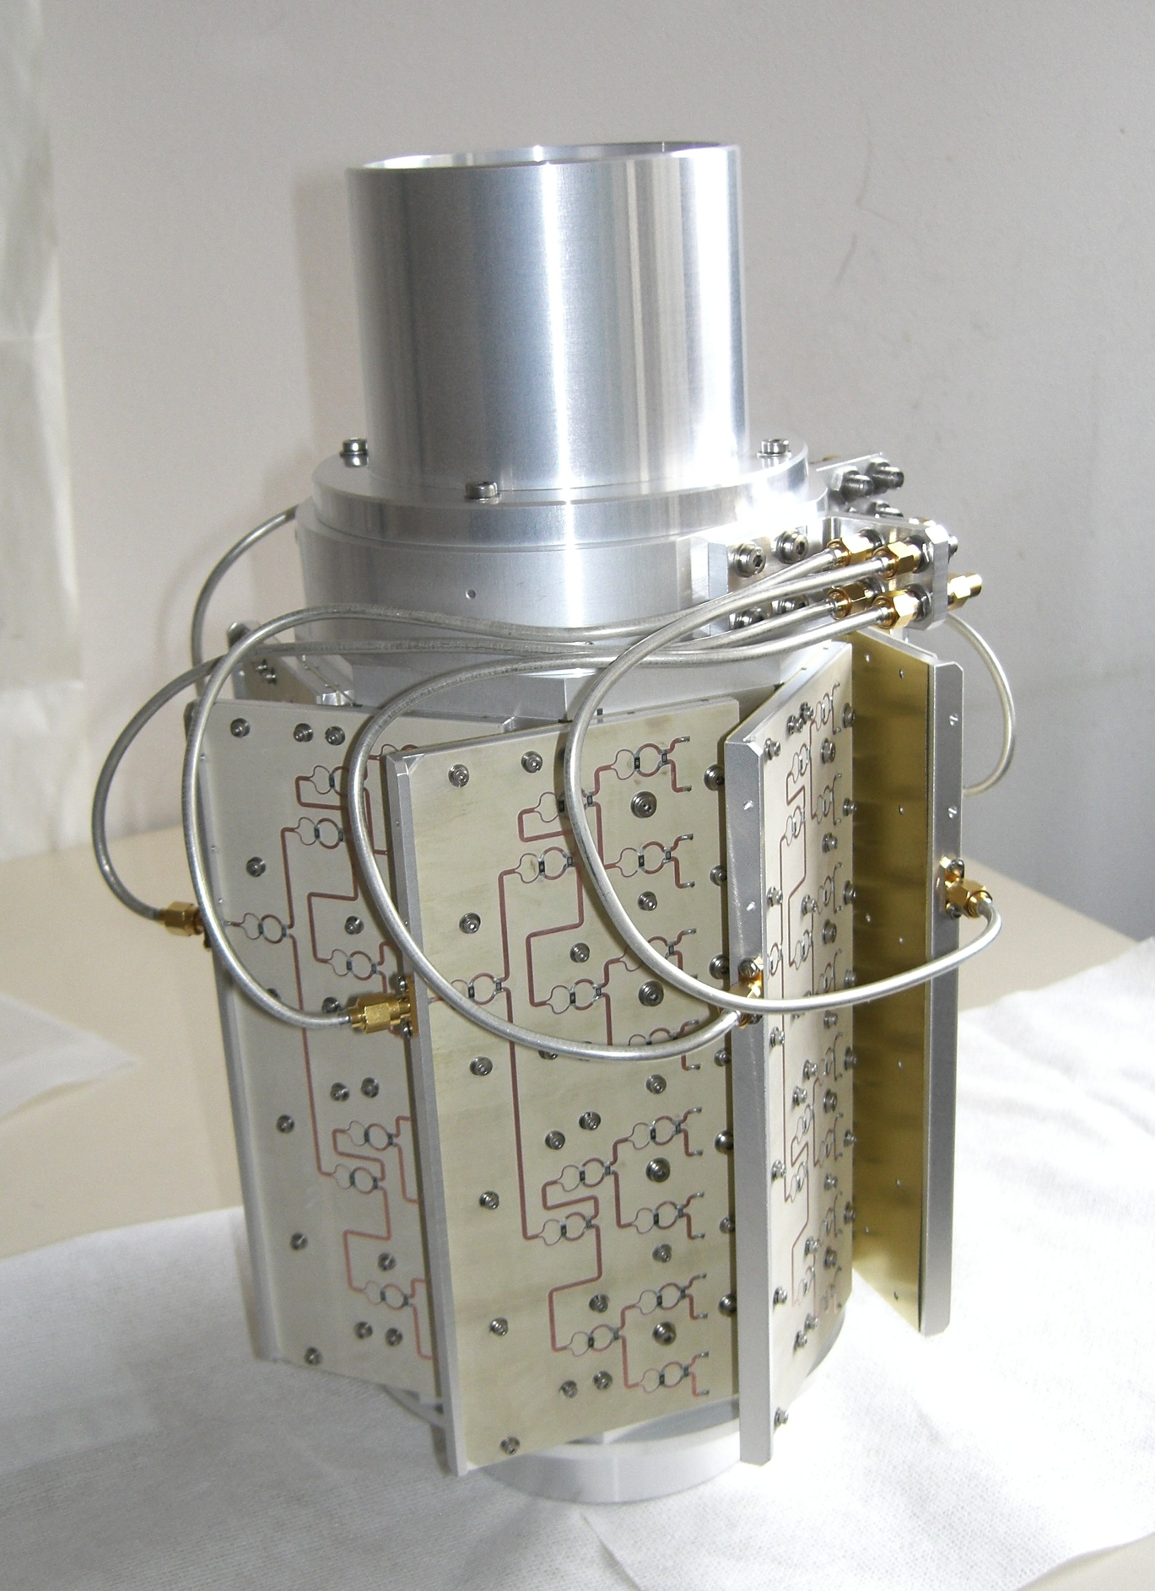
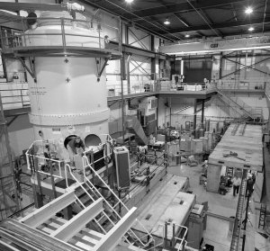
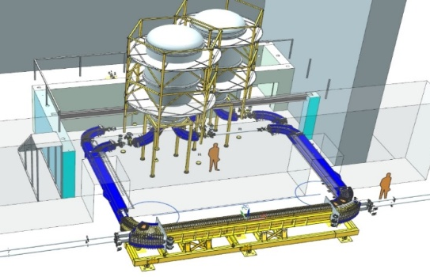
Challenge #3. Beam cooling systems: Electron & Stochastic
E Cooling: ultra-high energy of e beam;
cryogenic cathodes; hollow e beam
Stochastic cooling: 2-4 GHz, slot-ring-coupler (designed & produced for Nuclotron at FZJ as prototype for NICA) collaborating with FZJ (COSY, HESR), FAIR, FNAL.
COSY FZJ: 2 MeV,
S-cool slot-ring
coupler structure
NICA:
2.5 MeV
FZJ, COSY
FNAL:
4 MeV Pelletron
horizontal & vertical cooling ~10W/ each; gain 70~75 dB; total power: ~ 400 W;
TDR: 32 rings per each pick-up, 64 - per each kicker, ~ 400 rings for total system.
booster – typical;
collider –most challenging one, JINR & BINP: Ee 0.2-2.5 MeV, current 0.1-1A,
hollow beam, B=0.2T, cooling time ~10⌯300s in range 1⌯3 GeV/u
Challenges: advanced Notch-filter, accuracy of delay 1ps, effective 3D-cooling in 3⌯4.5GeV/u@ 300⌯700s, vacuum conditions for pick-up (warm section) 10⁻¹¹ Torr, simultaneous operation with beam accumulation
Challenges: high voltage generation; power transmission to high potential; generation of magnetic guiding field.

Slide 15
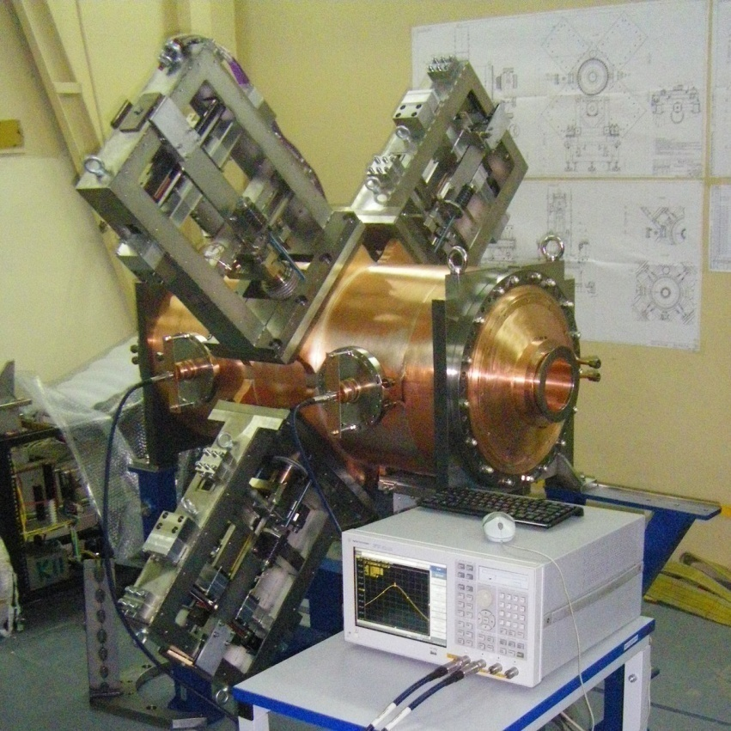
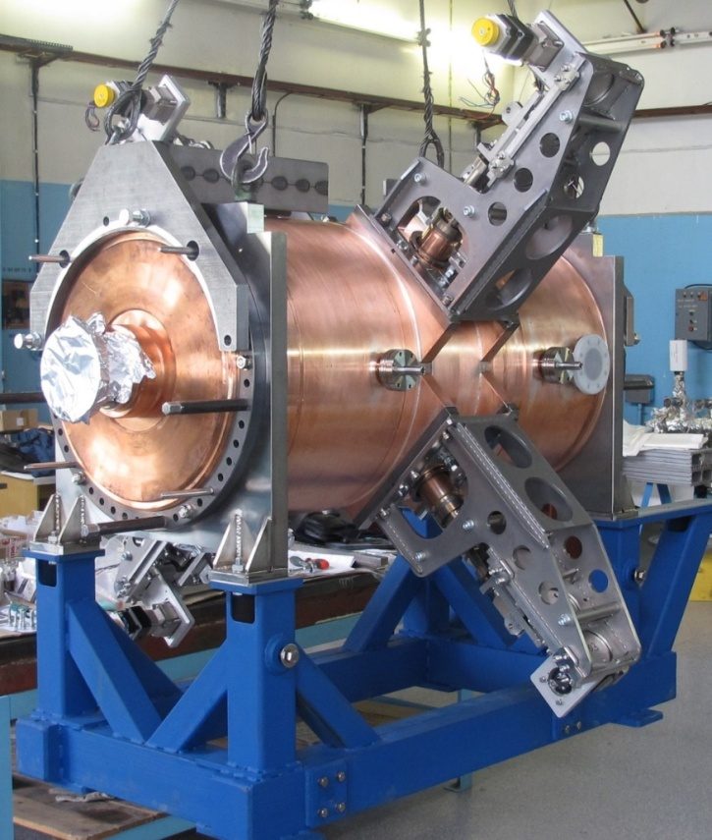
Challenge #4: Low energy ultra-high intensity Collider
2 х 503 m SC rings in one cryostat, separated vertically by 320 mm
Lattice: FODO, 12 cells x 90⁰ each arc
Electron & stochastic beam cooling
RF gymnastics:
from coasting beam to 22nd harmonics => 66th harmonics; cooling & stacking with RF1 barrier voltage (< 5 kV); accumulation efficiency ~ 95%;
~ 110 - 120 injection pulses (55-60 to each ring) every 5 s;
total accumulation time ~ 10 min.
Steps 2-3:
formation of the short ion bunches at cooling presence:
RF-2 (100 kV, 4 resonators) => RF-3 (1MV, 8 resonators).
RF-2 station
Number of bunches | 22
rms bunch length, m | 0.6
β-function in IP, m | 0.6
Kin. energy of Au⁷⁹⁺, GeV/u | 1.0 | 3.0 | 4.5
Number of ions per bunch | 2.0·10⁸ | 2.4·10⁹ | 2.3·10⁹
Luminosity, cm⁻² s⁻¹ | 0.6·10²⁵ | 1·10²⁷ | 1·10²⁷
IBS growth time, s | 160 | 460 | 1800
RF-3 station
Notes:
Challenge #4: Low energy ultra-high intensity Collider
2 х 503 m SC rings in one cryostat, separated vertically by 320 mm
Lattice: FODO, 12 cells x 90⁰ each arc Electron & stochastic beam cooling
Finally, the parameters will be reached indicated in the table.
Main one - Luminosity 10 27 at 11 GeV/u in the cms.

Slide 16
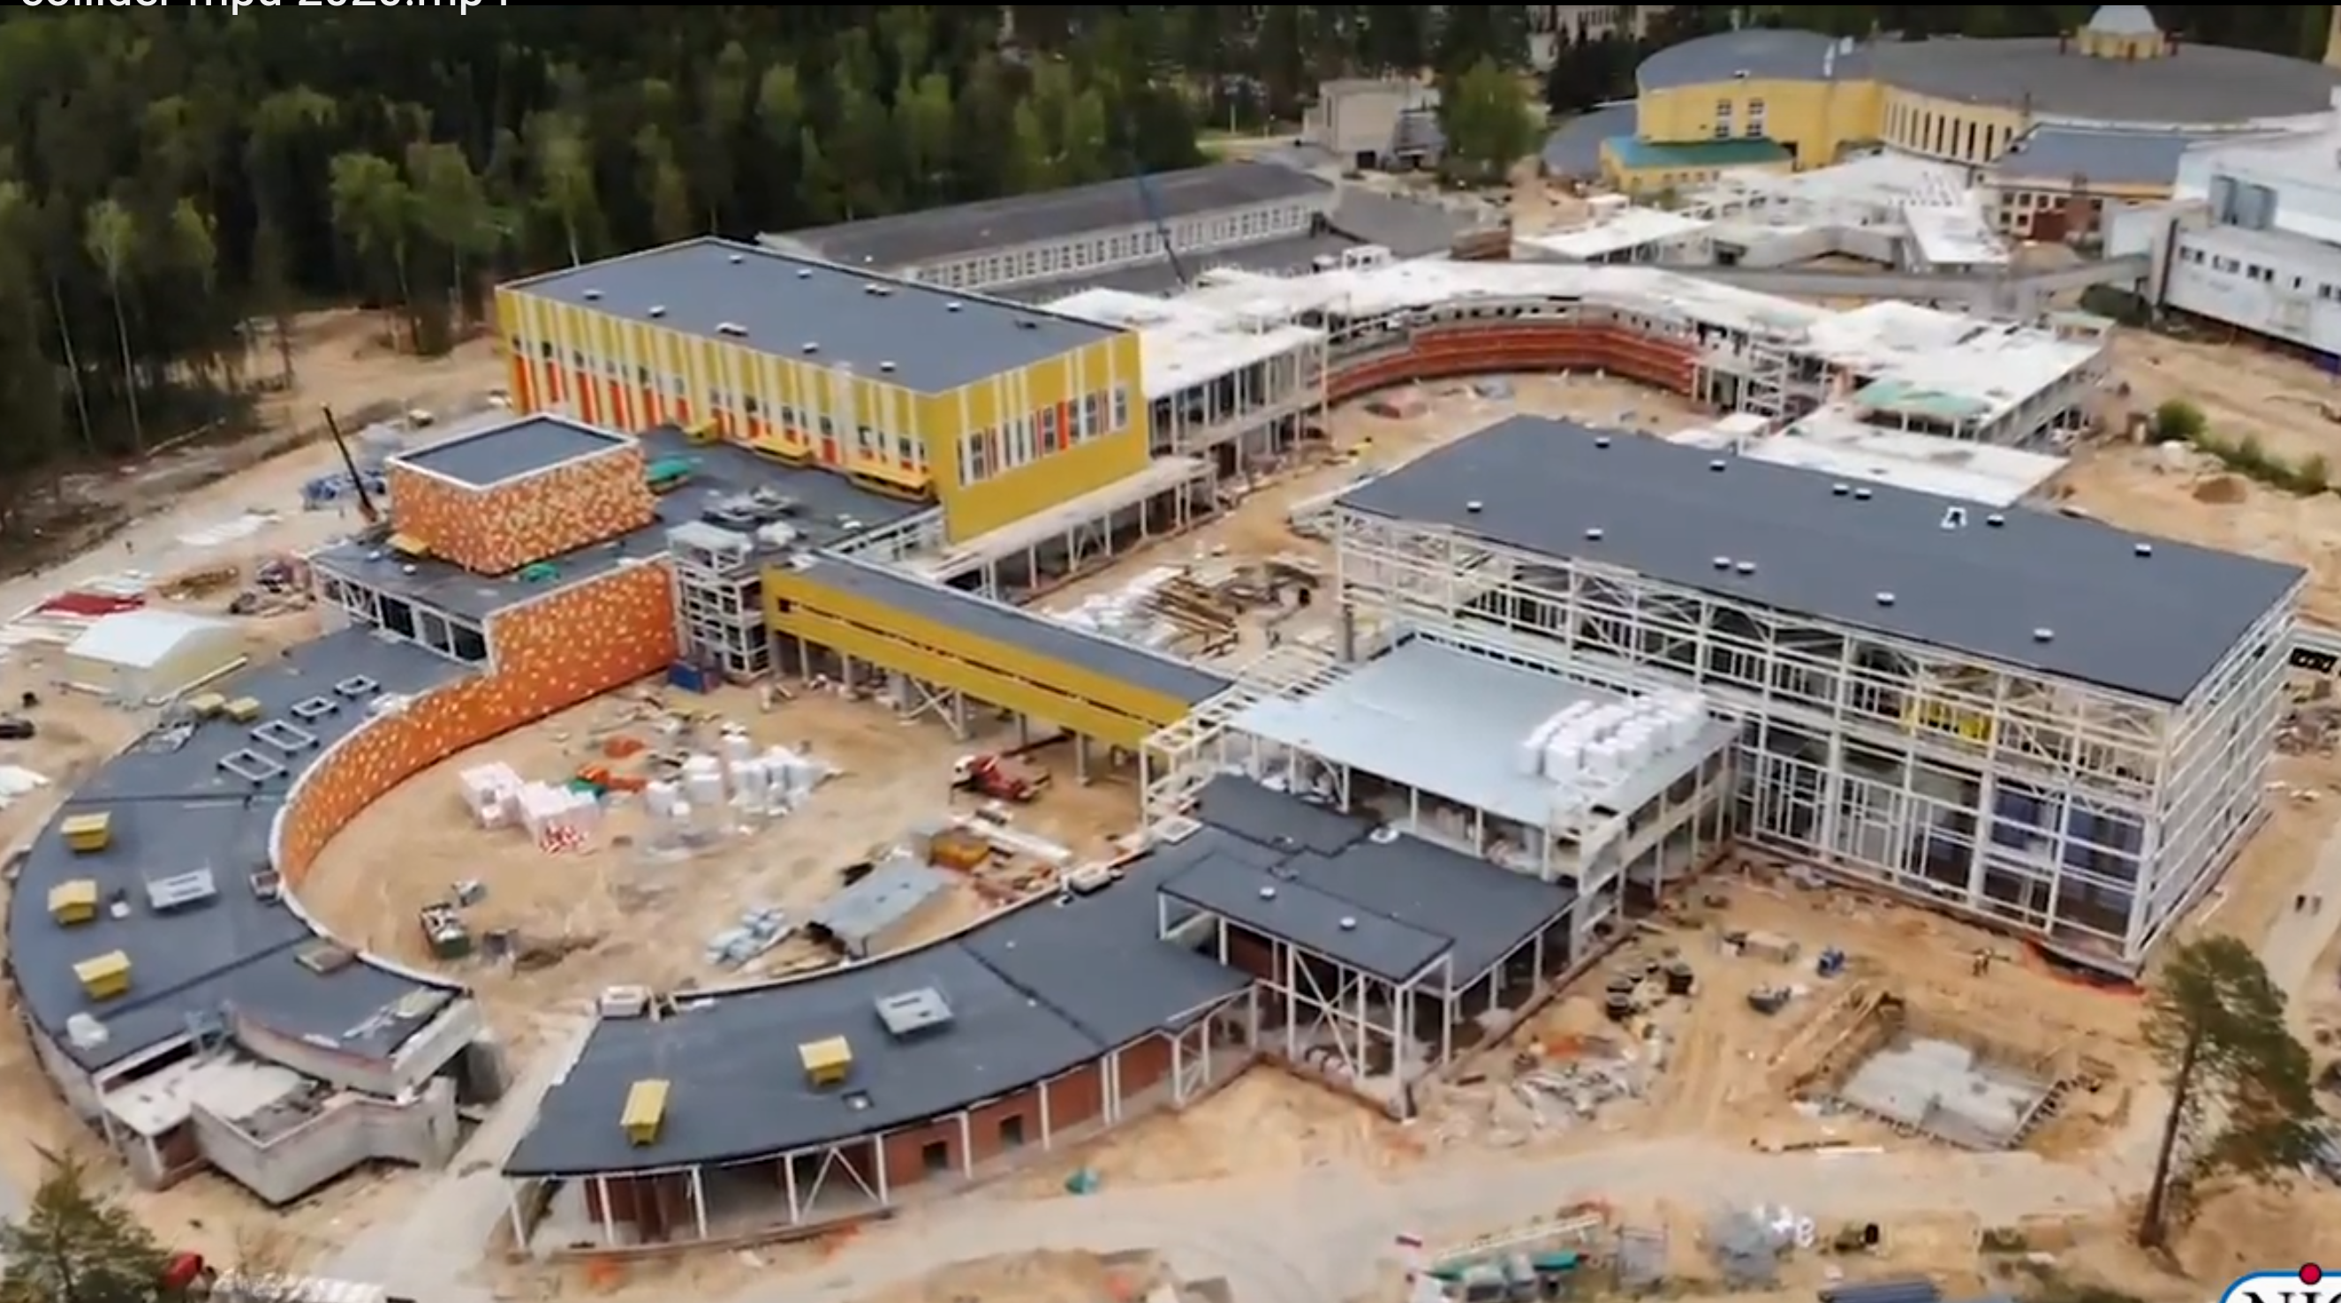
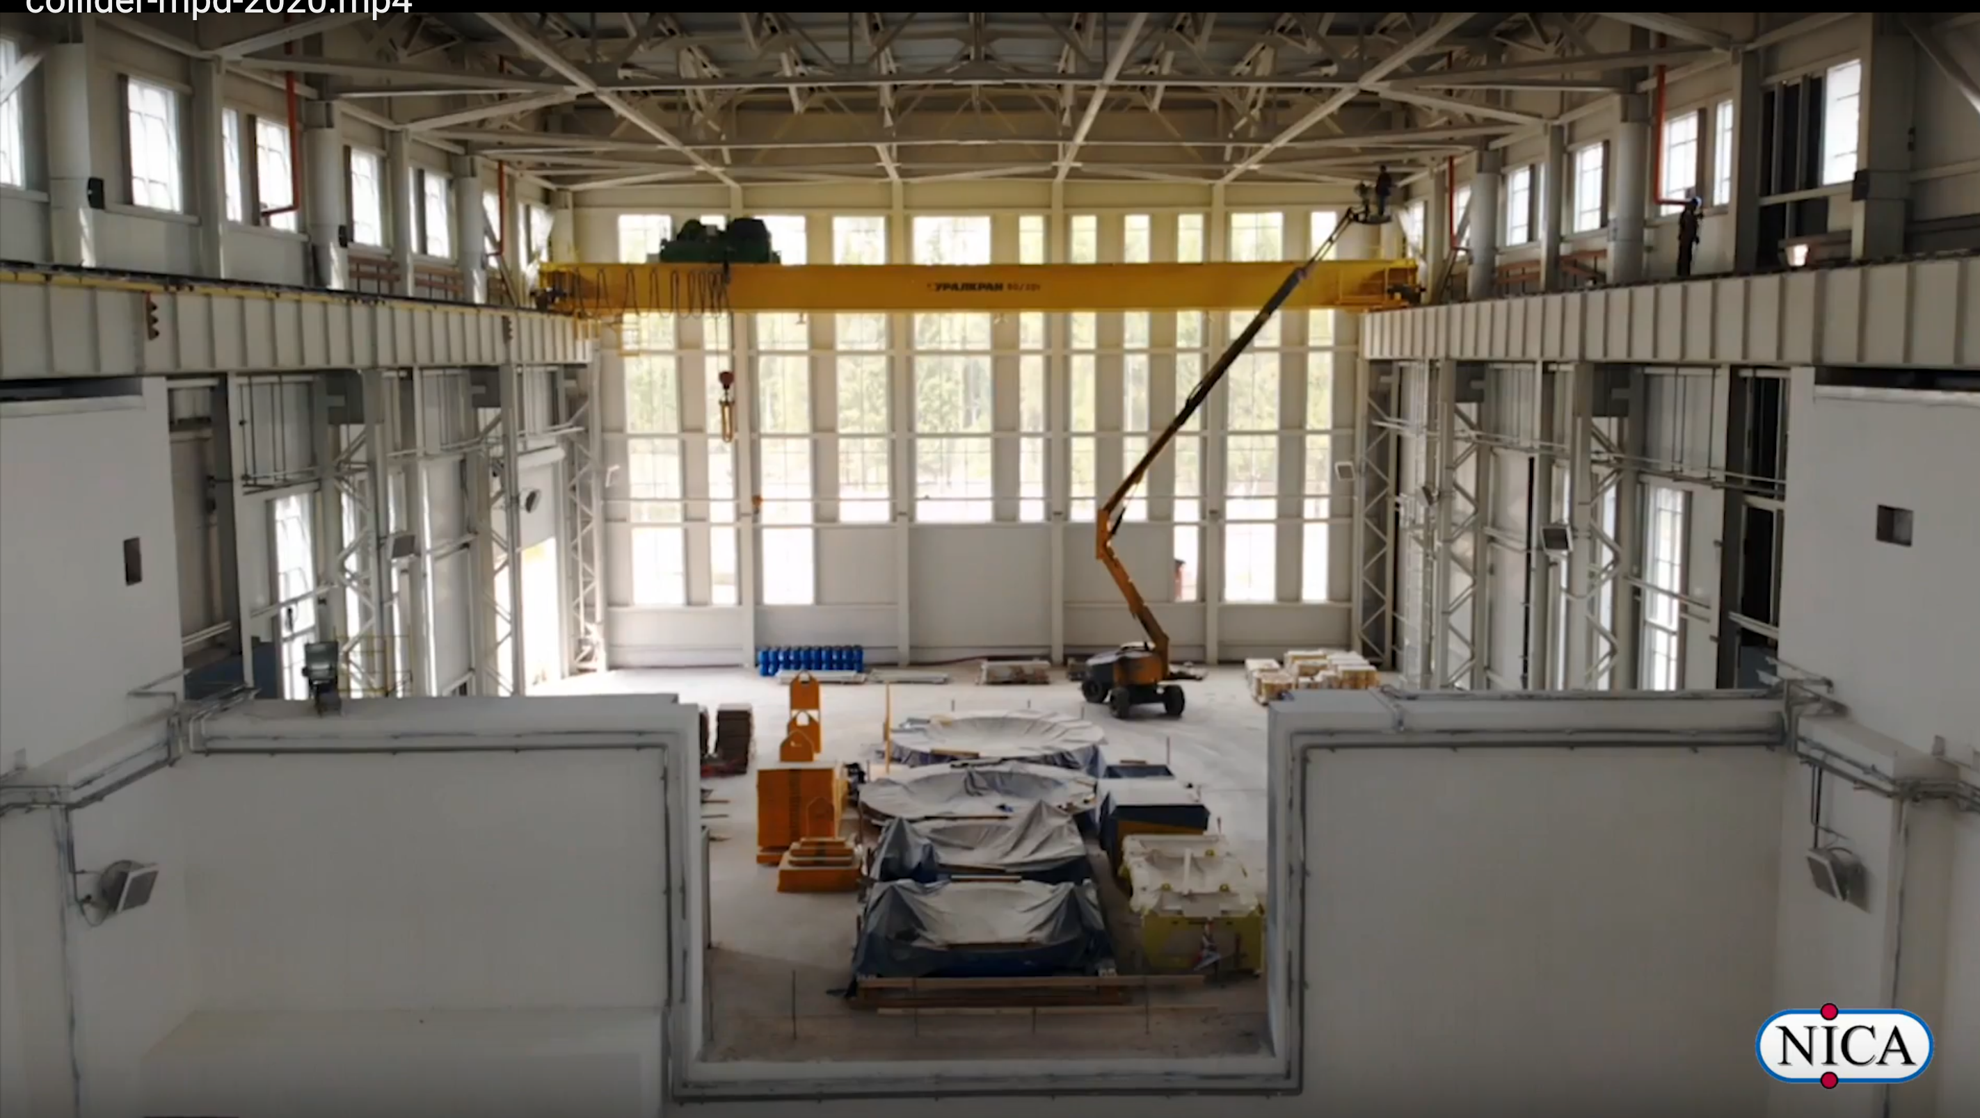
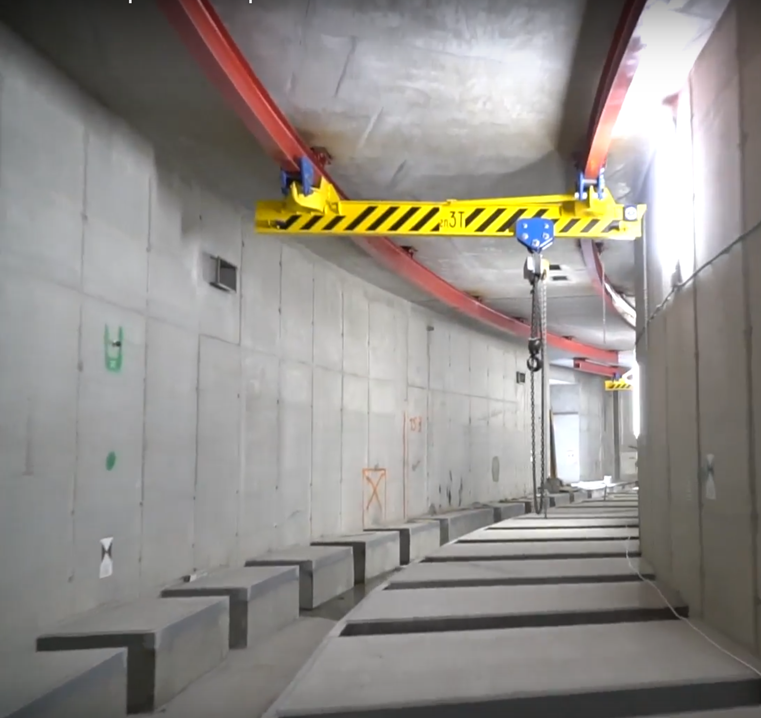
Civil construction: collider building (№ 17)
May 2020
completion in 2021
MPD
SPD
MPD Hall
tunnel
step-by-step commissioning
in stages for installation:
MPD hall - June ’20
collider – August ‘20

Slide 17
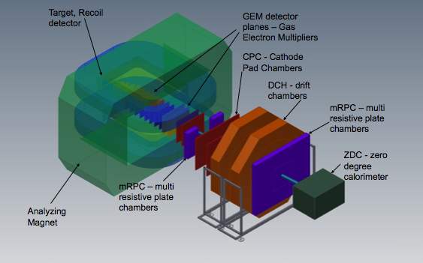

Baryonic Matter at Nuclotron
(BM@N) Collaboration:
10 Countries, 20 Institutions, 246 participants
University of Wroclaw, Poland;
St Petersburg University, Russia;
Institute of Nuclear Research RAS, Moscow, Russia;
NRC Kurchatov Institute, Moscow, Russia;
Institute of Theoretical & Experimental Physics, NRC KI, Moscow, Russia;
Moscow Engineer and Physics Institute, Russia;
Skobeltsin Institute of Nuclear Physics, MSU, Russia;
Moscow Institute of Physics and Technics, Moscow, Russia;
Massachusetts Institute of Technology, Cambridge, USA.
University of Plovdiv, Bulgaria;
Shanghai Institute of Nuclear and Applied Physics, CFS, China;
Tsinghua University, Beijing, China;
Nuclear Physics Institute CAS, Czech Republic;
CEA, Saclay, France;
TU Darmstadt & GSI Darmstadt, Germany;
Tubingen University, Germany;
Tel Aviv University, Israel;
Joint Institute for Nuclear Research;
Institute of Applied Physics, Chisinev, Moldova;
Warsaw University of Technology, Poland;

Slide 18
MPD Collaboration:
10 Countries, 32 Institutes, 465 participants
IHEP, Beijing, China;
University of South China, China;
Palacky University, Olomouc, Czech Republic;
NPI CAS, Rez, Czech Republic;
Tbilisi State University, Tbilisi, Georgia;
Tubingen University, Tubingen, Germany;
Tel Aviv University, Tel Aviv, Israel;
Joint Institute for Nuclear Research;
IPT, Almaty, Kazakhstan;
UNAM, Mexico City, Mexico;
Institute of Applied Physics, Chisinev, Moldova;
WUT, Warsaw, Poland;
NCN, Otwock – Swierk, Poland;
UW, Wroclaw, Poland;
Jan Kochanowski University, Kielce, Poland;
INR RAS, Moscow, Russia;
MEPhI, Moscow, Russia;
PNPI, Gatchina, Russia;
INP MSU, Moscow, Russia;
KI NRS, Moscow, Russia;
SPSU - Dept. of NP, Russia;
St. Petersburg, Russia;
SPSU – Dept. of HEP, St. Petersburg, Russia;
North Ossetia State University, Vladikavkaz, Russia;
Baku State University, NNRC, Azerbaijan;
University of Plovdiv, Bulgaria;
University Tecnica Federico Santa Maria, Valparaiso, Chili;
Tsinghua University, Beijing, China;
USTC, Hefei, China;
Huizhou University, Huizhou, China;
Institute of Nuclear and Applied Physics, CAS, Shanghai, China;
Central China Normal University, China;
Shandong University, Shandong, China;
Notes:
.

Slide 19
Search for phenomena:
onset of deconfinement
onset of chiral symmetry restoration
first order phase transition
critical endpoint
Observables:
particle yield
strangeness production
femtoscopy
evet-by-event fluctuations
dileptons, vector mesons
collective phenomena (flows, hydrodynamics)
vorticity - polarization
Notes:
Main task of these experiments is exploration of the QCD phase diagram in the region od maximum available net baryonic density.
The studies includes:
Search for phenomena:
onset of deconfinement
onset of chiral symmetry restoration
first order phase transition
critical endpoint
the Observables are:
particle yield
strangeness production
femtoscopy
evet-by-event fluctuations
dileptons, vector mesons
collective phenomena (flows, hydrodynamics)
vorticity – polarization following

Slide 20
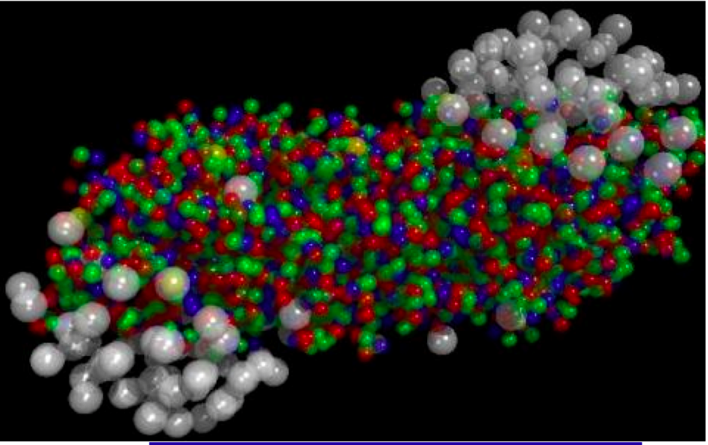
«The only source of knowledge is experience»
A. Einstein
QCD matter at the NICA energies
Existing experimental data & theory calculations indicate:
maximum in the net baryon density – density frontier;
maximum in Κ⁺/π⁺ ratio;
maximum in Λ/π ratio;
maximum yield of hypernuclei
maximum of the Λ polarization;

Slide 21

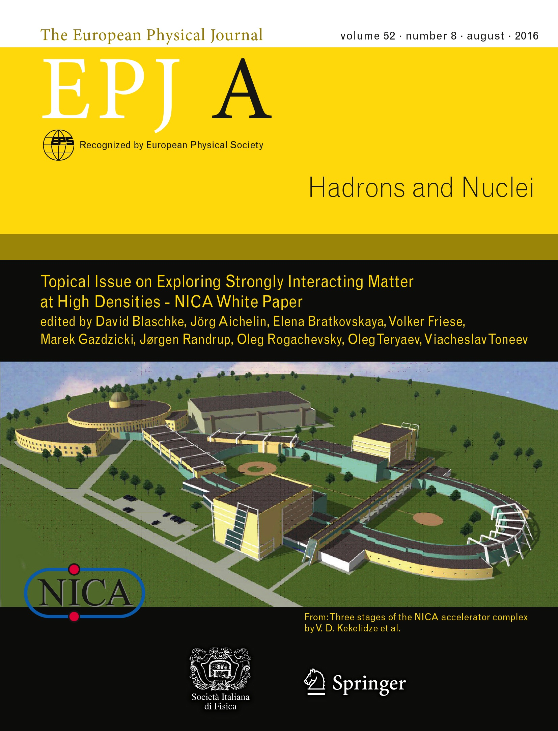
New issues: NICA White Paper, SQM proceedings
Physics targets for the exploration of first order phase transitions in the region of the QCD phase diagram accessible to NICA & FAIR and possible observable effects of a “mixed phase indicated in the release of the “NICA White Paper” as a Topical Issue of the EPJ A (July 2016).
111 contributions,
188 authors
from 24 countries

Slide 22
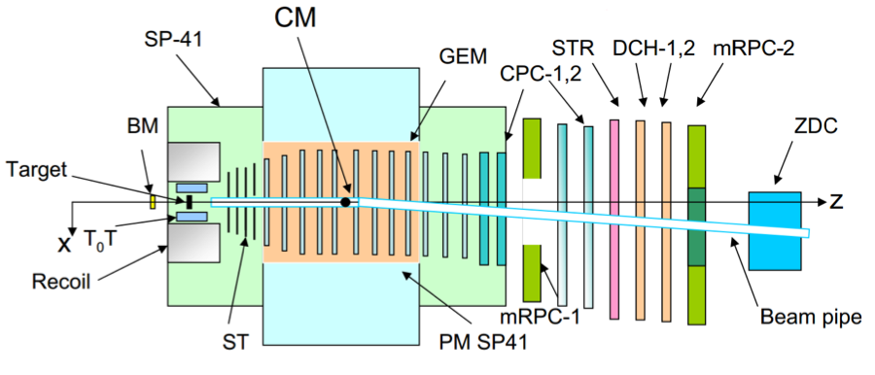
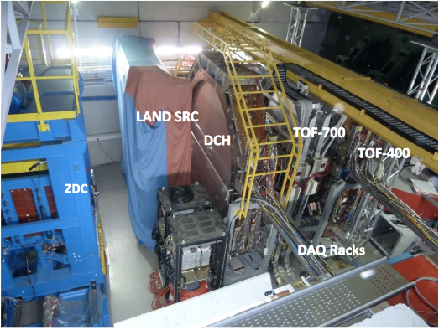


Baryonic Matter at Nuclotron (BM@N)
time resolution:
T0 ~43 ps
• ToF-700 ~65 ps
• ToF-400 ~53 ps
ECal
beam
pipe
GEM: 163 x 45 cm²
schematic view
plans
year | 2017 | 2020 | 2021 +
beam | C, Ar/Kr | Au | Au, p
intensity, Hz | 0,5M | 1M | 10M
trig. rate, Hz | 10k | 20k | 50k
central tracker | 10 GEM half pl. | 8 GEM full pl. | 12 GEM or 8+2Si
stage | 0 | 1 | 2
momentum resolution
Notes:
.

Slide 23


Multi-Purpose Detector (MPD)
stage I: TPC, TOF, ECAL, FHCal, FFD
acceptance
URQMD
charged
b<11 fm
11 A GeV
4 A GeV
dN/dη
TPC
TOF
ECal
FFD
FHCal
FHCal
FFD
η
stage I:
to be put in operation in 2021
Notes:
.

Slide 24
Multi-Purpose Detector (MPD)
stage I: TPC, TOF, ECAL, FHCal, FFD
stage II ( 2023): + ITS + EndCap (CPC, Straw, TOF, ECAL)
stage II
acceptance
URQMD
charged
b<11 fm
11 A GeV
4 A GeV
dN/dη
TPC
CPC
TOF
ECal
FFD
FHCal
FHCal
FFD
η
stage II:
to be put in operation in 2023

Slide 25




Challenge: Large SC Solenoid with high homogeneity MF
B₀=0.5 T
weight ~ 900 т
regular current: 1790 A
stored energy: 14.6 MJ
Control Dewar,
SC coil
Trim Coil
Cryostat
ТРС area
Δ B/B ~ 3x10⁻⁴
Cryostat & SC coil ready fot
Transportation to Dubna
Yoke control assembly
tolerances ~ 0,5 mm
Notes:
.

Slide 26






TPC – basic tracker
length | 340 сm
outer radius | 140 сm
Inner radius | 27 сm
gas | 0,9Ar+0,1CH₄
drift velocity | 5.45 сm/um;
Drift time | < 30 ms;
R/O chamb. | 12 + 12
channels | 95 232
Max rate | ~ 7 kGz
assembly in
clean room
Time of flight system (TOF)
efficiency and time resolution
28 module
280 MRPC’s
13 440 channels
20% of modules
produced & tested

Slide 27





The Challenges: Projective Electromagnetic Calorimetry
38 400 modules «shashlyk» type (Pb+Sc):
L ~35 cм (~ 14 X₀); segment 4x4 cm²
r/o: WLS fibers +MAPD;
π⁰ γγ
σ(E) ~ 5% @ 1 GeV;
σ(t) ~ 500 ps
projective
geometry
and Supporting structure
carbon fibre
~ 80 t
module
sector
- sagitta < 5 mm
- material budget (R) 0,13 X₀
blocks of modules

Slide 28





Inner Tracker System: charm particle detection
Coop with ALICE CERN
MAPS – CMOS technology
carbon fiber space frames;
D⁺
K⁻
π⁺
π⁺
ALPIDE MAPS
in 5 cylinders of 2 barrels
4,9۰10⁹ pixels,
active area 3,9 m².
beam pipe: berrilium
Stage I: 64 mm in diameter
Stage II: 38 mm in diameter
workshop for assembly & test
was put in operation in 2015

Slide 29
Set-ups: in operation
extracted
beams
10⁷
maximum baryonic density
colliders
10⁶
10⁵
Interaction rate, Hz
10⁴
HADES
SIS-18(GSI)
BES STAR/RHIC (BNL)
10³
10²
NA-61/SPS (CERN)
10
2
5
energy
10
√S_{NN}, GeV (Au+Au)

Slide 30
Set-ups: in operation
extracted
beams
10⁷
maximum baryonic density
colliders
10⁶
10⁵
BM@N/NICA (JINR)
Interaction rate, Hz
10⁴
HADES
SIS-18(GSI)
BES STAR/RHIC (BNL)
10³
10²
NA-61/SPS (CERN)
10
2
5
energy
10
√S_{NN}, GeV (Au+Au)

Slide 31
Set-ups: in operation
In construction
extracted
beams
CBM/SIS-100(FAIR)
2025
10⁷
maximum baryonic density
colliders
10⁶
10⁵
BM@N/NICA (JINR)
Interaction rate, Hz
MPD/NICA (JINR)
2022
10⁴
HADES
SIS-18(GSI)
BES STAR/RHIC (BNL)
10³
10²
NA-61/SPS (CERN)
10
2
5
energy
10
√S_{NN}, GeV (Au+Au)

Slide 32
Conclusions
Maximum achievable baryon density (density frontier)
- poorly understood region of the QCD phase diagram,
its research will clarify
urgent issues of strong interactions and astrophysics
and could led to discoveries
NICA Complex has the potential for competitive research
in this area
During the design and construction of the NICA accelerator and detector complex, a number of technological issues were resolved,
which will allow obtaining high-precision experimental data
The BM@N and MPD Collaborations are permanently developing
You are welcome to join!

Slide 33

«Everyone knows that he needs not to do something what disunites him from people, but what unites him with them.”
Lev Tolstoi
Thank you!

Slide 34




Study of hyperons
V. Vasendina, A. Zinchenko, V. Kolesnikov
8M minbias Au+Au @ 11 GeV (PHSD model)
TPC & TOF, |η|< 1.3
track reconstruction and PID (dE/dx+TOF)
secondary vertex finding technique
Yields for 10 weeks of running
PV - primary vertex;
V0 - vertex of decay;
dca- distance of closest approach;
path – decay length
Λ | Λ | Ξ⁻ | Ξ⁺ | Ω⁻ | Ω⁺
6 10⁹ | 7.3 10⁷ | 3 10⁷ | 1 10⁶ | 1 10⁶ | 3 10⁵

Slide 35



Hypernuclei @ MPD
P = 1 GeV/c
Hypertritons
central Au+Au @ 5A GeV
(DCM-QGSM)
PID
p
π⁻
d
~ 10⁶ ³_{Λ}H are expected
in 10 weeks
³_{Λ}H → ³He + π –
³_{Λ}H → p + d + π ⁻
Notes:
Hypernuclei could be reliably reconstructed and detected using PID based on the measurements of ToF and energy loss due to ionization in TPC

