Slide 1

Apache Hadoop at CERN
Zbigniew Baranowski
CERN IT-DB Hadoop and Spark Service, Streaming Service

Slide 2

Hadoop, Spark and Kafka service at CERN IT
Since 2013
Setup and run the infrastructure for scale-out solutions
Today mainly on Apache Hadoop framework and Big Data ecosystem
Support user community
  Provide consultancy
  Ensure knowledge sharing
  Train on the technologies

Slide 3
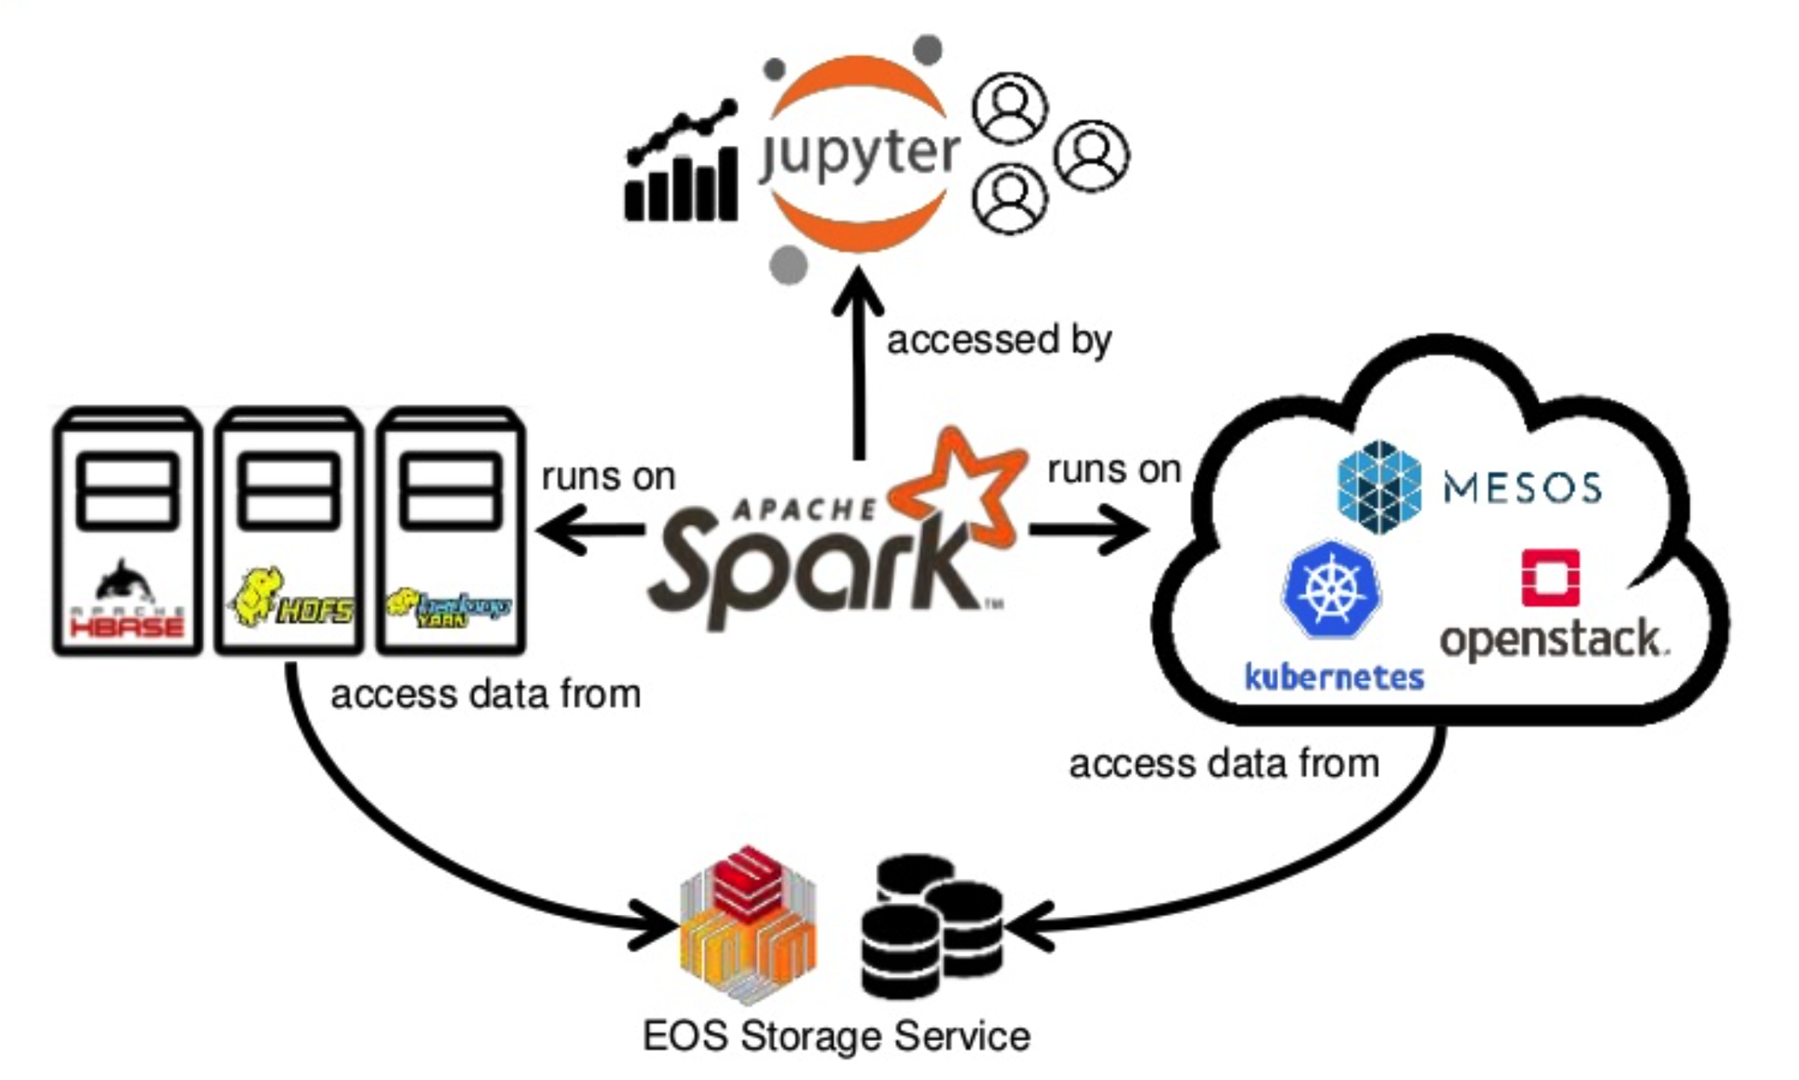
CERN analytics platform outlook
High throughput IO and compute workloads
Established systems
Flexible scalability for compute intensive workloads
Ad-hoc users

Slide 4








Hadoop service in numbers
5 clusters
  3 production (bare-metal)
  2 DEV clusters (BM & VMs)
100+ physical servers
40+ virtual machines
30+ PBs of Storage
30+ TB of Memory
1500+ physical cores
HDDs and SDDs
Data growth: 5 TB per day
CPU

Slide 5
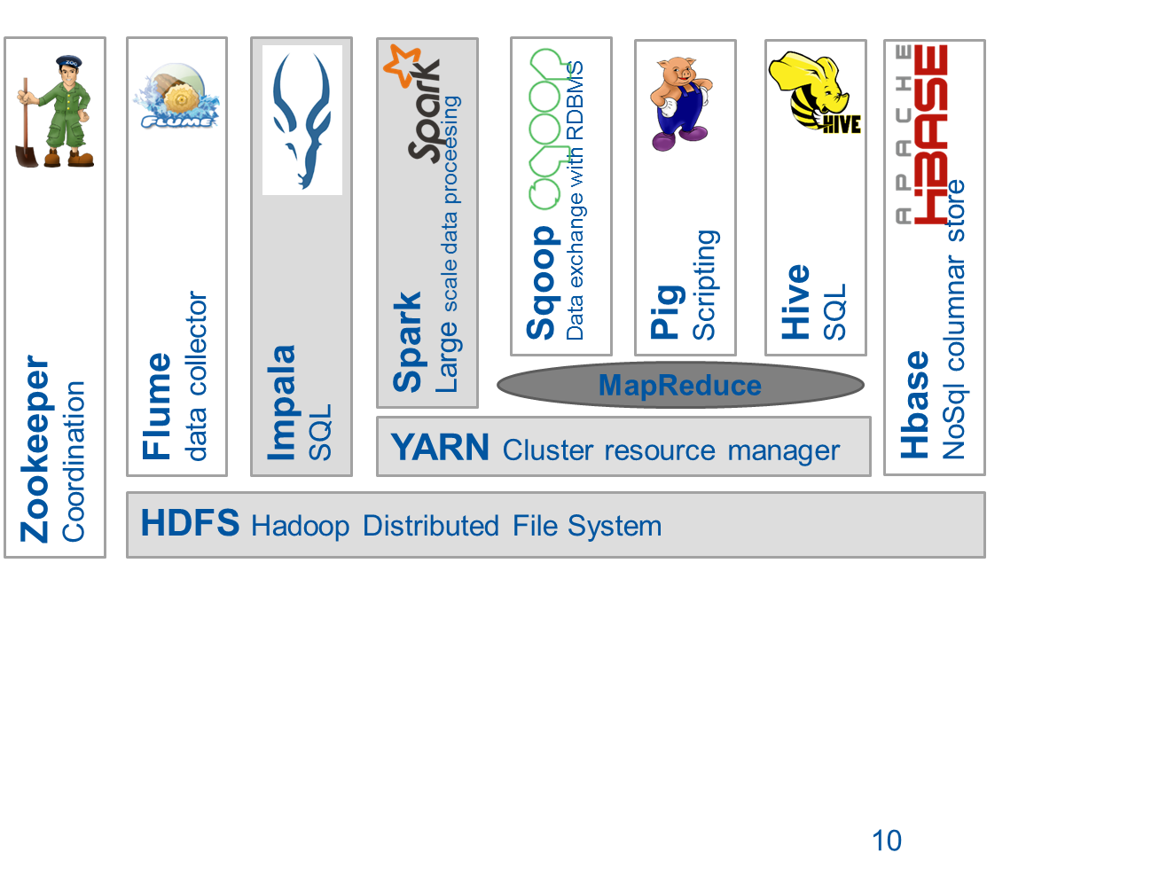






Overview of available components in 2020
Kafka:
streaming and ingestion
Reach data manipulation
bindings:
5

Slide 6








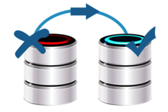

Hadoop and Spark production deployment
Software distribution
  Cloudera (since 2013)
  Vanilla Apache (since 2017)
Installation and configuration
  CentOS 7.x
  custom Puppet module
Security
  authentication Kerberos
  fine-grained authorization integrated with LDAP groups
High availability
  automatic master failover
  for HDFS, YARN, HBASE and HIVE
Rolling change deployment
  no service downtime
  transparent in most of the cases
Host monitoring and alerting
  via CERN IT Monitoring infrastructure
  ( collectd + flume + kafka + influx & hdfs)
Service level monitoring
  via CERN IT Monitoring (metrics and alerts)
  custom canary for availability and alerting
HDFS backups
  Daily incremental snapshots
  Sent to CERN tapes service (CASTOR)

Slide 7
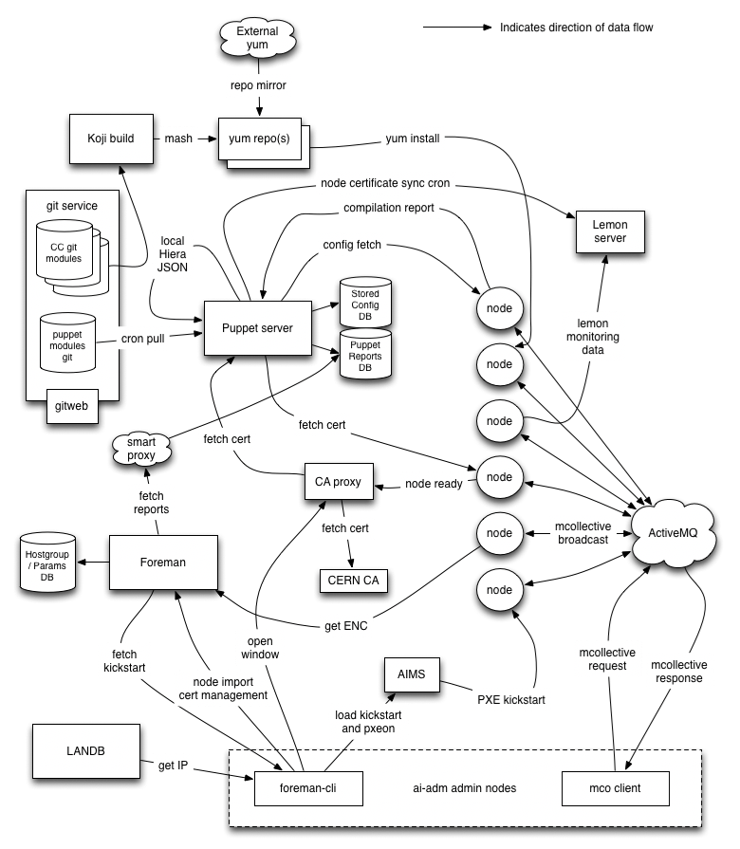
Puppet for service deployment
CERN IT provides central puppet service
  Manages configuration of most of the servers in the computer center
  Integrated with central Gitlab service
    All Puppet modules and service manifests are versioned
    Eases change management
Offers wide variety of upstream and in-house modules to integrate with
  Base linux configuration and packages installation
  Security enforcement
  Integration with other CERN services
    Kerberos, Load balancer, AFS, EOS, Secret manager, etc
We have developed in-house Hadoop modules
  For cluster setup - deploys hadoop clusters with all necessary components
    Installs packages, generates configuration files, runs the daemons
    Sets up monitoring and other core functionalities
    Only hostgroup (what components) and yaml (parameters) with cluster specific information has to be provided
  For cluster clients – to allow configure their own client instances

Slide 8



Security and role-based authorization
We offer multi-tenant clusters – security is a must
All our clusters are kerberized – each connection has to have confirmed identity - authentication with ticket/token
  Today we relay on CERN central ActiveDirectory
  AD is being replaced with FreeIPA at CERN as a part of MALT project
Authorization is controlled by CERN e-groups service
  We have integrated clusters to map membership of e-groups to Hadoop groups
ACLs on HDFS, YARN queues, HBase namespaces are also controlled with CERN e-groups

Slide 9
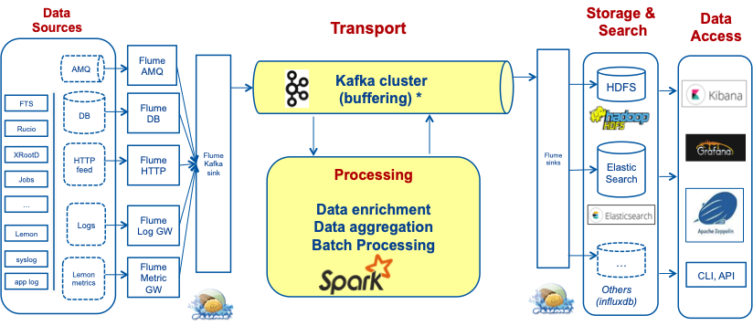
Cluster Monitoring
Today we are using MONIT (CERN IT Monitoring) pipelines for metrics collection and alerting
  Collectd agents installed on all machines to collect metrics
    With general and service specific upstream and in-house plugins
    We have created own plugins for hadoop and hbase
  Flume agents are also installed on each machine
    push collectd data to gateway which insert them to Kafka cluster
  Data from Kafka are reprocessed and pushed to
    InfluxDB – for real time access with Grafana
      1 week of high resolution data, 1 month of mid resolution data, 5 years of low resolution data
    HDFS – after 1 day all raw data available in parquet
Alerts are defined in collectd and Grafana
  Integrated with ServiceNow and internal Mattermost channel

Slide 10

Own backup solution
Every day we run incremental HDFS backup on each cluster
  Scan of HDFS to identify new files
  MapReduce job to copy blocks of new files to an external storage
Backup metadata are stored in RDBMS
We store HDFS backups on tapes
  CERN IT Castor provides a tape service
  We use native service xrootd protocol to write the data to CASTOR (integration between xrootd and Hadoop FileSystem interfaces was made)
We test random restores on daily bases

Slide 11
Hadoop portal
Since 2019 we run a portal where users can
  Can requests access to a cluster
  Check and resize HDFS quota on each cluster
    Requests beyond certain thresholds are granted only after approval
In progress
  Requesting dedicated yarn queues with guaranteed resources

Slide 12

Moving to Apache Hadoop distribution (since 2017)
Why?
  We don’t use Cloudera Manager
    Was limiting without paying the support (no rolling interventions)
    Some parts were difficult to integrate with CERN infrastructure ( e.g Kerberos)
  We have CERN custom solutions for running the infrastructure
    Deployment and configuration management, monitoring, backups
  We were just using their software bundle (rpms)
  Once we gained experience CDH turned out to be also limiting
    Significant delay for new upstream software version (Spark, HBase)
    You take all or nothing, cannot move to a newer component version
    Old interfaces - software locking - difficult to integrate with other Apache solutions

Slide 13
Moving to Apache Hadoop distribution (since 2017)
Gain?
  Better control of the core software stack
    Independent from a vendor/distributor
    Enabling non-default features (compression algorithms, R for Spark)
    Adding critical patches (that are not ported in upstream)
  Straight forward development
    We have version X people can set dependency to version X (not other)
  Upstream contributions
    We use upstream so we care about upstream

Slide 14
Moving to Apache Hadoop distribution (since 2017)
How?
  Building own rpms for software
    Hadoop, Spark, HBase, Hive, Sqoop, Zookeeper, Flume
    Building automated with CERN central services: Koji and GitlabCI
  Service daemons management with systemd scripts
  Deployment and configuration with Puppet
  The rest is the common for Apache and Cloudera

Slide 15
Moving to Apache Hadoop distribution (since 2017)
Differences?
  Colours in HDFS web UI ☺
  Homes and locations
    Cloudera files and dirs spread around /usr/lib and /usr/bin – you can have just a single version of software installed
    For Apache is a monolith for each component – single home dir (you can decide which), this allows to have multiple versions of a single component.
  We need to be more careful when testing new version of upstream software before putting in production
    Change management flow is helpful here: testing -> QA -> Production
  The rest is the same – the source code is in 95% same
    Administration, Procedures etc

Slide 16
The procedure overview
CDH 5.x to Hadoop >= 2.7 can be done in a rolling way if NN are in HA mode
Steps are the same as any Hadoop upgrade
1) Create snapshot of FS image
2) Update Namenodes one after other
      stop one NN change the software and start in upgrade mode
3) Update Datanodes, one after other
      For each in rolling way: stop one DN change the software and start it (startup will take longer than usual)
  4) Commit upgrade

Slide 17
CERN moved to Hadoop3
New features and bug fixes available
  Erasure coding, YARN Jobs in Docker containers, Intra queue preemption
  JAVA11, Better protection of the compute resources
Migrating to Apache Hadoop 3.2 from CDH 5.x/Hadoop 2.x secured cluster requires full shutdown
  downtime is proportional with the number of objects on HDFS
Spark 2.x officially does not support Hadoop3
  However it works on Hadop3 after minor reconfiguration ;)
  As a safety measure we are running Spark applications with classpaths from Hadoop 2.7

Slide 18
Service development effort
Pure development
  1-2FTs since 2013
  3-4 FTs since 2015
  2 FTs since 2018
Support
  ¼ FT
Preparation for Apache Hadoop – 3 months
Preparation for Hadoop3 – 8 months

Slide 19
Conclusions
Demand of “Big Data” platforms and tools is growing at CERN
  Many projects started and running
  Projects around Monitoring, Security, Accelerators logging/controls, physics data, streaming…
Hadoop, Spark, Kafka services at CERN IT
  Service is evolving: High availability, security, backups, external data sources, notebooks, cloud…
We decided to use Apache for better flexibility in terms of
  Choosing software versions and features
  Using other Apache upstream products
  Integration with other CERN services and infrastructure
  Supporting users community
Being independent from Cloudera native solutions eased the decision about the migration and allowed for smooth transition
  This is mainly because of wide number of services that are available at CERN for building service infrastructures

