Slide 1
Present status of the longitudinal impedance for (LHC and) HL-LHC
N. Mounet, D. Amorim, S. Antipov, N. Biancacci, E. Carideo, O. Frasciello, E. Métral, B. Salvant, R. Wanzenberg, C. Zannini, M. Zobov.
Acknowledgements: R. Bruce, F. Carra, R. de Maria, N. Kos A. Mereghetti, J. Mitchell.

Slide 2
LHC & HL-LHC longitudinal impedance models
WARNING: to be used with great caution!
DISCLAIMER: the model is a by-product of the impedance model generated for the transverse plane.
Hence it was constructed while having in mind the highest transverse impedance contributors, which are not necessarily the most important ones in longitudinal.
It has to be improved by RF & impedance experts.

Slide 3
LHC impedance model – ingredients
In longitudinal, the impedance contributors included in the model are:
  Resistive-wall impedance (collimators – including TCLD and TDIS, beam screens, warm pipe); for the beam screens, additional factors from the weld,
  Geometric impedance of collimator tapers – broad-band (BB) contribution from Stupakov formula (Phys. Rev. STAB 10, 094401 – 2007), checked recently with CST by E. Carideo and S. Antipov,
  Impedance from pumping holes using Mostacci’s model (BB from Kurennoy formula, plus a term in ~𝜔² from the propagation of a TEM coaxial mode outside the beam screen),
  BB contribution from arc BPMs, shielded & unshielded bellows, vacuum valves, Y-chambers and BI instruments, as provided in the LHC design report (chap. 5),
  Impedance from tapers between triplet beam screens, and from BPMs in the triplets, giving a (very small) BB contribution.
  BB and high order modes (HOMs) from RF & experimental cavities (CMS, ALICE, LHCb).

Slide 4
HL-LHC impedance model - additions
Modifications w.r.t. the LHC longitudinal model:
  Collimator at almost full upgrade (jaws of 2 TCPs and all but 2 TCSs in IR7 in Mo-Gr, Mo-coated for the TCSs); some TCTs in Cu-coated copper-diamond,
  Updated broad-band (BB) contribution from collimator tapers (E. Carideo & S. Antipov),
  New resistive-wall impedance & weld factors for the octagonal beam screens in triplets, with up-to-date dimensions, aC-coating, 75K copper (C. Zannini),
  Updated dimensions for pumping holes in the triplet beam screens,
  Updated HOMs from experimental chambers (ATLAS & CMS),
  New BB contribution from tapers and BPMs in the triplets region,
  HOMs from crab cavities – not fully up to date (J. Mitchell, S. Antipov).

Slide 5
LHC & HL-LHC longitudinal impedance models
Both are online in the impedance web page: https://impedance.web.cern.ch/ (in “Machines Summary”), with plots and the parameters / settings used (not yet at injection, coming soon).
Collimator settings all given in Appendix.
Summary of what is absent from the model also in Appendix.
The broad-band models used there have a cutoff frequency of 50 GHz – this was done with the transverse plane in mind, to stay conservative for instability predictions at high chromaticity.
In longitudinal, the question remains if the “physical” cutoff frequency of 5GHz would not be better (it corresponds to the half-gap of the arc beam screens – above this frequency, EM waves can propagate down the vacuum chamber).

Slide 6
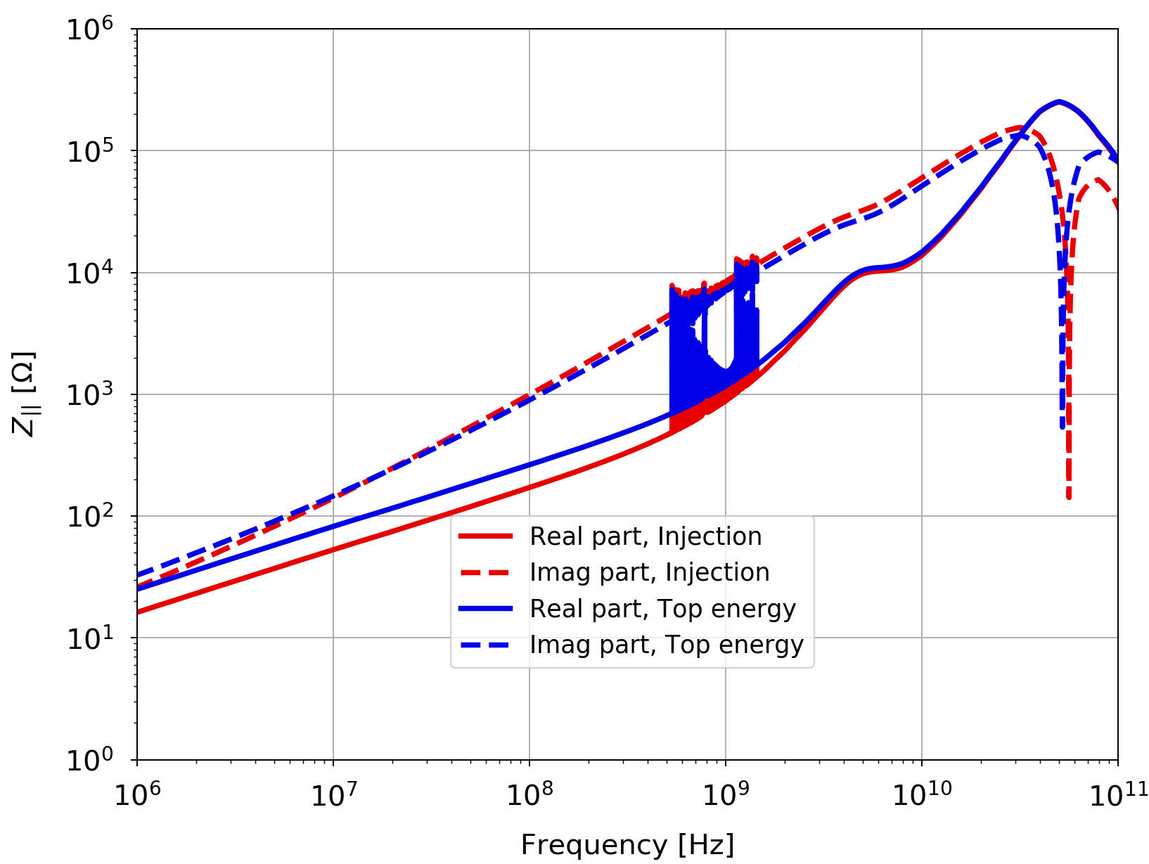
LHC Run 3 longitudinal impedance model
Difference between injection and top energy (real part) decreases with frequency (gets to ~30% at 1GHz):
Cutoff for BB at 50GHz here

Slide 7
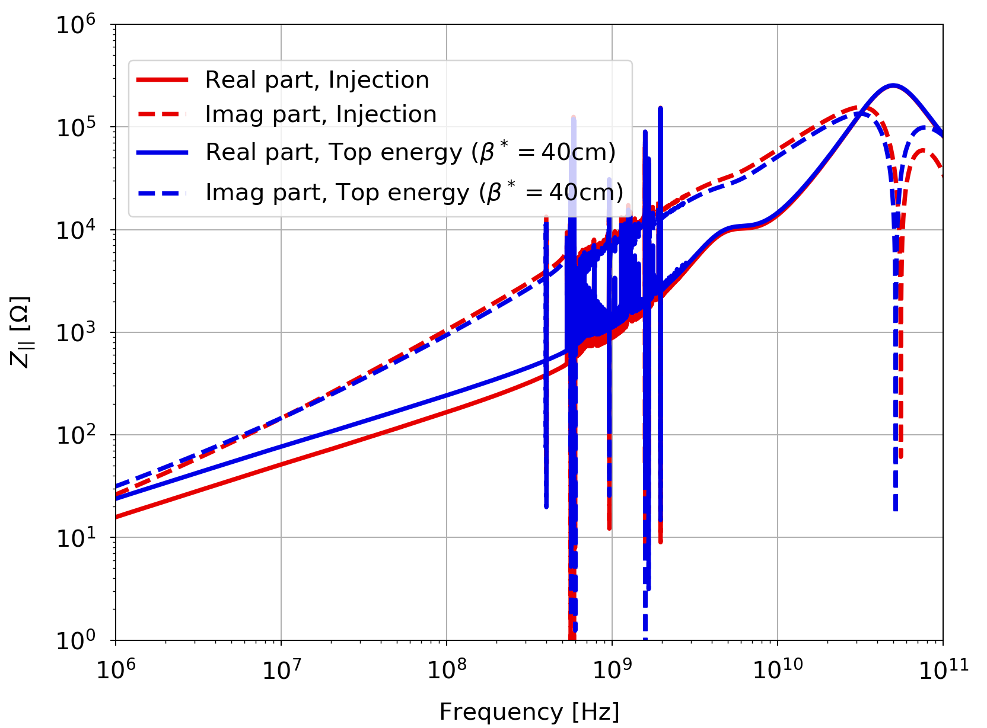
HL-LHC longitudinal impedance model
Difference between injection and top energy (real part) decreases with frequency (gets to ~25% at 1 GHz):
Cutoff for BB at 50GHz here

Slide 8
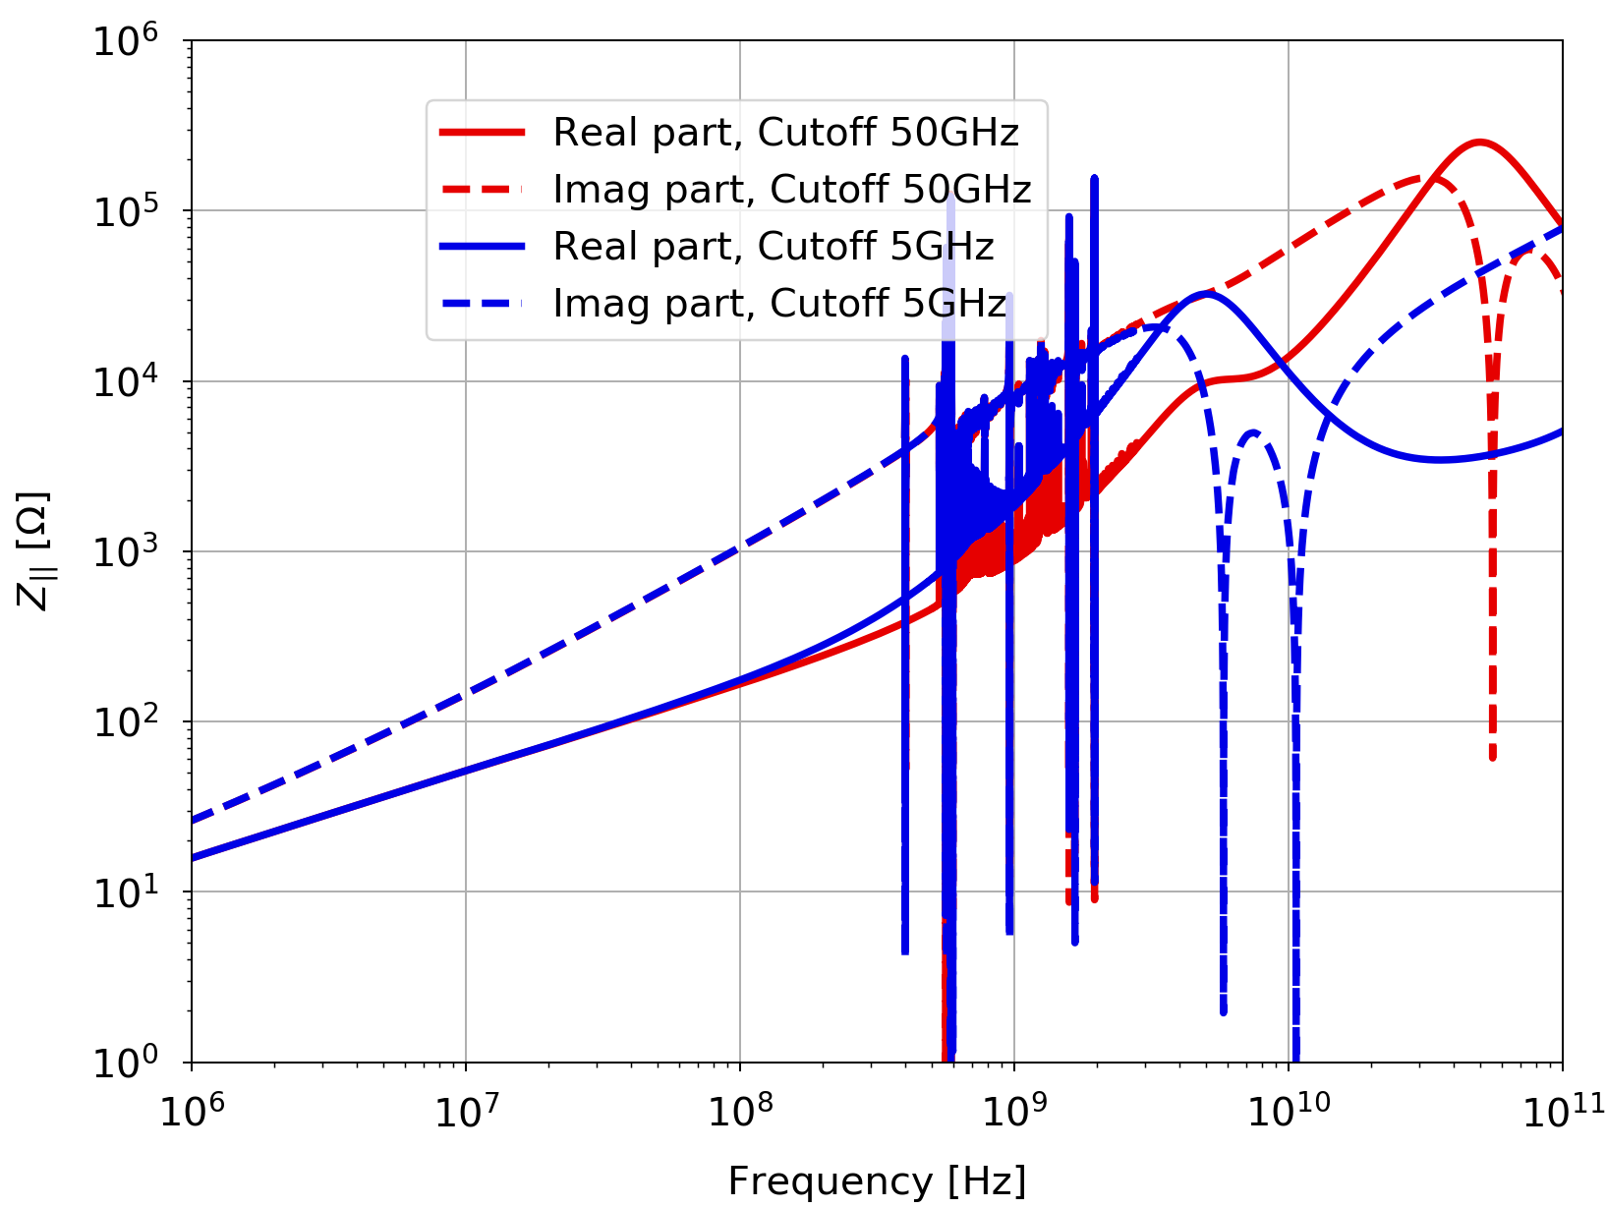
HL-LHC: comparison 5 vs. 50 GHz cutoff
Real part higher, in the GHz range, with 5GHz cutoff ⟶ expected from the position of the BB peak.

Slide 9
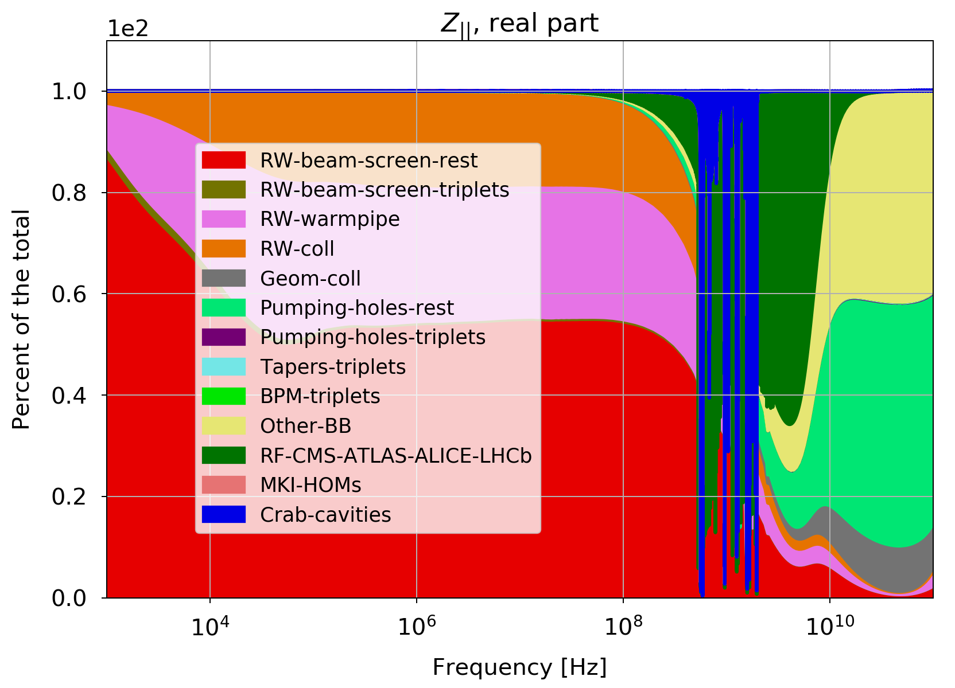
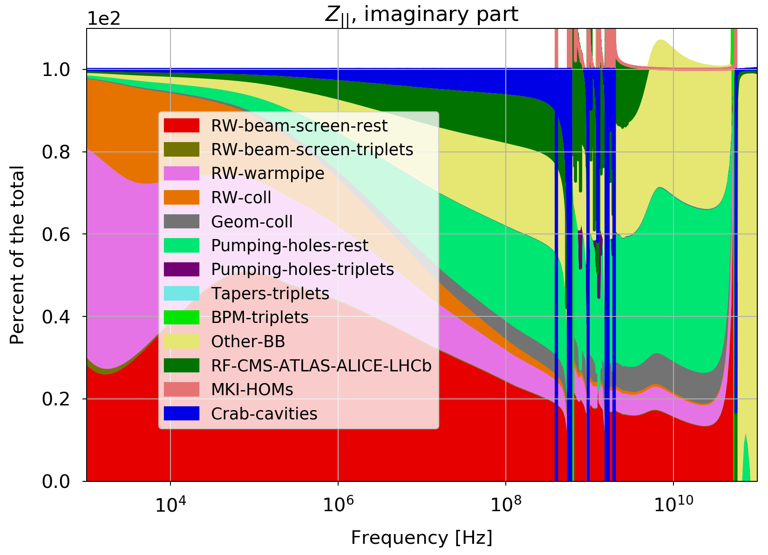
HL-LHC impedance contributors (50 GHz)
Contributions (as percentage of the total) to the long. Impedance:
⇒ Pumping holes, BB contributors, beam screens and HOMs from cavities are the main contributors.

Slide 10
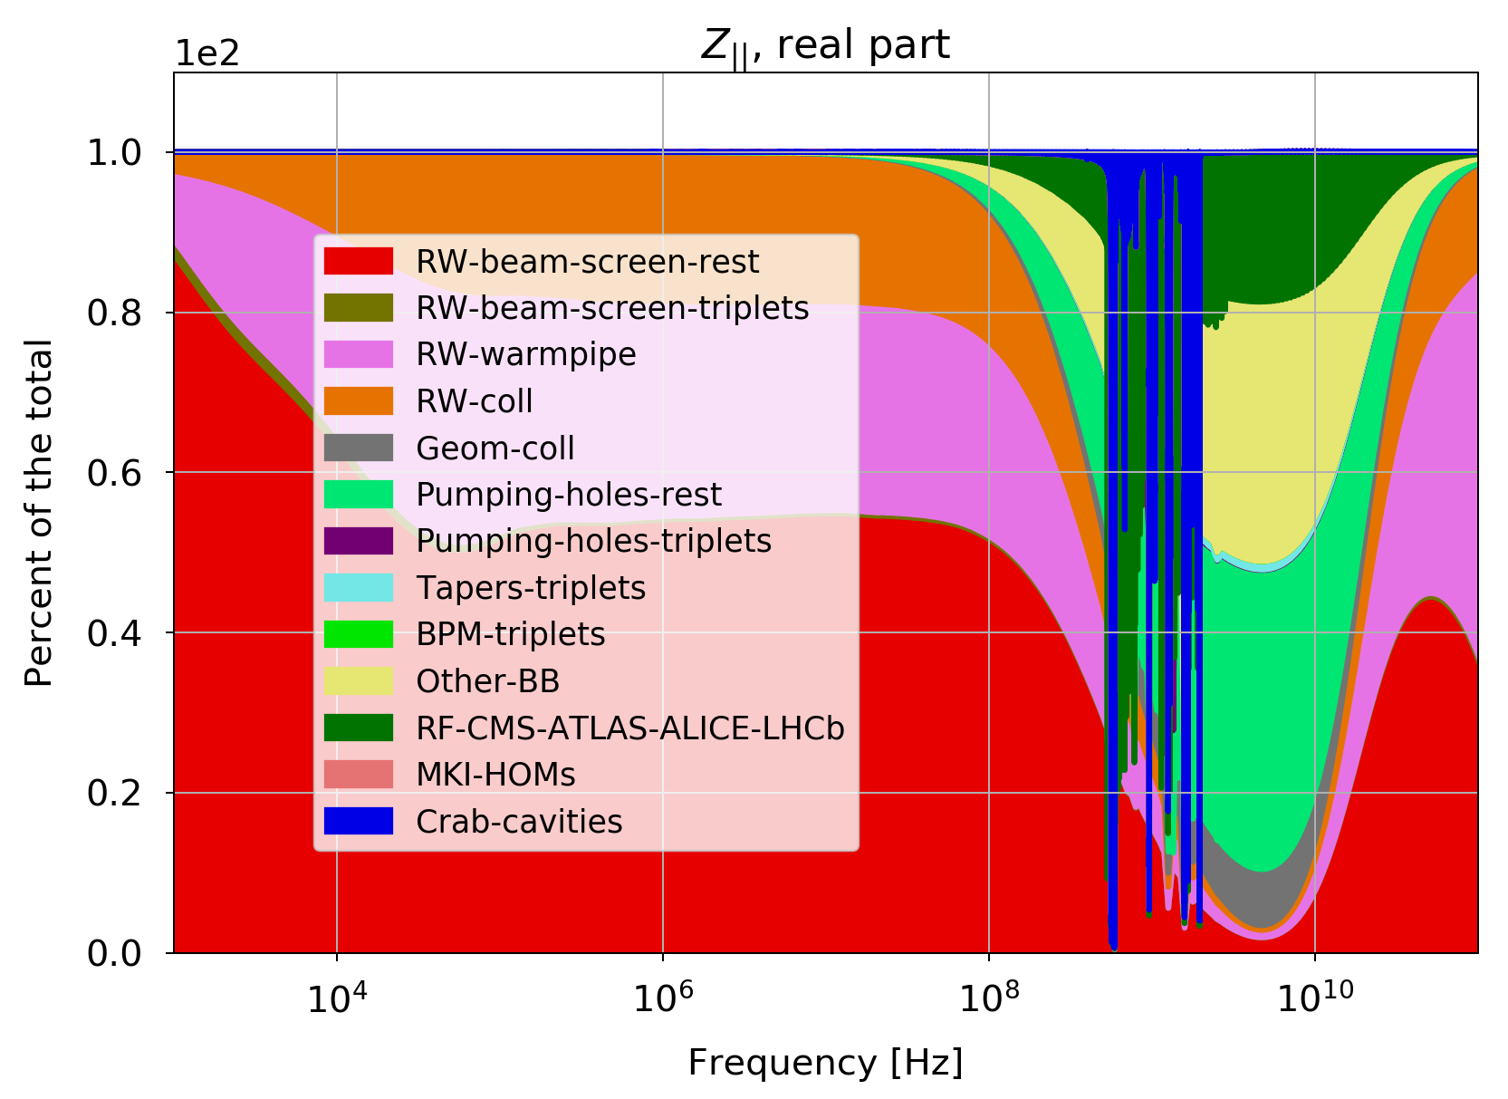
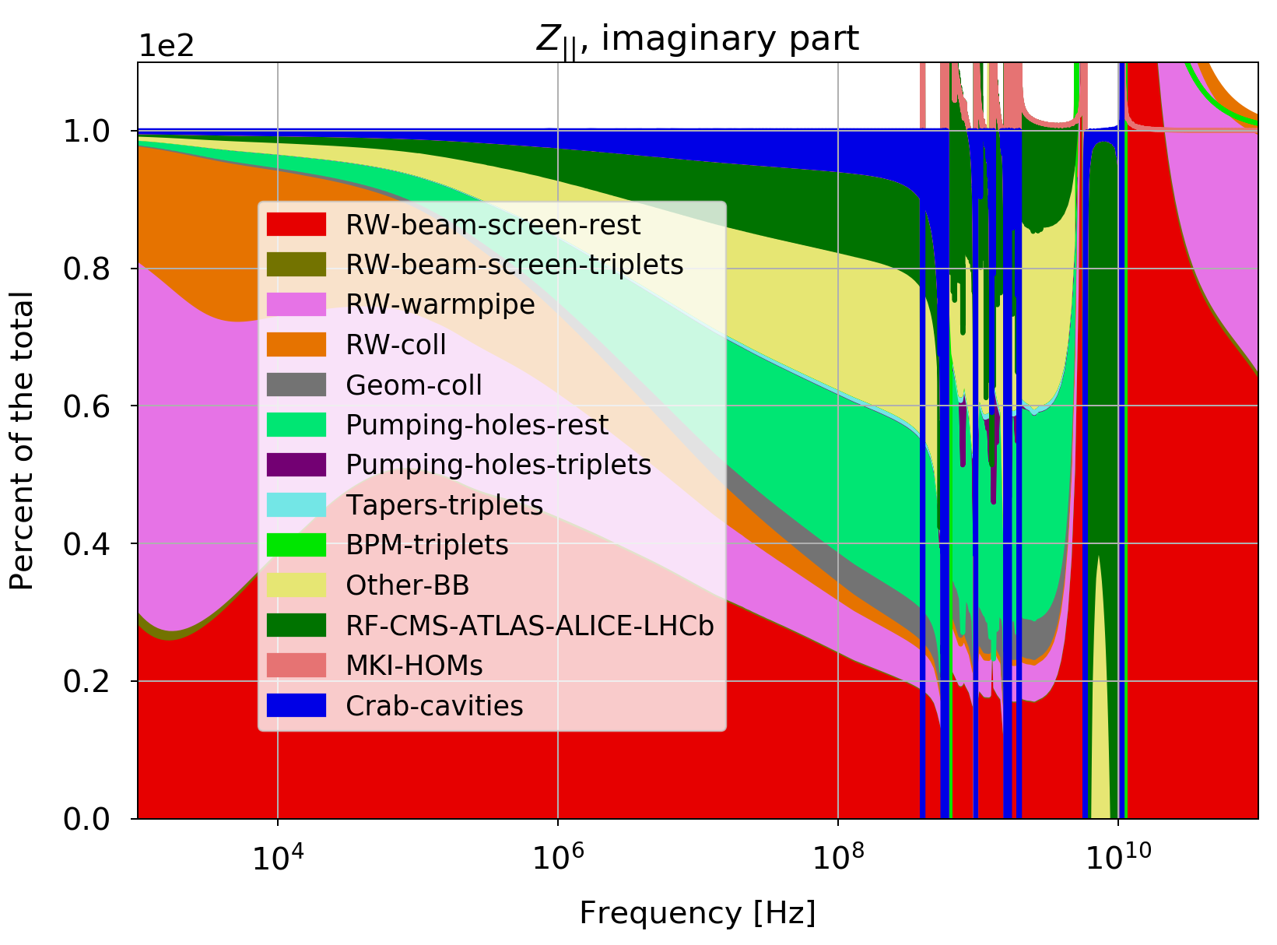
HL-LHC impedance contributors (5 GHz)
Contributions (as percentage of the total) to the long. impedance:
⇒ Pumping holes, BB contributors, beam screens and HOMs from cavities are the main contributors.

Slide 11
HL-LHC impedance contributors (5 GHz)
Contributions (as percentage of the total) to the long. impedance:
>20% of model from LHC design report (arc BPMs, bellows, valves, Y-chambers, BI instr.).
⇒ Pumping holes, BB contributors, beam screens and HOMs from cavities are the main contributors.

Slide 12
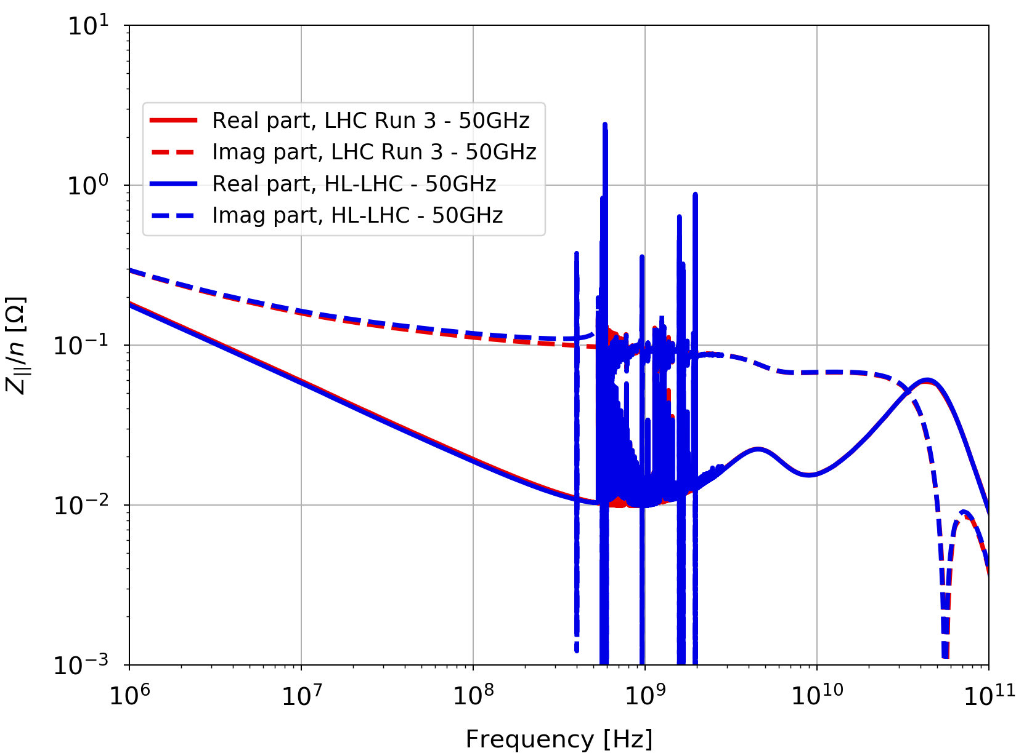
Comparison LHC Run 3 vs. HL-LHC
Plotting Z/n (with n=f/f_{rev}):
Cutoff for BB at 50GHz here (Im(Z/n) is constant for a BB model)
⇒ The two models are very similar.

Slide 13
Conclusions
LHC & HL-LHC longitudinal impedances and their various ingredients were presented.
Injection and flat top impedances are relatively similar (contrary to the transverse case); LHC & HL-LHC are almost identical.
Broad-band impedances, in particular from pumping holes and cavities (RF & experimental), are the main contributors in the current model.
Strong impact of cutoff frequency chosen for the BB model (5 vs 50 GHz).
Model was obtained as a “by-product” of the transverse impedance
⇒ there is room for improvements by RF & impedance experts
(in particular for the parts still coming from the design report - arcs BPMs, bellows, valves, Y-chambers, BI instrumentation).

Slide 14
Conclusions
LHC & HL-LHC longitudinal impedances and their various ingredients were presented.
Injection and flat top impedances are relatively similar (contrary to the transverse case); LHC & HL-LHC are almost identical.
Broad-band impedances, in particular from pumping holes and cavities (RF & experimental), are the main contributors in the current model.
Strong impact of cutoff frequency chosen for the BB model (5 vs 50 GHz).
Model was obtained as a “by-product” of the transverse impedance
⇒ there is room for improvements by RF & impedance experts
(in particular for the parts still coming from the design report - arcs BPMs, bellows, valves, Y-chambers, BI instrumentation).
WARNING: to be used with great caution!

Slide 15
Appendix

Slide 16
LHC Run III & HL-LHC collimator settings
At top energy:
Collimators | LHC half-gaps [#𝜎 (3.5𝜇m)] 𝛽*=1.5m | HL-LHC half-gaps [#𝜎 (3.5𝜇m)] 𝛽*=40cm | HL-LHC half-gaps [#𝜎 (2.5𝜇m)] 𝛽*=40cm
TCP/TCS/TCLA(D) IR7 | 5 / 6.5 / 10 (10) | 5.7 / 7.7 / 10.7 (14) | 6.7 / 9.1 / 12.7 (16.6)
TCP/TCS/TCLA IR3 | 15 / 18 / 20 | 15 / 18 / 20 | 17.7 / 21.3 / 23.7
TCDQ/TCS IR6 | 7.3 | 8.5 | 10.1
TCT IR1/5 | 7.8 | 13.9 | 16.4
TCL (IR1/5) Q4/Q5/Q6 | 15 / 15 / parking | 18.9 | 22.4
TCT IR2/8 | 37 / 15 | 30 / 15 | 35.5 / 17.7
TDI / TCLI | parking | parking | parking
Note: TCLD in IR2 in parking for protons.
From R. Bruce & A. Mereghetti

Slide 17
LHC Run III & HL-LHC collimator settings
At injection energy (with injection protection collimators in):
Collimators | LHC half-gaps [#𝜎 (3.5𝜇m)] | HL-LHC half-gaps [#𝜎 (3.5𝜇m)] | HL-LHC half-gaps [#𝜎 (2.5𝜇m)]
TCP/TCS/TCLA(D) IR7 | 5.7 / 6.7 / 10 (10) | 5.7 / 6.7 / 10 (16.9) | 6.7 / 7.9 / 11.8 (20)
TCP/TCS/TCLA IR3 | 8 / 9.3 / 12 | 8 / 9.3 / 10 | 9.5 / 11 / 11.8
TCDQ/TCS IR6 | 8 / 7.5 | 8 / 7 | 9.5 / 8.3
TCT IR1/5 | 13 | 13 | 15.4
TCL (IR1/5) Q4/Q5/Q6 | parking | parking | parking
TCT IR2/8 | 13 | 13 | 15.4
TDI / TCLI | 6.6 / 7 | parking | 7.8 / 8.3
LHC settings are Run 2 ones,
HL settings from CERN-ACC-NOTE-2018-0002
Note: TCLD in IR2 in parking for protons.

Slide 18
LHC Run 3 impedance model – what’s not there
Planned modifications that are not yet in the model (thanks to B. Salvant):
  experimental chamber upgrades (CMS, ALICE, LHCb),
  VELO and SMOG2 (LHCb),
  in-situ aC-coating in Q5 and Q6 (beam screens of stand-alones),
  new BGC (negligible) and potential new beam instrumentation.

Slide 19
HL-LHC impedance model: what’s not there
Modifications that are not (yet) in the model:
  VELO,
  experimental chambers ALICE and LHCb, possibly also CMS,
  new instrumentation,
  possible aC-coating in some sectors,
  possible additional collimators in IR1 & 5, TCLD in IR2 (in parking for protons) and updated design of all tertiaries and TCLs, old CFC collimators in parking?
  crab cavities HOMs as measured in real cavities,
  electron lens and crystal collimators (recently added to baseline),
  new roman pots,
  “SMOG3” in LHCb.

Slide 20
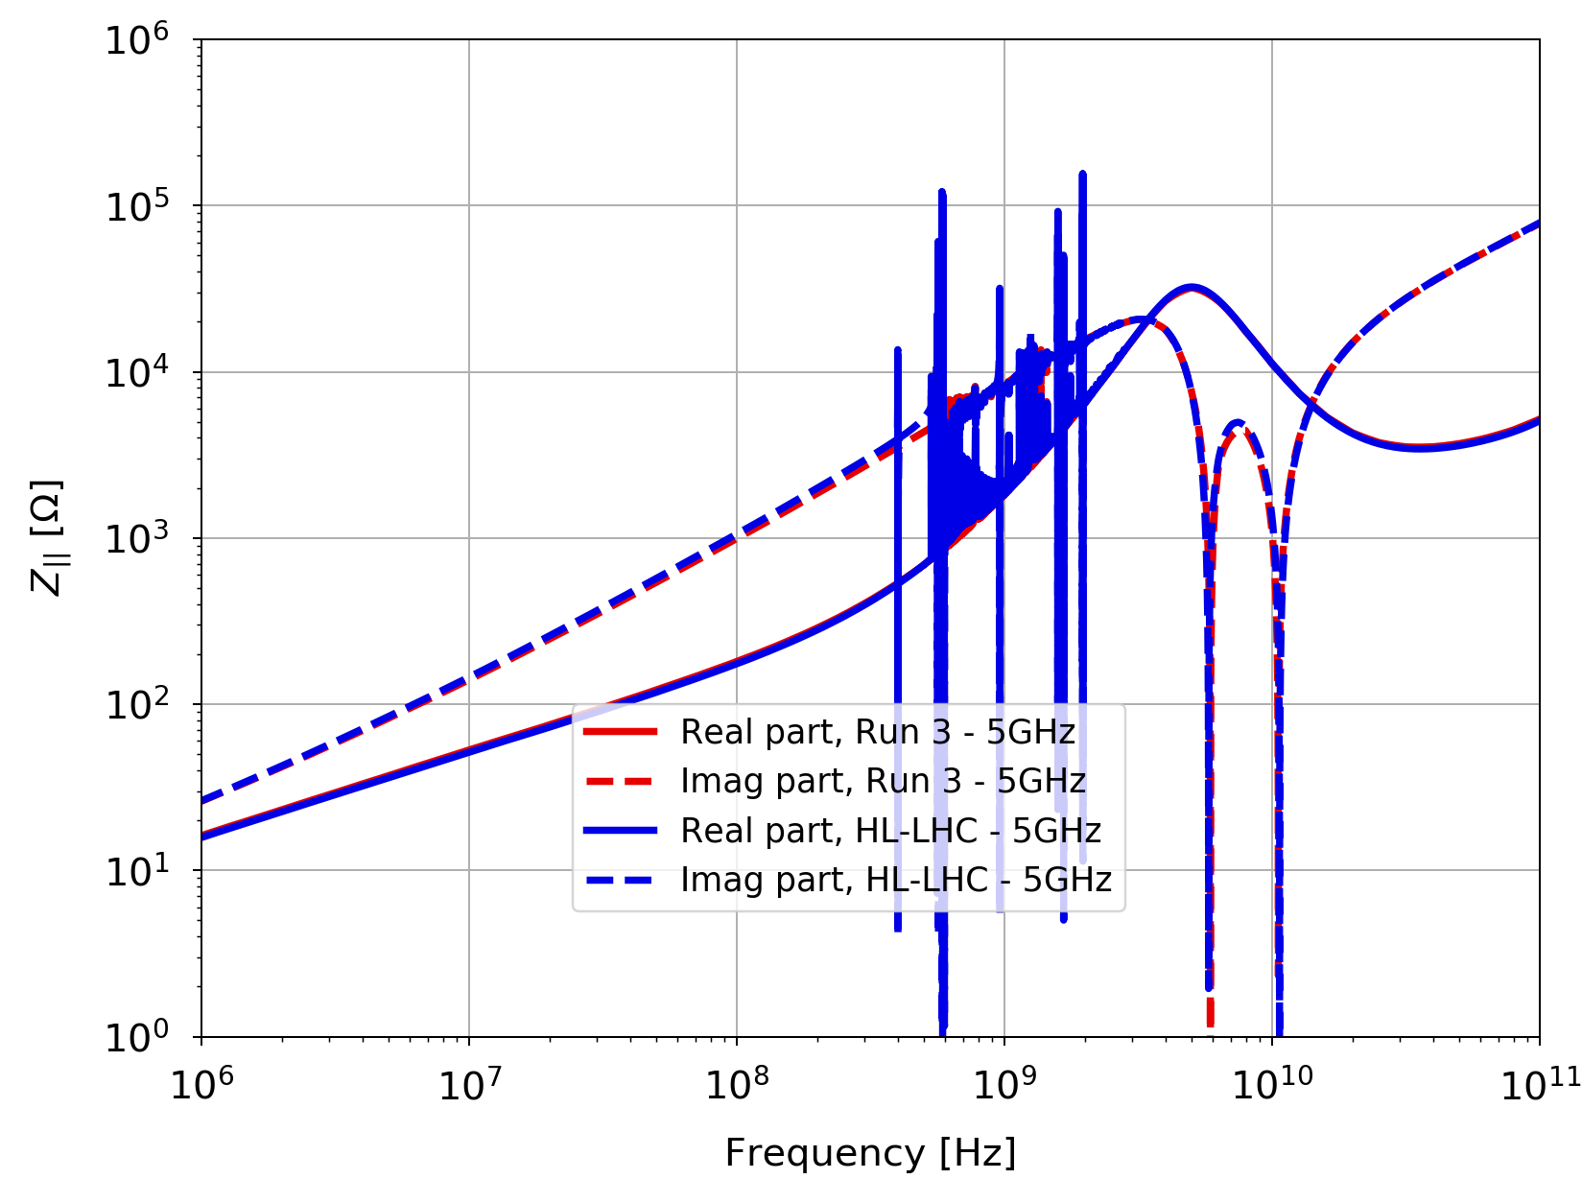
Comparison LHC Run 3 – HL-LHC
The two models are very similar:
Cutoff for BB at 5GHz here

