Slide 1
Update on longitudinal impedance studies for HL-LHC
Theodoros Argyropoulos, Ivan Karpov and Elena Shaposhnikova
Special Joint HiLumi WP2/WP4 Meeting, 26 May 2020

Slide 2

Recap on longitudinal stability studies
$V_{RF}$= 12 MV, beam energy 450 GeV
Loss of Landau damping (LD) in longitudinal plane is important intensity limitation in LHC.
Threshold observed in measurements cannot be explained by Sacherer approach
Based on accurate semi-analytic calculations, threshold depends on “cut-off” frequency
Which threshold should be used for HL-LHC?

Slide 3
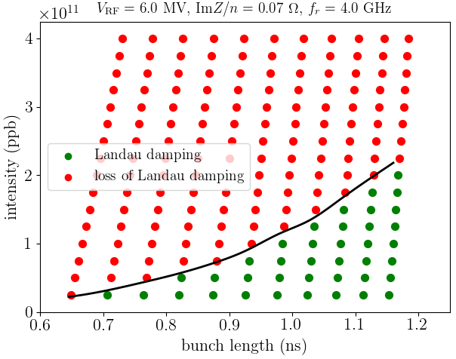
Van Kampen modes
Parameter scan using MELODY:
5 azimuthal modes
500 mesh points in energy of synchrotron oscillations
Resonator impedance Q=1

Slide 4
Van Kampen modes
Parameter scan using MELODY:
5 azimuthal modes
500 mesh points in energy of synchrotron oscillations
Resonator impedance Q=1

Slide 5
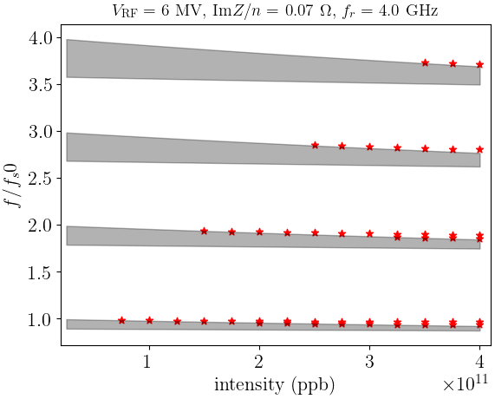
Van Kampen modes
Parameter scan using MELODY:
5 azimuthal modes
500 mesh points in energy of synchrotron oscillations
Resonator impedance Q=1
Coherent modes
$→$ Lower azimuthal modes have lower thresholds
Incoherent band

Slide 6
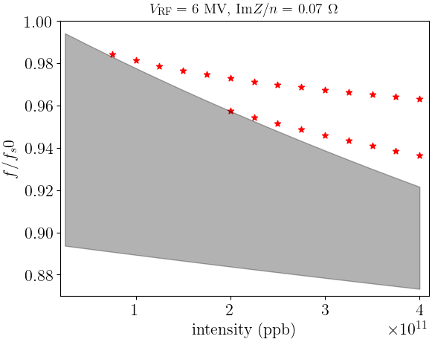

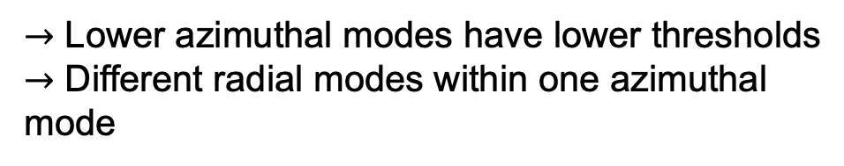
Van Kampen modes
Parameter scan using MELODY:
5 azimuthal modes
500 mesh points in energy of synchrotron oscillations
Resonator impedance Q=1
$$f_{r}=4 GHz$$
Coherent modes
$→$ Lower azimuthal modes have lower thresholds
$→$ Different radial modes within one azimuthal mode
Incoherent band

Slide 7
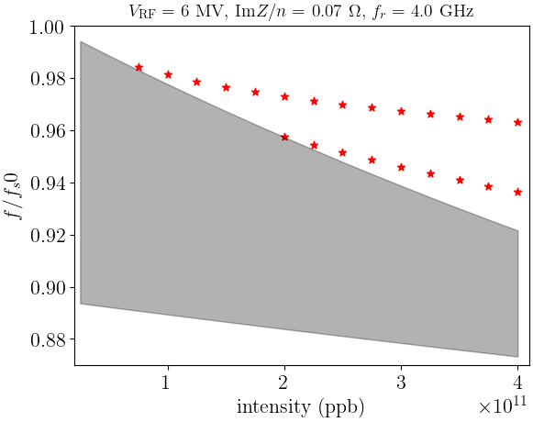
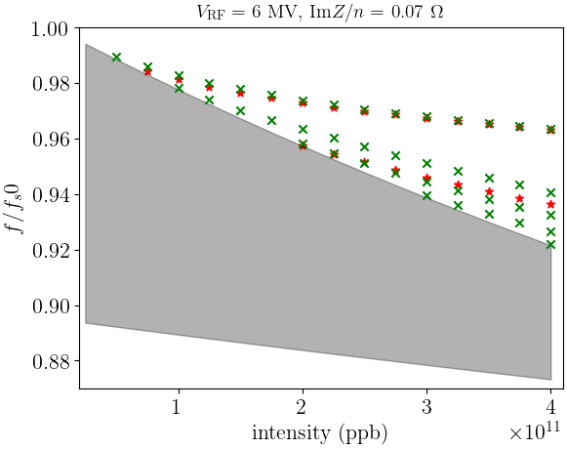

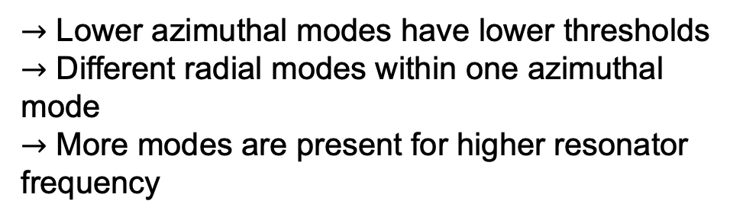
Van Kampen modes
Parameter scan using MELODY:
5 azimuthal modes
500 mesh points in energy of synchrotron oscillations
Resonator impedance Q=1
$$f_{r}=4 GHz$$
$$f_{r}=8 GHz$$
Coherent modes
$→$ Lower azimuthal modes have lower thresholds
$→$ Different radial modes within one azimuthal mode
$→$ More modes are present for higher resonator frequency
Incoherent band

Slide 8
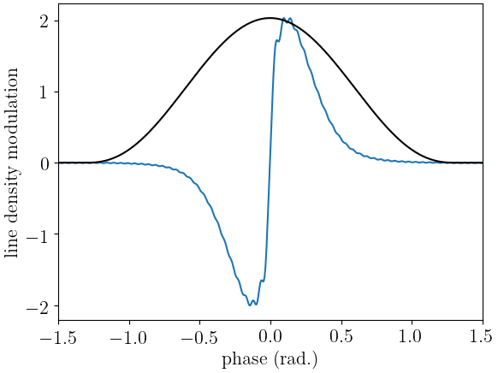
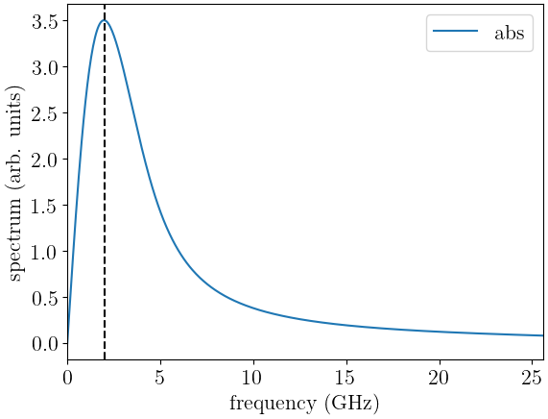

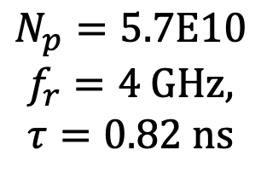
Mode pattern at threshold
$$f_{r}/2$$
$$N_{p}=5.7E10$$
$$f_{r}=4 GHz,$$
$$τ=0.82 ns$$
Density modulation is localised around bunch centre
Peak of the spectrum around half of resonant frequency

Slide 9
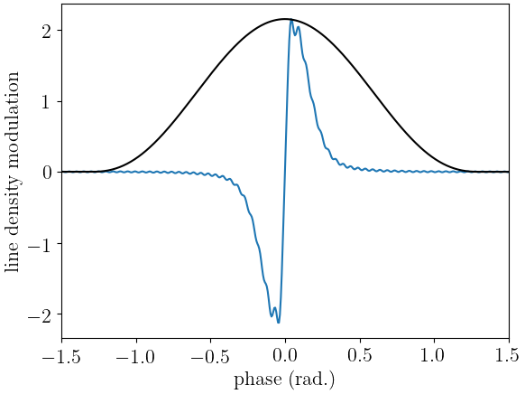
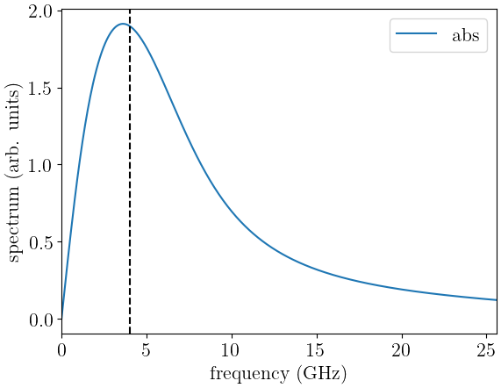
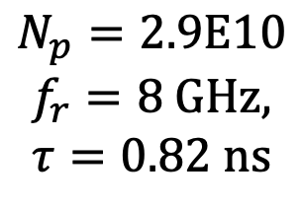

Mode pattern at threshold
$$f_{r}/2$$
$$N_{p}=2.9E10$$
$$f_{r}=8 GHz,$$
$$τ=0.82 ns$$
Density modulation is localised around bunch centre
Peak of the spectrum around half of resonant frequency

Slide 10
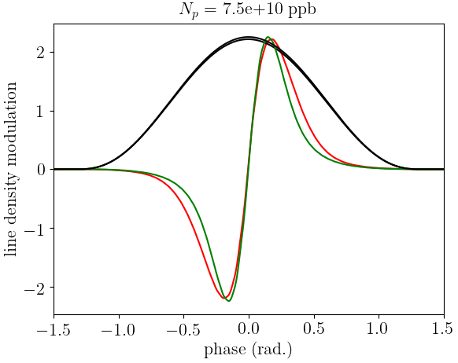
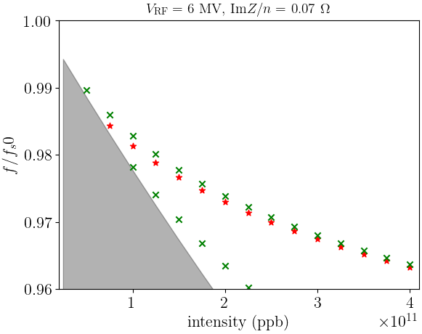


Mode pattern above threshold
$$f_{r}=4 GHz$$
$$f_{r}=8 GHz$$
$$f_{r}=4 GHz$$
$$f_{r}=8 GHz$$

Slide 11
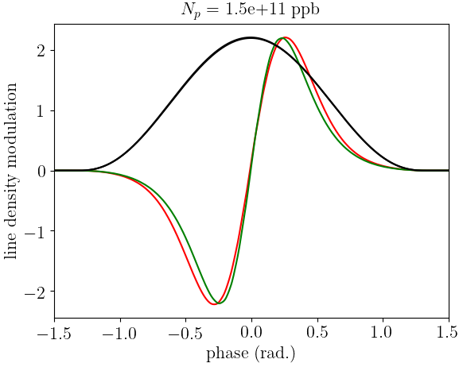
Mode pattern above threshold
$$f_{r}=4 GHz$$
$$f_{r}=8 GHz$$
$$f_{r}=4 GHz$$
$$f_{r}=4 GHz$$
$$f_{r}=8 GHz$$
$$f_{r}=8 GHz$$

Slide 12
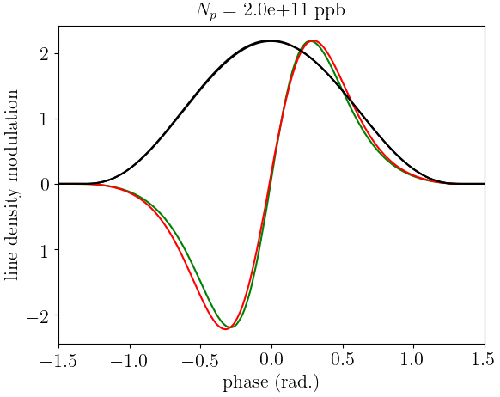
Mode pattern above threshold
$$f_{r}=4 GHz$$
$$f_{r}=8 GHz$$
$$f_{r}=4 GHz$$
$$f_{r}=4 GHz$$
$$f_{r}=8 GHz$$
$$f_{r}=8 GHz$$

Slide 13
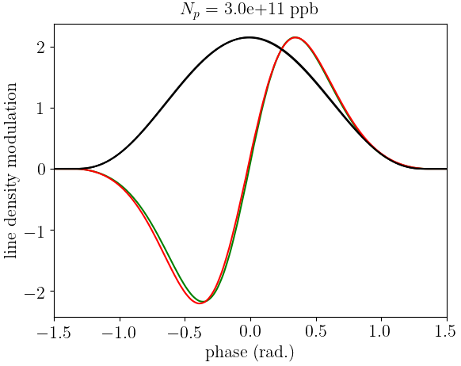
Mode pattern above threshold
$$f_{r}=4 GHz$$
$$f_{r}=8 GHz$$
$$f_{r}=4 GHz$$
$$f_{r}=4 GHz$$
$$f_{r}=8 GHz$$
$$f_{r}=8 GHz$$
$→$ Modes widen above threshold and become very similar for different $f_{r}$

Slide 14
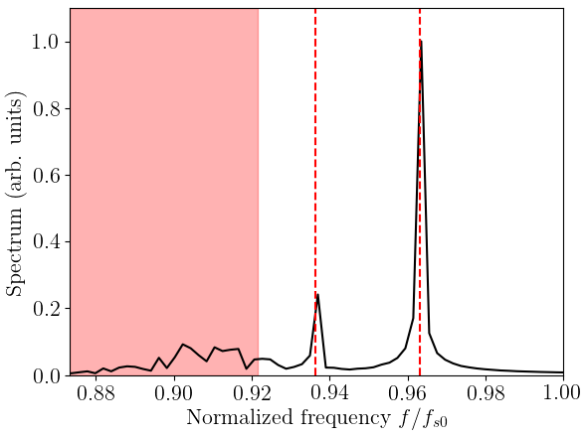
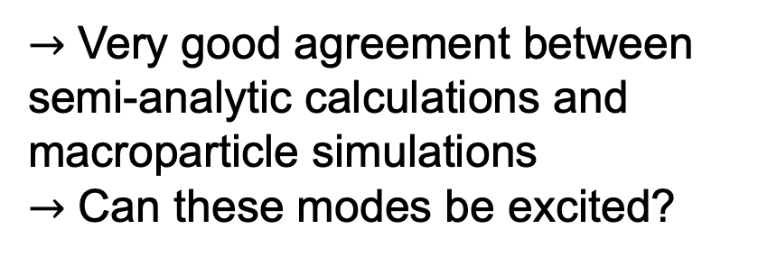
Comparison with BLonD
Coherent modes
Procedure:
Generation of matched bunch,
tracking for 1e5 – 1e6 turns,
storing mean and std value of particle coordinates
Number of macroparticles - 1e6
Number of slices per bucket – 256
Incoherent band
$→$ Very good agreement between semi-analytic calculations and macroparticle simulations
$→$ Can these modes be excited?

Slide 15
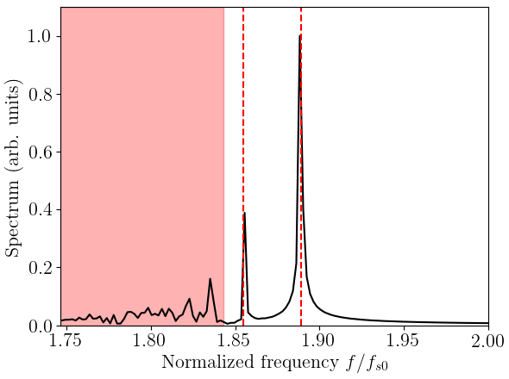
Comparison with BLonD
Coherent modes
Procedure:
Generation of matched bunch,
tracking for 1e5 – 1e6 turns,
storing mean and std value of particle coordinates
Number of macroparticles - 1e6
Number of slices per bucket – 256
Incoherent band
$→$ Very good agreement between semi-analytic calculations and macroparticle simulations
$→$ Can these modes be excited?

Slide 16
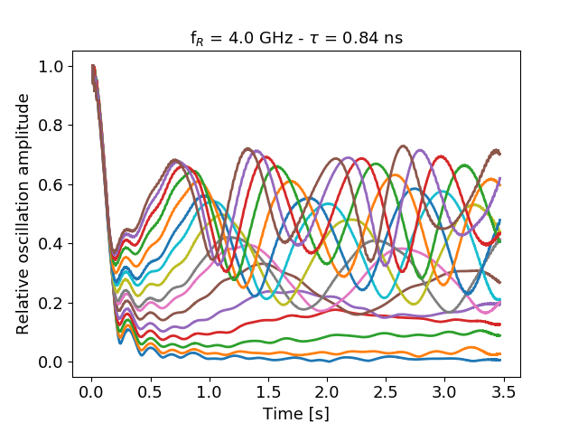
Residual oscillations after a kick
Procedure:
Generation of matched bunch,
Initial offset of 1 deg.
tracking for 40k turns,
storing mean value of particle coordinates
Number of macroparticles - 20e6
Number of slices per bucket – 256

Slide 17
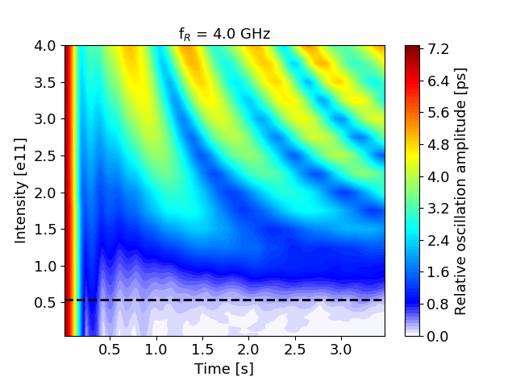
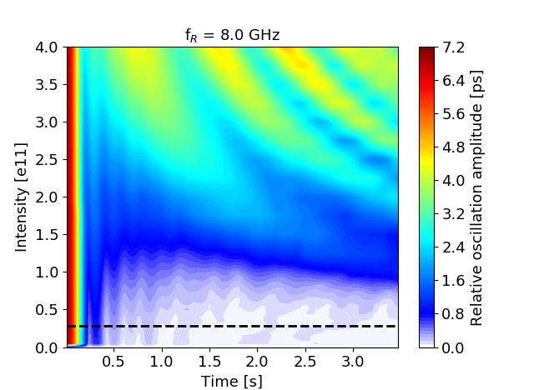
Comparison for 4 and 8 GHz
$→$ Similar residual oscillations for intensities >> threshold

Slide 18
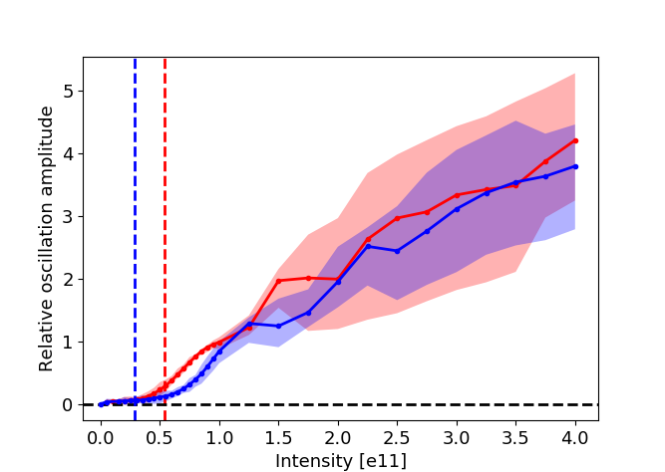
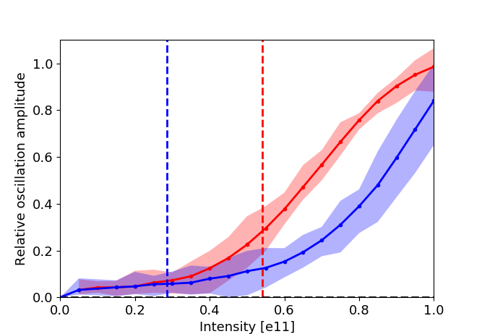
Comparison for 4 and 8 GHz
4 GHz
8 GHz
4 GHz
8 GHz
Scan around threshold is not fully conclusive. Potentially even more macroparticles is needed.

Slide 19
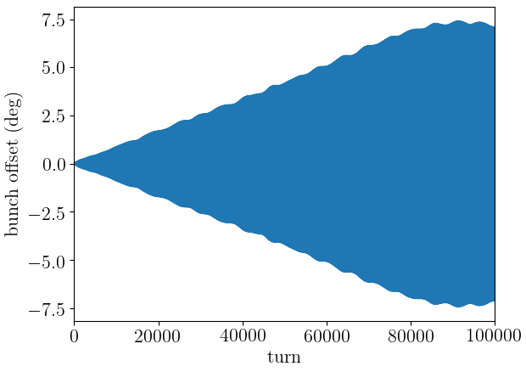
Noise excitation
Procedure:
Generation of matched bunch,
Monochromatic phase modulation with amplitude 0.01 deg. (10 times smaller than noise level!)
tracking for 100k turns,
storing mean and rms value of particle coordinates
Number of macroparticles - 1e6
Number of slices per bucket – 256

Slide 20
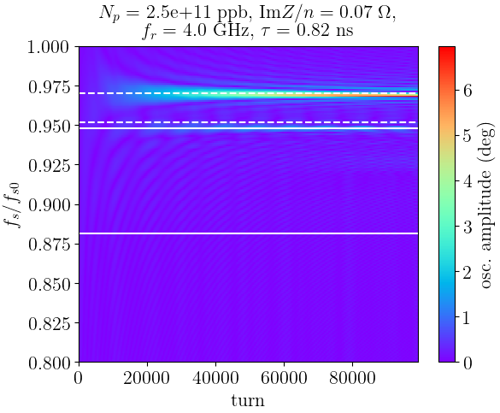
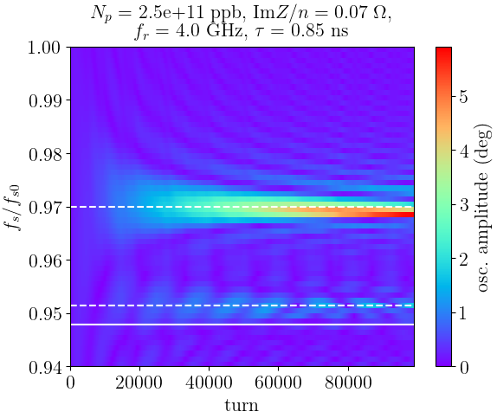

Results for $f_{r}=4$ GHz
Coherent oscillations can be driven by noise
Lowest radial mode is excited at most

Slide 21
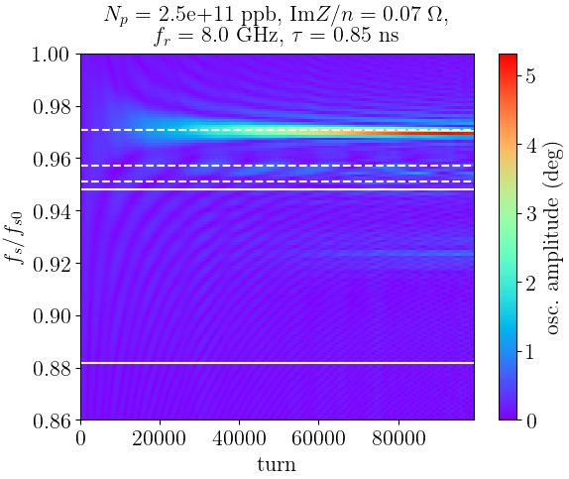
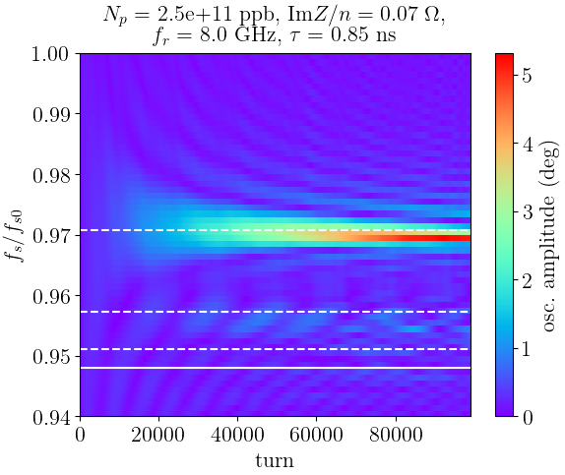

Results for $f_{r}=8$ GHz
Similar results to 4 GHz case. Higher-order radial modes are less excited.

Slide 22
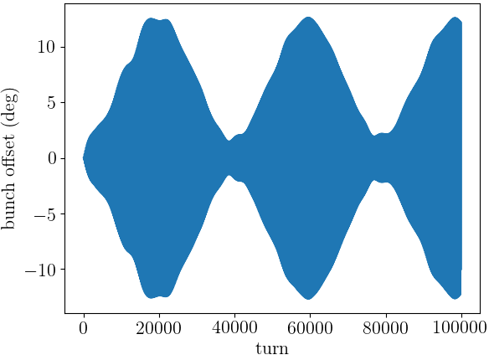
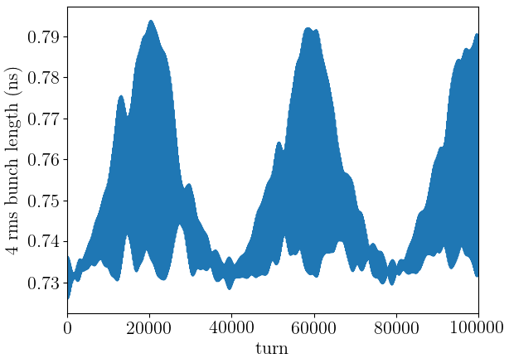
Example with higher noise amplitude
Phase modulation with amplitude 0.1 deg. at frequency 0.967 $f_{s0}$
Controlled emittance blow-up can affected by interaction of noise with coherent modes

Slide 23
Summary
“Cut-off” or resonant frequency defines the threshold of loss of Landau damping and corresponding mode pattern. Accurate impedance model is need for threshold evaluation.
Presence of Van Kampen modes was verified in macroparticle simulations.
Modes can be excited by the kick (injection error) and can be driven by noise (might have impact on controlled emittance blow-up).

Slide 24
Thank you for your attention!

Slide 25
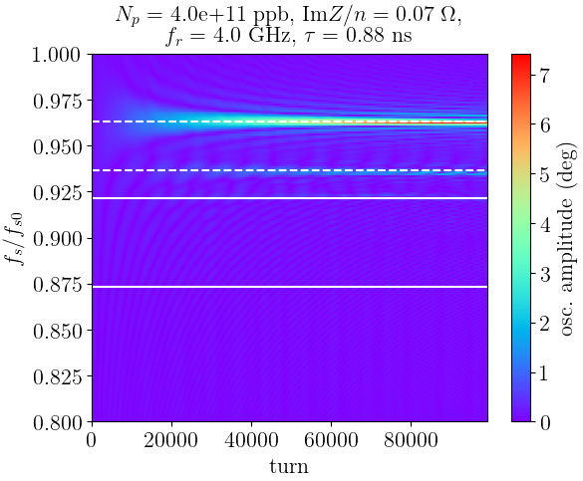
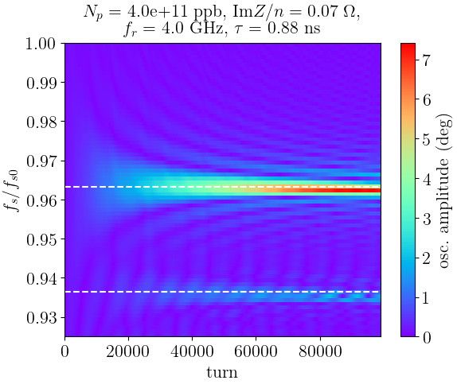

Slide 26
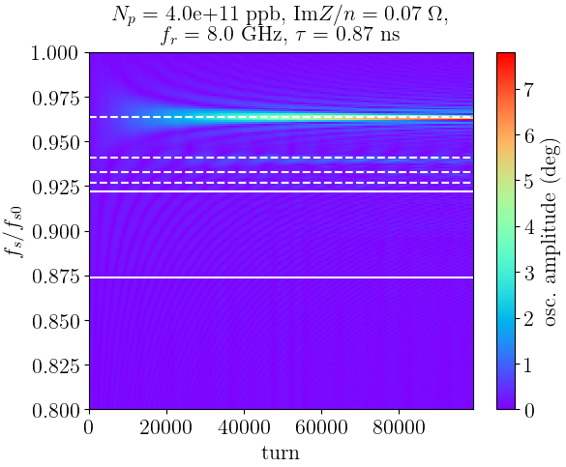
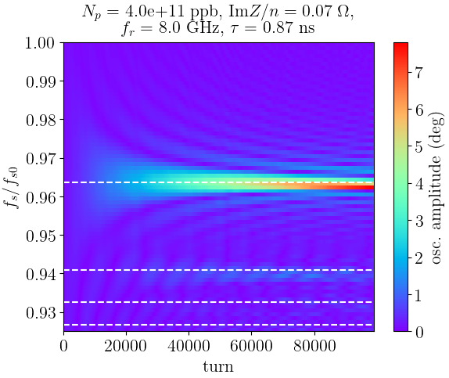

Slide 27
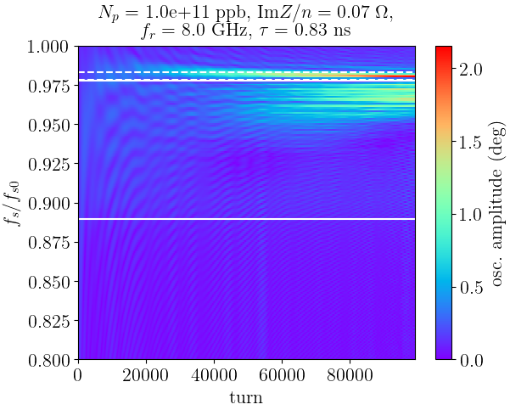
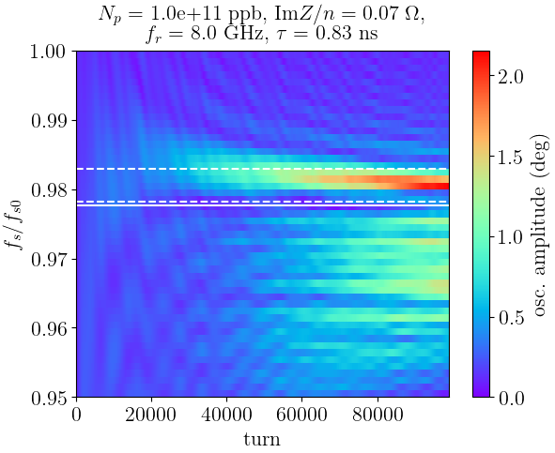

Slide 28
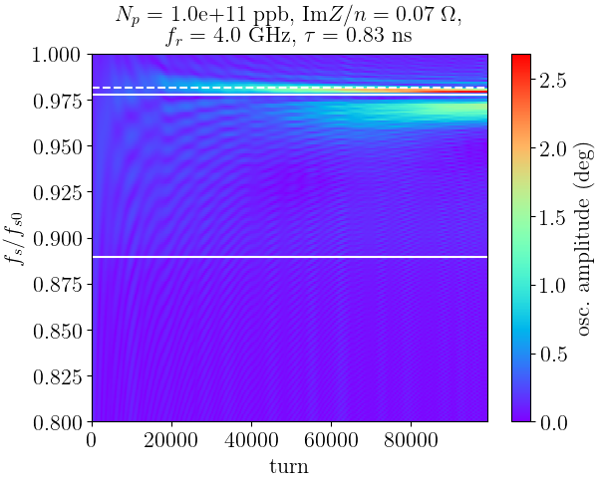
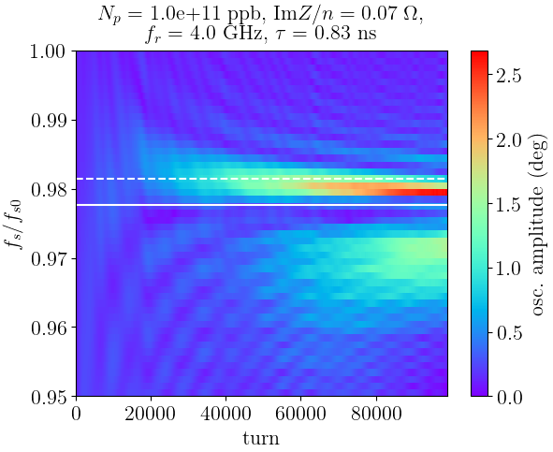

Slide 29
Phase noise

Slide 30
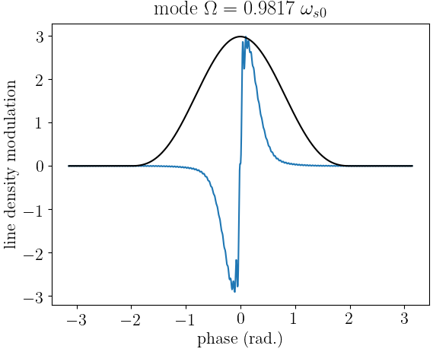
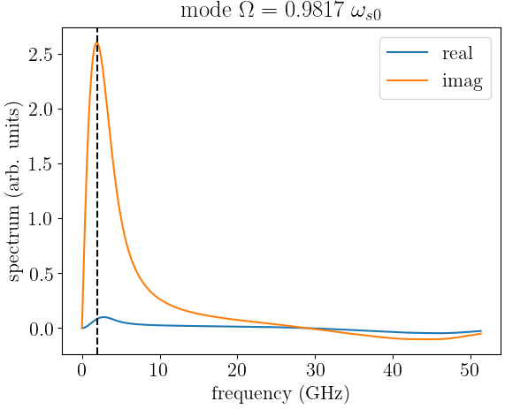
4 GHz 1.17 ns

