Slide 1
Options for crab cavity RF fingers: impedance
Benoit with the help of Rama, Christine (BE-RF), Ofelia, Teddy (EN-MME), Cedric, Jan, Monika (TE-VSC), Elias, Nicolas (BE-ABP)

Slide 2
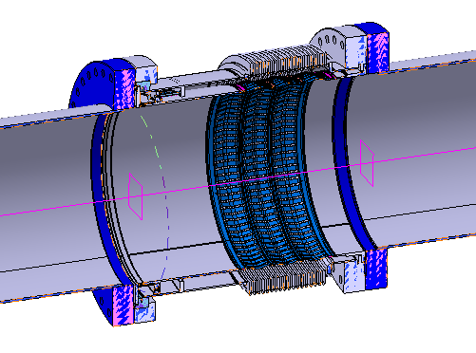
Context
Presentation at WP2 on March 10 (https://indico.cern.ch/event/881273)
Crab cavities deformable RF fingers present a much larger impedance than other modules, due to their larger angle and length
Example of DRF

Slide 3
Distances from the IP for the positions of the DRF
Ref. | DCUM (warm) | DCUM (cold) | Height of the convolution (mm) | Unfolded Length of one cavity (mm) | Length DRF (mm) | Length one oblong hole (mm) | Diameter of the module (mm) | Angle in deg (height/(hole length/2)) | Ng Formula longitudinal Im(Z/n) in mOhm | CST Im(Z/n) in mOhm | Ng Formula transverse in Ohm/m | CST Im(Zt) in Ohm/m
IP
 | 17597.5 |  | 8 |  | 32.2 |  | 82 |  | 0.081 |  | 345
VAX
 | 18872.5 |  | 8 |  | 32.2 |  | 82 |  | 0.081 |  | 345
TAXS
 | 21248.5 |  | 8 |  | 32.2 |  | 82 |  | 0.081 |  | 345
Q1
Q1/Q2a | 32895.5 | 32898.8 | 3.6 | 34.9 | 134.7 | 34.0 | 132 | 12.1 | 0.077 | 0.0064 | 143 | 14
Q2a/Q2b | 43680.5 | 43684.0 | 3.6 | 34.9 | 134.7 | 34.0 | 132 | 12.1 | 0.077 | 0.0064 | 143 | 14
Q2b/Q3 | 54465.5 | 54469.3 | 3.6 | 34.9 | 134.7 | 34.0 | 132 | 12.1 | 0.077 | 0.0064 | 143 | 14
Q3/CP | 65565.5 | 65564.9 | 3.6 | 34.9 | 134.7 | 34.0 | 132 | 12.1 | 0.077 | 0.0064 | 143 | 14
CP/D1 | 73519.5 | 73517.8 | 3.6 | 34.9 | 134.7 | 34.0 | 132 | 12.1 | 0.077 | 0.0064 | 143 | 14
End D1
D1/DFXJ | 82783.6 | 82775.6 | 3.6 | 34.9 | 134.7 | 34.0 | 150 | 12.1 | 0.068 | 0.0054 | 98 | 8
DFXJ/? | 83404.4 | / | 3.6 | 34.9 | 134.7 | 34.0 | 150 | 12.1 | 0.068 | 0.0054 | 98 | 8
? | 114804.4 | / | 3.6 | 34.9 | 134.7 | 34.0 | 250 | 12.1 | 0.041 | 0.0034 | 22 | 0.8
? | 121024.4 | / | 3.6 | 34.9 | 134.7 | 34.0 | 250 | 12.1 | 0.041 | 0.0034 | 22 | 0.8
?/TAXN | 127267.8 | / | 3.6 | 34.9 | 134.7 | 34.0 | 250 | 12.1 | 0.041 | 0.0034 | 22 | 0.8
Y chamber | 130467.0 |  |  |  |  |  |  |  |  | 0.1125 |  | 102.5
D2 |  |  |  |  |  |  |  |  |  |  |  | 166
/CA1 | 155037.7 | / | 10.8 | 70.3 | 227.0 | 66.9 | 80 | 17.9 | 0.676 | 0.0625 | 2854 | 280
CA1/CA2 | 156325.8 | / | 10.8 | 70.3 | 225.3 | 66.9 | 80 | 17.9 | 0.676 | 0.0625 | 2854 | 280
CA2/ | 157541.9 | / | 10.8 | 70.3 | 226.6 | 66.9 | 80 | 17.9 | 0.676 | 0.0625 | 2854 | 280
/CA3 | 158810.7 | / | 10.8 | 70.3 | 227.0 | 66.9 | 80 | 17.9 | 0.676 | 0.0625 | 2854 | 280
CA3/CA4 | 160098.8 | / | 10.8 | 70.3 | 225.3 | 66.9 | 80 | 17.9 | 0.676 | 0.0625 | 2854 | 280
CA4/ | 161314.9 | / | 10.8 | 70.3 | 226.6 | 66.9 | 80 | 17.9 | 0.676 | 0.0625 | 2854 | 280
END CRAB
? | 172,397.6 | / | 3.6 | 34.9 | 134.7 | 34.0 | 80 | 12.1 | 0.126 | 0.0092 | 612 | 52
/Q4 | 172,923.9 | / | 3.6 | 34.9 | 134.7 | 34.0 | 63 | 12.1 | 0.158 | 0.0119 | 1213 | 120
Start Q4
Q4/ | 183,286.7 | / | 3.6 | 34.9 | 134.7 | 34.0 | 63 | 12.1 | 0.158 | 0.0119 | 1213 | 120
? | 202,554.6 | / | 3.6 | 34.9 | 134.7 | 34.0 | 80 | 12.1 | 0.126 | 0.0092 | 612 | 52
/Q5 | 203,080.9 | / | 3.6 | 34.9 | 134.7 | 34.0 | 63 | 12.1 | 0.158 | 0.0119 | 1213 | 120
Start Q5
/Q5 | 211,506.66 | / | 3.6 | 34.9 | 134.7 | 34.0 | 63 | 12.1 | 0.158 | 0.0119 | 1213 | 120

Slide 4
What happened next?
EN-MME and WP4 took the matter in their hands (thanks!) and we had a few meetings and discussions with EN-MME, TE-VSC and BE-RF.
Several proposals were made to reduce the impedance contribution:
  2 from EN-MME (Teddy)
  2 from TE-VSC (Cedric)
These options will be compared to
  the previous design (original)
  Leaving the current bellow design unshielded (unshielded)

Slide 5
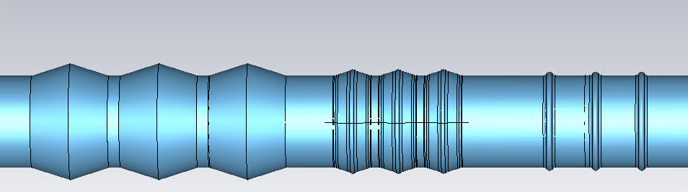
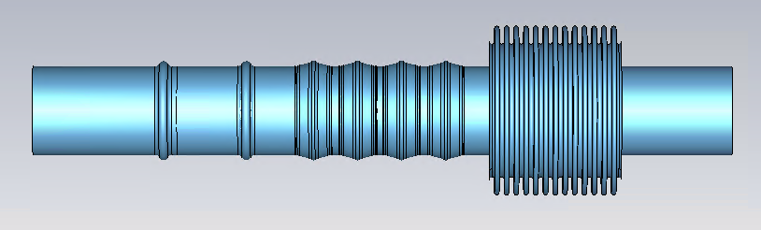
Options (same scale)
Original DRF
Cedric 3 convolutions
Teddy 3 convolutions
unshielded
Cedric 4 convolutions
Teddy 2 convolutions

Slide 6
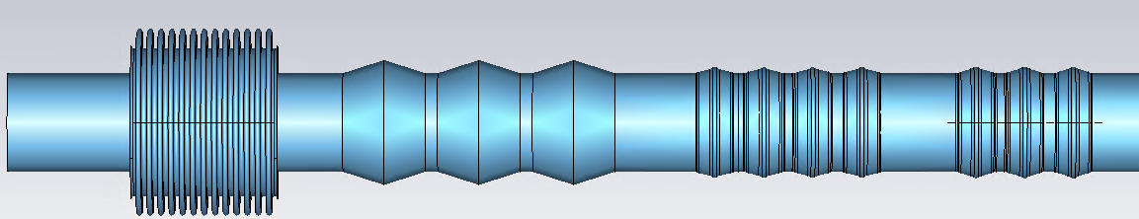
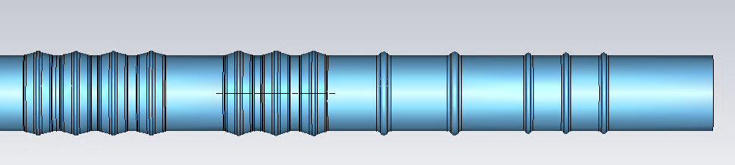
Options
unshielded
Cedric 4 convolutions
Teddy 2 convolutions
Original DRF
Cedric 3 convolutions
Teddy 3 convolutions
 | Im(Zlong/n) in μOhm | Im(Ztrans) in Ohm/m
unshielded | 753 | 2000
original DRF | 62 | 260
cedric4convolutions | 20 | 100
cedric3convolutions | 20 | 90
teddy2convolutions | 13 | 64
teddy3convolutions | 9 | 47
For
1 module

Slide 7
Options
unshielded
Cedric 4 convolutions
Teddy 2 convolutions
Original DRF
Cedric 3 convolutions
Teddy 3 convolutions
 | Im(Zlong/n) in mOhm | Im(Ztrans_eff) in kOhm/m
unshielded | 9.00 | 500
original DRF | 0.75 | 66
cedric4convolutions | 0.25 | 25
cedric3convolutions | 0.24 | 23
teddy2convolutions | 0.15 | 16
teddy3convolutions | 0.11 | 11
Full LHC | 90 | 16,500
For
12 modules
at their
beta
functions
Thanks Nicolas!

Slide 8
Options
unshielded
Cedric 4 convolutions
Teddy 2 convolutions
Original DRF
Cedric 3 convolutions
Teddy 3 convolutions
 | Im(Zlong/n) in mOhm | Im(Ztrans_eff) in kOhm/m | Comment
unshielded | 9.00 (10.0%) | 500 (3.0%) | Clearly unacceptable
original DRF | 0.75 (0.8%) | 66 (0.4%) | Not optimized
cedric4convolutions | 0.25 (0.3%) | 25 (0.15%) | Acceptable
cedric3convolutions | 0.24 (0.3%) | 23 (0.14%) | Acceptable
teddy2convolutions | 0.15 (0.2%) | 16 (0.1%) | Best
teddy3convolutions | 0.11 (0.1%) | 11 (0.07%) | Best
Full LHC | 90 | 16,500
For
12 modules
at their
beta
functions

