Slide 1
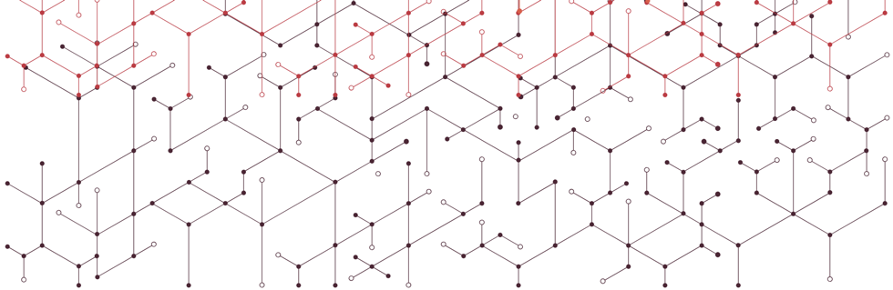

Knowledge Transfer @ CERN
Ash Ravikumar
Entrepreneurship Development Officer

Slide 2

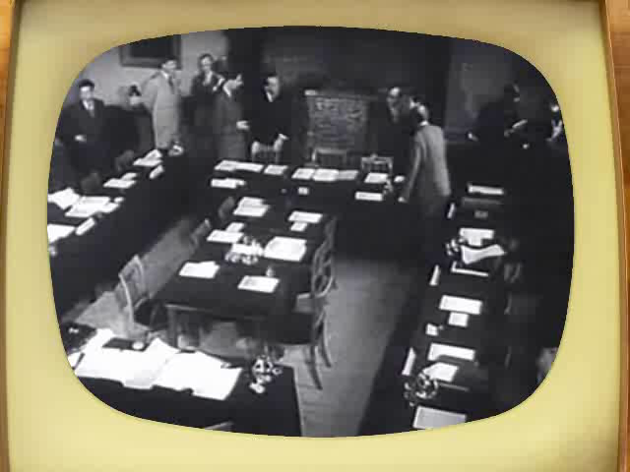
Council meeting in Amsterdam when the CERN convention was signed (1953).
Notes:
Ask the audience what they think «CERN» acronym stands for before showing the answer.
After WW II, fundamental research in Europe was not leading anymore.
Many scientists were flying away to the United States.
In order to stop this movement, eminent scientists gathered in meetings to setup a structure to continue fundamental research in physics in Europe.
They were gathered as a «Council» which means there were just holding meetings and they did not (yet) had a lab or led experiments.
The images are from Amsterdam meeting in 1953 when the CERN convention was signed.

Slide 3
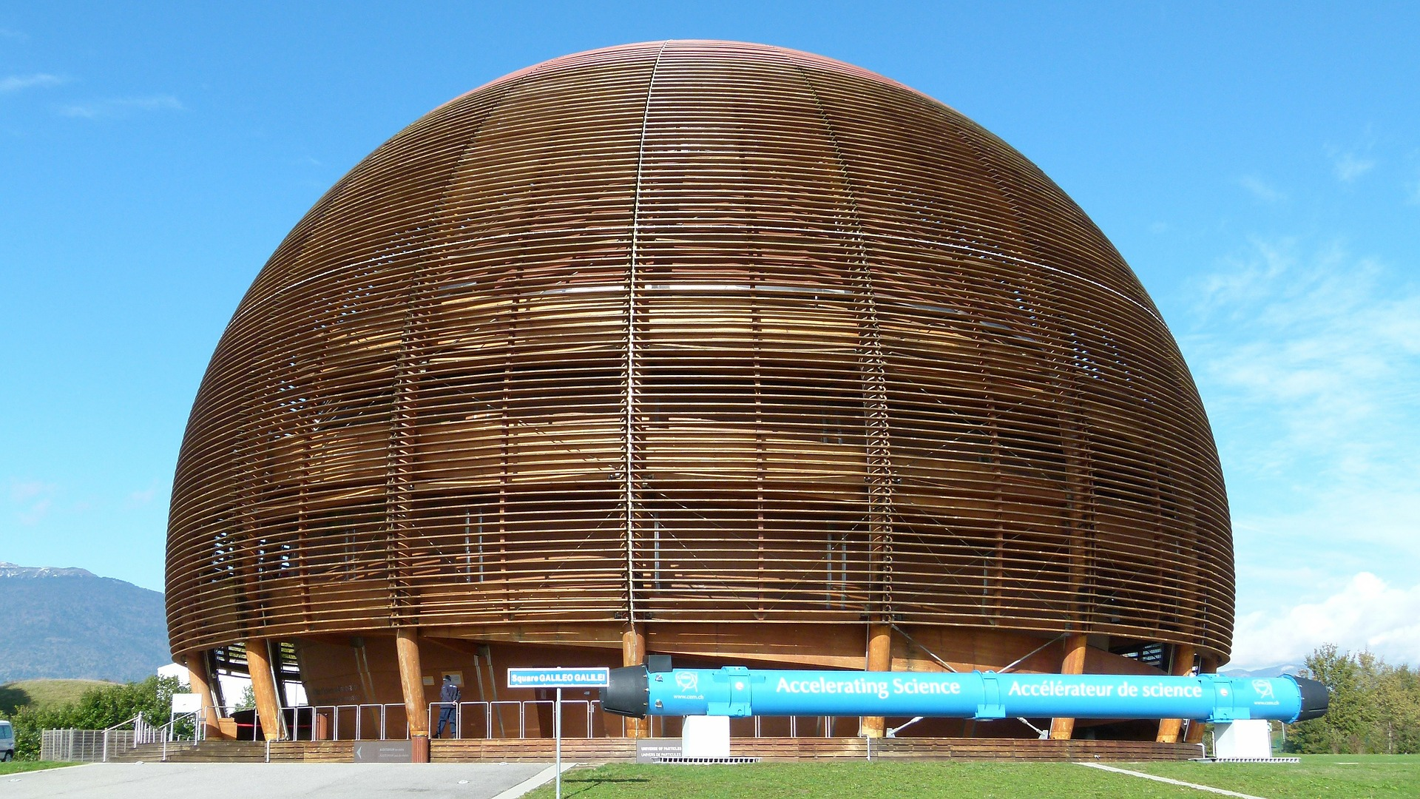
23
Member states
2300
Staff positions
1600
Other personnel
12700
Scientific users
Notes:
So we’ve been in business for 63 years. During that time we’ve grown to include 22 Member States. We have about 2300 members of staff and 1600 other personnel. Within these numbers you find a wide range of different job titles and backgrounds. We have lawyers, accountants, engineers…we have our own Fire brigade! And of course, in addition we have 12700 scientific users who work on the different experiments that are being conducted at CERN. This is where you find the positions that most people associate with CERN; the physicists and scientists. These people are typically paid by a university or a research institution.

Slide 4
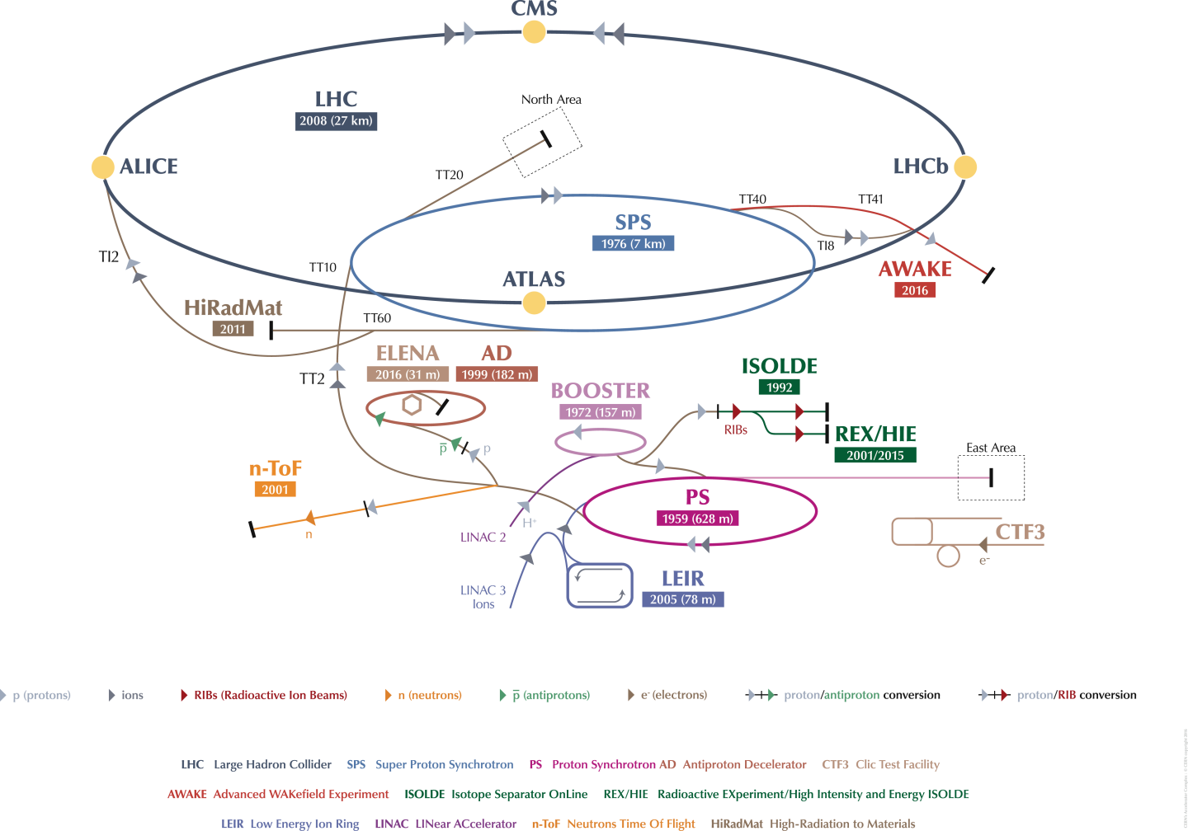
Notes:
In a nutshell, we do that by colliding particles in accelerators. Here you see our accelerator complex. The oldest accelerator that’s still operating is the Proton Synchrotron that dates back to 1959.

Slide 5
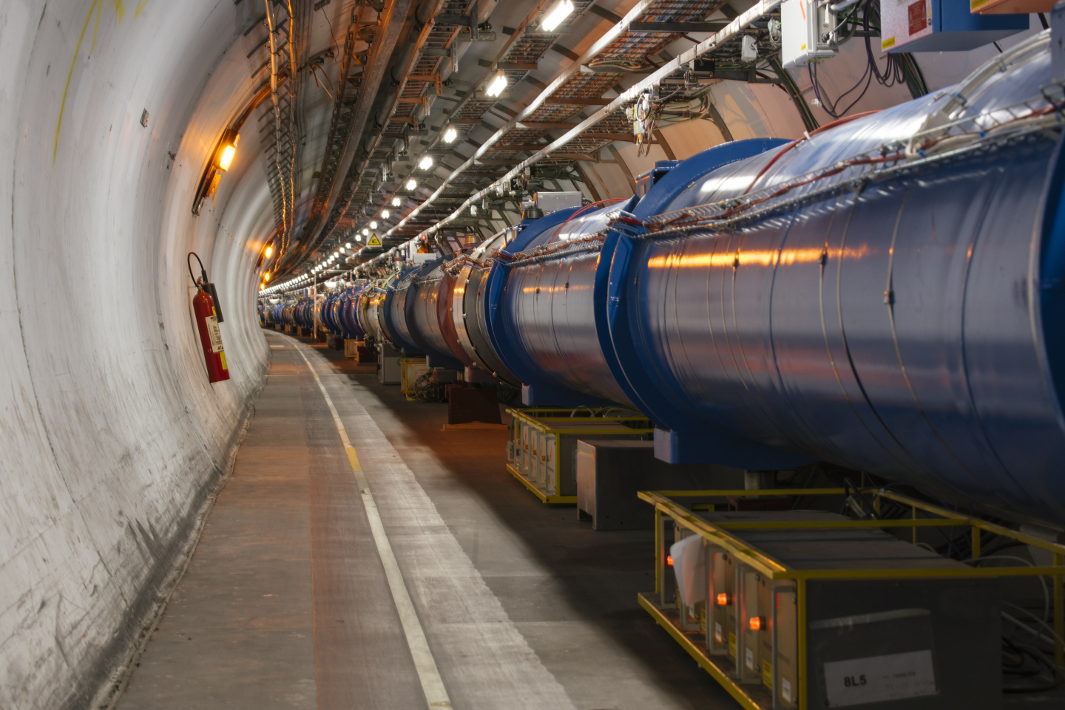
The Large Hadron Collider (LHC), 27km long, 100m deep.
Notes:
You have probably heard of the crown jewel of the accelerator complex, the large hadron collider. With its 27 kilometres in circumference it is the largest machine in the world, and inside it, particles travel almost at the speed of light, in temperatures lower than in the outer space.

Slide 6

Notes:
Here’s a map to give you an idea of just how big it actually is. As you see, it crosses the border between France and Switzerland four times.

Slide 7
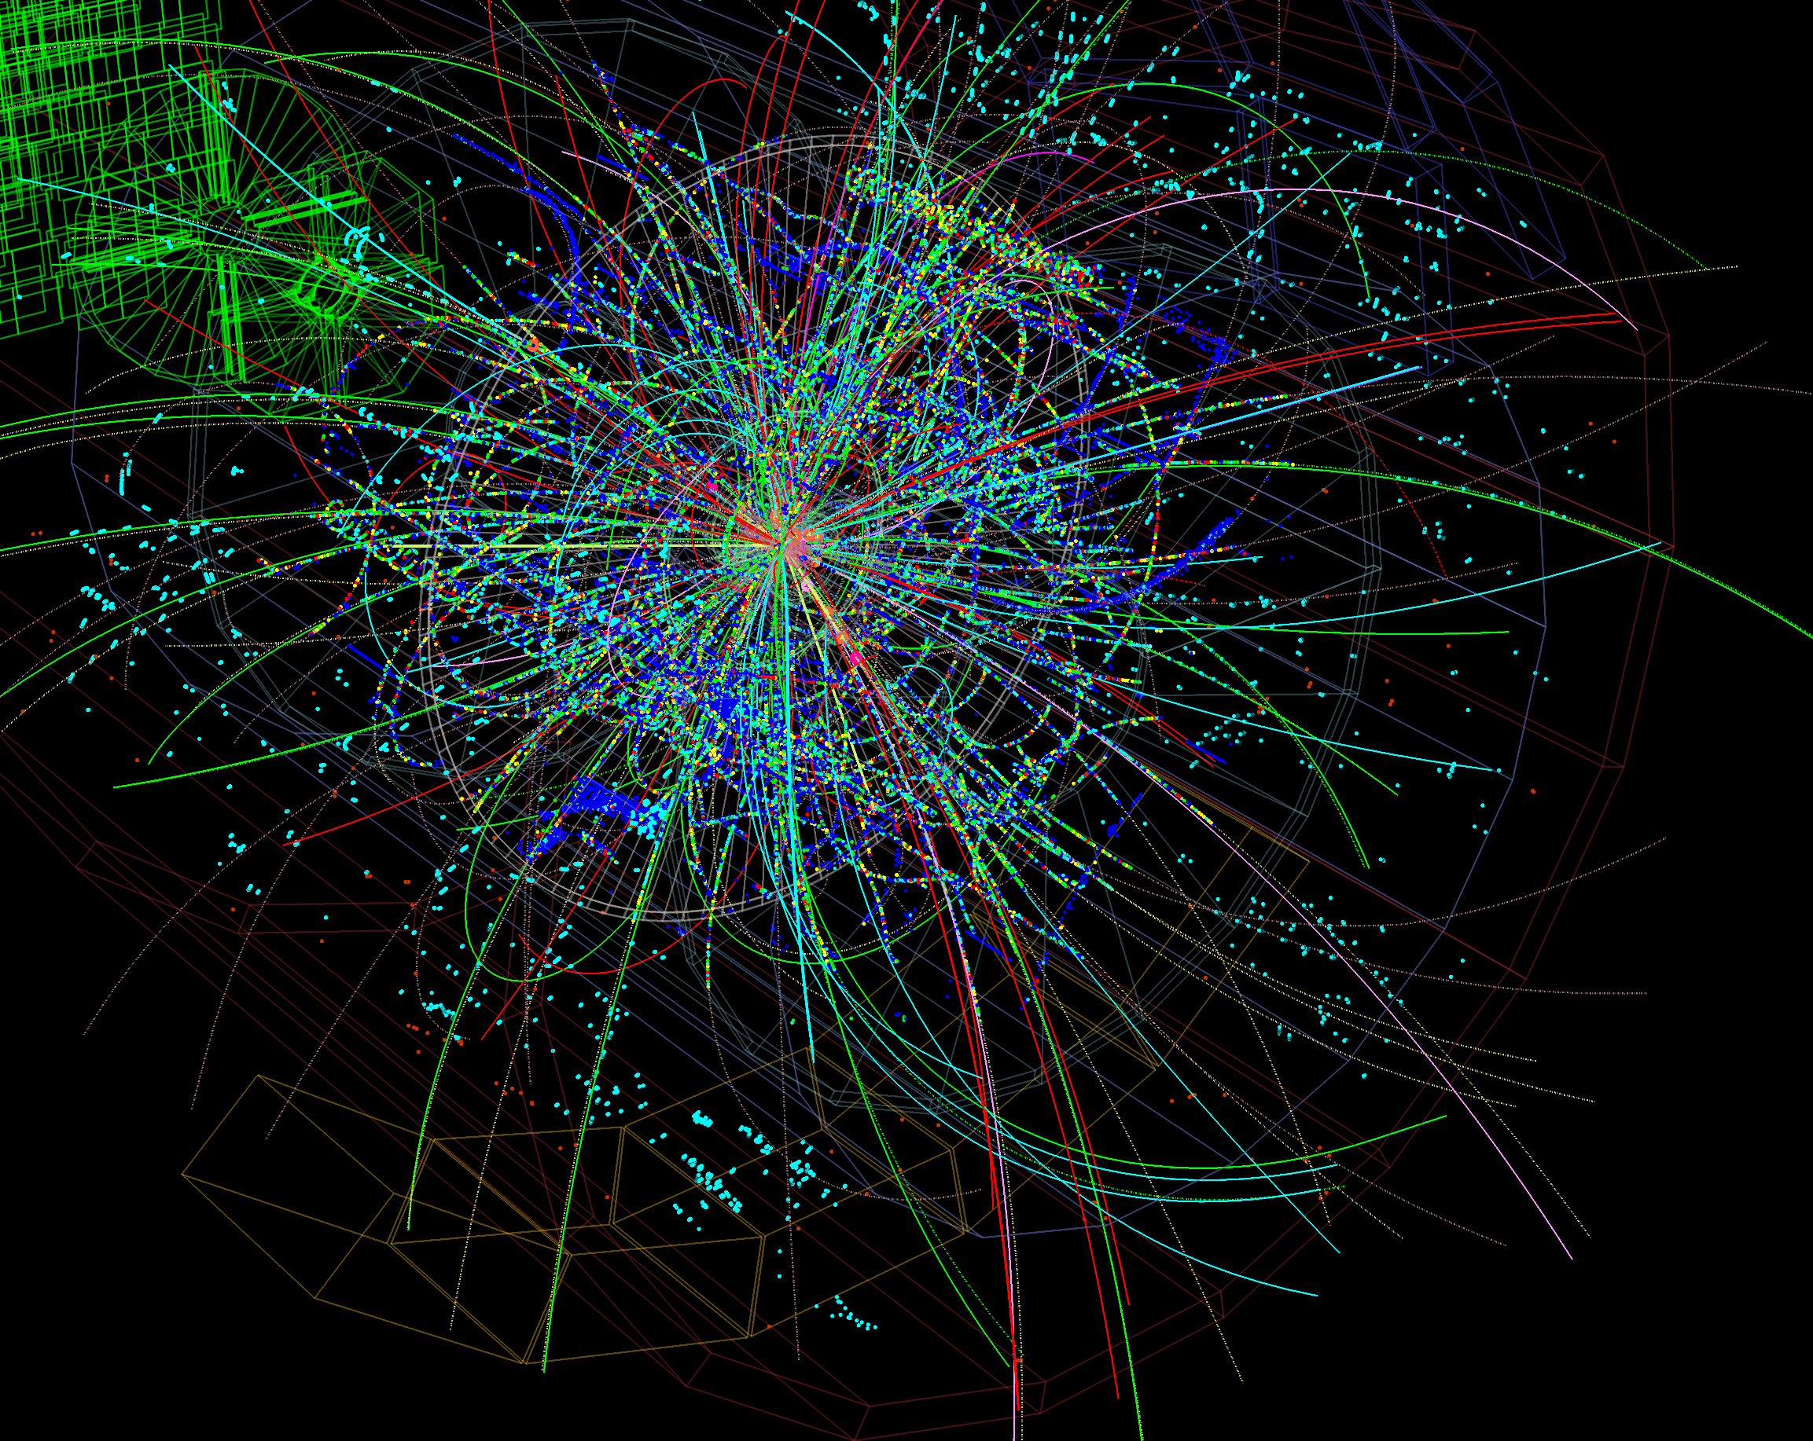

Slide 8
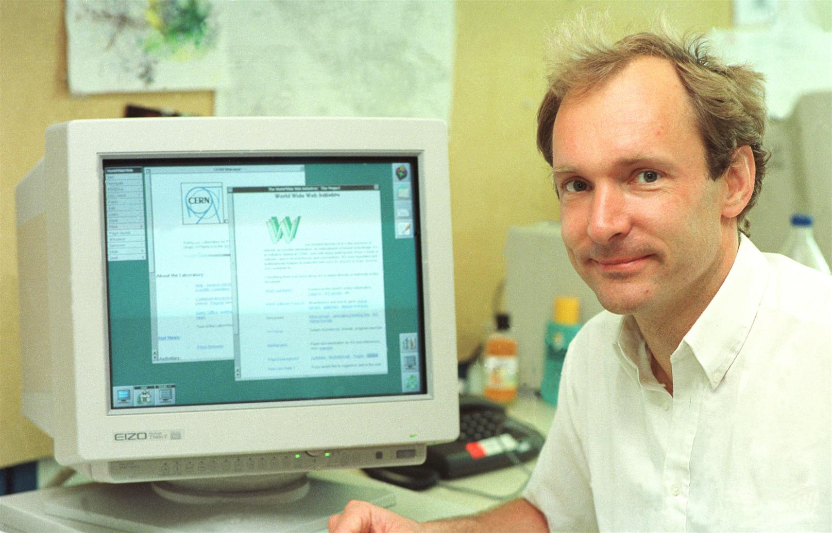
The World Wide Web born at CERN, later used by everyone…
Notes:
The most known example of technological impact on society is the WWW. How many here knew that the WWW was invented at CERN?
Open source culture…
Stories of Innovation:
Where the World Wide Web was born
Probably the technology that has most changed society in the last 100 years.
Tim Berners Lee.
Proposal "Vague but interesting"
Difficult to predict what impact things will have.
KT strength: Vision to recognise, liberty to just try. Advantage of a research institute over industry.
Keywords:
www = at the heart of the Third Industrial Revolution ( = digital revolution) [The industrial revolutions are: 1) Steam, 2) Electricity/Mass production 3) Digital 4) Internet of Things]
www at the heart of the Information Age.
Open.
Revolution.
Disruption of entire sectors of economy, media, society & even how science is done.
Exponential change.

Slide 9
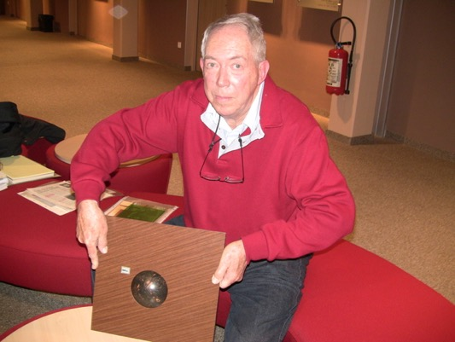
Trackball with optical encoders, used later in the mouse of a PC…

Slide 10
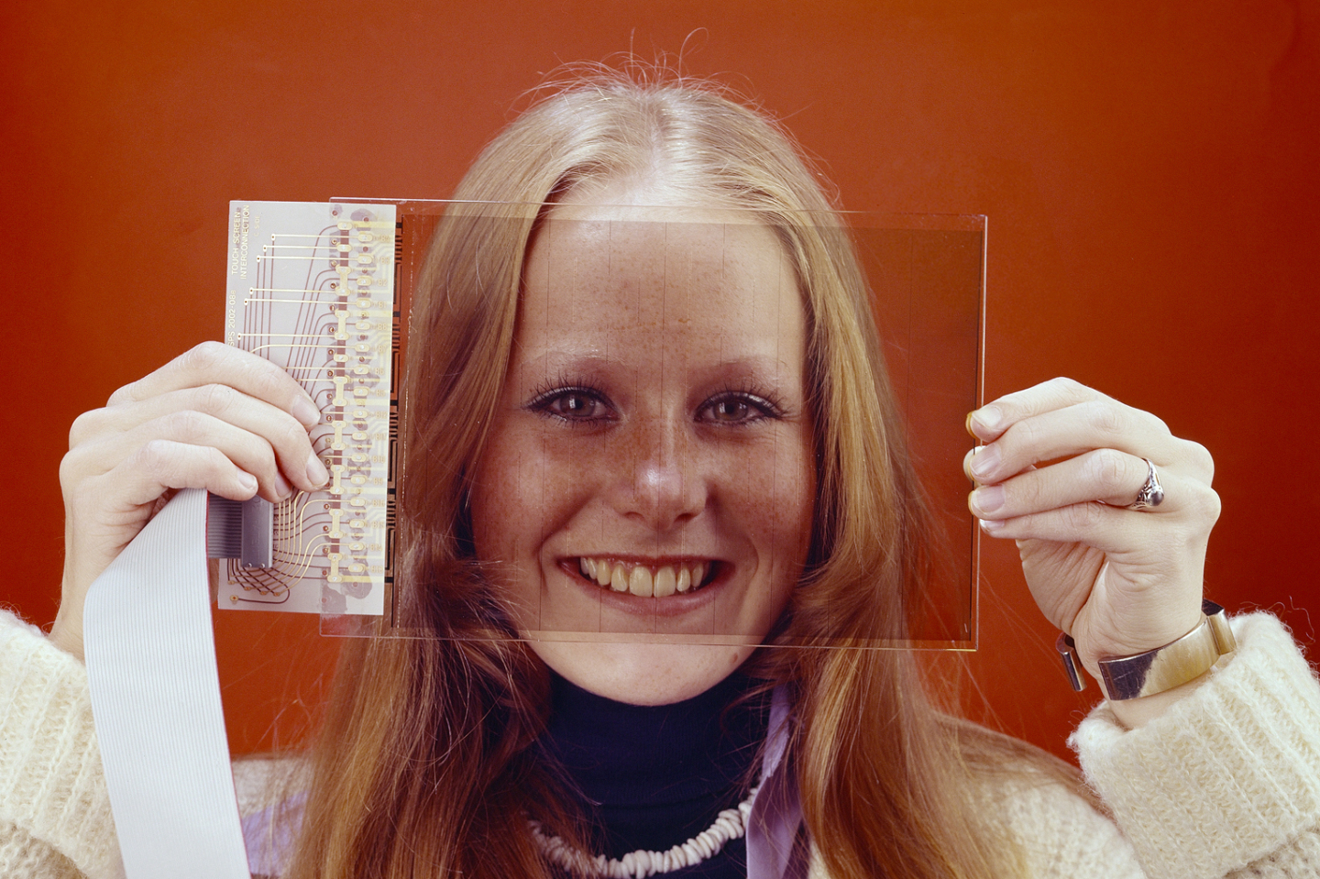
The first touchscreen to exist was at CERN, later used everywhere…
Notes:
Touchscreen’s and Track balls.
Soundbite: “The first touchscreen to exist was at CERN”
Try and keep a positive spin, e.g. Just so many exciting things happening at CERN with potential for incredible impact on society.
Goal of KT "recognize potential in technology & people"
Fragments of the Bulletin’s article on touchscreens
(full text at: http://cdsweb.cern.ch/record/1248908)
CERN has often been the incubator for the development of innovative technologies but very few people know about the capacitive touch screens invented for the consoles of the SPS Control Room in 1973. The Bulletin interviewed their inventor, Bent Stumpe, who also developed the CERN tracker ball and the computer-programmable knob.
Back in the 1970s, the SPS was being built and its control room required the installation of thousands of buttons, knobs, switches and oscilloscopes to operate the machine. Frank Beck, newly recruited from the DD Division to be in charge of the central control hub in the SPS control room, asked Bent Stumpe for solutions to the following problem: how to build the hardware for an ‘intelligent’ system which, in just three console units, would replace all those conventional buttons, switches, etc.
In just a few days, the Danish engineer, also from the DD Division, came up with a (hand-written) proposal to build a touch screen with a fixed number of programmable buttons, a tracker ball to be used as computer-controlled pointing device and a programmable knob. Following this proposal, Bent Stumpe was recruited by the SPS Controls Group to develop the hardware.
(…)
The SPS control consoles also included a tracker ball, (…) “The tracker ball we developed in 1973 worked on the same principle as the mice that industry developed later in the 1980s”.

Slide 11
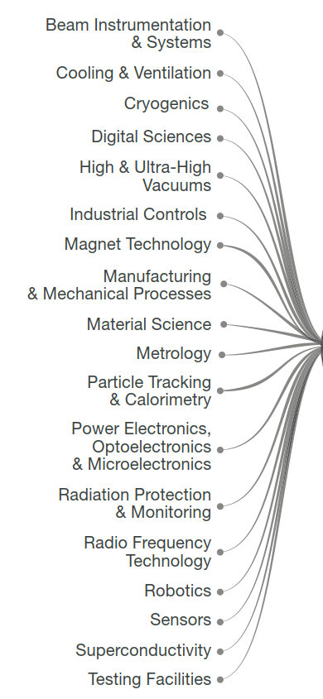
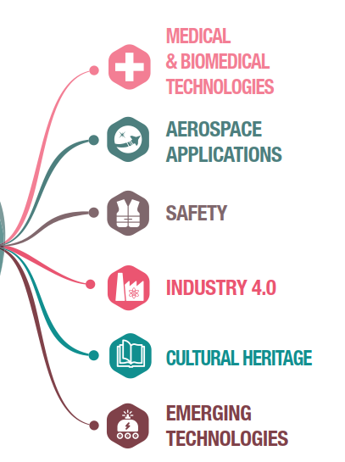
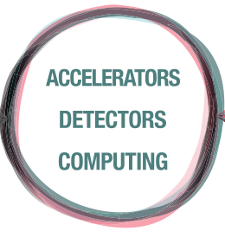
Notes:
…it looks something like this. Our expertise ranges from cryogenics to ultra-high vacuums, from super conductivity to particle tracking, radiation protection, testing facilities. The list goes on and on. These are things that are obvious necessities in a research facility like CERN. But how do they affect society and everyday life?

Slide 12

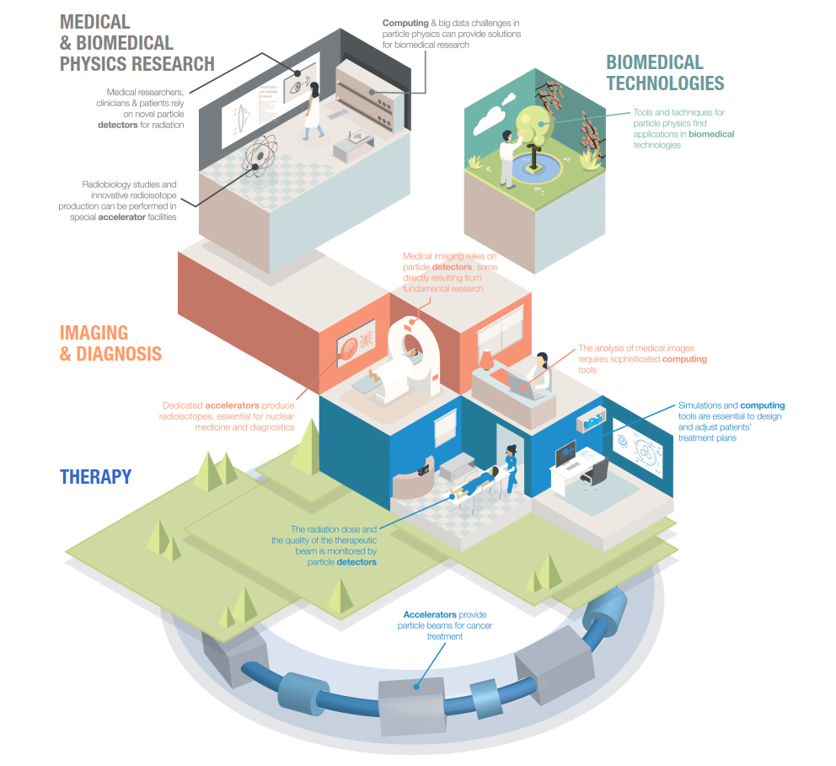
Medical & Biomedical Technologies
Notes:
There’s always been a tight link between high-energy physics and the medical and biomedical field. That’s because they’re both dependent on accelerators, detectors and computing. For instance, accelerators provide particle beams for cancer treatment. Particle detectors monitors the radiation dose and the quality of the therapeutic beam. And analysing medical images requires sophisticated computing tools.

Slide 13
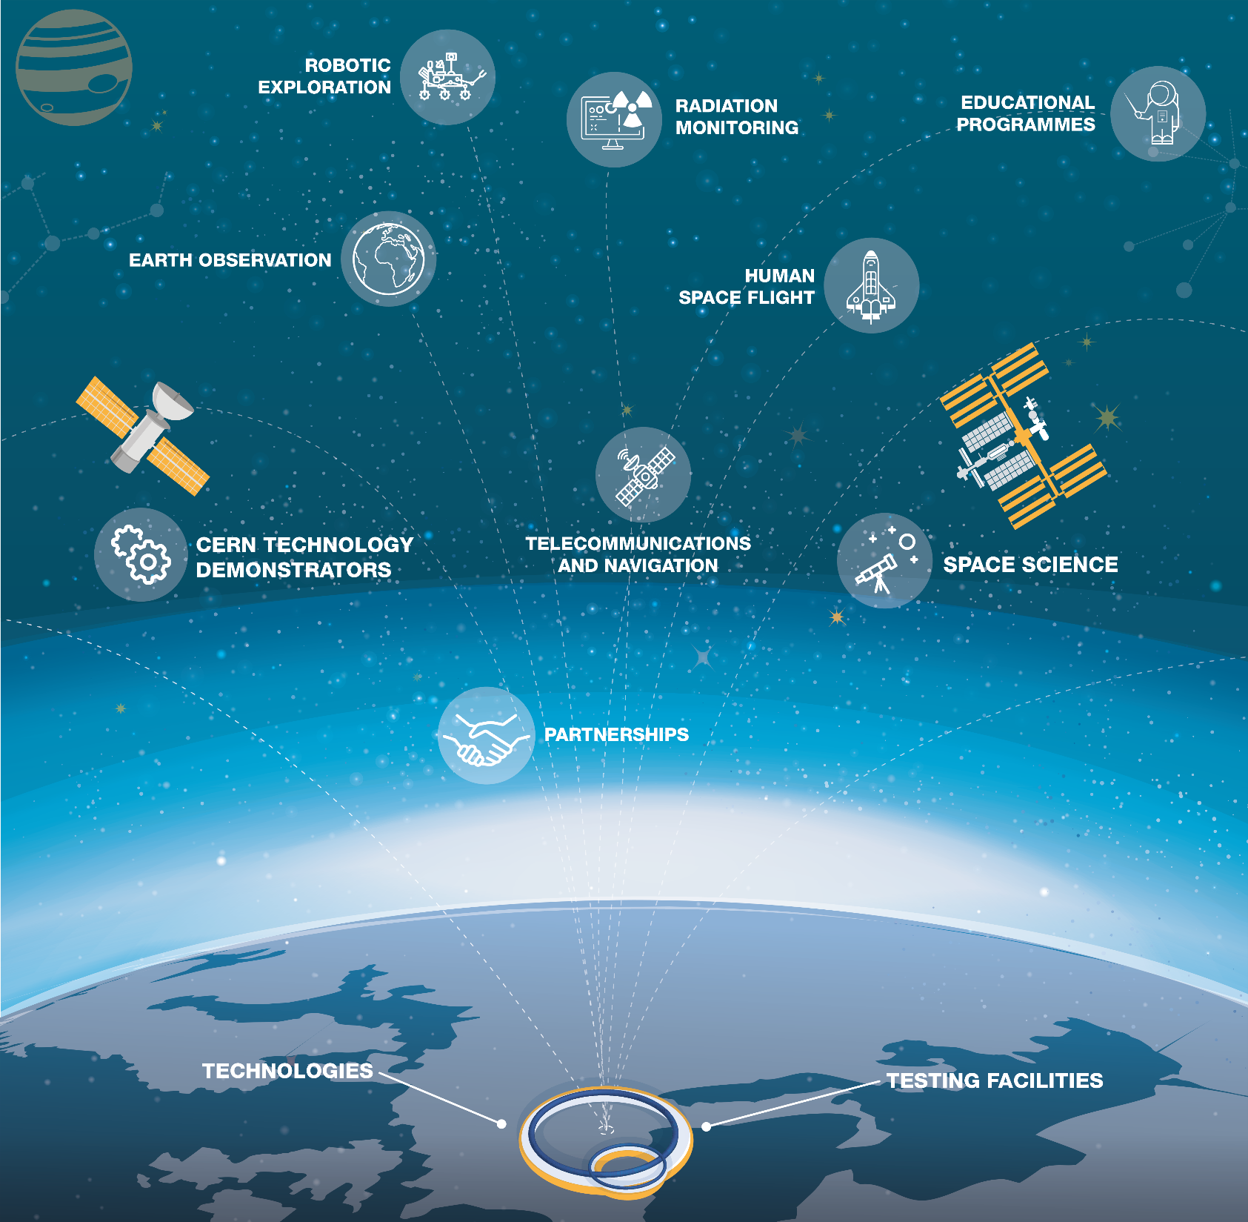
Aerospace Applications
Notes:
CERN technologies are not bound to planet Earth. For example, CERN technology is used for astronaut dosimetry on the International Space Station and for magnetic shield studies in space. We also host and provide computing support to UNOSAT, the United Nations Operational Satellite Applications Programme.

Slide 14
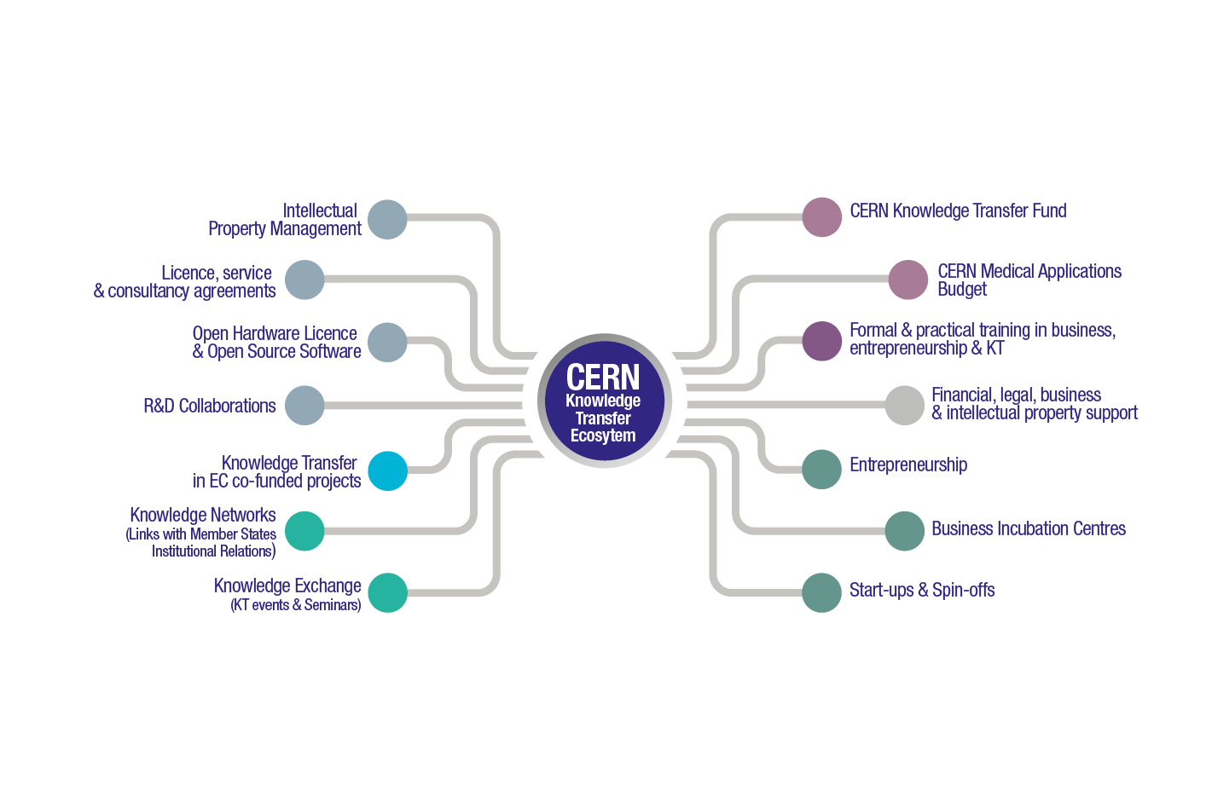

Slide 15
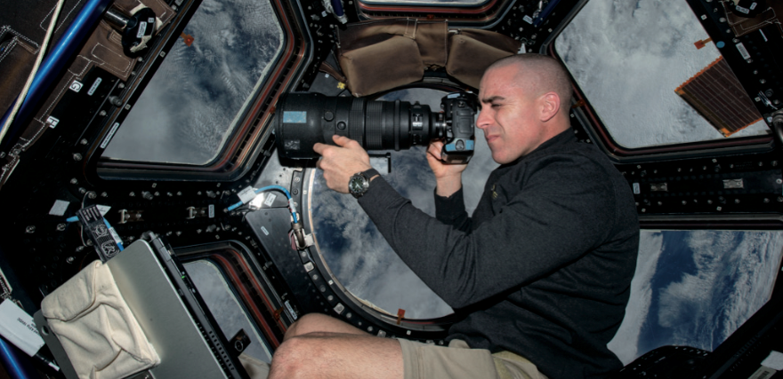
0
CERN tech used for monitoring radiation levels in space missions (courtesy of NASA ISS)

Slide 16
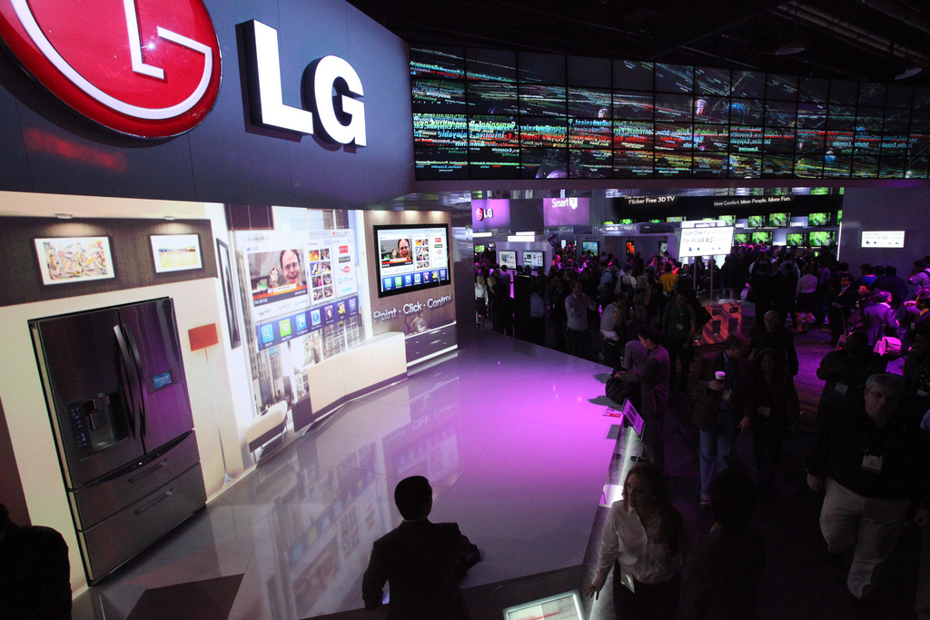
CERN’s Controls middleware software for worldwide factory automation at LG.

Slide 17
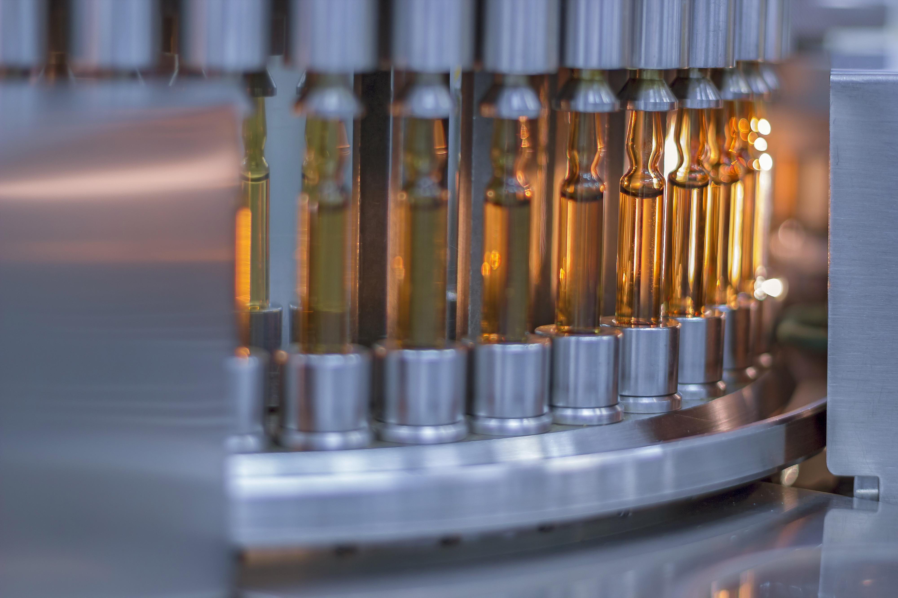
Machine learning to improve vaccine production at Sanofi.
Notes:
Example 1 - Medtech
CERN experts train Sanofi in machine learning - potential application in their vaccine production
Training was in 2017

Slide 18
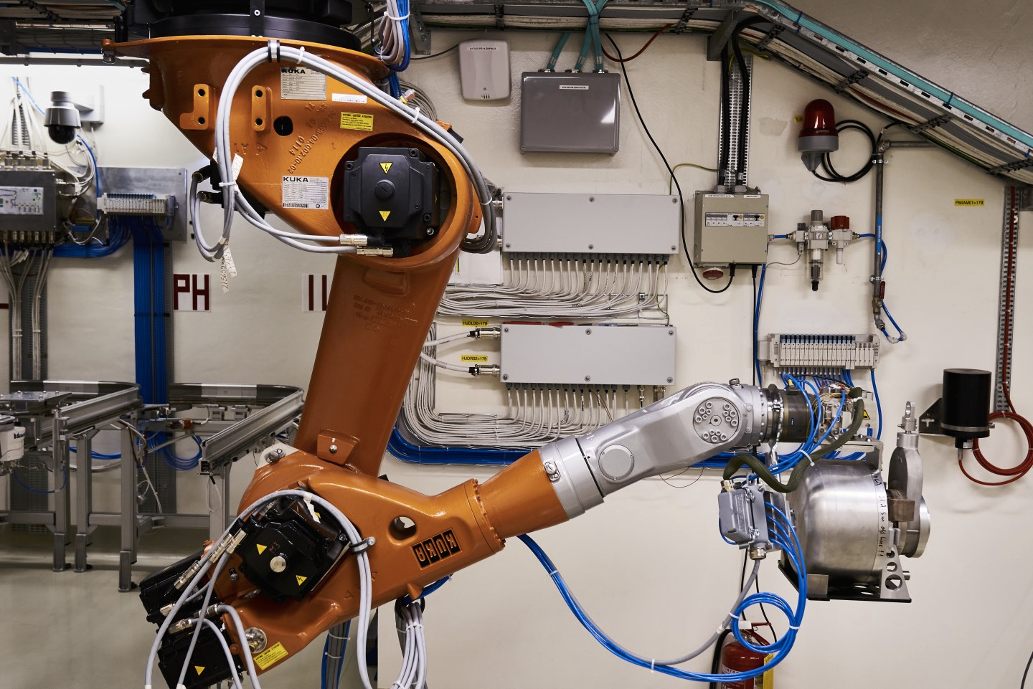
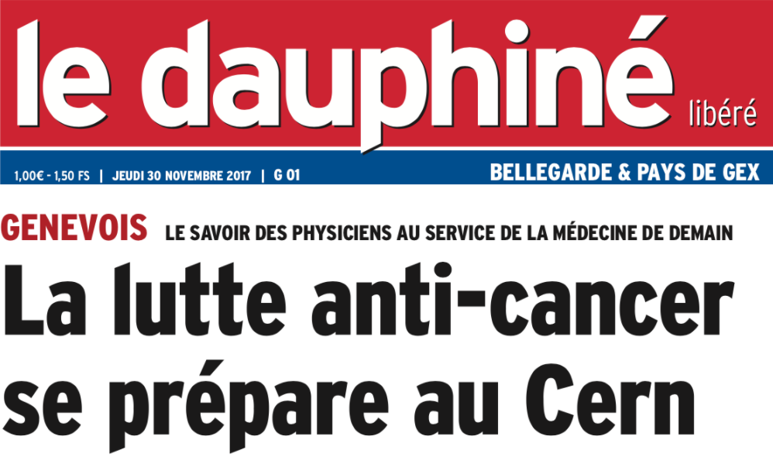
CERN-MEDICIS produces radioisotopes for medical research

Slide 19
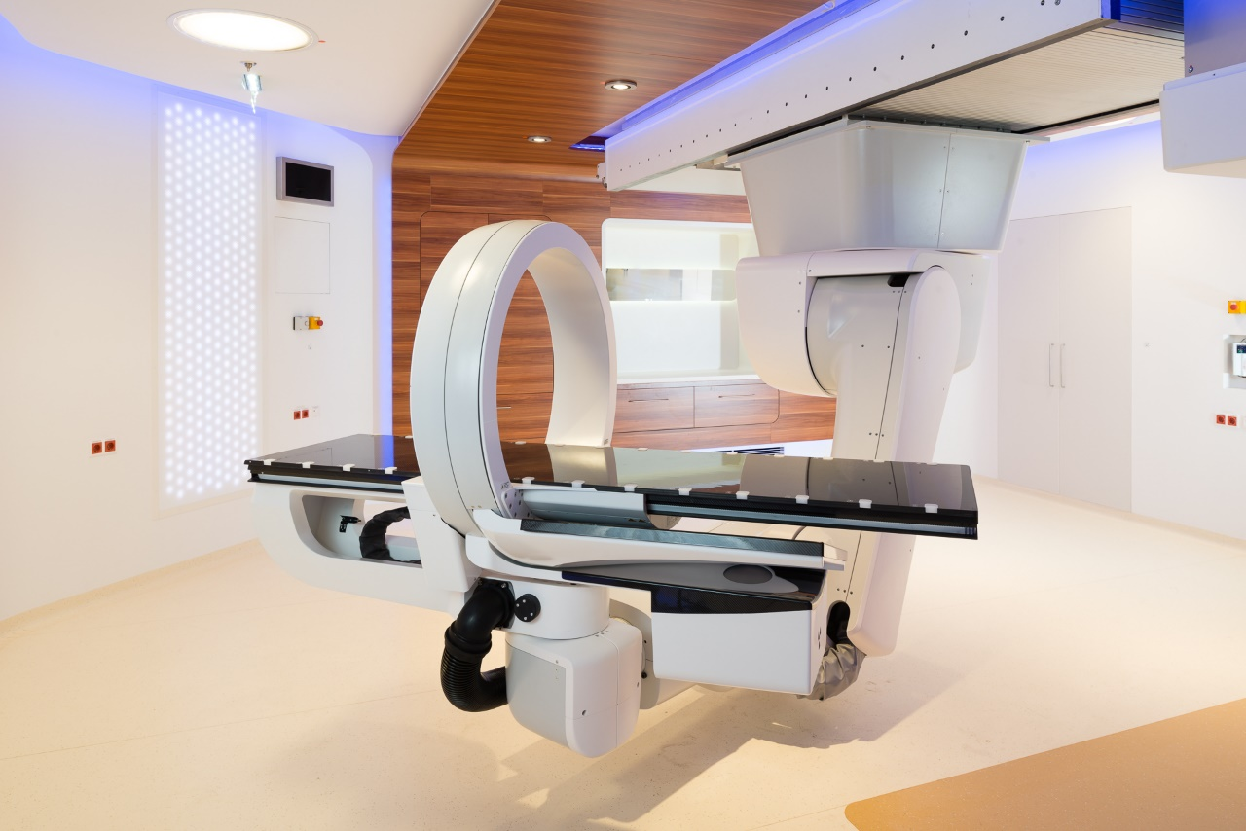
MedAustron started patient treatments in December 2016...

Slide 20
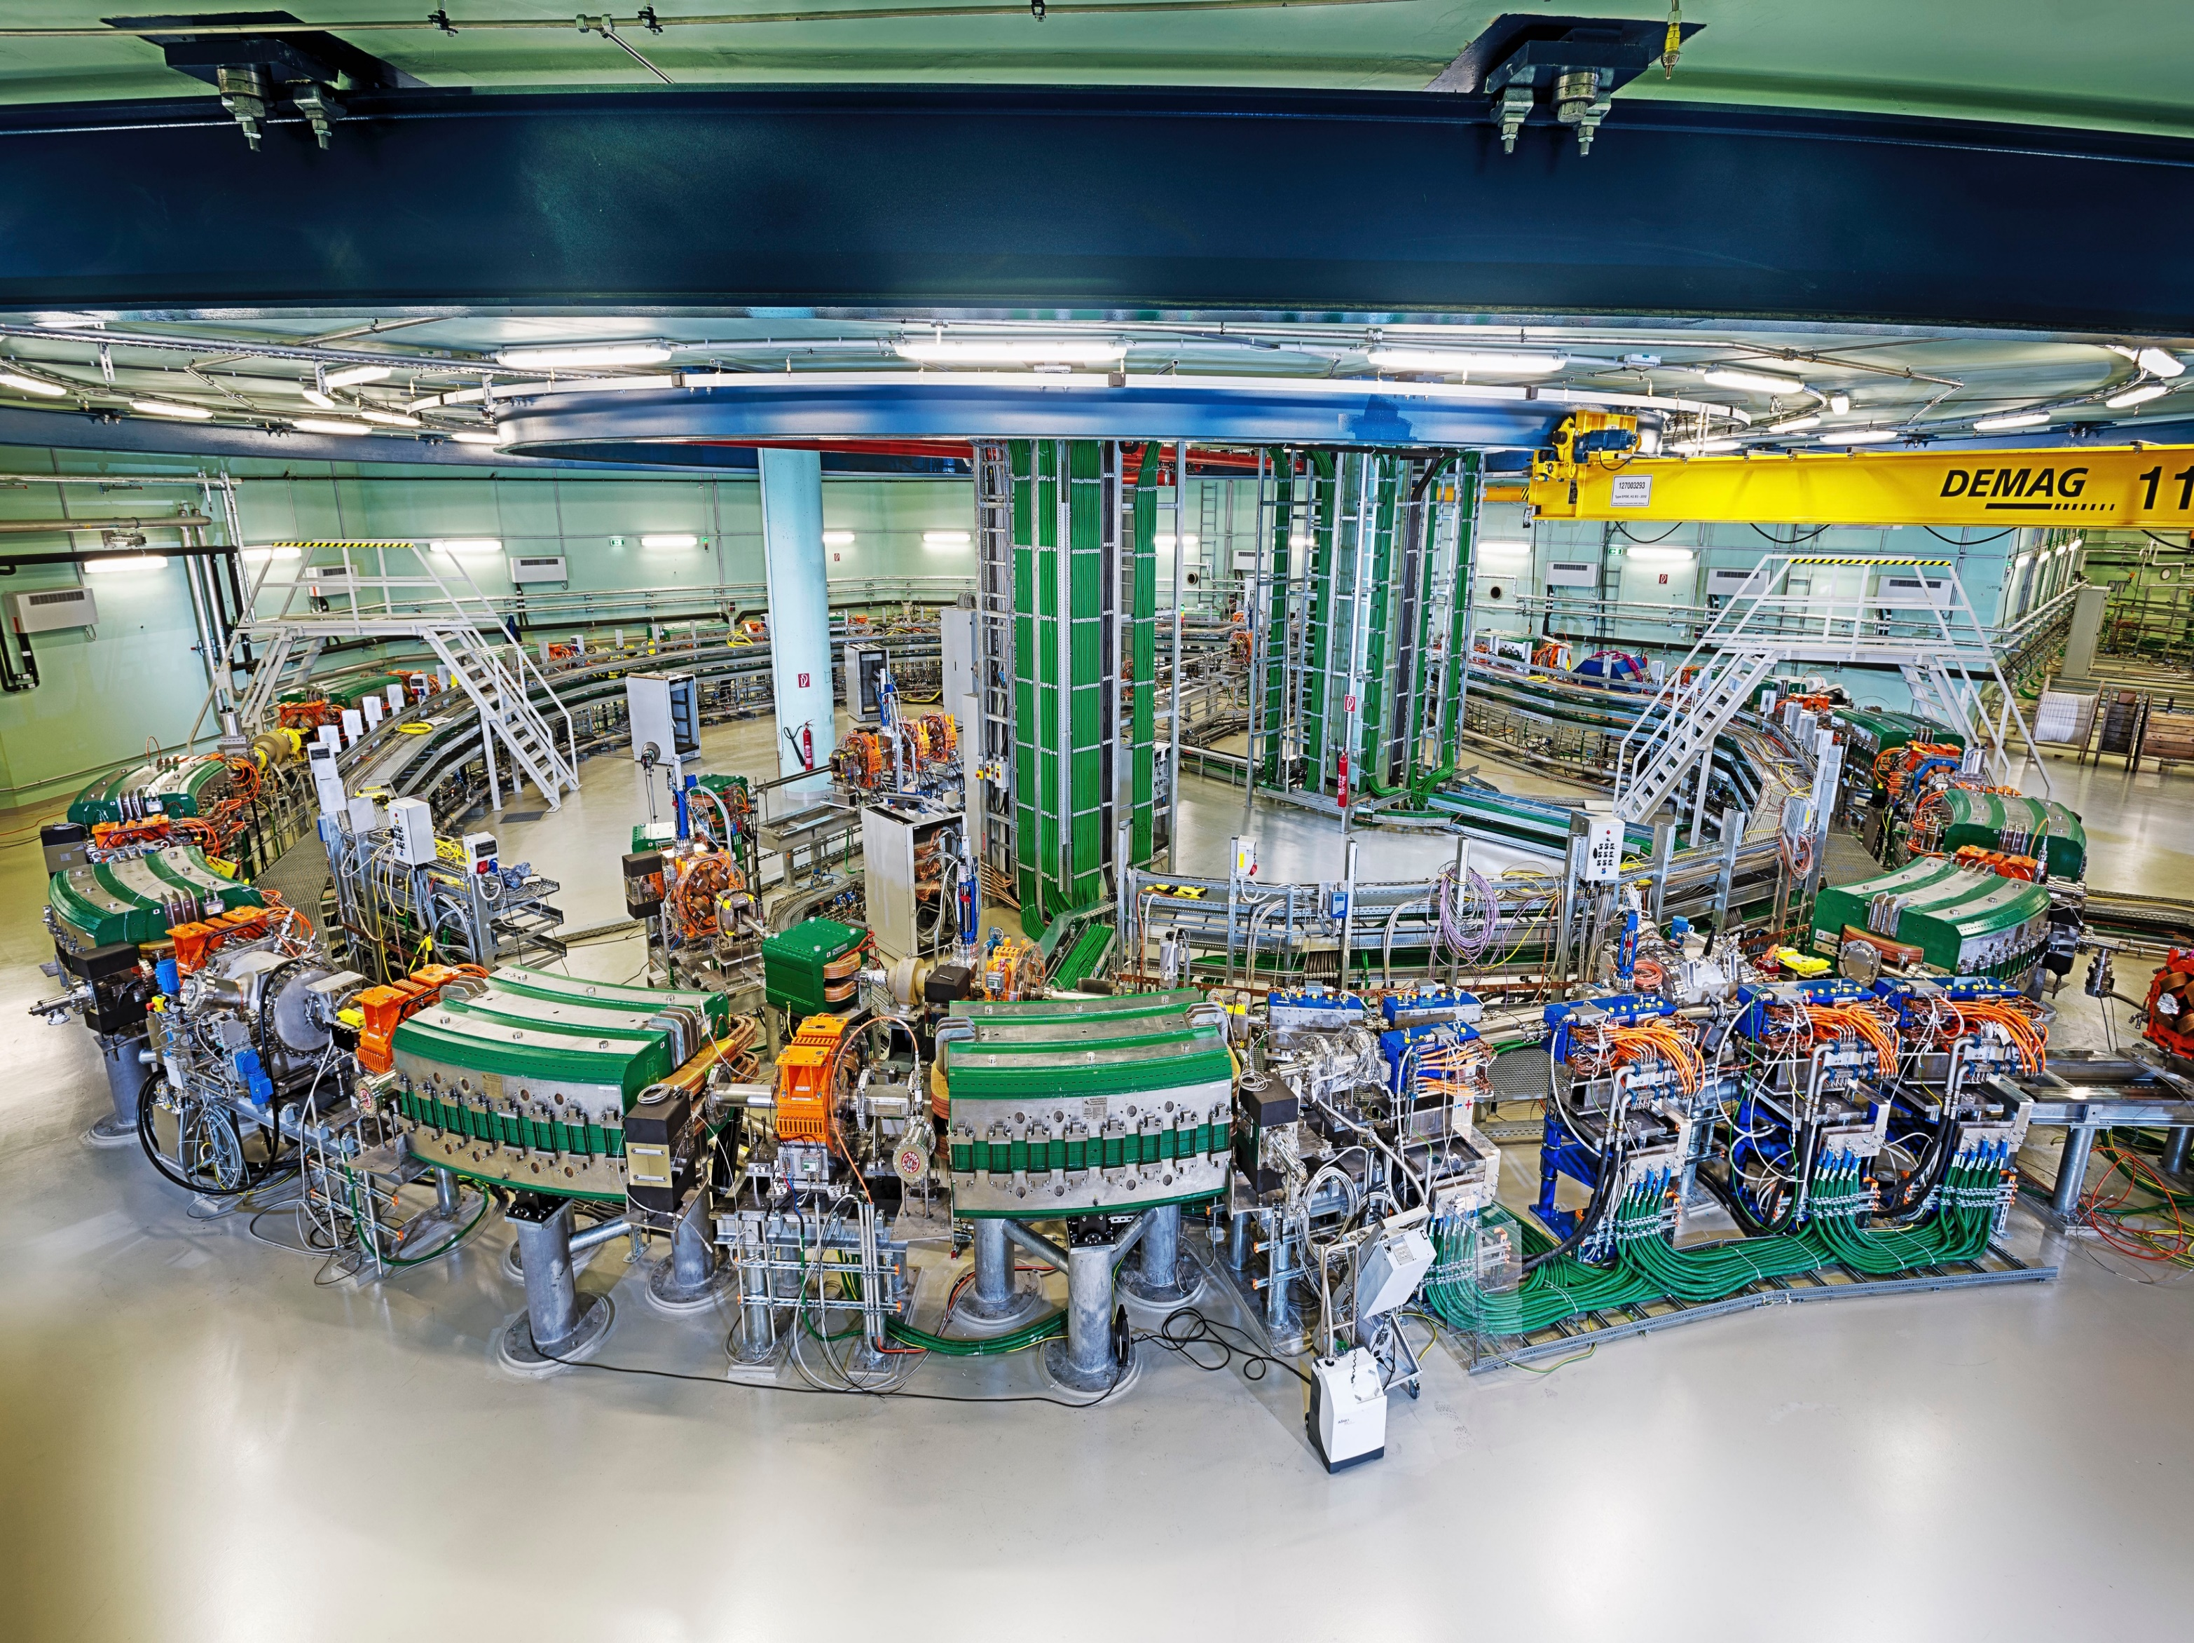
...and is using a lot of CERN technology for its proton acceleration

Slide 21

Bundesdruckerei (Berlin) works with CERN on next generation ideas for identity management and cryptography

Slide 22
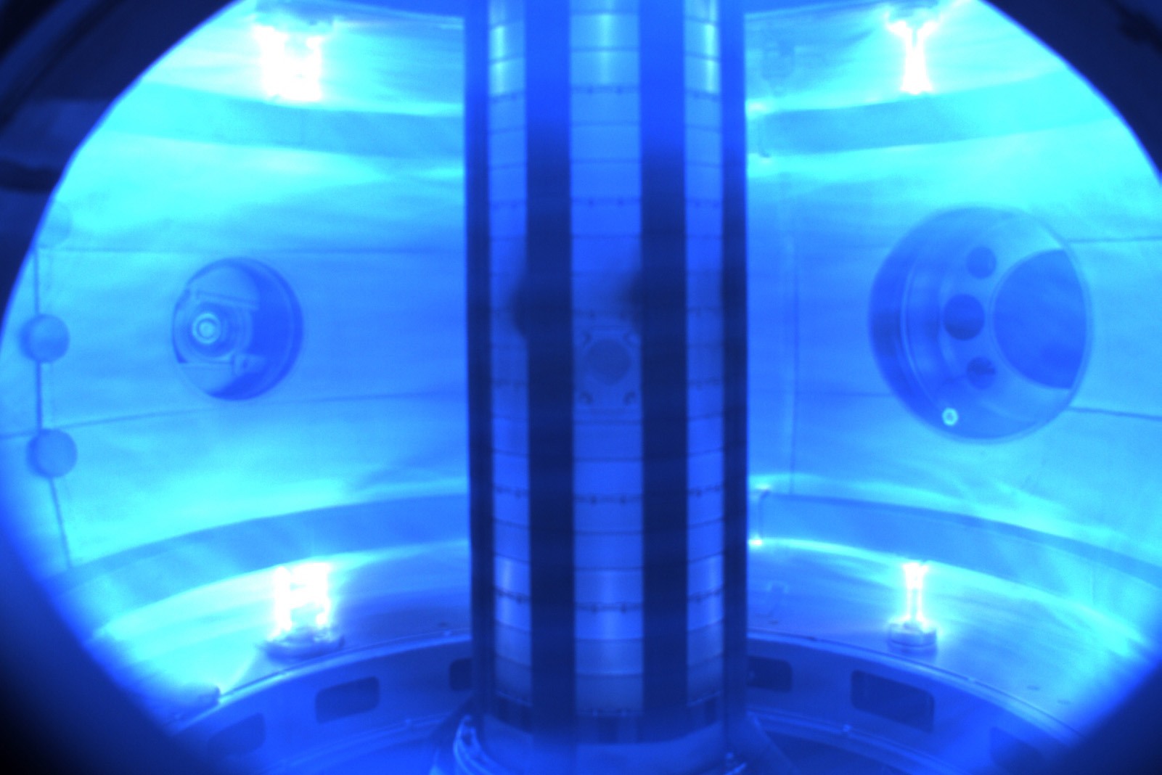
Tokamak Energy (fusion power) taps into expertise of CERN on simulation of currents and magnetic fields.

Slide 23
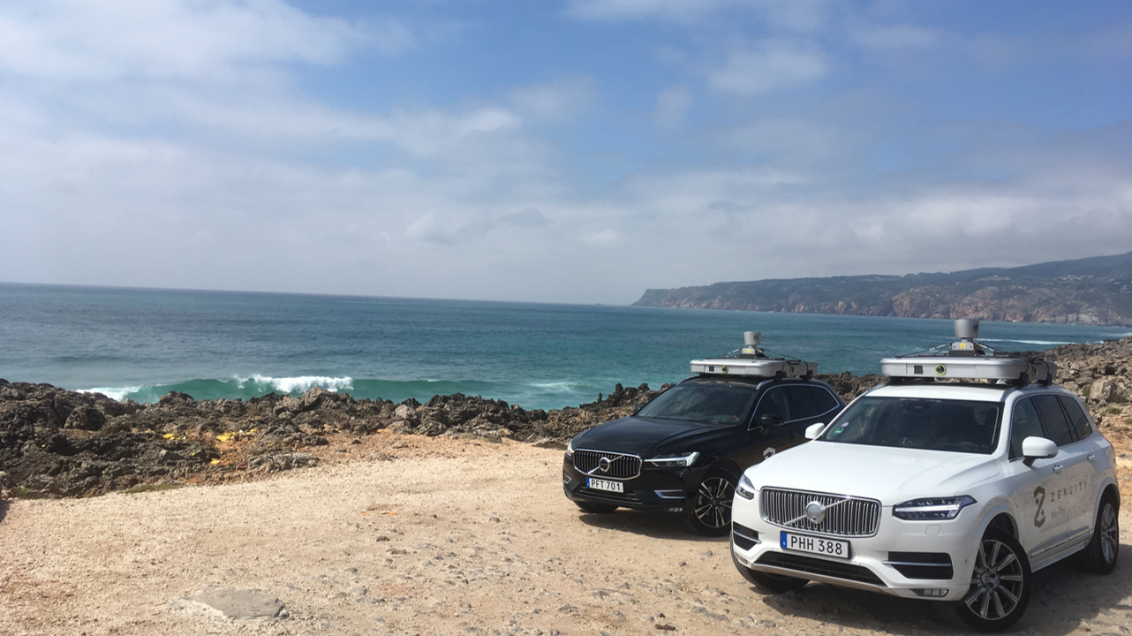
Zenuity (Volvo Cars / Veoneer) teams up with CERN on fast machine learning using FPGAs .

Slide 24
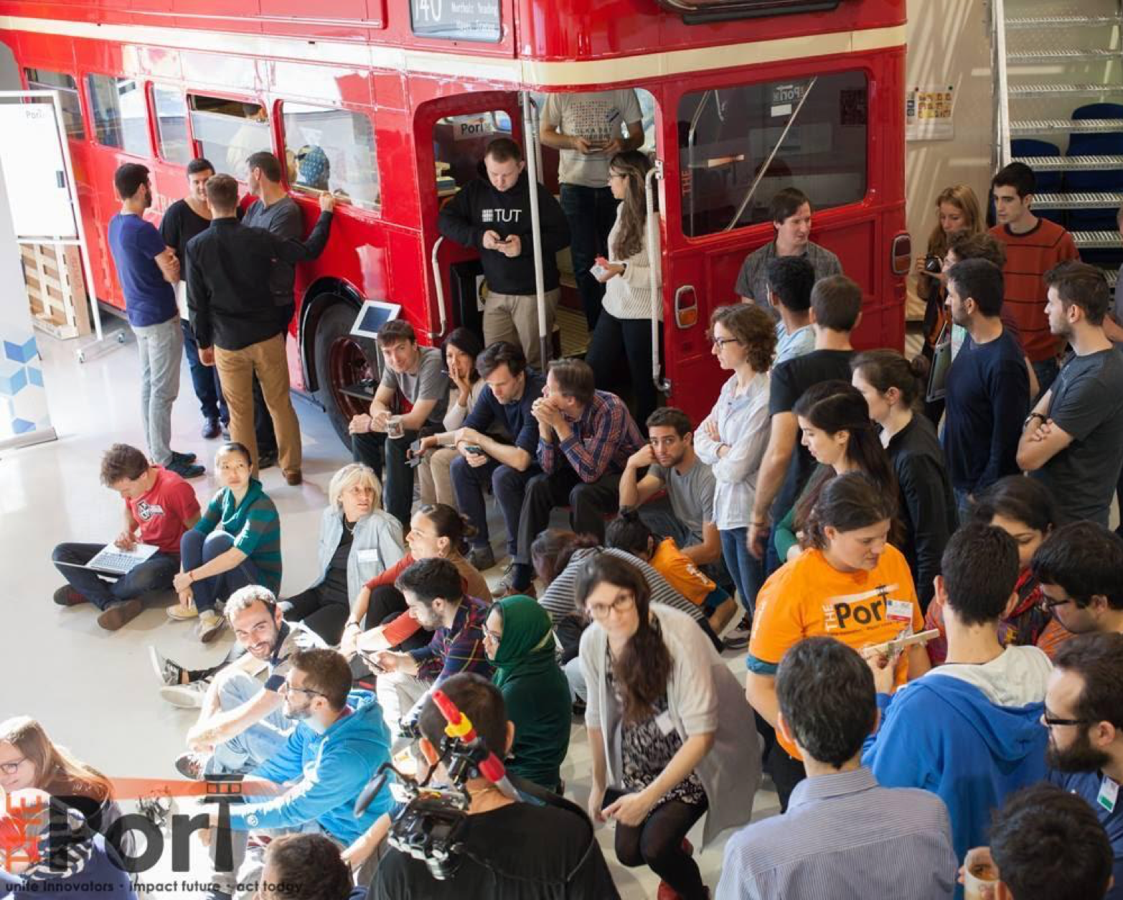
Entrepreneurship @CERN
Social Entrepreneurship THE PORT
Entrepreneur Mixer
Global Entrepreneurship Week
Entrepreneurship Meet-Ups
CERN-NTNU Screening Week
Challenge Based Innovation
Notes:
CERN is a knowledge hub, and many young researchers are trained at CERN and will not stay. We support those who have an entrepreneurial spirit with a number of initiatives
Material and documents made available to CERN people:
Business plan package tailored for CERN scientists and engineers
Financial spreadsheets for start-ups with explanations
Take-home message: many different activities to support a culture of entrepreneurship at CERN.

Slide 25
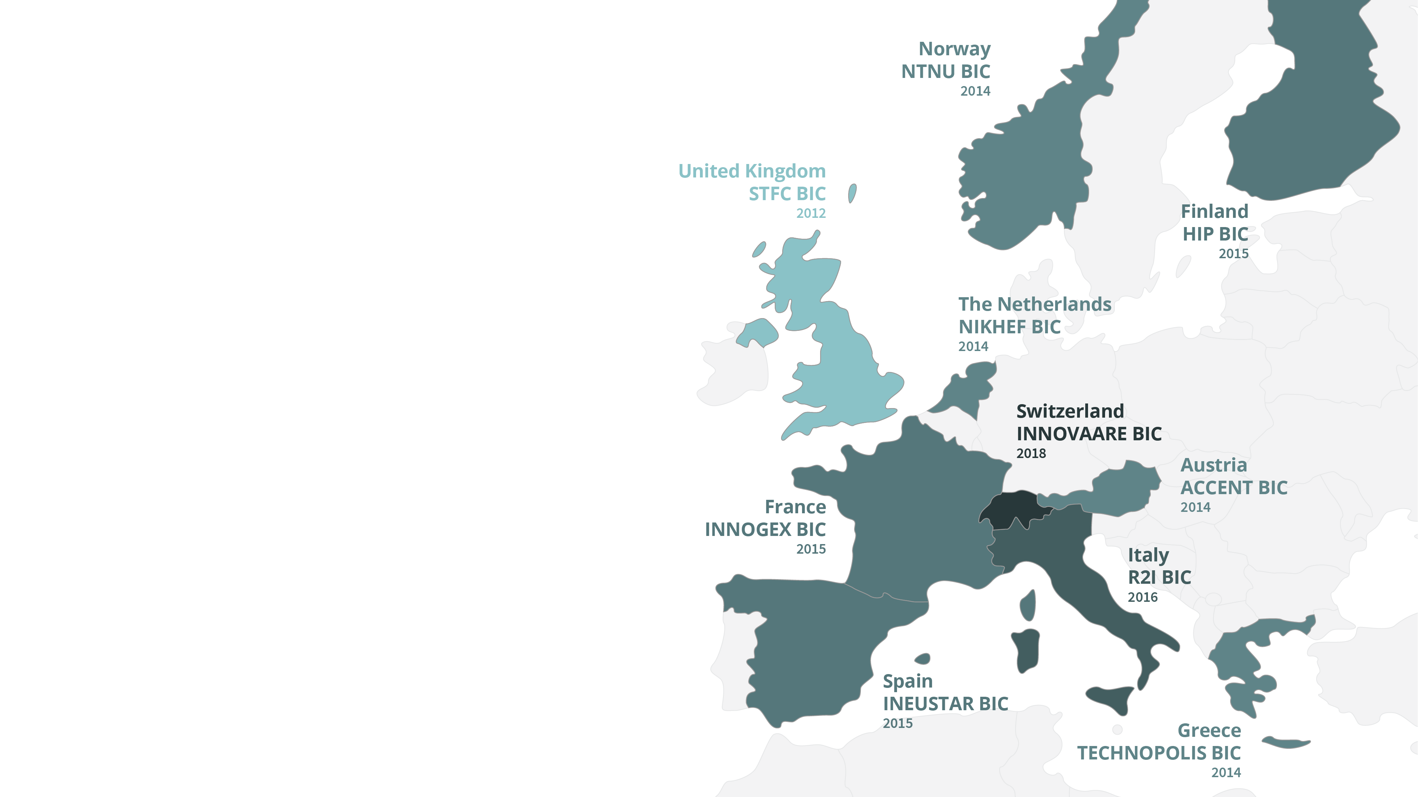
Our network of Business Incubation Centers (BICs) help accelerate innovation in the CERN Member States.

Slide 26
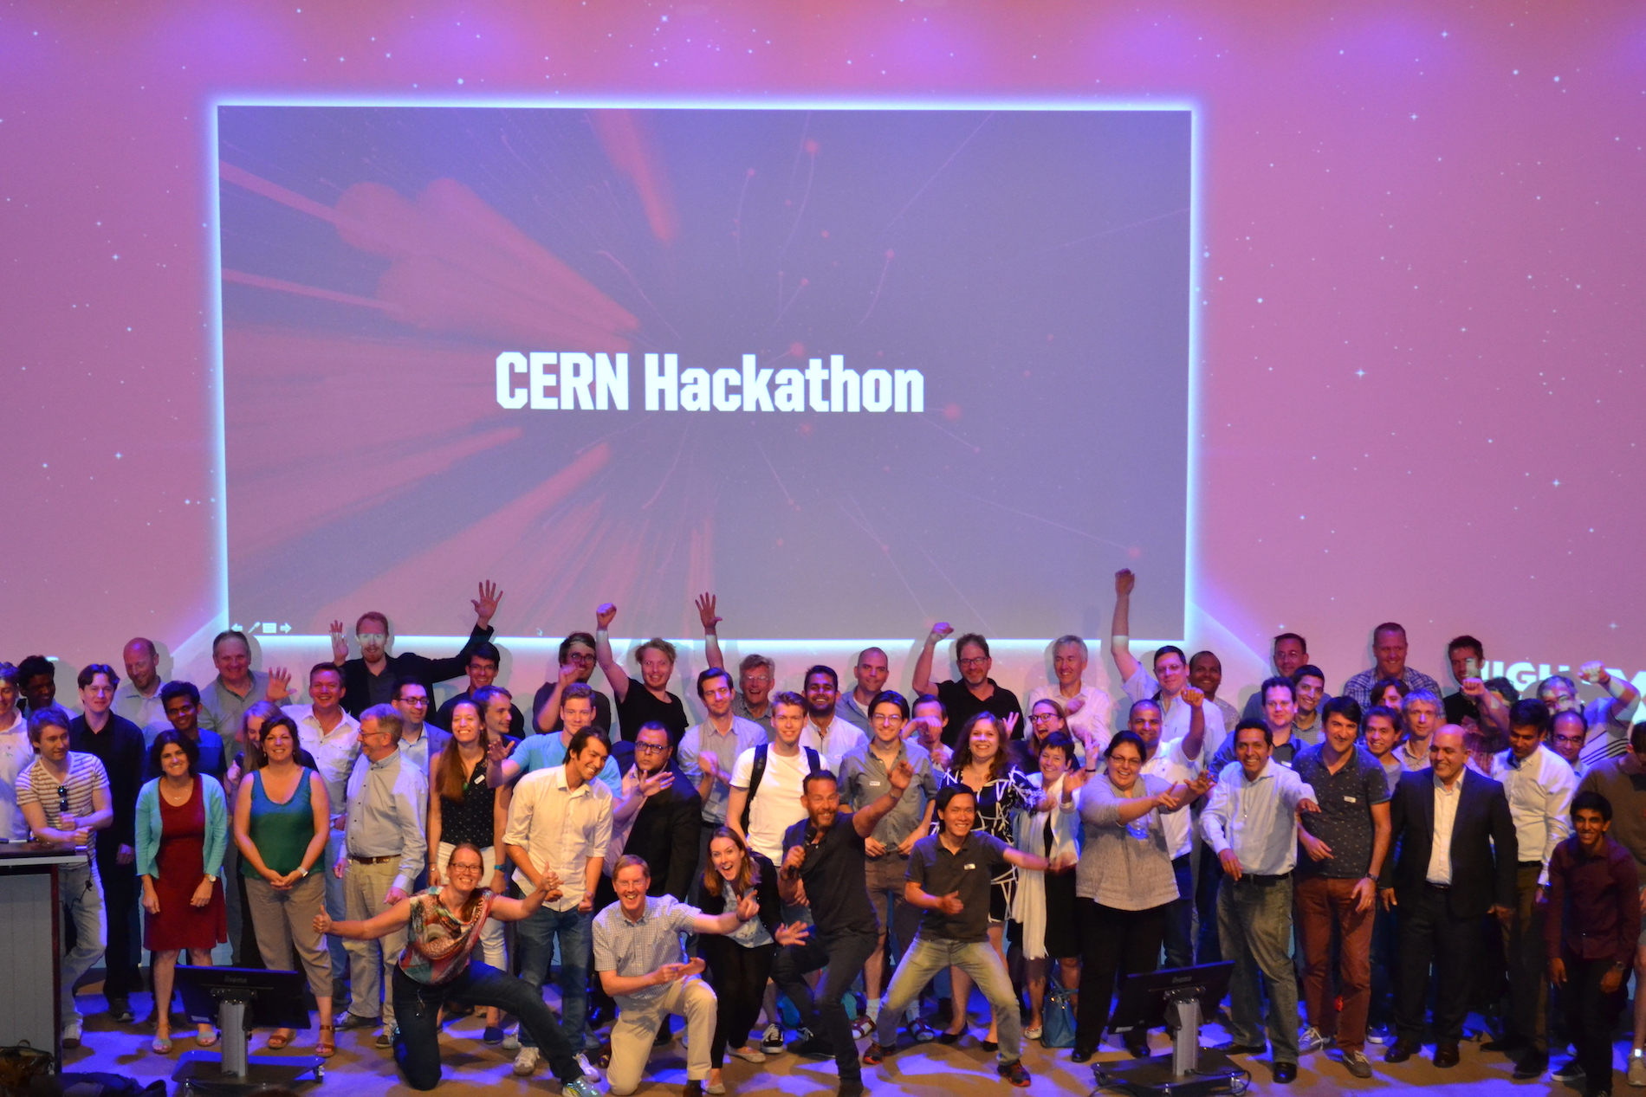
Many local initiatives organized by BICs to help (create) startups with CERN technology

Slide 27
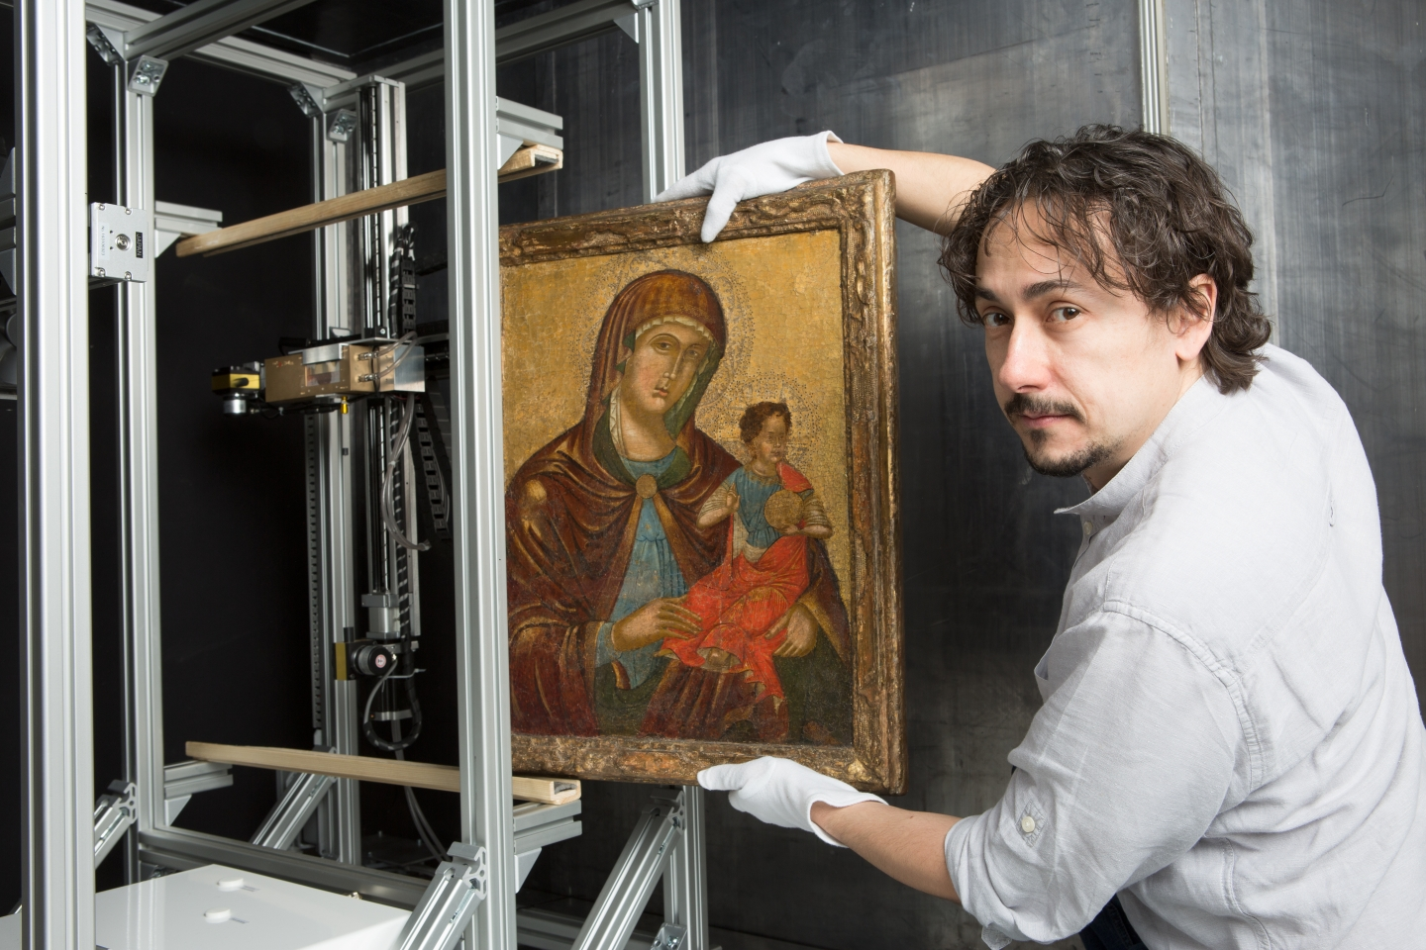
Using CERN Medipix detector to analyse art (InsightART).
Notes:
#EuropeForCulture = because 2018 is the European Year for Cultural Heritage.
At CERN, the Medipix collaborations have been developing pixel detector readout chips since the 1990s, enabling high-resolution, high-contrast, noise-free images – making them unique for imaging applications. Medipix2, Medipix3, Timepix and Timepix3 are state-of-the-art particle imaging and detection readout chips. Now they are being used to bring about a revolutionary improvement in the field of art authentication and restoration. A new start-up company based in Prague, InsightArt s.r.o., has adopted the technology to perform spectral X-ray scans of paintings.
Note: Cultural Heritage is defined as: “Cultural heritage takes many forms: from the tangible legacy of monuments, artwork and books, to digital resources, either newly created or used to ensure cultural preservation. The concept also includes intangible (such as language and oral traditions) and natural elements (such as flora and fauna). This heritage may seem remotely connected to CERN's technological advances, yet the opposite is true: in 2018, several projects related to art restoration and digital preservation are using CERN technology.”

Slide 28
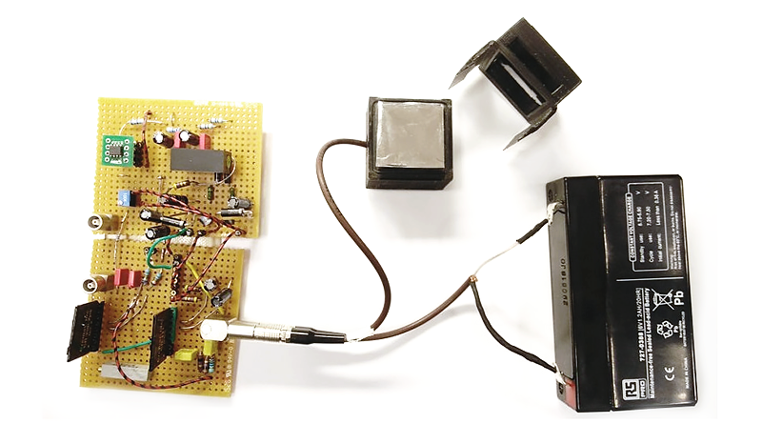
Tackling the risk of radon gas risk (BAQ).
Notes:
Financing from AIDA-2020 Proof-Of-Concept + CERN Medical Applications funds…
Develop a network of smart sensors, based on CERN tech, to monitor radon and better tackle the risks of high radon levels.
In 2017, the RaDoM project was in the final round of the MassChallenge 2017 Start-Up Accelerator Programme in Switzerland, with the goal of setting up a CERN spin-off company called Neasens.

Slide 29
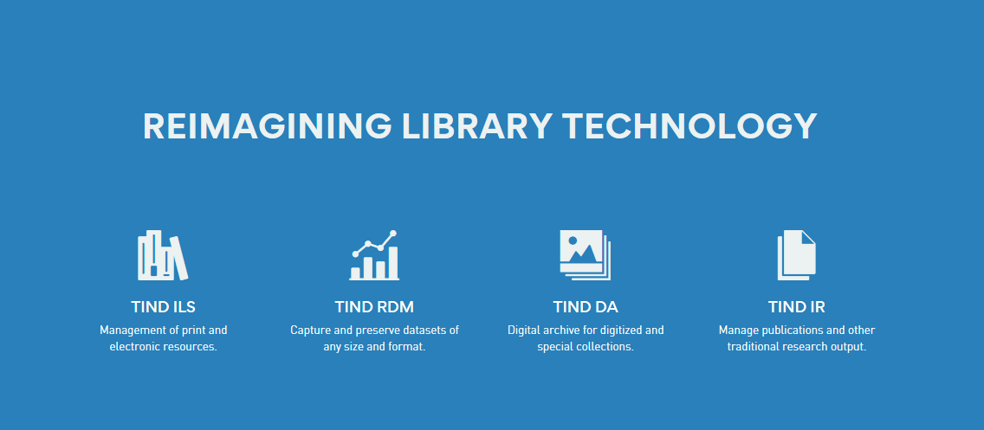
Library management and preservation (TIND).

Slide 30
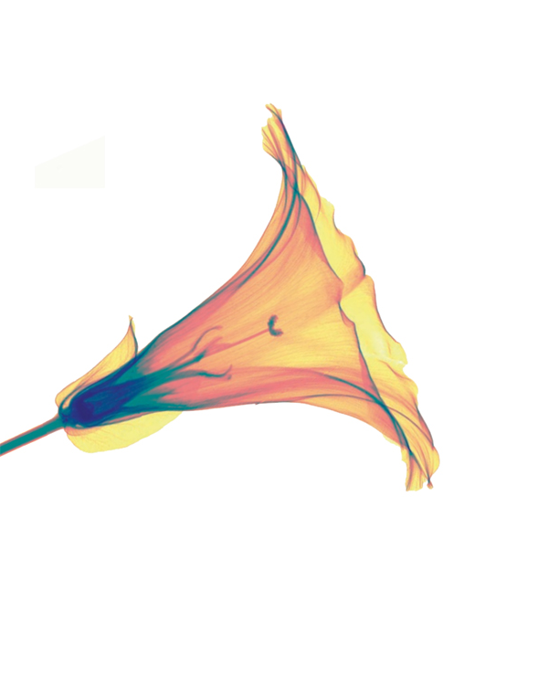
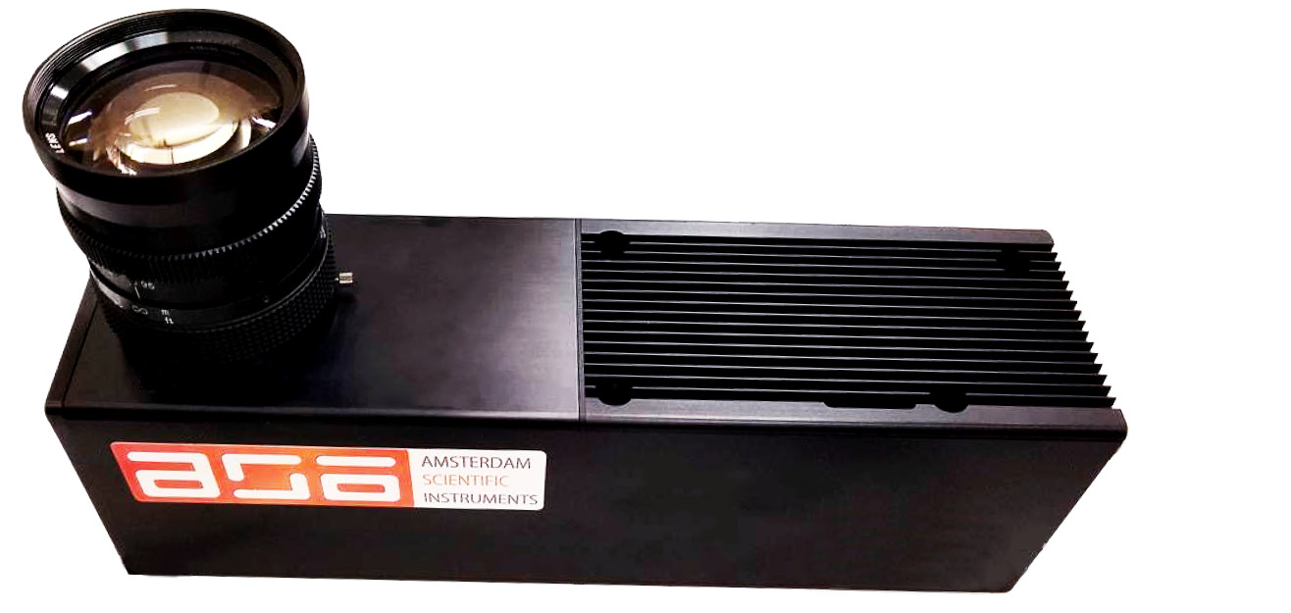
TPX3Cam fast optical photon camera (ASI)

Slide 31
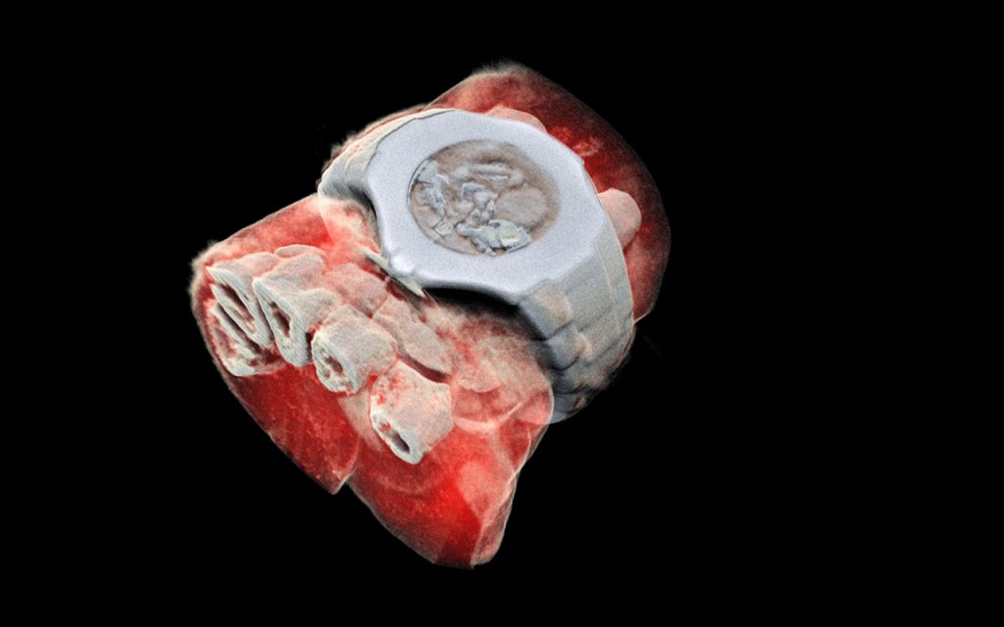
Next generation X ray finally in color (MARS Bio Imaging).

Slide 32
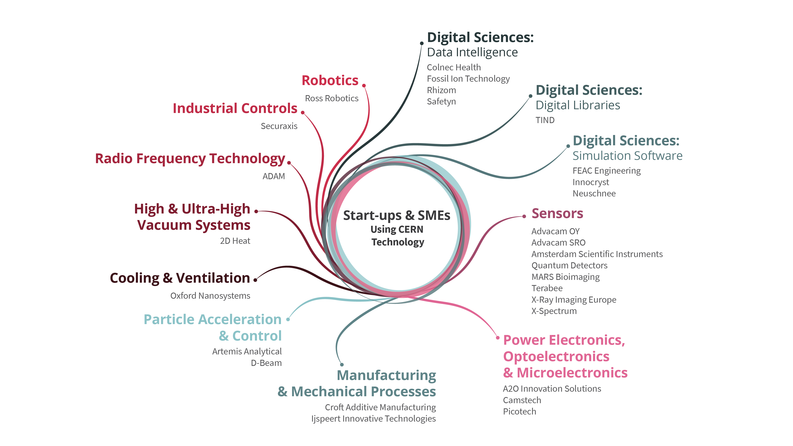
Notes:
Stats = currently 28 start-ups using CERN technology.
Fields from medtech to aersopace, and from industry 4.0 to cultural heritage.

Slide 33

THANK YOU!
Ashwin.ravikumar@cern.ch

