Slide 1
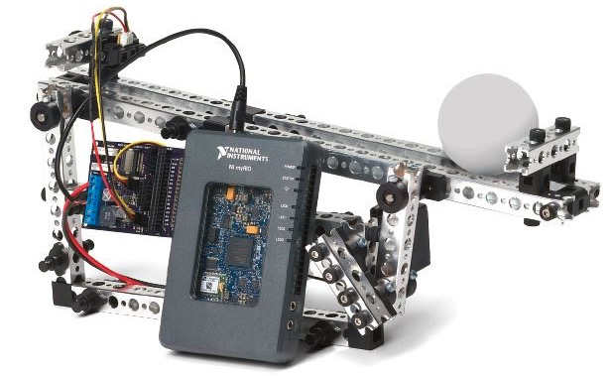
LabVIEW FPGA hands-on
part 2
CERN
Notes:
Welcome to the NI myRIO Design Real Systems, Fast Hands On

Slide 2



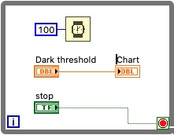

Content of LabVIEW FPGA hands-on 2
A few more LabVIEW basics
Introduction to LabVIEW FPGA
Overview of NI myRIO
Exercises
Resources and Next Steps
Notes:
This hands on is meant to be an introduction to both NI myR
IO HW and SW. These are the topics that we will be covering today. You have all received a manual that accompanies the slides I’ll be presenting today. The manual is meant to be a resources for you to use today as well as after this hands on and contains details on the topics we are covering today. We will refer to the manual in this class when we do exercises.

Slide 3
A few more LabVIEW basics
Notes:
This hands on is meant to be an introduction to both NI myRIO HW and SW. These are the topics that we will be covering today. You have all received a manual that accompanies the slides I’ll be presenting today. The manual is meant to be a resources for you to use today as well as after this hands on and contains details on the topics we are covering today. We will refer to the manual in this class when we do exercises.

Slide 4
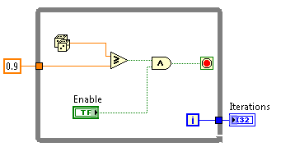
While loop tunnel
  Tunnels transfer data into and out of structures.
  When a tunnel passes data into a loop, the loop
  executes only after data arrive at the tunnel
  (at all tunnels,
  if there is more
  than one).
  Data pass out of
  a loop after the
  loop terminates.
Notes:
This hands on is meant to be an introduction to both NI myRIO HW and SW. These are the topics that we will be covering today. You have all received a manual that accompanies the slides I’ll be presenting today. The manual is meant to be a resources for you to use today as well as after this hands on and contains details on the topics we are covering today. We will refer to the manual in this class when we do exercises.

Slide 5
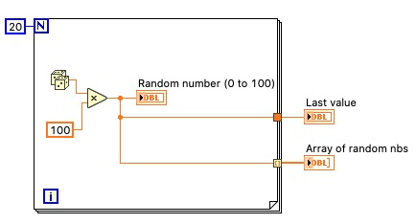
For loop
The value in the count terminal (an input terminal) indicates how many times to repeat the subdiagram.
Last value
Indexed
Notes:
This hands on is meant to be an introduction to both NI myRIO HW and SW. These are the topics that we will be covering today. You have all received a manual that accompanies the slides I’ll be presenting today. The manual is meant to be a resources for you to use today as well as after this hands on and contains details on the topics we are covering today. We will refer to the manual in this class when we do exercises.

Slide 6
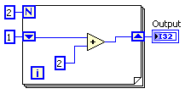
Shift register
  When programming with loops, you often need to know the values of data from previous iterations of the loop.
  Shift registers transfer values from one loop iteration to the next.
Notes:
This hands on is meant to be an introduction to both NI myRIO HW and SW. These are the topics that we will be covering today. You have all received a manual that accompanies the slides I’ll be presenting today. The manual is meant to be a resources for you to use today as well as after this hands on and contains details on the topics we are covering today. We will refer to the manual in this class when we do exercises.

Slide 7
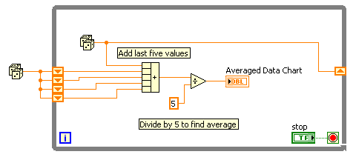
Shift register, multiple values
  Stacked shift registers remember values from multiple previous iterations and carry those values to the next iterations.
  Right-click the left shift register and select Add Element from the shortcut menu to stack a shift register.
Notes:
This hands on is meant to be an introduction to both NI myRIO HW and SW. These are the topics that we will be covering today. You have all received a manual that accompanies the slides I’ll be presenting today. The manual is meant to be a resources for you to use today as well as after this hands on and contains details on the topics we are covering today. We will refer to the manual in this class when we do exercises.

Slide 8
Introduction to LabVIEW FPGA
Notes:
We have now developed a good understanding of programming the processor side of NI myRIO including the special nature of Real-Time Operating Systems. Let’s now take a quick look at the other half of the Zynq chip, the FPGA, and discover some of the unique benefits that FPGAs offer.

Slide 9
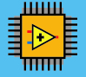
Why Are FPGAs Useful?
True Parallelism
Provides parallel tasks and pipelining
High Reliability
Designs become a custom circuit
High Determinism
Runs algorithms at deterministic rates down to 25 ns (faster in many cases)
Reconfigurable
Create new and alter existing tasks easily
Notes:
So, why would a designer want to use a reprogrammable FPGA? These are just some of the reasons:
True Parallelism - Whereas a processor is forced to execute one instruction at a time and use complex scheduling schemes, parallel circuits inside an FPGA operate completely independently.
FPGAs certainly have the reliability and determinism of a pure hardware solution. In fact, with LabVIEW FPGA you can specify loop rates of 25ns and faster achieving extremely low jitter.
FPGAs are reprogrammable unlike other hardware solutions (it is helpful here to make the comparison to burning a CD. Fixed asic like a CD-R, FPGA like a CD-RW)

Slide 10
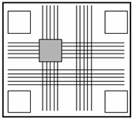
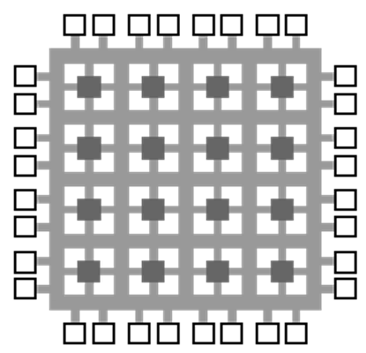
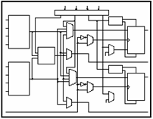
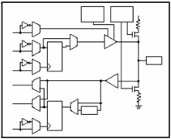
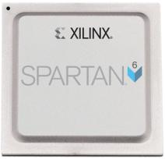
FPGA Technology
Programmable
Interconnects
Logic
Blocks
I/O Blocks
Notes:
Before we begin talking more about LabVIEW FPGA it is important to understand FPGA technology in general. A Field Programmable Gate array or FPGA is programmable chip composed of three basic components.
The logic blocks are where bits are crunched and processed to produce programmatic results.
These logic blocks are connected together with programmable interconnects which serve as a sort of micro switch matrix to route signals from one logic block to the next the interconnects can also route signals to the I/O blocks which are connected to the pins on the chip for two-way communication to surrounding circuitry.
FPGAs are really just a blank silicon canvas which can be programmed to be any type of custom digital hardware and that is what makes them so powerful.

Slide 11
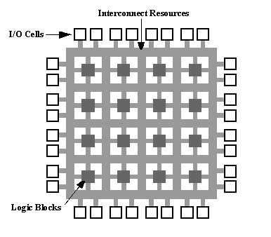
FPGAs are Dataflow Systems
E
F
Implementing Logic on FPGA:
F = {(A+B)CD} ⊕ E
AB
CD
Notes:
-When we compile our LV code…
-logic blocks are configured to implement the digital logic functions
-and the interconnects <click> are configured to wire each logic block together.
- Your LV code actually becomes a circuit on the FPGA. You have done the job of a digital designer!

Slide 12
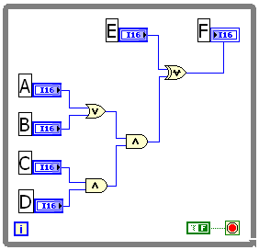
FPGAs are Dataflow Systems
Implementing Logic on FPGA: F = {(A+B)CD} ⊕ E
LabVIEW FPGA Code
E
F
AB
CD
Notes:
-When we compile our LV code…
-logic blocks are configured to implement the digital logic functions
-and the interconnects <click> are configured to wire each logic block together.
- Your LV code actually becomes a circuit on the FPGA. You have done the job of a digital designer!

Slide 13
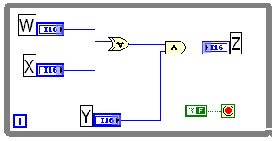
FPGAs are Parallel Dataflow Systems
E
F
AB
CD
Z
W X
Y
Notes:
To show the benefit of parellism, lets go back to our previous example and add a parallel loop
When we add a parallel path that implements a different set of logic, it runs completely independent of other logic
This is where LV becomes well suited for FPGAs b/c it can naturally represent parallelism
With text-based languages that execute sequentely, it is extremely difficult to implement code that runs things in parallel

Slide 14
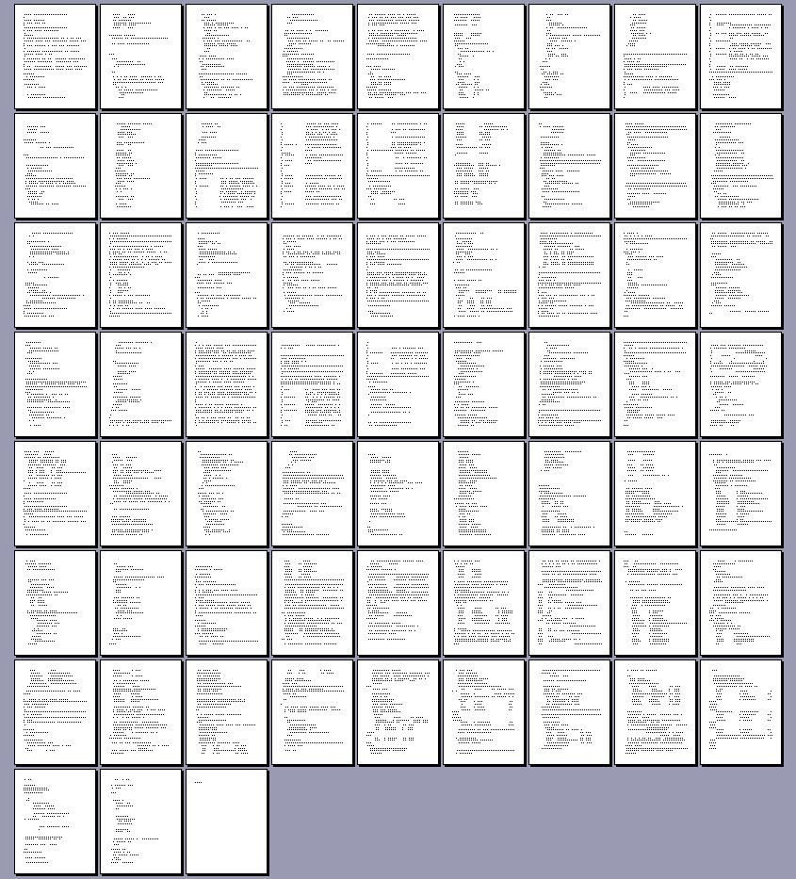
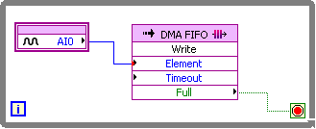
LabVIEW FPGA vs. VHDL
66 Pages ~4000 lines
I/O with DMA
Notes:
If you implemented the VHDL equivalent of a DMA FIFO that we just used in LabVIEW FPGA it would be on the order of 4000 lines of code. Implementing this feature from scratch in VHDL is expensive, especially if you do not expertise in this area and have to contract out the project to a third-party.

Slide 15

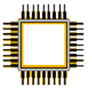
LabVIEW FPGA: How does it work?
LabVIEW FPGA
Xilinx ISE Compiler
LabVIEW FPGA
Xilinx FPGA Chip
LabVIEW VI
VHDL
Bitfile
Notes:
The LabVIEW FPGA module compiles your LabVIEW application to FPGA hardware through a compile process. Behind the scenes, your graphical code is translated to text-based VHDL code. Then, industry standard Xilinx ISE compiler tools are invoked and the VHDL code is optimized and synthesized into a hardware circuit realization of your LabVIEW design. This process also applies timing constraints to the design and tries to achieve an efficient use of FPGA resources (sometimes called “fabric”).
A great deal of optimization is performed during the FPGA compilation process to reduce digital logic and create an optimal implementation of the LabVIEW application. Then the design is synthesized into a highly optimized silicon implementation that provides true parallel processing capabilities with the performance and reliability of dedicated hardware.
The end result is a bitstream that contains the programming instructions LabVIEW downloads to the FPGA target. When you run the application, the bit stream is loaded into the FPGA chip and used to reconfigure the gate array logic. The bit stream can also be loaded into nonvolatile Flash memory and loaded instantaneously when power is applied to the FPGA target. There is no operating system on the FPGA chip, but you can control the FPGA chip through a host application.
Graphical LabVIEW FPGA code is translated to text-based VHDL code
Applies timing constraints on the circuit design
By default, the FPGA clock runs at 40 MHz
Xilinx ISE compiler tools are invoked
VHDL code is optimized
Logic is reduced
Gate array configuration is synthesized
Bit stream is loaded into the FPGA

Slide 16
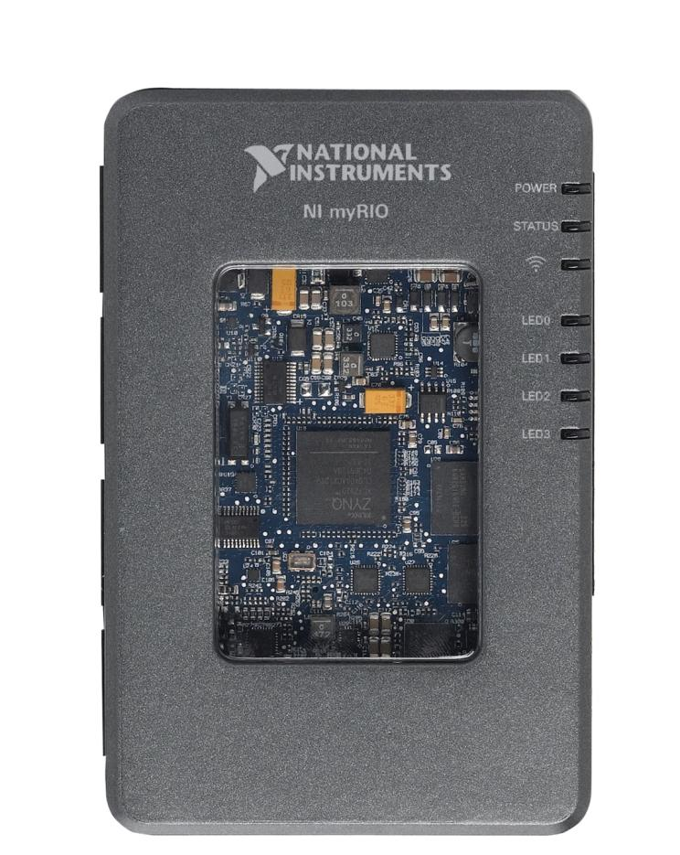
NI myRIO Product Overview: Front View
XILINX Zynq SoC
Notes:
The first thing that you will notice is the Xilinx Zynq chip right in the middle of the myRIO window. National Instruments is very excited to be partnering with Xilinx to bring this cutting edge technology to students. Let’s take a closer look at this chip.

Slide 17

What is Zynq?
Traditional Implementation
Processor
FPGA
Analogue Input
AXI Bus
Analogue Output
PCI Bus
Digital I/O
Custom I/O
Single System on Chip
Notes:
To appreciate what Zynq has to offer, let’s take a look at how the industry has traditionally implemented processors and FPGAs on embedded devices.
Traditionally the processor and FPGA have been two separate, desperate chips… connected with a generic computing bus
<animate>
NI has been working closely with technology leaders like Xilinx and ARM to help bring a new category of system on chip to market… the new Zynq all programmable SOC.
Zynq is revolutionary because it combines both a powerful dual-core processor and the power efficient 7 Series FPGA… and puts then onto a single chip

Slide 18
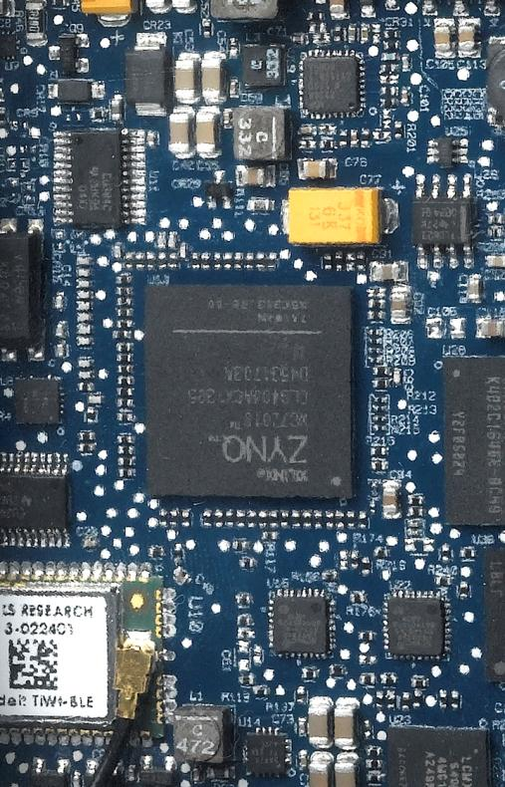
Why Zynq Matters in Education
Smaller Size, Lower Power
667 MHz Dual-Core ARM Cortex-A9 Processor
Artix-7 FPGA, 28k logic cells
16 DMA Channels
92 Billion calculations per second
Notes:
Why Zynq matters in education… Zynq allows us to create smaller, cheaper targets with faster communication between RT and FPGA. Effectively allowing us to develop an affordable student focused device.
However… why does Zynq REALLY matter in education?

Slide 19
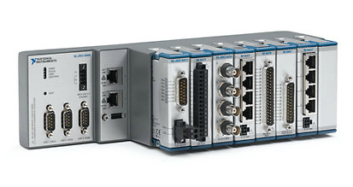
Why Zynq Really Matters in Education
Leading Industry Grade Technology
The same technology is used in the modular I/O Compact RIO systems
Notes:
Ultimately, we are excited to be featuring Zynq because it means that students are learning on the latest industry grade technology which will assure that they are prepared to enter industry having already learned on the tools they will see when they graduate.
<animate>
For instance… the same underlying RIO architecture used in myRIO is used in the NI Compact RIO platform.

Slide 20

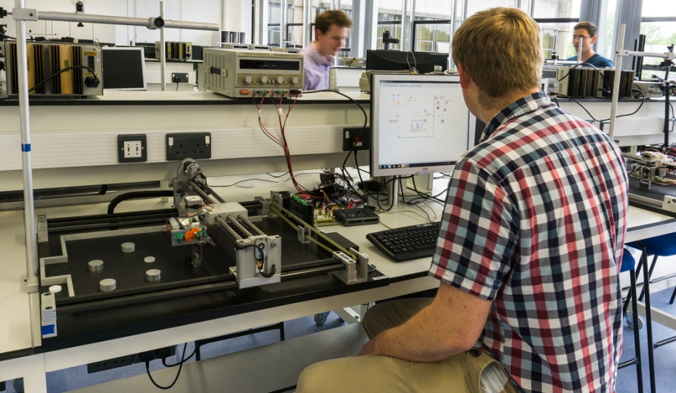
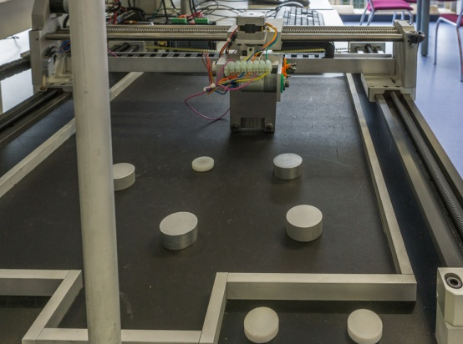
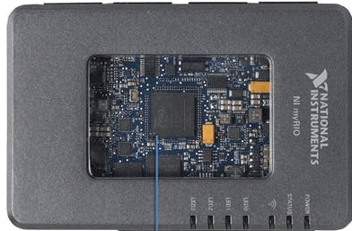
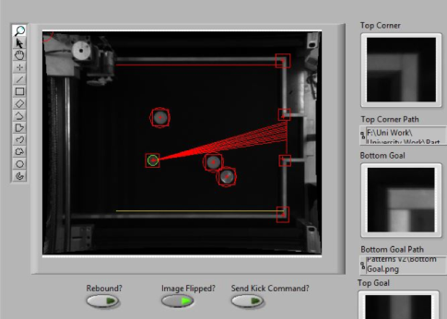
Robotic Table Football Revolutionising Mechatronics Education
The Challenge
The Solution
Students struggled to realise their innovations using textual programming, due to unintuitive syntax and complex hardware integration. Following many research successes, Loughborough wanted to incorporate LabVIEW into their refined Mechatronic module
Using LabVIEW and myRIO to develop the Robotic Table Football challenge. This practical approach to teaching mechatronic systems integration resulted in a marked increase in student engagement, improved grades and the best system implementations to date.
Notes:
Slide Creator: Richard Roberts
http://sine.ni.com/cs/app/doc/p/id/cs-16755
Challenge (4-8 bullet points to explain the challenge)
Mechatronics has always been a key part of the Mechanical Engineering degree programme at Loughborough – however students often struggle to realise their designs using traditional textual programming languages, due to unintuitive syntax and complex hardware integration
NI hardware and software have become cornerstones of their research work (includingDynamics, Thermofuids, Sports Technology, Intelligent Automation, and Laser Materials Processing). Also students use NI Hardware and prebuilt LabVIEW executables in their lab projects. HOWEVER... the Mechanical school had not directly taught LabVIEW programming to their undergraduate students.
But they realise that “To best prepare undergraduates for industry and advanced research, it is vital that universities expose their students to the tools and techniques they will encounter throughout their future careers” – and knew they had to exposing their students to LabVIEW and the RIO platform
Solution (4-8 bullet points to explain the NI based solution)
Loughborough is best known for its sports and engineering achievement – so they combined the two in the new mechatronics module... Which is almost entirely practical.
The module is based around a Robot Table Football challenge...
A “pitch” with raised sides and a goal mouth at one end
A number of “opposition players” represented by aluminium cylinders placed on the pitch. These “defenders” randomly placed on the pitch to “block” the goal mouth
A “foot ball” represented by a smaller plastic disk
A “kicker” – an actuator, mounted on an X-Y motion stage
A “machine vision” camera, mounted about the “pitch” to provide a birds eye view of the playing field
Students would first developer image analysis algorithms in LabVIEW (deployed to a myRIO) to locate the pitch and defending players in the field of view. Their LabVIEW code would then have to calculate clear vector shots to goal... Avoiding any “opposition players”. These shots could be direct – or via a rebound from the wall
The students would then design the control strategies to move the “kicker” to the correct location, aim the ball, and take the shot on goal
The first 5 weeks of the module were dedicated to learned about LabVIEW (using exercises based on LabVIEW Core 1) and myRIO (using the starter accessory kits and the myRIO project essentials guide) – the rest of the semester was spent developing the vision algorithms and control strategies
Result (2-4 bullet points to explain the results. I would suggest tying the result back to the challenge... And include any major benefits like reducing time/cost/enviromental impact etc)
The quality of work was unprecedented and student feedback has been entirely positive,
The NI tool chain accelerated the speed of development, enabling students to deploy solutions that easily match the complexity of previous projects in half the time, and with significantly fewer frustrations.
LabVIEW and myRIO have benefited the mechatronic module in many ways, including accelerated code development, superior user interface design, increasingly sophisticated control implementations, and a renewed focus on algorithm design rather than low-level coding.
The adoption of NI technologies resulted in a marked increase in student engagement, which naturally led to improved grades and the best system implementations and student feedback to date.
A student quote... “Having completed nearly five years of the mechanical engineering programme, I would’ve liked to have accessed more "real world" hands-on engineering opportunities. For me, the new mechatronics module was a highlight of the course - allowing us to develop both practical design skills and technical coding expertise, which we could not have achieved with lectures alone. Also, the ease-of-use of LabVIEW, enabled us to quickly try out complex ideas to further improve our work.”
Pull Quote (include a direct quote from the customer, as well as the customer’s name and job title)
“LabVIEW and myRIO have benefited the mechatronic module in many ways, including accelerated code development, superior user interface design, increasingly sophisticated control implementations, and a renewed focus on algorithm design rather than low-level coding”
Antony Sutton, Wolfson School of Mechanical and manufacturing Engineering, Loughborough University

Slide 21


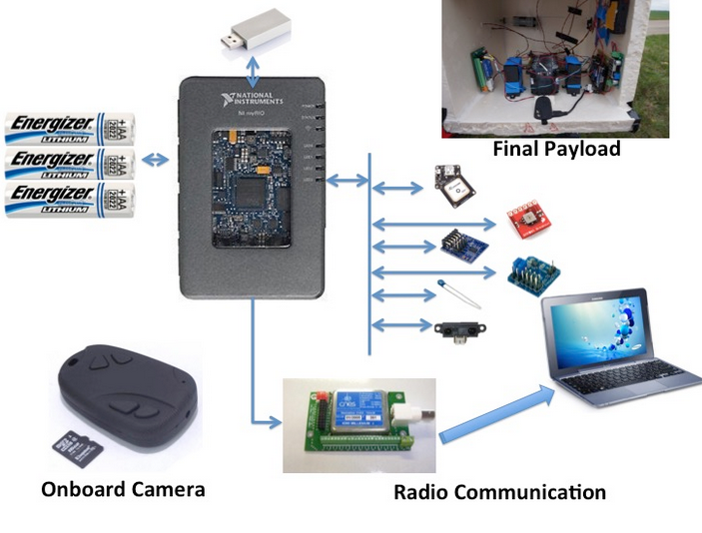
Orseus
myRIO in Space
The Challenge
The Solution
Developing an embedded system which operates under low pressure and temperature conditions - space. The system must carry out various experiments, including the study of solar radiation and atmospheric pollution
Using myRIO to control all on-board sensors and experimental equipment in a high altitude balloon, from the launch to the landing with real time monitoring and post processing.
Notes:
Slide Creator: Celine Duong
https://decibel.ni.com/content/docs/DOC-42834
Challenge (4-8 bullet points to explain the challenge)
A group of students decided to take over the Orseus project. The main goal is to design a high altitude balloon containing experiments. It will be launched to the space under very low pressure and temperature conditions. Then, the balloon will be burst in order to take it back and collect the measurements for post processing.
In collaboration with the “Planète Sciences” association and “CNES”, they have identified and selected several interesting physics experiments to be integrated inside the balloon payload. For instance, the design of a voltage generator based on thermoelectric effect, the study of solar radiation and the measurement of pollution. More conventional experiences were also included such as the study of the dynamics of the payload regarding its the altitude or the experimental validation of theoretical laws relating temperature and pressure.
This project also intends to assess the performance of new sensory and instrumentation technology under very low pressure and temperature conditions.
*NOTE: The image used in the Challenge was taken from the camera attached to this Orseus Project!!
Solution (4-8 bullet points to explain the NI based solution)
The Institute of Technology of Orsay (south of Paris) is one of the French LabVIEW Academy. For this project, they choose to design and to developpe the entire system with the myRIO and NI LabVIEW.
Taking advantage of a previous year high altitude balloon project experience, the students team have decided to radically improve the electronic architecture of the payload. They replaced the initial embedded microcontroller with the NI myRIO. This change made considerably easier the programmation for the students who already knew the concept of LabVIEW programming with NI myRIO.
The myRIO is the “heart” of the entire system and is connected to mutliple sensors (thermistor, accelerometer, photodiode, GPS receiver, IR distance sensor, Ultrasonic range finder), an onboard camera for live image recording and a radio station for communication. All the needed physical parameters will be recorded, save into an USB key and manage by LabVIEW.
A live / real-time processing can be done during the launching.
After the landing, even if the payload was a bit damaged, they still were able to collect the date for post processing.
Result (2-4 bullet points to explain the results. I would suggest tieing the result back to the challenge... And include any major benefits like reducing time/cost/enviromental impact etc)
The NI myRIO clearly allow the students to quickly design and to develop a real-time embedded system with high level of accuracy and high resistance to extreme environment conditions (low pressure, low temperature, high speed).
The results obtained are impressive : the NI myRIO registered during 13 hours without stopping ! Amazing pictures from the space and some beautiful landscape were captured during the trip. All the data were also totally readable for a post processing.
The association of NI software and hardware help the students to finalize the project, to decrease the time development and to focus on other issues related to the measurement.
Pull Quote (include a direct quote from the customer, as well as the customer’s name and job title)
“This experience was very rewarding for our students. They were able to use their knowledge and achieve with success a major project.” – Bastien VINCKE (Professor at the Institute of Technology of Orsay)

Slide 22



Student Design Contest Winner 2014
Sepios, the Omnidirectional Cuttlefish Robot
The Challenge
The Solution
A four-finned robot, each fin equipped with nine servo motors to generate waves of various shapes and perform any conceivable manoeuver. All this is coordinated by a single NI myRIO at the heart of the drone.
Creating a nautical robot driven by cuttlefish inspired fins to study this unique propulsion mechanism and its advantages
Notes:
Slide Creator: Jan Wagner
Case Study link from ni.com: https://decibel.ni.com/content/docs/DOC-37214
Challenge
In the third year of studying mechanical engineering teams of up to eight ETH students develop a product from the initial idea to a reliable prototype of a complex mechatronic system – the so called “focus project” is lasting two semesters
The projects are interdisciplinary and the ETH student teams collaborate with students from other departments and universities (HSLU, D-ITET, ZHdK, University of St. Gallen, NTB-Buchs, etc.).
Based on an innovative project idea, the teams pass through all phases of an industrial product development process. The students work in a realistic industrial environment and deal with all product development related topics: concept, draft, simulation, engineering, production, design and marketing.
Fascinated by the unique way of Sepia’s underwater locomotion, the Sepios team, decided to replicate and analyze the Sepia in the name of science.
Sepios was created with two major goals in mind:
it should focus on imitating the cuttlefish’s side fin propulsion mechanism and ideally operate solely with such fins.
for a lot of the potential applicators of such a technology, precise omnidirectional movement is key and thus the robot was designed to hold up to such standards
Solution (4-8 bullet points to explain the NI based solution)
In contrast to the two-finned actual cuttlefish, Sepios employs four fins but no tail fin or water jet
Each of these fins consists of nine rays, actuated individually by servos via bevel gears.
Every fin contains its own servo controller in charge of all the servos.
The four fins are attached to a single central base unit. This contains the only other actuator, a swim bladder used to assist the robot in staying on a level depth. It also contains a camera, and an inertial measurement unit (IMU) to measure acceleration and gyroscopic forces, a laser for collision detection, a humidity sensor to detect potential leaks and a depths sensor to gauge its depth.
NI myRIO takes these inputs as well as a user input provided by Ethernet and computes the proper actions for every single actuator to take in real time
The very first prototype of Sepios was a single finned boat driven by Lego NXT bricks
The hardware was done swiftly but the team struggled for over a week trying to implement even a simple sine wave in C, until one day a team member suggested to try LabVIEW instead
Within half a day the robot was able to perform any periodic function we could come up with
Result
Following this impressive display of LabVIEWs intuitive graphical programming approach, jumping ship from the planned Raspberry PI system to using a National Instruments myRIO was easy.
Fast forward to our first tests, once the hardware was sorted out everything else worked perfectly, the depth controller which may have taken ages to implement otherwise worked instantly and the robot performed exactly as wanted.
Pull Quote
“This would never have been possible using conventional programming tools and the huge amount of time saved by using LabVIEW allowed us to really focus on important areas such as control allocation and creating a handy user interface that would have otherwise likely been outside of the scope of this project.” – Team Sepios

Slide 23
NI myRIO Product Overview: Front View
User Defined LEDs
Built-in Accelerometer
Notes:
In addition to Zynq, you will also notice that there are 4 user programmable LEDs on the front face of NI myRIO. When we were designing myRIO, we wanted users to be able to do basic things very quickly out of the box without having to wire anything to myRIO. To that end, you will see that we put a few sensors and devices right on the myRIO board itself to enable students to get started very quickly.

Slide 24
Top View
Connection to PC
USB Port
Power
Notes:
The top of myRIO has a barrel connector for power. Unlike NI myDAQ, NI myRIO must be externally powered. The power requirement is 6-16V and 14W. NI myRIO can be powered off of 8 AA batteries running all of its I/O for 1.4 hours, but we have seen much longer durations doing more typical applications that use less I/O.
If you are a seasoned NI RIO programmer, you will know that we typically connect to RIO devices over Ethernet. NI myRIO has no Ethernet connection because, again, we wanted to simplify the student experience. Students will connect myRIO to their development computer via USB for initial setup and can deploy code over USB or WiFi.
Finally, we wanted to allow students to plug in other popular USB devices that they may have such as storage devices or cameras. We have placed an open USB port on myRIO which allows many devices to plug and play with myRIO.

Slide 25

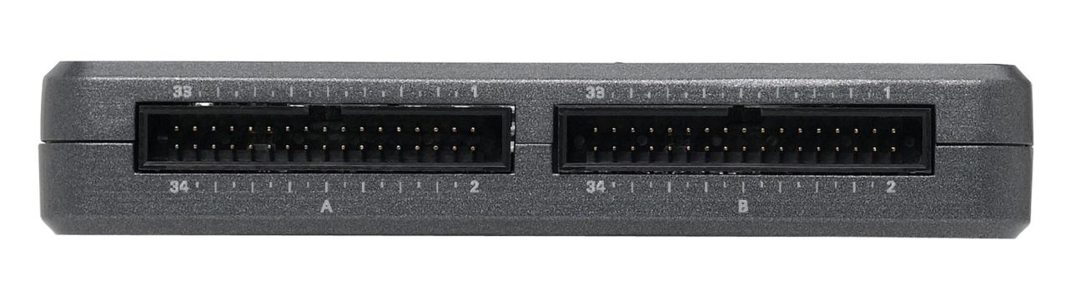
NI myRIO Expansion Port (MXP)
Identical Connectors
4 AI
MXP A
MXP B
6 DIO
2 AO
1 UART
1 SPI
1 Quad Encoder
1 I2C
3 PWMs
Notes:
Now let’s talk about I/O. myRIO ships with a pre-programmed FPGA which defines the I/O that you see on this slide. Of course students can reprogram the FPGA later if they would like to, but our goal was to offer I/O that would cover a wide range of applications out of the box. These two 34-pin headers are identical, so you get two copies of all of the I/O you see listed on the screen.
Additionally, you will notice the Multisim icon in the upper right hand corner. This is there to indicate that there are templates available for this connector so that Multisim can be used to do custom hardware design for these connectors.

Slide 26
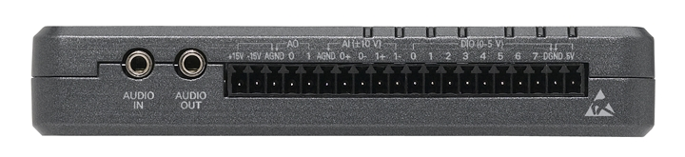
NI miniSystems Port (MSP)
Audio in/out more analog and digital I/O
Notes:
This side of myRIO should look familiar to those of you who are familiar with NI myDAQ. It is the exact same I/O so any custom hardware or miniSystems you have been using with myDAQ can plug into myRIO. This I/O adds an additional 2AI, 2AO and 8 DIO lines which are all programmable through the FPGA. Additionally, there is Audio In and Out.
Again you will notice the Multisim icon indicating that you can create custom hardware designs for this connector using Multisim.

Slide 27
myRIO exercise board
Notes:
Now that we have a basic understanding of the NI myRIO hardware, let’s begin to take a look at the real magic of myRIO. It’s all about the programming experience.

Slide 28
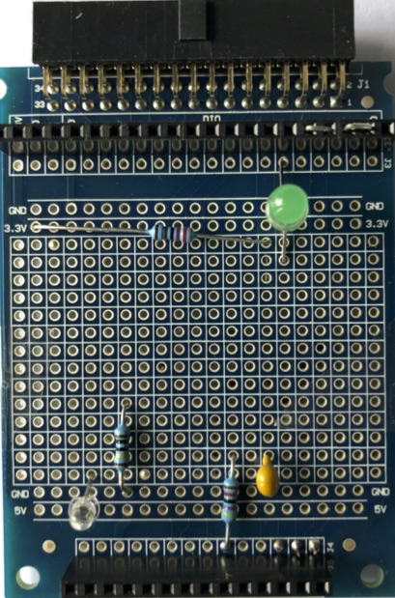
Exercise board
3.3 V
DIO0
DIO1
2.2 kΩ
DIO2
DIO3
DIO4
5 V
AO0
AI1
47 kΩ
AI0
AI2
1 MΩ
10 nF
Notes:
What is Real-Time?
First, let’s define the term real-time in the context of this seminar. Real-time does not necessarily mean real fast. Some real-time systems are indeed fast, but it is not always a one-to-one correlation. Real-time systems are designed to be more reliable than standard software systems. Real-time systems are those that have timing constraints that must be met to avoid failure. Lets look at some example application where the requires often warrant the use of real-time systems.
Instructor:
Even before showing the slide, ask the customers what does real-time mean to them?

Slide 29
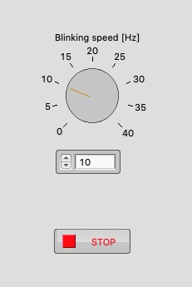
Exercise 1 Blinking LED
Make the LED blink with a controllable speed from 1 to 40 Hz
3.3 V
47 kΩ
DIO4
Question:
At what frequency you don’t see the blinking anymore?
Notes:
What is Real-Time?
First, let’s define the term real-time in the context of this seminar. Real-time does not necessarily mean real fast. Some real-time systems are indeed fast, but it is not always a one-to-one correlation. Real-time systems are designed to be more reliable than standard software systems. Real-time systems are those that have timing constraints that must be met to avoid failure. Lets look at some example application where the requires often warrant the use of real-time systems.
Instructor:
Even before showing the slide, ask the customers what does real-time mean to them?

Slide 30
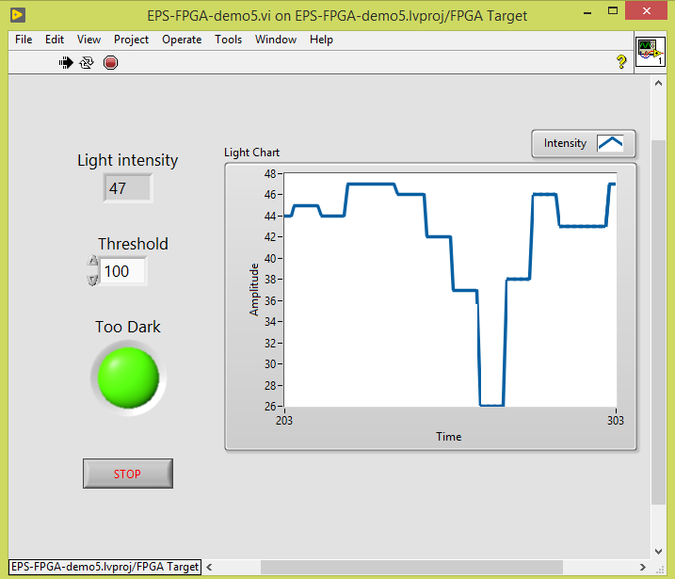
Exercise 2 Switch on when it’s dark
5 V
3.3 V
Switch on the LED when the photodiode signal is below the threshold 100 (arbritrary units)
Plot the photodiode signal in a chart
The threshold value should be set using a control
Remember the LED is on when D4 is False
photodiode
2.2 kΩ
AI0
1 MΩ
LED
D4
To test, block the light to the photodiode or increase light using your mobile phone
Question:
What would happen when the photodiode would pick up the LED light?
Notes:
What is Real-Time?
First, let’s define the term real-time in the context of this seminar. Real-time does not necessarily mean real fast. Some real-time systems are indeed fast, but it is not always a one-to-one correlation. Real-time systems are designed to be more reliable than standard software systems. Real-time systems are those that have timing constraints that must be met to avoid failure. Lets look at some example application where the requires often warrant the use of real-time systems.
Instructor:
Even before showing the slide, ask the customers what does real-time mean to them?

Slide 31
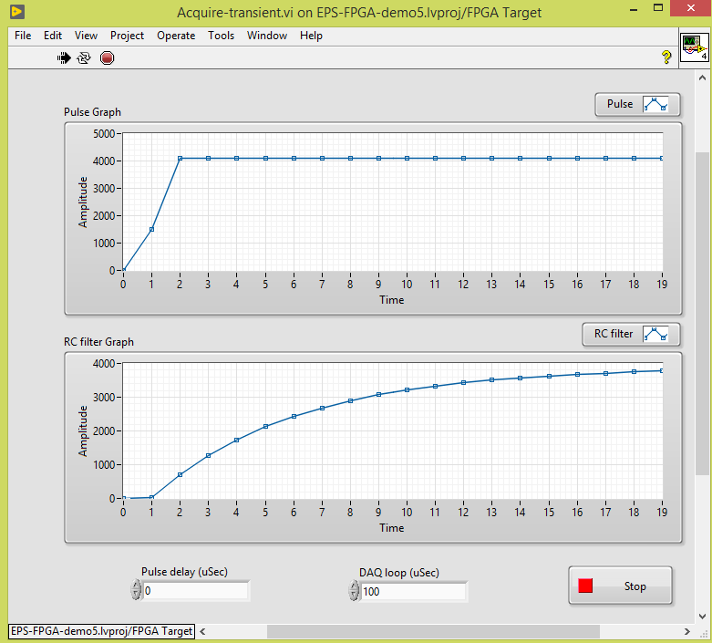
Exercise 3 Acquire transient
Generate a step function from 0 – 5 V (int. value 4095)
Acquire step function signal and response of RC circuit
Once per second
Generate output voltage from 0 to 5 V (and reverse)
Acquire both AI1 and AI2 signals using 20 points
Show both in a graph
RC value is 470 µs
Set DAQ loop time (with a control) to 100 µs
AO0
AI1
47 kΩ
AI2
10 nF
Questions:
Is the step function (AI1) really a step?
What do you see when changing the DAQ loop time (both AI1 and 2)?
Notes:
What is Real-Time?
First, let’s define the term real-time in the context of this seminar. Real-time does not necessarily mean real fast. Some real-time systems are indeed fast, but it is not always a one-to-one correlation. Real-time systems are designed to be more reliable than standard software systems. Real-time systems are those that have timing constraints that must be met to avoid failure. Lets look at some example application where the requires often warrant the use of real-time systems.
Instructor:
Even before showing the slide, ask the customers what does real-time mean to them?

Slide 32
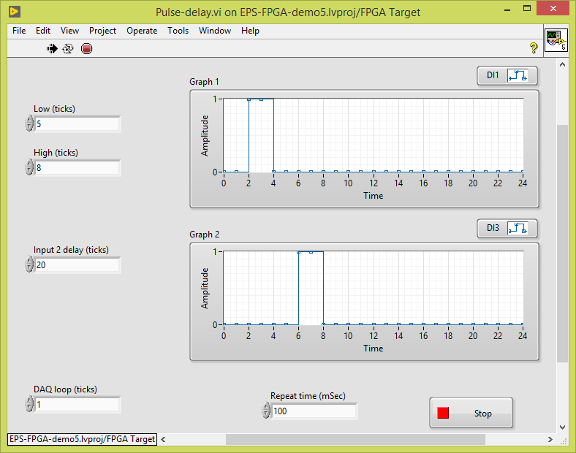
Exercise 4 Pulse delay
Generate short pulse on D0 and D2 (low – high – low)
Make a separate control for low D0 and D2 (using ticks)
Acquire 20 points on D1 and D3 with 1 tick loop delay
Repeat at 100 ms (10 Hz)
Control for low time of pulse (4 ticks)
Control for high time of pulse (8 ticks)
Control for DAQ loop (1 tick)
Graph D1
Graph D3
DIO0
DIO1
DIO2
DIO3
Questions:
What do you see when changing the high and low values?
Can you explain?
Notes:
What is Real-Time?
First, let’s define the term real-time in the context of this seminar. Real-time does not necessarily mean real fast. Some real-time systems are indeed fast, but it is not always a one-to-one correlation. Real-time systems are designed to be more reliable than standard software systems. Real-time systems are those that have timing constraints that must be met to avoid failure. Lets look at some example application where the requires often warrant the use of real-time systems.
Instructor:
Even before showing the slide, ask the customers what does real-time mean to them?

Slide 33
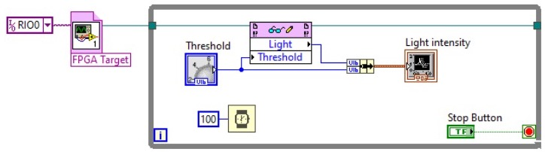
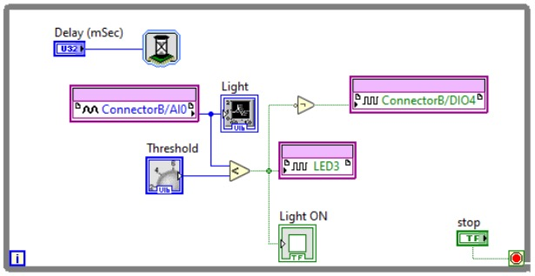
FPGA to ARM communication
Which
myRIO?
Which
VI?
Which
data?
ARM
FPGA
Notes:
What is Real-Time?
First, let’s define the term real-time in the context of this seminar. Real-time does not necessarily mean real fast. Some real-time systems are indeed fast, but it is not always a one-to-one correlation. Real-time systems are designed to be more reliable than standard software systems. Real-time systems are those that have timing constraints that must be met to avoid failure. Lets look at some example application where the requires often warrant the use of real-time systems.
Instructor:
Even before showing the slide, ask the customers what does real-time mean to them?

Slide 34
Resources and Next Steps
ni.com/students/learn-rio

Slide 35
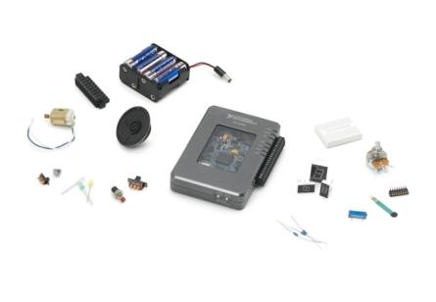
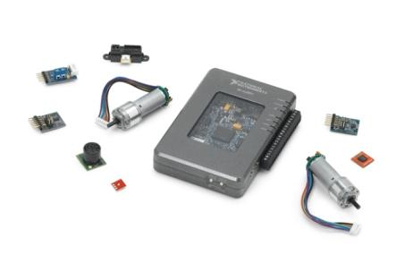
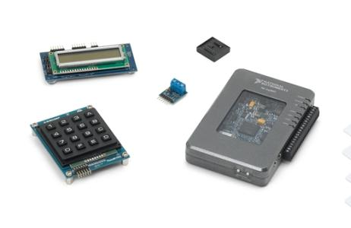
NI myRIO Kits | ni.com/myrio
Starter
Mechatronics
Embedded
LEDs & switches
7-segment display
Potentiometer
Thermistor
Photo resistor
Hall effect
Microphone/Speaker
Battery holder
DC motor
DC gear motors/encoders
H-bridge driver
Accelerometer
Triple-axis gyro
Infrared proximity sensor
Ambient light sensor
Ultrasonic range finder
Compass
Hobby servo motors
RFID reader kit
Numeric keypad
LED matrix
Digital potentiometer
Character LCD
Digital temp sensor
EEPROM

Slide 36
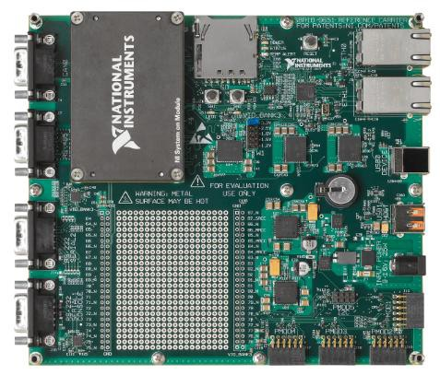
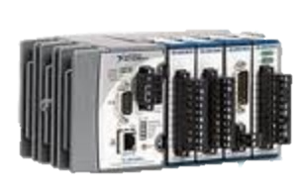
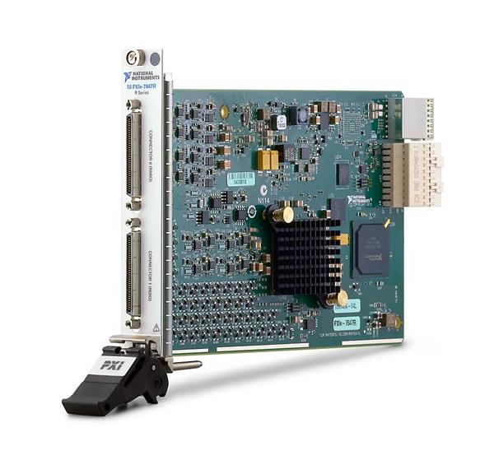
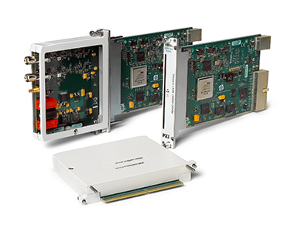
From small to big
myRIO
sbRIO
cRIO
PXIe R-series boards
PXIe FlexRIO boards

Slide 37
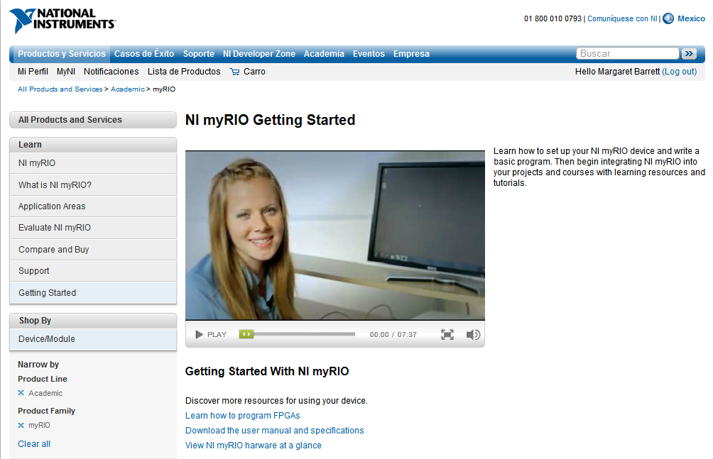
Learn More About Programming NI myRIO
ni.com/learn-myRIO
ni.com/community/myrio
Notes:
Tutorial videos and project guides to get you started with your myRIO projects

Slide 38
Thank you !!!
Notes:
Tutorial videos and project guides to get you started with your myRIO projects

Slide 39
Solutions
Notes:
Tutorial videos and project guides to get you started with your myRIO projects

Slide 40
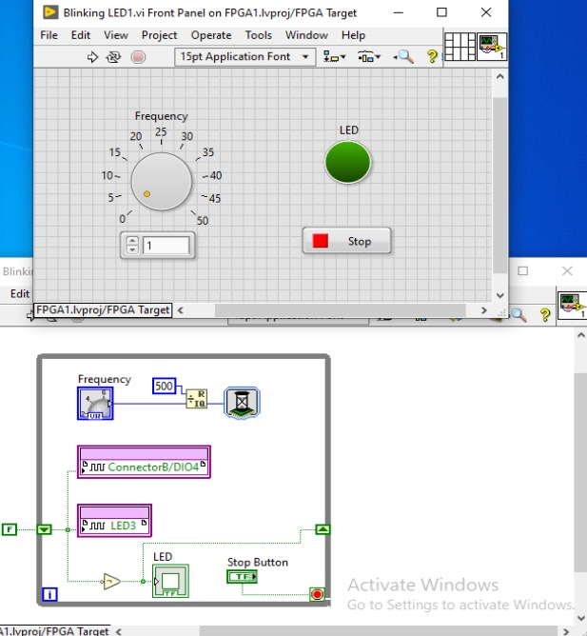
Diagram: Blinking LED
Notes:
Tutorial videos and project guides to get you started with your myRIO projects

Slide 41
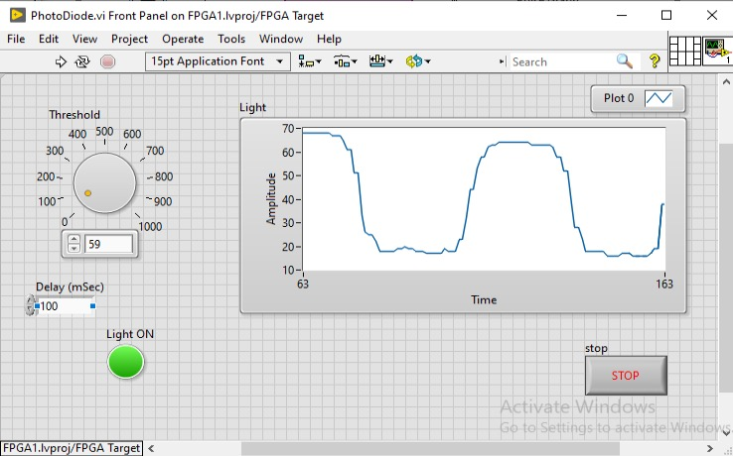
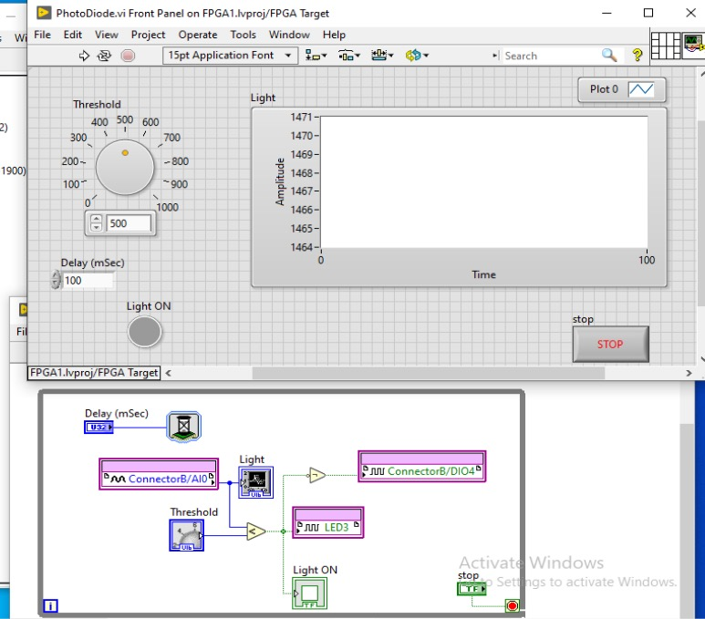
Diagram: Photodiode
Notes:
Tutorial videos and project guides to get you started with your myRIO projects

Slide 42
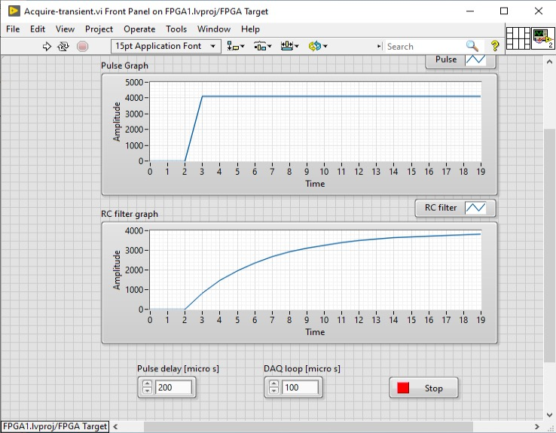
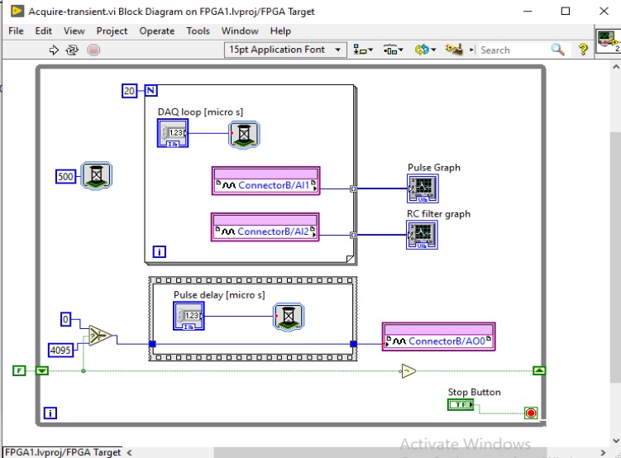
Diagram: Acquire transient
Notes:
Tutorial videos and project guides to get you started with your myRIO projects

Slide 43
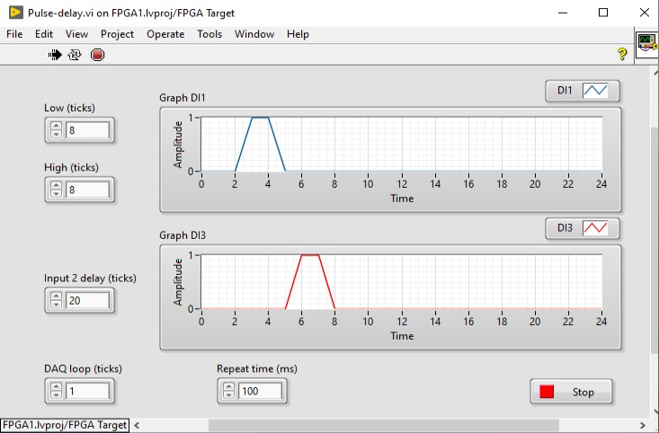
Diagram: Pulse delay (front panel)
Notes:
Tutorial videos and project guides to get you started with your myRIO projects

Slide 44
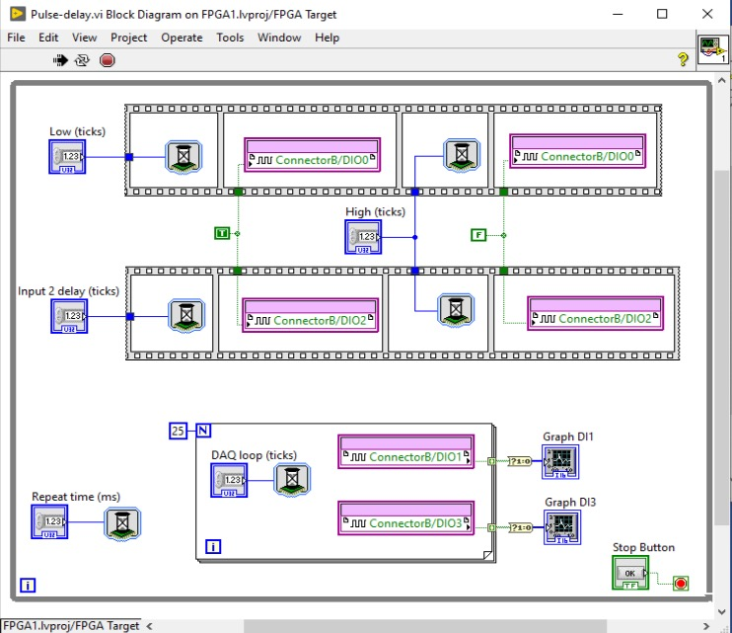
Diagram: Pulse delay (diagram)
Notes:
Tutorial videos and project guides to get you started with your myRIO projects

Slide 45

What is Real-Time?
Real-time does not always mean real fast
Real-time systems have timing constraints that must be met to avoid failure
Determinism is the timing reliability of the system
Notes:
What is Real-Time?
First, let’s define the term real-time in the context of this seminar. Real-time does not necessarily mean real fast. Some real-time systems are indeed fast, but it is not always a one-to-one correlation. Real-time systems are designed to be more reliable than standard software systems. Real-time systems are those that have timing constraints that must be met to avoid failure. Lets look at some example application where the requires often warrant the use of real-time systems.
Instructor:
Even before showing the slide, ask the customers what does real-time mean to them?

Slide 46


Critical Applications
Example
Event Response
Medical Applications
Notes:
Let’s start by considering some “critical applications”.
One type of application that can be considered critical is a category called event response. For example, imagine an air-bag system. The system must perform its intended task (deploying the air-bag) within a certain amount of time very reliably. If it takes too long, then the system is completely useless. The passenger may be seriously injured or even die.
OptiMedica
Die traditionelle Methode der panretinalen Laserkoagulation zur Behandlung von Netzhauterkrankungen, die durch Diabetes ausgelöst werden (diabetische Retinopathie), hat sich in den vergangenen 35 Jahren kaum verändert. Bei der Laserkoagulation wird die periphere Netzhaut mit gezielten Laserimpulsen kontrolliert verbrannt. Zwar senkt diese Behandlungsmethode die Wahrscheinlichkeit, dass Patienten einen Verlust des Sehvermögens erleiden, um 50 Prozent, doch ist die Prozedur sowohl für Patienten als auch für den behandelnden Arzt mühsam und langwierig. Augenärzte können nur eine Verbrennung auf einmal auslösen, die gesamte Behandlung erfordert aber u. U. 2000 Verbrennungen. Eine vollständige Therapie erfordert zwei bis vier Sitzungen, die jeweils 12 bis 15 Minuten dauern.
Bei OptiMedica sind wir auf das Design medizinischer Geräte spezialisiert, die Augenärzte dabei unterstützen, die Behandlung von Netzhauterkrankungen zu verbessern. Der Laserkoagulator PASCAL ist als vollständig integriertes Lasersystem zum Scannen von Mustern konzipiert, das den Arzt wesentlich bei der Behandlung unterstützt und auch für den Patienten die Therapie weniger unangenehm macht.
Die Experten von OptiMedica besitzen schon viel Erfahrung mit NI LabVIEW. Deshalb haben wir uns bei der Entwicklung des Laserkoagulators PASCAL für LabVIEW FPGA und ein intelligentes Datenerfassungsgerät der R-Serie entschieden, anstatt eine anwenderdefinierte Hardwarelösung zu verwenden. Das gesamte System wird von einem einzigen intelligenten Datenerfassungsgerät des Typs NI PCI-7833R gesteuert. Der Hardwaredeterminismus des NI PCI-7833R ermöglicht das schnellere Scannen der Netzhaut, so dass der Patient die Arztpraxis nicht mehr so oft aufsuchen muss. Mit einer einzigen grafischen Entwicklungsplattform konnten wir die Maschine schnell und effizient entwerfen und einen Prototypen erstellen. Dabei nutzten wir anpassbare Standard-PXI-Hardware und konnten das System so erfolgreich potenziellen Investoren vorstellen. Da der Prototyp unsere Anforderungen auf optimale Weise erfüllte, wussten wir, dass sich mit LabVIEW als Plattform für das grafische Systemdesign auch die Migration des fertigen Systems auf intelligente PCI-Datenerfassungshardware problemlos gestalten würde.
Die Verwendung eines FPGA in dieser Anwendung bietet die Zuverlässigkeit einer Hardwarelösung, bei welcher der Programmcode während des Genehmigungsprozesses nicht so oft überprüft werden muss wie bei prozessorbasierten Systemen. Aufgrund der Entscheidung für programmierbare Siliziumchips anstelle von festen ASIC-Chips verkürzte sich auch die Entwicklungszeit um 30 Prozent. Ein weiterer Vorteil ist die Möglichkeit, zu einem späteren Zeitpunkt Funktionalität zu ergänzen und das System bei Bedarf zu erweitern oder anzupassen.
Der Laserkoagulator PASCAL nutzt das präzise Timing und die Triggerung von intelligenten Datenerfassungsgeräten der R-Serie. Bei der konventionellen Laserkoagulation der Netzhaut richtet der Arzt mithilfe eines mechanischen Joysticks und eines Fußpedals einzelne Laserstrahlen mit einer Dauer von 100 Millisekunden auf abnormale Blutgefäße in der peripheren Netzhaut. Wir haben festgestellt, dass automatische, kürzere Impulse anstelle manuell platzierter Verbrennungen höhere Genauigkeit und Sicherheit gewährleisten. Darüber hinaus senkt PASCAL das Risiko erheblich, die Sehgrube (Fovea centralis) zu verletzen, was zu einem partiellen Verlust des Sehvermögens führen kann. Ärzte, die mit der traditionellen Photokoagulation arbeiten, müssen diese Region, mit der das menschliche Auge die größte Sehschärfe erzielt, manuell vermeiden.
Mit der Programmierung in LabVIEW FPGA konnten wir Timing und Stärke jedes Laserimpulses zur Optimierung von Geschwindigkeit und Genauigkeit variieren und dabei die Sehgrube schützen, indem Muster mit integrierten Zonen zur Aussparung der Sehgrube erstellt werden. Indem die Dauer des Laserimpulses von 100 auf nur 10 Millisekunden gekürzt wird und mit einer Betätigung des Fußpedals mehrere Impulse ausgelöst werden, verkürzt PASCAL auch die gesamte Behandlungszeit und macht die Behandlung für den Patienten weniger unangenehm.
Als Bedienfeld dient ein LCD-Touchscreen, mit dessen Hilfe der Arzt unter vorbestimmten Mustertypen wählen und bis zu 25 Impulse auf einmal anwenden kann. Das Gerät ist einem konventionellen Laserkoagulator sehr ähnlich (es verfügt auch über einen mechanischen Joystick und ein Fußpedal), so dass der Schulungsaufwand minimal ist. Wenn das Muster ausgewählt ist, wird ein separater roter Lichtstrahl zum Ausrichten und Visualisieren der Platzierung genutzt, bevor der Laserimpuls ausgelöst wird. Über die Bedienoberfläche des Touchscreens können auch verschiedene Parameter eingestellt werden, so z. B. Intensität des Lichtstrahls, Stärke und Dauer des Laserstrahls, Systemstatus und Abschaltung. Da Größe und Muster des Impulses vorhersehbar sind, ermöglicht PASCAL die gleichmäßige Verteilung der Verbrennungspunkte und sorgt so für ein besseres Ergebnis und wiederholbare Behandlungen.
Die Laserkoagulation ist eine bewährte Prozedur, die schon seit vielen Jahren manuell angewendet wird, um Patienten mit diabetischer Retinopathie zu behandeln. Mit der LabVIEW-FPGA-Technologie konnte diese bewährte Prozedur automatisiert und gleichzeitig Geschwindigkeit und Zuverlässigkeit erhöht werden. Der Laserkoagulator PASCAL reduziert die Behandlungszeit und sorgt dafür, dass die Therapie für den Patienten weniger unangenehm ist. Insgesamt wird die Anzahl der Therapiesitzungen und damit der Kostenaufwand für Ärzte und Patienten gesenkt, weshalb die Methode bei führenden Experten sehr beliebt ist.

Slide 47


Critical Applications to Consider
Event Response
Closed-Loop Control
Critical Tests
Notes:
Let’s start by considering some “critical applications”.
One type of application that can be considered critical is a category called event response. For example, imagine an air-bag system. The system must perform its intended task (deploying the air-bag) within a certain amount of time very reliably. If it takes too long, then the system is completely useless. The passenger may be seriously injured or even die.
Another type of critical application is closed-loop control. Consider any aircraft. Sensors must detect when the aircraft is tilted in a given direction, and then a control system must act in a certain amount of time to adjust flight surfaces to compensate for that tilt. If the delay between input and output is too great, the aircraft will fall out of the sky.
Finally, a third type of critical application is testing in situations where data is extremely important. For example, imagine a test system that it set up to monitor strain levels on a bridge over the course of a week to evaluate whether certain segments need to be replaced. If the test system takes data periodically and misses some data points, then a large vehicle could drive over and the strain data could be lost during that time. In the end, engineers may make the wrong decision about replacing bridge segments. Here, the system timing requirements may be more relaxed (maybe a sample every few seconds), but reliability is still very important.
What do these all have in common? These systems are characterized by a need for reliability (up-time) and in many cases precise timing as well.

Slide 48
When General Purpose OSs Fall Short
Design for fairness and user responsiveness vs. strictly prioritizing tasks
Focus on multitasking instead of maximum reliability / uptime
Not the result of bad products, only certain design goals
Notes:
So how do we build these systems? Well, a first-pass solution might be to use some kind of a computer running a general-purpose operating system (OS) such as Windows. However, there are a few reasons why this type of system isn’t a good fit for critical applications.
General-purpose OSs are designed to ensure that all tasks receive some CPU time, which is great for users that need a responsive UI (e.g. the mouse cursor updates on the screen even when a program is using a lot of CPU cycles). However, this means that if a critical application is running, it may be ignored for some time so that a lesser priority application receives some CPU cycles. If that critical application is something like a flight control system, then the system may fail (i.e. the airplane could fall out of the sky).
Note that the conclusion here is not that general-purpose OSs are “bad”. They are simply designed for a different use case than critical applications.

Slide 49
Key Careabouts for Critical Applications
Jitter: execution time variability of a given operation or application
2.8
Mean = 2.03 ms
2.1
2.1
2
Jitter
1.9
Execution
Time (ms)
1.3
Iterations
Notes:
So, if general-purpose OSs aren’t the right solution, then what do we need? Let’s consider the timing between iterations of a critical program (e.g. flight control system). Imagine that the loop rate of the application is programmed to be 2 ms. The first iteration may take 2 ms, while the second iteration may be a bit faster due to less interrupts or other applications that demand CPU time. Likewise, the timing of each subsequent loop iteration will vary by a certain amount.
On average, the varying loop periods should equal about 2 ms. We can then measure the variation in time between the average and the worst-case deviation – this is called “jitter”. In practice, jitter can be measured in different ways, but the main point is that it is a measure of the variation in timing between program iterations.

Slide 50
Key Careabouts for Critical Applications
Determinism: a condition that is met if an operation or application has bounded jitter
Bound (for hard
real-time systems)
2.8
Mean = 2.03 ms
2.1
2.1
2
Jitter
1.9
Execution
Time (ms)
1.3
…n
Iterations
Notes:
For critical applications, we need to ensure that the jitter is small to avoid a situation where one iteration takes too long and the system fails (e.g. the airbag fails to deploy, the plane falls out of the sky, or the bridge measurement isn’t taken).
Ideally, the jitter would have some maximum bound that would never be exceeded. Applications or operations that have this maximum bound are called “deterministic”. Entire systems that can predictably meet a worst-case time constraint can also be referred to as deterministic.

Slide 51
Introduction to LabVIEW Real-Time
ni.com/students/learn-rio
Notes:
Previously we converted temperature units by running a VI on the Windows operating system on our development machines. When we run code on the processor of myRIO, we are actually taking advantage of a Real-Time Operating System. Let’s learn a little bit about what makes this operating system special.

Slide 52

NI Linux Real-Time
Unlock the vast Linux ecosystem
Database
Security
Code Reuse
Connectivity
Raima
MySQL
SQLite
MongoDB
CouchDB
OpenVPN
IP Tables
System Logging
fail2ban
denyhost
C/C++
Shell Scripting
Python
Ruby
Perl
Isshd
IPv6
SNMP
NTP
netstat
Notes:
For starters, myRIO developers can leverage the vast ecosystem of software components and tools that the vibrant Linux community generates.
Mention the NIUK AE project, which uses myRIO to control a robot arm to play drafts/checkers. Rather than having to manually code the artificial intelligence of the robot drafts player, a quick “Google search” allowed the team to find a pre-created drafts engine via the Linux community… which they then downloaded from the web and deployed to the myRIO
This saved an enormous amount of time, which allowed the team to concentrate on using LabVIEW to create the algorithms and kinematics for controlling the arm.

Slide 53



NI Linux Real-Time
Reuse C/C++ code in and alongside Real-Time applications built with LabVIEW
eclipse
C/C++
Program the processor in C/C++ using Eclipse IDE
A custom distribution of Eclipse is available for FREE download from ni.com
Examples for NI myRIO provided with download
Notes:
But it also means that you will have new ways to use this our RIO through C code. Using Eclipse, one of the most popular embedded IDEs, you can develop, debug, and deploy C and C++ code. We are providing a custom distribution of Eclipse on NI.com for this purpose.
But using C and graphical LabVIEW are just a couple of the programming interfaces (or models of computation) that you can use to program the myRIO processor.

Slide 54



Deploy to Hardware Through LabVIEW
The MathWorks Inc. software development environment
MATLAB®
Simulink®
Control Design &
Simulation Module
MathScript RT
Module
Your .m code
Your .mdl code
Simulink Coder™
MATLAB® and Simulink® are registered trademarks of The MathWorks, Inc.
LabVIEW Real-Time
CompactRIO, Single-Board RIO, myRIO, PXI or desktop
Notes:
Another thing that LabVIEW allows you to do is…. Take existing .m code and import it or cut-and-paste it into a MathScript node within LabVIEW. The customer can also run their own .m code in the MathScript interactive window. The customer can also take their dynamic system or controls models (.mdl code) and bring them into native LabVIEW Control Design and Simulation code through the use of the simulation model converter located in the Control Design and Simulation section of the Tools menu.
Once the customer’s .m code and .mdl code resides in the LabVIEW MathScript and LabVIEW Control Design and Simulation modules, they can then run their algorithms and models in real-time by using the LabVIEW Real-Time Module. They can use NI real-time targets such as CompactRIO, Single-Board RIO, PXI, or real-time desktop computers. Also, the customer can bring their LabVIEW models into NI VeriStand.

Slide 55


LabVIEW MathScript RT Module
Text-based controls, signal processing, analysis, and math
  900 built-in functions / user-defined functions
  Reuse many of your .m file scripts created with The MathWorks, Inc. MATLAB® software and others
  Based on original math from
  NI MATRIXx software
A native LabVIEW solution
  Interactive and programmatic interfaces
  Does not require 3rd-party software
  Enables hybrid programming
  Works w/ LabVIEW Real-Time
MATLAB® is a registered trademark of The MathWorks, Inc..
Notes:
MathScript extends LabVIEW with a math-oriented text-based programming language that is compatible with the .m file script syntax used by software environments such as The MathWorks, Inc. MATLAB software development environment and others. Such compatibility means that you can “instrument your algorithms” by running your .m file scripts with LabVIEW to access productivity-enhancing LabVIEW features such as simplified instrument control/data acquisition, file/database access, user interface development, and more. Also, you have all of the tools you need to deploy your custom .m files for real-time execution with LabVIEW and MathScript.

Slide 56





MathScript RT Demo
DEMO
Real Time Processing
Filtering
or
Raw Audio Signal
Filtered Audio Signal

