Slide 1
Medipix3 chip, downscaled feature sizes, noise and timing resolution of the front-end
Rafael Ballabriga
17 June 2010

Slide 2
Outline
Motivation for Medipix3 design
Hardware algorithm (schematic)
Pixel layout
Advantages and disadvantages of dsm CMOS
Measurements
Reusability for CLIC pixel (Area, ENC, Time resolution)
Summary and conclusions

Slide 3
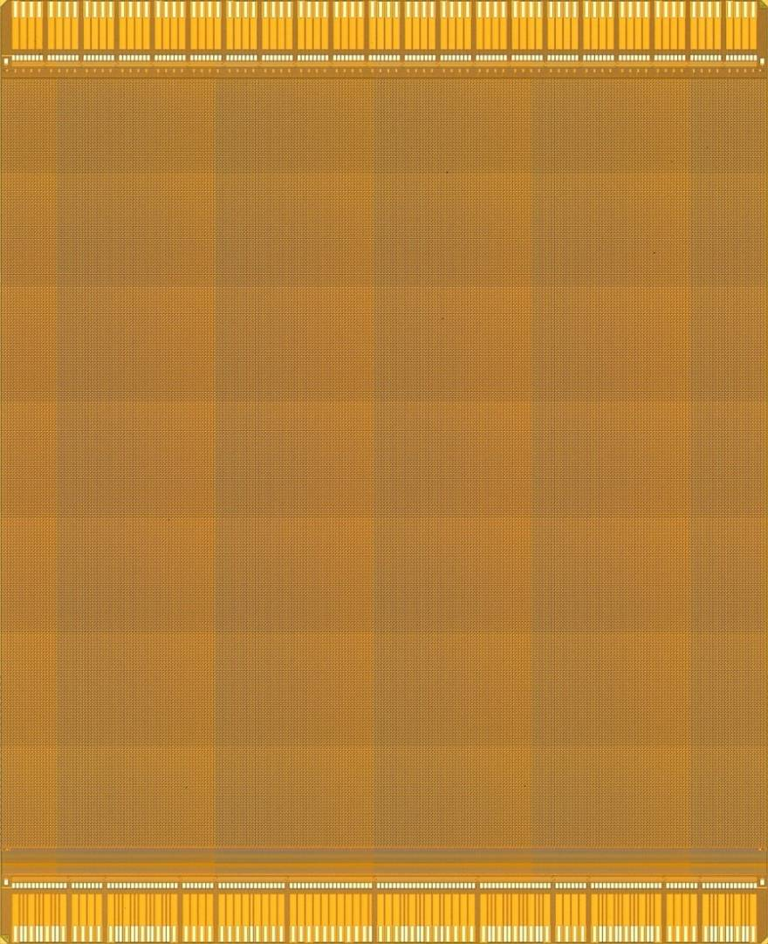
Medipix3 chip
Hybrid pixel detector readout chip working in single photon counting mode
CMOS 0.13μm, 8 metal layers
Pixel matrix of 256 x 256 pixels
> 115 Million transistors
Typical power consumption:
  600 mW in Single pixel mode
  900 mW in Charge summing mode
17.3 mm
14.1 mm

Slide 4
Motivation for the Medipix3 chip
γ
Sensor dimensions to scale (55μm pixel pitch, 300μm thick sensor)

Slide 5
Motivation for the Medipix3 chip
Simulated Data
Si 300μm, 55μm pixel
10keV monochromatic photon beam
Charge diffusion produces “charge sharing” tail
Threshold variations produce noise in image
Threshold
Simulation L.Tlustos
Notes:
This is one of the first simulations to validate the new architecture.
It simulates a hybrid pixel detector architecture with a three hundred micrometer thick silicon sensor and fifty five micron pixel pitch.
The simulation was done with a 10keV photon beam.
In blue the spectrum seen by one pixel working independently of its neighbours is shown. Because some of the charge deposited in the sensor is “shared” between pixels, the spectrum seen by one pixel has a low energy tail. The electronic noise of the pixel front end is simulated to be 100e-.
The influence of this effect on the spectrum increases as the pixel pitch is decreased with respect to the thickness of the sensor material.
This charge sharing tail means that any residual threshold variation between pixels produces a fixed pattern which varies with the incoming energy spectrum.
In red the new architecture in which 4 pixels contribute to the total charge sum and the hit is allocated to the circuit with the largest energy deposition. The electronics noise is 200 e- in this case.

Slide 6
Motivation for the Medipix3 chip
Simulated data
GaAs 300μm , 55μm pixel
20keV monochromatic beam
Fluorescence photons included in charge sum
Simulation L.Tlustos
Notes:
This is a Simulation with Gallium Arsenide detector. In the plot two peaks can be seen due to fluorescence photons.
The charge produced by fluorescence photons will be included in the charge sum provided that the deposition takes place within the volume of the pixels neighbouring the initial impact point.

Slide 7
Charge Summing Architecture on Medipix3
The winner takes all
Charge is summed in every 4 pixel cluster on an event-by-event basis
The incoming quantum is assigned as a single hit
55µm
Notes:
When a photon deposits its energy in the sensor volume, because of the charge diffusion some signal is induced in a cluster of pixels.
Summing circuits are placed at each pixel corner adding the signals of the 4 nearest neighbours.
The hit is allocated to the summing circuit with the largest energy deposition.

Slide 8
Medipix3 Pixel Schematic
Common circuitry wrt Medipix2
Notes:
The input charge is integrated in a Charge Sensitive Amplifier allowing holes and electrons collection, Then it is shaped by a first order semigaussian shaper acting as a transconductance (i.e. generates an output current whose amplitude is proportional to the input charge ) This current is sent to the nodes where the addition is done. Two discriminators are implemented per pixel to compare the charge with 2 different thresholds. Some arbitration logic is implemented in order to allocate the hit while inhibiting the neighbouring pixels.
The pixel contains two configurable depth binary ripple counters that can be configured as shift registers to shift the data to the periphery of the chip.

Slide 9
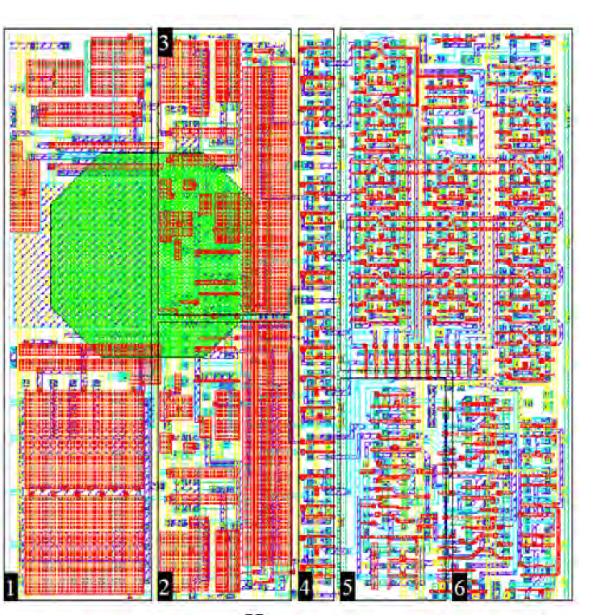
Medipix 2 and 3 pixel layouts
Mpix2 0.25μm CMOS
Mpix3 0.13μm CMOS

Slide 10
Advantages/disadvantages of vdsm CMOS
Main advantages
  Increased transistor density
  Improved radiation hardness (TID)
  Processes available in the future
Main disadvantages
  Increased leakage currents (IOFF, IGATE)
  Transistor matching

Slide 11
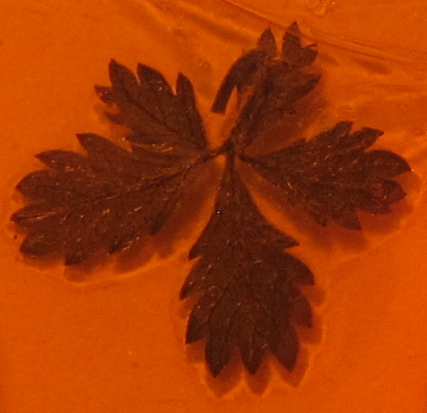
⁵⁵Fe image of a leaf
Image of a leaf with 55Fe source (88 masked pixels)
930 e⁻ minimum threshold (SPM, HGM) (dominated by threshold spread)
Simulation: 520 e⁻ minimum threshold (SPM, HGM) (dominated by noise)

Slide 12
Energy reconstruction in CSM
In CSM the photon energy is correctly reconstructed

Slide 13
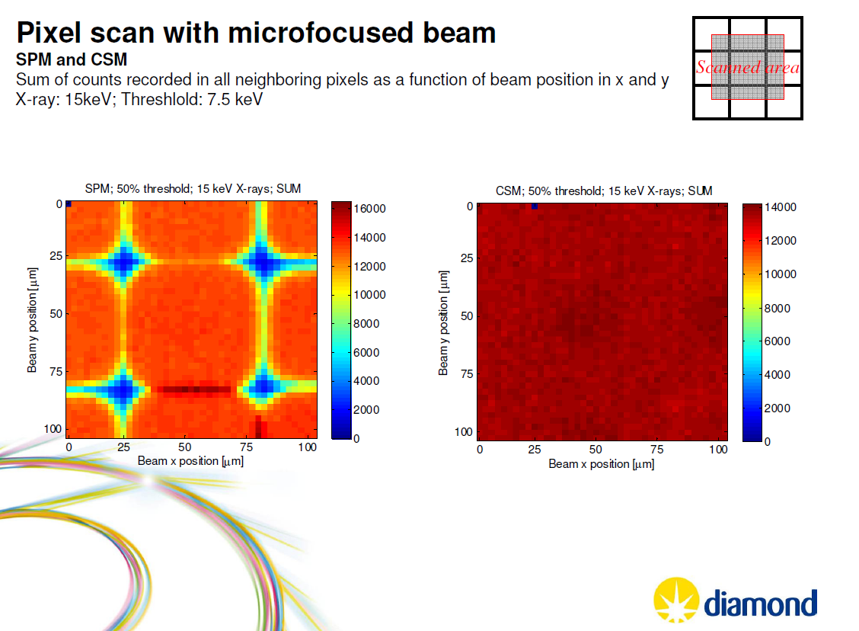
In CSM every photon counts
Courtesy Eva Gimenez-Navarro

Slide 14
Imaging in CSM
X-ray tube at 40kV, 40mA
0.5% pixels masked in equalization algorithm (~320)
In CSM the photon is not correctly allocated due to pixel-to-pixel threshold mismatch

Slide 15
Summary of electrical measurements
 |  | Single Pixel Mode | Charge Summing Mode
CSA Gain |  | 11.4 mV/ke⁻
CSA-Shaper Gain | High Gain | 34 nA/ke⁻
 | Low Gain | 20 nA/ke⁻
Non-Linearity | High Gain | <5% up to 10 ke⁻
 | Low Gain | <5% up to 20 ke⁻
Peaking time | HG / LG | ~110 ns
Return to baseline | High Gain | <1.5 µs for 12 ke⁻
 | Low Gain | <2.5 µs for 25 ke⁻
Electronic noise | High Gain | ~65 e⁻_{rms} | ~130 e⁻_{rms}
 | Low Gain | ~85 e⁻_{rms} | ~180 e⁻_{rms}
Minimum threshold | High Gain | ~900 e⁻ | ~1800 e⁻
Pixel power consumption | HG / LG | 8 µW | 15 µW
The chip can be operated up to 460Mrad and beyond with regular laid out transistors

Slide 16
Medipix3 circuitry use for CLIC vertex detector
Notes:
I am going to start talking about the motivation for implementing a new generation of the Medipix chips.

Slide 17
4
3
2
1

Slide 19
First order estimation for jitter calculation:
(Assuming triangular signal and noise bigger than threshold mismatch):
120e⁻
20ns
Assuming 1 hit/pixel/bunch train
4000e⁻
2μW power, 120e⁻ rms

Slide 20
Summary and conclusions
Downscaling the technology allows
  To increase the pixel functionality
  To reduce the pixel area
Downscaling has advantages but also challenges
A first hand calculation has been presented

Slide 21
Additional slides

Slide 22
Jitter as a function of the pixel side for different shaping times and power densities (0.5W/cm², 0.75W/cm², 1W/cm²). In the case the shaping time is fixed to 10ns, the condition τ_{s}>5τ_{r} is satisfied only in the case where the power density is 1W/cm². For a given shaping time, the jitter decreases with an increase in the power density. This is seen specially for short shaping times where the thermal noise dominates.
τ_{s}=1μs
τ_{s}=100ns
τ_{s}=20ns
τ_{s}=10ns

