Slide 1
Introduction to CERN Computing Services
Bernd Panzer-Steindel, CERN/IT

Slide 2
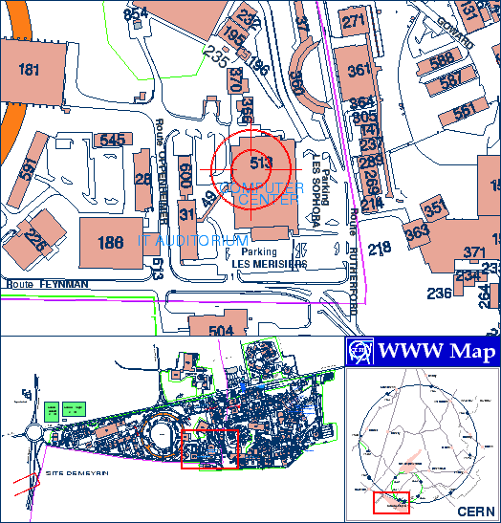
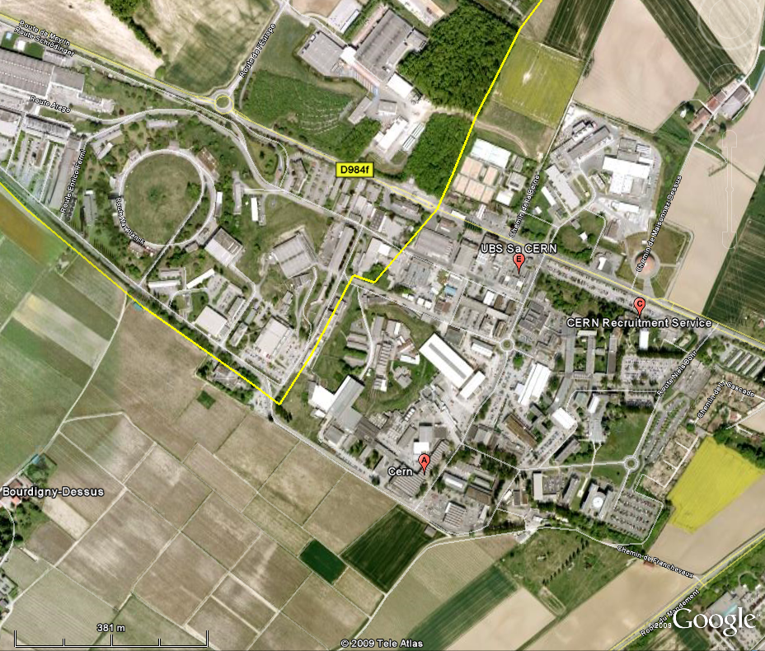
Location
Building 513
Opposite of Restaurant Nr. 2

Slide 3
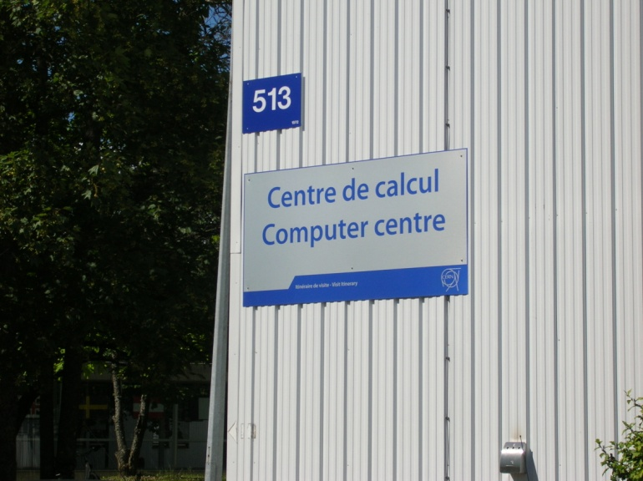
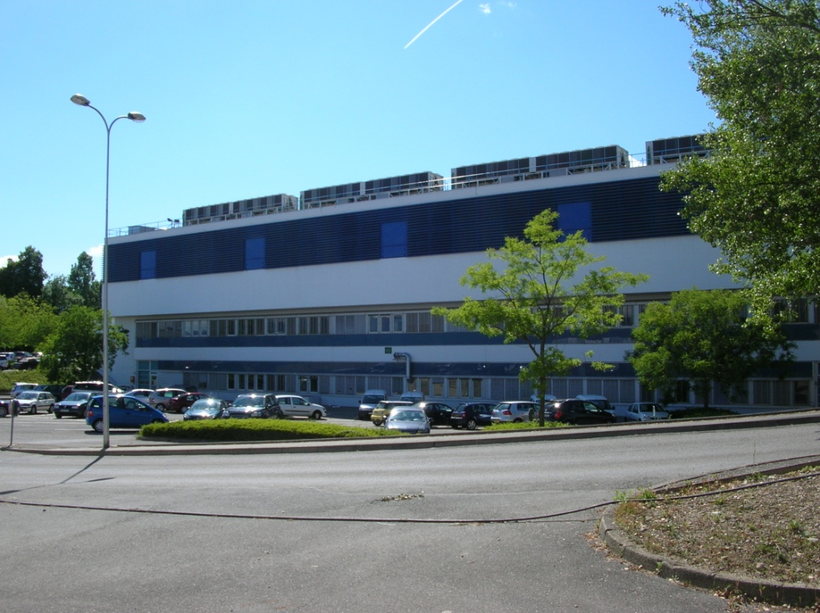
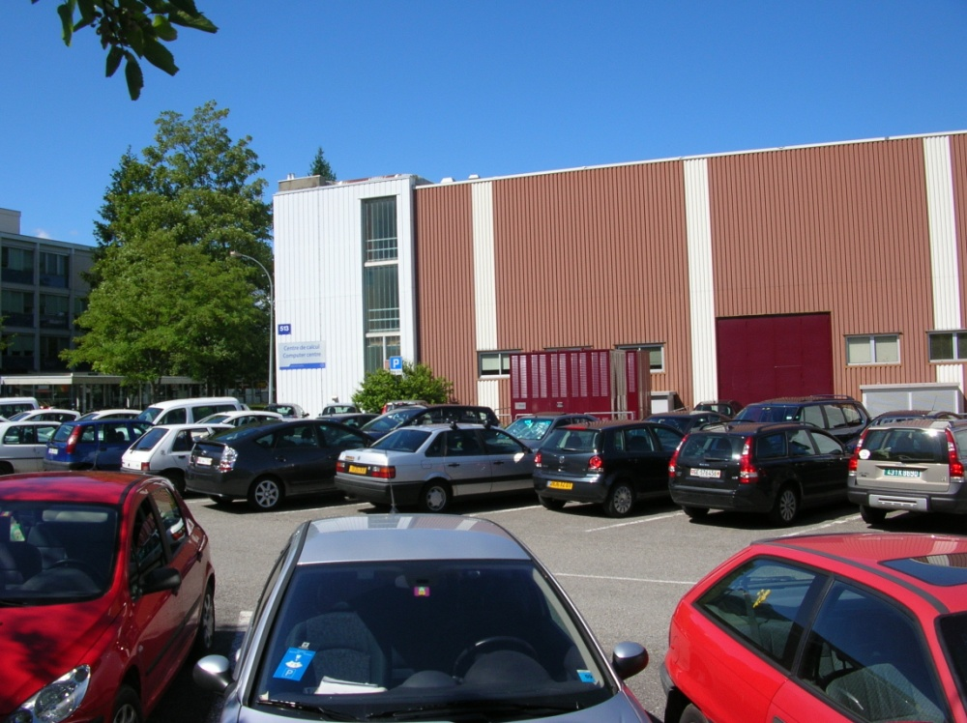
Building
Large building with 2700 m2 surface for
computing equipment, capacity for 2.9 MW
electricity and 2.9 MW air and water cooling
Chillers Transformers

Slide 4
Computing categories
Two coarse grain computing categories
Computing infrastructure
and
administrative computing
Physics data flow
and
data processing

Slide 5


Tasks overview
Users need access to
Communication tools : mail, web, twiki, GSM, …
Productivity tools : office software, software development,
compiler, visualization tools, engineering
software, …
Computing capacity : CPU processing, data repositories, personal
storage, software repositories, metadata
repositories, …
Needs underlying infrastructure
Network and telecom equipment,
Processing, storage and database computing equipment,
Management and monitoring software
Maintenance and operations
Authentication and security

Slide 6

Infrastructure and Services
Software environment and productivity tools
User registration and authentication
→ 22000 registered users
Web services
→ >8000 web sites
Mail
2M emails/day, 99% spam
18000 mail boxes
Tool accessibility
Windows, Office, CadCam
Home directories (DFS, AFS)
150 TB, backup service,
1 Billion files
PC management
Software and patch installations
Infrastructure needed :
> 400 PC server and 150 TB disk space

Slide 7
Bookkeeping
Data base services
More than 200 ORACLE data base instances on > 300 service nodes
-- bookkeeping of physics events for the experiments
-- meta data for the physics events (e.g. detector conditions)
-- management of data processing
-- highly compressed and filtered event data
-- …….
-- LHC magnet parameters
-- Human resource information
-- Financial bookkeeping
-- material bookkeeping and material flow control
-- LHC and detector construction details
-- ……..

Slide 8




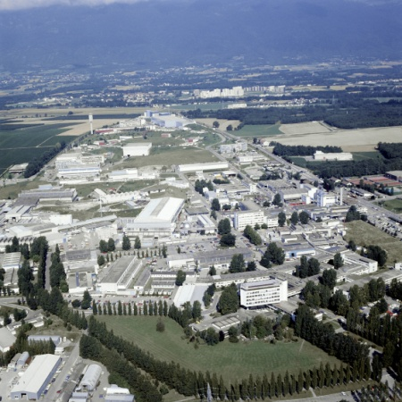
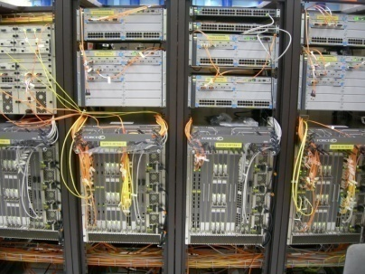
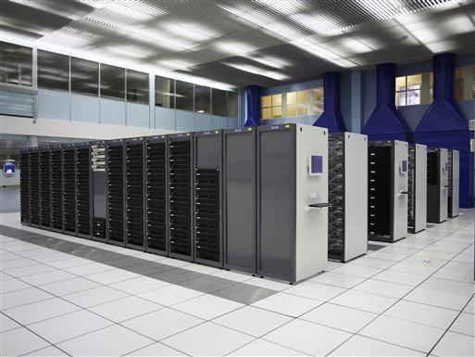
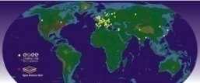
Network overview
ATLAS
Experiments
All CERN buildings
12000 users
Central, high speed network backbone
Computer center
Processing clusters
World Wide Grid centers

Slide 9
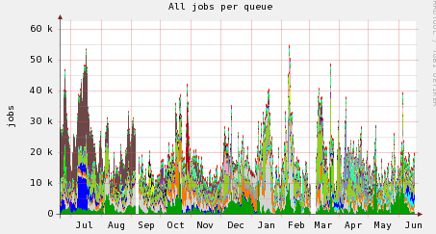
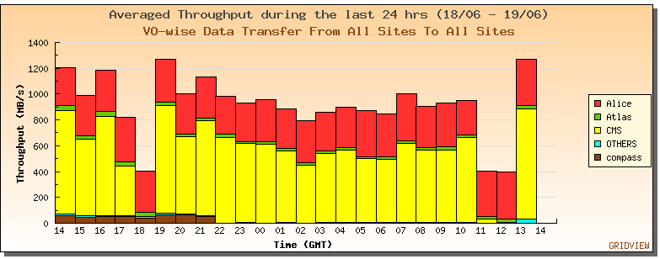
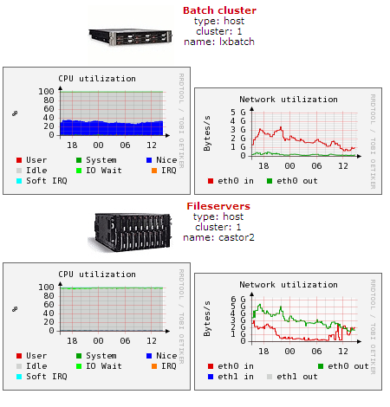
Monitoring
Large scale montitoring
Surveillance of all nodes in the
Computer center
Hundreds of parameters in various
time intervalls, from minutes to hours
per node and service
Data base storage and
interactive visalization

Slide 10
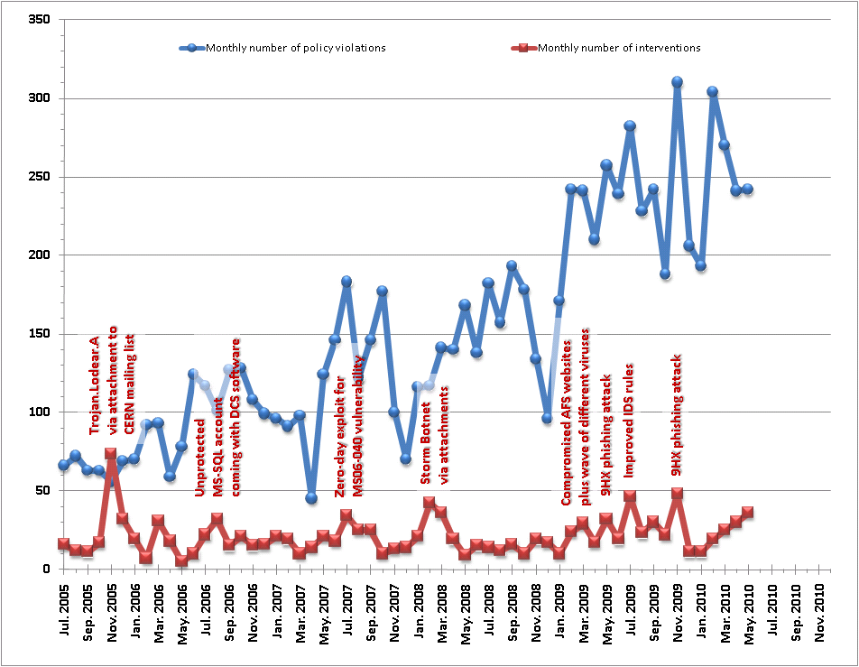
Security I
Threats are increasing,
Dedicated security team in IT
Overall monitoring and surveillance system in place
A few more or less serious incidents per day,
but ~100000 defended attacks per day

Slide 11
Security II
Software which is not required for a user's professional
duties introduces an unnecessary risk and should not
be installed or used on computers connected to
CERN's networks
The use of P2P file sharing software such as KaZaA,
eDonkey, BitTorrent, etc. is not permitted. IRC has
been used in many break-ins and is also not
permitted and Skype is tolerated provided it is
configured according to http://cern.ch/security/skype
Download of illegal or pirated data (software, music, video, etc)
is not permitted
Passwords must not be divulged or easily guessed and protect
access to unattended equipment

Slide 12
Security III
Please read the following documents
and follow their rules
http://cern.ch/ComputingRules
https://security.web.cern.ch/security/home/en/index.shtml
http://cern.ch/security/software-restrictions
In case of incidents or questions please contact :
Computer.Security@cern.ch

Slide 13
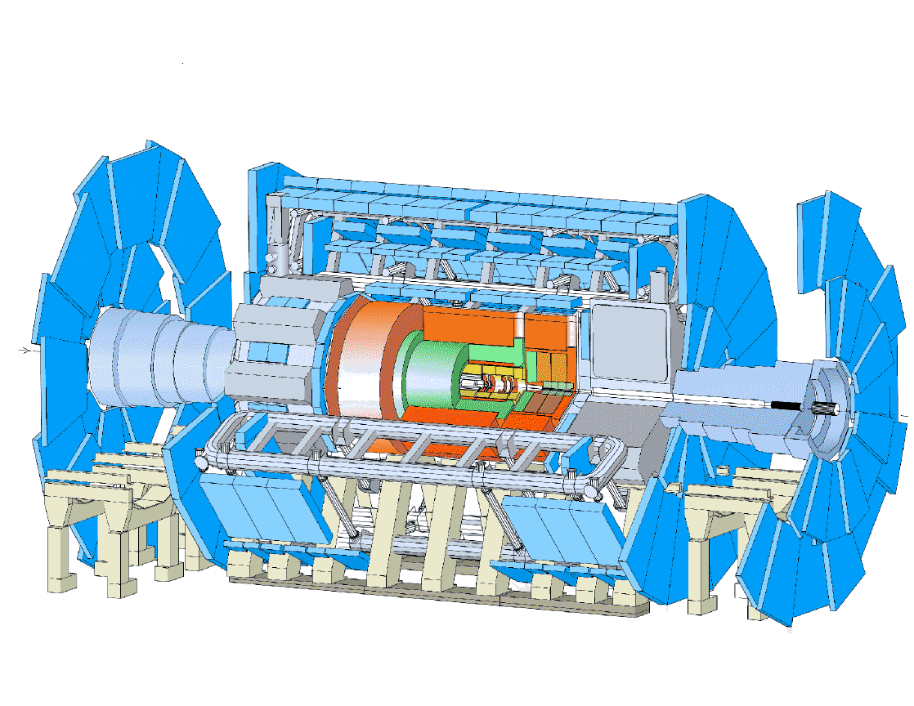
detector
Data Handling and Computation for Physics Analysis
reconstruction
event filter
(selection &
reconstruction)
analysis
event
summary
data
processed
data
raw
data
event
reprocessing
batch
physics
analysis
simulation
analysis objects
(extracted by physics topic)
event
simulation
interactive
physics
analysis
les.robertson@cern.ch

Slide 14
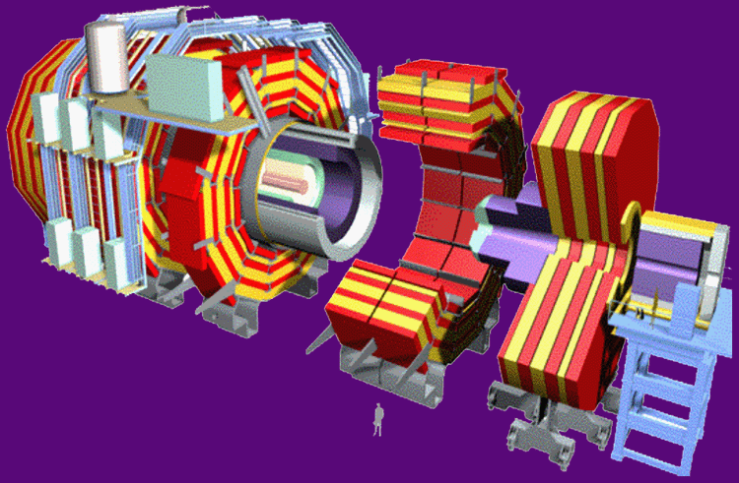
Physics dataflow I
One Experiment
Detector →
150 million electronic channels
1 PBytes/s
Level 1 Filter and Selection
Fast response electronics,
FPGA, embedded processors,
very close to the detector
Limits :
Essentially the budget
and the downstream
data flow pressure
150 GBytes/s
High Level Filter and Selection
O(1000) PC’s for processing,
Gbit Ethernet Network
N x 10 Gbit links to
the Computer Center
0.6 GBytes/s
CERN Computer Center

Slide 15
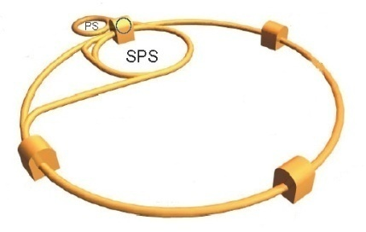

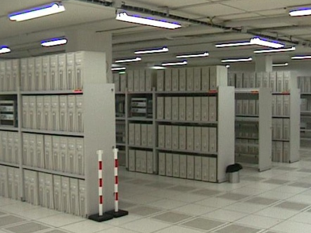
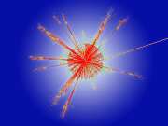
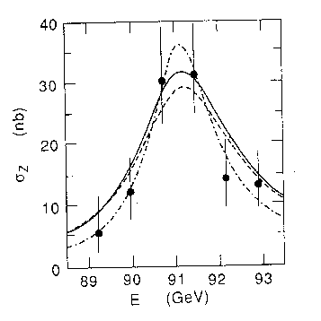


Physics dataflow II
1000 million
Events/s
LHC
4 Experiments
Filter and first selection
2 GB/s
Create sub-samples
World-Wide Analysis
3 GB/s
Physics
Explanation of nature
10 GB/s
Store on disk and tape
Export copies

Slide 16
Information growth
Zetta = 1000 Exa = 1000000 Peta = 1000000000 Tera
Library of congress ~ 200 TB
One email ~ 1 Kbyte yearly → 30 trillion emails (no spam)
30 Petabyte * N for copies
One LHC event ~ 1.0 Mbyte yearly → 10 billion RAW events
~ 70 Petabyte with copies
and selections
One photo ~ 2 Mbytes yearly → 500 billion photos
one Exabyte
25 billion photos on Facebook
World Wide Web 25 billion pages (searchable)
Deep web estimates > 1 trillion documents ~ one Exabyte
Blue-ray disks ~ 25 Gbytes yearly → 100 million units
2.5 Exabytes, copies
World-wide telephone calls → ~ 50 Exabyte (ECHELON)

Slide 17
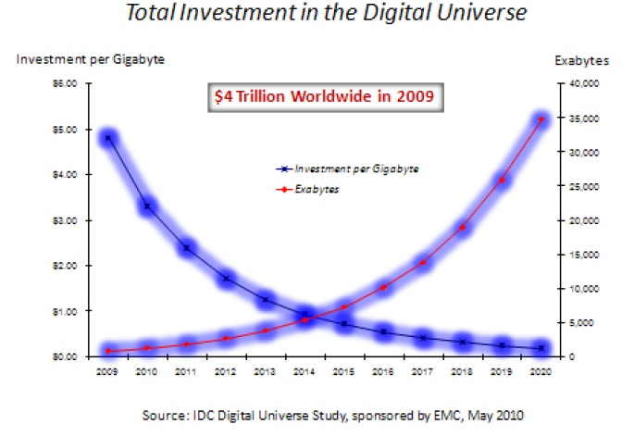
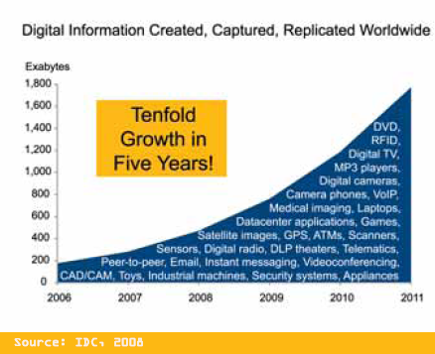
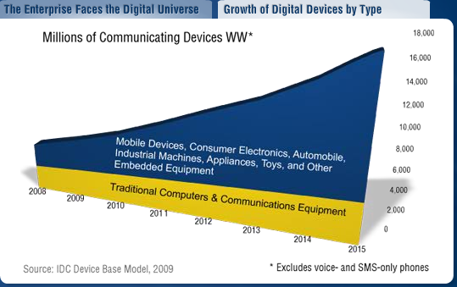
The Digital Universe
We will reach more than 1 Zettabyte of global information produced in 2010
http://indonesia.emc.com/leadership/digital-universe/expanding-digital-universe.htm

Slide 18
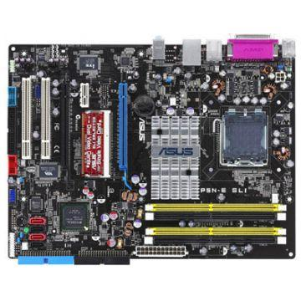
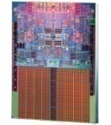
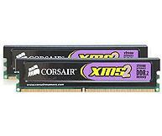
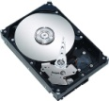
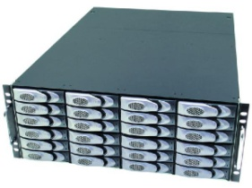
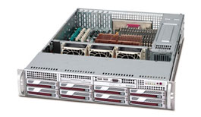
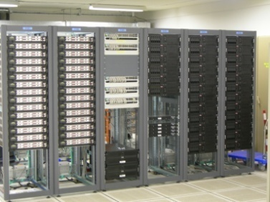
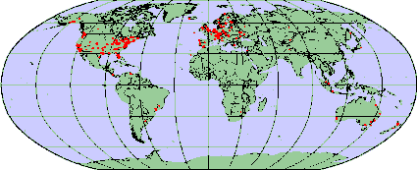
Physical and logical connectivity
Complexity
Hardware
Software
Components
CPU,disk,memory,
motherbord
PC, disk server
Operating system
Device drivers
Network,
Interconnects
Cluster,
Local fabric
Resource
Management
software
Wide area network
World Wide
Cluster
Grid and Cloud
Management software

Slide 19
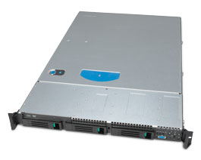
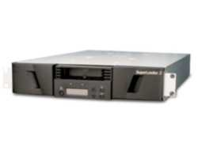
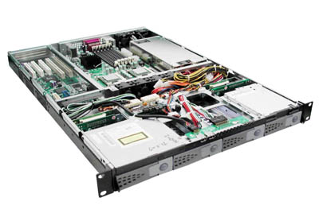
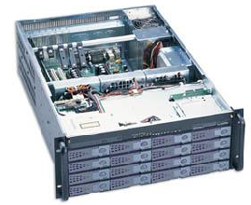
Computing building blocks
commodity market components
not cheap but cost effective !
simple components, but many of them
Tape server
=
CPU server
+ fibre channel connection
+ tape drive
CPU server or Service node
dual CPU, quad core,
16 GB memory
TCO Total Cost of Ownership
Disk server
=
CPU server
+RAID controler
+24 SATA disks
market trends more important
than technology trends

Slide 20
CERN Computing Fabric
Configuration
large scale !
Wide Area Network
Linux
Linux, Windows
Tape Server
Service
Nodes
Node repair
and
replacement
Purchasing
Installation
Mass
Storage
Network
Batch
Scheduler
Monitoring
Physical installation
Linux
Linux
Disk Server
CPU Server
Shared File
Systems
Logistic !
Fault Tolerance
Automation !
Electricity
Space
Cooling

Slide 21
Logistics
Today we have about 7000 PC‘s installed in the center
Assume 3 years lifetime for the equipment
→ Key factors = power consumption, performance, reliability
Experiment requests require investments of ~ 15 MCHF/year
for new PC hardware and infrastructure
Infrastructur and operation setup needed for :
~2000 nodes installed per year and ~2000 nodes removed per year
Installation in racks, cabling, automatic installation, Linux
software environment
Equipment replacement rate, e.g. 2 disk errors per day
several nodes in repair per week 50 node crashes per day

Slide 22

Functional Computing Units
Detectors
Data Import
And Export
1. Disk Storage
2. Tape Storage
‘Active’ Archive and Backup
3. Event Processing Capacity
CPU Server
4. Meta-Data Storage
Data Bases

Slide 23
Software ‘Glue’
Management of the basic hardware and software :
installation, configuration and monitoring system
(quattor, lemon, elfms)
Which version of Linux ? How to upgrade the software ?
What is going on in the farm ? Load ? Failures ?
Management of the processor computing resources :
Batch system (LSF from Platform Computing)
Where are free processors ? How to set priorities between
different users ? sharing of the resources ? How are the
results coming back ?
Management of the storage (disk and tape) : CASTOR
(CERN developed Hierarchical Storage Management system)
Where are the files ? How can one access them ?
How much space is available ? what is on disk, what is on tape ?
TCO Total Cost of Ownership
buy or develop ?!

Slide 24
Data and control flow I
Here is my program and I want to
analyze the ATLAS data from the
special run on the 16.June 14:45
or all data with detector signature X
Processing nodes (PC’s)
‘batch’ system to decide
Where is free computing
time
Management Software
Data management system
Where is the data and how
to transfer to the program
Database system
Translate the user request into physical location
And provide meta-data
(e.g. calibration data) to the program
Disk storage

Slide 25

Data and control flow II
Users
CERN installation
Repositories
- code
- metadata
- …….
Interactive
Lxplus
Data processing
Lxbatch
Bookkeeping
Data base
Tape storage
Disk storage
CASTOR
Hierarchical Mass Storage Management System (HSM)

Slide 26
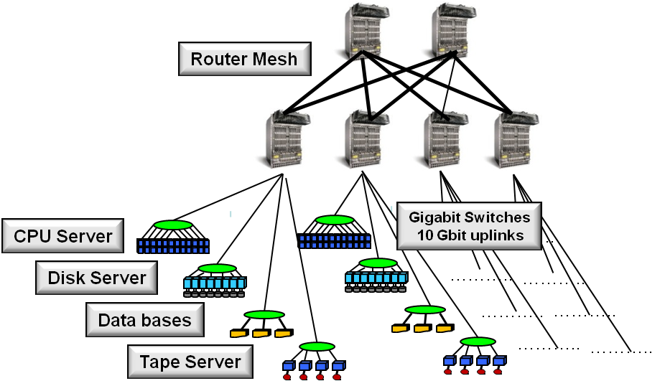
CERN Farm Network
4+12 Force10 Router
HP switches in the distribution layer, 10 Gbit uplinks,
Majority 1 Gbit and slowly moving to 10 Gbit server connectivity
Expect 100 Gbytes/s internal traffic (15 Gbytes/s peak today)
→ Depends on storage/cache layout data locality TCO

Slide 27
Network
Hierarchical network topology based on Ethernet
150+ very high performance routers
3’700+ subnets
2200+ switches (increasing)
50’000 active user devices (exploding)
80’000 sockets – 5’000 km of UTP cable
5’000 km of fibers (CERN owned)
140 Gbps of WAN connectivity

Slide 28
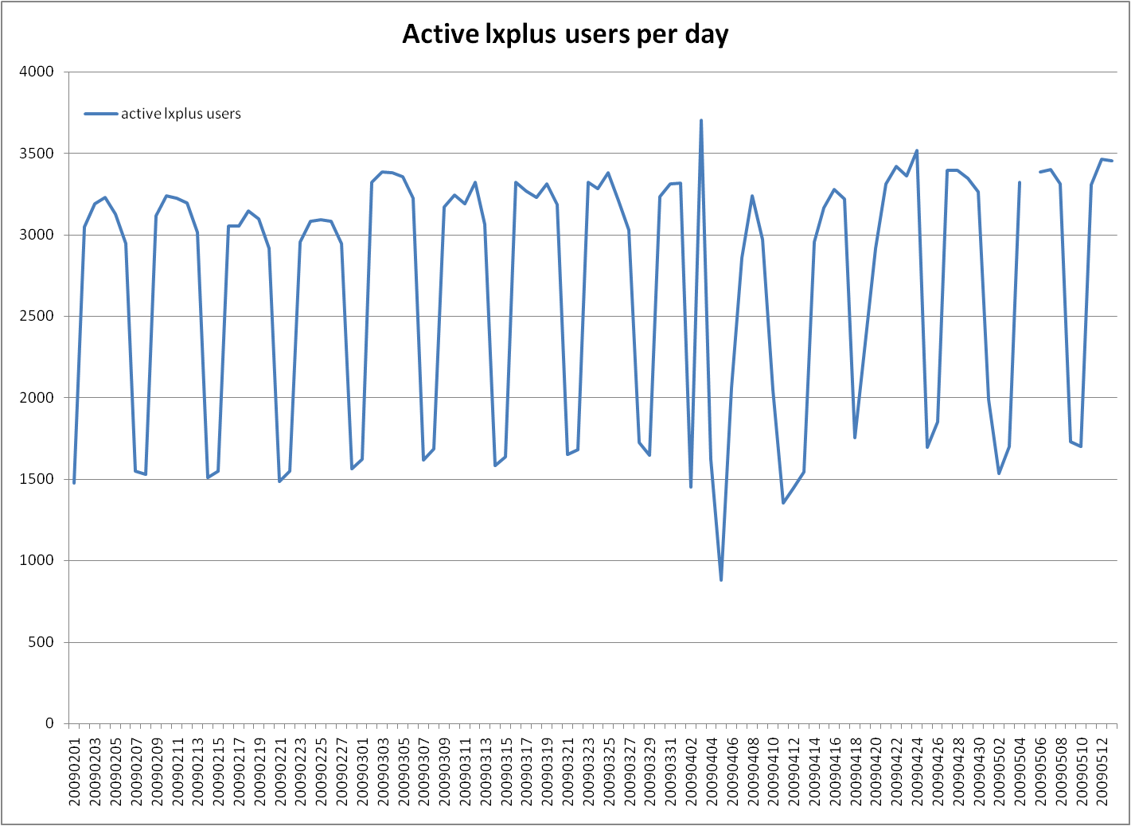
Interactive Service: Lxplus
lxplus
Active users per day
3500→
1000→
← Last 3 month →
Interactive computing facility
70 CPU nodes running Linux (RedHat)
Access via ssh, xterminal from Desktop/Notebooks ,Windows,Linux,Mac
Used for compilation of programs, short program execution tests, some
Interactive analysis of data, submission of longer tasks (jobs) into the
Lxbatch facility, internet access, program development, etc.

Slide 29
Processing Facility: Lxbatch
Jobs are submitted from Lxplus or channeled through GRID
interfaces world-wide
Today about 4000 nodes with 31000 processors (cores)
About 150000 user jobs are run per day
Reading and writing > 1 PB per day
Uses LSF as a management tool to schedule the various jobs from
a large number of users.
Expect a resource growth rate of ~30% per year

Slide 30
Mass Storage
Large disk cache in front of a long term storage tape system
1800 disk servers with 21 PB usable capacity
Redundant disk configuration, 2-3 disk failures per day
needs to be part of the operational procedures
Logistics again : need to store all data forever on tape
20 PB storage added per year, plus a complete copy every 4 years
(change of technology)
CASTOR data management system, developed at CERN,
manages the user IO requests
Expect a resource growth rate of ~30% per year

Slide 31
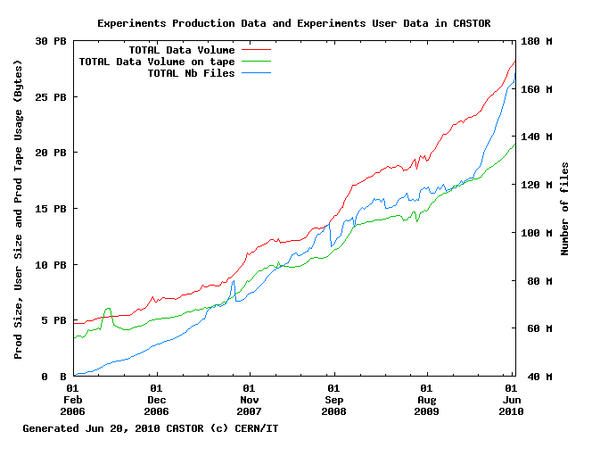
Mass Storage
165 million files
28 PB of data on tape already today

Slide 32



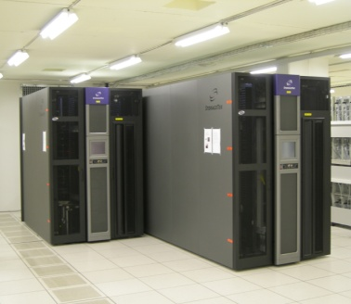

Storage
backup
per hour and per day
Administrative Data
1 million electronic documents
55000 electronic signatures per month
60000 emails per day
250000 orders per year
> 1000 million user files
Users
accessibility → 24*7*52 = always
tape storage → forever
continuous storage
Physics Data
21000 TB and
50 million files per year

Slide 33
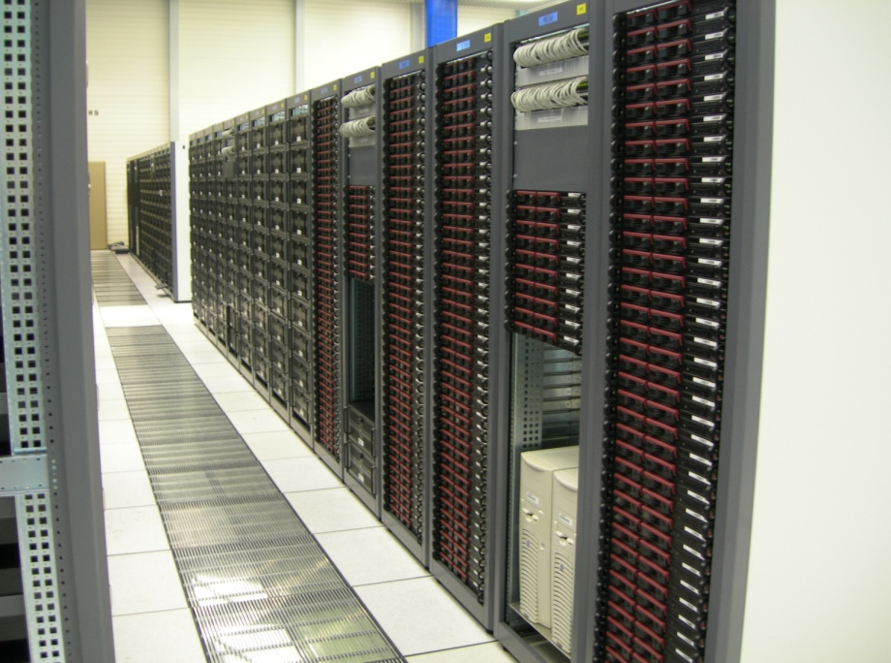


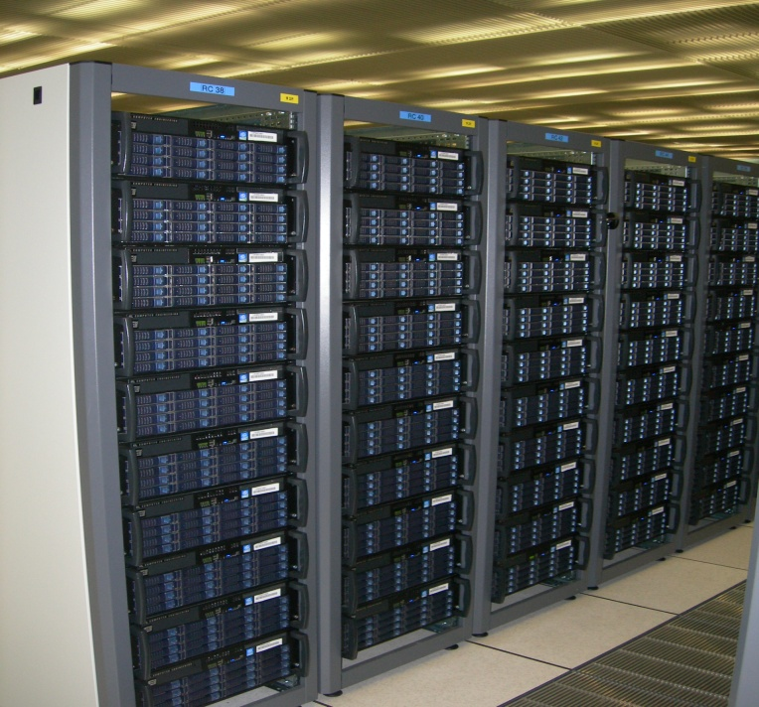
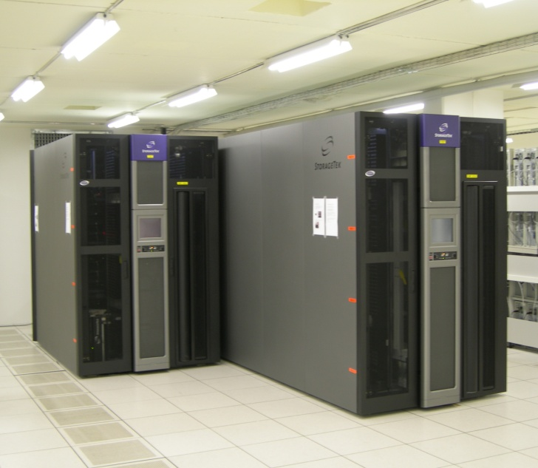
CERN Computer Center
ORACLE Data Base Server
2.9 MW Electricity
and Cooling
2700 m2
CPU Server
240 CPU and disk server
200 TB
160 Gbits/s
31000 processors
Tape Server
and
Tape Library
Disk Server
Network router
160 tape drives , 50000 tapes
40000 TB capacity
1800 NAS server, 21000 TB
30000 disks

Slide 34
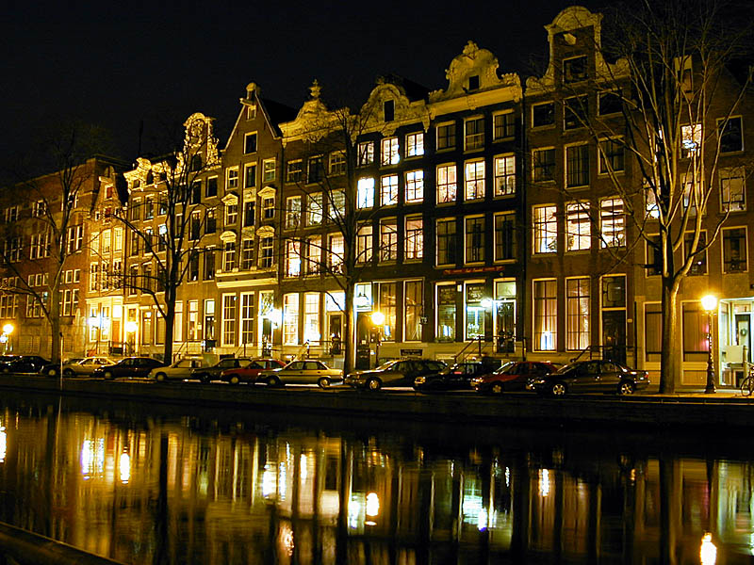

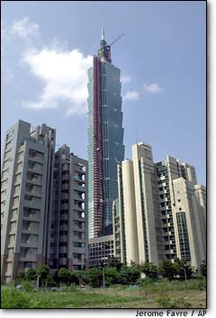
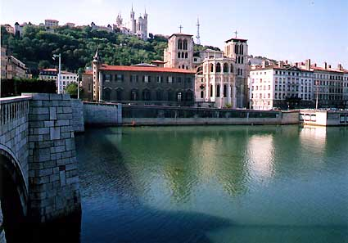
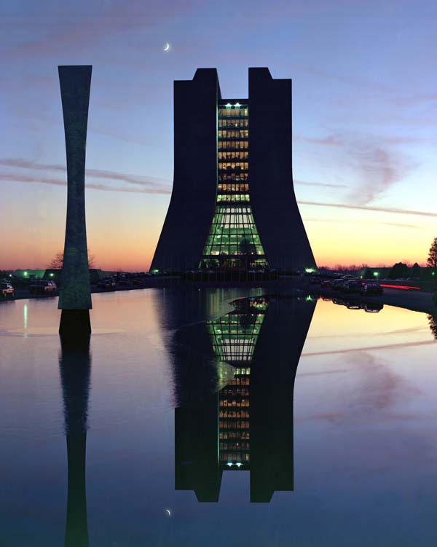
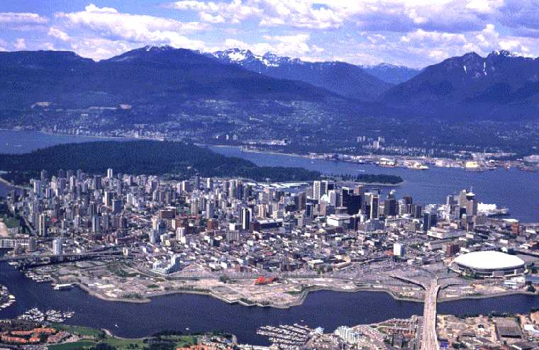
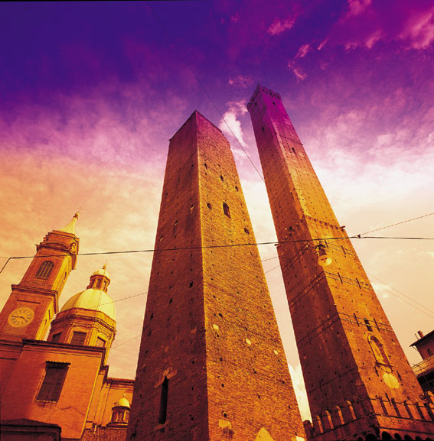

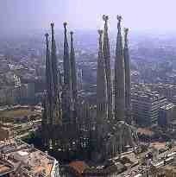
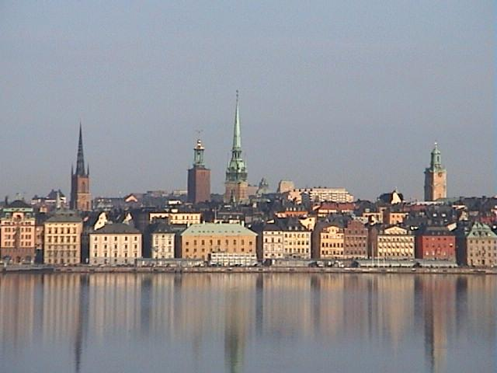
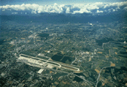

BNL
New York
CCIN2P3/Lyon
NIKHEF/SARA
Amsterdam
FNAL
Chicago
ASGC/Taipei
TRIUMF
Vancouver
RAL
Rutherford
CNAF
Bologna
PIC
Barcelona
NDGF
Nordic countries
TIER2s
CERN
FZK
Karlsruhe

Slide 35





WEB and GRID
The World Wide Web provides seamless access to information
that is stored in many millions of different geographical locations
The Grid is an infrastructure that provides seamless access to computing power and data storage capacity distributed over the globe
Tim Berners-Lee
invented the
World Wide Web
at CERN in 1989
Foster and
Kesselman 1997

Slide 36

How does the GRID work ?
It relies on advanced software, called middleware.
Middleware automatically finds the data the scientist needs, and the computing power to analyse it.
Middleware balances the load on different resources. It also handles security, accounting, monitoring and much more.

Slide 37
How does the GRID work ?
Local site batch system,
Monitoring and
data management
Programs
Monitoring
Event data
Computing Element
CE
Information
System
Storage Element
SE
GRID ‘batch’ system,
Monitoring and
data management

Slide 38
GRID infrastructure at CERN
GRID services
Work load management :
submission and scheduling of jobs in the GRID,
transfer into the local fabric batch scheduling systems
Storage elements and file transfer services :
Distribution of physics data sets world-wide
Interface to the local fabric storage systems
Experiment specific infrastructure :
Definition of physics data sets
Bookkeeping of logical file names and their physical location world-wide
Definition of data processing campaigns
→ which data need processing with what programs
Various types of PC’s needed > 400

Slide 39

Data and Bookkeeping
RAW data
RAW data copies
Sub-samples
10 PB RAW data per year
+ derived data, extracted physics
data sets, filtered data sets, artificial
data sets (Monte-Carlo), multiple versions,
Multiple copies
20 PB of data at CERN per year
50 PB of data in addition transferred and stored
world-wide per year
Enhanced copies
Enhanced copies
~1.6 Gbytes/s average data traffic per year between 400-500 sites (320 today),
but with requirements for large variations (factor 10-50 ?)

Slide 40

WLCG Tier structure
Tier-0 (CERN):
  Data recording
  Initial data reconstruction
  Data distribution
Tier-1 (11 centres):
Permanent storage
Re-processing
Analysis
Tier-2 (>200 centres):
Simulation
End-user analysis

Slide 41


Wide area network links
Tier 1 connectivity
High speed and redundant
network topology
Fibre cut during STEP’09:
Redundancy meant no interruption

Slide 42

LHC Computing Grid : LCG
Today
Active sites : > 300
Countries involved : ~ 70
Available processors : ~ 100000
Available space : ~ 100 PB

Slide 43




LHC Computing Grid : LCG
Running increasingly high
workloads:
  Jobs in excess of 900k / day; Anticipate millions / day soon
  CPU equiv. ~100k cores
900k jobs/day
Real data – from 30/3
OPN traffic – last 7 days
Castor traffic last month:
> 4 GB/s input
> 13 GB/s served

Slide 44

Access to live LCG monitoring
http://lcg.web.cern.ch/LCG/monitor.htm
52000 running jobs
630 MB/s

Slide 45
Links I
IT department
http://it-div.web.cern.ch/it-div/
http://it-div.web.cern.ch/it-div/need-help/
Monitoring
http://sls.cern.ch/sls/index.php
http://lemonweb.cern.ch/lemon-status/
http://gridview.cern.ch/GRIDVIEW/dt_index.php
http://gridportal.hep.ph.ic.ac.uk/rtm/
Lxplus
http://plus.web.cern.ch/plus/
Lxbatch
http://batch.web.cern.ch/batch/
CASTOR
http://castor.web.cern.ch/castor/

Slide 46
Links II
Windows, Web, Mail
https://winservices.web.cern.ch/winservices/
Grid
http://lcg.web.cern.ch/LCG/public/default.htm
http://www.eu-egee.org/
Computing and Physics
http://www.particle.cz/conferences/chep2009/programme.aspx
In case of further questions don’t hesitate to contact me:
Bernd.Panzer-Steindel@cern.ch

