Slide 1

MUON RADIOGRAPHY – MUON TOMOGRAPHY
Despina Hatzifotiadou
INFN Bologna, Italy
IPPOG Working Group
Applications for Society

Slide 2
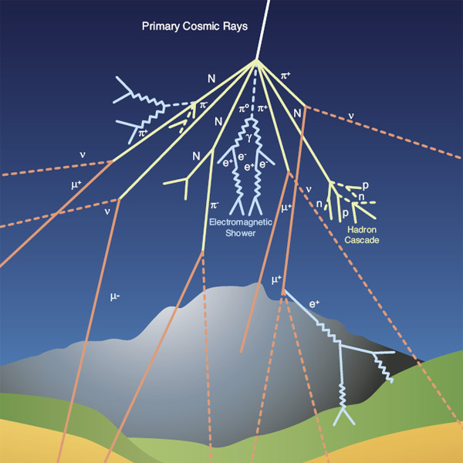
The Principle
Muon radiography is a technique that uses information on the absorption of cosmic ray muons to measure the thickness of the materials crossed by the muons.
Muon radiography tracks the number of muons that pass through the target volume to determine the density on the inaccessible internal structure, and in this way find empty spaces. It is similar to imaging with X-rays but can survey much larger objects. Since muons are less likely to interact, stop and decay in low density matter than high density matter, a larger number of muons will travel through the low density regions of target objects in comparison to higher density regions.
It finds applications in many domains:
geology – study of volcanoes
archeology – study of pyramids and tombs
Industry – study of large volumes (trucks, Fukushima reactor etc)
Primary cosmic rays, consisting mainly of protons and a small percentage of heavier nuclei, interact in the earth’s atmosphere producing showers; muons, the decay products of pions, are higly penetrative and reach us ; 10000 muons/(minute m2) hit the ground; typically one muon per second goes through a surface the size of our hand; 600 muons cross our body every minute.

Slide 3
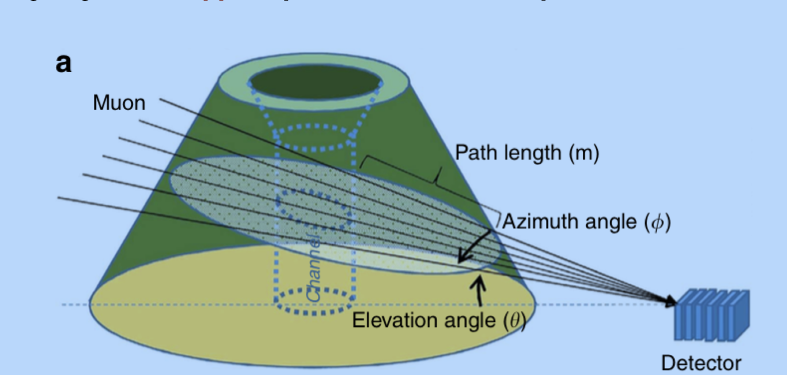
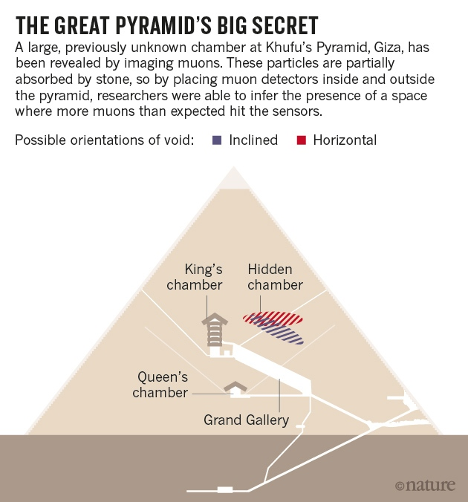
Pyramids
Muon radiography was first used in 1971 to investigate the pyramid of Chefrten, in Giza, Egypt by Nobel laureate Luis Alvarez. Spark chambers were used. He found no evidence of void.
The ScanPyramids mission found a big void in the Great Pyramid (Khufu’s Pyramid), above the Grand Gallery (Nature, 2017). It was observed with
Nuclear Emulsion films (Nagoya University)
Scintillator hodoscopes (KEK)
both inside the pyramid; reconfirmed with
Gaseous chambers (CEA)
outside the pyramid
Note : other techniques have been used, in addition to muography, such as infrared thermography

Slide 4
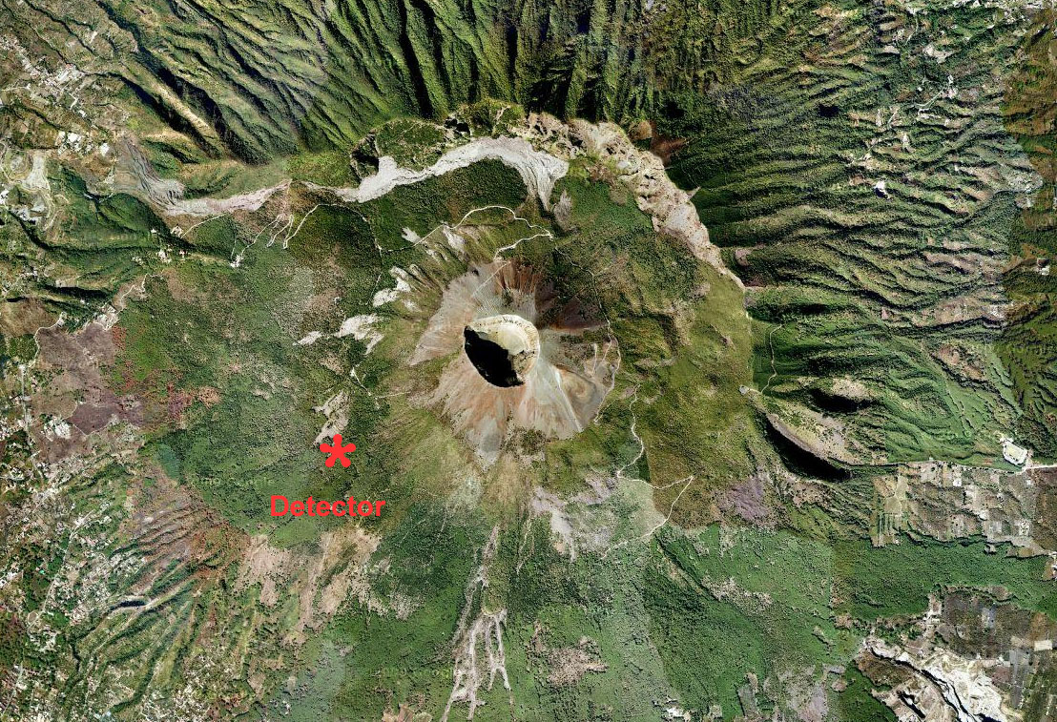
Volcanoes
Like X-ray scans of the human body, muon radiography allows to obtain an image of the internal structures of the upper levels of volcanoes. Although such an image cannot help to predict ‘when’ an eruption might occur, it can, if combined with other observations, help to foresee ‘how’ it could develop and serves as a powerful tool for the study of geological structures.
In 2007 Nagamine and Tanaka were the first to apply this technique for the study of volcanoes.
Volcanoes under study with muons:
Vesuvius Mu-Ray project
Etna MeV project
Stromboli
using nuclear emulsion films from OPERA
Soufrière (Montserrat, Guadeloupe)
Puy de Dôme (Massif Centrale)
TOMUVOL Collaboration
Satsuma-Iwojima (Japan)

Slide 5
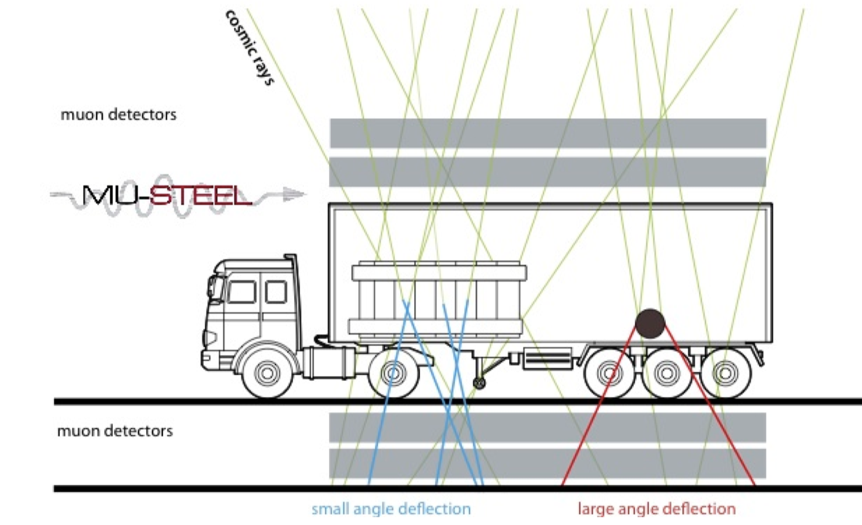
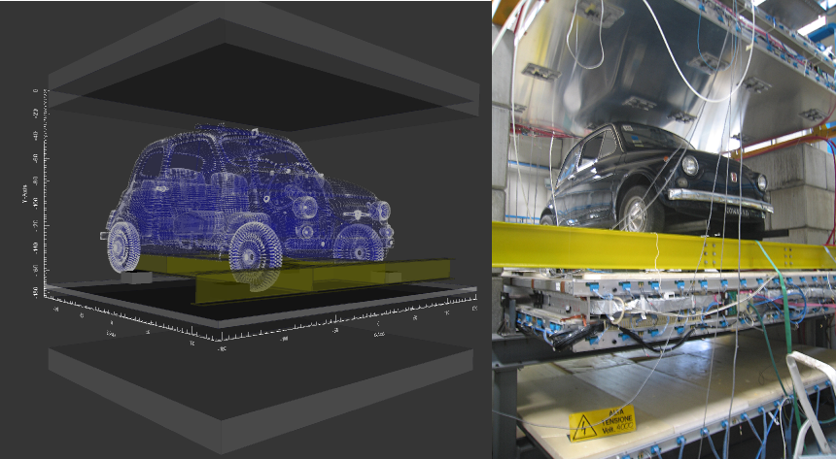
Muon scattering tomography
An extension of muon radiography based on muon absorption, muon scattering tomography, is based on the multiple Coulomb scattering of muons crossing the volume under investigation. Muons are deflected and slow down when they interact with a material with high atomic number. Using tracking detectors in front of and behind the volume under study the deflection is measured and thus high-z objects localized

Slide 6
Applications
Muon scattering tomography is suitable for scanning large volumes, and looking for high-density objects inside them
Security/Safety Cargo scanners to inspect the contents of trucks and containers
Control of spent nuclear fuel deposits (without opening, no radiation risk)
Study of the core of the Fukushima reactor plant
Industry : Control of trucks when entering steel foundries to detect hidden radioactive sources
Inspection of the inner structure of a blast furnace
Precision measurements : Measuring the alignment of structures / stability of buildings

Slide 7
Useful links
General
https://en.wikipedia.org/wiki/Muography
https://en.wikipedia.org/wiki/Muon_tomography
Muography for the study of volcanoes
Muons reveal the interiors of volcanoes
https://cds.cern.ch/journal/CERNBulletin/2010/51/News%20Articles/1312698
The secret life of volcanoes: Using Muon Radiography
https://www.scienceinschool.org/2013/issue27/muons
Attraverso la roccia – la tecnologia della radiografia muonica
https://www.asimmetrie.it/attraverso-la-roccia
https://physicstoday.scitation.org/doi/abs/10.1063/PT.3.1829?journalCode=pto
The MU-RAY project :Volcano Radiography with cosmic-ray muons
https://www.sciencedirect.com/science/article/pii/S0168900210014890?via%3Dihub
STROMBOLI: REALIZZATA LA PRIMA RADIOGRAFIA MUONICA DEL VULCANO
http://home.infn.it/it/comunicazione/comunicati-stampa/3536-stromboli-realizzata-la-prima-radiografia-muonica-del-vulcano
First muography of the Stromboli Volcano
https://www.nature.com/articles/s41598-019-43131-8

Slide 8
The MEV project: design and testing of a new high-resolution telescope for Muography of Etna Volcano
https://inspirehep.net/literature/1675335
http://wwwobs.univ-bpclermont.fr/tomuvol/presentation.php
Muography for the study of Pyramids
http://www.scanpyramids.org
https://www.sciencesetavenir.fr/archeo-paleo/archeologie/egypte-de-l-infrarouge-et-des-muons-pour-sonder-le-coeur-des-pyramides_103836
Cosmic-ray particles reveal secret chamber in Egypt's Great Pyramid
https://www.nature.com/news/cosmic-ray-particles-reveal-secret-chamber-in-egypt-s-great-pyramid-1.22939#/graphic
Discovery of a big void in Khufu’s Pyramid by observation of cosmic-ray muons https://www.nature.com/articles/nature24647.epdf?
Muon Scattering Tomography
Progress in Muon Tomography (G. Bonomi, EPS conf.2017)
https://indico.cern.ch/event/466934/contributions/2524834/attachments/1490162/2316412/progress_in_muon_tomography_EPS-2017.pdf
https://cms.cern/content/muon-tomography
Cosmic Muon Tomography Project http://mutomweb.pd.infn.it:5210

