Slide 1

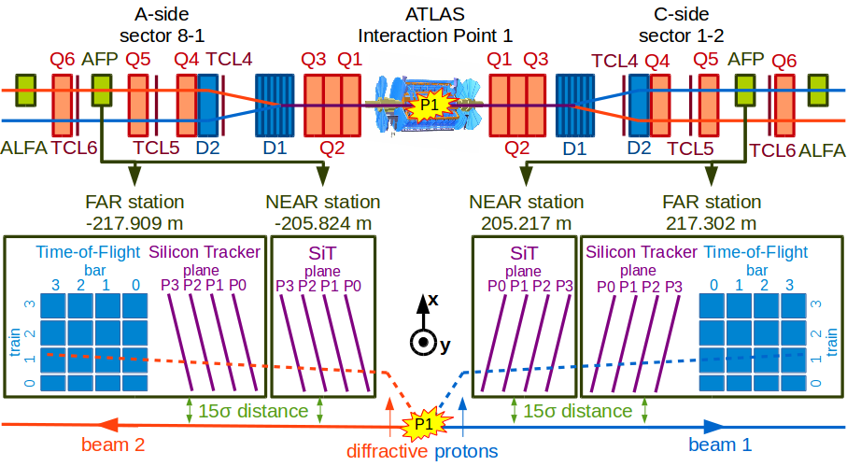
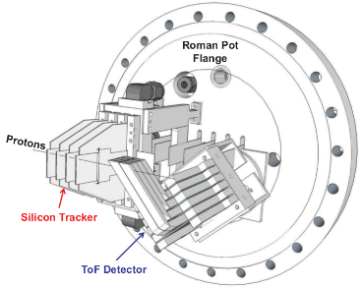
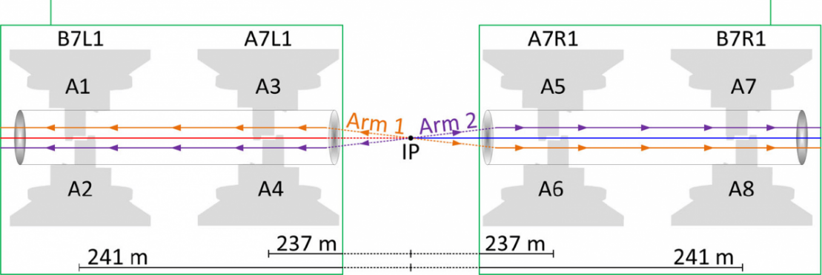
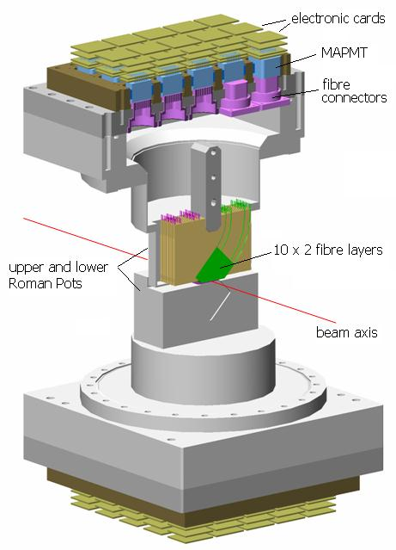
Start-up plans for ATLAS FWD
Remote TREX meeting
Marco Bruschi
on behalf of ATLAS FWD
CERN, 06.05.2020.

Slide 2
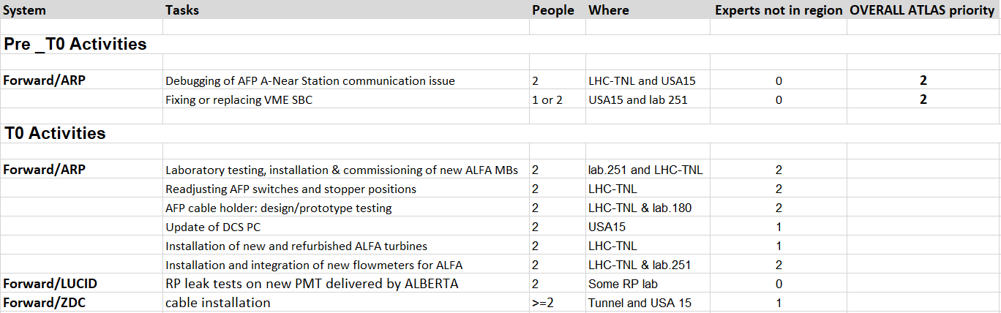
Start-up plans for AFP, ALFA, LUCID, ZDC in Pre-t0 & t0
Pre-t0 & t0 activites (FWD):
Got a green light from ATLAS Technical Coordination for the pre-T0 LHC-TNL activity; should be approved today during the online VIC with LS2C and EROS.
  https://twiki.cern.ch/twiki/pub/Atlas/AFP/AFP_RiskAssessment_pre-t0_DebuggingA-NEARstation.docx
  https://twiki.cern.ch/twiki/bin/viewauth/Atlas/Ls2ShutdownRestart
ZDC non activity is planned until the end of July.
08.05.2020

Slide 3
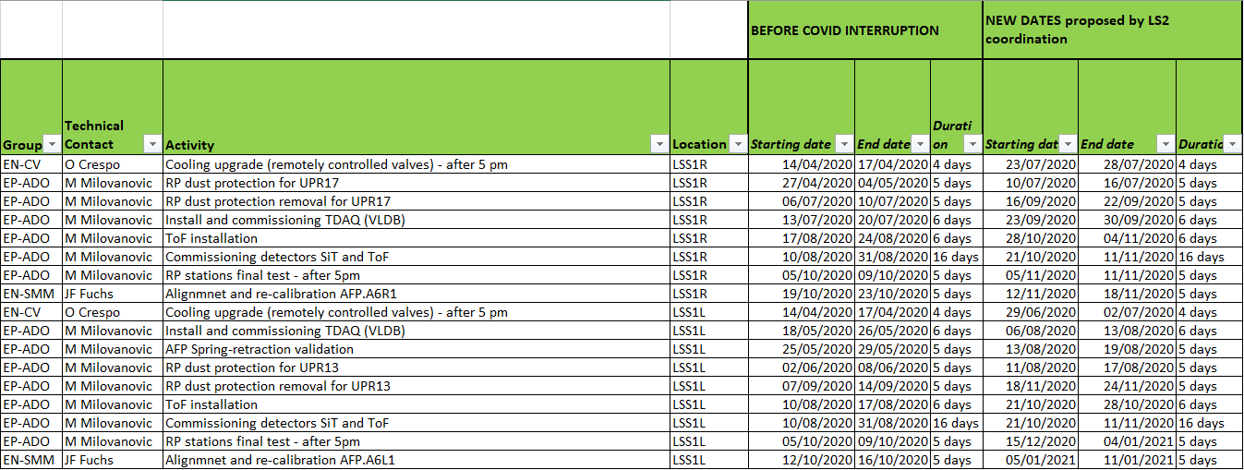
Start-up plans for Phase-2 (July 2020 onward)
For AFP already received a new proposed plan for LS2 from LS2 Coordination:
LS2C is pushing for an average of 3 month delay which seems optimistic
Constraints:
  Availability of experts (mostly depend on expert abroad who need to travel to CERN and back to their home country)
  Test beam (still not clear when, where and under which conditions will be held; DESY or SPS?..)
  Other potential delays due to pandemic and different conditions within collaborating institutes.

Slide 4
Backup
Backup slides

Slide 5
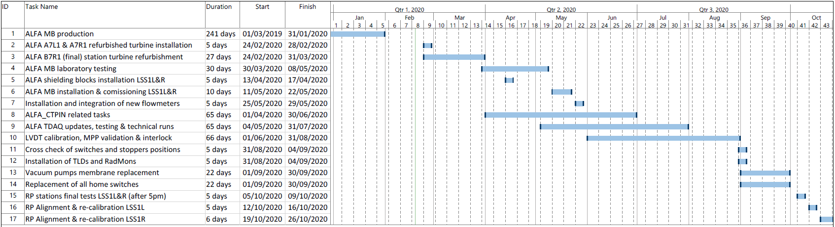
ALFA LS2 Schedule

Slide 6
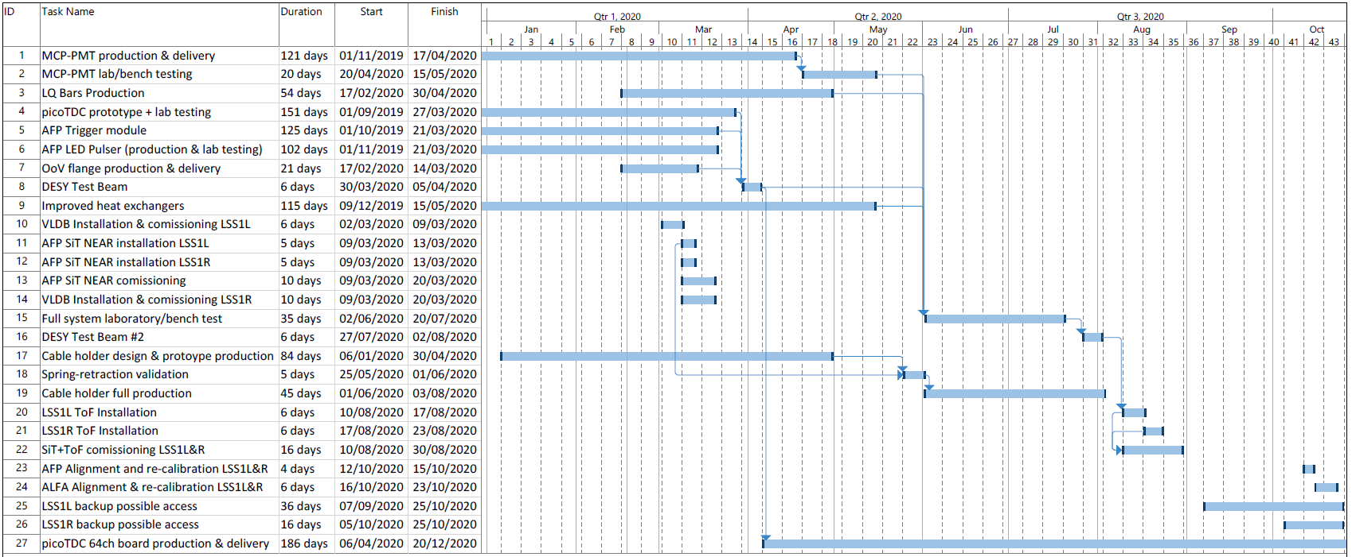
AFP LS2 Schedule

