Slide 1

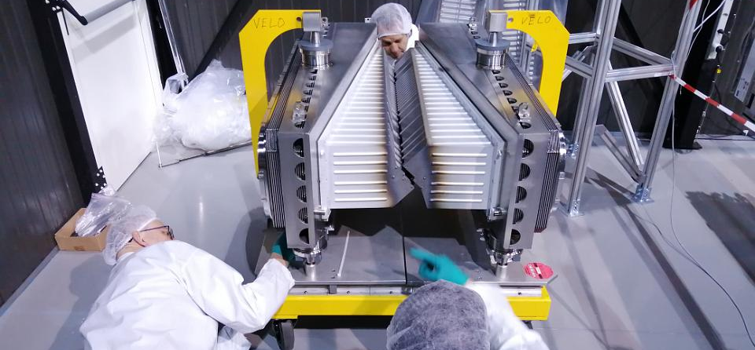


Installation of RF foils.
Pilot project
By: Freek Sanders
With COVID 19 measures

Slide 2
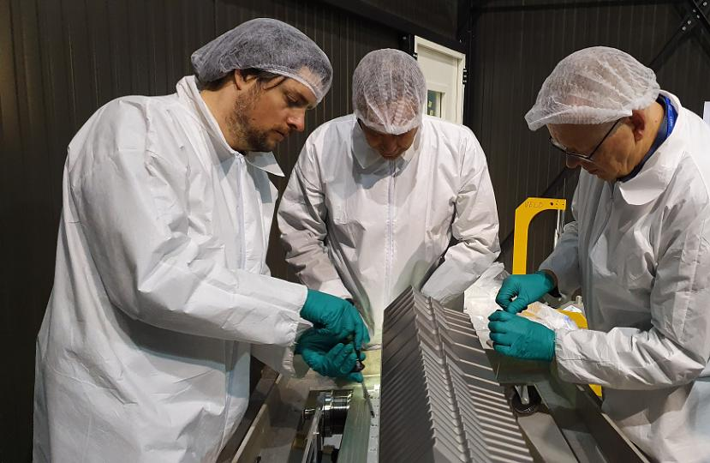
Pre lockdown
Coating issues, production delays
We are almost done with the installation and then COVID-19 happened.
Luckily 1 Nikhef engineer station at CERN.
Mounting of the foils

Slide 3
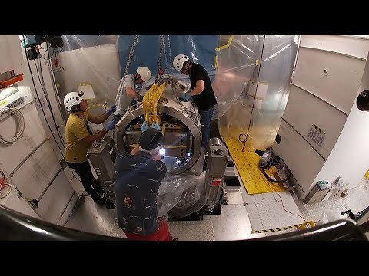
Movie of de-installation of RF foils
All activity at t=0.33 will change with lessons learned.
A link to more RF foil videos,
https://www.youtube.com/channel/UCgv6j8GNL4dzXgU1avzjnWw/videos

Slide 4
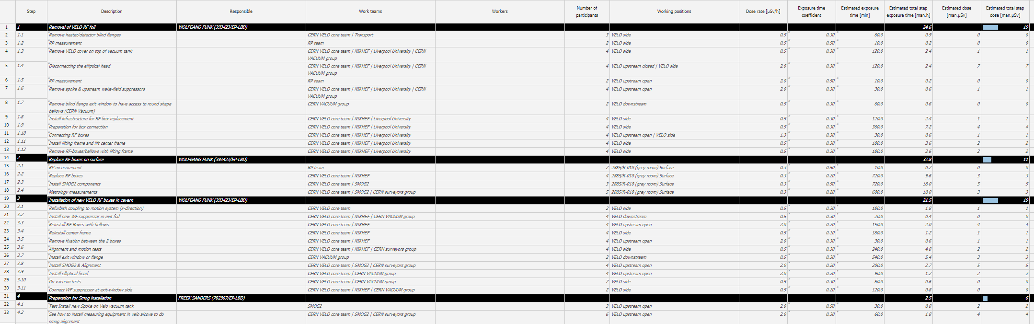
Safety
There is already a detailed plan for how many people work at what position for how long. This was done for the radiation dose planning.
Impact 144083
VIC 5398
DIMR 7985732/2
Work Dose Planning - 2022/2

Slide 5
Covid-19 measurements*
Remote support from Nikhef with a webcam.
  Reduced the amount of people from 5 to 3.
Reduce the amount of persons per activity to the minimum.
Wear face masks at all times. Wear goggles when > 2 meters distances can not be guaranteed.
RP will schedule measurements outside of activity.
Limit planned activity to half a day, too more contingency so that activity and people do not overlap.
Change masks after lunch.
*All measures are to be determined in an additional VIC, planned at 6 may at 14:00

Slide 6
Planning
When | What | Additional support | Amount of persons
06-May | VIC |  | Remote meeting
11-May | Lift RF foil + tooling to velo alcove | Transport | 3
 | Clean tank & pieces to insert. * | Vacuum group | 3-4
12-May | Insert RF foil assembly** | Nikhef remote team | 3
13-May | Remove tooling from alcove** | Transport | 2
 | Lift center frame to alcove | Transport | 2
 | Install center frame** | LHCb support (switching beams) | 3
14-May | Motion test | Xavier Pons | 2
15-May | Aligment of the RF foils* | Metrology team | 3
*Possibility that 2 meter boundary cannot be maintained.
**Certainty that 2 meter boundary cannot be maintained.

Slide 7
Future
Learn lessons from working in a close environment with a lot of people. Will need it for further activities in the Velo Alcove.
Learn lessons on how to work with remote support of additional experts, to support local experts.
Wait for Italian SMOG technicians to be able to come to CERN to install Smog 2.
In the mean time, validate the movement system of the Velo.
No easing of the lockdown foreseen in the UK,
  Construction half of Velo modules. Depends also heavy on travel of delicate parts.
  Assembly of Velo A & C side. CO2 plant needs to be cleaned.
  We will continue full force, but the future is not clear.

