Slide 1







CulturalCollisionsVienna 2019/ 2020 - Aula der Wissenschaft 2019 / mumok 2020.
Cross Disciplinary Science Education & Engagement Format for School Curriculum
EXHIBITION: Meet the Universe, 60th anniversary Austria@CERN- Aula der Wissenschaft Sep 2019
19th IPPOG meeting, May 2020
Michael Hoch for CMS and the art@CMS/ORIGIN team

Slide 2
Cultural Collisions Vienna - WS 2019/2020 and SS 2020
ÖAW announcements of Workshops: https://www.oeaw.ac.at/veranstaltungen/article/kreative-signale-zwischen-physik-kunst/
Content : Cultural Collisions Vienna format:
WS 2019/2020 : Sept. 2019 exhibition & initiation workshops in Aula der Wissenschaft
  Oct. – Nov. 2019 seminars at mumok
  Feb. Vernissage at mumok
SS 2020 : March 2020 exhibition & initiation workshops mumok
  April –May CMS virtual visit, e.g.
  June 15th 19th 2020, mumok, vernissage + exhibition
  June 21st – 30th, BasisKulturWien Atelierhof 1210 Vienna, festival + exhibition B
Collaboration: HEPHY / OeAW - Austrian Academy of Science Institute for High Energy Physics
ORIGIN – Scientific advisory collaboration - cross disciplinary engagement
mumok – Museum moderner Culture Foundation Ludwig Vienna
Bildungsakademie – City School Council
Basis Kultur Wien

Slide 3
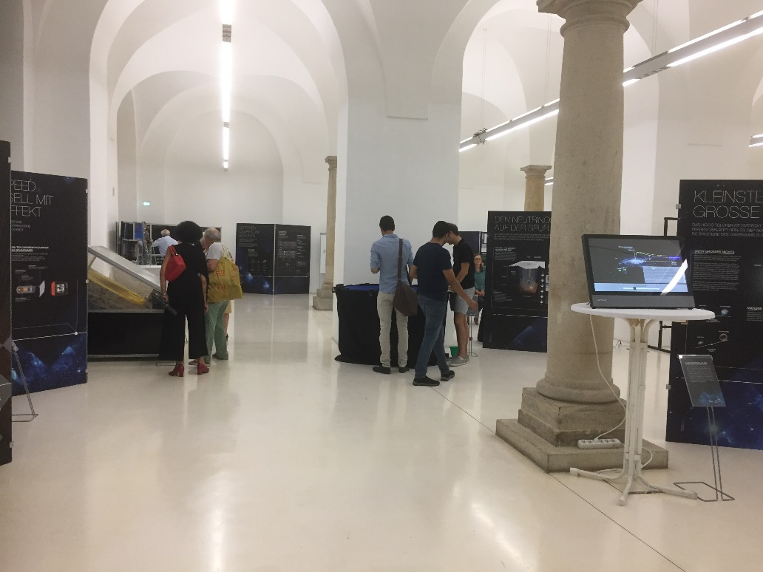
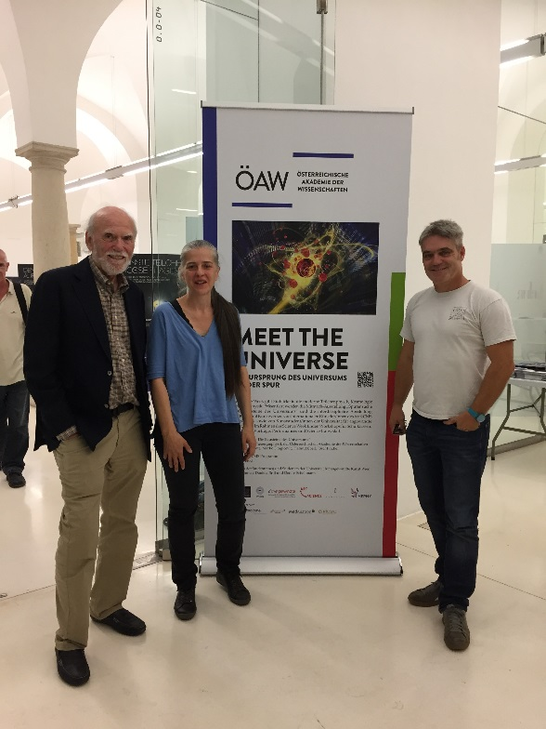
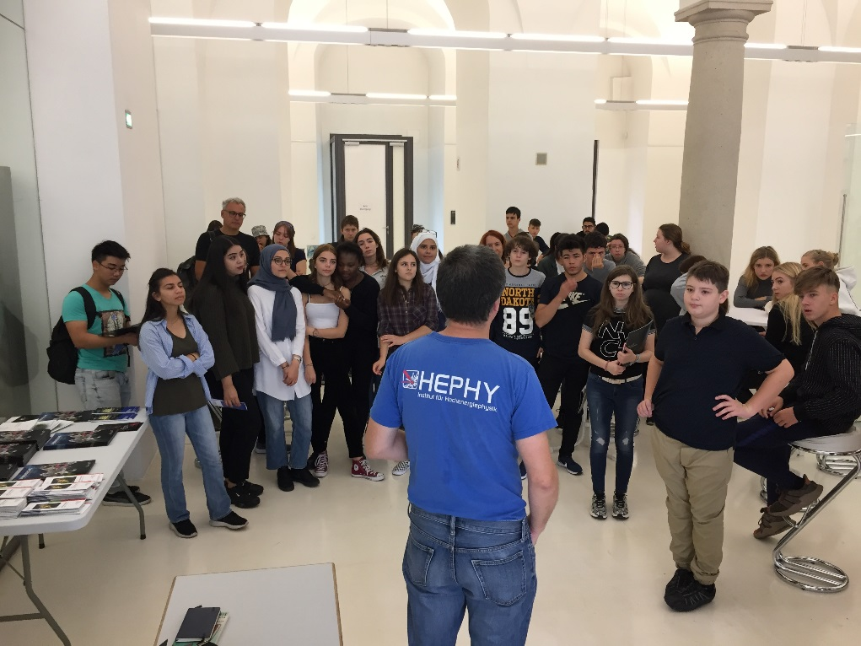
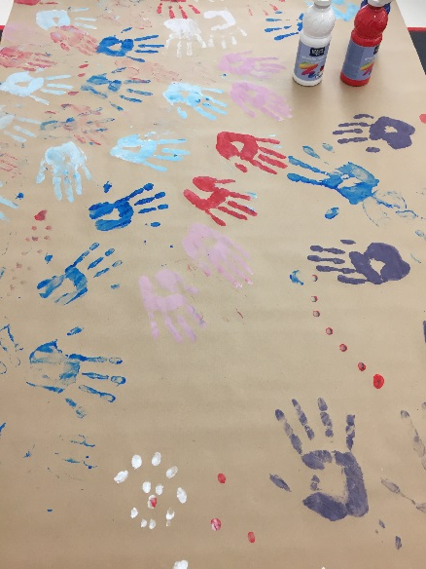
“Meet the Universe” 2019
Cultural Collisions Vienna /Austria by HEPHY Institute OeAW & ORIGIN;
. science & art exhibition [art works by students of Univ. Applied Arts Vienna],
. cross disciplinary workshops for schools [ORIGIN; HEPHY, MUMOK] exhibition September 2019; Cultural Collisions September 2019 – June 2020

Slide 4
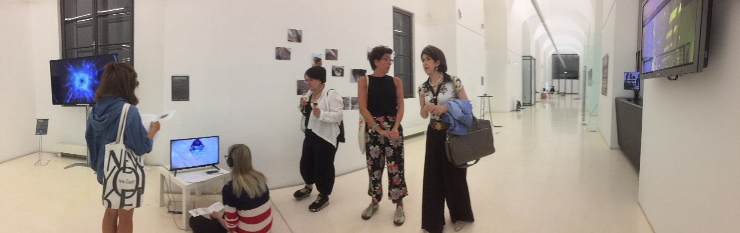
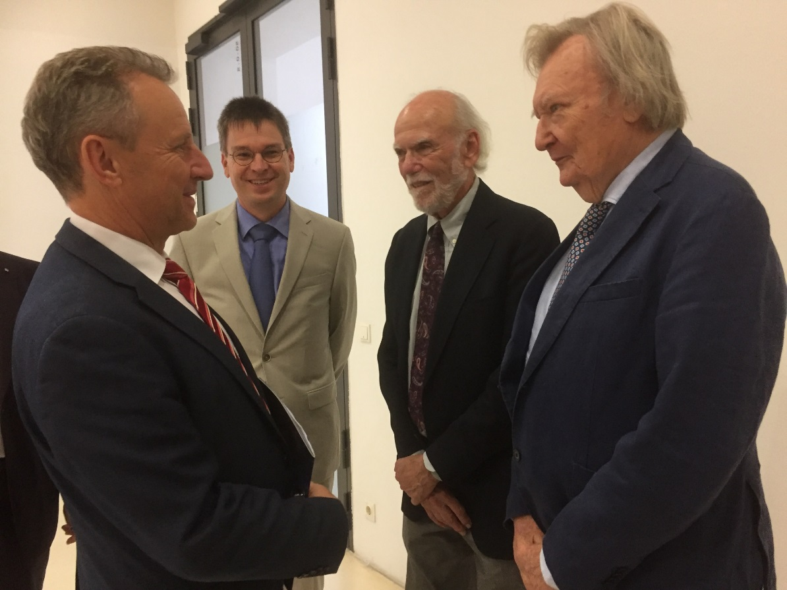
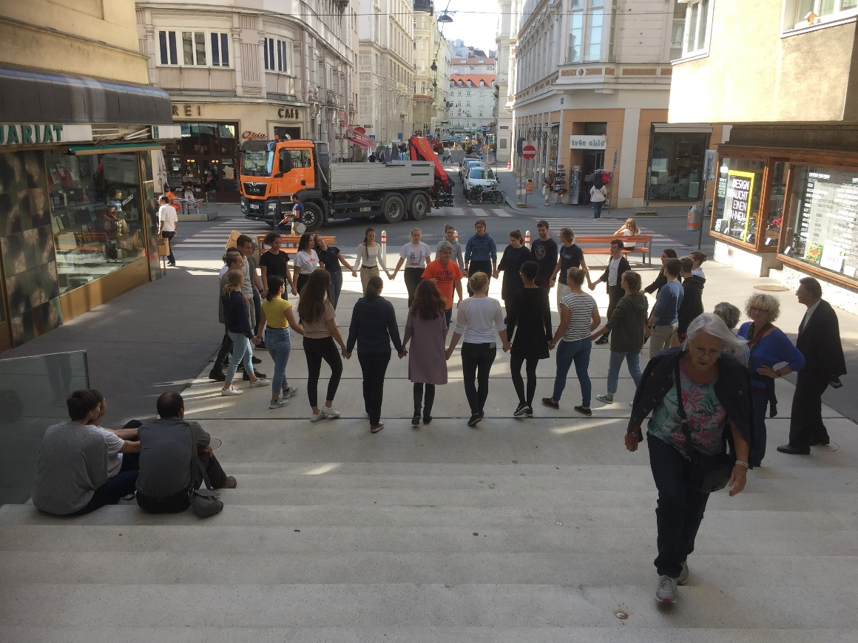
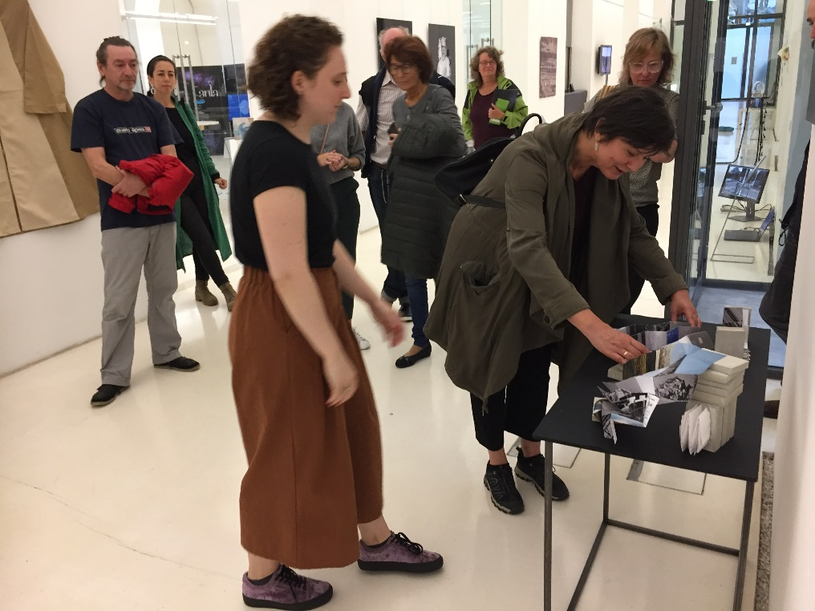
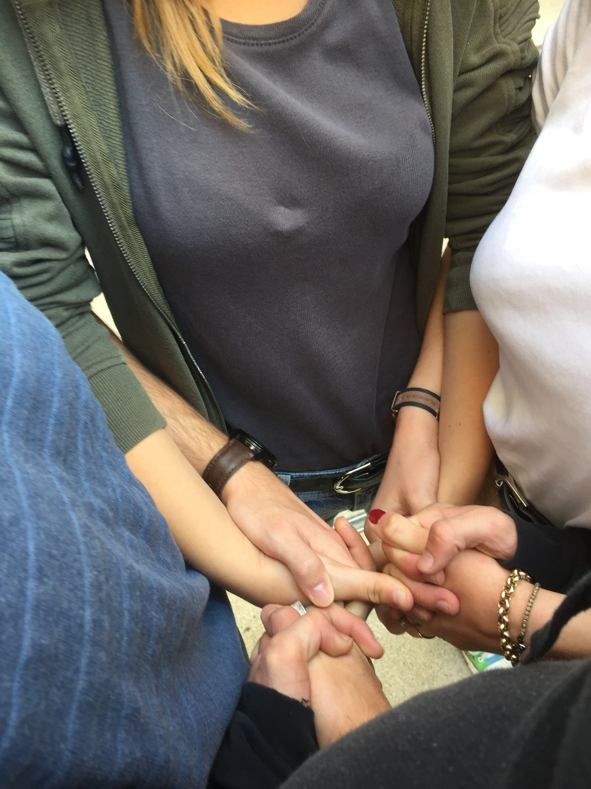
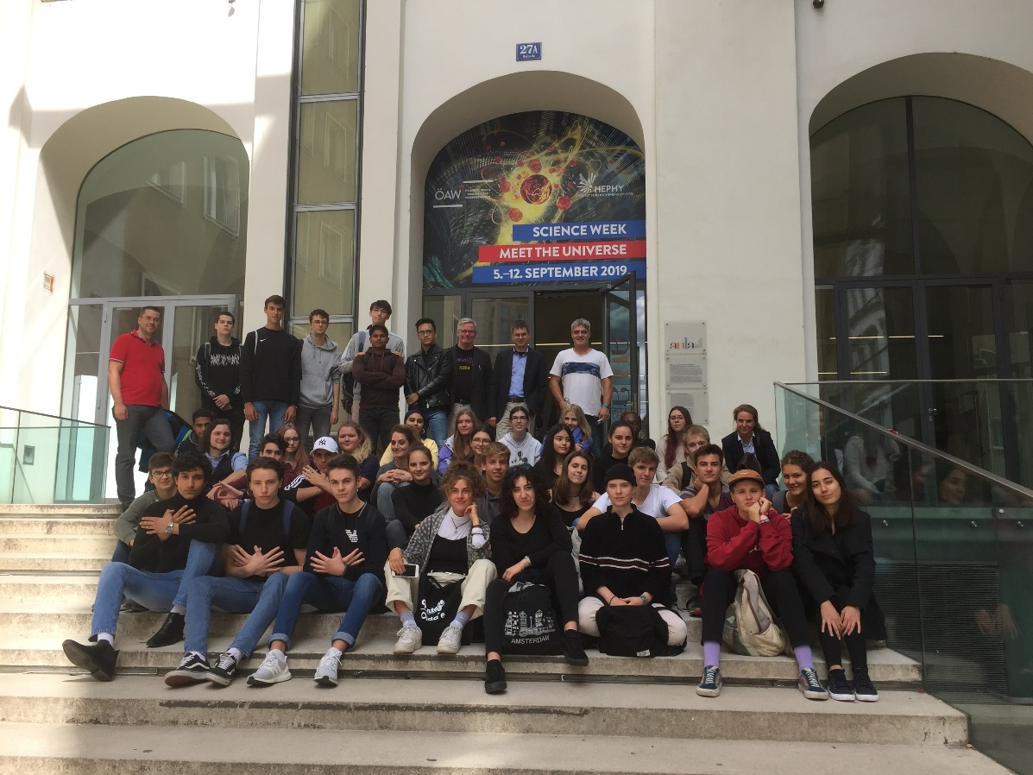
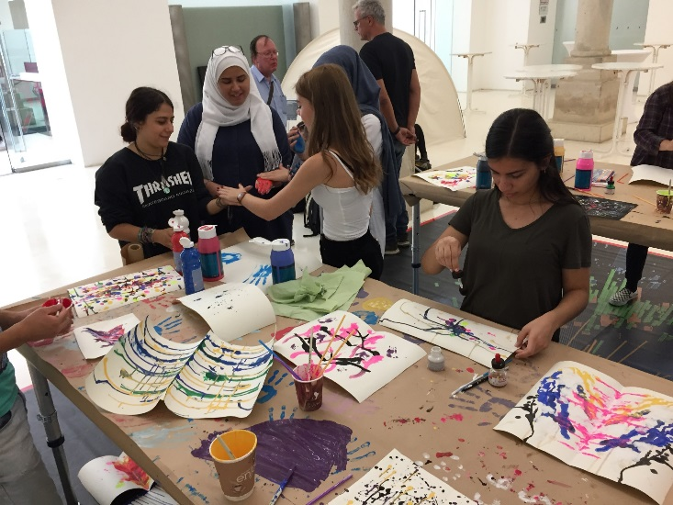
CERN DG Fabiola Gianotti
From left to right:
City Vienna Council President: Erich Wollner,
Director HEPHY: Jochen Schieck
Nobel Prize Laureate 2017 Barry Barish
Nobel Prize Laureate 1984 Carlos Rubbia
Daniela Brill – Applied Arts Vienna

Slide 5
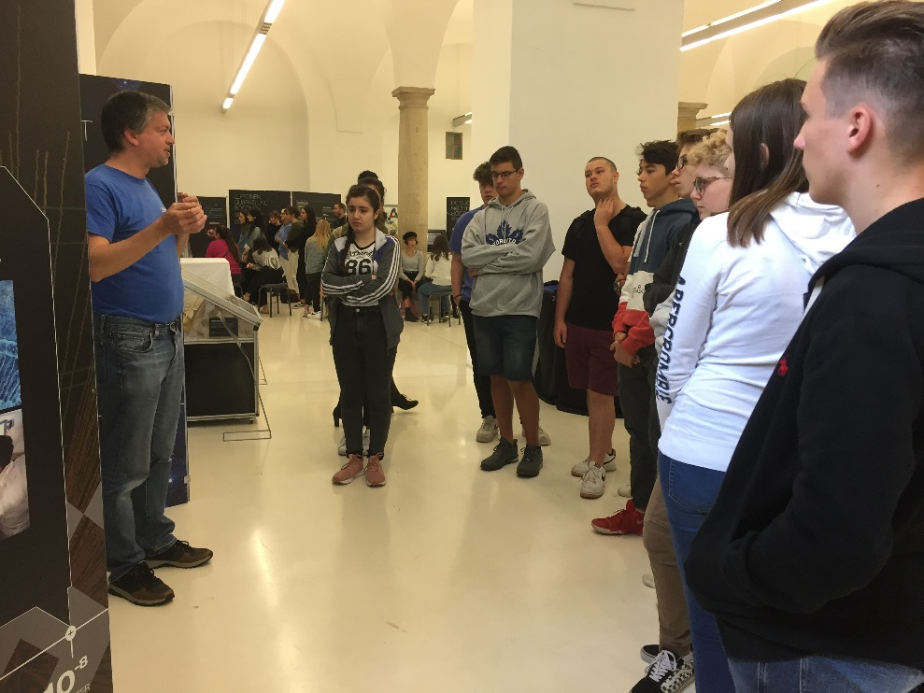
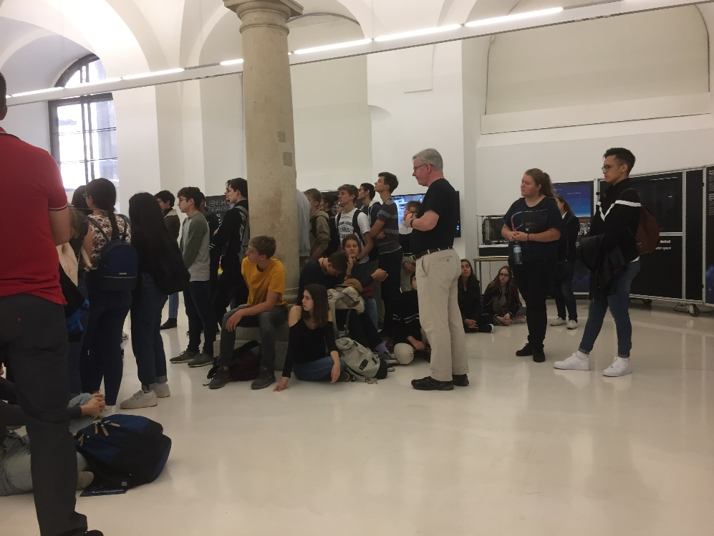
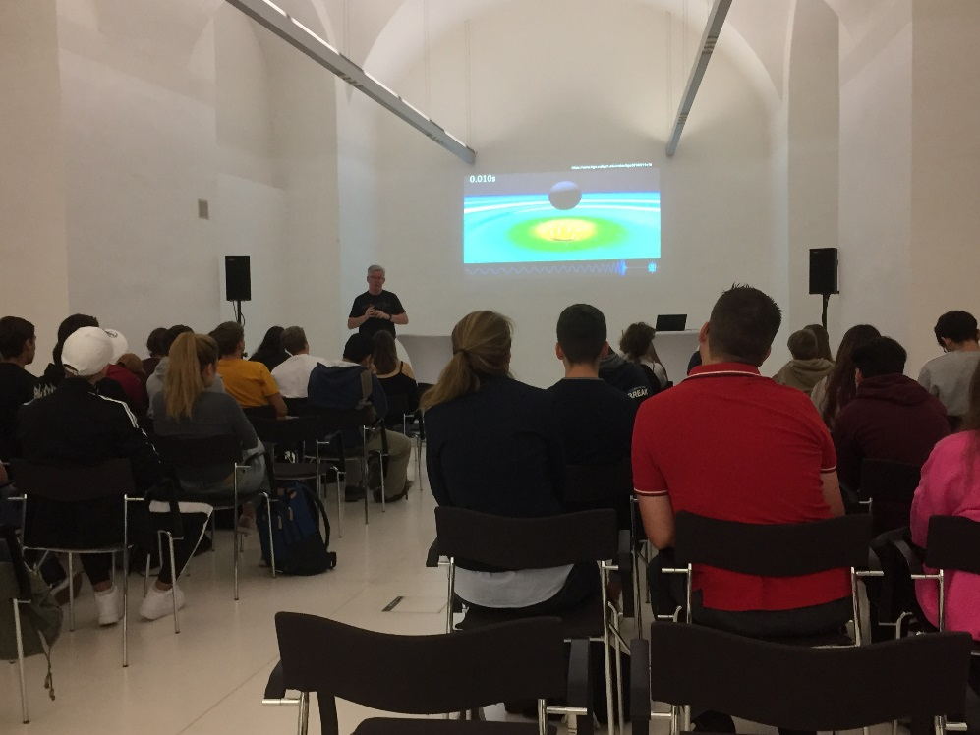
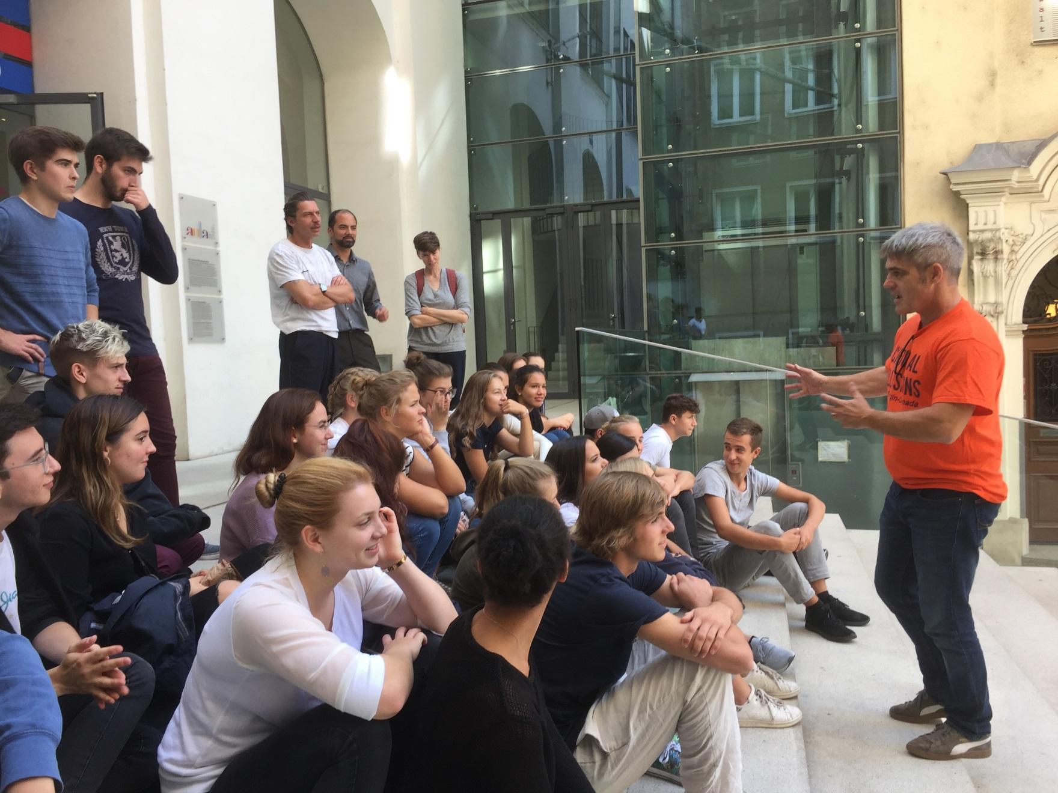
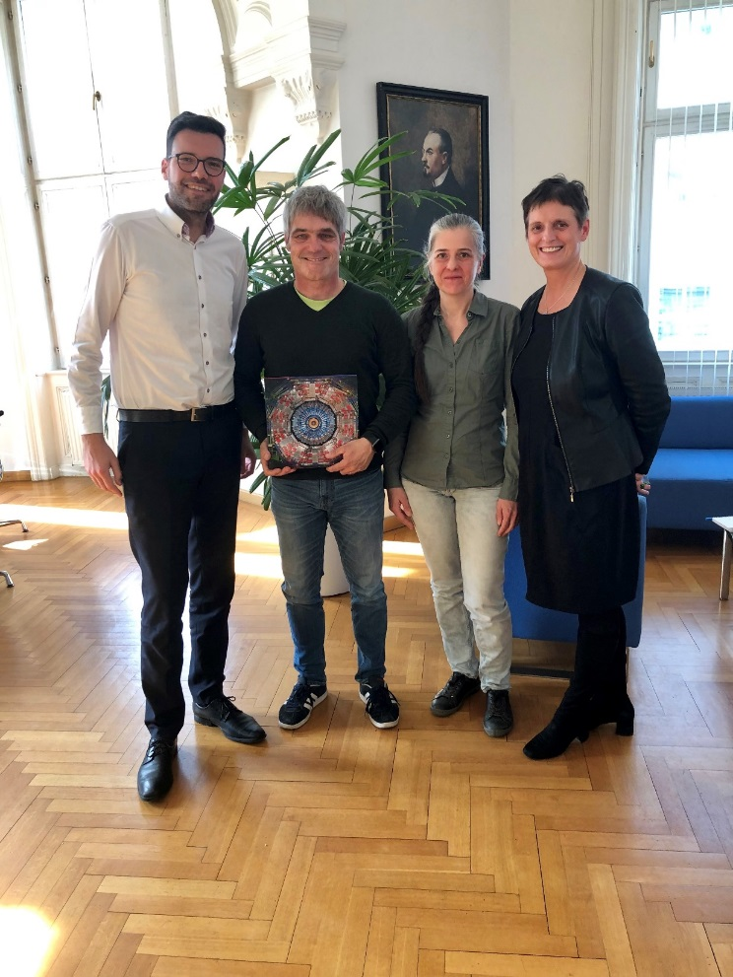
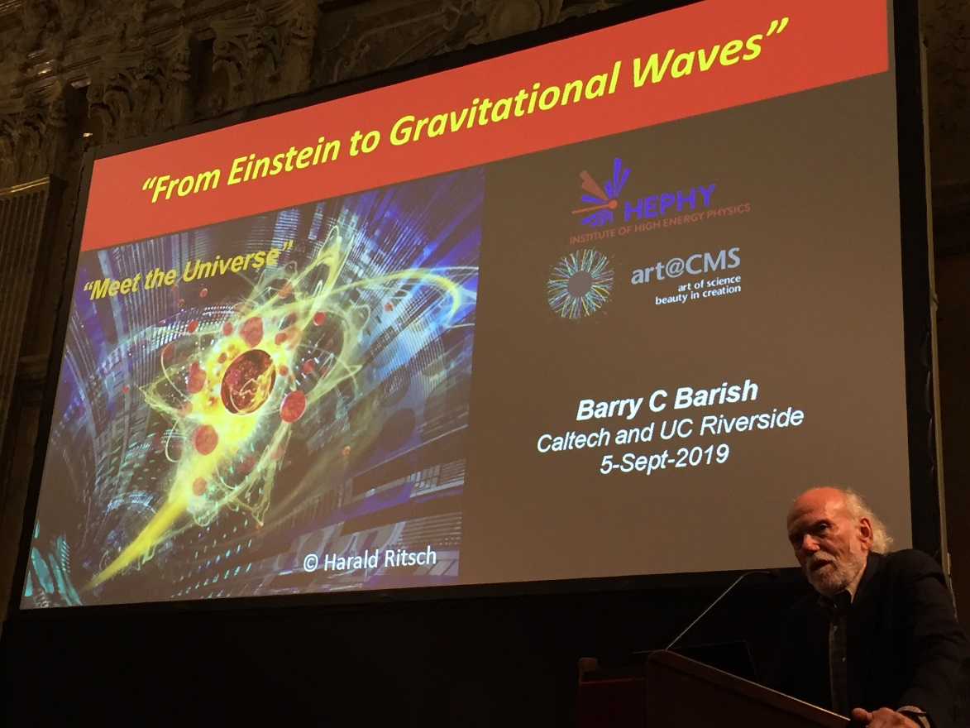
Workshop Markus Friedl /HEPHY
Workshop Martin Hendry LIGO/ Univ. Glasgow
From the right:
President Vienna City School Council: Heinrich Himmer
ORIGIN/CMS: Michael Hoch, HEPHY: Brigitte de Monte
Basis Kultur Wien: Monika Erb
Lecture Barry C Barish

Slide 6
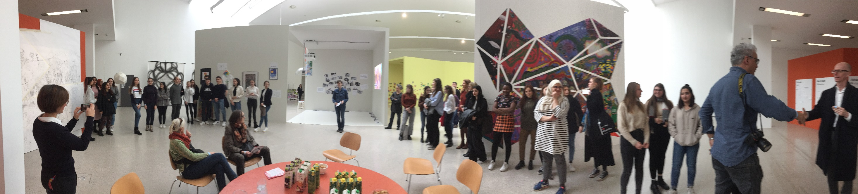
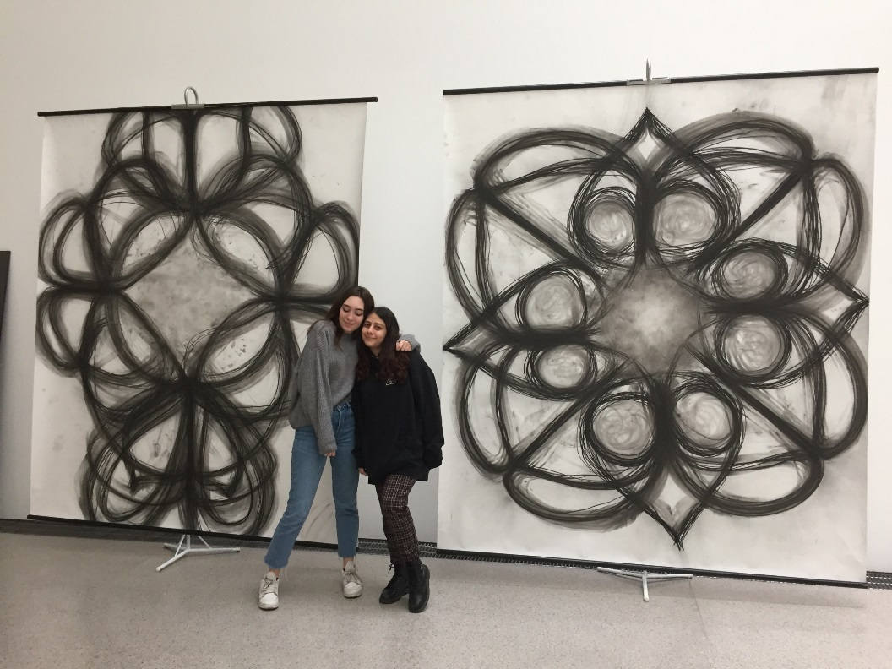
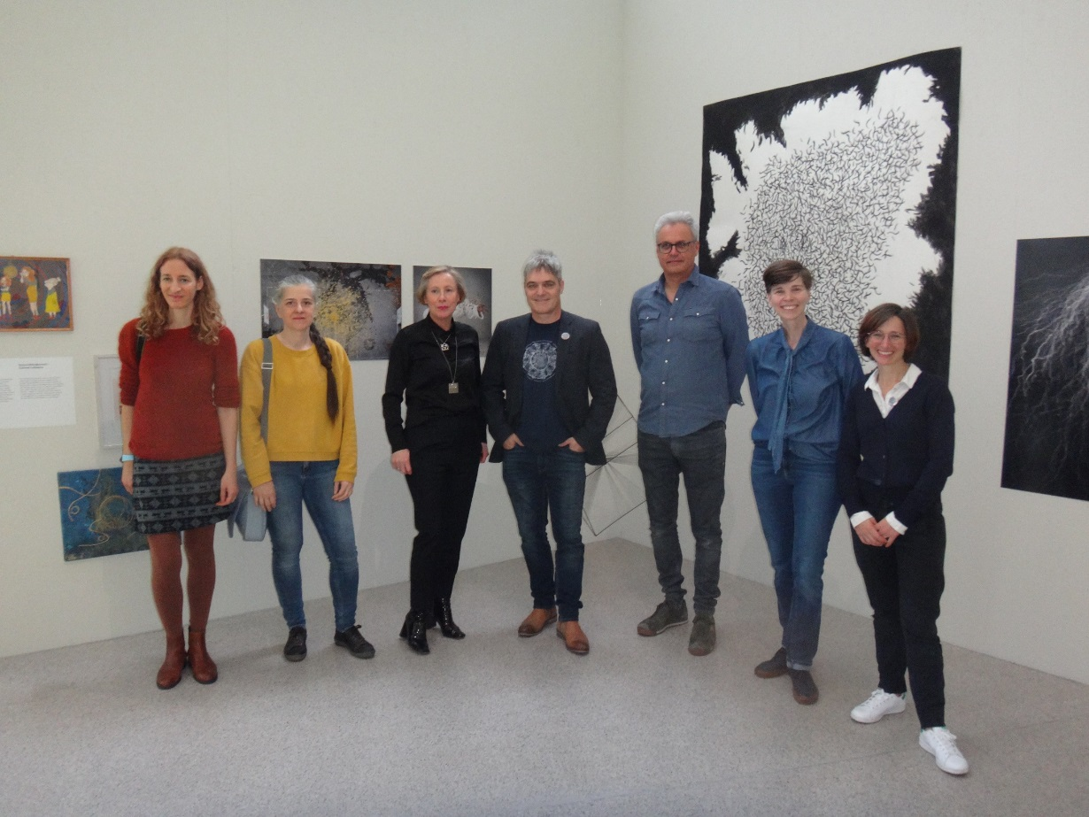
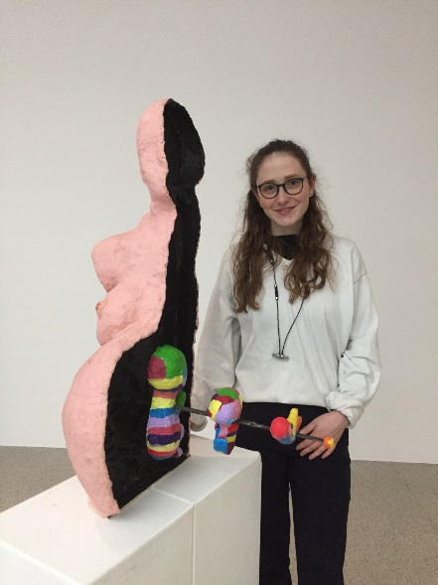
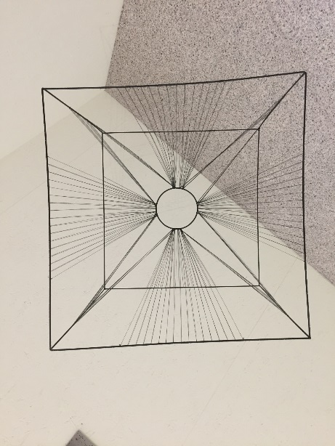
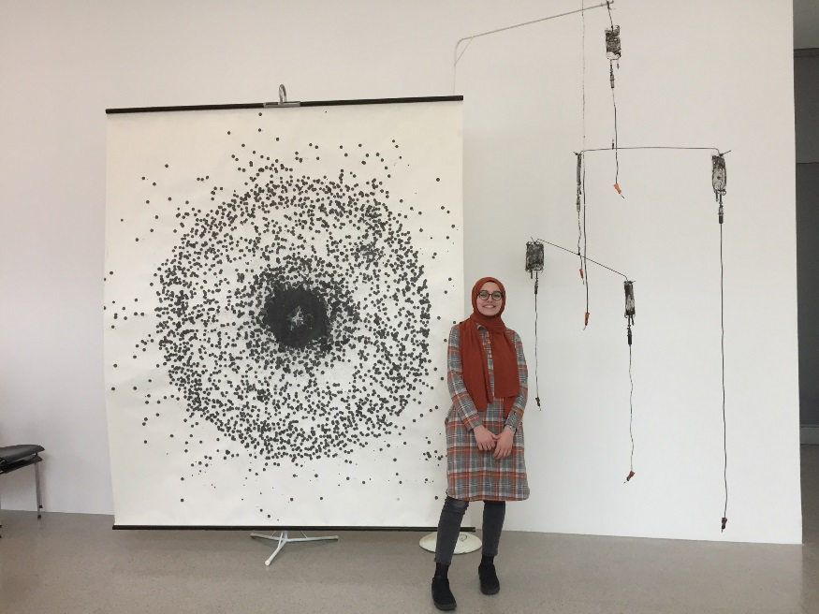
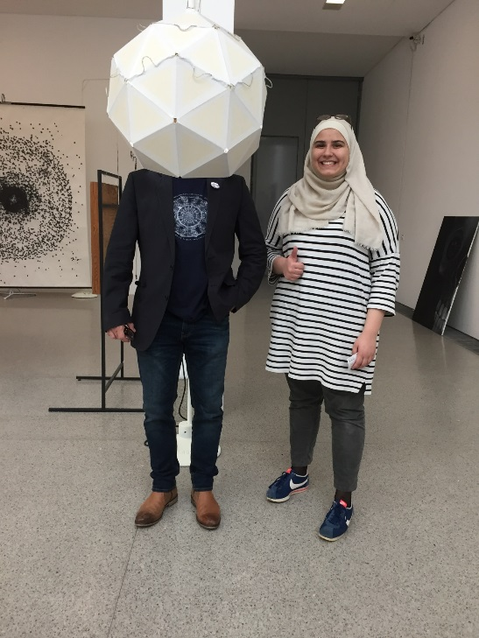
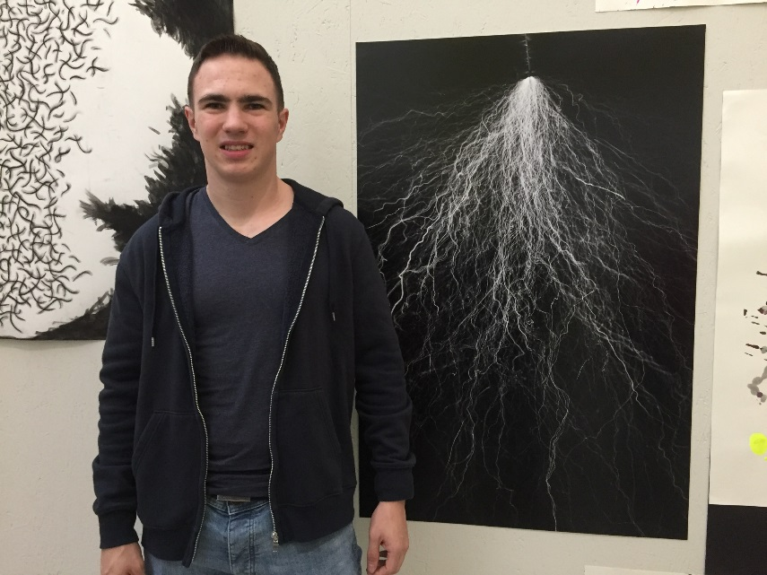
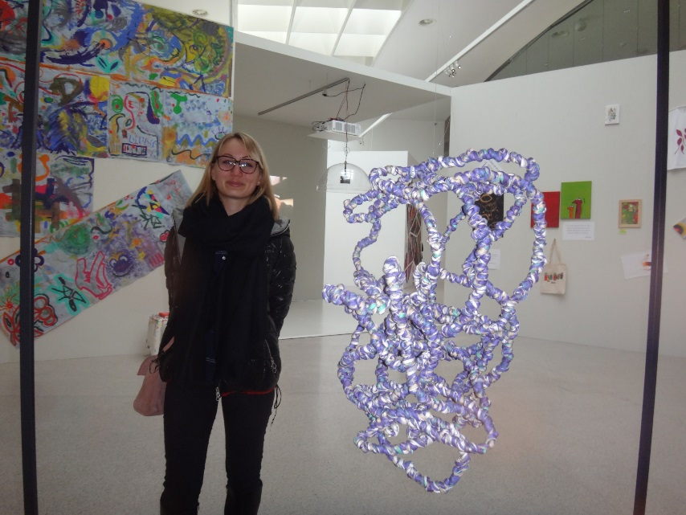
mumok vernissage Wintersemester 2019/2020 – February 28th
Director mumok: Karola Kraus & Team Christine Schelle
Lehrer: Norbert Metz, Anna Scheer, Maria Wambacher

Slide 7
Cultural Collisions – aims & strategies by Christine Morrow
Develop young people’s flexibility, agility and adaptability to move between diverse creative practices and intellectual frameworks.
Nurture interconnectivity between creative, analytical, productive, communicative and performative settings.
Employ approaches and skill-sets across arts, sciences and technology to give young people integrative tools, strategies and insights from multiple sources.
Employ workshop models that support young participants to integrate play, performance, experiment, information, creativity, knowledge-sharing, critical debate and negotiation and presentation
Workshops not for disseminating information or teaching new content but instead, to open up transdisciplinary as a framework to provide young participants the tools to apply, extend and adapt their own existing experience, analysis, insights and evaluation to unfamiliar settings.
Present innovative workshops that extend participants’ team-work and negotiation skills to arrive at collaborative solutions.
Build young people’s confidence, ownership of science topics capacity for innovation and problem-solving.
This will encourage their future leadership to tackle local & global challenges, critical thinking and creative problem solving

Slide 8
Creative Science HUB Vienna
Cultural Collisions Format open to all Science and Technology topics
Cultural Collisions provides : Cross disciplinary Inter - University development
e.g. University of Technology – Applied Arts University Vienna
Increase diversity in science : inspire Girls in Science & Technology via creative approach
more than 2/3 of participating students are female
Cultural Collisions train students in science research and critical thinking
Cultural Collisions students develop 21st centre skills like use creativity in scientific problem solving

Slide 9






Acknowledgement to all institutions involved:
HEPHY https://www.hephy.at/
Austrian Academy of Science https://www.oeaw.ac.at/
mumok https://www.mumok.at/
Bildungsakademie https://www.diebildungsakademie.at/
BASiS KULTUR WiEN https://basiskultur.at/
ORIGIN https://originnetwork.web.cern.ch/
For further questions please contact michael.hoch@CERN.ch phone: +41 754115720

