Slide 1
WP6: Quality Assurance and Reliability Testing
A. Honma, CERN PH/DT
Outline
Mandate
Manpower and Resources
Equipment
Achievements
Current Activities
2010 Plan, 2011+ ?

Slide 2
Mandate
Original WP6: Interconnect Technology and QA (for LHC silicon detector upgrades). Reliability Testing added as an essential QA component owing to lack of accessibility and long expected life times of detectors and electronics.
Common QA lessons learned from LHC silicon detector construction should be documented to avoid mistakes in the LHC detector upgrades.
Provide library of resources for QA planning and procedures as pertains to silicon detectors (pixel or strip sensors, FE electronics, module design and production).
Provide infrastructure (test equipment) and expertise (trained personnel) to apply QA and Reliability Testing for the upgrade R&D and construction phases.
QART lab created for this task. Incorporated into DSF/Bondlab premises.
QART Website: http://bondlab-qa.web.cern.ch/bondlab-qa/QA.html

Slide 3
Manpower and Resources
WP6 Funding in KCHF
 | 2009 | 2010 | 2011
Interconnect | 70 | 115 | 0
QART* | 150 | 85 | 0
Total | 220 | 200 | 0
* = PJAS paid from project budget

Slide 4
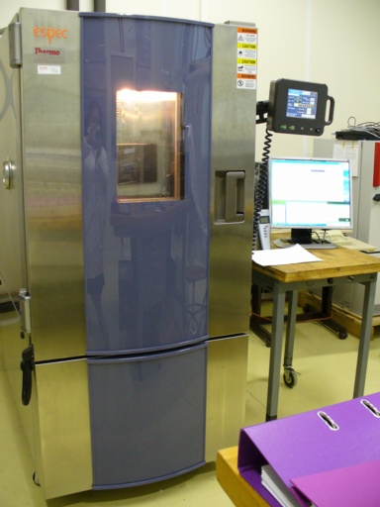
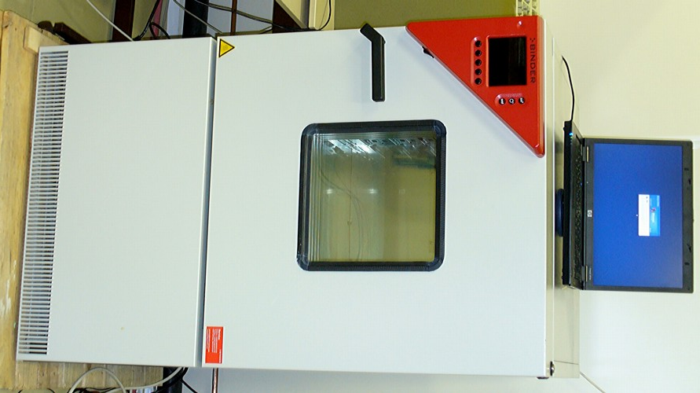
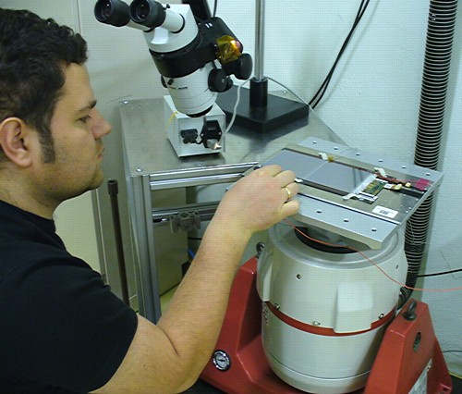
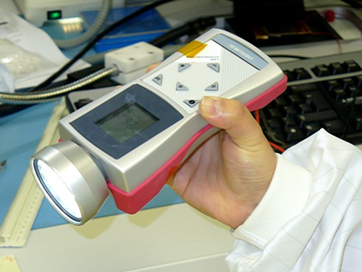
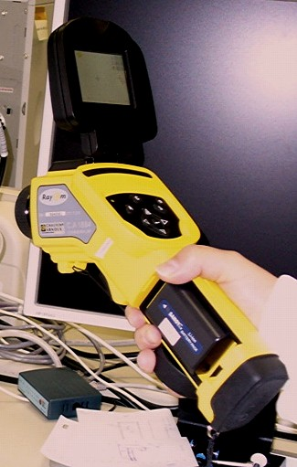
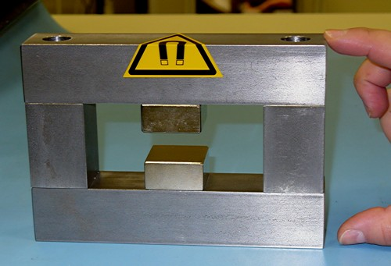
Equipment (QART + Bond Labs)
NEW equipment in magenta (< 2yrs old)
1
  Climatic chamber (large volume, fast temp. cycling with humidity control)
  Thermal cycling chamber (small volume, med. speed, no humidity control)
  Vibration tester (mono-axial shaker can deliver 10G’s to 10Kg payload)
  5KHz stroboscope (for vibration analysis)
  Small aperture permanent magnet with B=0.7T for high mag field studies, 2T electromagnet on order
  Infra-red thermal imaging video camera
2
3
4
6
5

Slide 5
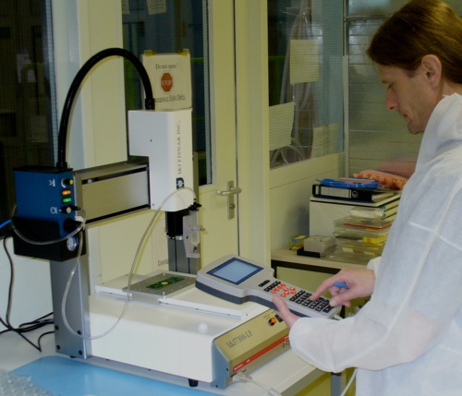
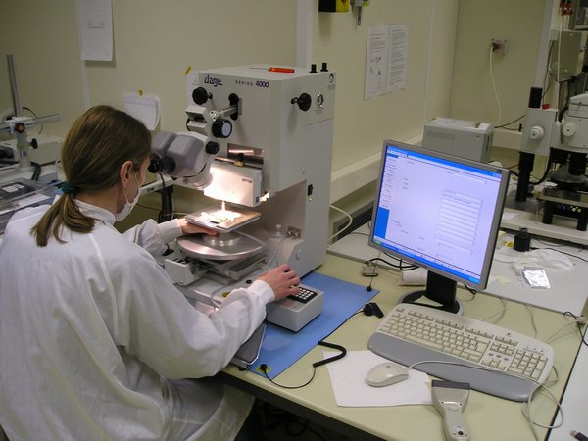
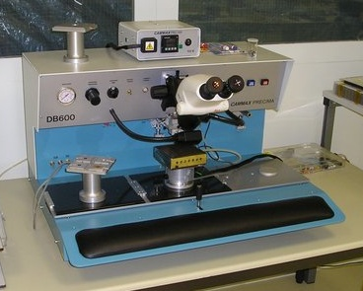
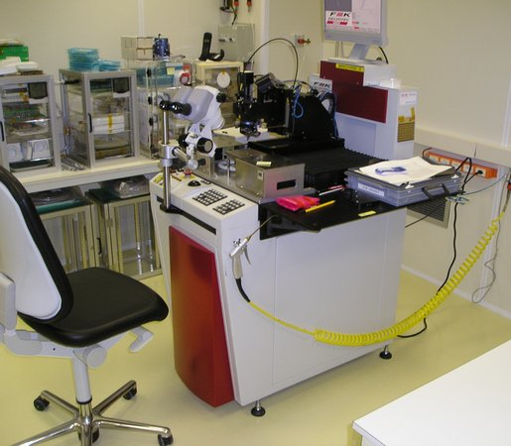
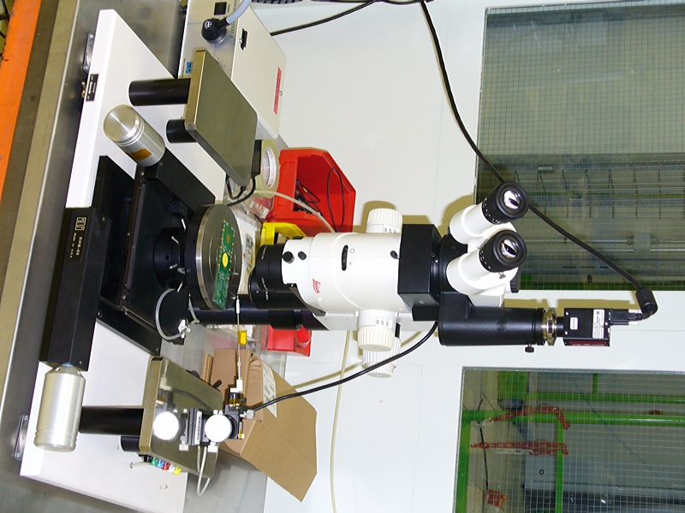
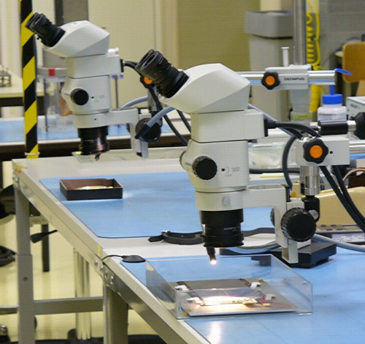
Equipment (QART + Bond Labs)
NEW equipment in magenta (< 2yrs old)
7
8
  Glue dispensing robot for wire bond encapsulation
  Die shear tester / bond wire pull tester
  2 Delvotec 6400 ultrasonic wedge wire bonding machines
  Die bonder with heated chuck (primarily for gluing chips)
  High magnification stereo-microscope on probe station with video camera
  Numerous medium magnification inspection stereo-microscopes
10
9
11
12

Slide 6
Achievements
Commissioning and routine operation of new climatic chamber.
Thermal cycling tests performed for: Front-end electronic (CMS, TOTEM, ALICE), standard PCBs (LHC QPS system, CMS), silicon sensors and chips (Medipix).
Accelerated aging studies performed on PCBs and wire bonds (corrosion, metal migration, oxidation).
Humidity studies made for corrosion and surface charge effects.
IR camera commissioned and initial study of silicon sensor hot spots performed. Camera used for thermal studies by users.
Small test set-up for studying bond wire damage in strong magnet fields produced quickly and at minimal cost. Successfully demonstrated wire vibration and showed agreement with FEA calculations.
Presentations to all 4 major LHC experiment upgrade groups made to inform them of the lab.
Web site is on-line, showing QART lab resources and capabilities.

Slide 7
Current activities
All envisaged major equipment acquisitions have been completed. However, commissioning and operational training still in progress for some. Ongoing activities:
Thermal cycling tests, humidity testing, cold testing as requested by clients. Additional infrastructure improvements (sound-proofing, DI water supply) needed.
Commissioning of vibration test system and vibration recording device in progress. Additional infrastructure for this system (separate sound proof room) needed.
Studies of bond wire damage in magnet fields in progress. 2T laboratory electromagnet ordered (0.7T permanent magnet for now).
Web site continually updated with current state of lab and more QART resources.
Advice and aid for QA issues in many projects. Usually bonding related but some for test jig and module design as well as RT issues.

Slide 8
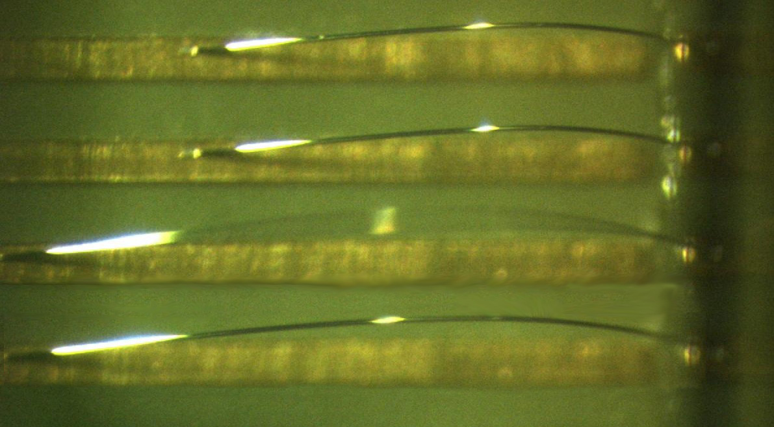
Example study: Wire Bond Breakage
Motivation: CDF silicon strip detector had broken bond wires from vibration owing to AC current at resonant frequency of wires (10-30KHz) in high B field (1.4T).
ATLAS has published an analysis for at-risk bonds in ATLAS silicon detectors. But no known systematic study of effects of wire loop properties and bonding quality on breakage risk. Try to quantify more generally these risks.
We were able to demonstrate the resonant effect with a simple test set-up (0.7T permanent dipole magnet, frequency generator, stroboscope). In addition, we can predict with good accuracy the resonant modes with an ANSYS model.
Resonant oscillation on bond wire of 3.5mm length found at 6.3 KHz. In agreement with FEA calculations
Measured vs Predicted resonant frequency
(primary mode) as function of wire length
Bondwire length | Meas. Freq. | ANSYS Freq.
1.5 mm | 31.6 KHz | 33.1 KHz
2.0 mm | 19.0 KHz | 21.0 KHz
2.5 mm | 12.8 KHz | 13.3 KHz
3.0 mm | 8.6 KHz | 9.2 KHz
3.5 mm | 6.3 KHz | 6.9 KHz

Slide 9
2010 Plan, outlook 2011+
Fully commission and be capable of running quality/reliability tests on all equipment.
Assist clients in determining and performing appropriate reliability tests. Provide advice on QA planning and application to silicon detector R&D and construction.
Continue developing resource and experience on-line library concerning quality assurance for silicon detector projects.
Hold Workshop on QA experience from LHC silicon detectors construction, commissioning and operation. In addition, invite contributions from any recent silicon detectors in HEP. Goal: late 2010.
And for 2011+ ??
Future depends on usage by user community.
Delay of LHC schedule ➔ delay of detector upgrades ➔ delay of lab usage.
Hence opening facility to a larger community.
WP6 funding will stop at the end of this year.
QART lab to become part of the DSF run by DT(?)
Anticipated 2011+ QART lab manpower requirement: 2 FTE.

