Slide 1
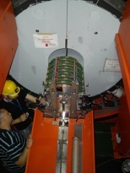
WP5: Micropattern Gas Detectors
status report
Leszek Ropelewski
CERN – PH - DT
RD51 Collaboration Site
CERN, DT Steering Committee meeting, 30th of April 2010

Slide 2
WP5 Micropattern Gas Detectors: Mandate and Objectives
Within this work package PH department will help initiating an R&D collaboration for MPGD, in analogy to RD50. Its goal is to bundle and coordinate detector development and simulation work, which is currently being performed in numerous groups at universities and research institutes. The collaboration will allow to:
- structure, coordinate and focus ongoing R&D efforts;
- share knowledge, experience and infrastructure, agree on common test and quality standards;
- coordinate widespread simulation efforts towards setting-up a common maintainable software package for gas detector simulations;
- share investment of common projects (e.g. larger mask sets for GEMs).
Besides the initiating task, specific development work on MPGD (mostly GEM) will be carried out. General performance properties like rate capability and radiation tolerance of detectors and materials used for construction will be evaluated. This will comprise measurements of the maximal gain, temporal and spatial stability, rate capability, time resolution and discharge probability. The performance will be compared with alternative gas detector technologies (Bulk Micromegas; Thick GEM).
Main emphasis is put on the development of large size (~m²) planar detectors, including their full characterization and integration towards priority applications.
CERN-PH will also contribute towards the common maintainable software package.
Deliverables | Description | Nature | Date
1 | Construction of small prototypes | Prototypes | 30-Aug-08
2 | Full characterization of small prototypes | Beam and lab tests | 31-Dec-08
3 | Technology assessment report within new collab. framework | Report | 30-Apr-09
4 | Construction of large detector prototype | Prototype | 30-Aug-09
5 | Full characterization of large prototype | Beam and lab tests | 30-Jun-10
6 | Prototype maintainable simulation package | Software+Report | 30-Jun-10
7 | Construction of integrated large detector prototype | Demonstator | 31-Mar-11
8 | Full characterization of integrated detector prototype | Beam and lab tests | 31-Dec-11
9 | Full maintainable simulation package | Software+Report | 31-Dec-11

Slide 3
WP5 Micropattern Gas Detectors: Resources
People involved:
M. Alfonsi Fell (1), S. Martoiu Fell (1), R. Veenhof PA (1), G. Croci Doct (1) WP5
M. Villa Doct (1), H. Schindler Doct (1) other programs
L. Ropelewski (0.5), H. Taureg (0.7) , S. Duarte Pinto Doct (1), E. David (.5), M. Van Stenis (0.7), B. Brunel (0.5) PH-DT
H. Muller (0.3), A. Sharma (0.3), J. Wotschack (0.3) experiments
5 | Micropattern Gas Detectors
WP5-1 |  |  |  | Begin | 01-Jan-08
 |  |  |  | End | 31-Dec-11
Year | 2008 | 2009 | 2010 | 2011 | total
Staff existing (in RRP) | 0.5 | 2.0 | 3.0 | tbd | 5.5
Staff new cat2 (FTE) | 0.0 | 1.0 | 2.0 | tbd | 3.0
Staff new cat3-4 (FTE) | 0.0 | 0.5 | 0.5 | tbd | 1.0
Fell/Ass/Stud (FTE) | 1.5 | 2.0 | 2.0 | 2.0 | 7.5
M (project) (kCHF) | 150 | 200 | 200 | 150 | 700
M (oper.) (kCHF) | 20 | 60 | 90 | 60 | 230

Slide 4
WP5 - DT RD51 Activities Indico [MPGD]
RD51 organization proposal approved by CERN RB; coordination; 4 MPGD workshops 94th LHCC Meeting Agenda (02-03 July 2008) CERN-LHCC-2008-011 186th Research Board meeting
Large area GEM detectors development new technology development and evaluation, prototype construction, paper presented in IEEE NSS/MIC Symposium in Dresden test beam test– electronics, DAQ
New amplifiers structures and geometries blind (TH)GEMs with/without resistive anode; spherical GEM
Development of large UV photon detectors for RICH applications based on THGEM technology technology evaluation, beam test, paper presented in IEEE NSS/MIC Symposium in Dresden
Development of radiation hard MPGD technologies construction materials, detector components, detectors (GEM, Micromegas) radiation hardness evaluation, progress reported during RD51 workshop
Development of electronics for MPGD requirements definition, chip matrix, scalable readout system
Software tools development for MPGD simulations GARFIELD model refinements for electron transport and field calculation, interface to GEANT4 and ROOT, comparison with experimental data, RD51 WG coordination, detector seminar, progress reported during RD51 workshop (Rob, Heinrich, Gabriele, Matteo) micro tracking and neBEM field calculation implementation
General support in detectors construction and tests CERN groups, experiments and external institutes
Gas detector lab infrastructure gas system, new X-ray generators, DAQ, support
Beam facility for RD51 RD51 WG coordination, requirements and contributions for the beam and irradiation facilities, CERN contribution (trigger, tracker), services installation SPS Schedule
MPGD Production aspects RD51 WG coordination, IP, production facility requirements, industrial partners, EN ICE DEM workshop upgrade

Slide 5
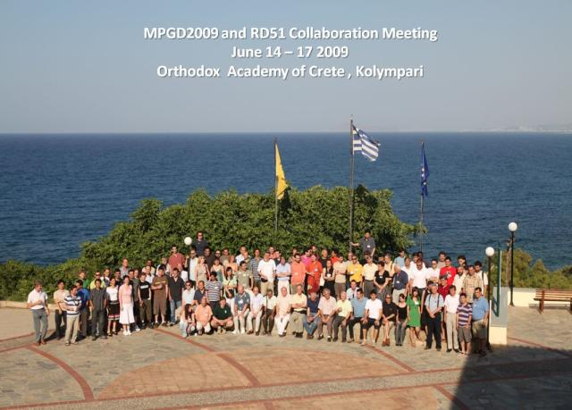
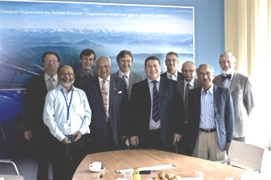
RD51 Collaboration: Milestones
CERN MPGD workshop (10-11 September 2007)
Micro Pattern Gas Detectors. Towards an R&D Collaboration. (10-11 September 2007)
1st draft of the proposal presentation during Nikhef meeting (17 April 2008)
Micro-Pattern Gas Detectors (RD-51) Workshop, Nikhef, April 16-18, 2008
Gas detectors advance into a second century - CERN Courier
Proposal presentation in LHCC open session (2 July 2008)
94th LHCC Meeting Agenda (02-03 July 2008);
CERN‐LHCC‐2008‐011 (LHCC‐P‐011)
LHCC closed session (24 September 2008)
Meeting with LHCC referees (23 September 2008); LHCC-095 minutes
2nd RD51 Collaboration meeting (Paris 13-15 October 2008)
2nd RD51 Collaboration Meeting (13-15 October 2008)
CERN Research Board approval(5 December 2008)
186th Research Board meeting minutes
WG2 meeting (10 December 2008)
WG1 meeting: large area MPGDs (21 January 2009)
GEM & Micromegas detector assembly training session (16 February 2009)
RD51 Mini-Week (27-29 April 2009)
3rd RD51 Collaboration Meeting (Kolympari, Crete, June 16-17, 2009)
MPGD2009 Conference
RD51 Mini-Week (CERN, September 23-25, 2009)
4th RD51 Collaboration Meeting (CERN, Nov. 23-25, 2009)
LHCC review (17-18 February 2010)
Collaboration of ~70 institutes worldwide, ~ 400 authors
MoU -70% signed
Common Fund – 50% collected

Slide 6
RD51 Collaboration – Activities
Consolidation around common projects: large area MPGD R&D, CERN/MPGD
Production Facility, electronics developments, software tools, beam tests
WG1: large area Micromegas, GEM; THGEM R&D; MM resistive anode readout (discharge protection); design and detector assembly optimization; large area readout electrodes and electronics interface
WG2: radiation tolerance, discharge protection, rate effects, single-electron response, avalanche fluctuations, photo detection with THGEM, TPC (IBF) readout optimization
WG3: applications beyond HEP, industrial applications (X-ray diffraction, homeland security)
WG4: microtracking; neBEM field solver, electroluminescence simulation tool, Penning transfers, GEM charging up; MM transparency and signal, MM discharges
WG5: scalable readout system; Timepix multi-chip MPGD readout
WG6: CERN MPGD Production Facility; TT Network
WG7: RD51 test beam facility (November 2009 - 8 groups/5 setups)

Slide 7
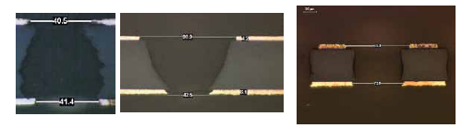
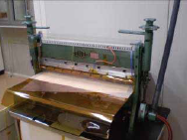
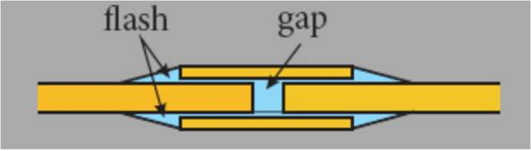
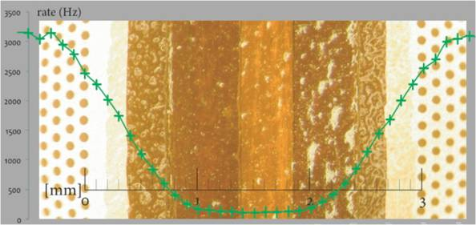
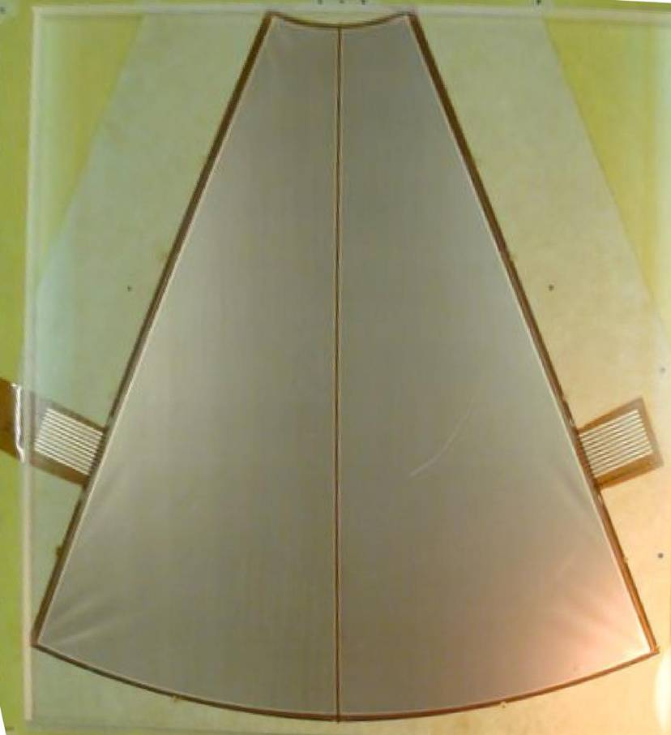
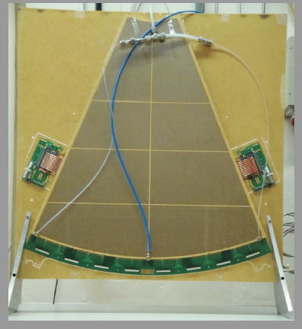
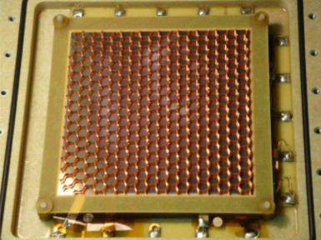
Large Area GEM Detectors Development
New single mask technology:
Development and evaluation
with small prototypes
Technology picked up by:
KLOE, TOTEM, CMS
Two-sectors triple-GEM prototype for
TOTEM T1 upgrade
(60x60 cm²)
Tested in the RD51 beam facility
60 cm

Slide 8
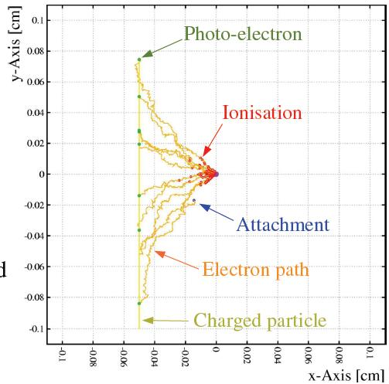
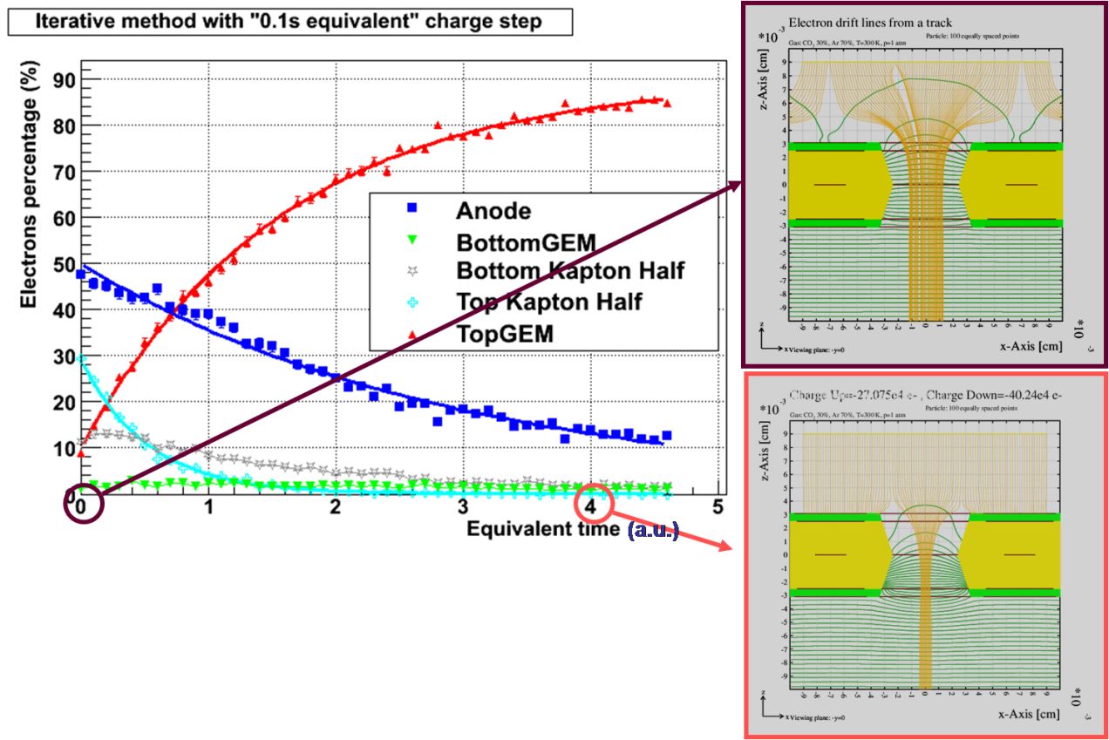
Software Tools Development for MPGD Simulations
Objective: Development of common, open access software and documentation for MPGD simulations
Development of common platform for detector simulations (gas detector simulation in Geant4, interface to ROOT).
Development of algorithms (in particular in the domain of very small scale structures - implementation of nearly exact boundary element method interfaced to Garfield).
Simulation improvements (penning transfer
studies, photon excitation via excimers)
New features:
microscopic electron tracking + avalanches (under test);
updates of the gas parameters (regularly);
boundary element field calculations);
root+Geant4 interface (prototypes).
In progress:
avalanche statistics;
Penning transfer from experimental data.

Slide 9
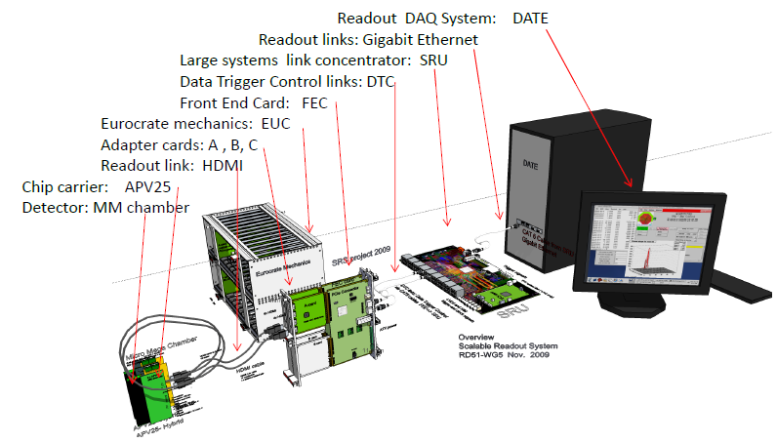
Development of Portable Multichannel DAQ Systems for MPGD
First prototype system
to be ready in Fall 2010
LHC exp. upgrade users:
ATLAS Micromegas upgrade (MAMMA)
ALICE: DCAL and EMCal readout upgrade
Scalability from small to large system
Common interface for replacing the chip
frontend
Integration of proven and commercial
solutions for a minimum of development
Default availability of a very robust and
supported DAQ software package.
→ Scalable Readout System
H. Muller, RD51 Collab. Meet., Nov.23-25, 2009, WG5 Meeting

Slide 10
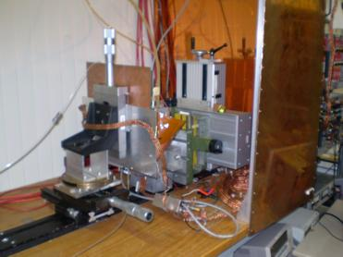
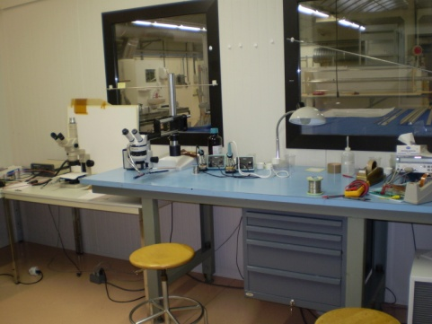
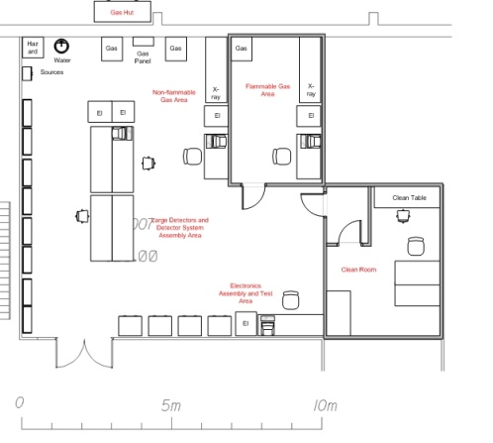
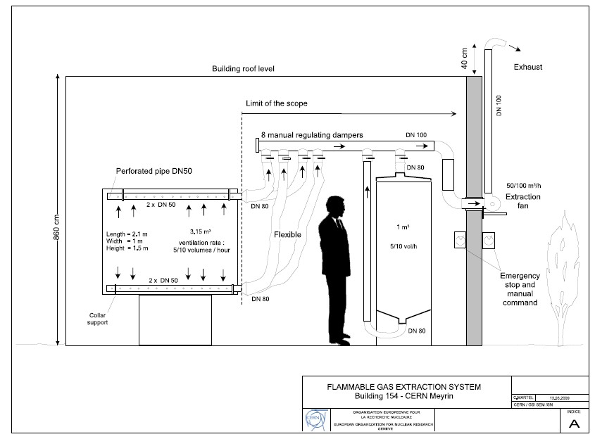
Gas Detector Lab Infrastructure – bld 154
Lab infrastructure:
Clean room
3 X-Ray tubes
4 test stations
assembly space
Gas system:
Upgrade to flammable
gas mixtures
Une installation de détection constituée de
- 8 capteurs OLC20 avec ses supports et ses liaisons NG4
- 4 interfaces WB
- 6 panneaux lumineux avec leur liaison 2 x 2.5
- 4 sirènes avec leur liaison 2 x 2.5
- 1 interface d’acquit sirène
- la pose des chemins de câble et des câbles nécessaires à l’installation
- 1 électrovanne avec leur liaison 3 x 1.5
- 1 coupure électrique avec leurs liaisons NG4
- 1 commande ventilation/extraction
1 mode maintenance
Lab is being used by several groups including ATLAS, CMS, TOTEM, COMPASS

Slide 11
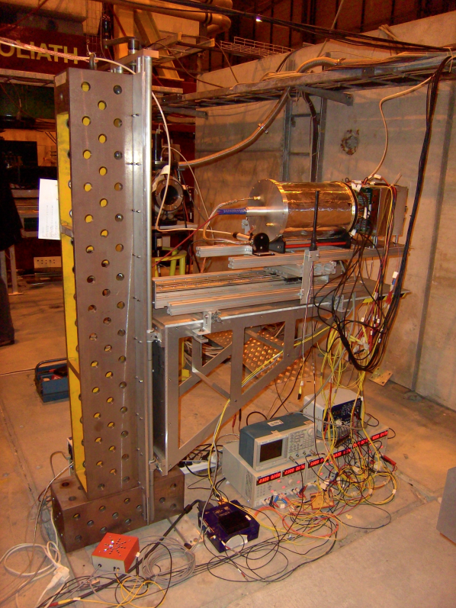
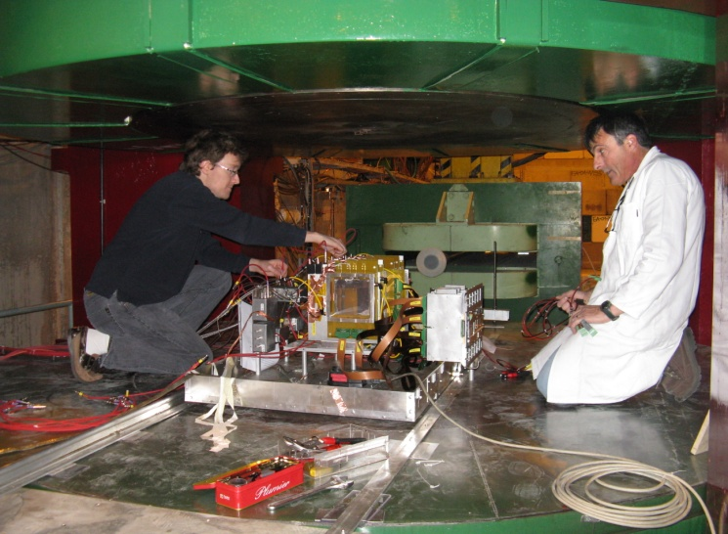
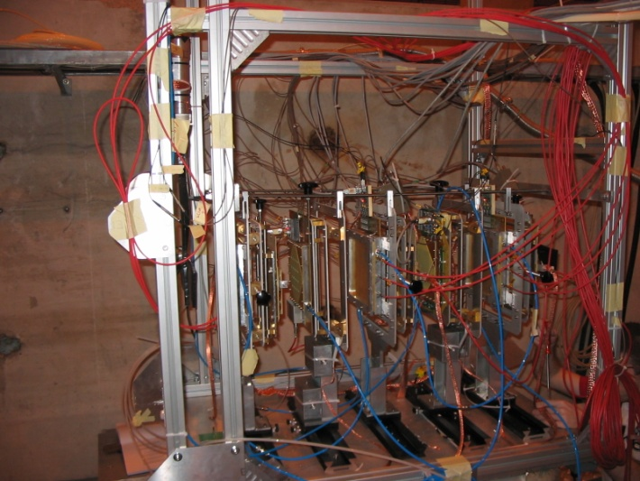
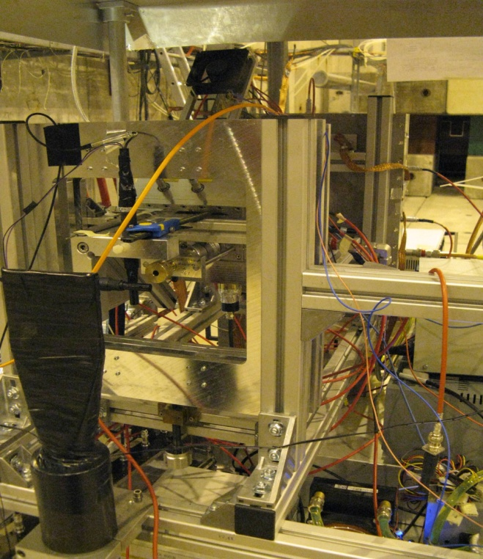
RD51 Common Beam Test Facility
Objective: Design and maintenance of common infrastructure for detector
characterization (“semi-permanent” test-beam infrastructure at CERN SPS@H4 beam)
Bonn setup
(ILC TPC)
SACLAY setup
(CLAS12, COMPASS)
RD51 GEM & Micromegas Telescope
Trieste setup
(COMPASS RICH)
INFN setup (KLOE2)
Common infrastructure:
Services, trigger, tracking
Telescope, DAQ, Slow control
8 RD51 groups have been taking data in parallel during
the last test beam campaign (Oct. 22 – Nov. 2, 2009)

Slide 12
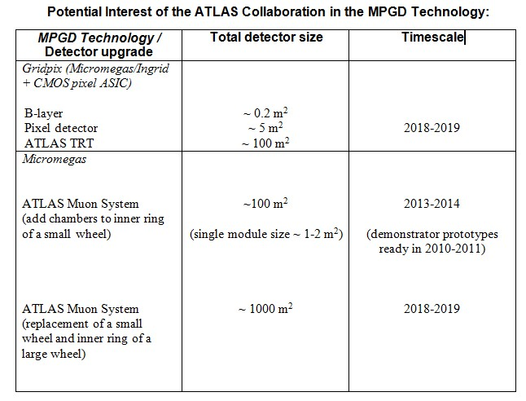
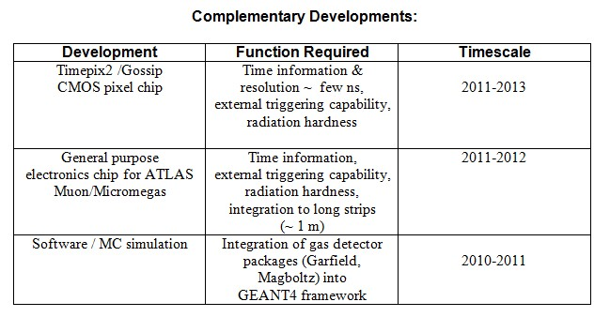
MPGD in the sLHC Upgrades – Requests from Experiments
Atlas - Nigel Hessey
CMS - Jordan Nash
LHCb - Sheldon Stone
ALICE - Paolo Giubellino
TOTEM - Angelo Scribano
PANDA - Bernd Voss
ATLAS – Micromegas (muon)
CMS – GEM (muon)
LHCb – GEM (muon)
ALICE – THGEM (photon detector)
TOTEM – GEM (tracker & trigger)
Panda & GSI – GEM (tracker)
LC Time Projection Chamber – Micromegas & GEM
LC Hadronic Calorimeter (DHCAL) - Micromegas & GEM
STAR & RHIC – GEM (tracker)
KLOE2 – GEM (tracker)
JLAB – GEM & Micromegas
Potential clients from neutrino community

Slide 13
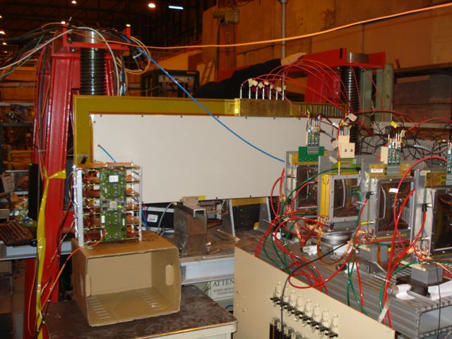
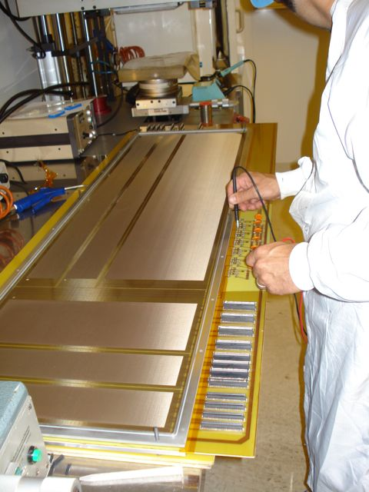
ATLAS Micromegas R&D (MAMMA)
Purpose: Development of large-area muon chambers based on bulk Micromegas technology
Collaboration: 19 institutes (most) in ATLAS, but also active in RD51
Main lines of R&D activities:
Spark neutralization and/or suppression
  Resistive coating on readout strips
  Multi-stage amplification schemes
Large-area chambers
  P3 (1.5 x 0.5 m²) successfully tested in H6; strips of 400 and 1000 mm length, strip pitches 250 and 500 µm
  Full-size chamber (1.2 x 1.2 m²) under construction; with front-end electronics (demonstrator project with APV25 ) and services integration.
  To be tested in 2010 test beam (October)
Front-end end readout electronics
  Scalable Readout System (RD51, H. Muller)
  Readout chip specs and design (BNL, LAPP, CEA, CERN)
H6 Test beam Nov 2009
1.5 x 0.5 m² prototype
J. Wotschack, ATLAS Micromegas muon chamber R&D

Slide 14
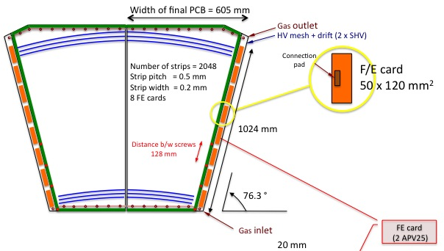
ATLAS micromegas … cont’d
Close collaboration with EN-ICE workshop (R. de Oliveira)
Heavy use of PH-DT services (very much appreciated)
  Common lab & clean room (L. Ropelewski)
  Sharing of infrastructure, instrumentation, manpower, and know-how
  Engineering support (A. Catinaccio)
  Technical support (H. Danielsson)
Plans for 2010/12 @ CERN
  2010: construction and test of full-size chamber (single plane)
  2011: construction and test of module-0 multi-plane chamber
  2012: installation of module-0 in ATLAS ??
  Count and rely on continued collaboration with PH-DT groups
J. Wotschack, ATLAS Micromegas muon chamber R&D

Slide 15
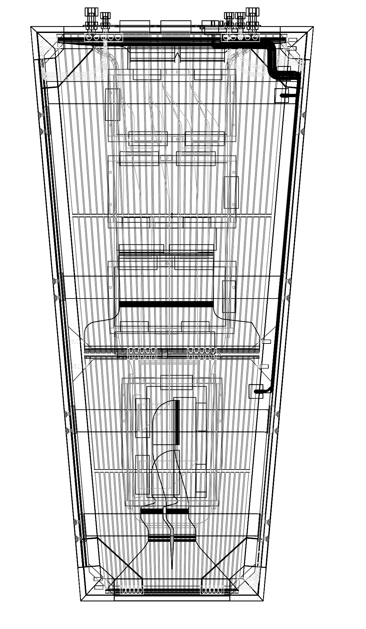
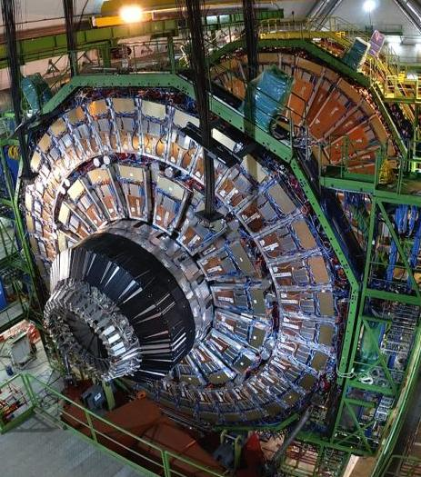
CMS R&D and Feasibility studies for high eta
Purpose: Evaluation and development of Triple GEMs technology for high eta muon trigger and tracker
Collaboration: 6 institutions in CMS, 1 TOTEM
Comparison of small-size prototypes in the two technologies. Two small detectors of identical size and built with comparable quality, are compared for various aspects of performance and robustness.
3D modeling of a full-scale detector and services integration.
Detailed modeling of a full-scale detector, to support construction of mock-up & functional prototype. Analysis of integration of power & readout, including routing of cables.
Construction of full-scale mock-up
Mechanical prototype to study handling and integration aspects.
Construction and test of a full-scale functional prototype
Demonstrate performance of a real-size detector with realistic readout electronics. Investigate in detail all construction aspects.
Plans for 2010/11 @ CERN:
2010: construction and test of full-size chamber
2011: Submit feasibility report for possible construction project
A. Sharma CMS 30.4.2010

Slide 16
MPGD Production
Objective: Development of cost-effective technologies and industrialization
1) Current: CERN-MPGD workshop is the UNIQUE MPGD production facility (generic R&D, detector components production, quality control)
Detector Technology | Currently produced | Future Requirements
GEM | 40 * 40 | 50 * 50
GEM, single mask | 70 * 40 | 200 * 50
THGEM | 70 * 50 | 200 * 100
RTHGEM, serial graphics | 20 * 10 | 100 * 50
RTHGEM, Kapton | 50 * 50 | 200 * 100
Micromegas, bulk | 150 * 50 | 200 * 100
Micromegas, microbulk | 10 * 10 | 30 * 30
GEM Technology
New Flex (Korea, Seoul)
Tech-ETCH (USA, Boston)
Scienergy (Japan, Tokyo)
Micromegas Technology
TRIANGLE LABS (USA, Nevada)
SOMACIS (Italy, Castelfidarco)
CIRE (France, Paris)
THGEM Technology
ELTOS S.p.A. (Italy)
2) Future MPGD R&D: Reinforcement of CERN-MPGD workshop infrastructure to produce 2x1m; Bulk Micromegas and 2x0.5 m GEMs has been approved by CERN Management (Nov. 2009); Participation the AIDA proposal
3) Technology Industrialization → transfer “know-how” from
CERN workshop to industrial partners for MASS PRODUCTION

Slide 17
Summary
Consolidation of the RD51 Collaboration and MPGD community integration
Considerable progress in MPGD technologies in particular large area GEM, THGEM, Micromegas; some picked up by experiments (including sLHC upgrades) for feasibility studies and prototyping
Secured future of the MPGD technologies development through the ICE DEM workshop upgrade and AIDA contribution
Improved MPGD simulation software framework allowing first applications
Infrastructure - open Gas Detectors lab, common RD51 test beam facility
Development of common, scalable electronics system
TT, IP issues and contacts with industry

Slide 18
Future Plans and Perspectives
Maintenance of the open Gas Detector lab and RD51 beam facility
Focus on the LHC experiment upgrade projects (CMS – high η trigger and tracking; TOTEM T1; ATLAS - MAMMA)
CERN based technical support for the upgraded ICE DEM workshop
Completion of the scalable readout system for MPGD
Strategic R&D (pixel detectors, MPGD photo detectors, integration of large readout structures with fast electronics)

