Slide 1
White Paper R&D WP7
Facilities and Component Analysis for Detector R&D
http://cern.ch/WP7
In this talk:
  Optimization of the closed loop gas systems for the RPCs at LHC
  Materials DB
  GIF++
Upgrade of the irradiation facilities at the PS (M.Moll)

Slide 2
WP7 Resource Overview
Yearly averages 2008 - 2010
Running budget
  35% Running Expenditure related to all activities (FSU, subsistance…)
  35% Consumables (RPC Gas is a significant expense!)
  30% Long-term Investments for GIF++ and the PS Irradiation Facilities
Personnel
≈ 3.5 FTE /year

Slide 3
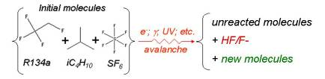
RPC studies
Motivation: Study the impurities produced in RPC chambers irradiated in the GIF radiation field in order to understand the properties of possible absorbers and improve the closed-loop gas systems at LHC.
ATLAS and CMS rely strongly on RPCs for triggering at LHC so long term survival is crucial.
  15 m³ of gas volume in ATLAS and CMS RPCs systems (closed-loop gas systems, nowadays running cost is ∼700 €/day)
  Need efficient removal of impurities
Team: R.Guida (50% - Physicist responsible), I.Gluskov (WP7 fellow), S.Rouwette (WP7 Tech. Std. since Feb), Summer students (3 in 3 y) and Technical help from the Gas Group
  + Collaboration Gas Group, ATLAS and CMS RPC teams

Slide 4
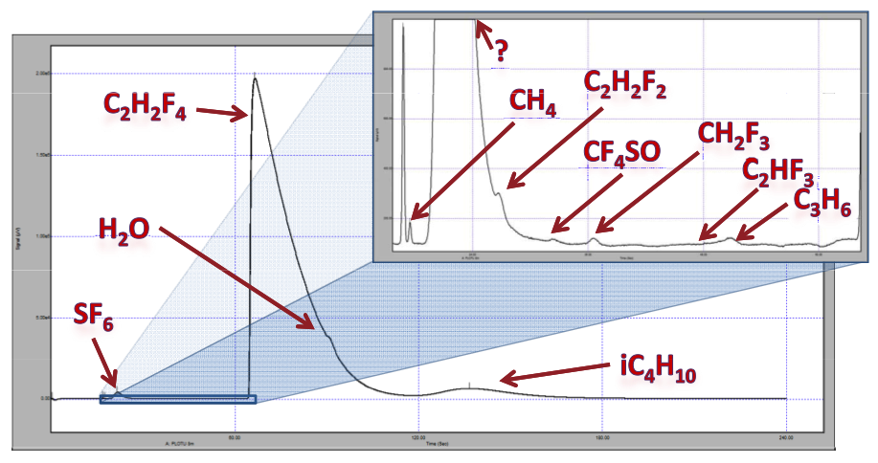
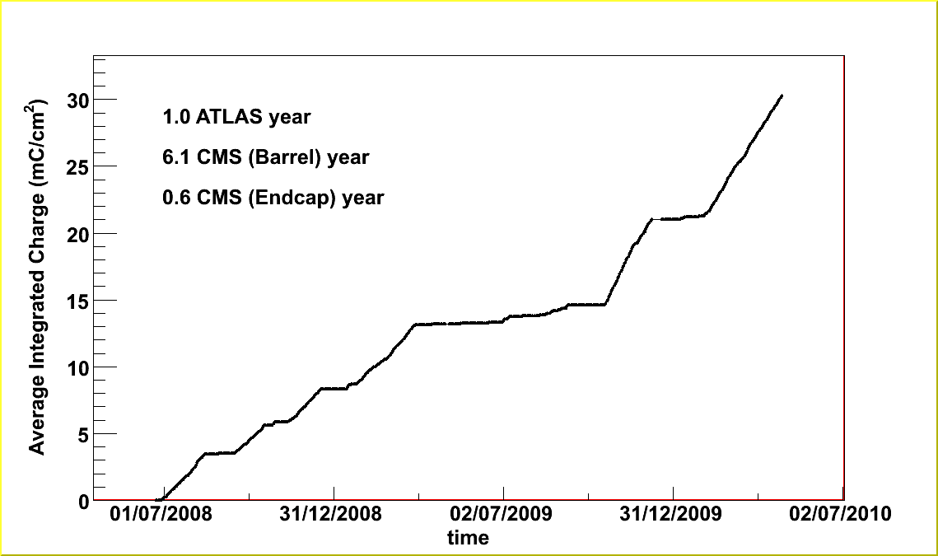
RPC studies
Recovered GIF set-up (RPC chambers, DCS, built a environmentally controlled test stand…)
Built new gas racks and installed fancy analysis devices (GC/MS, Fluoride station…)
The recovered GIF set-up is also being used by other groups (CALICE, ATLAS MDT and RPC upgrade, LHC Beam Line Monitor, NA62 soon…).
We chair a weekly GIF run meeting to discuss results and coordinate work in the area.
Outcome
Characterized RPC gas mixture (fresh, irradiated, circulated)
Monitored long-term chamber performance (currents, resistivity)
Characterized 9 possible absorbers
Found optimal combination of absorbers, in terms of filtering capacity, removal of pollutants and simplification of operation

Slide 5
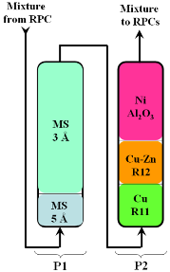
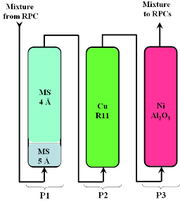
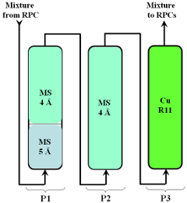
RPC studies
Current configuration at LHC
Proposals, under test
Validated up to 2 LHC y
P1: Mol Sieve > Filters H₂O
  Saturates too fast (1.4 days) > limits the gas flow
  Regenerated too often > it ages too fast
P2: Metallic > Filters O₂
  R11: OK
  R12: does not filter impurities, can pollute mixture
  NiAl₂O₃: reacts with the mixture
Needs to be tested at GIF (next 12 months)

Slide 6
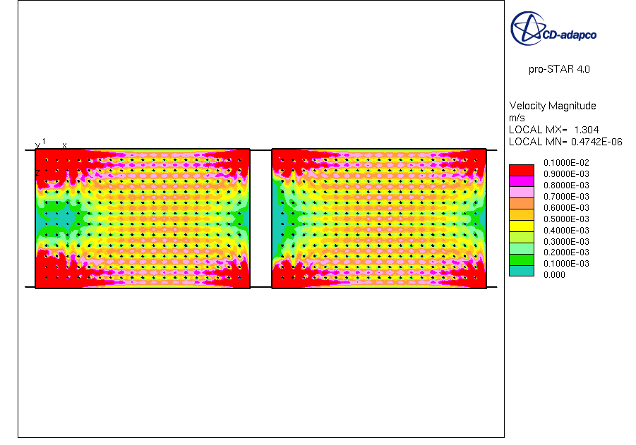
- New study -
Gas Flow distribution inside RPC chambers
Why RPCs under high radiation need a up to 0.5 - 1 gas vol exchange per hour while other gas detectors typically run at 1 vol exch/day and less?
The velocity field map shows areas where the gas is basically stagnant
Those areas will age faster
The overall gas flow in the RPC systems is defined by those areas
Gas velocity (m/s)
inlets
Room for improvement?
Built a flexible RPC prototype (gas inlet/outlets, HV sectors….) and test it at GIF
Input to new RPC stations for CMS, upgrades of existing systems

Slide 7
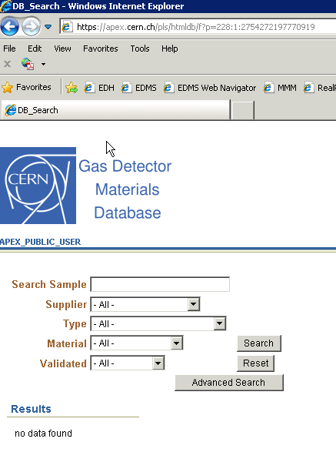
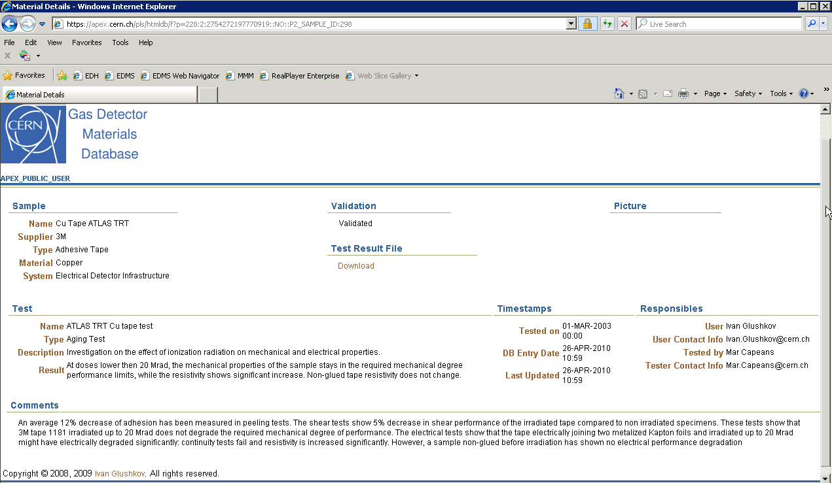
Materials DB
Motivation: Extend the available knowledge on materials for detectors and gas systems and, in collaboration with LHC detector groups, collect and classify the available data in the best possible way. In particular important for LHC detector improvements and upgrades.
Team: I.Glushkov
Status: Technically in reasonable shape. Need time (resources) to populate correctly the DB
http://cern.ch/materials/

Slide 8
GIF++: gamma irradiation facility combined with a high-energy particle beam
Motivation:
  Strong needs from the LHC and sLHC detector and accelerator communities.
  GIF++ follows up on the very successful GIF facility in the SPS west area, which lost its access to a particle beam in 2004 and which currently suffers from a lack of sufficient source intensity and aged infrastructure.
Timescale defined by:
  Availability of White Paper funds (2008-2011)
  GIF lifetime (Cs source exceeds the original 10 y lifetime)
  Agreed to liberate the GIF area in the West hall at the beginning of 2011
Team: M.Capeans, R.Fortin and C.Rembser have been collecting user requirements and linking to EN to specify and develop plans for the new GIF++ facility

Slide 9
GIF++ Project Timeline
Nov 07: White Paper R&D WP7 established, with GIF Upgrade as one of its tasks
Feb 08: budget allocation, start of activities. Launched Questionnaire (>> Irradiation Facilities Working Group, chaired by L.Linssen)
Aug 08: Presented outcome of Questionnaire (38 responses) and 1st implementation plan to users
Several proposals worked out by EN Dept. and discussed with users
April 09: Implementation plan at SPS/H4 beam line presented to users
June 09: Improved implementation plan presented to users:
>> Current Proposal <<

Slide 10
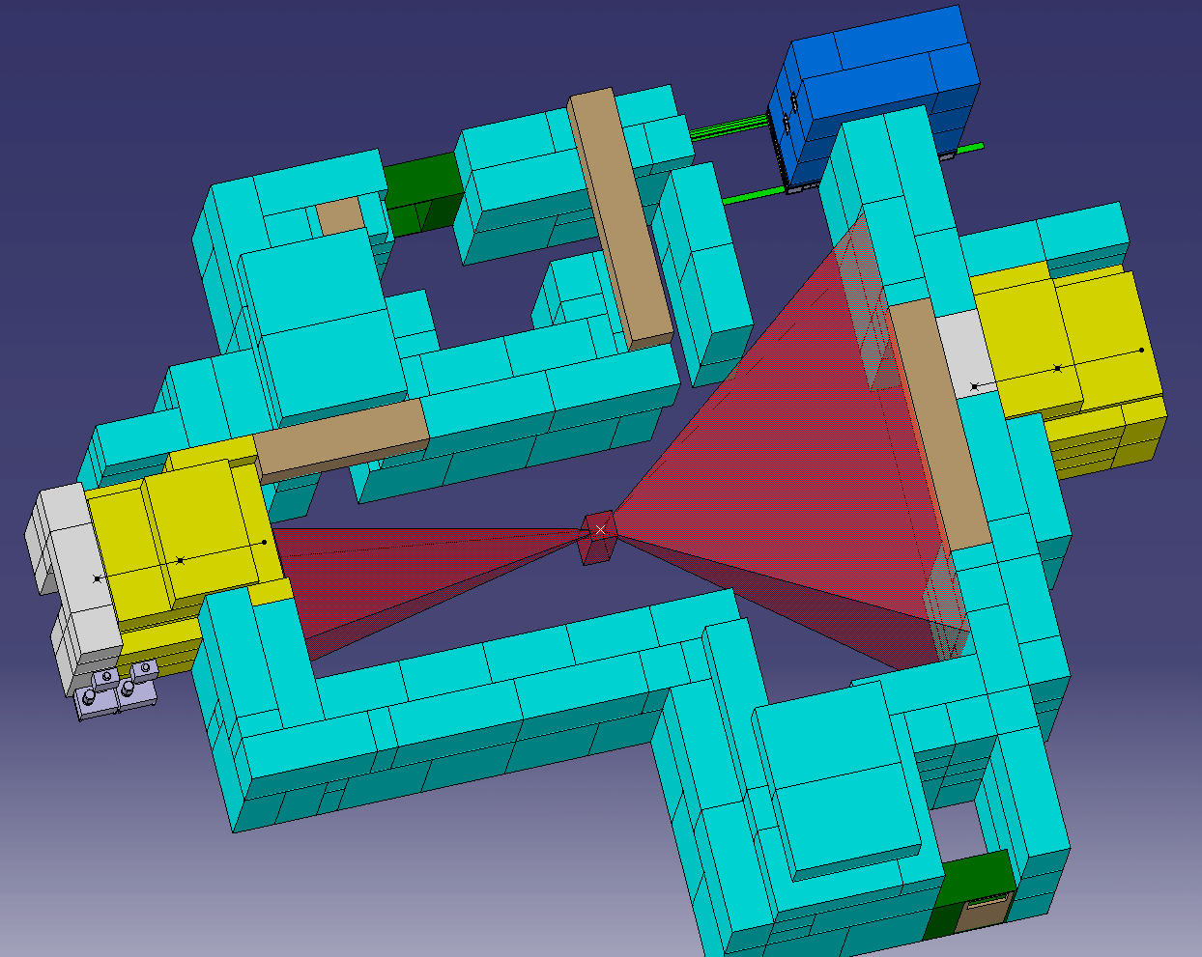
GIF++ at H4 beam line in the EHN1
As submitted to SPSC in Sept 09
Area: 8m(W)  12m(L)  4m(H) irradiation area, 2 irradiation zones and optimized infrastructure for testing large detectors
Source
  ¹³⁷Cs 662 keV photons, ~7-10 TBq
  Up to ~2 Gy/h at a distance of 50 cm
  30 y isotope half-life
Particle Beam
  EHN1 location in the SPS H4 beam
  100 GeV muons
  10⁴ particles/spill traversing 10x10 cm²
Operation
  6-8 weeks/year as primary beam user; go-through muons as parasitic users of tests installed downstream the beam line
  Operation throughout the year with the source
Max. expected doses at sLHC | Equivalent time at GIF++ (~ 50 cm from source)
Si-trackers: ~ MGy/y | >> years
Calorimeters: ~ 20 kGy/y | < 1 year
Muon systems: ~ 0.1 Gy/y | ~ minutes

Slide 11
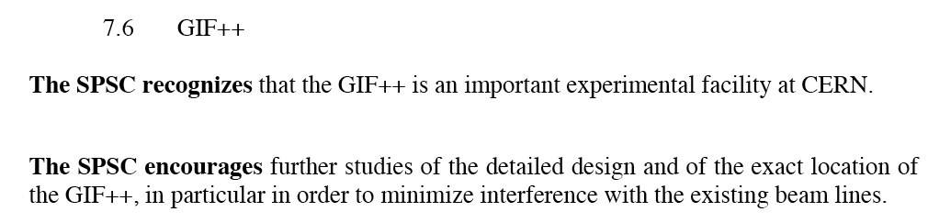
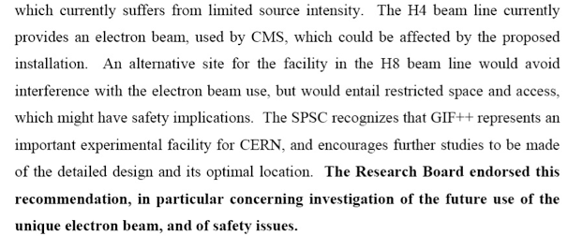
GIF++ Project at the SPSC, RB
  Sept 09: Request SPCS to endorse the scientific case and to support the implementation of the facility in the H4 location
Minutes SPSC Nov 09
  Dec 09: Research Board
Minutes RB Dec 09

Slide 12
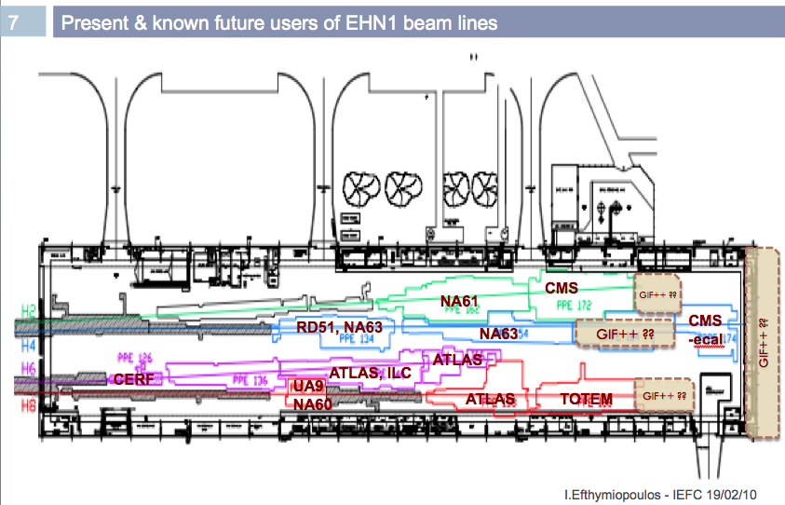
RE-study of locations (RB Feb 2010, I.E.)
IEFC recognizes the implementation of GIF++ at the H4 as the only cost and performance effective option
IEFC - LHC Injectors and Experimental Facilities Committee -: sector-wide executive committee concerned with all technical and performance aspects of the CERN accelerators and experimental areas

Slide 13
Issues raised at the LEAF meeting (Nov 09)
Availability of manpower in EN to prepare the facility
  EN will prepare an overall resource-loaded schedule with all the other projects to be carried out by EN: HiRadMat, NA62, NA61, Cloud, GIF++.
  The consequence will be most likely a delay in the availability of the GIF++.
Financing of the project
  Overall cost estimate: 1.3 MCHF
  Resources from the White paper (300k in 2009, 200k in 2010)
  Allocation from EN (100k)
  Missing funds (700k): discussed favorably with Research Director, EN and PH Depts
  Users in-kind contribution via AIDA (FP7 IA, 2011-2014) > Radiation filters, Cosmic trigger, DAQ, DCS
End 2011 remains as Target for GIF++ Ready for Users

Slide 14
WP7 in 2011 and beyond
Studies at GIF
  Long-term validation of new, optimized filter configuration for the RPC gas systems at LHC
  RPC Gas flow optimization studies
  Aging Test of NA62 straw prototype
    12-18 months (or till GIF is dismantled)
    R.Guida, S.Rouwette + continued collaboration with RPC groups
Detector Materials DB
    Work can continue slowly
    M.Capeans and detector people
GIF++
  Secure funding and start implementation in 2011
    M.Capeans, C.Rembser, R.Fortin. Need additional resources to supervise construction and commission the facility (New Fellow + Leading physicist from the user community)

