Slide 1
Detector Technology Group
PH-DT
Steering Board Meeting
(short version of PH Retreat Talk)
Structure and organization of DT
Resources and Infrastructure
Snapshot of activities and resource attribution
Expected evolution
Services (few topics)
AOB
cern.ch/ph-dep-dt
See also ‘Annual Report 2009’ under ‘Documents’

Slide 2
Mandate of DT group (spring 2008)
The mandate of the PH/DT group comprises development, construction, operation and maintenance of particle detectors for the experiments at CERN. The group clusters common services and infrastructure which are at the benefice of all experiments at CERN.
The group’s activities are concentrated in four areas:
  Completion and consolidation of the ongoing LHC projects;
  Maintenance and operation: piquet services, shutdown and preventive maintenance, repairs and infrastructure support;
  New detector projects: participation in new developments (LHC upgrade);
  R&D: participation in common R&D activities in strategic fields;
The two main bodies to steer and manage the group are the Steering Board (SB) and the Coordination Panel (CP)
Steering Board
PH DDL (chair), TCs (LHC exp.), GL, DGLs
Monitor and define main directions, global resource sharing.
Meets 1x / year
Meets every 3 weeks
Coordination Panel
GL, DGLs, SLs, ECPs + invited
Exchange information, monitor progress, adjust resources.

Slide 3
Structure and organization of DT
DT = 78 staff
(HRT snap shot, Feb 2010.
More details later)
http://cern.ch/ph-dep-dt/
Group Leader : C.Joram
Deputies F. Hahn (Resource Coordinator)
A. Onnela (Safety, workshops)
Secretariat: V. Wedlake (shared with NA48/NA62/CLOUD/RD50/RD51)
The group comprises 5 sections.
Section | Description | Staff | Leader
PH-DT-PO | Projects Office | 13 | A. Catinaccio
PH-DT-DI | Detector Infrastructure | 26 | F.Hahn
PH-DT-TP | Technology and Physics | 12 | C.Joram
PH-DT-EM1 | Engineering & Mechanics 1 | 14 | D.Perini
PH-DT-EM2 | Engineering & Mechanics 2 | 13 | H.Danielsson
Two staff members are on leave (ITER). They are not counted.
For each of the LHC experiments, we appointed a DT experiment contact person (ECP):
Paolo Martinengo (ALICE), Mar Capeans (ATLAS), Paolo Petagna (CMS), Burkhard Schmidt (LHCb), Joachim Bächler (TOTEM).

Slide 4
Staff composition
ALICE, CAST, NA62, Gas systems, Survey
cat. 4
appl. phys.
Tech.
Fellows
cat. 3
cat. 2
“normal”
White
Paper
Marie
Curie
engineers
Doct.
Σ = 21
2 24 14
B C D
In addition 2 FSU teams (not counted in the following):
PH01 – pipe work, mech. supp., welding (4 FTE)
PH-02 – cabling work, electro-mech. support, (5+2 FTE)
Σ = 80 (incl. 2 engineers at ITER)
Available manpower in 2010: 88.4 FTE (accounts for retirements, end of contracts)

Slide 5
The activities of DT are organized in
14 projects
12 services
6 R&D activities
+ 8 mechanical workshops (see below)
Most of the projects extend
over more than 1 section
→ Matrix organization.
Projects
AEGIS
ALICE Operation
ATLAS ALFA
ATLAS Operation
ATLAS Tracker Upgrade
CAST M&O
CLIC Det. Studies
Cloud
CMS Operation
CMS Pre-shower
LHCb Operation
NA48/62
TOTEM Operation
TOTEM RP
Services
B-Field Measurements
Bond. Lab. / DSF
Gas Support
Glueing Techniques
Irrad. Facilities
Magnet M&O
Magnet Support
Optical Lab.
Rad. Mon.
Scintillators
Thin Film
WP11/Cooling
R&D
WP4 / RD50
WP5 / RD51
WP6 / QC
WP7 / New Irrad Fac / Mat. Studies
WP11/Cooling Reverse Engineering/3D survey
AX-PET

Slide 6
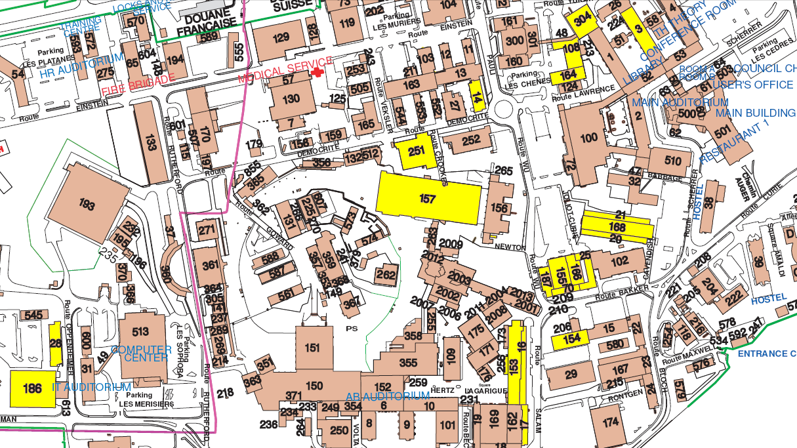
DT people are spread over 7 clusters of buildings. A possible regrouping will be subject of next SPOB meeting.

Slide 7
Comparison 2010 - 2008
Comparison 2008 - 2010

Slide 8
‘Expected’ evolution of activities
2010
2012
2014
TOTEM, ALFA
finished
15
20
15
10
15
15
10
15
20
20
10
15
10
10
LHC direct
LHC
common
Services
Non-LHC
R&D
WS/Safety/
Admin
29
13
11
15
24
8
LHC
upgrade
Det. Cooling
becomes a service
Parts of R&D WP enter in LHC upgrade projects
A reasonable fraction of focused RD should be kept
DT composition - 20% phys, 20% eng, 60% tech (incl. designers) - looks reasonable.
Number of designers must be increased. Number of technicians must not drop!

Slide 9
Gas Piquet Interventions in 2009
(S. Haider)
Number of interventions outside normal working hours (about 25% of all).
Σ = 74
From 2010 on,
All interventions will be recorded (in and outside normal working hours)
Number of piquet hours outside normal working hours.
Σ = 82 h

Slide 10
Magnet, DSS, RCS, Piquet Interventions in 2009
(G. Olesen)
Piquet is operational since 2006
Σ = 208
Σ = 119

Slide 11
M&O Budget Magnet Controls
(G. Olesen)
 | Expected Yearly (WP) | 2009 Paid | 2010 Paid | 2010 Outstanding
PH |  | 440k | 30k | 0
ALICE | 76k (16%) | 76k | 0 | 13k
ATLAS | 243k (51%) | 0 | 243k | 38k
CMS | 132k (28%) | 0 | 0 | 155k
LHCb | 25k (5%) | 0 | 25k | 3k
Total | 476k (100%) | 516k | 298k | 209k
Contributions
 | 2009 Spent | 2010 Spent | 2010 Outstanding
FSU | -195k | -95k | -180k
Spares | -126k | -23k | -28k
Consolidation | -106k | -81k | -50k (*)
Other | -88k | -49k
Total | -515k | 248k | -258k
Expenses
Balance | 0 | Expected 0
Balance
* Includes test set ups for upgrades of MSS and MDS

Slide 12
M&O Budget Gas Systems
(S.Haider)
 | Expected Yearly (WP) | 2009 Paid | 2010 Paid | 2010 Outstanding
PH |  | 65k | 35k | 0
ALICE | 130k (22%) | 130k | 0 | 130k
ATLAS | 189k (32%) | 189k | 0 | 189k
CMS | 157k (27%) | 0 | 0 | 314k
LHCb | 106k (18%) | 106k | 0 | 106k
TOTEM | 8k (1.4%) | 8k | 0 | 8k
Total | 590k (100%) | 498k | 782k
Contributions
 | 2009 Spent | 2010 Spent | 2010 Outstanding
FSU | -411k
Material | - 92k
Spares | -135k
Other | - 31k
Total | -669k
Expenses
Balance | -171k | Expected 0
Balance

Slide 13
Comments to M&O Work Packages
WP Magnet control:
  WP Term ends in 2010. Continuation should be defined this year.
  Upgrade proposals for MDS and MSS will be made in the course 2010.
  Replacement of ATLAS technician in piquet team. Important to have a competent person.
WP Gas Systems:
  WP Term 2008 – 2011.

Slide 14
Back-up

Slide 15
Bondlab / DSF
Bondlab activities performed in 2009
Main effort: Totem (All Roman Pot modules), Atlas-ALFA (85 PMF PCBs), Medipix (Mpx2, Mpx3, Timepix), Axial Pet (gluing), CMS Opto.
Other jobs: Atlas (LUCID,ABCN,FEC), PH/ESE (5+ different PCB jobs), RD50, NA62, Compass (silicon strip and RICH detector repairs), Isolde, Alice (Pixel, Upgrade / Phoenix), AMS, UA9-SPS, CMS Upgrade (sensor studies), numerous other small jobs. Bondlab remains very active.
Departmental Silicon Facility (DSF):
Only Alice pixel, RD50 and occasionally Medipix still active in DSF clean room.
Currently scheduling a meeting with all 4 main LHC experiments and other users to discuss usage of clean and non clean room for next 5 years.
570 cm
511 cm
800 cm
LHCb
LHCb
LHCb Inner Tracker
500 cm
500 cm
RICH
VELO
(Lausanne + Santiago d.C.)
28.5 m
40 m2
2
25 m
2
CMS - Tracker
DSF = 350m² high value clean space.
01/06 - 02/07
150 cm
1000 cm
200 cm
450 cm
190 cm
ALICE cooling racks
561 cm
CMS - Tracker
CMS
LHCb- Tracker
743 cm
01/06 - 02/07
500 cm
- Integration -
ALICE
04/06 - 04/07
1365 cm
Pixel
300 cm
CMS- Preshower
126 m
15 m2
2
PH-DT
Bondlab
ATLAS
CMS - Tracker
SCT
01/06 - 02/07

Slide 16
p/n irradiations in 2009 (PS T7 area)
(M. Glaser/M. Moll)
Main users:
  LHC Experiments (in particular innermost detector components – silicon tracking detectors)
  most requests linked to R&D projects for LHC-upgrade (up to 2x10¹⁶ p/cm² ~ 5MGy requested)
Irradiations in 2009
  110 sets of objects irradiated
  155 dosimeters (Al) measured
  126 days of beam time
  Main users:
    ATLAS Inner Detector upgrade, CMS Tracker Upgrade, CMS PLT
    ATLAS LARG, LHCb RICH, CMS ECAL & Crystal Clear
    RD50, RD42, PH Workpackages: WP2, WP4, …….
  Main materials:
    Silicon sensors (Pixel, Strip, Pad, 3D)
    Electronics (CMOS devices, Front end and optoelectronic components, ….)
    Scintillating crystals, ……
General tendency:
Irradiations become more complex (less objects but more time intensive set up & irradiations)
  Silicon sensors: under bias and in cold environment
  Electronics: readout during irradiation, tests in scattered proton field
  Crystals (heavy materials getting strongly activated)

Slide 17
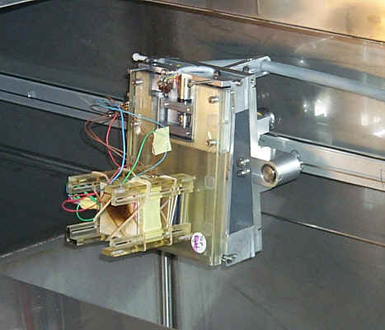
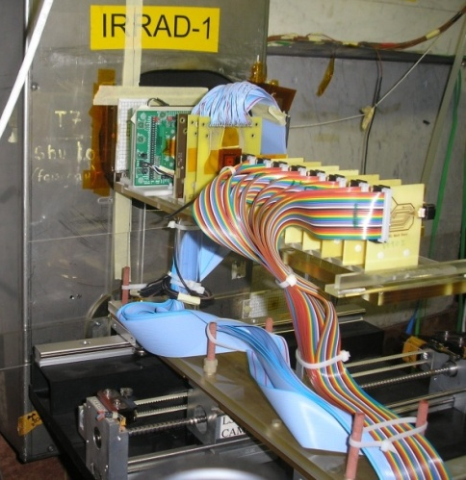
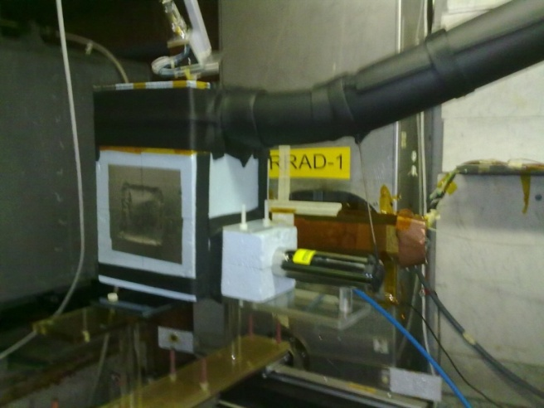
p/n irradiations in 2009 (PS T7 area)
Problems
  We get a rather low proton flux (often only one spill of a supercycle) making irradiation for SLHC fluences a very long experiment
Future upgrades: PS2 abandoned (??) … new chances for EAST HALL ??
  Up to the last Charonix Workshop the PS2 was planned to replace the PS in ‘near’ future. Making any major upgrade inside the East Hall impossible (not worth to invest in an infrastructure that anyway soon will disappear).
  In view of the latest discussions a long term operation of the PS (… for the next 25 years ??) seems to be a financially very attractive option. We assume this strategy will open up again the possibility to have a real upgrade in the EAST HALL as arguments regarding the limited lifetime of any investment for the facility are no longer valid.
Shuttle - Sample holder
New cold box inside facility

Slide 18
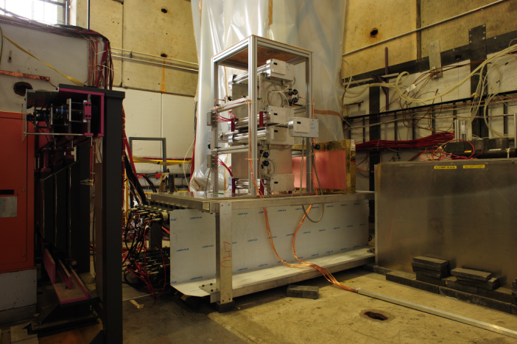
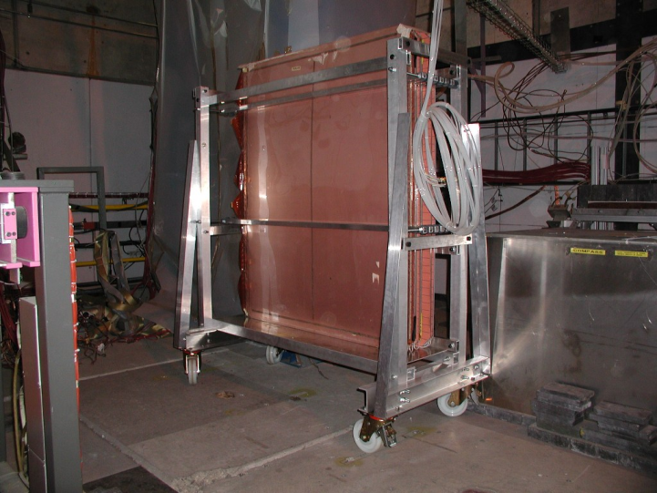
Gamma Irradiation Facility
(R. Fortin)
ATLAS MDT Drift tube chambers (Ar + 7% CO2)
Two periods:
2009-05-01 - 2009-07-08. 924 h
2009-11-01 - 2009-11-31. 672 h
Gas filtering techniques for RPC (PH-DT, ATLAS and CMS)
(94% C2H2F4 + 5.5% + iC4H10 + 0.5% SF6)
2009-01-05 - 2009-12-17. 5036 h
LHC BLM (beam line monitors) (100 % N2)
- 2009-04-17 - 2009-04-20 1h
2009-12-14 - 2009-12-14 1h
Radio-Protection (Test rad monitors):
2009-10-19 - 2009-10-19, 3 h
Proposal for GIF++ exists, but financial contributions of experiments are unclear.
M. Capeans et al., CERN-SPSC-2009-029 / SPSC-P-339

Slide 19
Example: Matrix of EM2 section
Row Labels | ATLAS ALFA | ATLAS Operation | CAST M&O | DT Admin. | Irrad. Facilities | Magnet Support | NA48/62 | PH Safety Office | Scintillators | TOTEM RP | TSO | Work-Shop | WP5 / RD51 | (blank) | Aegis | WP11/Cooling | Total
BENDOTTI Jerome |  | 0.10 |  |  |  |  | 0.60 |  |  |  | 0.10 | 0.20 |  |  |  |  | 1.00
BODE Alain |  | 1.00 |  |  |  |  |  |  |  |  |  |  |  |  |  |  | 1.00
BRUNEL Bernard |  | 0.50 |  |  |  |  |  |  |  |  |  |  | 0.50 |  |  |  | 1.00
CHARRA Patrick | 0.50 | 0.50 |  |  |  |  |  |  |  |  |  |  |  |  |  |  | 1.00
DANIELSSON Hans Olof |  | 0.20 |  | 0.15 |  |  | 0.65 |  |  |  |  |  |  |  |  |  | 1.00
DIXON Neil David |  | 0.25 |  |  |  |  | 0.65 |  |  |  | 0.10 |  |  |  |  |  | 1.00
FOLLEY Adrian |  |  |  |  |  |  |  |  | 0.60 |  |  | 0.40 |  |  |  |  | 1.00
GARNIER Francois Andre |  |  |  |  |  | 0.20 |  |  |  |  |  | 0.80 |  |  |  |  | 1.00
GIUDICI Pierre-Ange |  |  | 0.15 |  |  | 0.65 |  |  |  |  |  |  |  |  | 0.20 |  | 1.00
GONCALVES MARTINS DE OLIVEIRA Antonio | 0.10 |  |  |  |  |  | 0.70 | 0.10 |  |  | 0.10 |  |  |  |  |  | 1.00
LANCON Philippe | 0.10 |  |  |  | 0.50 |  |  |  |  | 0.10 |  | 0.30 |  |  |  |  | 1.00
NOEL Jerome | 0.20 |  |  |  |  |  |  |  |  | 0.20 |  |  |  |  |  | 0.60 | 1.00
PEREZ GOMEZ Francisco |  |  |  |  |  |  | 1.00 |  |  |  |  |  |  |  |  |  | 1.00
Total | 0.90 | 2.55 | 0.15 | 0.15 | 0.50 | 0.85 | 3.60 | 0.10 | 0.60 | 0.30 | 0.30 | 1.70 | 0.50 |  | 0.20 | 0.60 | 13.00

Slide 20
Group matrix
Row Labels | ALICE Operation | ALICE Upgrade | ATLAS ALFA | ATLAS Operation | AX-PET | B-Field Measurements | Bond. Lab. / DSF | CAST M&O | Cloud | CMS Operation | CMS Pre-shower | CSO | DT Admin. | FP7 Admin. | FSU Admin. | Gas Support | Glueing Techniques | Irrad. Facilities | LHCb Operation | LHCb Upgrade | Magnet M&O | Magnet Support | Micro Cosmos | NA48/62 | Optical Lab. | PH Safety Office | Rad. Mon. | RD50 Admin. | RD51 Admin. | Scintillators | Thin Film | TOTEM Operation | TOTEM RP | TSO | Work-Shop | WP4 / RD50 | WP5 / RD51 | WP6 / QC | WP7 | X-HPD | (blank) | EIRO FORUM | ME R&D WP's | FEM calculation | Si Telescope | Misc. Safety | Reverse Engineering | CLIC Det. Studies | Aegis | ATLAS Tracker Upgrade | CMS Tracker Upgrade | MSS upgrade | CERN Exhibition | WP11/Cooling | NA61 | LC R&D Panel Member | ArDM | Total
ALFONSI Matteo |  |  |  |  |  |  |  |  |  |  |  |  |  |  |  |  |  |  |  |  |  |  |  |  |  |  |  |  |  |  |  |  |  |  |  |  | 0.67 |  |  |  |  |  |  |  |  |  |  |  |  |  |  |  |  |  |  |  |  | 0.67
ANSTETT Didier | 1.00 |  |  |  |  |  |  |  |  |  |  |  |  |  |  |  |  |  |  |  |  |  |  |  |  |  |  |  |  |  |  |  |  |  |  |  |  |  |  |  |  |  |  |  |  |  |  |  |  |  |  |  |  |  |  |  |  | 1.00
BAECHLER Joachim |  |  |  |  |  |  |  |  |  |  |  |  |  |  |  |  |  |  |  |  |  |  |  |  |  |  |  |  |  |  |  | 0.90 |  |  |  |  |  |  |  |  |  |  |  |  |  |  |  |  |  |  |  |  |  |  | 0.10 |  |  | 1.00
BAULT Christophe Daniel |  |  |  | 0.50 |  |  |  |  |  |  |  |  |  |  |  |  |  |  |  |  |  |  |  |  |  |  |  |  |  |  |  |  |  |  |  |  |  |  |  |  |  |  |  |  |  |  |  |  |  | 0.50 |  |  |  |  |  |  |  | 1.00
BENDOTTI Jerome |  |  |  | 0.10 |  |  |  |  |  |  |  |  |  |  |  |  |  |  |  |  |  |  |  | 0.60 |  |  |  |  |  |  |  |  |  | 0.10 | 0.20 |  |  |  |  |  |  |  |  |  |  |  |  |  |  |  |  |  |  |  |  |  |  | 1.00
BERGSMA Felix |  |  |  |  |  | 1.00 |  |  |  |  |  |  |  |  |  |  |  |  |  |  |  |  |  |  |  |  |  |  |  |  |  |  |  |  |  |  |  |  |  |  |  |  |  |  |  |  |  |  |  |  |  |  |  |  |  |  |  | 1.00
BODE Alain |  |  |  | 1.00 |  |  |  |  |  |  |  |  |  |  |  |  |  |  |  |  |  |  |  |  |  |  |  |  |  |  |  |  |  |  |  |  |  |  |  |  |  |  |  |  |  |  |  |  |  |  |  |  |  |  |  |  |  | 1.00
BOURGEOIS Nicolas |  |  |  |  |  |  |  | 0.15 |  |  |  |  |  |  |  |  |  |  |  |  | 0.85 |  |  |  |  |  |  |  |  |  |  |  |  |  |  |  |  |  |  |  |  |  |  |  |  |  |  |  |  |  |  |  |  |  |  |  |  | 1.00
BOUVIER Philippe | 1.00 |  |  |  |  |  |  |  |  |  |  |  |  |  |  |  |  |  |  |  |  |  |  |  |  |  |  |  |  |  |  |  |  |  |  |  |  |  |  |  |  |  |  |  |  |  |  |  |  |  |  |  |  |  |  |  |  | 1.00
BRAEM Andre |  |  | 0.50 |  | 0.10 |  |  |  |  |  |  |  |  |  |  |  |  |  |  |  |  |  |  |  |  |  |  |  |  |  | 0.30 |  |  |  |  |  |  |  |  | 0.10 |  |  |  |  |  |  |  |  |  |  |  |  |  |  |  |  |  | 1.00
BRUNEL Bernard |  |  |  | 0.50 |  |  |  |  |  |  |  |  |  |  |  |  |  |  |  |  |  |  |  |  |  |  |  |  |  |  |  |  |  |  |  |  | 0.50 |  |  |  |  |  |  |  |  |  |  |  |  |  |  |  |  |  |  |  |  | 1.00
CANTIN Bernard | 0.25 |  |  |  |  |  |  |  |  |  |  |  |  |  |  |  |  |  |  |  |  |  |  |  |  |  |  |  |  |  |  |  |  |  | 0.75 |  |  |  |  |  |  |  |  |  |  |  |  |  |  |  |  |  |  |  |  |  |  | 1.00
CAPEANS GARRIDO Maria Del Mar |  |  |  | 0.05 |  |  |  |  |  |  |  |  |  | 0.20 |  | 0.05 |  |  |  |  |  |  |  |  |  |  |  |  |  |  |  |  |  |  |  |  |  |  | 0.40 |  |  |  |  |  |  |  |  |  |  | 0.30 |  |  |  |  |  |  |  | 1.00
CARRIE Patrick |  |  |  |  |  |  |  |  |  |  |  |  |  |  |  | 1.00 |  |  |  |  |  |  |  |  |  |  |  |  |  |  |  |  |  |  |  |  |  |  |  |  |  |  |  |  |  |  |  |  |  |  |  |  |  |  |  |  |  | 1.00
CATINACCIO Andrea |  |  |  | 0.50 |  |  |  |  |  |  |  |  | 0.15 |  |  |  |  |  |  |  |  |  |  |  |  |  |  |  |  |  |  |  |  |  |  |  |  |  |  |  |  |  | 0.05 |  |  |  |  |  |  | 0.30 |  |  |  |  |  |  |  | 1.00
CHARRA Patrick |  |  | 0.50 | 0.50 |  |  |  |  |  |  |  |  |  |  |  |  |  |  |  |  |  |  |  |  |  |  |  |  |  |  |  |  |  |  |  |  |  |  |  |  |  |  |  |  |  |  |  |  |  |  |  |  |  |  |  |  |  | 1.00
DANIELSSON Hans Olof |  |  |  | 0.20 |  |  |  |  |  |  |  |  | 0.15 |  |  |  |  |  |  |  |  |  |  | 0.65 |  |  |  |  |  |  |  |  |  |  |  |  |  |  |  |  |  |  |  |  |  |  |  |  |  |  |  |  |  |  |  |  |  | 1.00
D'AURIA Andrea |  |  |  |  |  |  |  |  |  |  |  |  |  |  |  | 1.00 |  |  |  |  |  |  |  |  |  |  |  |  |  |  |  |  |  |  |  |  |  |  |  |  |  |  |  |  |  |  |  |  |  |  |  |  |  |  |  |  |  | 1.00
DAVENPORT Martyn |  |  |  |  |  |  |  | 1.00 |  |  |  |  |  |  |  |  |  |  |  |  |  |  |  |  |  |  |  |  |  |  |  |  |  |  |  |  |  |  |  |  |  |  |  |  |  |  |  |  |  |  |  |  |  |  |  |  |  | 1.00
DAVID Claude |  |  | 0.40 |  |  |  |  |  |  |  |  |  |  |  |  |  |  |  |  |  |  |  |  |  |  |  |  |  |  |  | 0.60 |  |  |  |  |  |  |  |  |  |  |  |  |  |  |  |  |  |  |  |  |  |  |  |  |  |  | 1.00
DAVID Eric |  |  |  |  |  |  |  |  |  |  |  |  |  |  |  |  |  |  |  |  |  |  |  | 0.40 |  |  |  |  |  |  |  |  | 0.10 |  |  |  | 0.50 |  |  |  |  |  |  |  |  |  |  |  |  |  |  |  |  |  |  |  |  | 1.00
DE MENEZES Louis-Philippe |  |  |  |  |  |  |  |  |  |  |  |  |  |  |  | 1.00 |  |  |  |  |  |  |  |  |  |  |  |  |  |  |  |  |  |  |  |  |  |  |  |  |  |  |  |  |  |  |  |  |  |  |  |  |  |  |  |  |  | 1.00
DENARIE Charles-Henri | 0.60 |  |  |  |  |  |  |  |  |  |  | 0.10 |  |  |  |  |  |  |  |  |  |  |  |  |  |  |  |  |  |  |  |  |  | 0.10 |  |  |  |  |  |  |  |  |  |  |  |  |  |  |  |  |  |  | 0.20 |  |  |  |  | 1.00
DERONT Laurent |  |  |  |  |  |  |  |  |  |  |  |  |  |  |  |  |  |  |  |  | 0.70 |  |  |  |  |  |  |  |  |  |  |  |  |  |  |  |  |  |  |  |  |  |  |  |  |  |  |  |  |  |  | 0.30 |  |  |  |  |  | 1.00
DIXON Neil David |  |  |  | 0.25 |  |  |  |  |  |  |  |  |  |  |  |  |  |  |  |  |  |  |  | 0.65 |  |  |  |  |  |  |  |  |  | 0.10 |  |  |  |  |  |  |  |  |  |  |  |  |  |  |  |  |  |  |  |  |  |  |  | 1.00
DUMPS Raphael |  |  |  |  |  |  |  |  |  |  |  |  |  |  |  |  |  |  | 0.50 | 0.20 |  |  | 0.10 |  |  |  |  |  |  |  |  |  |  |  |  |  |  |  |  |  |  |  |  |  |  |  |  |  |  |  |  |  |  | 0.20 |  |  |  | 1.00
FAHRER Manuel |  |  |  |  |  |  |  |  |  |  |  |  |  |  |  |  |  |  |  |  |  |  |  |  |  |  |  |  |  |  |  |  |  |  |  | 0.83 |  |  |  |  |  |  |  |  |  |  |  |  |  |  |  |  |  |  |  |  |  | 0.83
FOLLEY Adrian |  |  |  |  |  |  |  |  |  |  |  |  |  |  |  |  |  |  |  |  |  |  |  |  |  |  |  |  |  | 0.60 |  |  |  |  | 0.40 |  |  |  |  |  |  |  |  |  |  |  |  |  |  |  |  |  |  |  |  |  |  | 1.00
FORTIN Richard Georges |  |  |  |  |  |  | 0.30 |  |  |  |  |  |  |  |  |  |  | 0.10 |  |  |  |  |  |  |  |  |  |  |  |  |  |  |  | 0.10 |  |  |  |  | 0.50 |  |  |  |  |  |  |  |  |  |  |  |  |  |  |  |  |  |  | 1.00
FRAISSARD Daniel
GARNIER Francois Andre |  |  |  |  |  |  |  |  |  |  |  |  |  |  |  |  |  |  |  |  |  | 0.20 |  |  |  |  |  |  |  |  |  |  |  |  | 0.80 |  |  |  |  |  |  |  |  |  |  |  |  |  |  |  |  |  |  |  |  |  |  | 1.00
GIUDICI Pierre-Ange |  |  |  |  |  |  |  | 0.15 |  |  |  |  |  |  |  |  |  |  |  |  |  | 0.65 |  |  |  |  |  |  |  |  |  |  |  |  |  |  |  |  |  |  |  |  |  |  |  |  |  |  | 0.20 |  |  |  |  |  |  |  |  | 1.00
GLASER Maurice |  |  |  |  |  |  |  |  |  |  |  |  |  |  |  |  |  | 0.60 |  |  |  |  |  |  |  |  | 0.20 |  |  |  |  |  |  | 0.10 |  | 0.10 |  |  |  |  |  |  |  |  |  |  |  |  |  |  |  |  |  |  |  |  |  | 1.00
GLUSHKOV Ivan |  |  |  |  |  |  |  |  |  |  |  |  |  |  |  |  |  |  |  |  |  |  |  |  |  |  |  |  |  |  |  |  |  |  |  |  |  |  | 0.50 |  |  |  |  |  |  |  |  |  |  |  |  |  |  |  |  |  |  | 0.50
GONCALVES MARTINS DE OLIVEIRA Antonio |  |  | 0.10 |  |  |  |  |  |  |  |  |  |  |  |  |  |  |  |  |  |  |  |  | 0.70 |  | 0.10 |  |  |  |  |  |  |  | 0.10 |  |  |  |  |  |  |  |  |  |  |  |  |  |  |  |  |  |  |  |  |  |  |  | 1.00
GUIDA Roberto |  |  |  |  |  |  |  |  |  |  |  |  |  |  |  | 0.33 |  |  |  |  |  |  |  |  |  |  |  |  |  |  |  |  |  |  |  |  |  |  | 0.33 |  |  |  |  |  |  |  |  |  |  |  |  |  |  |  |  |  |  | 0.67
GUIPET Antoine |  |  |  |  |  |  | 0.50 |  |  |  |  |  |  |  |  |  |  | 0.50 |  |  |  |  |  |  |  |  |  |  |  |  |  |  |  |  |  |  |  |  |  |  |  |  |  |  |  |  |  |  |  |  |  |  |  |  |  |  |  | 1.00
GYS Thierry |  |  |  |  |  |  |  |  |  |  |  |  |  |  |  |  |  |  | 0.70 | 0.30 |  |  |  |  |  |  |  |  |  |  |  |  |  |  |  |  |  |  |  |  |  |  |  |  |  |  |  |  |  |  |  |  |  |  |  |  |  | 1.00
HAHN Ferdinand |  |  |  |  |  |  |  |  |  |  |  |  | 0.35 |  |  |  |  |  |  |  |  |  |  | 0.60 |  |  |  |  |  |  |  |  |  |  |  |  |  |  | 0.05 |  |  |  |  |  |  |  |  |  |  |  |  |  |  |  |  |  |  | 1.00
HAIDER Stefan |  |  |  | 0.05 |  |  |  |  |  |  |  |  |  |  |  | 0.85 |  |  |  |  |  |  |  |  |  |  |  |  |  |  |  |  |  |  |  |  |  |  |  |  |  |  |  |  |  |  |  |  | 0.10 |  |  |  |  |  |  |  |  | 1.00
HATCH Mark |  |  |  |  |  |  |  |  |  |  |  |  |  |  |  |  |  |  |  |  |  |  |  | 0.60 |  |  |  |  |  |  |  |  |  |  |  |  |  |  |  |  |  |  |  | 0.30 |  |  | 0.10 |  |  |  |  |  |  |  |  |  |  | 1.00
HONMA Alan |  |  |  |  |  |  | 0.20 |  |  | 0.50 |  |  |  |  |  |  |  |  |  |  |  |  |  |  |  |  |  |  |  |  |  |  |  |  |  |  |  | 0.30 |  |  |  |  |  |  |  |  |  |  |  |  |  |  |  |  |  |  |  | 1.00
IJZERMAN Peter | 1.00 |  |  |  |  |  |  |  |  |  |  |  |  |  |  |  |  |  |  |  |  |  |  |  |  |  |  |  |  |  |  |  |  |  |  |  |  |  |  |  |  |  |  |  |  |  |  |  |  |  |  |  |  |  |  |  |  | 1.00
JORAM Christian |  |  | 0.20 | 0.05 | 0.10 |  |  |  |  |  |  |  | 0.50 |  |  |  |  |  |  |  |  |  |  |  |  |  |  |  |  |  |  |  |  |  |  |  |  |  |  | 0.10 |  | 0.05 |  |  |  |  |  |  |  |  |  |  |  |  |  |  |  | 1.00
KLEMPT Wolfgang |  |  |  |  |  |  |  |  |  |  |  |  |  |  |  |  |  |  |  |  |  |  |  |  |  |  |  |  |  |  |  |  |  |  |  |  | 0.50 |  |  |  |  |  |  |  |  |  |  | 0.50 |  |  |  |  |  |  |  |  |  | 1.00
KOTTELAT Luc-Joseph |  |  | 0.20 |  |  |  |  |  |  |  |  |  |  |  |  |  |  |  |  |  |  |  |  |  |  |  |  |  |  |  |  |  | 0.40 |  | 0.40 |  |  |  |  |  |  |  |  |  |  |  |  |  |  |  |  |  |  |  |  |  |  | 1.00
KRISTIC Robert |  |  |  |  |  |  |  |  | 0.70 |  |  |  |  |  |  |  |  |  | 0.20 |  |  |  |  |  |  |  |  |  |  |  |  |  |  | 0.10 |  |  |  |  |  |  |  |  |  |  |  |  |  |  |  |  |  |  |  |  |  |  |  | 1.00
LA ROSA Alessandro |  |  |  |  |  |  |  |  |  |  |  |  |  |  |  |  |  |  |  |  |  |  |  |  |  |  |  |  |  |  |  |  |  |  |  | 0.38 |  |  |  |  |  |  |  |  |  |  |  |  |  |  |  |  |  |  |  |  |  | 0.38
LABBE Jean-claude
LANCON Philippe |  |  | 0.10 |  |  |  |  |  |  |  |  |  |  |  |  |  |  | 0.50 |  |  |  |  |  |  |  |  |  |  |  |  |  |  | 0.10 |  | 0.30 |  |  |  |  |  |  |  |  |  |  |  |  |  |  |  |  |  |  |  |  |  |  | 1.00
LENOIR Philippe | 0.40 |  |  |  |  |  |  |  |  |  |  |  |  |  |  |  |  |  |  |  |  |  |  | 0.30 |  |  |  |  |  |  |  |  |  |  |  |  |  |  |  |  |  |  |  |  |  |  |  |  | 0.30 |  |  |  |  |  |  |  |  | 1.00
LESENECHAL Yannick | 0.90 |  |  |  |  |  |  |  |  |  |  |  |  |  |  |  |  |  |  |  |  |  |  |  |  |  |  |  |  |  |  |  |  | 0.10 |  |  |  |  |  |  |  |  |  |  |  |  |  |  |  |  |  |  |  |  |  |  |  | 1.00
LOOS Robert |  |  |  |  |  |  |  |  |  |  |  |  |  |  |  |  |  |  |  |  |  |  |  |  |  |  |  |  |  |  |  |  |  |  |  |  |  |  |  |  |  |  |  |  | 0.40 |  |  |  | 0.20 |  |  |  |  |  |  |  |  | 1.00
MAIRE Gilles |  |  |  |  |  |  |  |  |  |  |  |  |  |  |  |  |  |  |  |  | 0.50 |  |  |  |  |  |  |  |  |  |  |  |  |  |  |  |  |  |  |  |  |  |  |  |  |  |  |  |  |  |  |  |  |  |  |  | 0.50 | 1.00
MARTINENGO Paolo | 0.75 | 0.25 |  |  |  |  |  |  |  |  |  |  |  |  |  |  |  |  |  |  |  |  |  |  |  |  |  |  |  |  |  |  |  |  |  |  |  |  |  |  |  |  |  |  |  |  |  |  |  |  |  |  |  |  |  |  |  | 1.00
MCGILL Ian |  |  |  |  |  |  | 0.80 |  |  |  |  |  |  |  |  |  |  |  |  |  |  |  |  |  |  |  |  |  |  |  |  |  |  |  |  |  |  | 0.20 |  |  |  |  |  |  |  |  |  |  |  |  |  |  |  |  |  |  |  | 1.00
MERLET Frederic |  |  |  |  |  |  |  |  |  |  |  |  |  |  | 0.10 | 0.70 |  |  |  |  |  |  |  |  |  |  |  |  |  |  |  |  |  |  |  |  |  |  |  |  |  |  |  |  |  |  |  |  |  |  |  |  | 0.20 |  |  |  |  | 1.00
MOLL Michael |  |  |  |  |  |  |  |  |  |  |  |  |  |  |  |  |  | 0.25 |  |  |  |  |  |  |  |  | 0.15 | 0.10 |  |  |  |  |  |  |  | 0.50 |  |  |  |  |  |  |  |  |  |  |  |  |  |  |  |  |  |  |  |  |  | 1.00
NOEL Jerome |  |  | 0.20 |  |  |  |  |  |  |  |  |  |  |  |  |  |  |  |  |  |  |  |  |  |  |  |  |  |  |  |  |  | 0.20 |  |  |  |  |  |  |  |  |  |  |  |  |  |  |  |  |  |  |  |  | 0.60 |  |  |  | 1.00
OLESEN Gert |  |  |  |  |  |  |  |  |  |  |  |  |  |  | 0.25 |  |  |  |  |  | 0.40 |  |  |  |  |  |  |  |  |  |  |  |  |  |  |  |  |  |  |  |  |  |  |  |  |  |  |  |  |  |  | 0.35 |  |  |  |  |  | 1.00
ONNELA Antti Tero Olavi |  |  |  |  |  |  |  |  | 0.25 | 0.10 |  |  | 0.25 |  |  |  |  |  |  |  |  |  |  |  |  |  |  |  |  |  |  |  |  |  |  |  |  |  |  |  |  |  |  |  |  |  |  |  |  |  | 0.40 |  |  |  |  |  |  | 1.00
PAVIS Steven |  |  |  |  |  |  |  |  |  |  |  |  |  |  |  | 1.00 |  |  |  |  |  |  |  |  |  |  |  |  |  |  |  |  |  |  |  |  |  |  |  |  |  |  |  |  |  |  |  |  |  |  |  |  |  |  |  |  |  | 1.00
PEREZ GOMEZ Francisco |  |  |  |  |  |  |  |  |  |  |  |  |  |  |  |  |  |  |  |  |  |  |  | 1.00 |  |  |  |  |  |  |  |  |  |  |  |  |  |  |  |  |  |  |  |  |  |  |  |  |  |  |  |  |  |  |  |  |  | 1.00
PERINI Diego | 0.30 | 0.20 |  |  |  |  |  |  |  |  |  |  | 0.15 |  |  |  |  |  |  |  |  |  |  |  |  |  |  |  |  |  |  |  |  |  |  |  |  |  |  |  |  |  |  |  |  |  |  | 0.10 | 0.25 |  |  |  |  |  |  |  |  | 1.00
PIEDIGROSSI Didier |  |  |  |  |  |  |  |  |  |  |  |  |  |  |  |  | 0.30 |  | 0.50 |  |  |  |  |  | 0.20 |  |  |  |  |  |  |  |  |  |  |  |  |  |  |  |  |  |  |  |  |  |  |  |  |  |  |  |  |  |  |  |  | 1.00
PINTUS Ronald |  |  |  |  |  |  |  |  |  | 0.50 |  |  |  |  |  |  |  |  |  |  |  |  |  |  |  |  |  |  |  |  |  |  |  |  |  |  |  |  |  |  |  |  |  |  |  |  |  |  |  |  |  |  |  |  |  |  |  | 0.50
PONS Xavier |  |  | 0.15 |  |  |  |  |  |  | 0.05 |  |  |  |  |  |  |  |  |  |  | 0.60 |  |  |  |  |  |  |  |  |  |  |  | 0.20 |  |  |  |  |  |  |  |  |  |  |  |  |  |  |  |  |  |  |  |  |  |  |  |  | 1.00
RAVAT Sylvain |  |  | 0.35 |  |  |  |  |  |  |  |  |  |  |  |  |  |  |  |  |  | 0.50 |  |  |  |  |  |  |  |  |  |  |  | 0.15 |  |  |  |  |  |  |  |  |  |  |  |  |  |  |  |  |  |  |  |  |  |  |  |  | 1.00
ROPELEWSKI Leszek |  |  |  |  |  |  |  |  |  |  |  |  |  |  |  |  |  |  |  |  |  |  |  |  |  |  |  |  | 0.10 |  |  | 0.10 |  |  |  |  | 0.50 |  |  |  |  |  |  |  |  |  |  |  |  |  |  |  |  |  |  |  |  | 1.00
SCHMIDT Burkhard |  |  |  |  |  |  |  |  |  |  |  |  |  |  |  |  |  |  | 0.70 | 0.10 |  |  |  |  |  |  |  |  |  |  |  |  |  |  |  |  |  |  |  |  |  |  |  |  |  |  |  | 0.10 |  |  |  |  |  |  |  | 0.10 |  | 1.00
SCHNEIDER Thomas Hans |  |  | 0.10 |  | 0.10 |  |  |  |  |  |  |  |  |  |  |  |  |  | 0.10 |  |  |  |  |  |  |  |  |  |  |  | 0.70 |  |  |  |  |  |  |  |  |  |  |  |  |  |  |  |  |  |  |  |  |  |  |  |  |  |  | 1.00
TAUREG Hans |  |  |  |  |  |  |  |  |  |  |  |  |  |  |  |  |  |  |  |  |  |  |  |  |  |  |  |  |  |  |  |  |  |  |  |  | 0.70 |  |  |  |  |  |  |  |  | 0.30 |  |  |  |  |  |  |  |  |  |  |  | 1.00
VAN BEELEN Jacob Bastiaan | 0.40 | 0.20 |  |  |  |  |  |  |  |  |  |  |  |  |  |  | 0.30 |  |  |  |  |  |  |  |  |  |  |  |  |  |  |  |  | 0.10 |  |  |  |  |  |  |  |  |  |  |  |  |  |  |  |  |  |  |  |  |  |  |  | 1.00
VAN STENIS Miranda |  |  | 0.10 |  |  |  |  |  |  |  |  |  |  |  |  |  |  |  |  |  |  |  |  |  |  |  |  |  |  |  | 0.20 |  |  |  |  |  | 0.70 |  |  |  |  |  |  |  |  |  |  |  |  |  |  |  |  |  |  |  |  | 1.00
WASEM Albin |  |  |  |  |  |  |  |  |  |  |  |  |  |  |  | 0.90 |  |  |  |  |  |  |  |  |  |  |  |  |  |  |  |  |  | 0.10 |  |  |  |  |  |  |  |  |  |  |  |  |  |  |  |  |  |  |  |  |  |  |  | 1.00
WERTELAERS Piet |  |  |  |  |  |  |  |  |  |  | 0.20 |  |  |  |  |  |  |  |  |  |  |  |  | 0.50 |  |  |  |  |  |  |  |  |  |  |  |  |  |  |  |  |  |  |  |  |  |  |  |  |  |  |  |  |  |  |  |  |  | 1.00
BLANC Pascal |  |  |  |  |  | 0.50 |  |  |  |  |  |  |  |  |  |  |  |  |  |  | 0.50 |  |  |  |  |  |  |  |  |  |  |  |  |  |  |  |  |  |  |  |  |  |  |  |  |  |  |  |  |  |  |  |  |  |  |  |  | 1.00
PETAGNA Paolo |  |  |  |  |  |  |  |  |  | 0.15 |  |  |  |  |  |  |  |  |  |  |  |  |  |  |  |  |  |  |  |  |  |  |  |  |  |  |  |  |  |  |  |  |  |  |  |  |  |  |  |  |  |  |  | 0.85 |  |  |  | 1.00
MAURISSET Aureli |  |  |  |  |  |  |  |  |  |  |  |  |  |  |  |  |  |  |  |  |  |  |  |  |  |  |  |  |  |  |  |  |  |  |  |  |  |  |  |  |  |  |  |  |  |  | 0.50 |  |  |  |  |  |  |  |  |  |  | 0.50
PACIFICO Nicola |  |  |  |  |  |  |  |  |  |  |  |  |  |  |  |  |  |  |  |  |  |  |  |  |  |  |  |  |  |  |  |  |  |  |  | 1.00 |  |  |  |  |  |  |  |  |  |  |  |  |  |  |  |  |  |  |  |  |  | 1.00
VILLA Marco |  |  |  |  |  |  |  |  |  |  |  |  |  |  |  |  |  |  |  |  |  |  |  |  |  |  |  |  |  |  |  |  |  |  |  |  | 0.92 |  |  |  |  |  |  |  |  |  |  |  |  |  |  |  |  |  |  |  |  | 0.92
BELTRAME Paolo |  |  | 0.50 |  | 0.50 |  |  |  |  |  |  |  |  |  |  |  |  |  |  |  |  |  |  |  |  |  |  |  |  |  |  |  |  |  |  |  |  |  |  |  |  |  |  |  |  |  |  |  |  |  |  |  |  |  |  |  |  | 1.00
JAMET Olivier |  |  |  |  |  |  |  |  |  |  |  |  |  |  |  |  |  |  | 0.50 |  |  |  |  | 0.50 |  |  |  |  |  |  |  |  |  |  |  |  |  |  |  |  |  |  |  |  |  |  |  |  |  |  |  |  |  |  |  |  |  | 1.00
MARTOIU Victor Sorin |  |  |  |  |  |  |  |  |  |  |  |  |  |  |  |  |  |  |  |  |  |  |  |  |  |  |  |  |  |  |  |  |  |  |  |  | 1.00
Average = 2.4 activities / person

Slide 21
8 workshops, with different roles / different locations
3 workshops for 3 specific service activities in DT
  Small park of dedicated machines and equipment. Located right next to other work areas and offices of the Service.
  Thin films, glass and ceramics;
  Gas systems;
  Scintillators.
3 general purpose workshops + 2 small workshops
  Prototypes, very short series, complex pieces/assemblies, quick fixes during assembly phases.
  Mostly conventional machine tools, but also some high-precision and numerically-controlled units.
  Proximity to testing labs, assembly halls, experimental areas.
  Proximity to detector project teams (designers, engineers, physicists) [Favored, but not always fully possible].
  Work-space and tools also for project members of visiting teams, but only under agreed conditions.

Slide 22
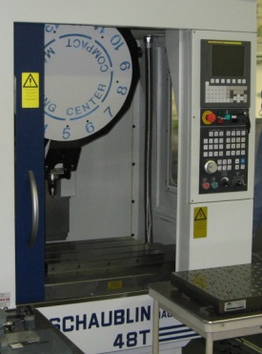
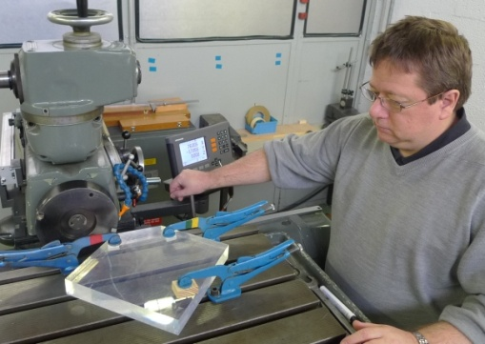
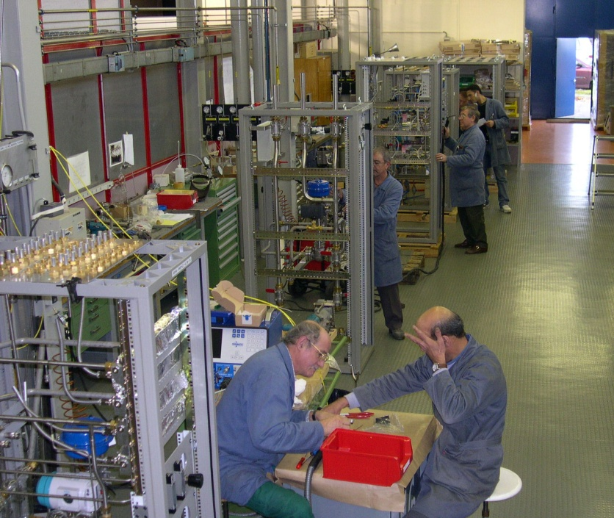
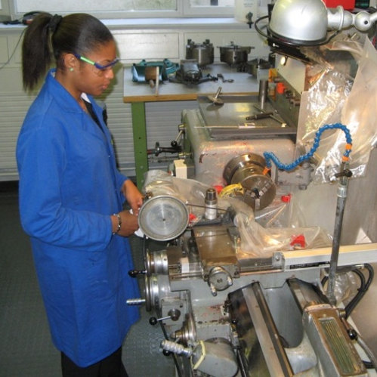
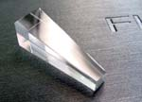
3 workshops for specific services in DT
Building | Responsible | Main Use
3 | M. Van Stenis | Small workshop specialized in Glass and Ceramic machining. CNC milling machine.
155 | A. Wasem | Small workshop for Gas Lab. Pipe working tools and specialised welding equipment.
155 | A. Folley | Small workshop for Scintillator production.

Slide 23
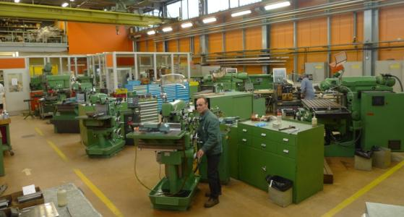
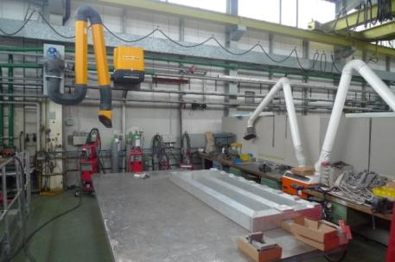
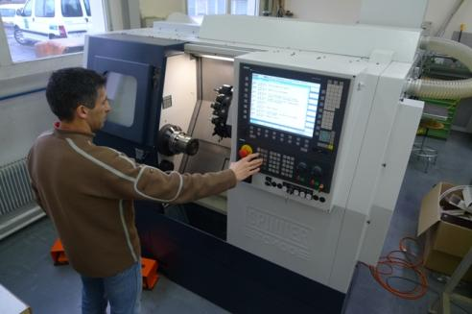
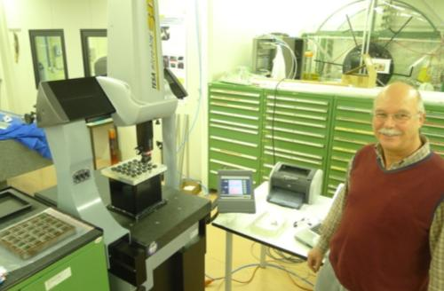
3 + 2 general purpose workshops
Building | Responsible | Main Use
108 | F. Garnier | Large workshop. Welding. ATLAS Point 1 activities.
162 | B. Cantin | Large workshop, conventional tools.
166 | L. Kottelat / J.Bendotti | Conventional and CNC machines.
2252 | D. Anstett | ALICE activities at Point 2.
20 | R. Dumps | Small workshop, conventional tools.

Slide 24
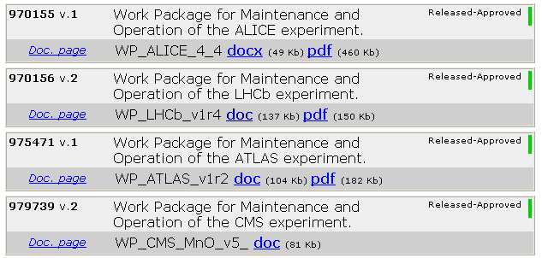

Snapshot of activities and manpower attribution (~APT 2010)
LHC “direct” = Construction, M&O, Upgrade
ALICE Operation | 7.60
ALICE Upgrade | 1.15
ATLAS ALFA | 3.40
ATLAS Operation | 3.95
ATLAS Tracker Upgrade * | 0.80
CMS Operation | 1.70
CMS Pre-shower | 0.20
CMS Tracker Upgrade | 0.40
LHCb Operation | 3.20
LHCb Upgrade | 0.60
TOTEM Operation | 1.00
TOTEM RP | 1.15
SUM | 25.15
4 approved M&O work packages
TOTEM M&O to be done in 2010 (RP still in construction).
* IBL project not yet included
WP draft exists.

Slide 25
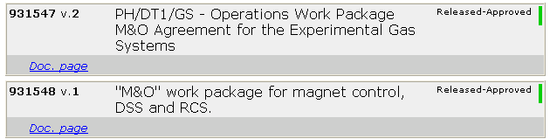
Snapshot of activities and manpower attribution (~APT 2010)
LHC “Common”
2 approved M&O work packages
(Gas Systems + Magnet Control)
Gas Support | 6.83
Magnet M&O | 4.05
MSS upgrade | 0.65
Grand Total | 11.53
MSS upgrade work to be better defined in 2010 (S. Ravat, G. Olesen).

Slide 26
Snapshot of activities and manpower attribution (~APT 2010)
Services for all (CERN) experiments
Non-LHC projects
B-Field Measurements | 1.50
Bond. Lab. / DSF | 1.80
Glueing Techniques | 0.60
Irrad. Facilities | 1.95
Magnet Support | 0.85
Optical Lab. | 0.20
Rad. Mon. | 0.35
Scintillators | 0.60
Thin Film | 1.80
Grand Total | 9.85
Aegis | 1.05
CAST M&O | 3.30
CLIC Det. Studies | 0.70
Cloud | 0.95
NA48/62 | 7.50
Grand Total | 13.50
The group provides the Technical Coordinators for
CAST M. Davenport
CLOUD A. Onnela
NA62 F. Hahn

Slide 27
Snapshot of activities and manpower attribution (~APT 2010)
R&D
WP11/Cooling | 2.95
DUMPS Raphael | 0.20
GODLEWSKI Jan | 0.70
NOEL Jerome | 0.60
PETAGNA Paolo | 0.85
TROPEA Paula | 0.60
WP4 / RD50 | 0.60
GLASER Maurice | 0.10
MOLL Michael | 0.50
WP5 / RD51 | 3.40
BRUNEL Bernard | 0.50
DAVID Eric | 0.50
KLEMPT Wolfgang | 0.50
ROPELEWSKI Leszek | 0.50
TAUREG Hans | 0.70
VAN STENIS Miranda | 0.70
WP6 / QC | 0.50
HONMA Alan | 0.30
MCGILL Ian | 0.20
WP7 / New Irrad + Material | 0.95
CAPEANS GARRIDO Maria Del Mar | 0.40
FORTIN Richard Georges | 0.50
HAHN Ferdinand | 0.05
AX-PET | 0.60
CLIC Det. Studies | 0.70
LC R&D Panel Member | 0.10
ME R&D WP's | 0.05
WP11/Cooling | 4.95
WP4 / RD50 | 2.81
WP5 / RD51 | 8.32
WP6 / QC | 1.50
WP7 | 1.78
Grand Total | 20.81
More than 50% are Fell/Doct/Tech
Staff breakdown
in R&D WP

Slide 28
Snapshot of activities and manpower attribution (~APT 2010)
Workshops + Admin + TSO, FP7 etc.
CERN Exhibition | 0.40
CSO | 0.10
DT Admin. | 1.55
FEM calculation | 0.30
FSU Admin. | 0.35
Misc. Safety | 0.30
RD50 Admin. | 0.10
RD51 Admin. | 0.10
TSO | 0.90
Work-Shop | 2.85
Grand Total | 6.95
Currently not allocated :
~1 FTE (spread over 3 people)

Slide 29
M&O for LHC experiments
General approach
DT contributes to the completion and consolidation of the (approved) detector
DT participates in the operation and maintenance of the sub-detectors with DT (or CERN) involvement. This may also include participation in (central) shifts, RPA interventions, etc.
DT prepares and executes shutdown work
DT maintains lab infrastructure, equipment, documentation, etc. required for maintenance and repair.
Scope and foreseen resources are agreed in M&O WPs, one for each LHC experiment.
Upgrade work is in general not included in the M&O WP. (LHCb VELO replacement (~1:1) is included.)

