Slide 1
PH-DT steering group meeting 30.4.2010
WP4: Radiation Hard Semiconductor Detectors
- Status of activities -
Michael Moll (PH-DT)
OUTLINE
WP4 – Challenge and Aim
WP4 – Work program, organization and participants
Status:
  Pixel sensor evaluation/development ( in collaboration with ATLAS)
  Strip sensor evaluation/development ( in collaboration with CMS)
  Generic R&D ( in collaboration with RD50)
  Build up of infrastructure ( common CERN infrastructure)
Work plan for 2010/2011
Notes:
Bonjour tout le monde.
Premièrement j'aime vous remercier de l'invitation.
Deuxièmement j'aime dire que je suis désolé pour mon Français
Si vous pensez à un moment qui mon Français est trop mauvais, je m'arrêterai et continuerai en anglais.
Cependant, je voudrais vraiment essayer de donner cette présentation en français
Alors je commence:
Aujourd'hui je voudrais parler au sujet du développement des détecteurs de semi-conducteur pour le futurs générations de collisionneurs avec de très haute luminosité
….et en particulier au sujet des développements pour le remise a niveau (upgrade) du LHC (le Grand Collisionneur Hadronique), le Super LHC.
..la plus grande partie des développements que je vais présenter
.. ont été effectuées par la collaboration CERN-RD50

Slide 2
Challenge: Sensors for the sLHC Trackers
Pixel sensors:
max. cumulated fluence for LHC and sLHC
Note: Measured partly under different conditions! Lines to guide the eye
(no modeling)!
status 2007
“sLHC” = 3000fb⁻¹
LHC detectors would fail in
SLHC due to radiation damage
SLHC will need
more radiation tolerant
tracking detector concepts!
Strip sensors:
max. cumulated fluence for LHC and sLHC

Slide 3
Work program and structure of WP 4
WP4 is organized around 4 partly overlapping projects
1. Development and evaluation of pixel sensor concepts
in framework of ATLAS Pixel Upgrade projects (H.Pernegger)
  Evaluation of rad. tolerant sensors for innermost pixel layers in view of IBL and sLHC pixel:
  Pixel technologies: Silicon planar sensors, Silicon 3D sensors, Diamond sensors
  Support in organizing and running of testbeam and irradiation campaigns for the ATLAS pixel community.
2. Development and evaluation of sensor concepts for CMS upgrade
in framework of CMS Tracker upgrade projects (A.Peisert (since 2010), M.Mannelli (before))
  Sensor R&D program with HPK (Hamamatsu) to evaluate sensors based on various silicon sensor materials: FZ, MCZ and EPI silicon of n- and p-type and different thickness
  Part of prg. for preproduction, qualification and large scale production of CMS phase II upgrade
3. Generic R&D on radiation tolerance of silicon sensors
in framework of RD50 project (M.Moll)
  Generic R&D on understanding of radiation damage in silicon
4. Build up of test equipment & infrastructure for PH common use (M.Moll)
  Equipment: Probestations for CV/IV measurements of sensors
  TCT/ β-source test system in climate controlled container
  Offer services as part of PH Departmental Silicon Facility

Slide 4
WP4 – Participants
Challenge: make WP4 a common activity with long term profit for CERN-PH
Coordinator: Michael Moll (PH-DT)
Project 1 (ATLAS - Pixel):
WP4-Fellow: Alessandro La Rosa; WP4-PhD: Christian Gallrapp
Daniel Dobos, Heinz Pernegger, (B.di Girolamo, F.Dittus)
Project 2 (CMS - Tracker):
A.Peisert, M.Mannelli, S.Mersi, student Joyeeta Sinha (4 months),
Georg Auzinger (PhD), (Duccio Abbaneo)
Technical support (1.3 FTE: J.F. Pernot, J.P. Chatelain,
E. Albert, H. Postema, A. Tsirou, I. Ahmed)
Project 3 & 4 (RD50 & ssd test equipment):
WP4-Fellows: Manuel Fahrer , Irena Dolenc
M.Moll, N.Pacifico (MCPAD ESR), E.Castillo Sanchez (Trainee)
R.Fortin, DT-FSU (Technical support)
Observers (presently no active role)
LHCb : Paula Collins
ALICE : Petra Riedler
TOTEM: Gennaro Ruggiero
ATLAS
CMS
Note: Tech support also given to Project 3&4
RD50
PH-DT ssd
support to
all CERN
Experiments
Note: Participation also
in Project 2

Slide 5

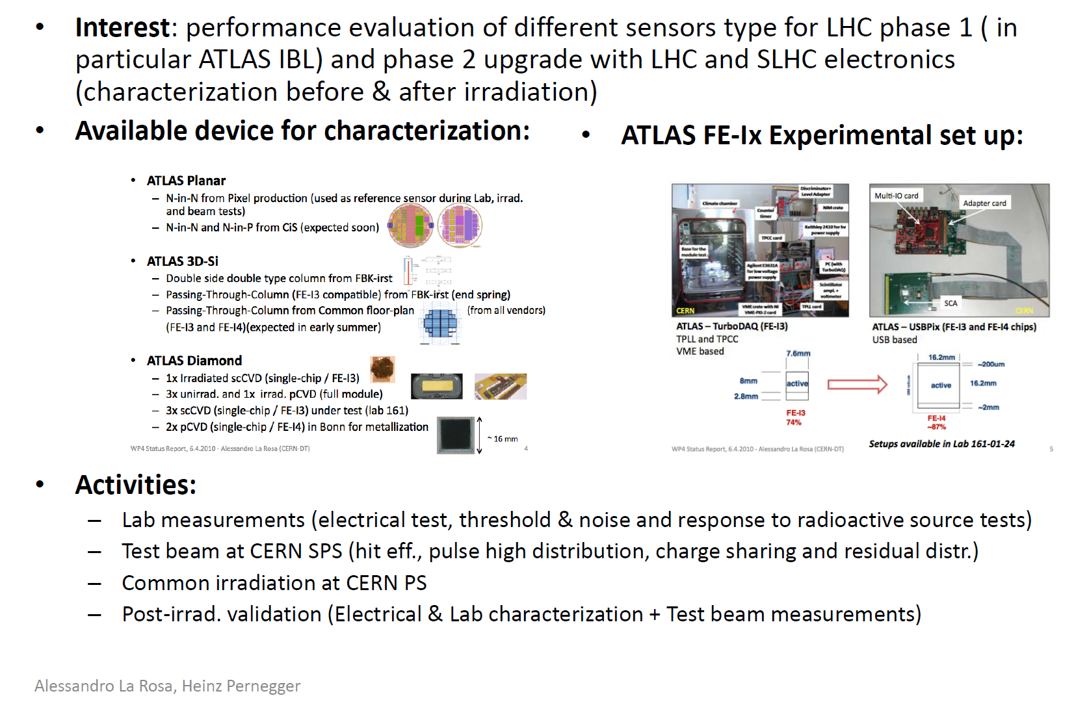
ATLAS Pixel R&D

Slide 6
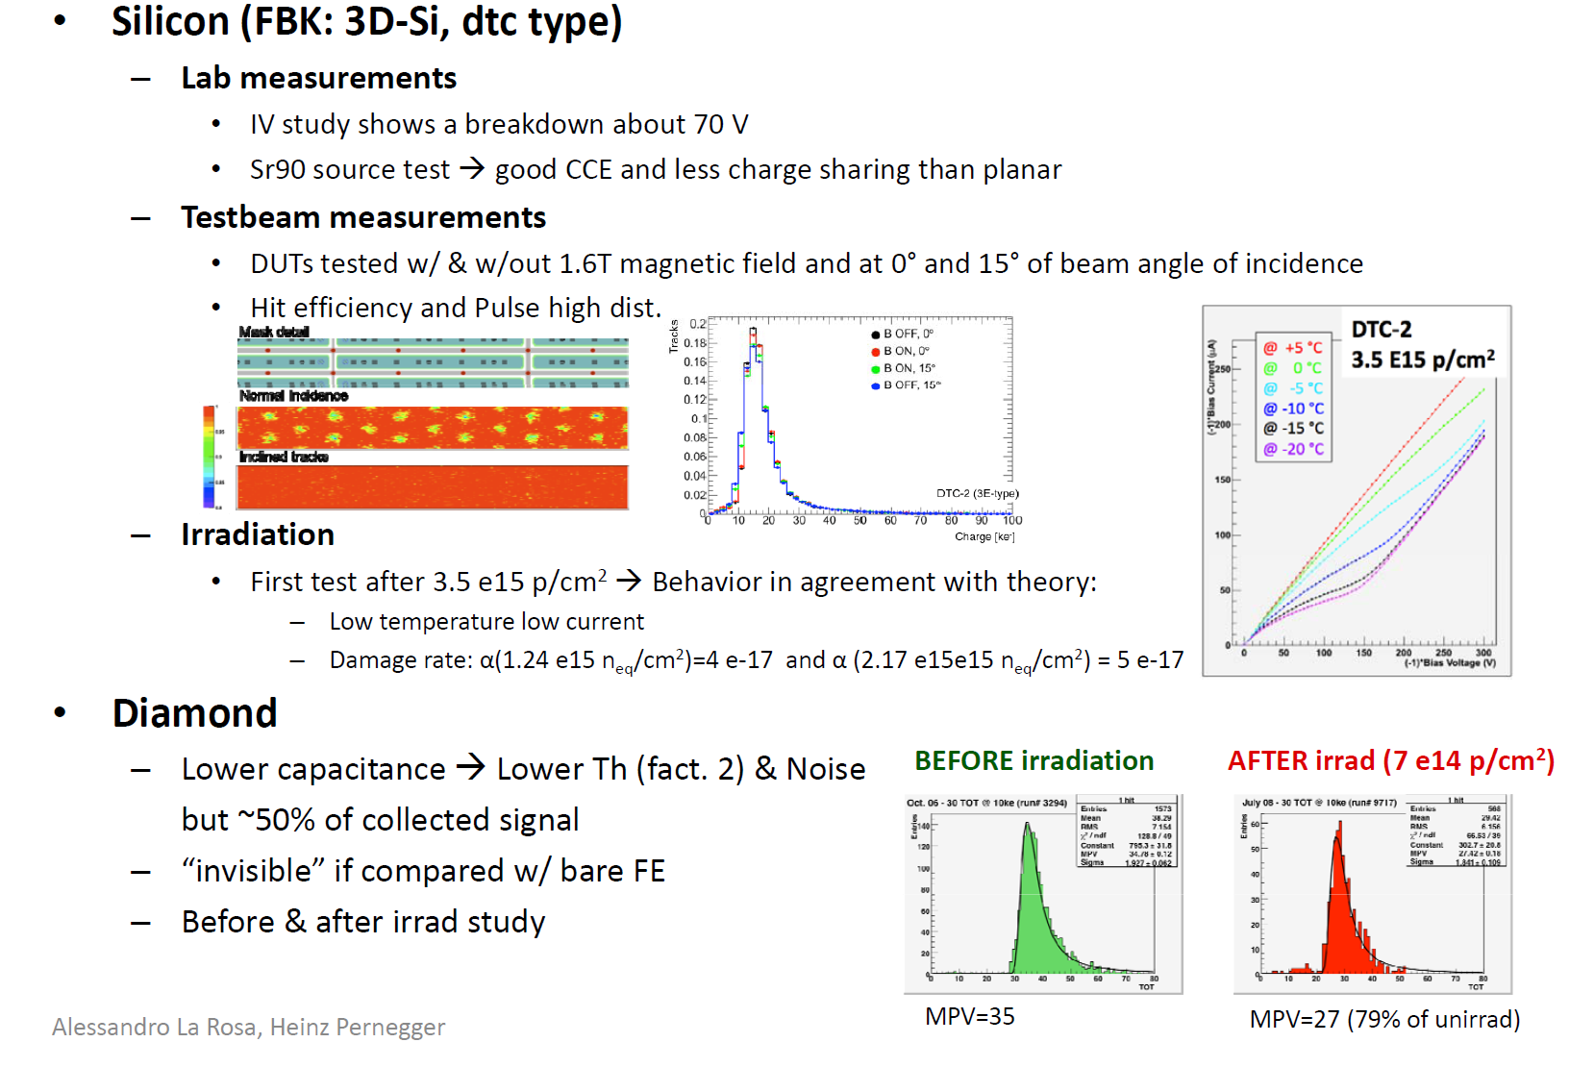
Some results

Slide 7

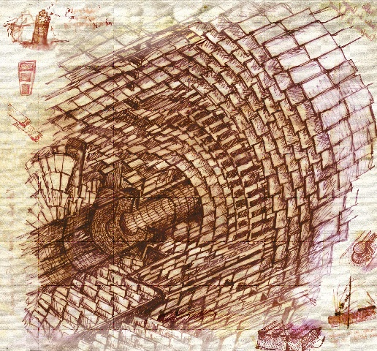
CMS SLHC Tracker
- Thin Sensor R&D with HPK -
WP4 participation in Phase I:
coordination of project: F.Hartmann
M .Mannelli (HPK contact)
A. Peisert (coord meas. at CERN)
irradiation of sensors
characterization of sensors
(… requires still set up of some
specific equipment at CERN)
Project is integral part of CMS Tracker upgrade
Outline plan:
Phase I: Targeted R&D
  Establish required sensors characteristics & basic specifications
  Single Source R&D with HPK agreed with CERN, together with framework for Market Survey & Procurements for Phase II & Phase III
Phase II: Preproduction and Qualification
  Finalize detailed specifications and QA protocols
  Qualify for large scale production
Phase III: Large Scale Production
Input: Marcello Mannelli

Slide 8
Status of HPK Thin Sensor R&D Order
Aim: Identify technology for tracker upgrade
Delivery of sensors expected in June 2010
  Different silicon material, different technologies
 | substrate type | FZ 200um | MCZ 200um | FZ 100um | epi 100um | epi 75um | FZ 300um | Total
 | & Active Thickness | carrier | thinning | carrier
 | P-on-N Production | 6 | 6 | 6 | 6 | 6 | 6 | 36
 | N-on-P Production p-spray | 6 | 6 | 6 | 6 | 6 | 6 | 36
 | N-on-P Production p-stop | 6 | 6 | 6 | 6 | 6 | 6 | 36
 | 2'nd metal production P-on-N | 6 |  |  |  |  |  | 6
 | 2'nd metal production N-on-P p-stop | 6 |  |  |  |  |  | 6
 | 2'nd metal production N-on-P p-spray | 6 |  |  |  |  |  | 6
 | Total | 36 | 18 | 18 | 18 | 18 | 18 | 126
Evaluate
  Geometry
  Radiation hardness and annealing behavior

Slide 9
Status of HPK Thin Sensor R&D Order
Each wafer contains ~ 30 different sensors and test structures
Massive irradiation and test campaign organized
CERN will participate in evaluation of
  A) multi-geometry strip and pixel detectors (A.Peisert et al.)
  B) pad diode test structures (M.Moll et al.)
  - CV, IV, CCE measurements, annealing studies
Setups for measurements have to be ready in June
3 regions, 4 groups of 32 strips in each region
pitch 70 μm, 80 μm, 240 μm, 120 μm
different width/pitch in each region
~3 cm long strips
Electrical tests: IV, CV, C_{interstrip}, R_{interstrip}, C_{coupling}
Cosmic rack and x-y table for measurements with a source:
CCE, noise, position resolution

Slide 10
RD50 – Radiation hard semiconductor devices for very high luminosity colliders
RD50
RD50 collaboration: 47 Institutions with 250 members
WP4 involvement in management of collaboration (M.Moll co-spokesperson)
CERN (WP4) R&D focused on RD50 key questions:
  p-type silicon and its annealing behavior (‘base line option’ for ATLAS Tracker upgrade)
  charge multiplication in highly irradiated sensors
  radiation tolerance of p-in-n Magnetic Czochralski silicon sensors
1700V
800V
500V

Slide 11
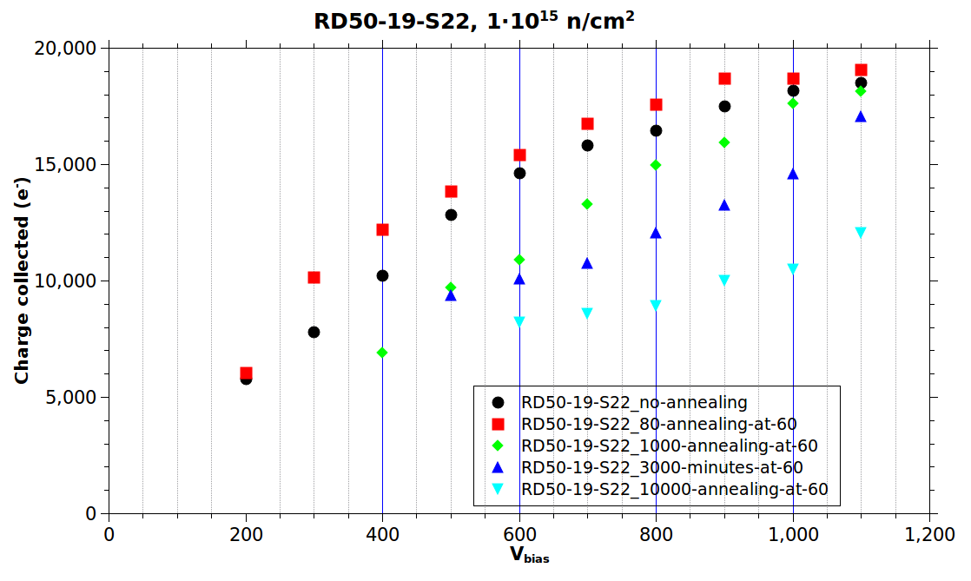
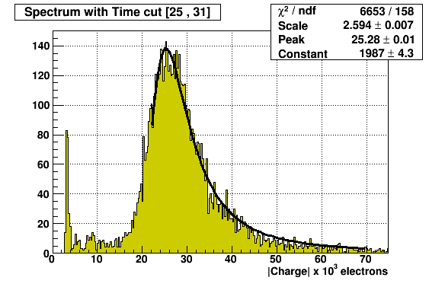
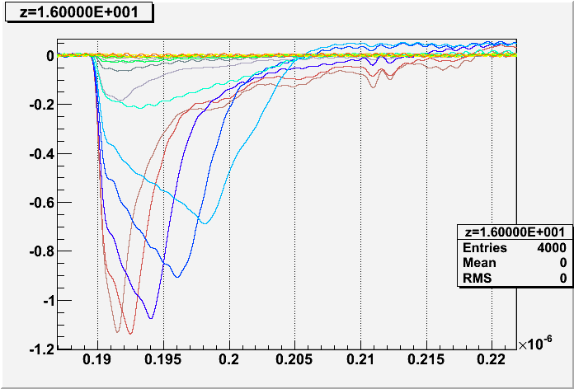
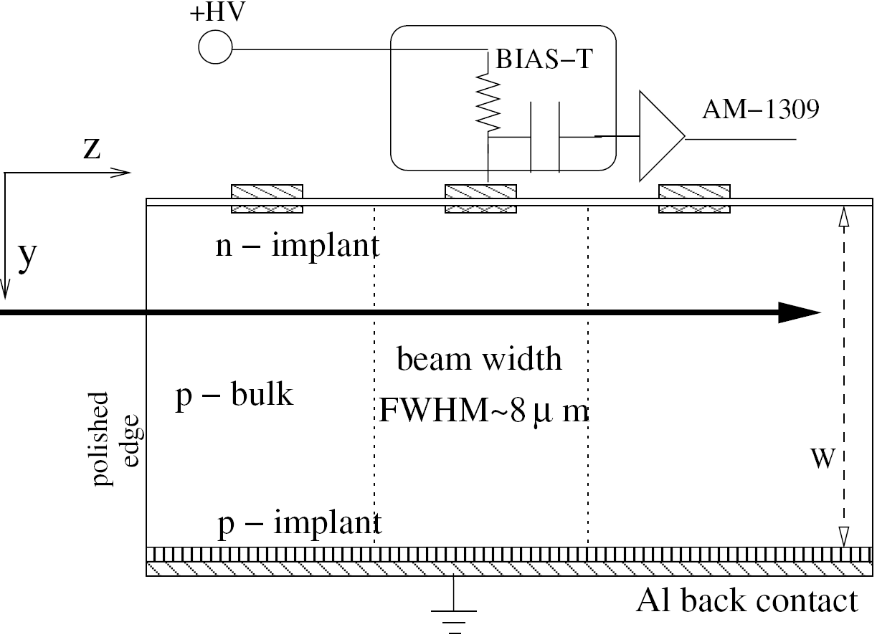
Example: RD50 activities at CERN
RD50
Characterization of irradiated ministrip sensors
Annealing study on irradiated MCZ silicon strip sensors
  CCE with beta source and LHCb Beetle chip based DAQ (ALIBAVA)
Characterization of charge transport inside irradiated sensors
  Edge TCT (Transient Charge Technique) with infrared picosecond laser

Slide 12
Status: Build up of test equipment
# Solid State Detector Lab (SSD) in bldg.28 (attached to Silicon Facility – 186)
‘Refurbishment’ of ssd characterization tools
  Probe station for CV/IV measurements (4” chuck in dark box, CV/IV up to 1000V)
  CCE with Sr⁹⁰ source (one channel, μs shaping, cooling)
  Status: Done, including centralized data storage and database
New TCT(Transient Charge Technique)/CCE setup in bldg.28
  Status: Done, see next slide (cooling needs to be improved to reach -40ºC)
New edge TCT system in bldg.28
  Status: first measurements done, needs further work
Pixel test stations in Bat 161 for sensor + FE chip measurments
  Status: Fully operational; With source and electronic calibration in climate chamber
New 4 inch probe station with cold chuck for CV/IV measurements
  Status: Almost ready, delay due to work load of technicians in other projects
Cold box installation for measuring CMS multistrip geometry sensors
  Status: Will be ready in June for arrival of first HPK sensors
# ATLAS Pixel laboratory (bldg. 161)
# Silicon Facility – bldg 186

Slide 13
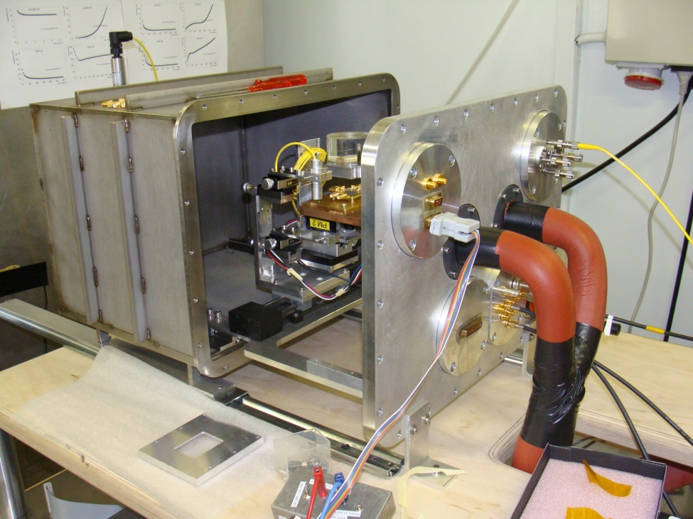
Example: New TCT/CCE/CV/IV setup
Characterization methods
TCT (Transient Charge Technique)
  strip and pad sensors, multichannel
  lasers illumination on both sides of sample
  red + infrared laser (ps pulses)
CCE (Charge collection efficiency)
  Sr⁹⁰ source
  Scintillator based trigger
CV / IV
  CV with frequency up to 1 MHz
Mechanics & Cooling
Cooled with silicon oil
  vacuum or dry air atmosphere
  Temperatures down to below -25°C
  (down to -40° C with peltier booster)
Movable with linear motor stage
  laser and source
  can be scanned over DUT
Modular system with flanshes
  allows for easy mounting of additional feedthroughts
Sample mounting & Electronics
SMA connectors (HF)
  2.5 GHz oscilloscope (epool)
Sample boards (support PCB)
  detectors to be bonded
  good thermal & HF properties
Amplification
  Fast commercial amplifiers
  ALIBAVA system for strip sensor CCE
    based on LHCb Beetle Chip
    25ns shaping time, 128 channels

Slide 14
Link between WP4 and Experiments
IBL project and WP projects
Comment from Heinz Pernegger:
Two major areas of contributions for ATLAS IBL and sLHC upgrade
  IBL Pixel Sensor Development interrelates with WP project on sensors
  IBL Integration and stave studies interrelates with WP project on cooling (CO₂)
People currently involved:
  D. Dobos, F. Dittus, C. Gallrapp, A. La Rosa, H. Pernegger
  M. Capeans, A. Catinaccio
  Work carried out in close cooperation between PH-ADE, PH-ADO and PH-DT
Pixel Sensor Development for IBL and sLHC
  Planar, 3D silicon and CVD diamond pixel sensors
    Studies of irradiated pixel detectors in Lab
  Major responsibility for Irradiation and Testbeams
    Coordinator for IBL and 3D irradiation (A. La Rosa)
  We have setup and operate facility for pixel tests in
  Bat 161 which is used by whole collaboration
Significant contribution to the ongoing IBL module development program:
  Module prototype program (tests of sensor-chip assemblies)
  Tests of new FEI4 pixel chip for IBL (module test analysis, DAQ)
  Major partners: Bonn, Ohio, Genova/Trento, Dortmund

Slide 15
Link between WP4 and Experiments
WP4 and ATLAS pixel sensor R&D
Comment from Heinz Pernegger:
The cooperation between WP4 and ATLAS pixel sensor development
has been very successful and beneficial for both
The generic sensor development benefit strongly from experiment developments
(e.g. availability of pixel electronics)
For ATLAS, in particular the IBL, it allowed to support the development and evaluation of pixel sensors of different technologies
Specific support made possible through WP & Atlas cooperation on sensors
Participation in sensor prototyping runs and manufacturing of evaluation prototypes
  3D sensor development at FBK-irst for double sided and active-edge 3D sensors, optimization of design charge collection and noise performance
  Planar sensor development for new n-n planar sensors at CIS with slim edges and improved radiation hardness
  pCVD and scCVD diamond sensors for charge collection studies and diamond pixel module tests
  Pixel bump-bonding to sensors at IZM
Infrastructure
  Update and improvement of sensor characterization lab in Bat 161
  acquisition and further development of new readout electronics
Support of personnel
  Currently support one fellow (A. La Rosa) and one doctoral student (C. Gallrapp)
  through WP funds.

Slide 16
Link between WP4 and Experiments
WP4 and CMS Tracker upgrade
Comment from Duccio Abbaneo:
CMS silicon sensors R&D relies on WP4 and collaboration with the group of M. Moll
Results from RD50 are the basis of the R&D program
Access to DSF facilities and expertise
CERN financial contribution to the project comes from WP4 funds
As soon as CMS has developed a well-structured R&D project, WP4 resources have been made available to the project (with a fair share with the other experiments). Without that, CERN participation in the project would not have been possible.
Thanks to this policy, WP4 resources are being used in the most effective way, without any barrier between “generic R&D” and “detector-specific R&D”.
In few words: fully useful WP, managed in an exemplary way.

Slide 17
Budget 2010
CET: 155KCHF from 2009 commitment on 34004 not balanced yet !
Budget allocation 2010: 340 KCHF
Splitting on activities in 2010:
ATLAS activities 65 KCHF
CMS activities 65 KCHF
RD50 activities 65 KCHF
Infrastructure (common setups) 65 KCHF
PhD student, FSU, Fellow, epool, travel, others 80 KCHF

Slide 18
Manpower – Students/Fellows
On WP budgets (2008-2012):
1 PhD (WP4-budget)
1 Trainee (WP4-budget)
3 Fellows (WP-global)
Details:
Some commitment for 2012
All students/Fellows in WP4:

Slide 19
Workplan for next 12 months
Workplan “ATLAS pixels”:
  Test of sensor assemblies with new FEI4 chip (for IBL and sLHC)
  Characterization of irradiated sensors (planar, 3D and diamond)
  Organize and support common irradiations and test beams for ATLAS Pixel community
  Performance studies of pixel sensors for phase I upgrade (IBL)
Workplan “sensors for CMS”
  Participate in CMS work on HPK sensor characterization before & after irradiation
  with main focus on multistrip stuctures and diodes/ministrip sensors
Workplan on activities in framework of RD50
  Submission of detector production runs at Micron (2010)
  Detailed studies on reverse annealing in p-type silicon strip sensors
  Sensor characterizations with new infrastructure (fast/multi and edge TCT, Alibava)
  Start project on simulation of irradiated silicon sensors using commercial software
Workplan on common infrastructure at CERN
  Produce second setup for CCE measurements with LHCb Beetle chip (ALIBAVA)
  Finalization of cold chuck system for CV/IV measurements

