Slide 1
Electronics, Trigger, DAQ
CERN Summerstudent Programme 2010
Niko Neufeld, CERN-PH

Slide 2
Contents
Lecture 1: Mostly electronics, some triggering
Lecture 2: More electronics, basics of Data Acquisition
Lecture 3: Data Acquisition 2 and more Trigger
Lecture 4: Data Acquisition of LHC experiments and running an experiment
Lecture 5: High Level Trigger
Topics are related, no 100% separation between the 3
We want to fill in some of the blanks from W. Riegler’s detector lectures to G. Dissertori’s data analysis primer
Wherever possible we will take a “system” perspective: which requirement of our experiment lets us do what? What are the consequences of a certain choice for the detector (the experiment) at large

Slide 3
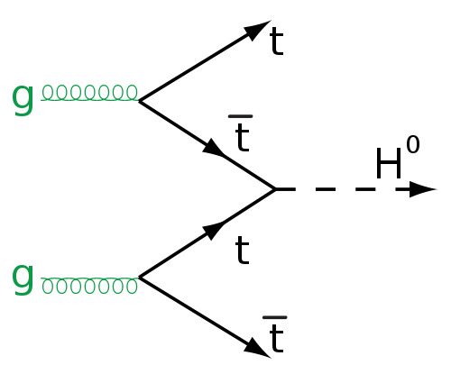
Physics, Detectors, Electronics Trigger & DAQ
High rate collider
Fast electronics
rare, need many collisions
Big data acquisition
trigger

Slide 4
Disclaimer
Electronics, Trigger and DAQ are vast subjects covering a lot of physics and engineering
Based entirely on personal bias I have selected a few topics
While most of it will be only an overview at a few places we will go into some technical detail
Some things will be only touched upon or left out altogether – information on those you will find in the references at the end
  Quantitative treatment of detector electronics & physics behind the electronics
  Derivation of the “physics” in the trigger → field theory lectures
  DAQ of experiments outside HEP/LHC
  Management of large networks and farms &High-speed mass storage

Slide 5
Thanks
Some material and lots of inspiration for this lecture was taken from lectures by my predecessors: P. Mato, P. Sphicas, J. Christiansen
In the electronics part I learned a lot from H. Spieler (see refs at the end)
Trigger material I got from H. Dijkstra and T. Christiansen
Many thanks to S. Suman for his help with the animations!

Slide 6
Lecture 1/5
Mostly electronics

Slide 7
Electronics in a nutshell

Slide 8
Electronics: introduction
Why do we care about electronics?
  As physicists?
  As computer scientists?
The Readout Chain
  Shaping, Amplifying
  Digitizing, Transmitting, Noise and all that
Timing and Synchronization
Systems
  Power, Cooling & Radiation

Slide 9

Physicists stop reading here
It is well known that
“Only technical details are missing”
Werner Heisenberg, 1958
A physicist is someone who learned Electrodynamics from Jackson

Slide 10
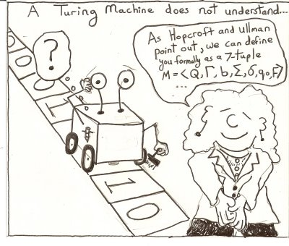
Computer scientists are digital people
so why bother with this gruesome analogue electronics stuff
The problem is that Turing machines are so bad with I/O and it is important to understand the constraints of data acquisition and triggering

Slide 11
The bare minimum
From Maxwell’s equations derive
Ohm’s law and power
The IV characteristics of a capacitance
Kirchhoff’s laws
where: Q = charge (Coulomb), C = Capacitance (Farad), U = V = Voltage (Volt), P = Power (Watt), I = Current (Ampere)

Slide 12
Detector Frontend Electronics (FEE)

Slide 13
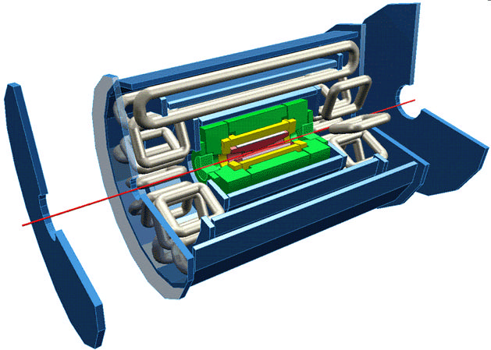
Looking at ATLAS
Electromagnetic Calorimetry
Muon chambers
Beam pipe
Tracking (in solenoid field)
Hadronic Calorimetry

Slide 14
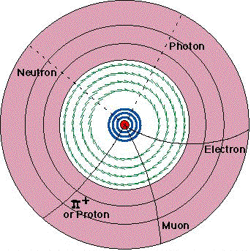
Tracking
Separate tracks by charge and momentum
Position measurement layer by layer
  Inner layers: silicon pixel and strips → presence of hit determines position
  Outer layers: “straw” drift chambers → need time of hit to determine position

Slide 15
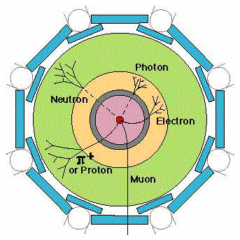
Calorimetry
Particles generate showers in calorimeters
  Electromagnetic Calorimeter (yellow): Absorbs and measures the energies of all electrons, photons
  Hadronic Calorimeter (green): Absorbs and measures the energies of hadrons, including protons and neutrons, pions and kaons
amplitude measurement
position information provided by segmentation of detector

Slide 16
Muon System
Track
Electrons formed along the track drift towards the central wire.
The first electron to reach the high-field region initiates the avalanche, which is used to derive the timing pulse.
Since the initiation of the avalanche is delayed by the transit time of the charge from the track to the wire, the detection time of the avalanche can be used to determine the radial position^{(*)}.
Principle also used in straw tracker – need fast timing electronics
Δt
ATLAS Muon drift chambers have a radius of 3 cm and are between 1 and 6 m long
(*) Clearly this needs some start of time t=0 (e.g. the beam-crossing)

Slide 17
Summary of measurements
Si Tracking position to ~10 μm accuracy in rφ (through segmentation) timing to 25 ns accuracy to separate bunch crossings
Straw Tracker position to 170 μm at r > 56 cm
EM calorimeter energy via LAr ionization chambers position through segmentation
Hadron calorimeter energy via plastic scintillator tiles position through segmentation
Muon System signal via ionization chambers position through timing measurement
Although these various detector systems look very different, they all follow the same principles:
Sensors must determine
  presence of a particle
  magnitude of signal
  time of arrival
Some measurements depend on sensitivity, i.e. detection threshold, e.g.: silicon tracker, to detect presence of a particle in a given electrode
Others seek to determine a quantity very accurately, i.e. resolution, e.g. : calorimeter – magnitude of absorbed energy; muon chambers – time measurement yields position
All have in common that they are sensitive to:
signal magnitude
fluctuations

Slide 18
The “front-end” electronics`
Front-end electronics is the electronics directly connected to the detector (sensitive element)
Its purpose is to
  acquire an electrical signal from the detector (usually a short, small current pulse)
  tailor the response of the system to optimize
    the minimum detectable signal
    energy measurement (charge deposit)
    event rate
    time of arrival
    insensitivty to sensor pulse shape
  digitize the signal and store it for further treatment
incident radiation
Digitization
Amplifier
digitization
pre-amplifier
Detector
detector
DSP
DSP
DAQ
Buffering
DAQ
Shaping
buffering
shaping
Interface
Triggering
Interface
triggering
Multiplexing
multiplexing
ETC.
etc.

Slide 19
The read-out chain
Detector / Sensor
Amplifier
Filter
Shaper
Range compression
clock (TTC)
Sampling
Digital filter
Zero suppression
Buffer
Feature extraction
Buffer
Format & Readout
to Data Acquisition System

Slide 20
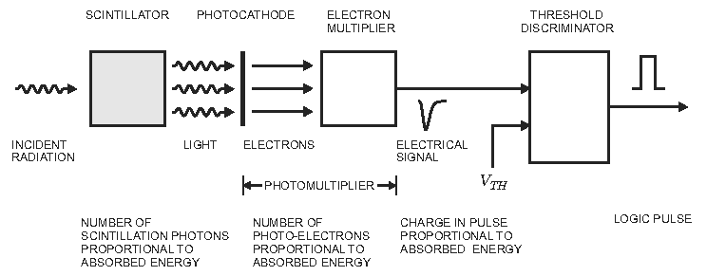
Example: Scintillator
from H. Spieler “Analog and Digital Electronics for Detectors”
Photomultiplier has high intrinsic gain (== amplification) → no pre-amplifier required
Pulse shape does not depend on signal charge → measurement is called pulse height analysis

Slide 21
The read-out chain
Detector / Sensor
Amplifier
Filter
Shaper
Range compression
clock (TTC)
Sampling
Digital filter
Zero suppression
Buffer
Feature extraction
Buffer
Format & Readout
to Data Acquisition System

Slide 22
The signal
The signal is usually a small current pulse varying in duration (from ~ 100 ps for a Si sensor to O(10) μs for inorganic scintillators)
There are many sources of signals. Magnitude of signal depends on deposited signal (energy / charge) and excitation energy
Signal | Physical effect | Excitation energy
Electrical pulse (direct) | Ionization | 30 eV for gases 1- 10 eV for semiconductors
Scintillation light | Excitation of optical states | 20 – 500 eV
Temperature | Excitation of lattice vibrations | meV

Slide 23
The read-out chain
Detector / Sensor
Amplifier
Filter
Shaper
Range compression
clock (TTC)
Sampling
Digital filter
Zero suppression
Buffer
Feature extraction
Buffer
Format & Readout
to Data Acquisition System

Slide 24
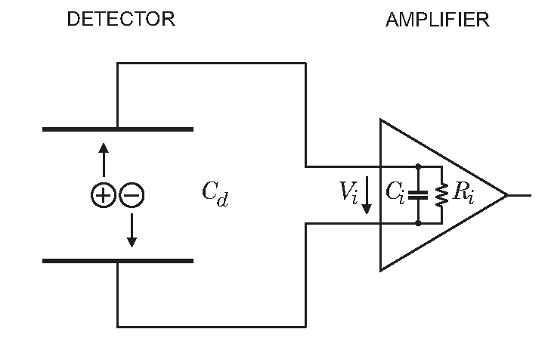
Acquiring a signal
Interesting signal is the deposited energy ➔ need to integrate the current pulse
  on the sensor capacitance
  using an integrating pre-amplifier
  using an integrating Analog Digital Converter (ADC)
The signal is usually very small ➔ need to amplify it
  with electronics
  by signal multiplication (e.g. photomultiplier)
Not so practical! Response depends
on sensor capacitance

Slide 25
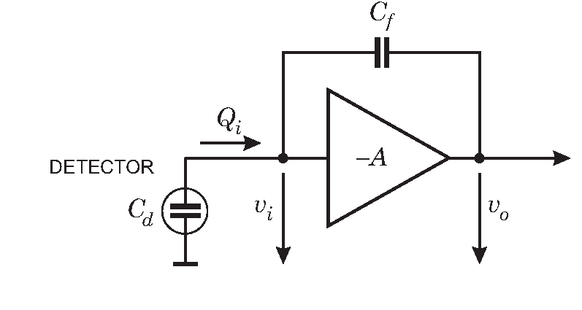
Charge sensitive amplification
Feedback amplifier with gain –A
Assume infinite input impedance (no current flows into the amplifier)
Input signal produces v_{i} at the input of the amplifier generating –Av_{i} on output
All charge must build up on feed back capacitance
Charge gain depends only on C_{f}
C_{f} x A needs to be large compared to C_{d}

Slide 26
Fluctuations and Noise
There are two limitations to the precision of signal magnitude measurements
  Fluctuations of the signal charge due to a an absorption event in the detector
  Baseline fluctuations in the electronics (“noise”)
Often one has both – they are independent from each other so their contributions add in quadrature:
Noise affects all measurements – must maximize signal to noise ration S/N ratio

Slide 27
Signal fluctuation
A signal consists of multiple elementary events (e.g. a charged particle creates one electron-hole pair in a Si-strip)
The number of elementary events fluctuates where F is the Fano factor (0.1 for Silicon)
r.m.s.

Slide 28
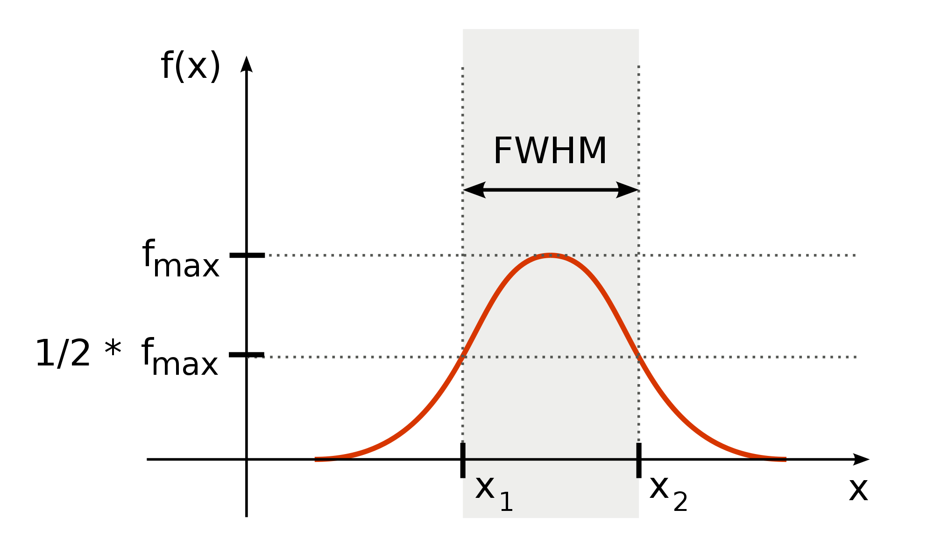
Full Width at Half Maximum (FWHM)
from Wikipedia
FWHM = 2.35 σ for a Gaussian distribution

Slide 29
Electronics Noise
Thermal noise
  created by velocity fluctuations of charge carriers in a conductor
  Noise power density per unit bandwidth is constant: white noise ➔
  larger bandwidth → larger noise (see also next slide)
Shot noise
  created by fluctuations in the number of charge carriers (e.g. tunneling events in a semi-conductor diode)
  proportional to the total average current

Slide 30
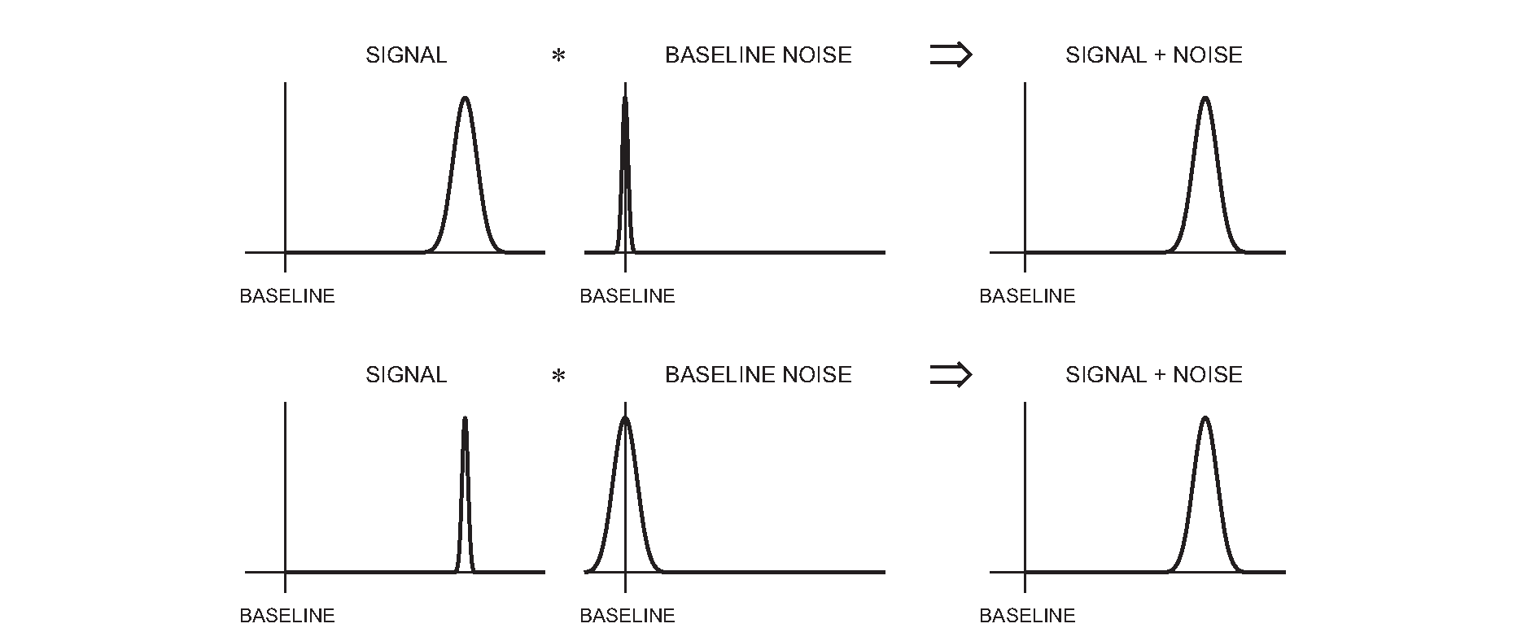
SNR / Signal over Noise
Need to optimize Signal over Noise Ratio (SNR)

Slide 31
Two important concepts
The bandwidth BW of an amplifier is the frequency range for which the output is at least half of the nominal amplification
The rise-time t_{r} of a signal is the time in which a signal goes from 10% to 90% of its peak-value
For a linear RC element (amplifier):
BW * t_{r} = 0.35
For fast rising signals (t_{r} small) need high bandwidth, but this will increase the noise (see before) → shape the pulse to make it “flatter”

Slide 32
SNR and detector capacitance
For a given signal charge Q_{s}:
V_{s} – Q_{s}/(C_{d} + C_{i})
Assume amplifier has an input noise voltage V_{n}, then
SNR =
SNR is inversely proportional to total capacitance on the input → thicker sensor gives more signal but also more noise

Slide 33
The read-out chain
Detector / Sensor
Amplifier
Filter
Shaper
Range compression
clock (TTC)
Sampling
Digital filter
Zero suppression
Buffer
Feature extraction
Buffer
Format & Readout
to Data Acquisition System

Slide 34
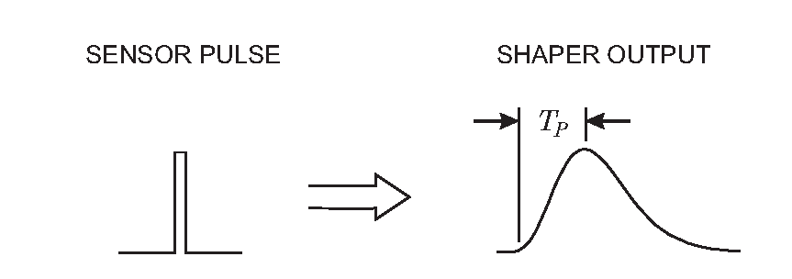
The pulse-shaper should “broaden”…
Sharp pulse is “broadened” – rounded around the peak
Reduces input bandwidth and hence noise

Slide 35
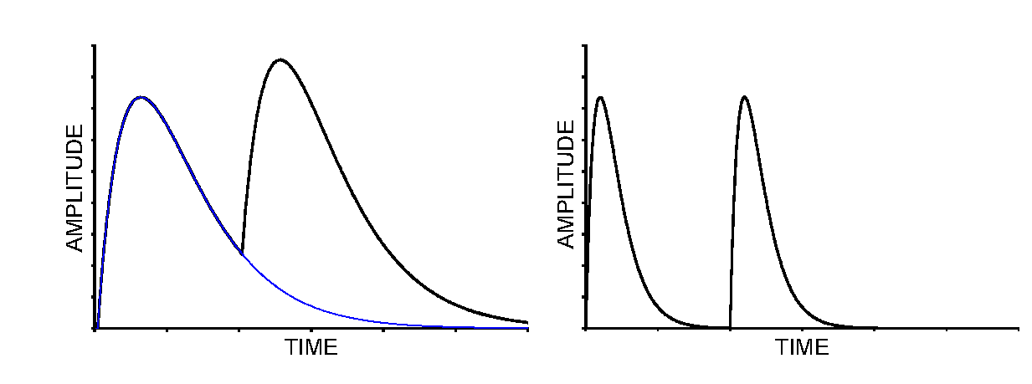
…but not too much
Broad pulses reduce the temporal spacing between consecutive pulses
Need to limit the effect of “pile-up” → pulses not too borad
As usual in life: a compromise, in this case made out of RC and CR filters

Slide 36
Lecture 2/5
More electronics & trigger

Slide 37
Analog/Digital/binary
1) Analog memory
Mux
ADC
After amplification and shaping the signals must at some point be digitized to allow for DAQ and further processing by computers
Analog readout: analog buffering ; digitization after transmission off detector
Digital readout with analog buffer
Digital readout with digital buffer
Binary: discriminator right after shaping
  Binary tracking
  Drift time measurement
control
2) Analog memory
Mux
ADC
Mux
control
3) Digital memory
ADC
Mux
ADC
ADC
ADC

Slide 38
Analog to digital conversion
There is clearly a tendency to go digital as early as possible
  This is extensively done in consumer goods
The “cost” of the ADC determines which architecture is chosen
  Strongly depends on speed and resolution
Input frequencies must be limited to half the sampling frequency.
  Otherwise this will fold in as additional noise.
High resolution ADC also needs low jitter clock to maintain effective resolution

Slide 39
An important truth
A solution in detector-electronics can be:
  fast
  cheap
  low-power
Choose two of the above: you can’t have three
Cost means:
  Power consumption
  Silicon area
  Availability of radiation hard ADC

Slide 40
Time measurements
Time measurements are important in many HEP applications
  Identification of bunch crossing (LHC: 25ns)
  Distinguishing among individual collisions (events) in continuous beam like experiments (or very short bunch interval like CLIC: ~250ps)
  Drift time
    Position in drift tubes ( binary detectors with limited time resolution: ~1ns)
    Time projection chamber (both good time and amplitude)
    Time Of Flight (TOF) detectors (very high time resolution: 10-100ps)
Time walk: Time dependency on amplitude
  Low threshold (noise and pedestal limited)
  Constant fraction discrimination
    Works quite well but needs good analog delays (cable delay) which is not easy to integrate on chip.
  Amplitude compensation (done in DAQ CPU’s)
    Separate measurement of amplitude (expensive)
    Time measurements with two thresholds: 2 TDC channels
    Time over threshold (TOT): 1 TDC channel measuring both leading edge and pulse width
Time Over Threshold (TOT) can even be used as a poor mans ADC
  E.g. ATLAS Pixel
TH₂
TH₁
Constant fraction discriminator
1/k
delay
delay
D
R
delay
Vi
Th
TOT₁
TOT₁
T=T_{r} – f(TOT)

Slide 41
Time to digital conversion
Start
Stop
Counter
  Large dynamic range
  Good and cheap time references available as crystal oscillators
  Synchronous to system clock so good for time tagging
  Limited resolution: ~1ns
Charge integration (start – stop)
  Limited dynamic range
  High resolution: ~1-100 ps
  Sensitive analog circuit needing ADC for final conversion.
  Sensitive to temperature, etc. so often needs in-system calibration
  Can be combined with time counter for large dynamic range
Clock
Counter
Reset
Start-stop type
Clock
Counter
Hit
Register
Time tagging type
Start
Stop
ADC
Start
Stop

Slide 42
Readout

Slide 43
After shaping and amplifying
As usual ☺ what you do depends on many factors:
Number of channels and channel density
Collision rate and channel occupancies
Triggering: levels, latencies, rates
Available technology and cost
What you can/want to do in custom made electronics and what you do in standard computers (computer farms)
Radiation levels
Power consumption and related cooling
Location of digitization
Given detector technology

Slide 44
Single integrator
Simple (only one sample per channel)
Slow rate (and high precision) experiments
Long dead time
Nuclear physics
Not appropriate for HEP
ADC
DAQ
Collect charge from event
Convert with ADC
Send data to DAQ

Slide 45
Double buffered
Use a second integrator while the first is readout and reset
Decreases dead time significantly
Still for low rates
ADC
DAQ

Slide 46
Multiple event buffers
Good for experiments with short spills and large spacing between spills (e.g. fixed target experiment at SPS)
Fill up event buffers during spill (high rate)
Readout between spills (low rate)
ADC can possibly be shared across channels
Buffering can also be done digitally (in RAM)
Shaping
Channel mux.
ADC
DAQ

Slide 47
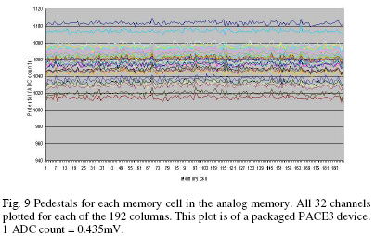
Analog buffers
Extensively used when ADC not available with sufficient speed and resolution or consuming too much power
Large array of storage capacitors with read and write switches (controlled digitally)
For good homogeneity of memory
  Voltage mode
  Charge mode with Charge integrator for reading
Examples:
  Sampling oscilloscopes
  HEP: CMS tracker, ATLAS calorimeter, LHCb trackers, etc.

Slide 48
Constantly sampled
Needed for high rate experiments with signal pileup
Shapers and not switched integrators
Allows digital signal processing in its traditional form (constantly sampled data stream)
Output rate may be far to high for what following DAQ system can handle
With local zero-suppression this may be an option for future high rate experiments (SLHC, CLIC)
Sampling clock
Shaping
ADC
DSP
(zero-sup.)
DAQ

Slide 49
Excursion: zero-suppression
Why spend bandwidth sending data that is zero for the majority of the time ?
Perform zero-suppression and only send data with non-zero content
  Identify the data with a channel number and/or a time-stamp
  We do not want to loose information of interest so this must be done with great care taking into account pedestals, baseline variations, common mode, noise, etc.
  Not worth it for occupancies above ~10%
Alternative: data compression
  Huffman encoding and alike
TANSTAFL (There Aint No Such Thing As A Free Lunch)
  Data rates fluctuates all the time and we have to fit this into links with a given bandwidth
  Not any more event synchronous
  Complicated buffer handling (overflows)
  Before an experiment is built and running it is very difficult to give reliable estimates of data rates needed ( background, new physics, etc.)

Slide 50
Synchronous readout
All channels are doing the same “thing” at the same time
Synchronous to a global clock (bunch crossing clock)
Data-rate on each link is identical and depends only on trigger -rate
On-detector buffers (de-randomizers) are of same size and there occupancy (“how full they are”) depends only on the trigger-rate
☹ Lots of bandwidth wasted for zero’s
  Price of links determine if one can afford this
☺ No problems if occupancy of detectors or noise higher than expected
  But there are other problems related to this: spill over, saturation of detector, etc.
On-detector
Off-detector
MUX
DAQ
Data
formatting
Zero-
suppression
Data buffering during trigger
Derandomizer buffer
Trigger
Global clock

Slide 51
Trigger & DAQ
(Sneak Preview)

Slide 52
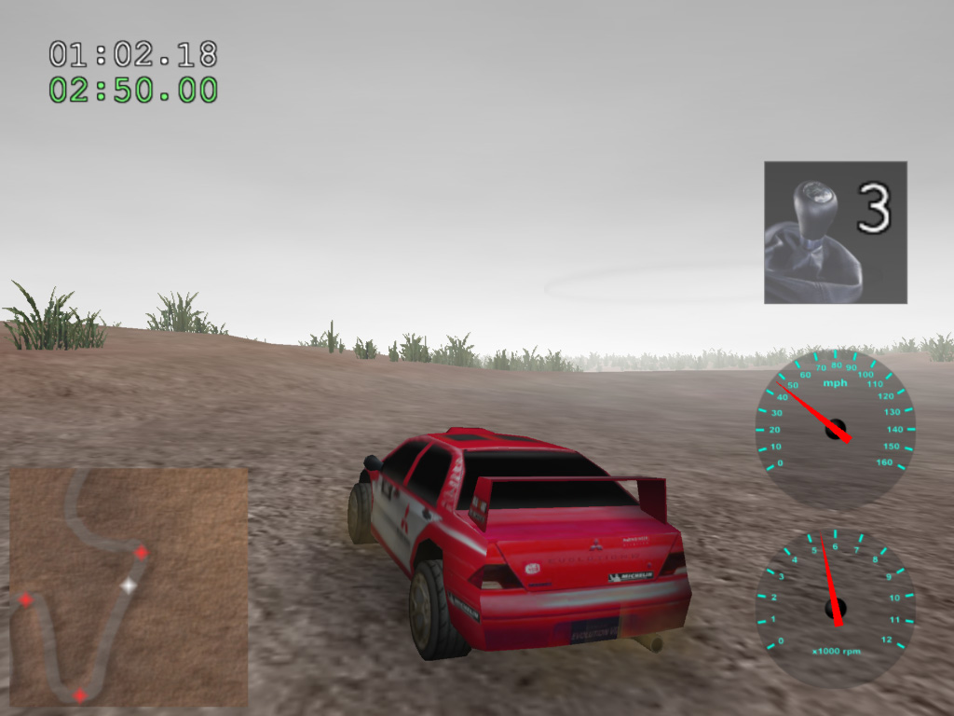
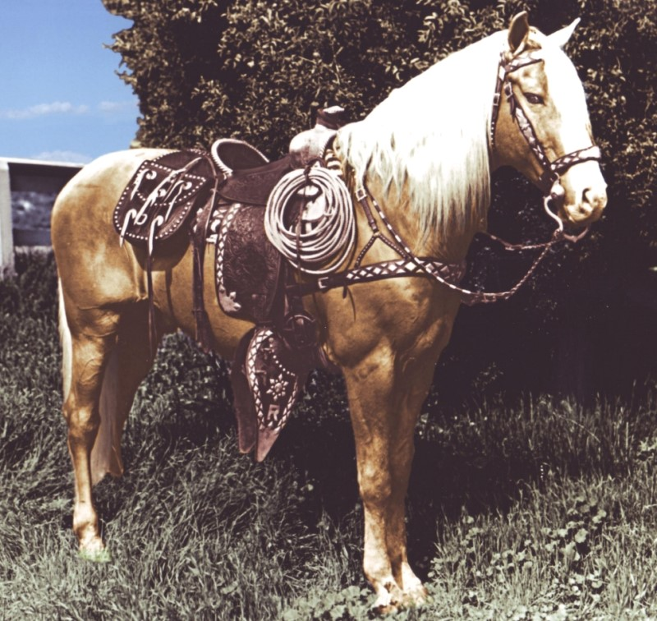
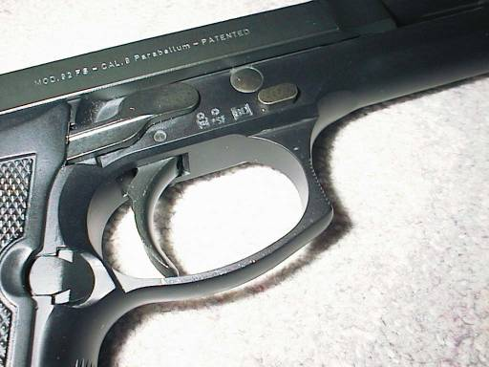
What is a trigger?
An open-source
3D rally game?
An important part
of a Beretta
The most famous
horse in
movie history?

Slide 53
What is a trigger?
Wikipedia: “A trigger is a system that uses simple criteria to rapidly decide which events in a particle detector to keep when only a small fraction of the total can be recorded. “

Slide 54
Trigger
Simple
Rapid
Selective
When only a small fraction can be recorded
Notes:
This is not a scientific precise definition, but it catches what most physicists think about, when they hear “trigger”
Simple: because you want to be able to understand what the trigger did to your measurement – a selection of data will influence the result!
Rapid: because the data you want to keep, might be lost if you wait to long to decide
Decide to keep: a trigger is a selection mechanism, depending on what you want and what your apparatus is
When only a small fraction can be recorded: most of the time we are a looking for rare event and consider all events, which create similar signals in our detectors as “background”, the cheap & dumb approach would be to record everything and then try to select in the analysis the good events. Even though sometimes this would be nice, in practice we do not have enough money to do that.

Slide 55
Trivial DAQ
External View
sensor
Physical View
sensor
CPU
ADC Card
disk
Logical View
Proces-
sing
ADC
storage

Slide 56
Trivial DAQ with a real trigger
Sensor
Trigger
Delay
Discriminator
ADC
Start
Proces-
sing
Interrupt
storage
What if a trigger is produced when the ADC or
processing is busy?

Slide 57
Trivial DAQ with a real trigger 2
Sensor
Trigger
Delay
Discriminator
Start
Busy Logic
ADC
and
not
Proces-
sing
Interrupt
Set
Q
Clear
Ready
storage
Deadtime (%) is the ratio between the time the DAQ
is busy and the total time.

Slide 58
Trivial DAQ with a real trigger 3
Sensor
Trigger
Discriminator
Delay
Start
Busy Logic
ADC
and
Full
FIFO
DataReady
Proces-
sing
storage
Buffers are introduced to de-randomize data,
to decouple the data production from the data
consumption. Better performance.

Slide 59
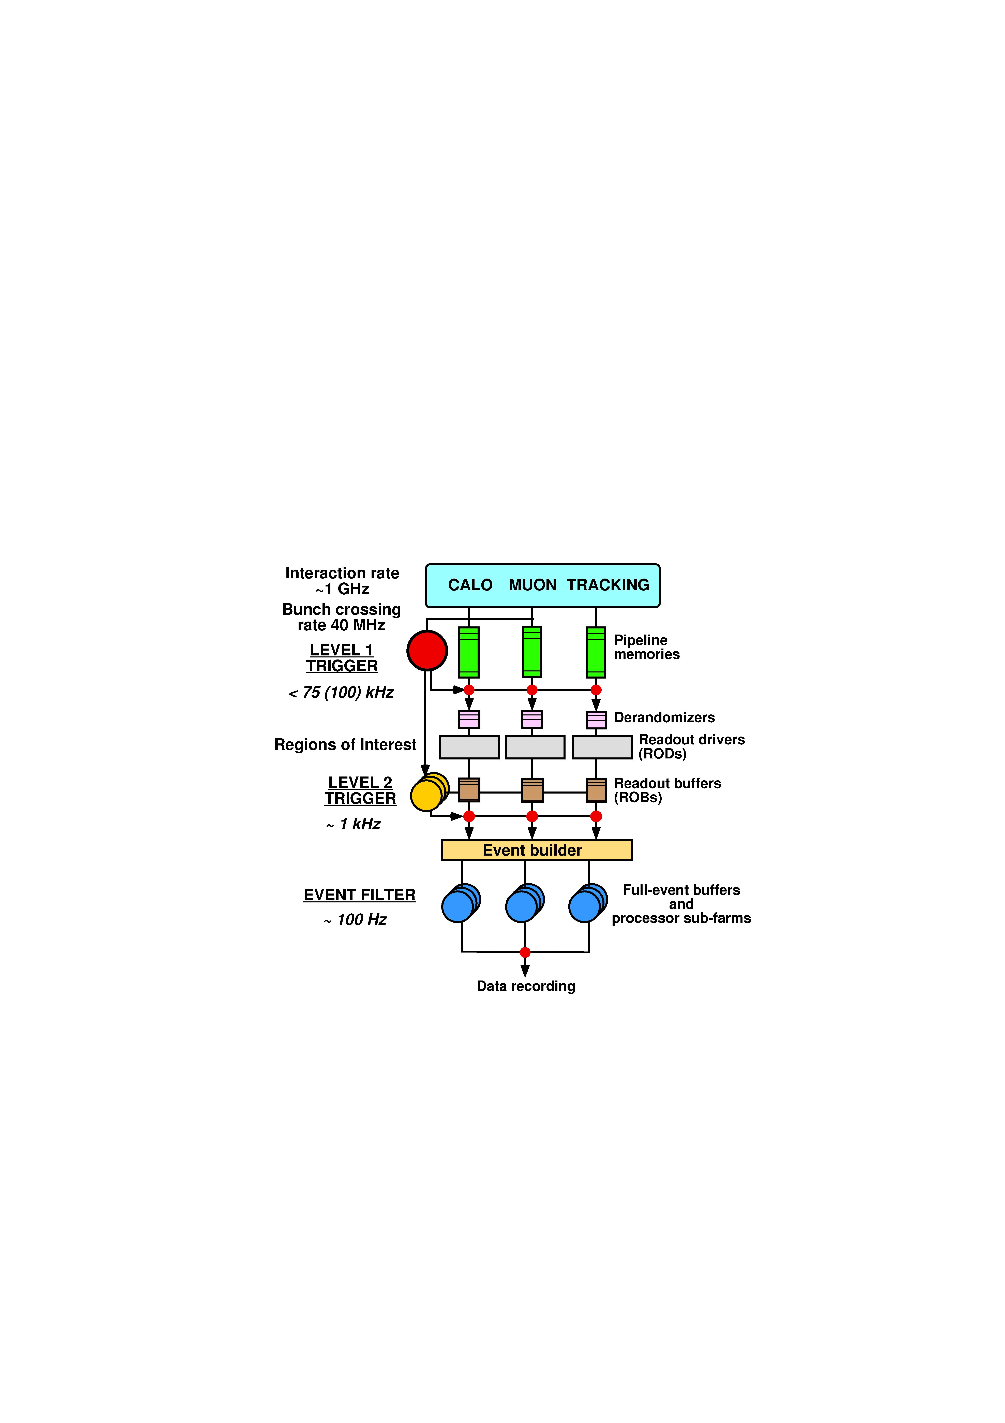
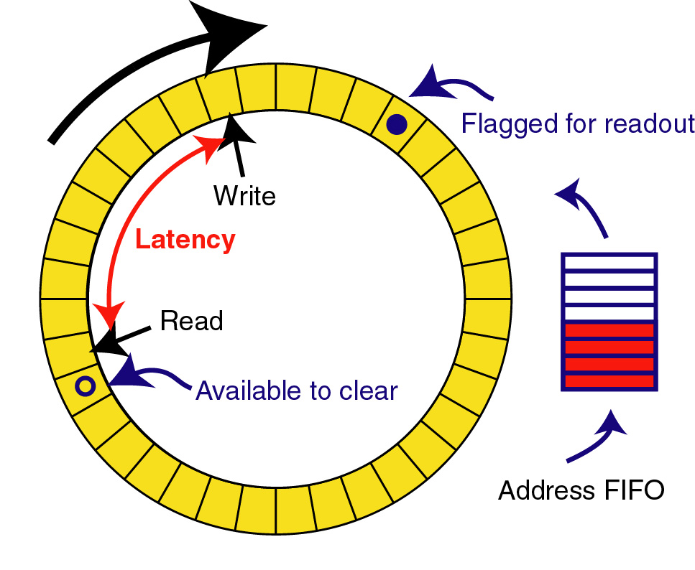
Triggered read-out
Trigger processing requires some data transmission and processing time to make decision so front-ends must buffer data during this time. This is called the trigger latency
For constant high rate experiments a “pipeline” buffer is needed in all front-end detector channels:
analog or digital
  Real clocked pipeline (high power, large area, bad for analog)
  Circular buffer
  Time tagged (zero suppressed latency buffer based on time information)
Shaping
Constant writing
Channel mux.
ADC
DAQ
Trigger

Slide 60
Trigger rate control
Trigger rate determined by physics parameters used in trigger system:
1 kHz – 1MHz
  The lower rate after the trigger allows sharing resources across channels (e.g. ADC and readout links)
Triggers will be of random nature i.e. follow a Poisson distribution → a burst of triggers can occur within a short time window so some kind of rate control/spacing is needed
  Minimum spacing between trigger accepts → dead-time
  Maximum number of triggers within a given time window
Derandomizer buffers needed in front-ends to handle this
  Size and readout speed of this determines effective trigger rate

Slide 61
Effect of de-randomizing
Sensor
Sensor
Trigger
Trigger
Delay
Discriminator
Delay
Discriminator
ADC
Start
and
Busy Logic
ADC
Start
Busy Logic
Full
and
not
FIFO
Proces-
sing
Interrupt
Set
Proces-
sing
DataReady
Ready
Clear
Q
storage
storage
The system is busy during the ADC conversion time + processing time until the data is written to the storage
The system is busy during the ADC conversion time if the FIFO is not full (assuming the storage can always follow!)

Slide 62
System optimisation: LHCb front-end buffer
Trigger latency
Fixed to 4 us in LHCb
Working point for LHCb
Max readout time: 900 ns
Derandomzier depth:
16 events
➔ 1 MHz maximum trigger accept rate

Slide 63
Asynchronous readout
Remove zeros on the detector itself
  Lower average bandwidth needed for readout links Especially interesting for low occupancy detectors
Each channel “lives a life of its own” with unpredictable buffer occupancies and data are sent whenever ready (asynchronous)
In case of buffer-overflow a truncation policy is needed → BIAS!!
  Detectors themselves do not have 100% detection efficiency either.
  Requires sufficiently large local buffers to assure that data is not lost too often (Channel occupancies can be quite non uniform across a detector with same front-end electronics)
DAQ must be able to handle this (buffering!)
Async. readout of detectors in LHC: ATLAS and CMS muon drift tube detectors, ATLAS and CMS pixel detectors, ATLAS SCT, several ALICE detectors as relatively low trigger rate (few kHz).
Off-detector
On-detector
Data
formatting
MUX
DAQ
Data
formatting
Zero-
suppression
Trigger
Data buffering
during trigger
Data
formatting
MUX
DAQ
Data
formatting
Zero-
suppression
Derandomizer buffer

Slide 64
Summary: Readout to DAQ
Large amount of data to bring out of detector
  Large quantity: ~100k in large experiment
  High speed: Gbits/s
Point to point unidirectional
Transmitter side has specific constraints
  Radiation
  Magnetic fields
  Power/cooling
  Minimum size and mass
  Must collect data from one or several front-end chips
Receiver side can be commercially available module/components (use of standard link protocols when ever possible)

Slide 65
Lecture 3/5
Electronics for LHC experiments

Slide 66
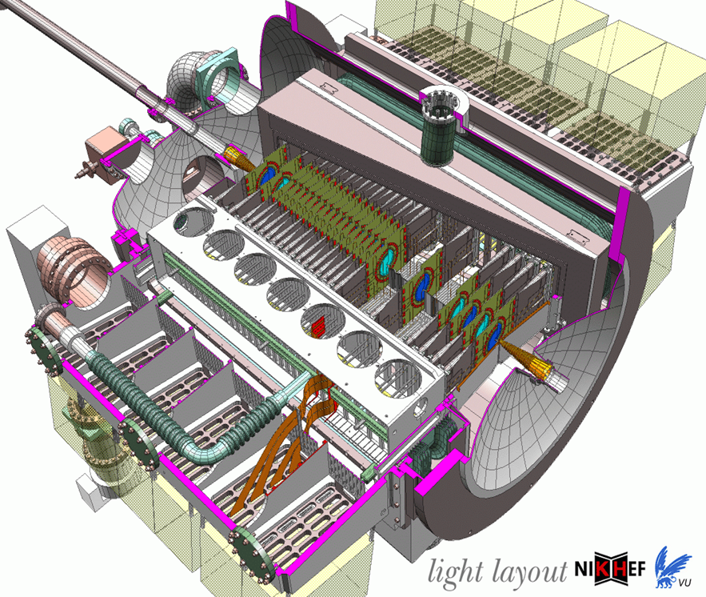
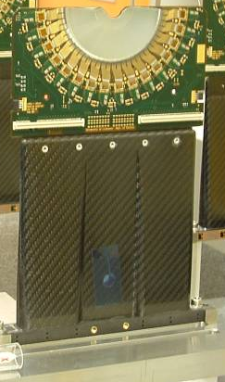
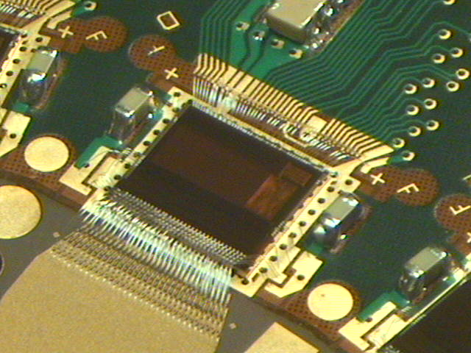
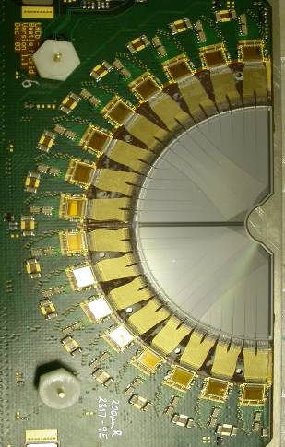
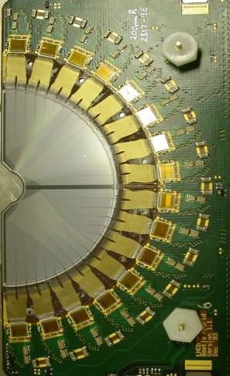
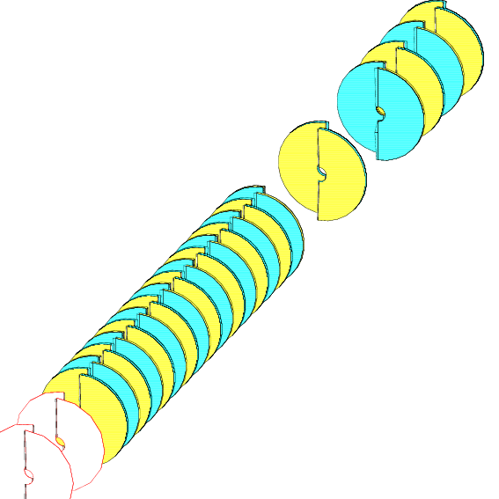
An example: the LHCb Vertex detector and its readout IC beetle
172k Channels
Strips in R and φ projection
(~10um vertex resolution)
Located 1cm from beam
Analog readout (via twisted pair cables over 60m)
Interaction
region
Beam
~1m

Slide 67
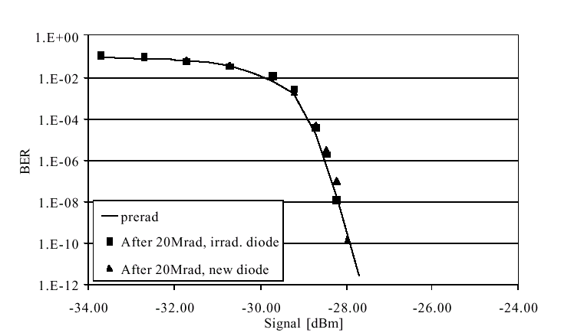
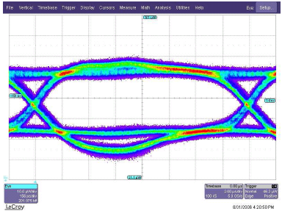
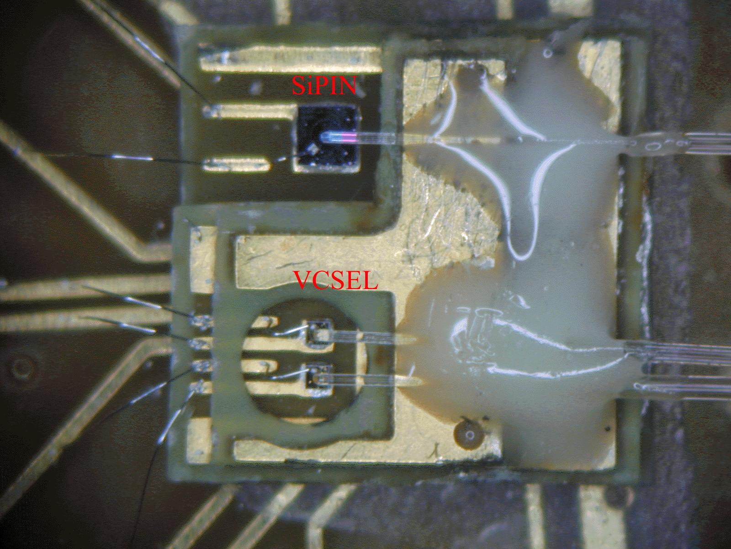
Digital optical links
High speed: 1Ghz - 10GHz – 40GHz
Extensively used in telecommunications (expensive) and in computing (“cheap”)
Encoding
  Inclusion of clock for receiver PLL’s
  DC balanced
  Special synchronization characters
  Error detection and or correction
Reliability and error rates strongly depending on received optical power and timing jitter
Multiple (16) serializers and deserializers directly available in modern high end FPGA’s.

Slide 68
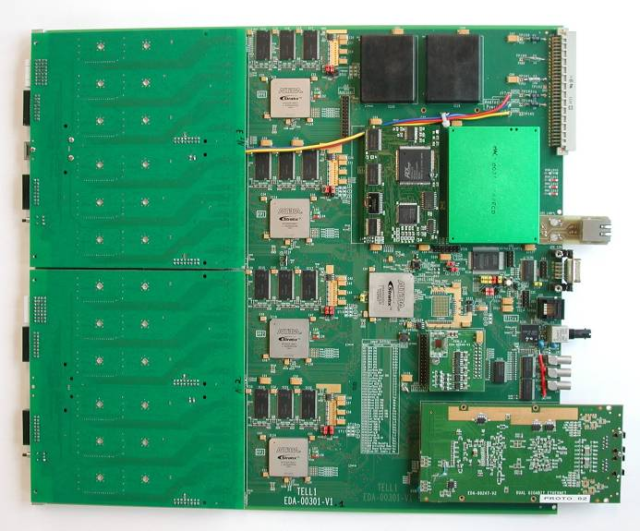
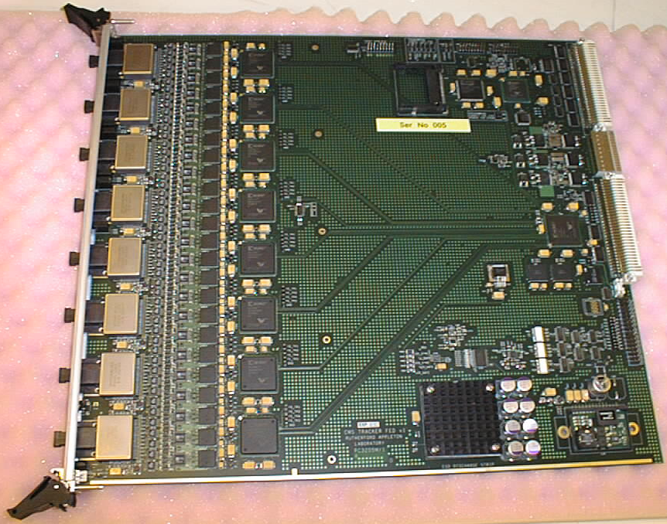
DAQ interfaces / Readout Boards
Front-end data reception
  Receive optical links from multiple front-ends: 24 - 96
  Located outside radiation
Event checking
  Verify that data received is correct
  Verify correct synchronization of front-ends
Extended digital signal processing to extract information of interest and minimize data volume
Event merging/building
  Build consistent data structures from the individual data sources so it can be efficiently sent to DAQ CPU farm and processed efficiently without wasting time reformatting data on CPU.
  Requires significant data buffering
High level of programmability needed
Send data to CPU farm at a rate that can be correctly handled by farm
  1 Gbits/s Ethernet (next is 10Gbits/s)
  In house link with PCI interface: S-link
Requires a lot of fast digital processing and data buffering: FPGA’s, DSP’s, embedded CPU
Use of ASIC’s not justified
Complicated modules that are only half made when the hardware is there: FPGA firmware (from HDL), DSP code, on-board CPU software, etc.

Slide 69
(Large) Systems

Slide 70
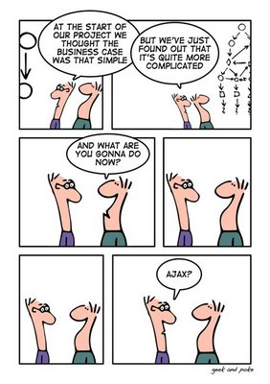
New problems
Going from single sensors to building detector read-out of the circuits we have seen, brings up a host of new problems:
  Power, Cooling
  Crosstalk
  Radiation (LHC)
Some can be tackled by (yet) more sophisticated technologies

Slide 71
Radiation effects
In modern experiments large amounts of electronics are located inside the detector where there may be a high level of radiation
  This is the case for 3 of the 4 LHC experiments (10 years running)
    Pixel detectors: 10 -100 Mrad
    Trackers: ~10Mrad
    Calorimeters: 0.1 – 1Mrad
    Muon detectors: ~10krad
    Cavern: 1 – 10krad
Normal commercial electronics will not survive within this environment
  One of the reasons why all the on-detector electronics in the LHC experiment are custom made
Special technologies and dedicated design approaches are needed to make electronics last in this unfriendly environment
Radiation effects on electronics can be divided into three major effects
  Total dose
  Displacement damage
  Single event upsets
1 Rad == 10 mGy
1 Gy = 100 Rad

Slide 72
Total dose
Generated charges from traversing particles gets trapped within the insulators of the active devices and changes their behavior
For CMOS devices this happens in the thin gate oxide layer which have a major impact on the function of the MOS transistor
  Threshold shifts
  Leakage current
In deep submicron technologies
( <0.25um) the trapped charges are removed by tunneling currents through the very thin gate oxide
    Only limited threshold shifts
The leakage currents caused by end effects of the linear transistor (NMOS) can be cured by using enclosed transistors
  For CMOS technologies below
  the 130nm generation the use
  of enclosed NMOS devices does
  not seem necessary.
  But other effects may show up
No major effect on high speed
bipolar technologies

Slide 73
Displacement damage
Traversing hadrons provokes displacements of atoms in the silicon lattice.
Bipolar devices relies extensively on effects in the silicon lattice.
  Traps (band gap energy levels)
  Increased carrier recombination in base
Results in decreased gain of bipolar devices with a dependency on the dose rate.
No significant effect on MOS devices
Also seriously affects Lasers and PIN diodes used for optical links.

Slide 74
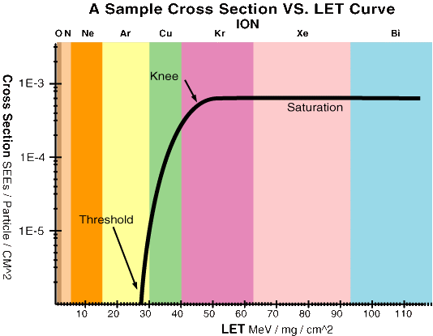
Single event upsets
Deposition of sufficient charge can make a memory cell or a flip-flop change value
As for SEL, sufficient charge can only be deposited via a nuclear interaction for traversing hadrons
The sensitivity to this is expressed as an efficient cross section for this to occur
This problem can be resolved at the circuit level or at the logic level
Make memory element so large and slow that deposited charge not enough to flip bit
Triple redundant (for registers)
Hamming coding (for memories)
  Single error correction, Double error detection
  Example Hamming codes: 5 bit additional for 8 bit data
    ham[0] = d[1] $ d[2] $ d[3] $ d[4];
    ham[1] = d[1] $ d[5] $ d[6] $ d[7];
    ham[2] = d[2] $ d[3] $ d[5] $ d[6] $ d[8];
    ham[3] = d[2] $ d[4] $ d[5] $ d[7] $ d[8] ;
    ham[4] = d[1] $ d[3] $ d[4] $ d[6] $ d[7] $ d[8];
    $ = XOR
  Overhead decreasing for larger words
  32bits only needs 7hamming bits
Example of SEU cross section

Slide 75
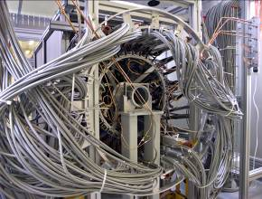
Powering
Delivering power to the front-end electronics highly embedded in the detectors has been seen to be a major challenge (underestimated).
The related cooling and power cabling infrastructure is a serious problem of the inner trackers as any additional material seriously degrades the physics performance of the whole experiment.
A large majority of the material in these detectors in LHC relates to the electronics, cooling and power and not to the silicon detector them selves (which was the initial belief)
How to improve
  Lower power consumption
  Improve power distribution

Slide 76
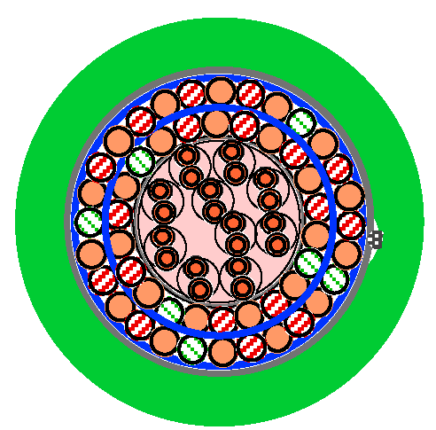
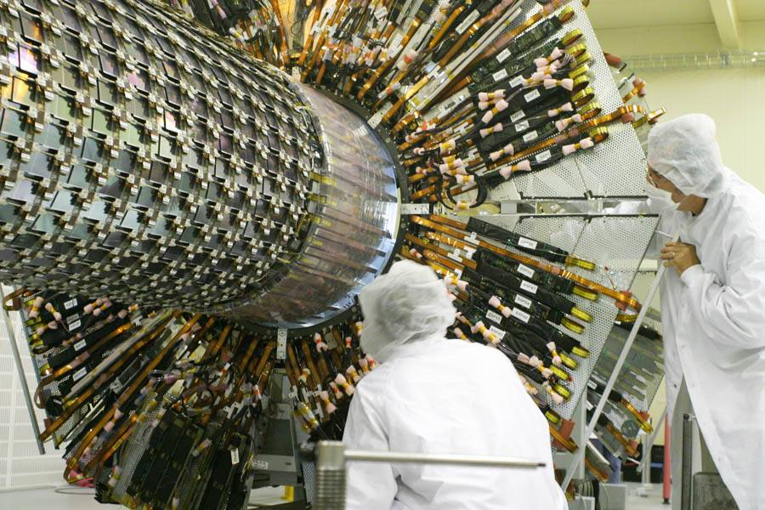
The problem as is
Total power: ~500kw (to be supplied and cooled)
  Trackers: ~ 60 kW
  Calorimeters: ~ 300 kW
  Muon: ~ 200 kW
  Must for large scale detectors be delivered over 50m – 100m distance
Direct supply of LV power from ~50m away
  Big fat copper cables needed
    Use aluminum cables for last 5-10m to reduce material budget
  Power supply quality at end will not be good with varying power consumption (just simple resistive losses)
    If power consumption constant then this could be OK
  Use remote sense to compensate
    This will have limited reaction speed
    May even become unstable for certain load configurations
  Power loss in cables will be significant for the
  voltages (2.5v) and currents needed: ~50% loss
  in cables (that needs to be cooled)
Use of local linear regulators
  Improves power quality at end load.
  Adds additional power loss: 1 – 2 v head room
  needed for regulator
  Increases power losses and total efficiency now
  only: ~25% (more cooling needed)
Voltage drop
Load
Remote sense

Slide 77
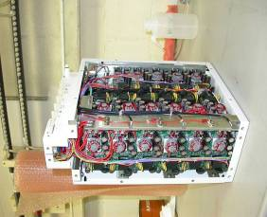
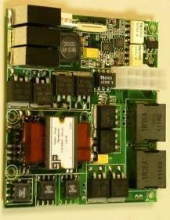
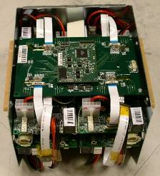
Use of DC-DC converters
For high power consumers (e.g. calorimeter) the use of local DC-DC converters are inevitable.
These must work in radiation and high magnetic fields
  This is not exactly what switched mode DC-DC converters like
  Magnetic coils and transformers saturated
  Power devices do not at all like radiation:
  SEU - > single event burnout -> smoke -> disaster
DC-DC converters for moderate radiation and moderate magnetic fields have been developed and used
  Some worries about the actual reliability of these for long term

Slide 78
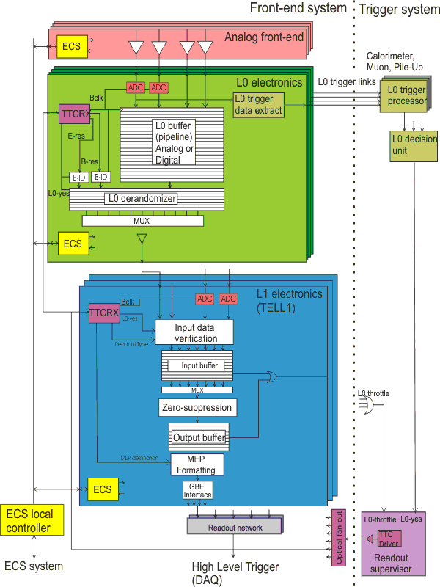
FEE & DAQ by electronics engineers
FEE = Front End Electronics
Example from LHCb

Slide 79
Lecture 4/5
Data Aquisition

Slide 80
Introduction: DAQ
Data Acquisition is a specialized engineering discipline thriving mostly in the eco-system of large science experiments, particularly in HEP
It consists mainly of electronics, computer science, networking and (we hope) a little bit of physics

Slide 81
Outline
Introduction
  Data acquisition
  The first data acquisition campaign
A simple DAQ system
  One sensor
  More and more sensors
Read-out with buses
  Crates & Mechanics
  The VME Bus
A DAQ for a large experiment
  Sizing it up
  Trigger
  Front-end Electronics
  Readout with networks
    Event building in switched networks
    Problems in switched networks
A lightning tour of ALICE, ATLAS, CMS and LHCb DAQs

Slide 82
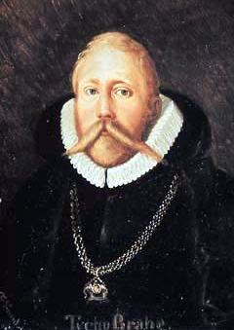
Tycho Brahe and the Orbit of Mars
I've studied all available charts of the planets and stars and none of them match the others. There are just as many measurements and methods as there are astronomers and all of them disagree. What's needed is a long term project with the aim of mapping the heavens conducted from a single location over a period of several years.
Tycho Brahe, 1563 (age 17).
First measurement campaign
Systematic data acquisition
  Controlled conditions (same time of the day and month)
  Careful observation of boundary conditions (weather, light conditions etc…) - important for data quality / systematic uncertainties

Slide 83
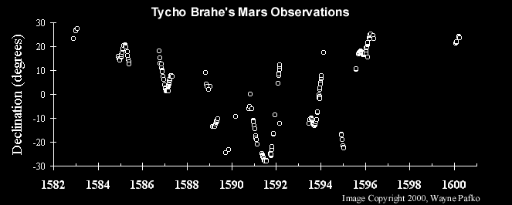
The First Systematic Data Acquisition
Data acquired over 18 years, normally e every month
Each measurement lasted at least 1 hr with the naked eye
Red line (only in the animated version) shows comparison with modern theory

Slide 84
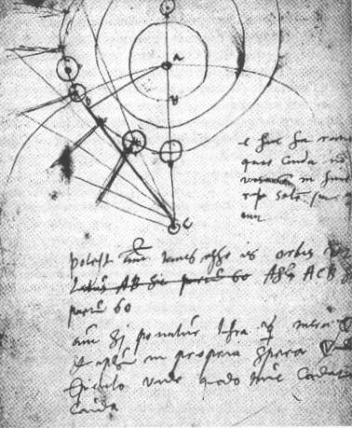
Tycho’s DAQ in Today’s Terminology
Bandwith (bw) = Amount of data transferred / per unit of time
  “Transferred” = written to his logbook
  “unit of time” = duration of measurement
  bw_{Tycho} = ~ 100 Bytes / h (compare with LHCb 40.000.000.000 Bytes / s)
Trigger = in general something which tells you when is the “right” moment to take your data
  In Tycho’s case the position of the sun, respectively the moon was the trigger
  the trigger rate ~ 3.85 x 10⁻⁶ Hz (compare with LHCb 1.0 x 10⁶ Hz)

Slide 85
Some More Thoughts on Tycho
Tycho did not do the correct analysis of the Mars data, this was done by Johannes Kepler (1571-1630), eventually paving the way for Newton’s laws
Morale: the size & speed of a DAQ system are not correlated with the importance of the discovery!

Slide 86
A Very Simple Data Acquisition System

Slide 87
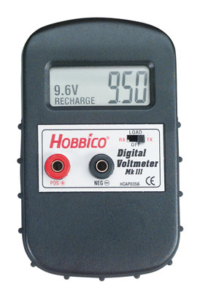
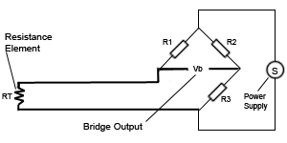
Measuring Temperature
Suppose you are given a Pt100 thermo-resistor
We read the temperature as a voltage with a digital voltmeter

Slide 88
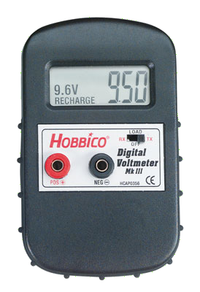
Reading Out Automatically
#include <libusb.h>
struct usb_bus *bus;
struct usb_device *dev;
usb_dev_handle *vmh = 0;
usb_find_busses(); usb_find_devices();
for (bus = usb_busses; bus; bus = bus->next)
for (dev = bus->devices; dev; dev = dev->next)
if (dev->descriptor.idVendor == HOBBICO) vmh = usb_open(dev);
usb_bulk_read(vmh ,3,&u,sizeof(float),500);
Note how small the sensor has become.
In DAQ we normally need not worry about the details of the things we readout
USB/RS232

Slide 89
Read-out 16 Sensors
Buy 4 x 4-port USB hub (very cheap) (+ 3 more voltmeters)
Adapt our little DAQ program
No fundamental (architectural) change to our DAQ

Slide 90
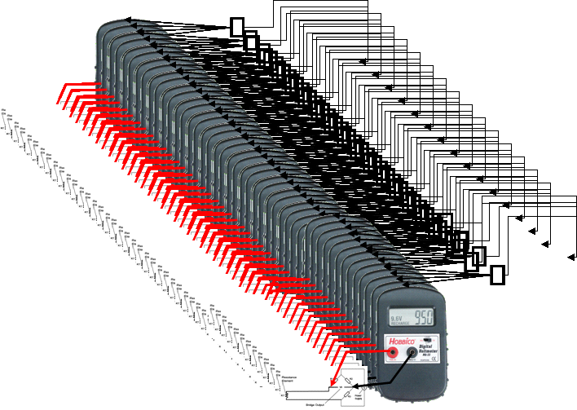
Read-out 160 Sensors
For a moment we (might) consider to buy 52 USB hubs, 160 Voltmeters
…but hopefully we abandon the idea very quickly, before we start cabling this!
Expensive, cumbersome, fragile →
our data acquisition system is not scalable

Slide 91
Read-out with Buses

Slide 92
A Better DAQ for Many (temperature) Sensors
19”
Buy or build a compact multi-port volt-meter module, e.g. 16 inputs
Put many of these multi-port modules together in a common chassis or crate
The modules need
  Mechanical support
  Power
  A standardized way to access their data (our measurement values)
All this is provided by standards for (readout) electronics such as VME (IEEE 1014)
7U VME Crate
(a.k.a. “Subrack”)
7U
Backplane Connectors
(for power and data)
VME Board
Plugs into Backplane

Slide 93
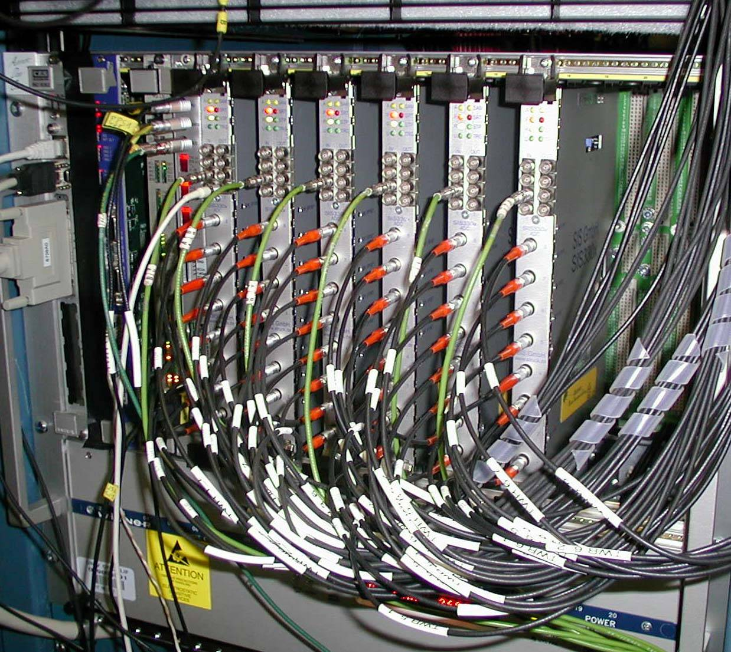
DAQ for 160 Sensors Using VME
Readout boards in a VME-crate
  mechanical standard for
  electrical standard for power on the backplane
  signal and protocol standard for communication on a bus
Notes:
modules (6U x 200 mm, 9U x 400 mm)
Crates 19’’ wide

Slide 94
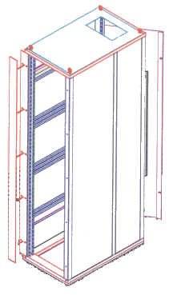

A Word on Mechanics and Pizzas
The width and height of racks and crates are measured in US units: inches (in, '') and U
  1 in = 25.4 mm
  1 U = 1.75 in = 44.45 mm
The width of a "standard" rack is 19 in.
The height of a crate (also sub-rack) is measured in Us
Rack-mountable things, in particular computers, which are 1 U high are often called pizza-boxes
At least in Europe, the depth is measured in mm
Gory details can be found in IEEE 1101.x (VME mechanics standard)
19 in
49 U
1 U

Slide 95
Communication in a Crate: Buses
A bus connects two or more devices and allows the to communicate
The bus is shared between all devices on the bus → arbitration is required
Devices can be masters or slaves (some can be both)
Devices can be uniquely identified ("addressed") on the bus
Master
Slave
Slave
Master
Device 1
Device 2
Device 3
Device 4
Device 1
Device 2
Device 3
Device 4
Data Lines
Data Lines
Select Line
Select Line
Notes:
Address and data signals can be on separate electrical lines or share the same lines (multiplexed)

Slide 96
Buses
Famous examples: PCI, USB, VME, SCSI
  older standards: CAMAC, ISA
  upcoming: ATCA
  many more: FireWire, I2C, Profibus, etc…
Buses can be
  local: PCI
  external peripherals: USB
  in crates: VME, compactPCI, ATCA
  long distance: CAN, Profibus

Slide 97
The VME Bus
In a VME crate we can find three main types of modules
  The controller which monitors and arbitrates the bus
  Masters read data from and write data to slaves
  Slaves send data to and receive data from masters
Addressing of modules
  In VME each module occupies a part of a (flat) range of addresses (24 bit to 32 bit)
  Address range of modules is hardwired (conflicts!)
0x000-0x1ff
0x200-0x2ff
0x300-0x3ff
0x400-0x4ff
0x500-0x5ff
0x600-0x6ff
Notes:
Masters request bus ownership from the controller. There is only one controller per crate.
the controller also handles interrupts from slaves

Slide 98
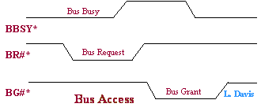
VME protocol 1) Arbitration
Arbitration: Master asserts^{*)} BR#, Controller answers by asserting BG#
If there are several masters requesting at the same time the one physically closest to the controller wins
The winning master drives BBSY* high to indicate that the bus is now in use
Pictures from http://www.interfacebus.com
^{*)} assert means driving the line to logical 0 (VME control lines are inverted or active-low)

Slide 99
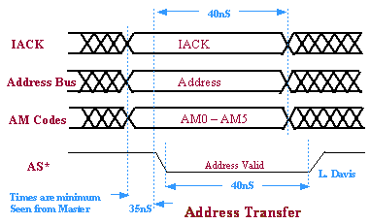
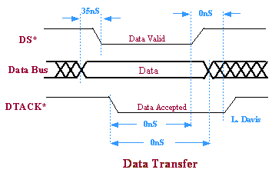
VME protocol 2) Write transfer
The Master writes data and address to the data / respectively data bus
It asserts DS* and AS* to signal that the data and address are valid
The slave reads and acknowledges by asserting DTACK
The master releases DS*, AS* and BSBSY*, the cycle is complete
Note: there is no clock! The slave can respond whenever it wants. VME is an asynchronous bus

Slide 100
Speed Considerations
Theoretically ~ 16 MB/s can be achieved
  assuming the databus to be full 32-bit wide
  the master never has to relinquish bus master ship
Better performance by using block-transfers

Slide 101

VME protocol 3) Block transfer
After an address cycle several (up to 256) data cycles are performed
The slave is supposed to increment the address counter
The additional delays for asserting and acknowledging the address are removed
Performance goes up to 40 MB/s
In PCI this is referred to as "burst-transfer"
Block transfers are essential for Direct Memory Access (DMA)
More performance can be gained by using the address bus also for data (VME64)

Slide 102
Advantages of buses
Relatively simple to implement
  Constant number of lines
  Each device implements the same interface
Easy to add new devices
  topological information of the bus can be used for automagically choosing addresses for bus devices: this is what plug and play is all about.

Slide 103
Buses for DAQ at LHC?
A bus is shared between all devices (each new active device slows everybody down)
  Bus-width can only be increased up to a certain point (128 bit for PC-system bus)
  Bus-frequency (number of elementary operations per second) can be increased, but decreases the physical bus-length
Number of devices and physical bus-length is limited (scalability!)
  For synchronous high-speed buses, physical length is correlated with the number of devices (e.g. PCI)
  Typical buses have a lot of control, data and address lines (look at a SCSI or ATA cable)
Buses are typically useful for systems < 1 GB/s

Slide 104
Data Acquisition for a Large Experiment

Slide 105



Moving on to Bigger Things…
The CMS Detector

Slide 106
Moving on to Bigger Things…
15 million detector channels
@ 40 MHz
= ~15 * 1,000,000 * 40 * 1,000,000 bytes
= ~ 600 TB/sec
?

Slide 107
Designing a DAQ System for a Large HEP Experiment
What defines "large"?
  The number of channels: for LHC experiments O(10⁷) channels
    a (digitized) channel can be between 1 and 14 bits
  The rate: for LHC experiments everything happens at 40.08 MHz, the LHC bunch crossing frequency (This corresponds to 24.9500998 ns or 25 ns among friends)
HEP experiments usually consist of many different sub-detectors: tracking, calorimetry, particle-ID, muon-detectors

Slide 108
First Questions
Can we or do we want to save all the data?
How do we select the data
Is continuous read-out needed, i.e. an experiment in a collider? Or are there idle periods mixed with periods with many events – this is typically the case for fixed-target experiments
How do we make sure that the values from the many different channels refer to the same original event (collision)

Slide 109
What Do We Need to Read Out a Detector (successfully)?
A selection mechanism (“trigger”)
Electronic readout of the sensors of the detectors (“front-end electronics”)
A system to keep all those things in sync (“clock”)
A system to collect the selected data (“DAQ”)
A Control System to configure, control and monitor the entire DAQ
Time, money, students

Slide 110
Large DAQ

Slide 111
Data Acquisition
Event-data are now digitized, pre-processed and tagged with a unique, monotonically increasing number
The event data are distributed over many read-out boards (“sources”)
For the next stage of selection, or even simply to write it to tape we have to get the pieces together: enter the DAQ

Slide 112
Network based DAQ
In large (HEP) experiments we typically have thousands of devices to read, which are sometimes very far from each other → buses can not do that
Network technology solves the scalability issues of buses
  In a network devices are equal ("peers")
  In a network devices communicate directly with each other
    no arbitration necessary
    bandwidth guaranteed
  data and control use the same path
    much fewer lines (e.g. in traditional Ethernet only two)
  At the signaling level buses tend to use parallel copper lines. Network technologies can be also optical, wire-less and are typically (differential) serial

Slide 113
Network Technologies
Examples:
  The telephone network
  Ethernet (IEEE 802.3)
  ATM (the backbone for GSM cell-phones)
  Infiniband
  Myrinet
  many, many more
Note: some of these have "bus"-features as well (Ethernet, Infiniband)
Network technologies are sometimes functionally grouped
  Cluster interconnect (Myrinet, Infiniband) 15 m
  Local area network (Ethernet), 100 m to 10 km
  Wide area network (ATM, SONET) > 50 km

Slide 114
Connecting Devices in a Network
On an network a device is identifed by a network address
  eg: our phone-number, the MAC address of your computer
Devices communicate by sending messages (frames, packets) to each other
Some establish a connection lilke the telephone network, some simply send messages
Modern networks are switched with point-to-point links
  circuit switching, packet switching

Slide 115
Switched Networks
In a switched network each node is connected either to another node or to a switch
Switches can be connected to other switches
A path from one node to another leads through 1 or more switches (this number is sometimes referred to as the number of "hops" )

Slide 116

A Switched Network
While 2 can send data to 1 and 4, 3 can send at full speed to 5
2 can distribute the share the bandwidth between 1 and 4 as needed
3
4
1
2
5

Slide 117
Switches
Switches are the key to good network performance
They must move frames reliably and as fast as possible between nodes
They face two problems
  Finding the right path for a frame
  Handling congestion (two or more frames want to go to the same destination at the same time)

Slide 118
Ethernet
Cheap
Unreliable – but in practice transmission errors are very low
Available in many different speeds and physical media
We use IP or TCP/IP over Ethernet
By far the most widely used local area network technology (even starting on the WAN)

Slide 119

IP Packets over Ethernet
Ethernet Header
IP Header
UDP Header
Data
0 … 32 bits

Slide 120
Lecture 5/5
Trigger and Data Acquisition for LHC experiments

Slide 121
Building a trigger (recap)
Keep it simple! (Remember Einstein: “As simple as possible, but not simpler”)
Even though “premature optimization is the root of all evil”, think about efficiency (buffering)
Try to have few adjustable parameters: scanning for a good working point will otherwise be a night-mare

Slide 122

Should we read everything?
A typical collision is “boring”
  Although we need also some of these “boring” data as cross-check, calibration tool and also some important “low-energy” physics
“Interesting” physics is about 6–8 orders of magnitude rarer (EWK & Top)
“Exciting” physics involving new particles/discoveries is ≥ 9 orders of magnitude below σ_{tot}
  100 GeV Higgs 0.1 Hz
  600 GeV Higgs 0.01 Hz
We just ☺ need to efficiently identify these rare processes from the overwhelming background before reading out & storing the whole event
10⁹ Hz
5⋅10⁶ Hz
EWK: 20–100 Hz
10 Hz

Slide 123

Trigger for LHC
No (affordable) DAQ system could read out O(10⁷) channels at 40 MHz → 400 TBit/s to read out – even assuming binary channels!
What’s worse: most of these millions of events per second are totally uninteresting: one Higgs event every 0.02 seconds
A first level trigger (Level-1, L1) must somehow select the more interesting events and tell us which ones to deal with any further
Black magic happening here
Notes:
c.f. 2 500 000 000 simultaneous(!) phone conversations (practically everybody on the planet is on the phone - like 31st of December 23:59)

Slide 124
Inside the Box: How does a Level-1trigger work?
Millions of channels →: try to work as much as possible with “local” information
  Keeps number of interconnections low
Must be fast: look for “simple” signatures
  Keep the good ones, kill the bad ones
  Robust, can be implemented in hardware (fast)
Design principle:
  fast: to keep buffer sizes under control
  every 25 nanoseconds (ns) a new event: have to decide within a few microseconds (μs): trigger-latency

Slide 125


Challenges for the L1 at LHC
N (channels) ~ O(10⁷); ≈20 interactions every 25 ns
  need huge number of connections
Need to synchronize detector elements to (better than) 25 ns
In some cases: detector signal/time of flight > 25 ns
  integrate more than one bunch crossing's worth of information
  need to identify bunch crossing...
It's On-Line (cannot go back and recover events)
  need to monitor selection - need very good control over all conditions

Slide 126
Clock Distribution and Synchronisation
An event is a snapshot of the values of all detector front-end electronics elements, which have their value caused by the same collision
A common clock signal must be provided to all detector elements
  Since the c is constant, the detectors are large and the electronics is fast, the detector elements must be carefully time-aligned
Common system for all LHC experiments TTC based on radiation-hard opto-electronics
Plus:
Trigger decision
Bunch cross ID

Slide 127

Timing & sync control
Sampling clock with low jitter
Synch reset
Synchronization with machine bunch structure
Calibration
Trigger (with event type)
Time align all the different
sub-detectors and channels
  Programmable delays
Fan-out – unidirectional
  Global fan-out to whole experiment or
  Sub-detector fan-out
Must be reliable as system otherwise may get de-synchronized which may take quite some time to correct

Slide 128
Know Your Enemy: pp Collisions at 14 TeV at 10³⁴ cm⁻²s⁻¹
σ(pp) = 70 mb --> >7 x 10⁸ /s (!)
In ATLAS and CMS* 20 min bias events will overlap
H→ZZ
Z →μμ
H→ 4 muons:
the cleanest
(“golden”)
signature
And this
(not the H though…)
repeats every 25 ns…
^{*)}LHCb @2x10³³ cm⁻²-1 isn’t much nicer and in Alice (PbPb) it will be even worse

Slide 129
Mother Nature is a … Kind Woman After All
pp collisions produce mainly hadrons with transverse momentum “p_{t”} ~1 GeV
Interesting physics (old and new) has particles (leptons and hadrons) with large p_{t}:
  W→eν: M(W)=80 GeV/c²; p_{t}(e) ~ 30-40 GeV
  H(120 GeV)→γγ: p_{t}(γ) ~ 50-60 GeV
  B→μD^{*+}ν p_{t}(μ) ~ 1.4 GeV
Impose high thresholds on the p_{t} of particles
  Implies distinguishing particle types; possible for electrons, muons and “jets”; beyond that, need complex algorithms
Conclusion: in the L1 trigger we need to watch out for high transverse momentum electrons, jets or muons
p
p_{t}

Slide 130
How to defeat minimum bias: transverse momentum p_{t}

Slide 131

ATLAS Calorimeters

Slide 132

ATLAS L1 Calo Trigger
Form analogue towers 0.1 x 0.1 (δη x δφ )
igitize, identify
bunch-xing, Look-Up Table (LUT) → E_{T}
Duplicate data to Jet/Energy-sum
(JEP) and Cluster (CP) processors
Send to CTP 1.5 μs after bunch-crossing (“x-ing”).
Store info at JEP and CP to seed next level of trigger

Slide 133

Distributing the L1 Trigger
Assuming now that a magic box tells for each bunch crossing (clock-tick) yes or no
  Triggering is not for philosophers – “perhaps” is not an option
This decision has to be brought for each crossing to all the detector front-end electronics elements so that they can send of their data or discard it
Local level-1 trigger
Global Trigger 1
Primitive e, γ, jets, µ
≈ 2-3 µs latency loop
Front-End Digitizer
Trigger
Primitive Generator
Pipeline delay
( ≈ 3 µs)
Accept/Reject LV-1

Slide 134

High Level Trigger
And that, in simple terms, is what
we do in the High Level Trigger

Slide 135


High Level Trigger
Complicated Event structure
with hadronic jets (ATLAS) or
secondary vertices (LHCb) require
full detector information
Methods and algorithms are the
same as for offline reconstruction
(Lecture “From raw data to physics”)

Slide 136
The High Level Trigger is …
Detector
L1
VELO
ST
OT
RICH
ECal
HCal
Muon
Trigger
FE
FE
FE
FE
FE
FE
FE
LHC clock
TTC
Electronics
Electronics
Electronics
Electronics
Electronics
Electronics
Electronics
System
Readout
Readout
Readout
Readout
Readout
Readout
Readout
Board
Board
Board
Board
Board
Board
Board
Front
-
End
Experiment Control System (ECS)
40 GB/s
READOUT NETWORK
Event building
SWITCH
SWITCH
SWITCH
SWITCH
SWITCH
SWITCH
SWITCH
HERE
C
C
C
C
C
C
C
C
C
C
C
C
C
C
C
C
C
C
C
C
C
C
C
C
C
C
C
P
P
P
P
P
P
P
P
P
P
P
P
P
P
P
P
P
P
P
P
P
P
P
P
P
P
P
P
U
U
U
U
U
U
U
U
U
U
U
U
U
U
U
U
U
U
U
U
U
U
U
U
U
U
U
U
HLT farm

Slide 137
After L1: What’s next?
Where are we after L1
  ATLAS and CMS : rate is ~75 to 100 kHz, event size ~ 1 - 2 MB
  LHCb: rate is 1 MHz, event size 40 kB / ALICE: O(kHz) and O(GB)
Ideally
  Run the real full-blown physics reconstruction and selection algorithms
  These application take O(s). Hence: even at above rates still need 100 MCHF server farm (Intel will be happy!)
In Reality:
  Start by looking at only part of the detector data seeded by what triggered the 1st level
  LHCb: 1st level Trigger confirmation" algorithms: < 10 ms/event
  Atlas: Region of Interest" (RoI): < 40 ms/event
➔ Reduce the rate by factor ~ 30, and then do offline analysis

Slide 138
Event Building
(providing the data for the High Level Trigger)

Slide 139
LHCb DAQ
40 GB/s
80 MB/s
Average event size 40 kB
Average rate into farm 1 MHz
Average rate to tape 2 kHz

Slide 140


Two philosophies
Send everything, ask questions later (ALICE, CMS, LHCb)
Send a part first, get better question
Send everything only if interesting (ATLAS)

Slide 141




Event Building
To Trigger
Algorithms
Event Builder 3
Event Builder 3
Data Acquisition
Switch
Event Builder 3
1
2
3
4
Event fragments are received from detector front-end
Event fragments are read out over a network to an event builder
Event builder assembles fragments into a complete event
Complete events are processed by trigger algorithms

Slide 142
Push-Based Event Building
Switch Buffer
Event Builder 1
Event Builder 2
Data Acquisition
Switch
“Send next event to EB1”
Readout
Supervisor
“Send next event to EB2”
1
2
3
Readout Supervisor tells readout boards where events must be sent (round-robin)
Readout boards do not buffer, so switch must
No feedback from Event Builders to Readout system

Slide 143
Congestion
1
3
"Bang" translates into random, uncontrolled packet-loss
In Ethernet this is perfectly valid behavior and implemented by very cheap devices
Higher Level protocols are supposed to handle the packet loss due to lack of buffering
This problem comes from synchronized sources sending to the same destination at the same time
2
2
Bang
2

Slide 144
Pull-Based Event Building
“Send me
an event!”
“Send me
an event!”
Event Builder 1
Event Builder 1
“Send me
an event!”
Event Builder 2
Data Acquisition
Switch
“Send me
an event!”
Event Builder 3
EB1:
EB2:
EB3:
0
0
0
1
1
1
0
1
1
0
0
1
1
0
1
“Send next event to EB1”
“Send next event to EB2”
“Send next event to EB3”
1
2
3
Event Builders notify Readout Supervisor of available capacity
Readout Supervisor ensures that data are sent only to nodes with available capacity
Readout system relies on feedback from Event Builders

Slide 145
AACL
ALICE, ATLAS, CMS, LHCb
DAQs in 4 slides

Slide 146


ALICE DAQ
Rare/All
CTP
L0, L1a, L2
BUSY
LTU
BUSY
LTU
DDL
H-RORC
L0, L1a, L2
HLT Farm
TTC
TTC
FEP
FEP
Event
Fragment
Sub-event
Event
File
FERO
FERO
FERO
FERO
144 DDLs
342 DDLs
10 DDLs
10 D-RORC
10 HLT LDC
416 D-RORC
194 Detector LDC
Load Bal.
LDC
LDC
LDC
LDC
LDC
EDM
Event Building Network 2500 MB/s
GDC
GDC
GDC
GDC
50 GDC
25 TDS
DS
DS
5 DSS
Storage Network 1250 MB/s
PDS
Two stage hardware trigger L0 + L1
High Level Trigger (HLT) on separate farm
TDS
TDS

Slide 147


ATLAS DAQ
ATLAS
L1 selects events at 100 kHz and defines regions of interest
L2 pulls data from the region of interest and processes the data in a farm of processors
L2 accepts data at ~ 1 kHz
Event Filter reads the entire detector (pull), processes the events in a farm and accepts at 100 Hz
147
Notes:
147

Slide 148

Readout Architectures
CMS DAQ

Slide 149
LHCb DAQ
40 GB/s
80 MB/s
Average event size 40 kB
Average rate into farm 1 MHz
Average rate to tape 2 kHz

Slide 150




Trigger/DAQ parameters
No.Levels Level-0,1,2 Event Readout HLT Out
Trigger Rate (Hz) Size (Byte) Bandw.(GB/s) MB/s (Event/s)
4 Pb-Pb 500 5x10⁷ 25 1250 (10²)
p-p 10³ 2x10⁶ 200 (10²)
3 LV-1 10⁵ 1.5x10⁶ 4.5 300 (2x10²)
LV-2 3x10³
2 LV-1 10⁵ 10⁶ 100 ~1000 (10²)
2 LV-0 10⁶ 3.5x10⁴ 35 70 (2x10³)
ALICE
ATLAS
CMS
LHCb
Notes:
Trigger levels include HLT which is operating on entire events

Slide 151

On to tape...and the GRID
Networks, farms and data flows
To regional centers
To regional centers
622 Mbit/s
622 Mbit/s
Remote
Remote
control rooms
control rooms
Controls:
Controls:
1 Gbit/s
1 Gbit/s
Events:
Events:
10 Gbit/s
10 Gbit/s
Controls:
Controls:
1 Gbit/s
1 Gbit/s
Raw Data:
Raw Data:
1000 Gbit/s
1000 Gbit/s

Slide 152
The end

Slide 153
The ISOTDAQ permanent lab
In February 2010 the first ISOTDAQ school was held in Ankara
See: http://isotdaq.web.cern.ch/isotdaq/isotdaq/2010.html
Slides and videos can be found at:
http://indico.cern.ch/conferenceTimeTable.py?confId=68278#20100201
Publcite
Advertisement
Some of the exercises that were prepared for this school were (or will soon be) installed at CERN
Interested students can register themselves to do some of these exercises. To register:
  Add yourself to: https://twiki.cern.ch/twiki/bin/view/Sandbox/DaqSchoolLab#Requests_for_access
  Or write an e-mail to markus.joos@cern.ch
It is recommended to have a look at the slides / videos before doing an exercise
NOTE: We cannot guarantee that the exercises will take place. So, don’t be disappointed

Slide 154
Further Reading
Electronics
  Helmut Spielers web-site: http://www-physics.lbl.gov/~spieler/
Buses
  VME: http://www.vita.com/
  PCI
  http://www.pcisig.com/
Network and Protocols
  Ethernet
  “Ethernet: The Definitive Guide”, O’Reilly, C. Spurgeon
  TCP/IP
  “TCP/IP Illustrated”, W. R. Stevens
  Protocols: RFCs
  www.ietf.org
  in particular RFC1925 http://www.ietf.org/rfc/rfc1925.txt
  “The 12 networking truths” is required reading
Wikipedia (!!!) and references therein – for all computing related stuff this is usually excellent
Conferences
  IEEE Realtime
  ICALEPCS
  CHEP
  IEEE NSS-MIC
Journals
  IEEE Transactions on Nuclear Science, in particular the proceedings of the IEEE Realtime conferences
  IEEE Transactions on Communications

Slide 155
More Stuff
Data format, DIY DAQ, run-control

Slide 156
Overcoming Congestion:
Queuing at the Input
1
3
Two frames destined to the same destination arrive
While one is switched through the other is waiting at the input port
When the output port is free the queued packet is sent
2
2
2

Slide 157
Head of Line Blocking
1
3
The reason for this is the First in First Out (FIFO) structure of the input buffer
Queuing theory tells us* that for random traffic (and infinitely many switch ports) the throughput of the switch will go down to 58.6% → that means on 100 MBit/s network the nodes will "see" effectively only ~ 58 MBit/s
2
2
4
Packet to node 4 must wait
even though port to node 4 is free
2
4
*) "Input Versus Output Queueing on a Space-Division Packet Switch"; Karol, M. et al. ; IEEE Trans. Comm., 35/12

Slide 158
Output Queuing
In practice virtual output queueing is used: at each input there is a queue → for n ports O(n²) queues must be managed
Assuming the buffers are large enough(!) such a switch will sustain random traffic at 100% nominal link load
1
3
2
2
4
Packet to node 2 waits at output to
port 2. Way to node 4 is free
4
2

Slide 159


Raw data format
There are 10 kinds of people in the world
Those who can read binary and those who cannot

Slide 160
Binary vs Text
11010110 Pros:
  compact
  quick to write & read (no conversion)
Cons:
  opaque (humans need tool to read it)
  depends on the machine architecture (endinaness, floating point format)
  life-time bound to availability of software which can read it
<TEXT></TEXT> Pros:
  universally readable
  can be parsed and edited equally easily by humans and machines
  long-lived (ASCII has not changed over decades)
  machine independent
Cons:
  slow to read/write
  low information density (can be improved by compression)

Slide 161
A little checklist for your DAQ
Remember:
YMMV

Slide 162

Runcontrol
© Warner Bros.

Slide 163

Run Control
The run controller provides the control of the trigger and data acquisition system. It is the application that interacts with the operator in charge of running the experiment.
The operator is not always an expert on T/DAQ. The user interface on the Run Controller plays an important role.
The complete system is modeled as a finite state machine. The commands that run controller offers to the operator are state transitions.
LHCb DAQ /Trigger Finite State Machine diagram (simplified)

Slide 164
Finite State Machine
Each component, sub-component of the system is modeled as a Finite State Machine. This abstraction facilitates the description of each component behavior without going into detail
The control of the system is realized by inducing transitions on remote components due to a transition on a local component
State A
State C
Component 1 can only
complete the transition to
State B if Component 2 is
in state D.
State B
State D
Component 1
Component 2
Each transition may have actions associated. The action consist of code which needs to be executed in order to bring the component to its new state
The functionality of the FSM and state propagation is available in special software packages such as SMI

Slide 165
Detector Control
The detector control system (DCS) (also Slow Control) provides the monitoring and control of the detector equipment and the experiment infrastructure.
Due to the scale of the current and future experiments is becoming more demanding: for the LHC Experiments: ≈ 100000 parameters
Control hierarchy
Experiment
Control
Run / DAQ
Control
Detector
Control

Slide 166

Run Control GUI
Main panel of the LHCb run-control
(PVSS II)

Slide 167


Control and monitoring
Access to setup registers (must have read-back)
Access to local monitoring functions
  Temperatures, power supply levels, errors, etc.
Bidirectional with addressing capability (module, chip, register)
Speed not critical and does not need to be synchronous
  Low speed serial bus: I²C, JTAG, SPI
Must be reasonably reliable (read-back to check correct download and re-write when needed)
SPECS
Example: ELMB

Slide 168
Online Trigger Farms 2009
 | ALICE | ATLAS | CMS | LHCb | CERN IT
# servers | 81⁽¹⁾ | 837 | 900 | 550 | 5700
# cores | 324 | ~ 6400 | 7200 | 4400 | ~ 34600
total available power (kW) |  | ~ 2000⁽²⁾ | ~ 1000 | 550 | 2.9 MW
currently used power (kW) |  | ~ 250 | 450⁽³⁾ | ~ 145 | 2.0 MW
total available cooling power | ~ 500 | ~ 820 | 800 (currently) | 525 | 2.9 MW
total available rack-space (Us) | ~ 2000 | 2449 | ~ 3600 | 2200 | n/a
CPU type(s) | AMD Opteron | Intel Hapertown | Intel (mostly) Harpertown | Intel Harpertown | Mixed (Intel)
(1) 4-U servers with powerful FPGA preprocessor cards H-RORC
(2) Available from transformer (3) PSU rating

Slide 169




Gallery
ALICE Storage System
ATLAS Online Network Infrastructure
CMS on-line computing center

Slide 170
Even more stuff

Slide 171

Transistors
Exampe: bi-polar transistor of the NPN type
C collector, E emitter, B Base
EB diode is in forward bias: holes flow towards np boundary and into n region
BC diode is in reverse bias: electrons flow AWAY from pn boundary
p layer must be thinner than diffusion length of electrons so that they can go through from E to N without much recombination
from Wikipedia

Slide 172
Multilevel triggering
First level triggering.
  Hardwired trigger system to make trigger decision with short latency.
  Constant latency buffers in the front-ends
Second level triggering in DAQ interface
  Processor based (standard CPU’s or dedicated custom/DSP/FPGA processing)
  FIFO buffers with each event getting accept/reject in sequential order
  Circular buffer using event ID to extracted accepted events
    Non accepted events stays and gets overwritten by new events
High level triggering in the DAQ systems made with farms of CPU’s: hundreds – thousands.
(separate lectures on this)
DAQ interface
Front-end
MUX
DAQ
Data
formatting
Zero-
suppression
Trigger L2
Trigger L1

Slide 173
ADC architectures
Flash
  A discriminator for each of the 2^{n} codes
  New sample every clock cycle
  Fast, large, lots of power, limited to ~8 bits
  Can be split into two sub-ranging Flash
  2x2^{n/2} discriminators: e.g. 16 instead of 256
  plus DAC
    Needs sample and hold during the two stage
    conversion process
Ramp
  Linear analog ramp and count clock cycles
  Takes 2^{n} clock cycles
  Slow, small, low power, can be made with large resolution
1
Linear to binary encoder
2
V_{in}
3
2^{n}
V_{ref}
S&H
Flash1
DAC
-
Flash2
V_{in}
Ramp
V_{in}
Start
Stop
V_{in}
1
Counter
I
Start
Clock

Slide 174
ADC architectures
Successive approximation
  Binary search via a DAC and single discriminator
  Takes n clock cycles
  Relatively slow, small, low power, medium to large resolution
Pipelined
  Determines “one bit” per clock cycle per stage
    Extreme type of sub ranging flask
  n stages
  In principle 1 bit per stage but to handle imperfections each stage normally made with ~2bits and n*2bits mapped into n bits via digital mapping function that “auto corrects” imperfections
  Makes a conversion each clock cycle
  Has a latency of n clock cycles
    Not a problem in our applications except for very fast triggering
  Now dominating ADC architecture in modern CMOS technologies and impressive improvements in the last 10 years: speed, bits, power, size
DAC voltage
V_{in}
Aprox reg.
DAC
ADC code
DAC code
100
010
011

Slide 175
ADC imperfections
Quantization (static)
  Bin size: Least significant bit (LSB) =V_{max}/2^{n}
  Quantization error: RMS error/resolution:
Integral non linearity (INL): Deviation from ideal conversion curve (static)
  Max: Maximum deviation from ideal
  RMS: Root mean square of deviations from ideal curve
Differential non linearity (DNL): Deviation of quantization steps (static)
  Min: Minimum value of quantization step
  Max: Maximum value of quantization step
  RMS: Root mean square of deviations from ideal quantization step
Missing codes (static)
  Some binary codes never present in digitized output
Monotonic (static)
  Non monotonic conversion can be quite unfortunate in some applications.
  A given output code can correspond to several input values.

