Slide 1
Background Rejection and Jet Tagging using ML
Thiago Bergamaschi – 8.13 – May 2020

Slide 2
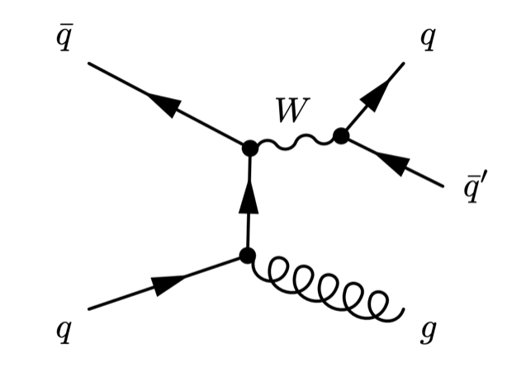
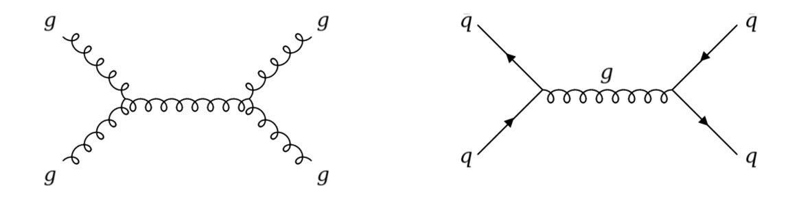
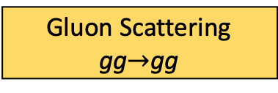
How can we identify W boson processes? [1]
W Boson Decay
Gluon Scattering
gg$→$gg
Quark antiquark
annihlation
Main Background Processes

Slide 3
How can we identify W boson processes?
W Boson Decay
Gluon Scattering
gg$→$gg
Quark antiquark
annihilation
Goal is to identify Jets that came from 2 quarks

Slide 4
CMS data flow and analysis setup [2]
CMS Detector
Trigger Algorithm
LHC data from 8 TeV collisions.
Monte Carlo Simulations of QCD and W/Z collisions
Fed through Jet reconstruction algorithm (PUPPI) [11]
Constructs n-tuples of jet variables
Signal stream
Jet Reconstruction Algorithm
Kinematics MC
Detector MC
Jets, Clusters, Tracks
Particle
Generation

Slide 5
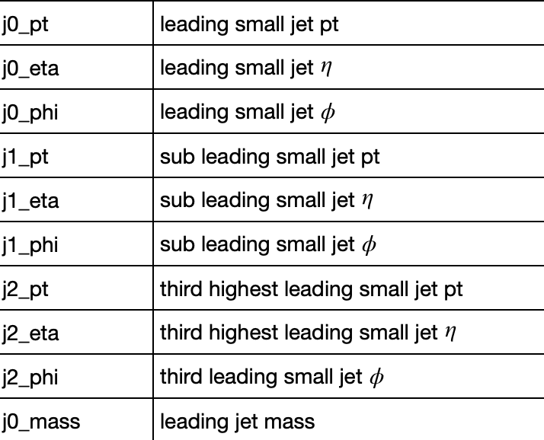
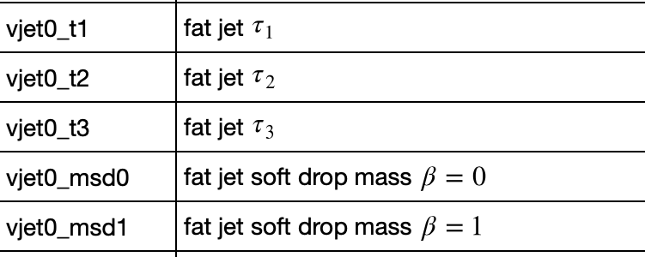
The Dataset Variables
Subjet 4 Vector Coordinates
Clustering Algorithm results
and around 40 extra variables

Slide 6
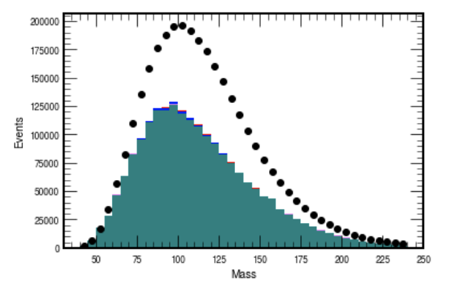
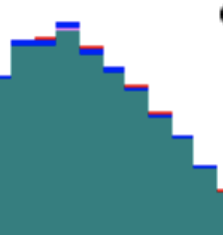
How do we boost the W population?
Goal Select out QCD, Boost W/Z

Slide 7
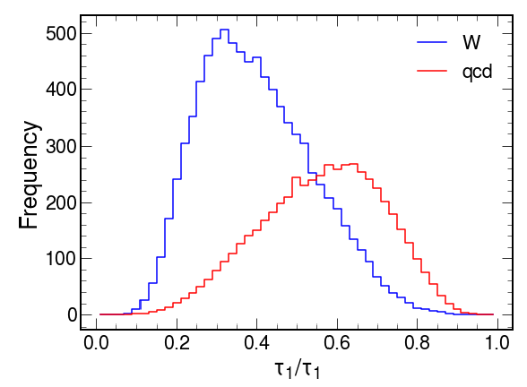
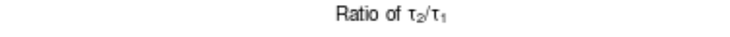

Manual Decorrelation and Rejecting QCD [1]
Manually Introducing Filters could select out populations
e.g., lower $\frac{τ_{2}}{τ_{1}}$ has higher probability of being W/Z
Can we learn optimal filters for background rejection?

Slide 8
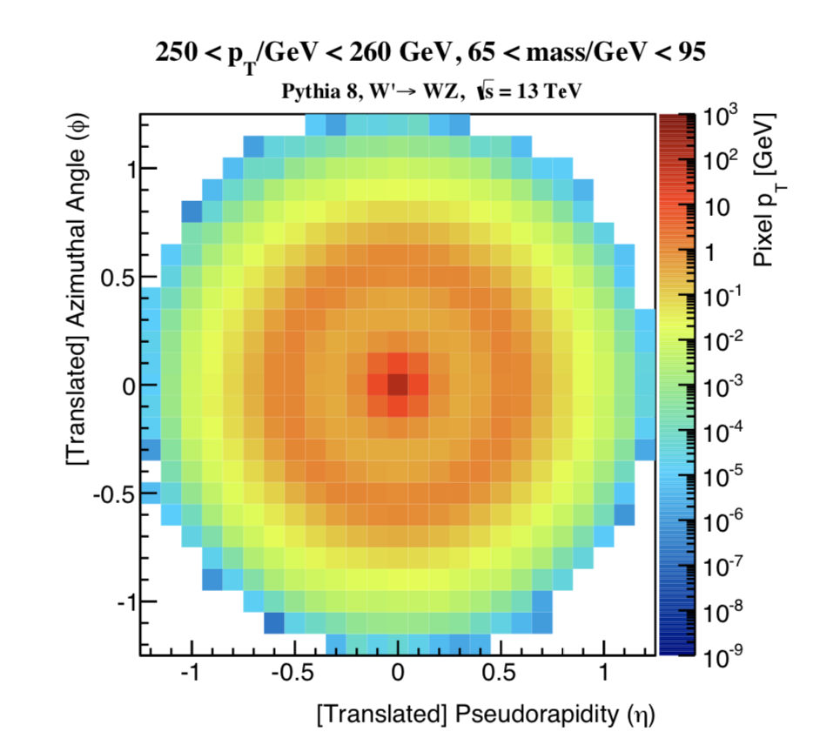
CNNs work well on Jet Energy Profiles (Images)
Featurization
Previous Work
Approach
L. de Oliveira et al. (2016)
Images
P. Baldi et al. (2016)
G. Louppe et al. (2019)
Trees, Sequences,
Graphical Models
A. Andreassen et al. (2019)
P. T. Komiske et al. (2018)
K. Datta et al. (2018)
Physics Based Models
K. Datta et al. (2019)
L. de Oliveira et al. (2016)

Slide 9
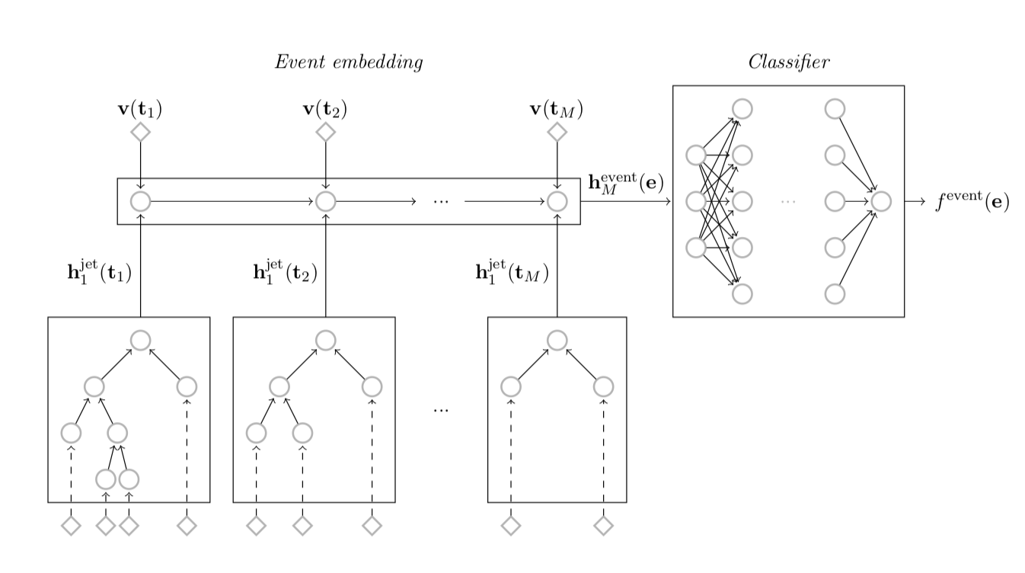
Jet reconstruction algorithms embed Collision Structure
Featurization
Previous Work
Approach
L. de Oliveira et al. (2016)
Images
P. Baldi et al. (2016)
G. Louppe et al. (2019)
Trees, Sequences,
Graphical Models
A. Andreassen et al. (2019)
P. T. Komiske et al. (2018)
K. Datta et al. (2018)
Physics Based Models
G. Louppe et al. (2019)
K. Datta et al. (2019)

Slide 10
Encoding is key in Physics Based Approaches
Featurization
Previous Work
Approach
L. de Oliveira et al. (2016)
Learn basis of energy flow polynomials
Optimal Combinations of Subjetiness Variables
Learn Lorentz invariant quantities
Images
P. Baldi et al. (2016)
G. Louppe et al. (2019)
Trees, Sequences,
Graphical Models
A. Andreassen et al. (2019)
P. T. Komiske et al. (2018)
Rotations and Translations of 4-Vectors don’t conserve jet mass!
K. Datta et al. (2018)
Physics Based Models
K. Datta et al. (2019)

Slide 11
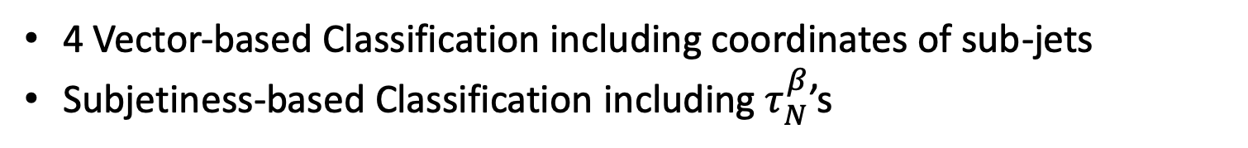
A Blind (Physics Based) Algorithmic Approach
Two very Simple Deep Neural Nets with 32, 64, or 100 nodes/layer
Binary Search on number of necessary layers until .9 accuracy
Sigmoid Activation on Last Layer
Binary Cross Entropy Loss
The Architecture
The Featurization
4 Vector-based Classification including coordinates of sub-jets
Subjetiness-based Classification including $τ_{N}^{β}$’s
Train and Cross-Validate on Labelled Simulation Data, then run on signal

Slide 12
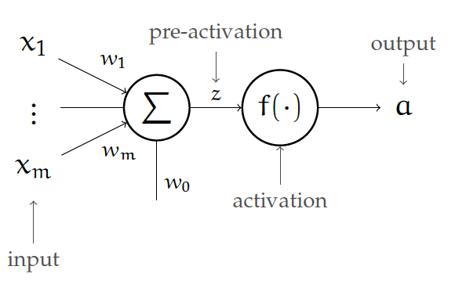
A Simple Neural Net Design
Very Simple Deep Neural Nets with 16, 32, 64, or 100 nodes/layer
Binary Search on number of necessary layers until .9 accuracy
Sigmoid Activation on Last Layer
Binary Cross Entropy Loss
The Architecture
From the 6.036 lecture notes, p. 42

Slide 13
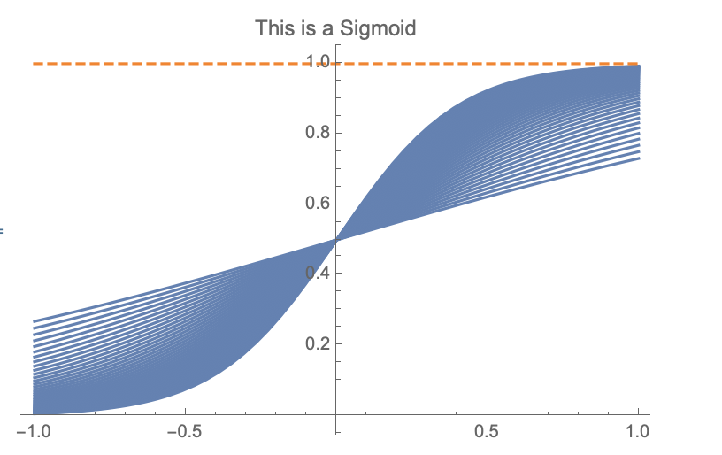
NN Discriminator as Classification Probability
Two very Simple Deep Neural Nets with 32, 64, or 100 nodes/layer
Binary Search on number of necessary layers until .9 accuracy
Sigmoid Activation on Last Layer
Binary Cross Entropy Loss
The Architecture
Strictly in (0, 1), so can we interpret it as a probability?

Slide 14
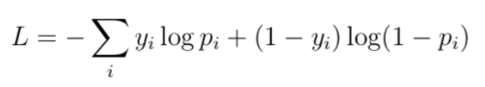
How to Penalize Misclassification
Two very Simple Deep Neural Nets with 32, 64, or 100 nodes/layer
Binary Search on number of necessary layers until .9 accuracy
Sigmoid Activation on Last Layer
Binary Cross Entropy Loss
The Architecture

Slide 15
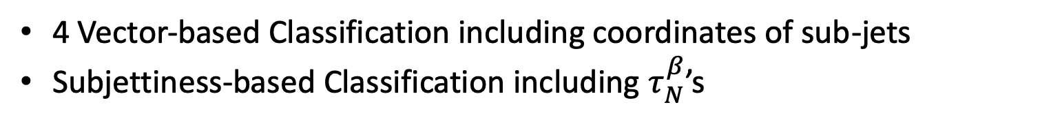
Picking the Relevant Variables
Two very Simple Deep Neural Nets with 32, 64, or 100 nodes/layer
Binary Search on number of necessary layers until .9 accuracy
Sigmoid Activation on Last Layer
Binary Cross Entropy Loss
The Architecture
The Featurization
4 Vector-based Classification including coordinates of sub-jets
Subjettiness-based Classification including $τ_{N}^{β}$’s
Train and Cross-Validate on Labelled Simulation Data, then run on signal

Slide 16
The Eli5 Permutation Importance Sensitivity Test
Removing each feature and re-training is computationally expensive!
The Algorithm
Train model on every variable
One by one, pick a variable and replace it with noise in the test set
Measure mean decrease in accuracy (MDA) over test set
Needs to be over the same domain
Should be drawn over the same distribution
Permute the column!
The Noise Model

Slide 17
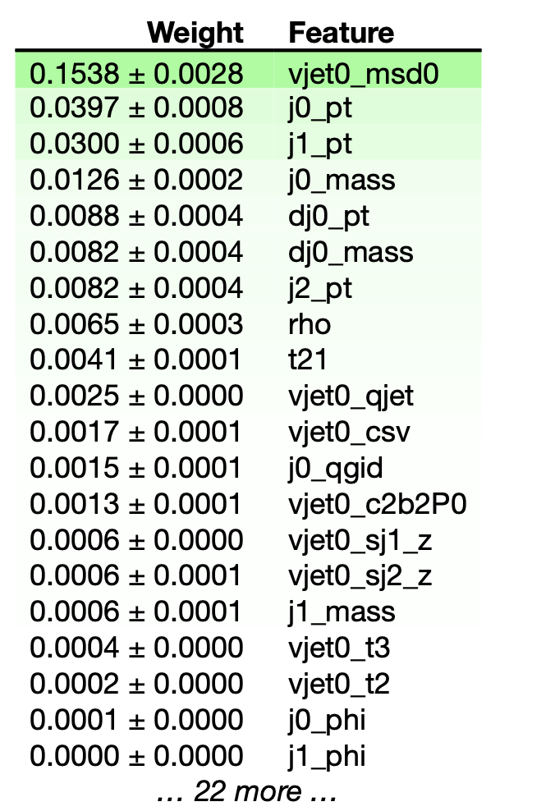
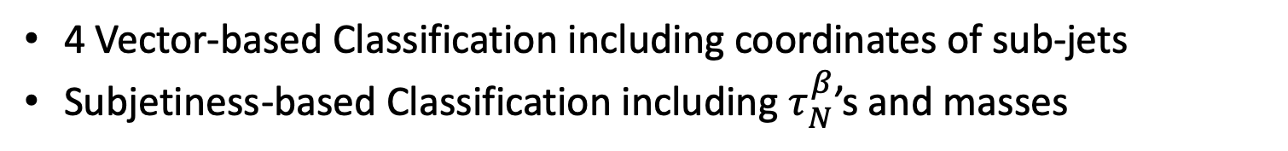
Subjet Coordinates and Subjetiness Probabilities are the most relevant
Our Physics based models
4 Vector-based Classification including coordinates of sub-jets
Subjetiness-based Classification including $τ_{N}^{β}$’s and masses
+ a concatenation of the 10 most relevant variables

Slide 18
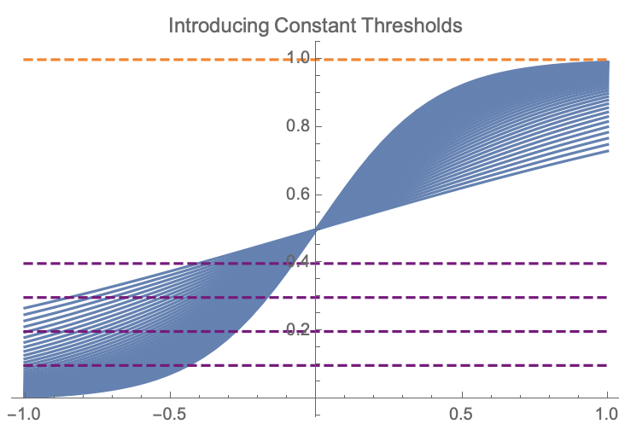
How do we make hard decisions?
A first attempt: A hard probability threshold
Varying the threshold allows us to construct rejection vs. efficiency curves

Slide 19
How do we make hard decisions?
A first attempt: A hard probability threshold
Varying the threshold allows us to construct rejection vs. efficiency curves
+ we can compare different models!

Slide 20
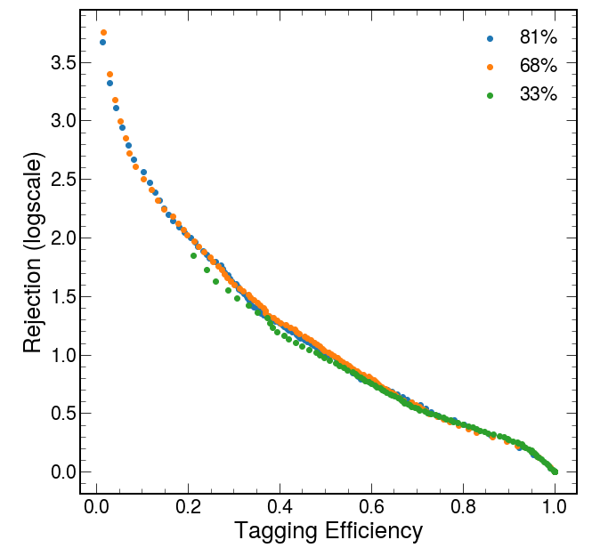
How to address a Drastically Imbalanced Dataset?
Roughly 30 times more QCD data than everything else!
Sampled Down QCD population in Dataset had low effect on rejection/efficiency ROC
Remark
Future attempts could include SMOTE [10]
(Synthetic Minority Oversampling Technique, 2013)

Slide 21
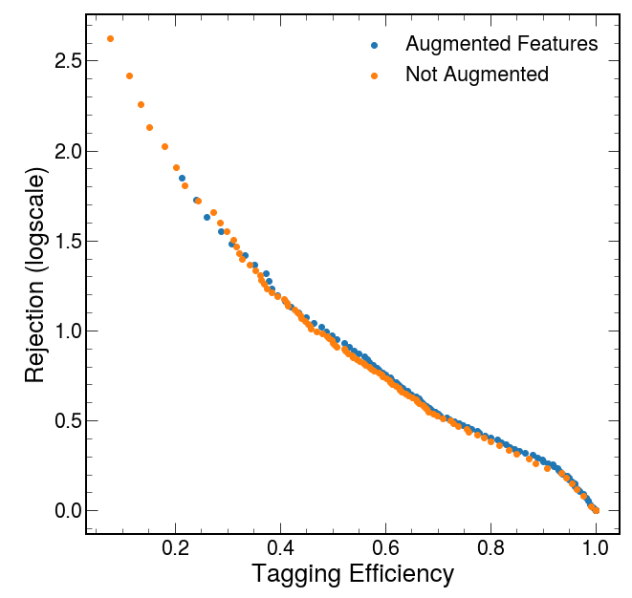
Can we augment our featurization like the manual approach?
Manually introduced subjetiness ratios and rho
as feature augmentation
Simple Augmentations had
minimal effect on rejection/efficiency ROC

Slide 22
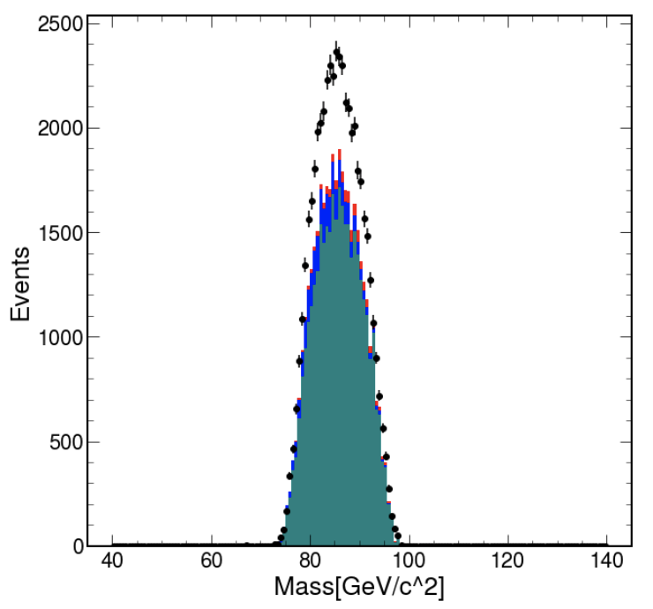
Jet Sculpting still is the fundamental Issue
We can reject efficiently, but mass extraction isn’t reliable
A peak on top of a peak!

Slide 23
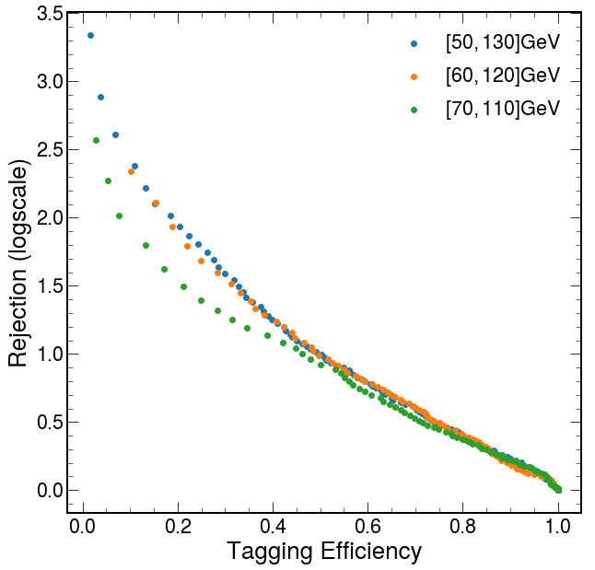
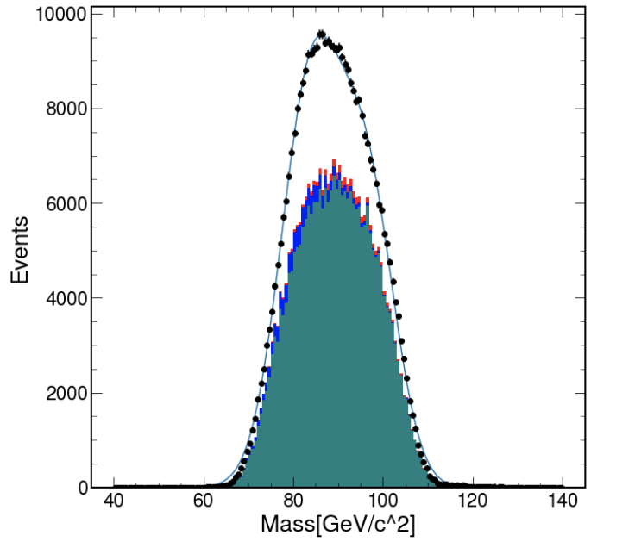
Can we force the net to distinguish just over the relevant mass region?
Mass Windowing doesn’t improve rejection,
and doesn’t help the sculpting

Slide 24
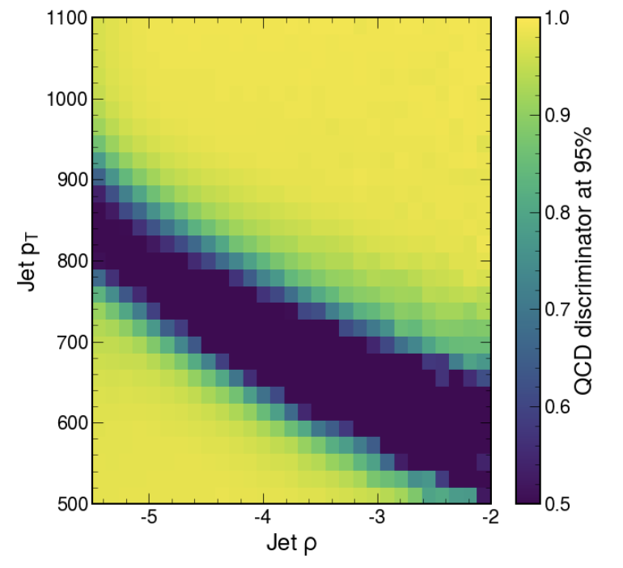
Characterizing the classification via Discriminator Plots
Very sharp changes in classification probability
How should we understand (and control) the correlation
of rejection and these variables?

Slide 25
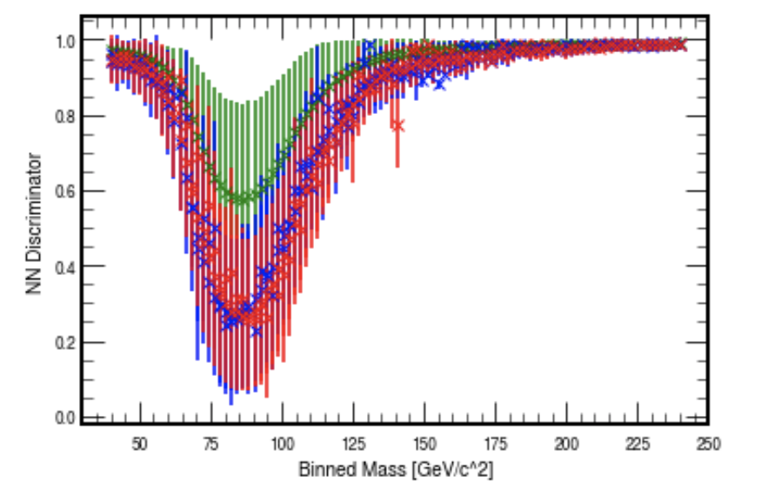
Constant thresholds always sculpt
A plot of the average discriminator for each population
A constant threshold is bound to correlate with the mass, and thus sculpt
(Indeed we are more likely to find a W boson near the W boson mass)

Slide 26
Constant thresholds always sculpt
A plot of the average discriminator for each population
A constant threshold is bound to correlate with the mass, and thus sculpt
So how do we decorrelate the mass?

Slide 27
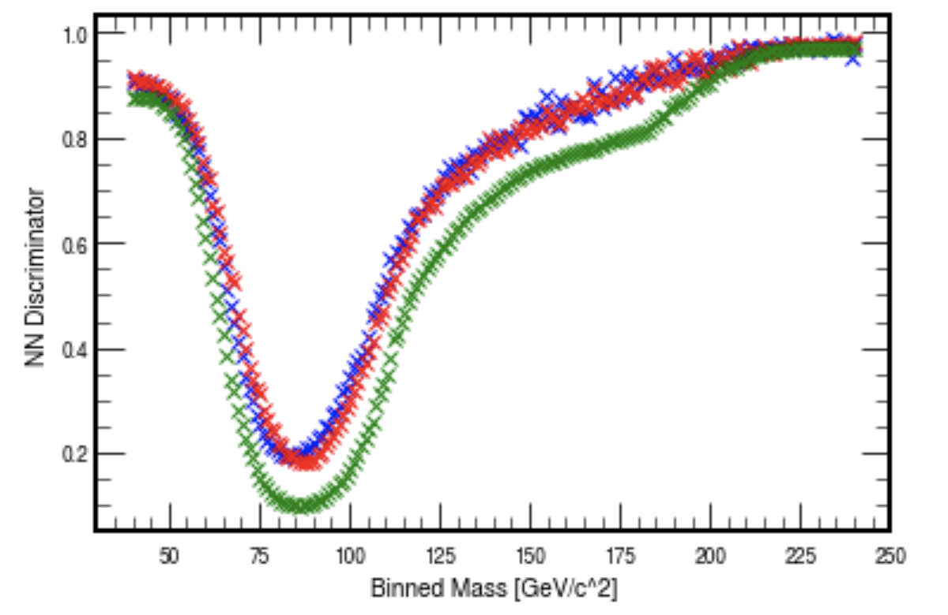
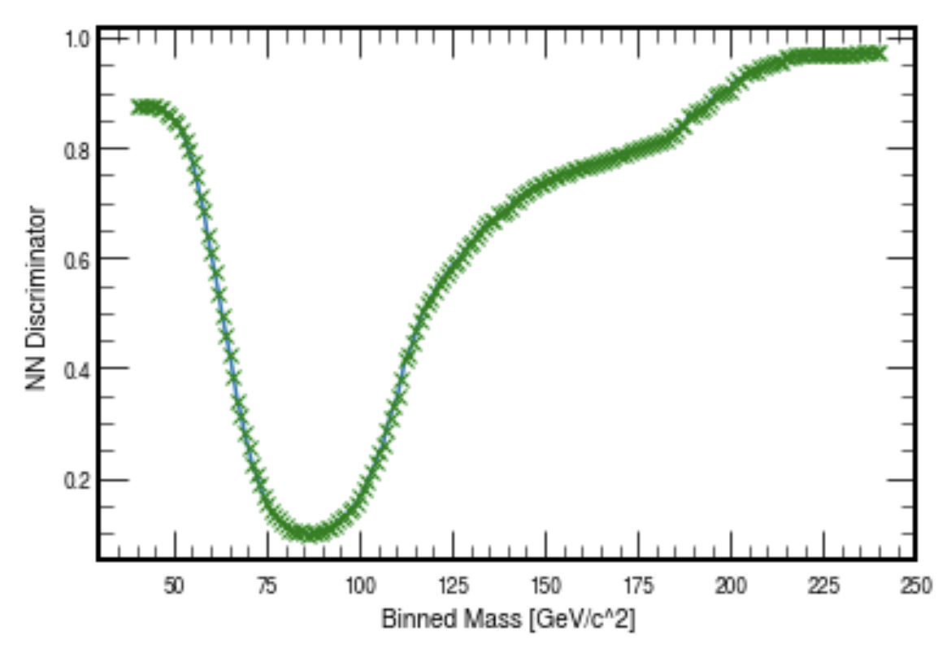
Discriminator Plots allow us to sculpt at our discretion
Let us pick just the 5th percentile QCD discriminator at each bin
Spline, and use as a mass dependent threshold

Slide 28
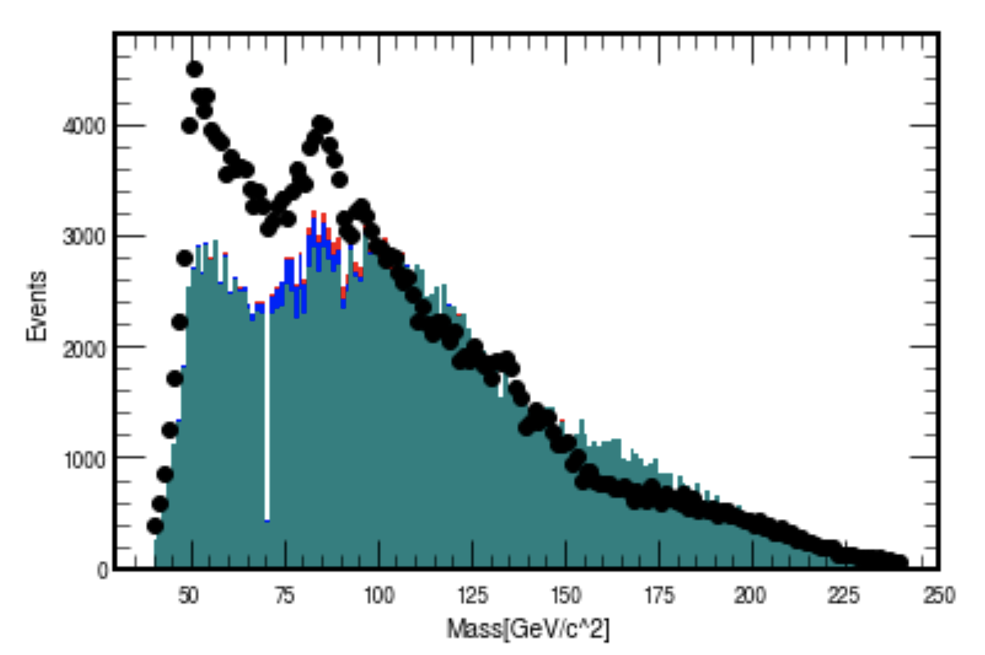
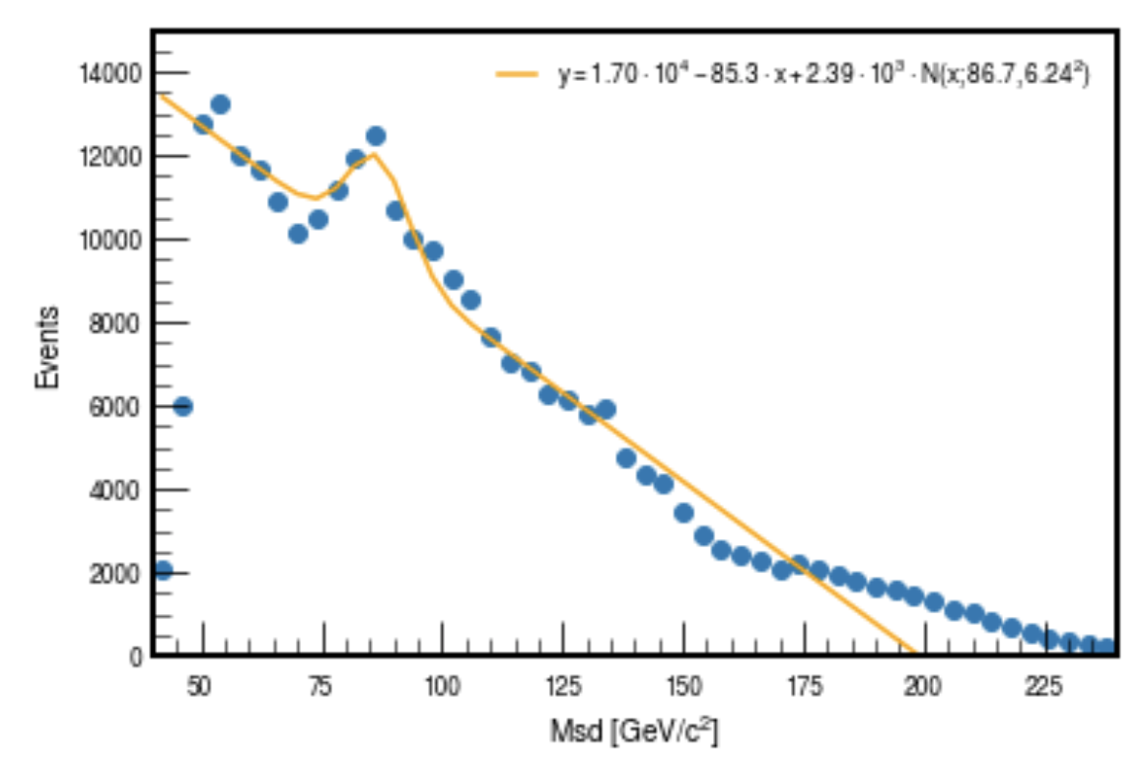
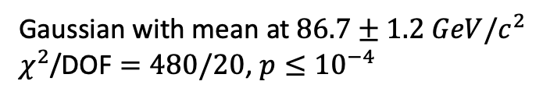
Splining the QCD percentiles shows considerable progress
Still a bit bumpy and not a great fit
Gaussian with mean at $86.7±1.2 GeV/c^{2}$
$χ^{2}$/DOF $=480/20$, $p≤{10}^{−4}$

Slide 29
Failed attempts and Motivating Questions
Can we decorrelate the rejection from the mass by performing PCA and removing the vector with largest mass component?
Can we penalize mass sculpting during training, by introducing a regularization that is a function of the distance between the rejected and original distributions?
Once we have a net that can reject without sculpting, can we revisit other blackboxes like random forest regression, k nearest neighbors, gradient boosted trees?

Slide 30
References
1. Vqq 8.13 Notebook
2. Ryan Reece, Ph.D., Santa Cruz Institute for Particle Physics, https://reece.scipp.ucsc.edu
3. L. de Oliveira, M. Kagan, L. Mackey, B. Nachman, A. Schwartzman, Jet- images —
deep learning edition, JHEP 07 (2016) 069. arXiv:1511.05190, doi:10.1007/JHEP07(2016)069.
4. P. Baldi, K. Bauer, C. Eng, P. Sadowski, D. Whiteson, Jet Substruc- ture Classification in High-Energy Physics
with Deep Neural Networks, Phys. Rev. D93 (9) (2016) 094034. arXiv:1603.09349, doi:10.1103/ PhysRevD.93.094034.
5. G. Louppe, K. Cho, C. Becot, K. Cranmer, QCD-Aware Recursive Neural Networks for Jet Physics,
JHEP 01 (2019) 057. arXiv:1702.00748, doi: 10.1007/JHEP01(2019)057.
6. A. Andreassen, I. Feige, C. Frye, M. D. Schwartz, JUNIPR: a Frame- work for Unsupervised Machine Learning in
Particle Physics, Eur. Phys. J. C79 (2) (2019) 102. arXiv:1804.09720, doi:10.1140/epjc/ s10052-019-6607-9.
7. K. Datta, A. Larkoski, How Much Information is in a Jet?, JHEP 06
(2017) 073. arXiv:1704.08249, doi:10.1007/JHEP06(2017)073.
8. K. Datta, A. Larkoski, B. Nachman, Automating the Construction of Jet Observables with
Machine Learning (2019) arXiv:1902.07180.
9. A. Larkowski, I. Moult, B. Nachman, Jet Substructure at the Large Hadron Collider: A Review of Recent Advances
in Theory and Machine Learning (2019) arXiv:1709.04464v2
10. Blagus, R., Lusa, L. SMOTE for high-dimensional class-imbalanced data. BMC Bioinformatics 14, 106 (2013).
https://doi.org/10.1186/1471-2105-14-106
11. D. Bertolini, P. Harris, M. Low, N. Tran, Pileup Per Particle Identification, JHEP 10 (2014) 059.
arXiv:1407.6013, doi:10.1007/JHEP10(2014) 059.

Slide 31
Thank you!

Slide 32
Extra Slides

Slide 33
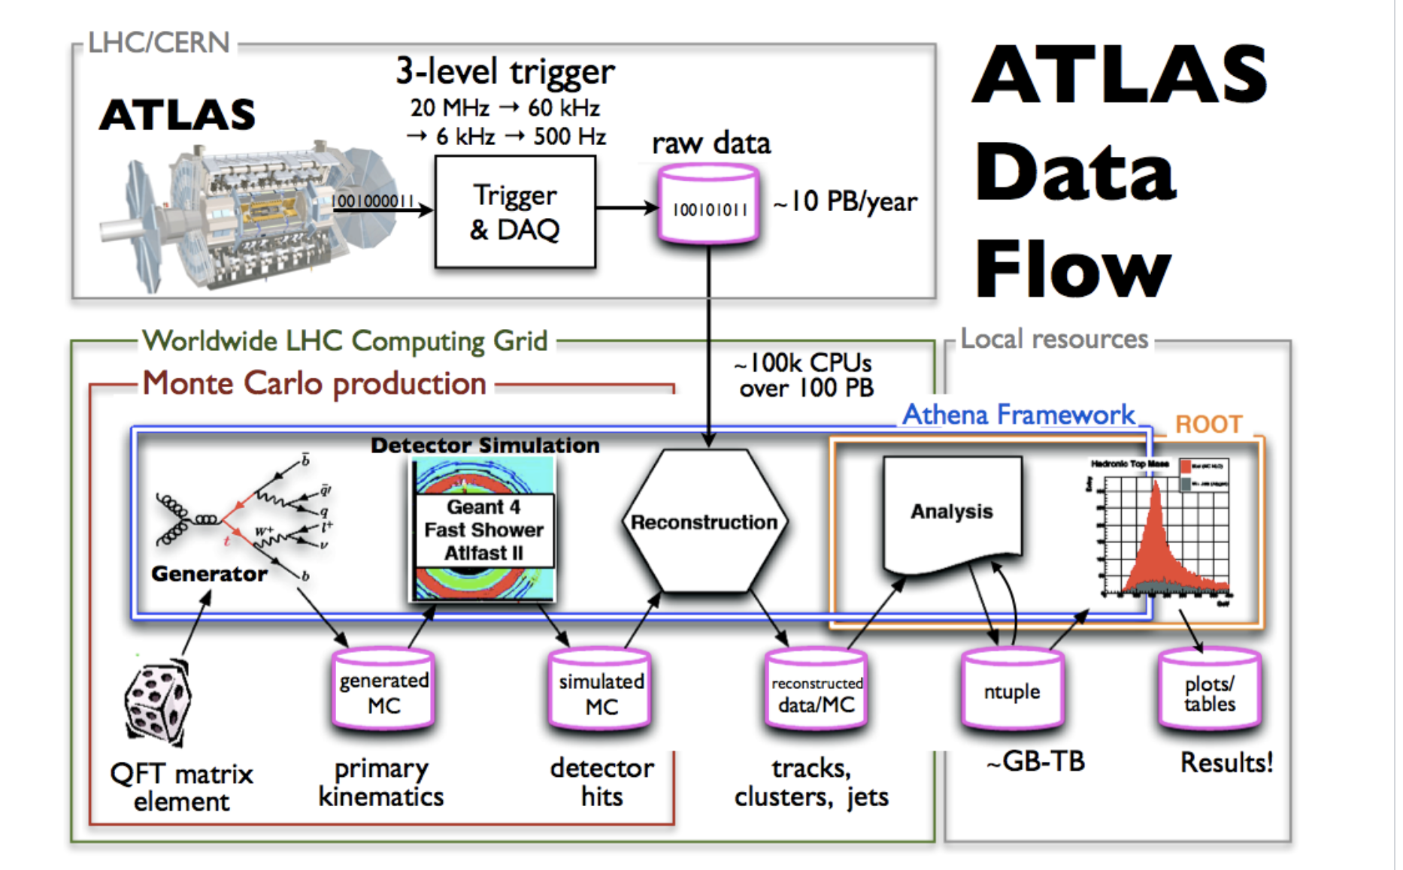
ATLAS data flow and analysis setup [2]
LHC data from 8 TeV collisions.
Monte Carlo Simulations of QCD and W/Z collisions
Fed through Jet reconstruction algorithm (PUPPI) [11]
Constructs n-tuples of jet variables

Slide 34
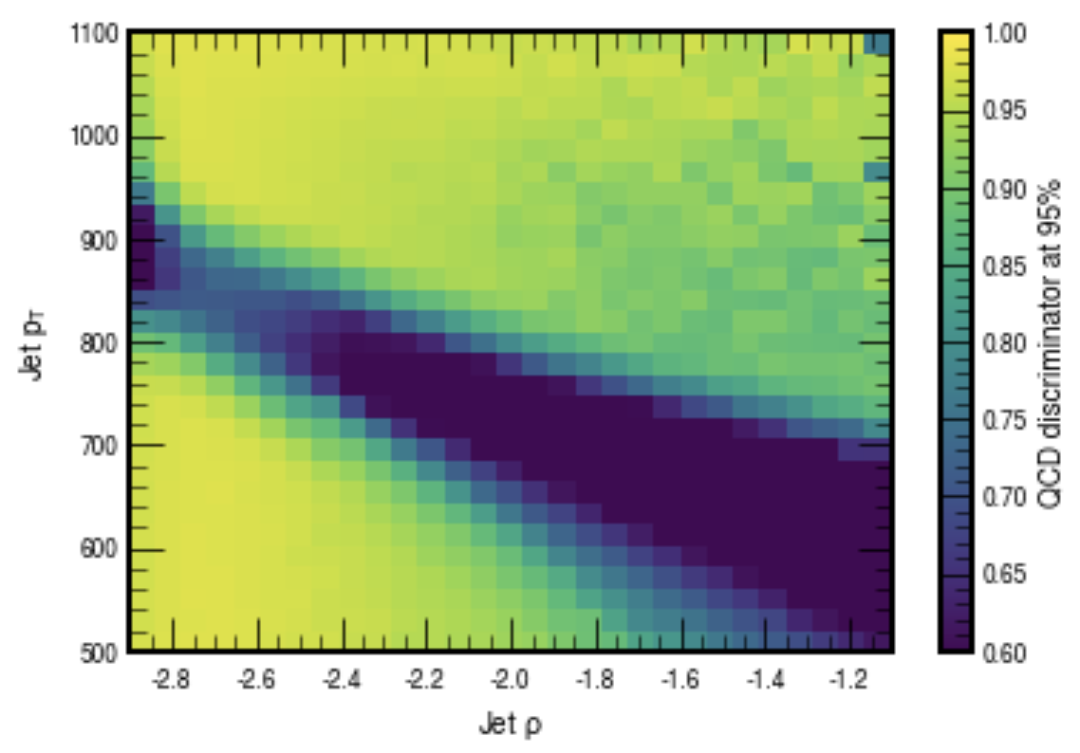
PCA shows progress in smoothing the discriminator

