Slide 1
FCC-ee Injector Conceptual Design and Positron Source test stand at PSI
WP0. Coordination - P. Craievich, deputy A. Grudiev
Task 0.1 Coordination – P. Craievich, A. Grudiev
Task 0.2 Overall parameter optimization - A. Grudiev
CERN: Michael Benedikt, Frank Zimmermann, Alexej Grudiev, Andrea Latina, Steffen Doebert, Salim Ogur
PSI: Paolo Craievich, Hans Braun, Simona Bettoni, Riccardo Zennaro, Marco Pedrozzi, Stephane Sanfilippo
LNF Frascati : Catia Milardi
KEK: Katsunobu Oide
IJCLab: Angeles Faus Golfe, Iryna Chaikovska
WP1. e+/e- 6 GeV Injector Linacs - A. Grudiev, S. Bettoni
Task 1.1 Single or two guns schemes: DC-Gun/RF Gun design and comparative studies – S. Doebert
CERN: Steffen Doebert, CERN student
PSI: Paolo Craievich + PSI Postdoc
Task 1.2 RF-structure optimization for the linac 1, 2 and 3 based on beam dynamics analysis (Task 1.3) – A. Grudiev
CERN: A. Grudiev, CERN fellow
Task 1.3 Electron optics and transport optimization including collective effects in Linac 1, 2 & 3 – S. Bettoni
CERN: A. Latina
PSI: S. Bettoni, PSI Postdoc
Task 1.4 RF modules design and costs (gun, Linac 1, 2 and 3); cost estimates based on SwissFEL prices – R. Zennaro
CERN: A. Grudiev, CERN fellow
PSI: R. Zennaro, PSI Postdoc
WP2. Electron and positron Linac extension study (Linac 4) - S. Bettoni, A. Grudiev
Task 2.1 RF-structure optimization based on longitudinal beam dynamics analysis – A. Grudiev
CERN: A. Grudiev, CERN fellow
Task 2.2 Optics and transport optimization including collective effects in linac 4 – S. Bettoni
CERN: A. Latina
PSI: S. Bettoni, PSI Postdoc
Task 2.3 RF module design and costs (Linac 4) – R. Zennaro
CERN: A. Grudiev, CERN fellow
PSI: R. Zennaro, PSI Postdoc

Slide 2
WP3. Positron source: target and capture system – I. Chaikovska
Task 3.1 Physics design of the positron target and capture system (optimization of the positron source: fixed/movable, conventional/hybrid, bypass line, beam energy) – I. Chaikovska
IJCLab: I. Chaikovska, A. Faus-Golfe, PhD, Postdoc
CERN: S. Doebert
PSI: R. Zennaro, H. Braun, PhD
BINP: P. Martyshkin
Task 3.2 Capture system: Concepts of a SC solenoid and/or of flux concentrator and comparative – S. Sanfilippo
IJCLab: I. Chaikovska, PhD/Postdoc
CERN: S. Doebert
PSI: S. Sanfilippo, Postdoc (magnet group)
BINP: P. Martyshkin
Task 3.3 Capture system: Design of the RF structures and NC solenoids – R. Zennaro
PSI: R. Zennaro, P. Craievich, R. Fortunati, PhD
Task 3.4 Capture system beam dynamics – R. Zennaro
PSI: R. Zennaro, P. Craievich, PhD
IJCLab: I. Chaikovska, PhD/postdoc
CERN: A. Latina
Task 3.5 Target area shielding – CERN expert
Task 3.6 Target thermo-mechanical studies – CERN expert
CERN: expert, CERN fellow, I. Chaikovska (IJCLab) + PhD/postdoc (IJCLab )
WP4. Damping ring and transfer lines – C. Milardi (LNF)
Task 4.1 Design damping ring. C. Milardi (LNF) + LNF postdoc + CERN experts
Task 4.2 Transfer lines to/from DR. CERN experts
Task 4.3 Compression scheme before reinjection. LNF and CERN experts
WP5 5 CDR+, all partners 5.1 Editing CDR. PSI postdoc will coordinate between all partners, CERN will provide editing platform and guidelines.

Slide 3
WP6. Proof of Principle positron source in SwissFEL – P. Craievich (work in progress)
Task 6.1 Design test beamline. PSI Staff + PhD (PSI)
Task 6.2 Engineering of the RF structures and NC solenoids of the capture system. R. Fortunati (PSI) + Magnet Postdoc (PSI) + PhD (PSI)
Task 6.3 Manufacturing of the RF structures and NC solenoids of the capture system PSI experts
Task 6.4 Engineering & procurement target. CERN
Task 6.5 Engineering and procurement SC solenoids. PSI magnet experts
Task 6.6 Shielding of target area. PSI, CERN
Task 6.7 Component procurement and implementation. PSI experts
Task 6.8 Positron production experiment. All partners

Slide 4
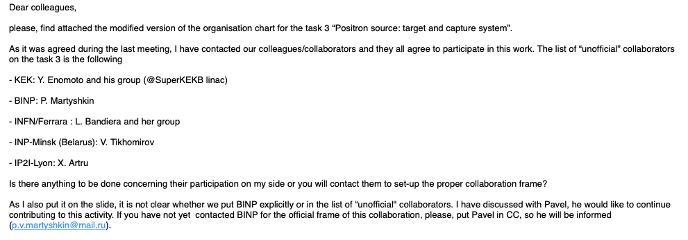
Other external partners
by Iryna
Question:
by Frank
To create a link to, and possibly profit from the relevant expertise available at, KEK and BINP, we think it might be helpful to identify one representative each from these two partners, which we could also include in the mailing list for the injector coordination meetings.
For KEK, Kazuro Furukawa has been proposed to be such representative or link person. Kazuro has ample experience with the KEK positron sources and linacs; presently he is one of the three leaders of SuperKEKB (and in charge of its injectors).
For BINP, we are waiting for feedback from Eugene Levichev.

