Slide 1
Particle Detectors
Summer Student Lectures 2010
Werner Riegler, CERN, werner.riegler@cern.ch
History of Instrumentation ↔ History of Particle Physics
The ‘Real’ World of Particles
Interaction of Particles with Matter
Tracking Detectors, Calorimeters, Particle Identification
Detector Systems

Slide 2
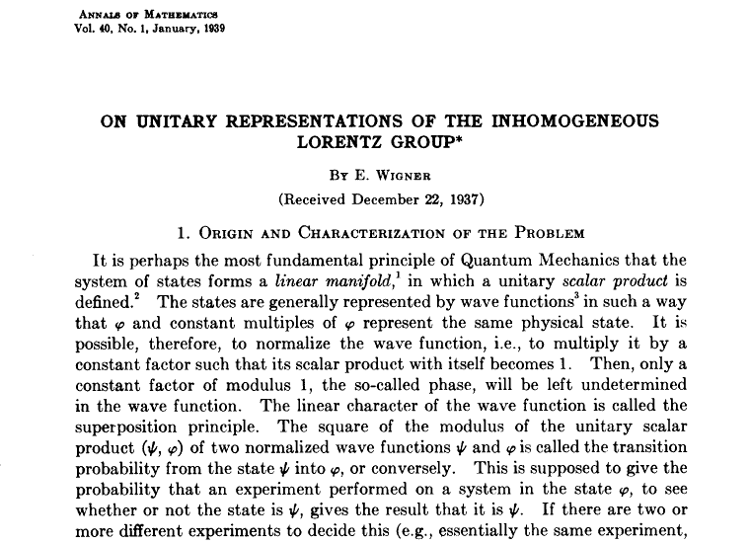
The ‘Real’ World of Particles
E. Wigner:
“A particle is an irreducible representation of the inhomogeneous Lorentz group”
Spin=0,1/2,1,3/2 … Mass>0
E.g. in Steven Weinberg, The Quantum Theory of Fields, Vol1

Slide 3
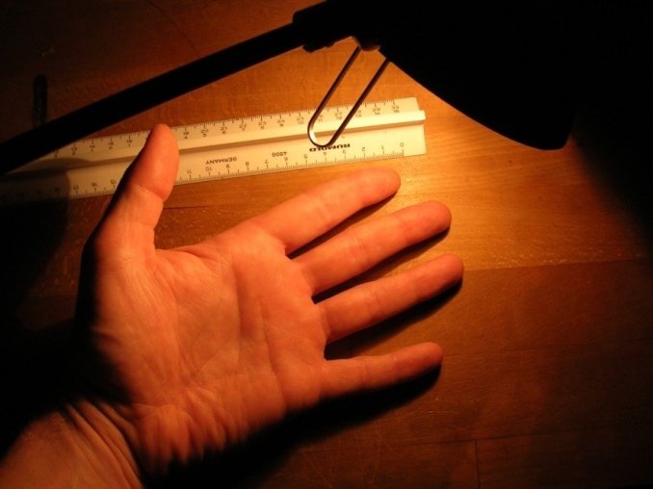
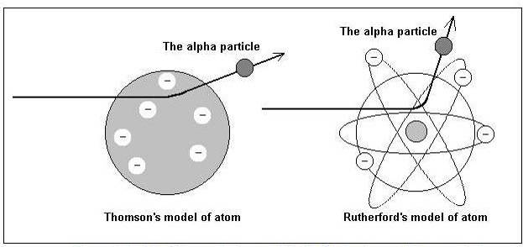
The ‘Real’ World of Particles
W. Riegler:
“…a particle is an object that interacts with your detector such that you can follow it’s track,
it interacts also in your readout electronics and will break it after some time,
and if you a silly enough to stand in an intense particle beam for some time you will be dead …”
Are particles “real” ?
are they in principle “invisible” ?
…
Looking at your hand by scattering light off it is the same thing as looking at the nucleons by scattering alpha particles (or electrons) off it.
)* the content of this slide represents only the personal view of the lecturer, and must not be quoted as an official point of view of the particle physics community’

Slide 4
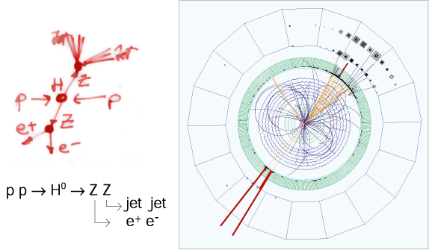
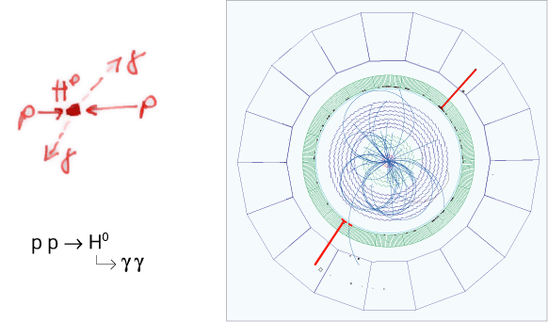
The ‘Real’ World of Particles
Elektro-Weak Lagrangian
Higgs Particle

Slide 5
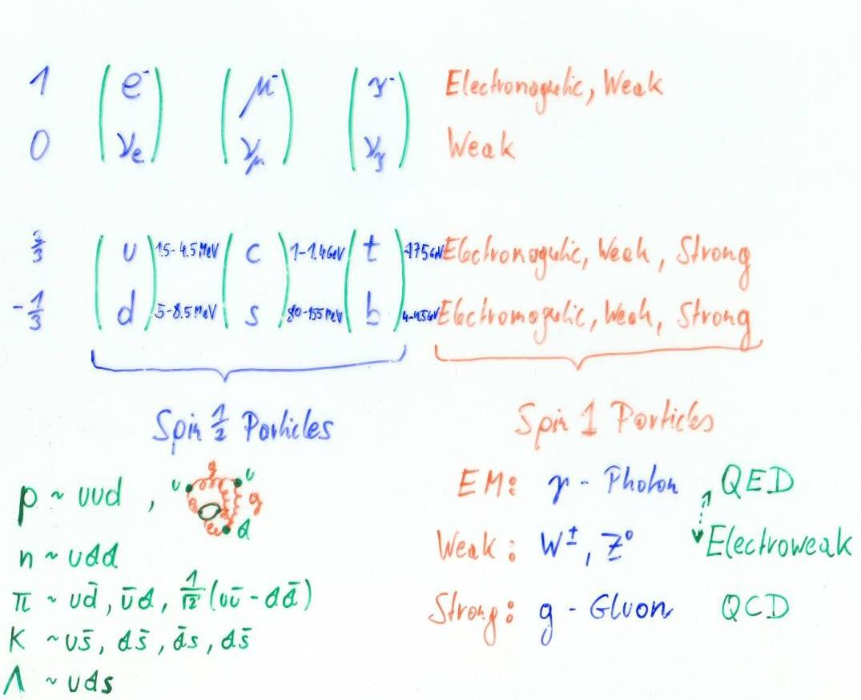
The ‘Real’ World of Particles

Slide 6
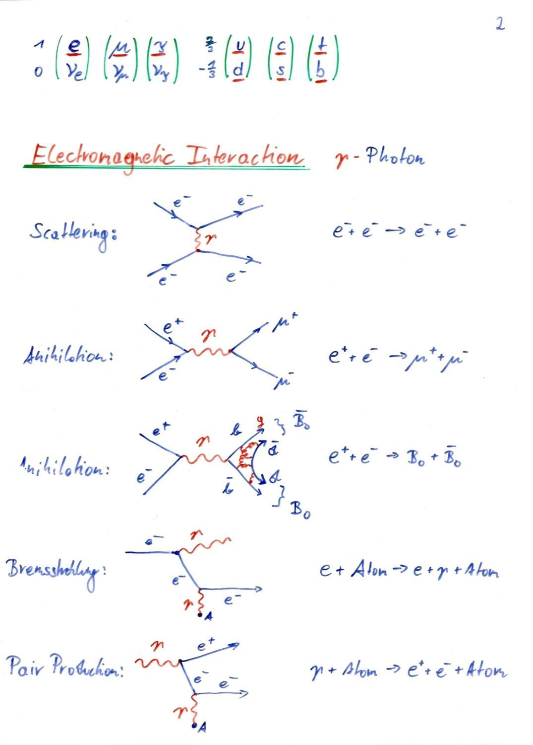

Slide 7
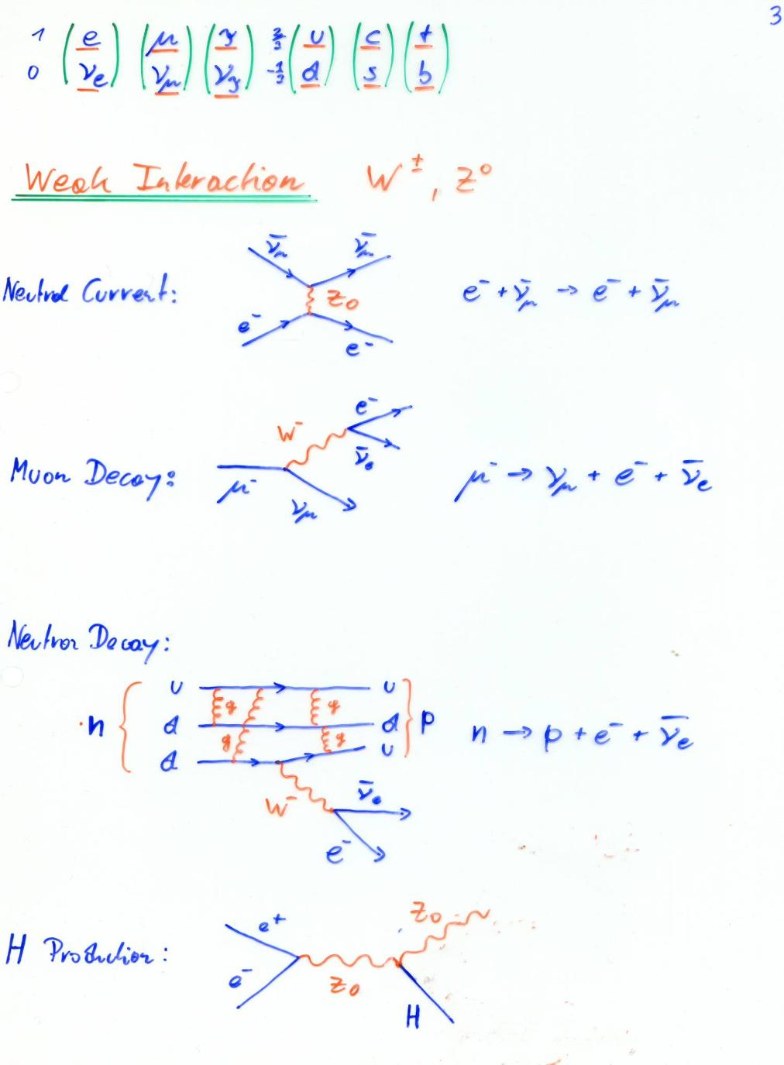

Slide 8
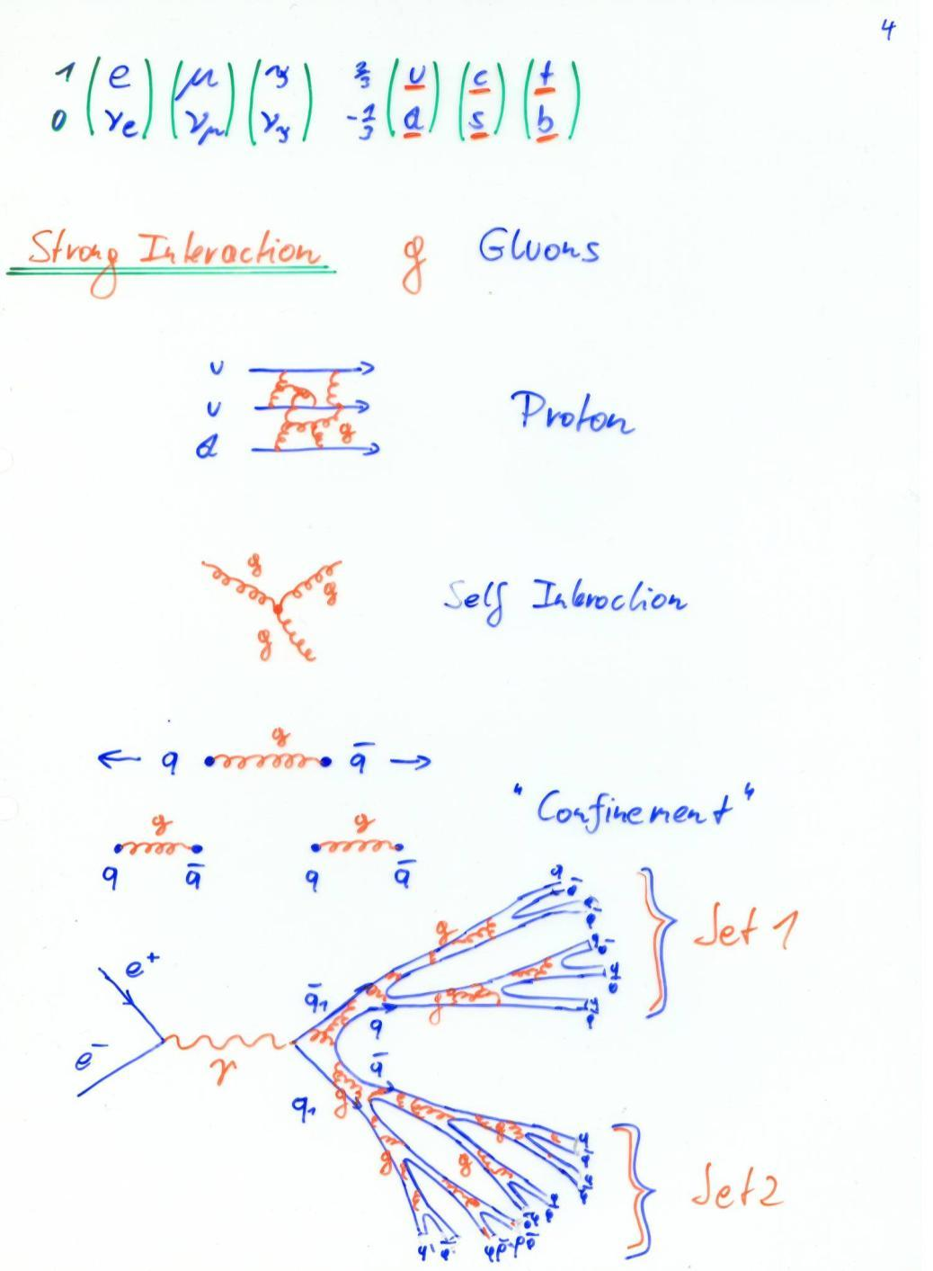

Slide 9
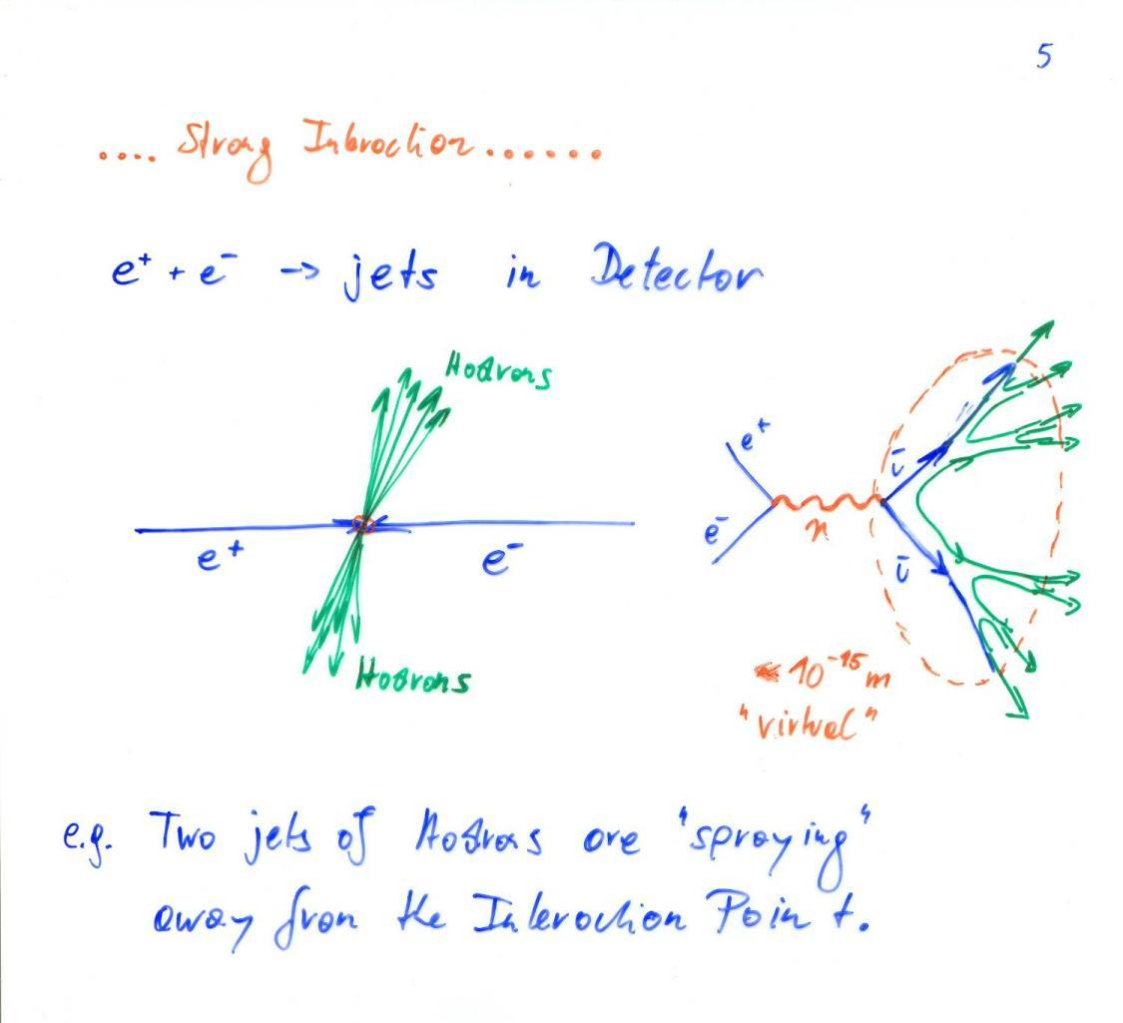

Slide 10
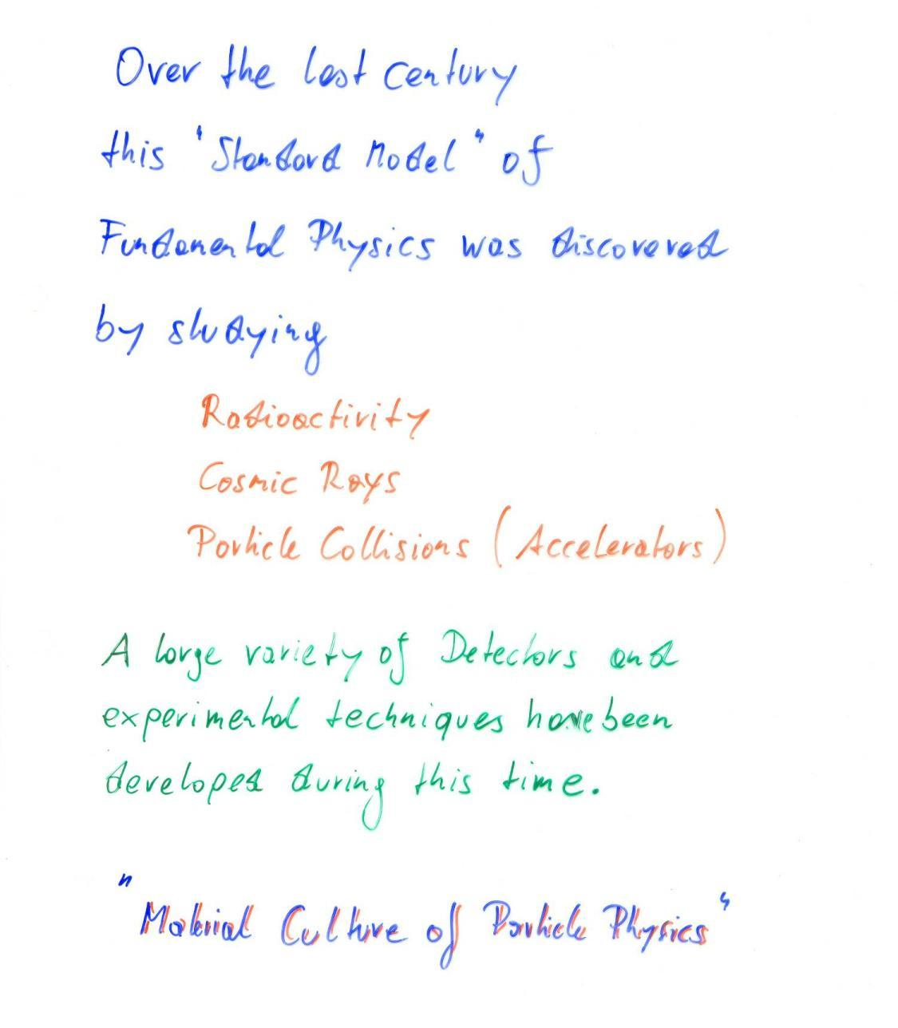

Slide 11
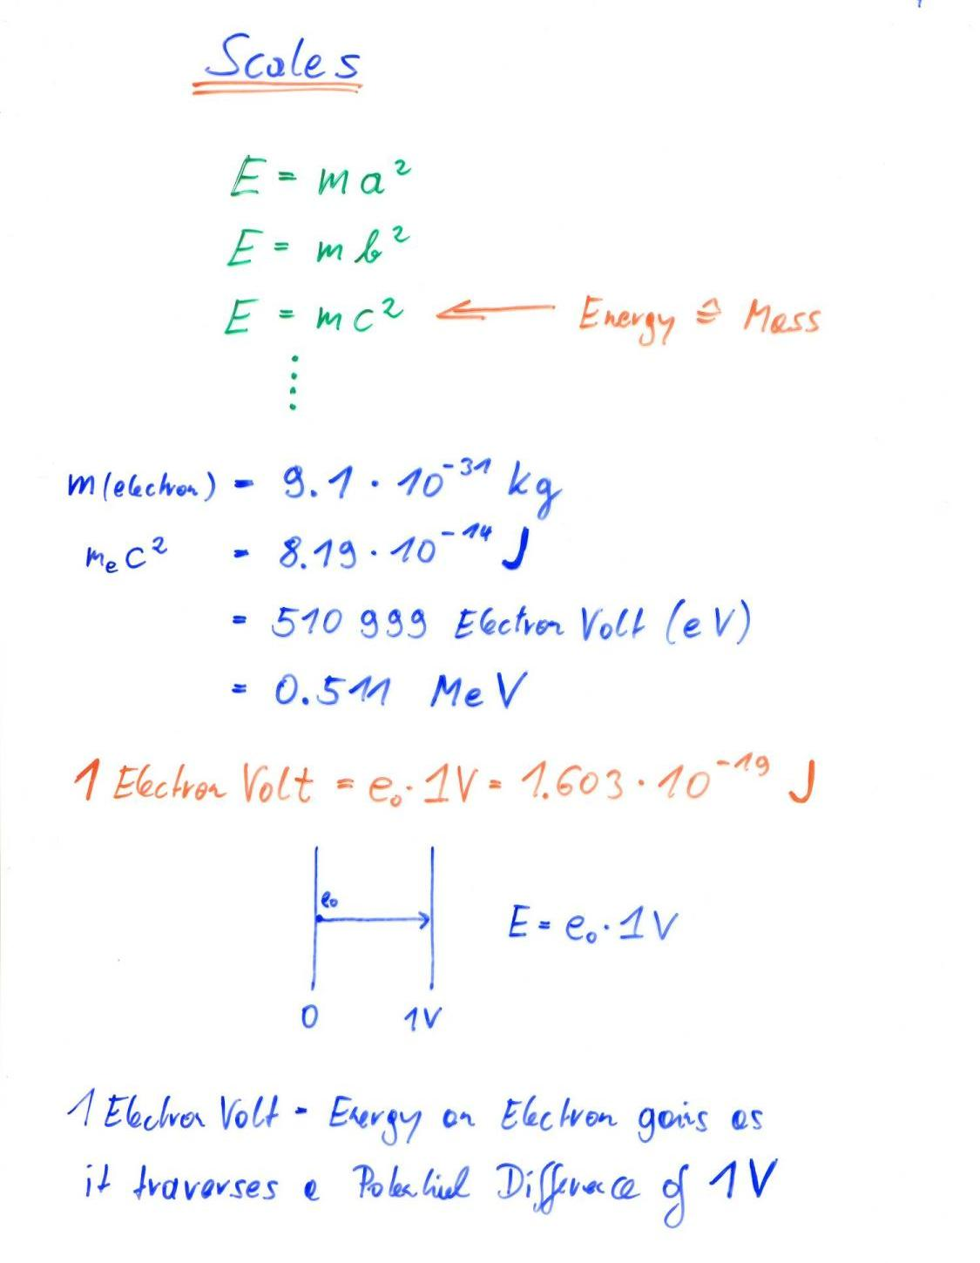

Slide 12
Build your own Accelerator
E_{kin}= 1.5eV =
2 615 596 km/h
+
1.5V
_
e⁻

Slide 13
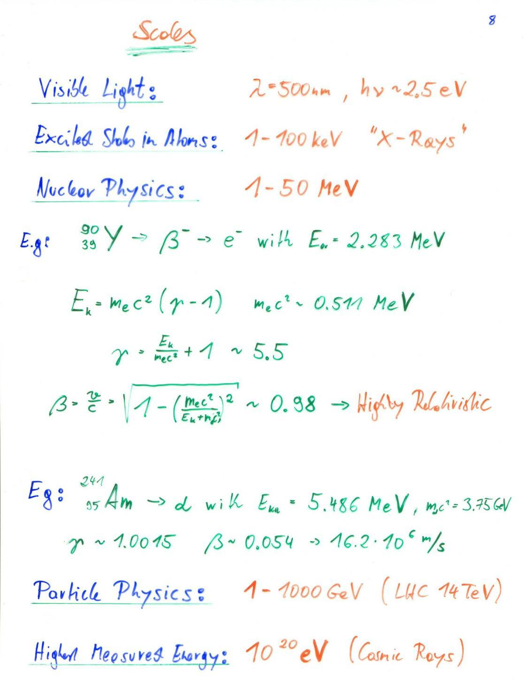
E_{kin}=mc² → mc²(γ-1)=mc² → γ =2 → β=0.87

Slide 14
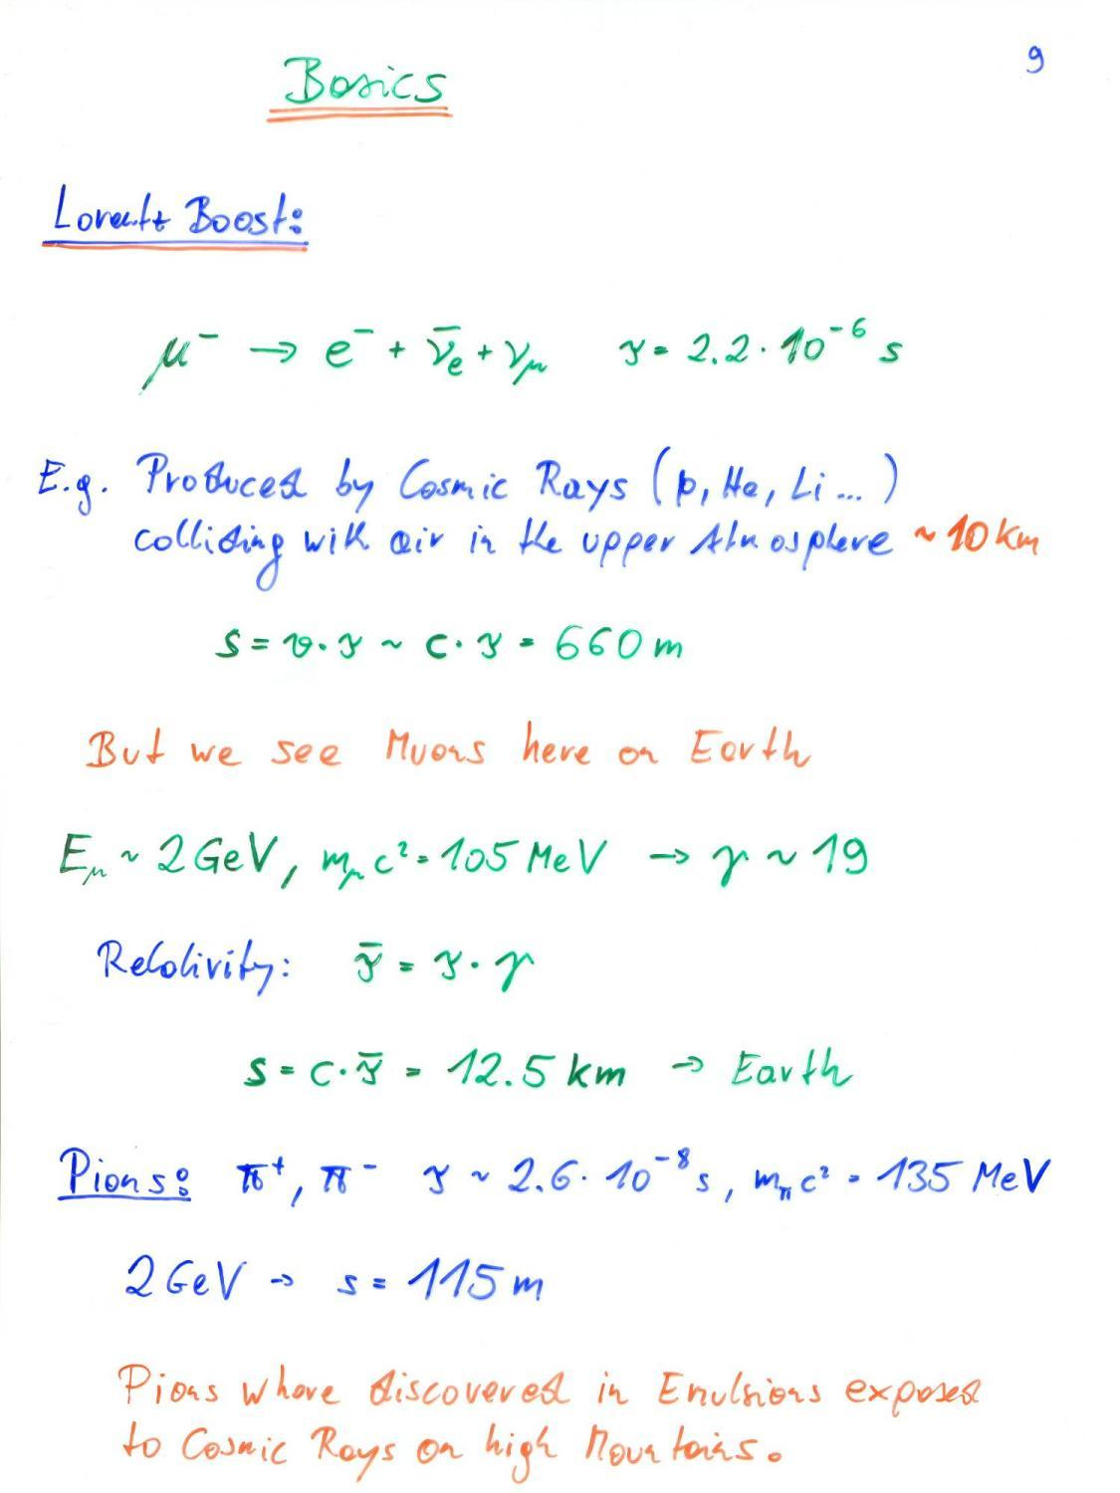

Slide 15
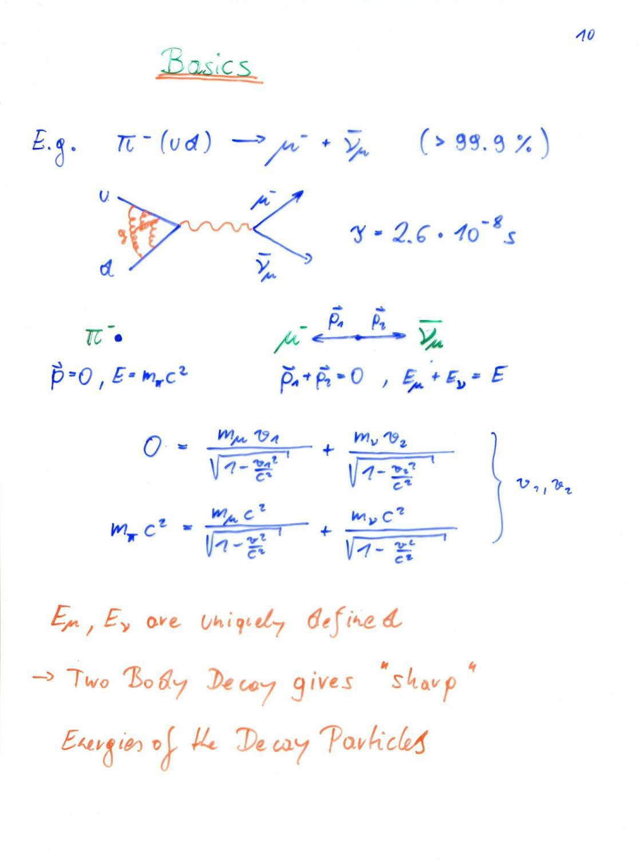

Slide 16
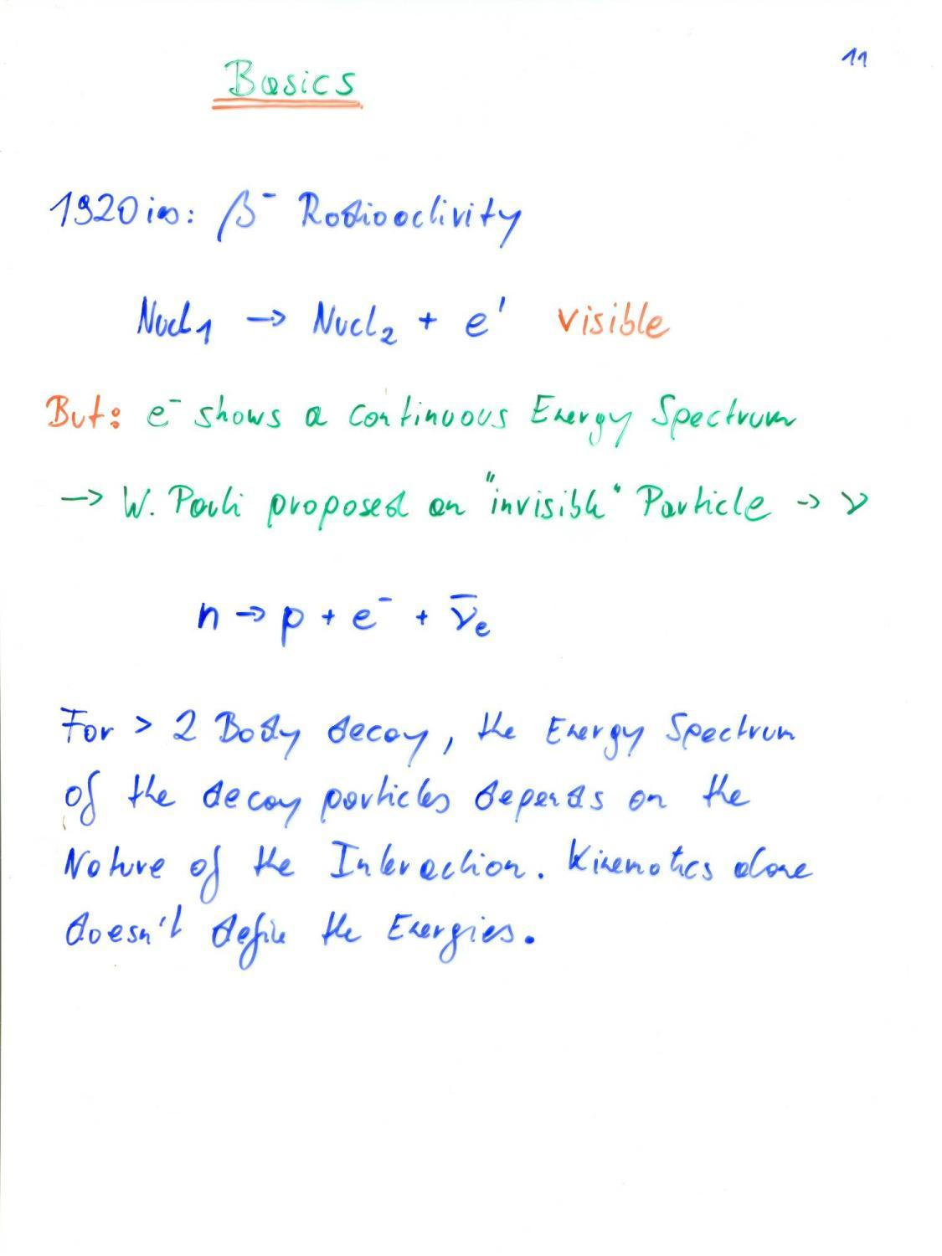

Slide 17
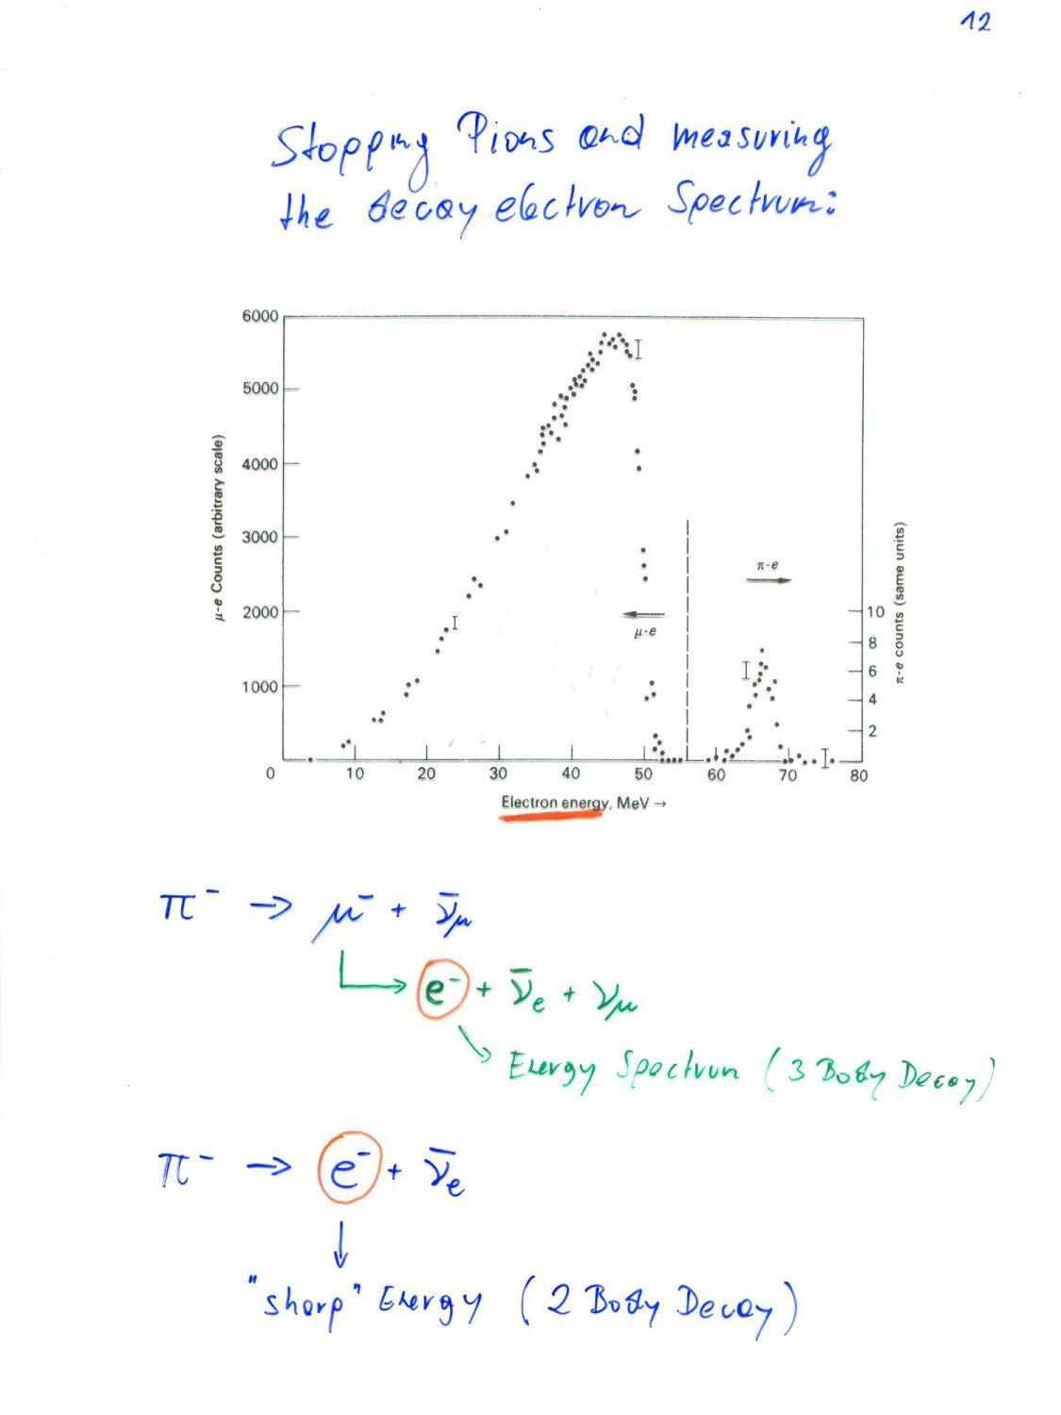

Slide 18
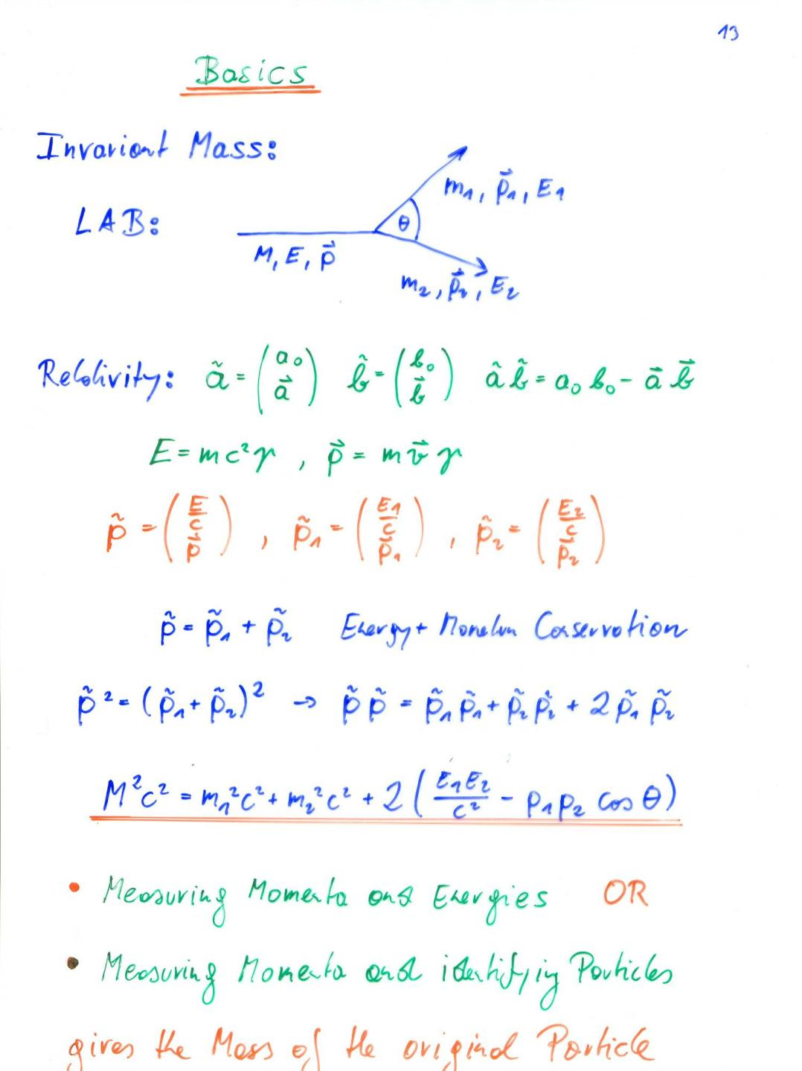

Slide 19
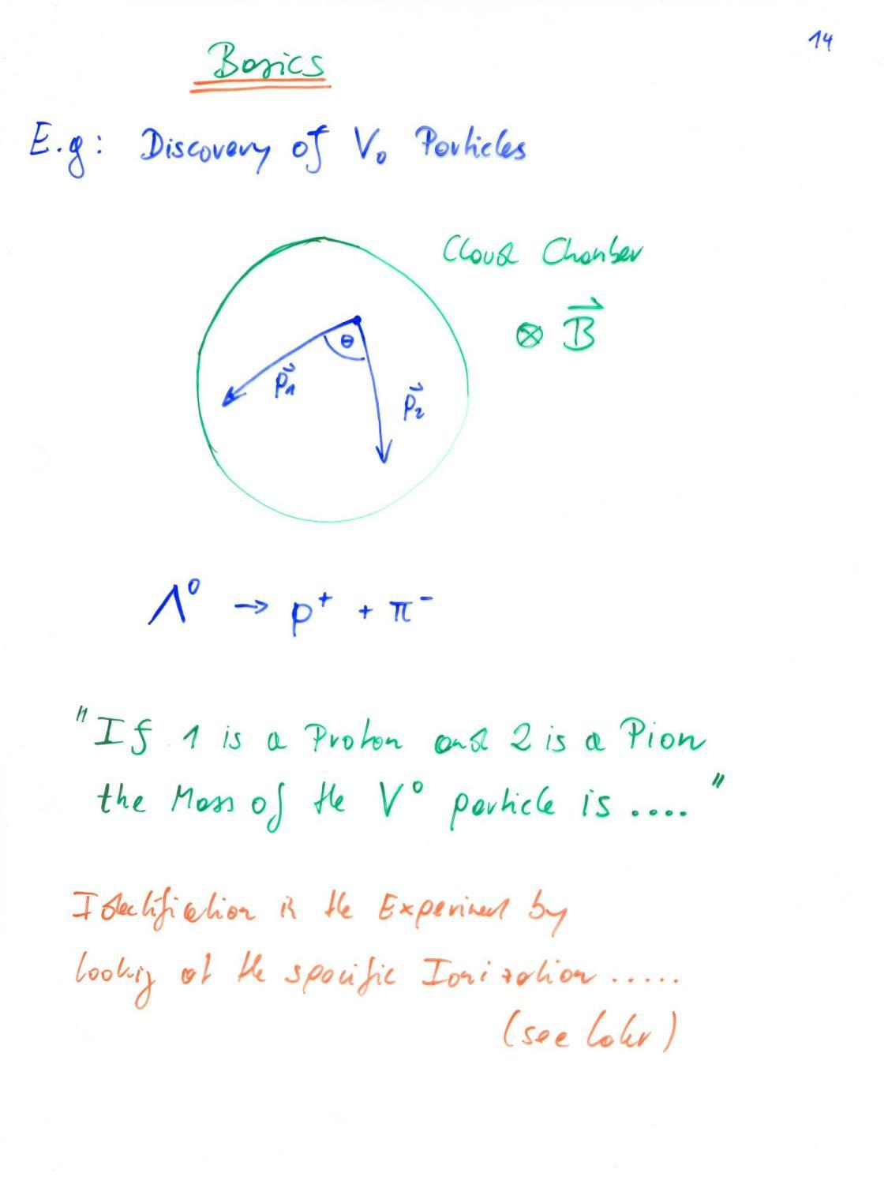

Slide 20
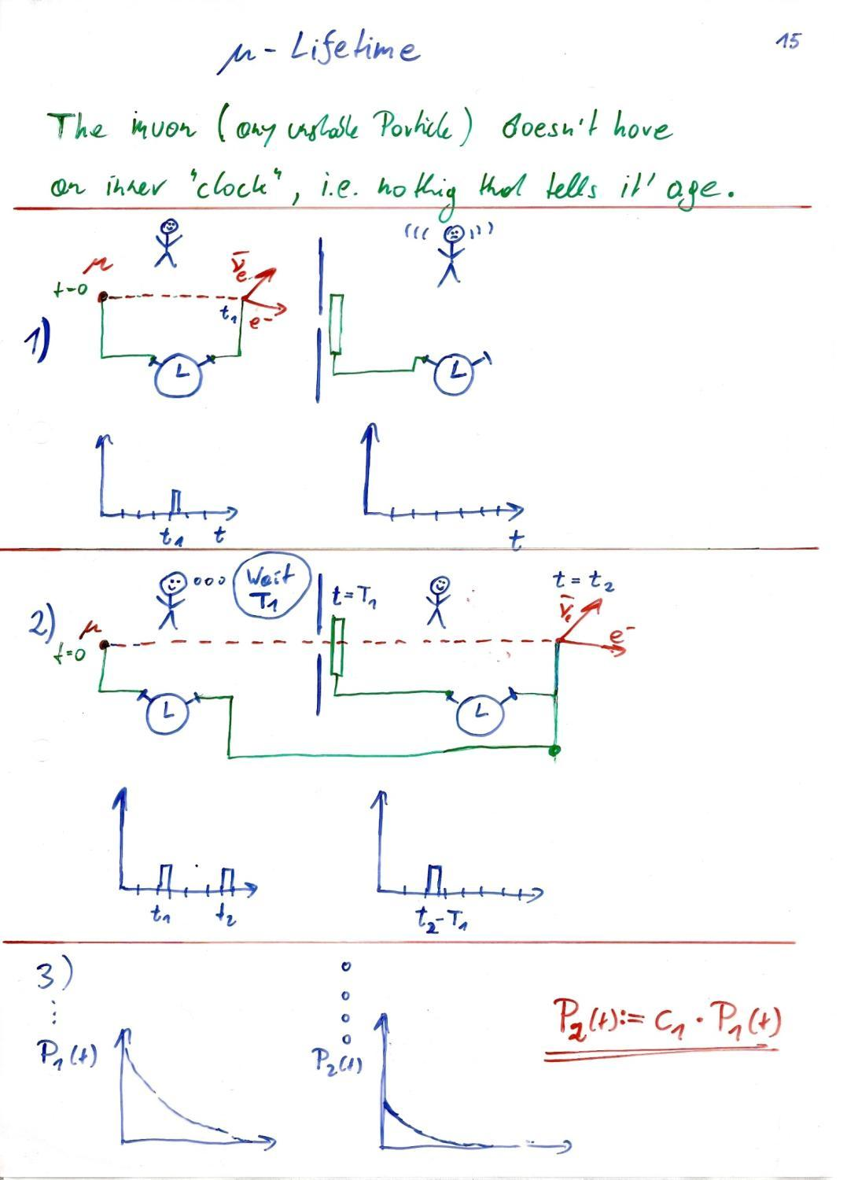
Probability that it decays in the time interval Δt = p

Slide 22
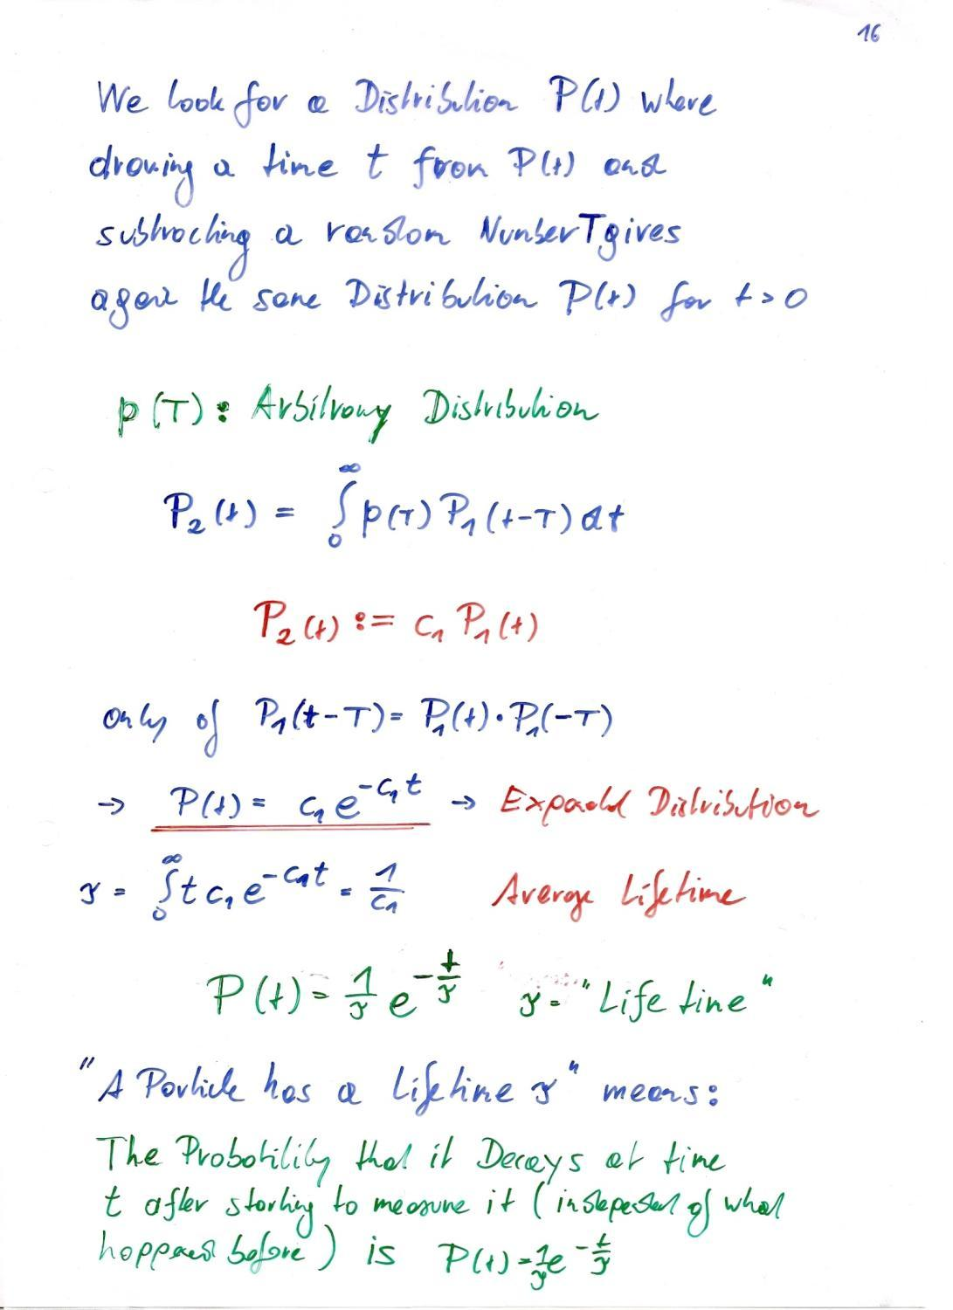

Slide 23
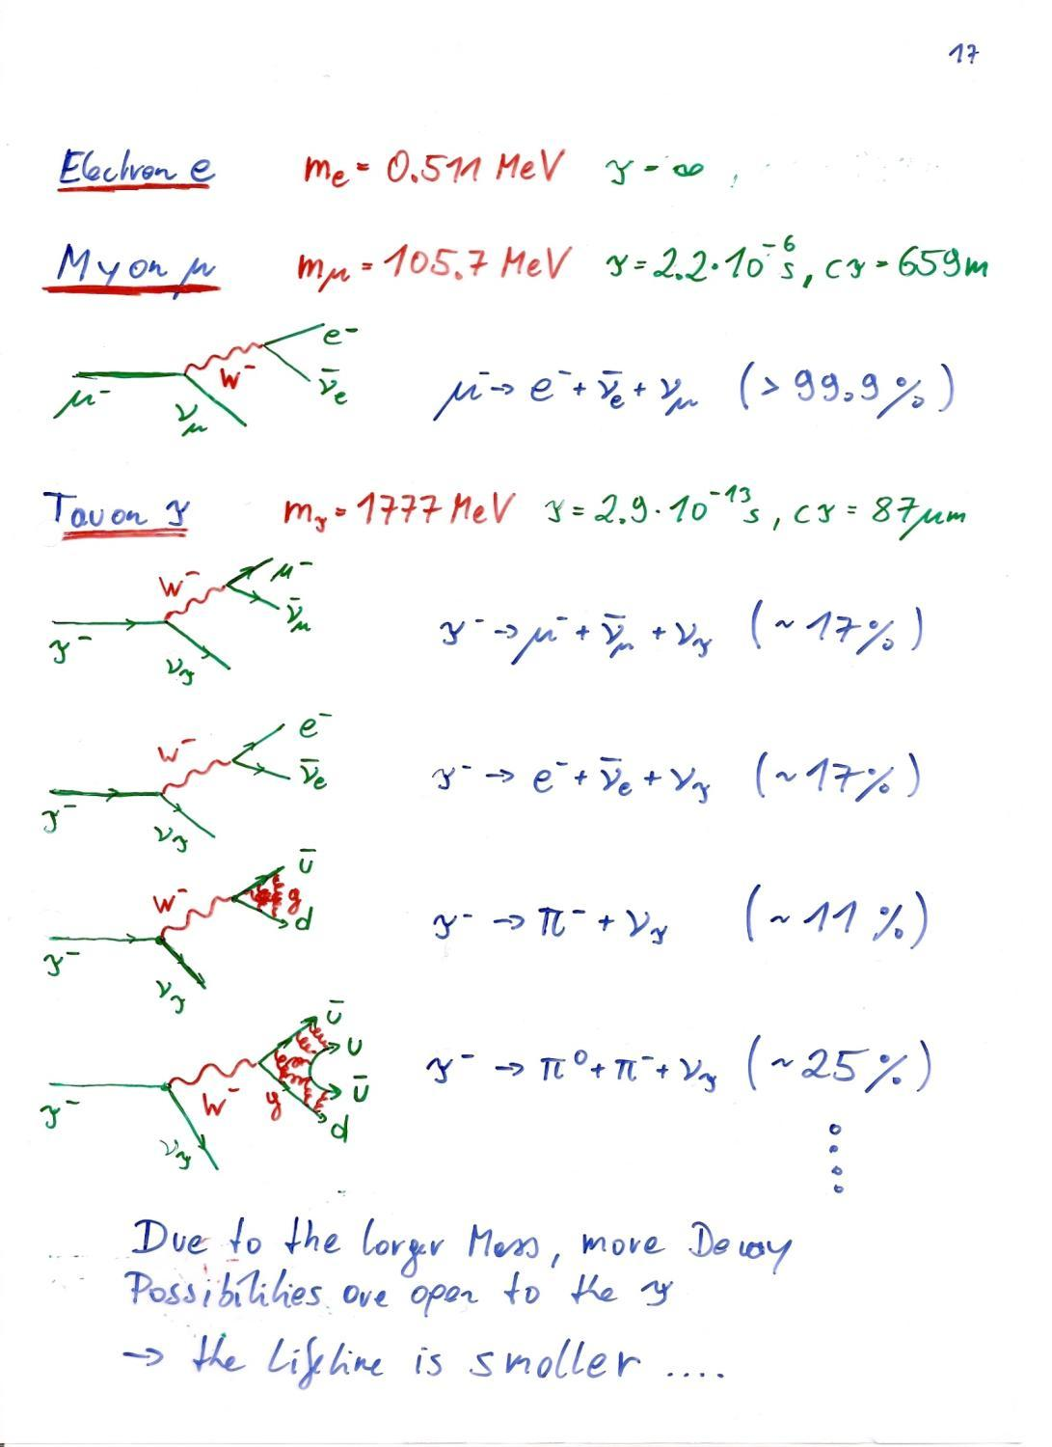

Slide 24
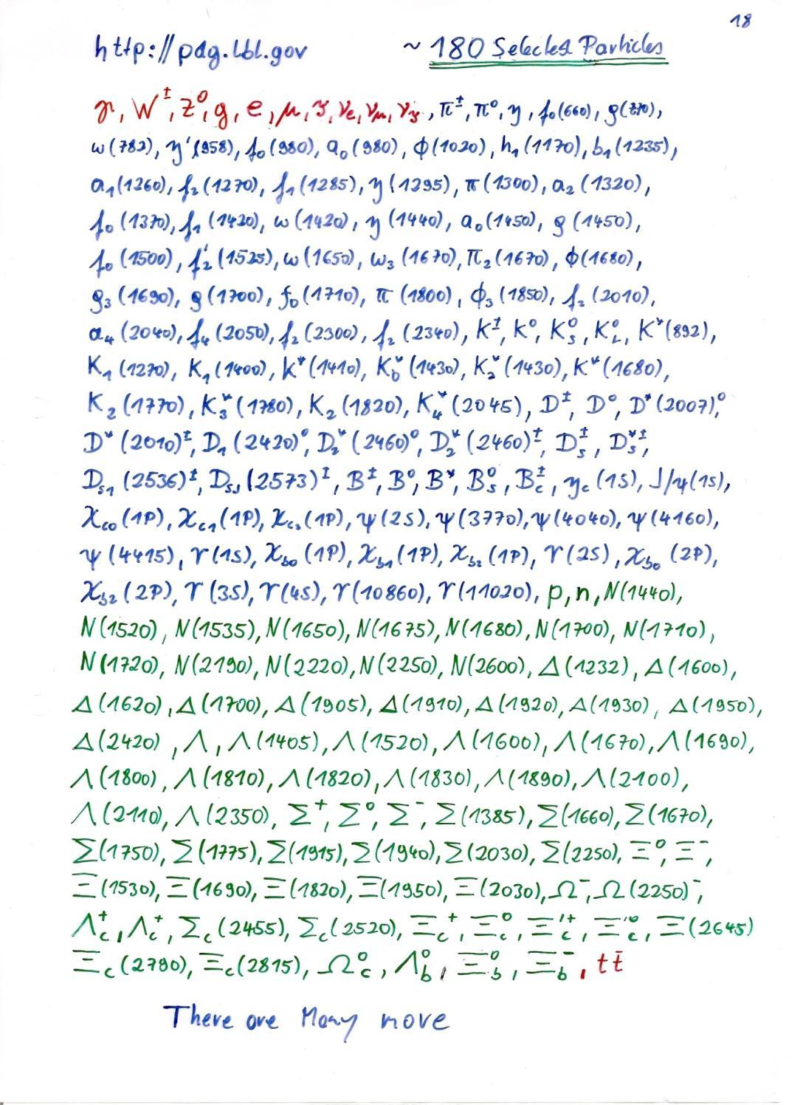

Slide 25
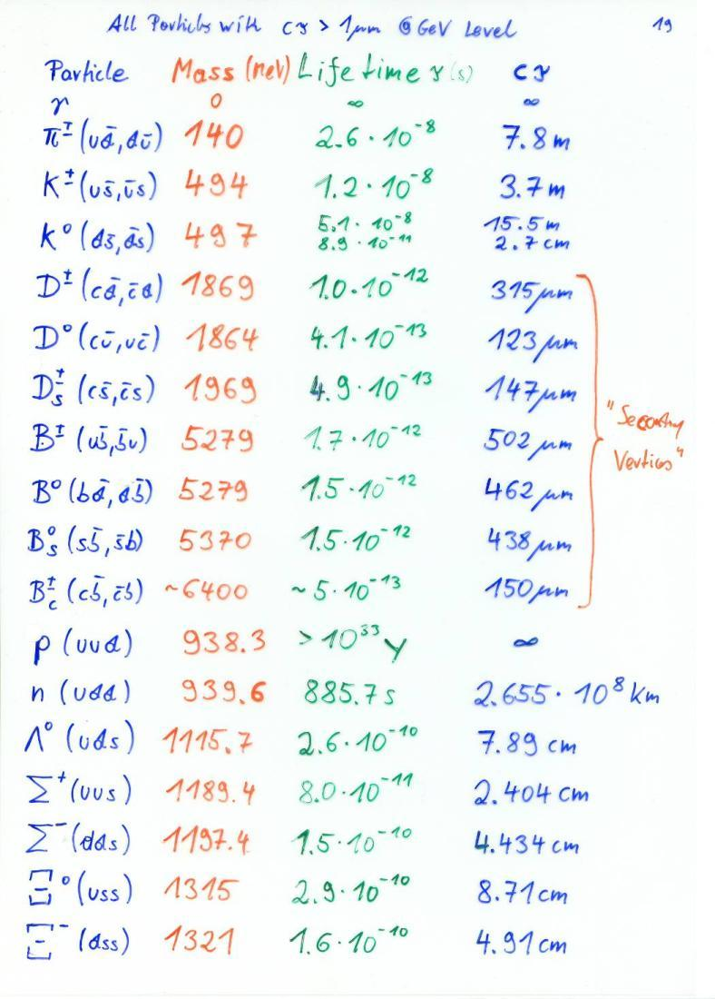
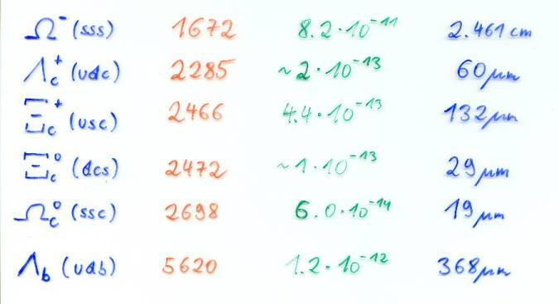

Slide 26
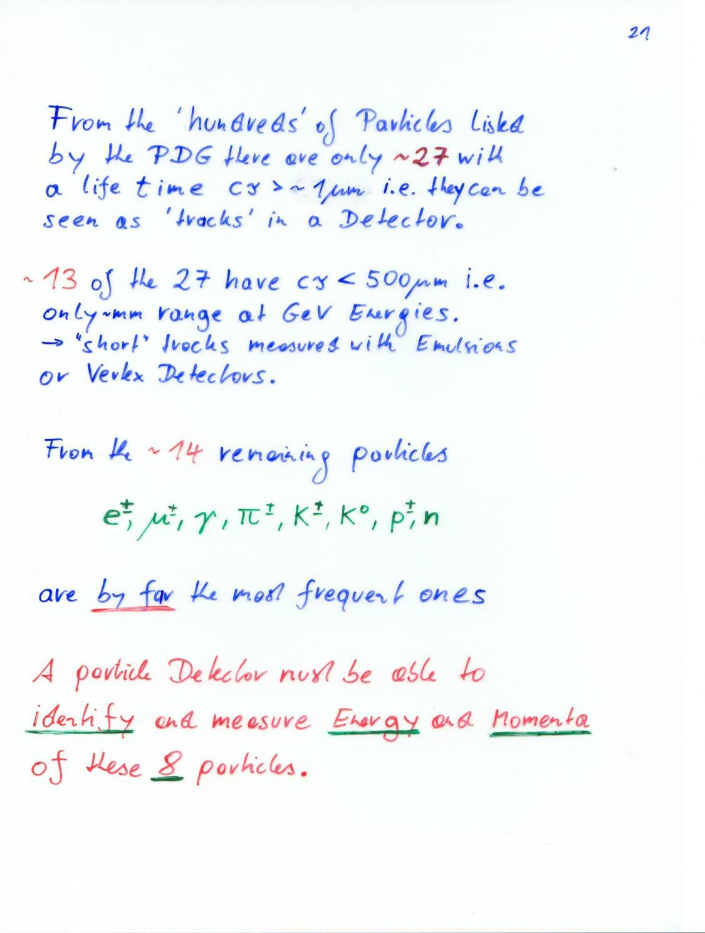

Slide 27
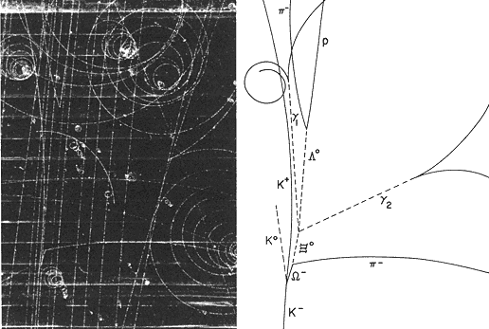

Slide 28
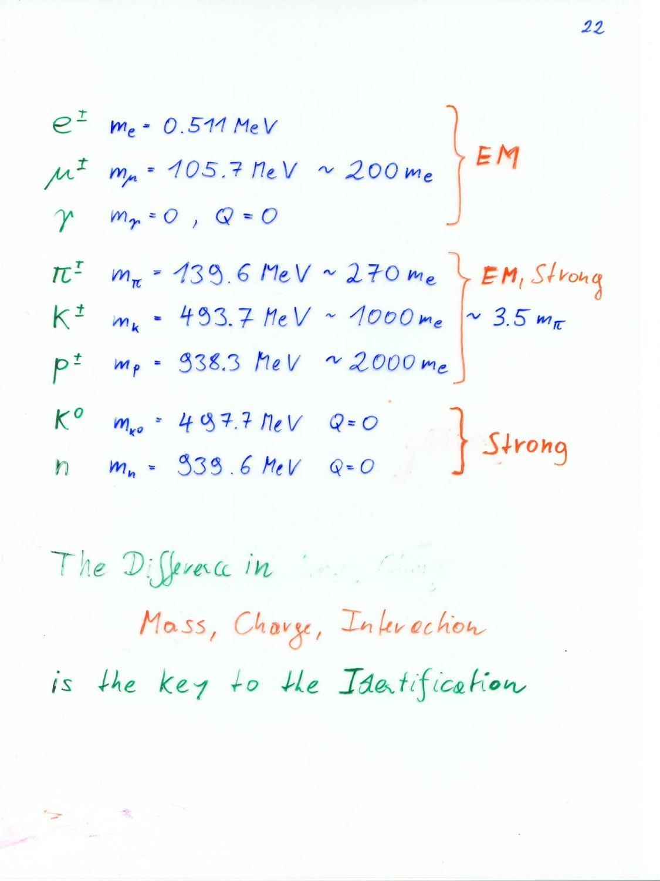

Slide 29
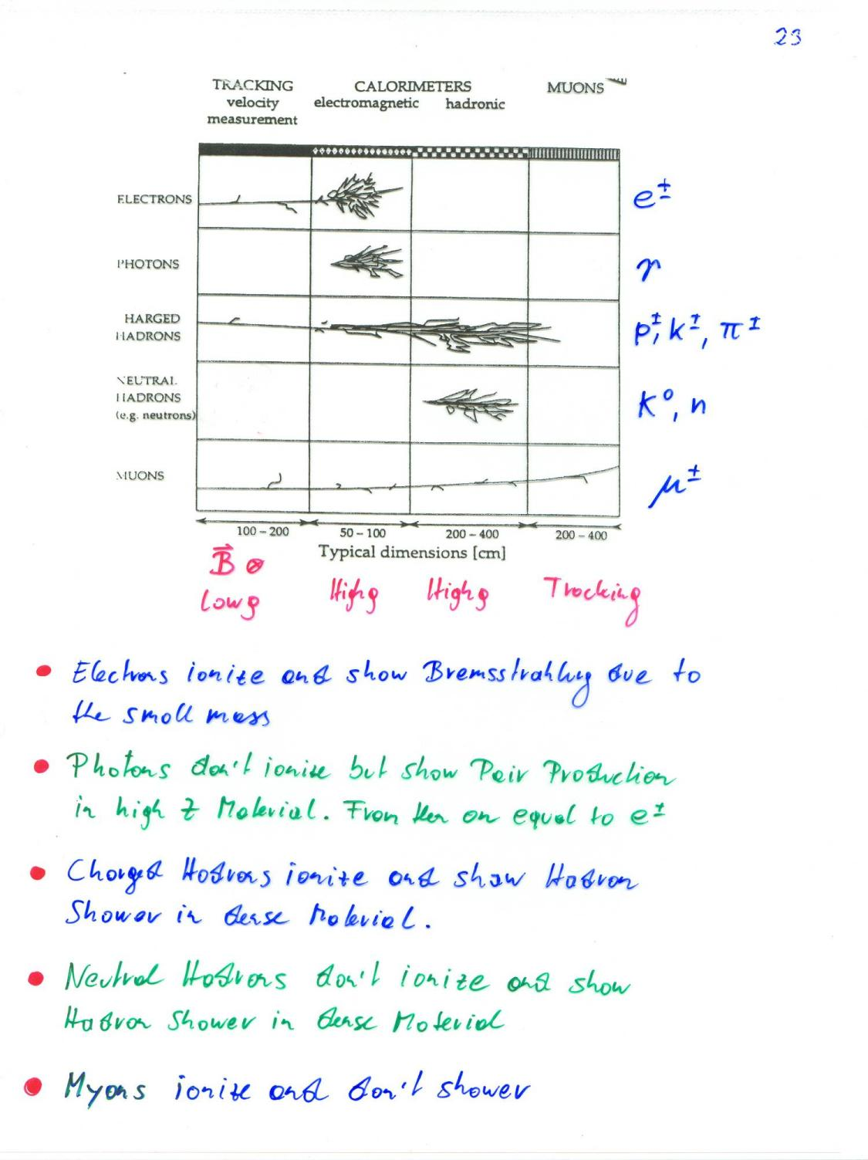

Slide 30
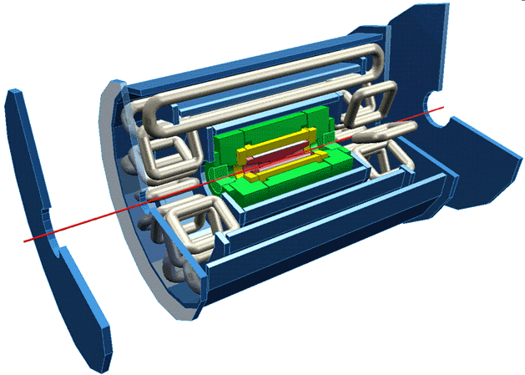
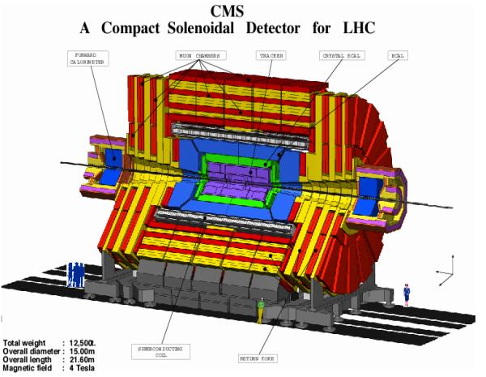
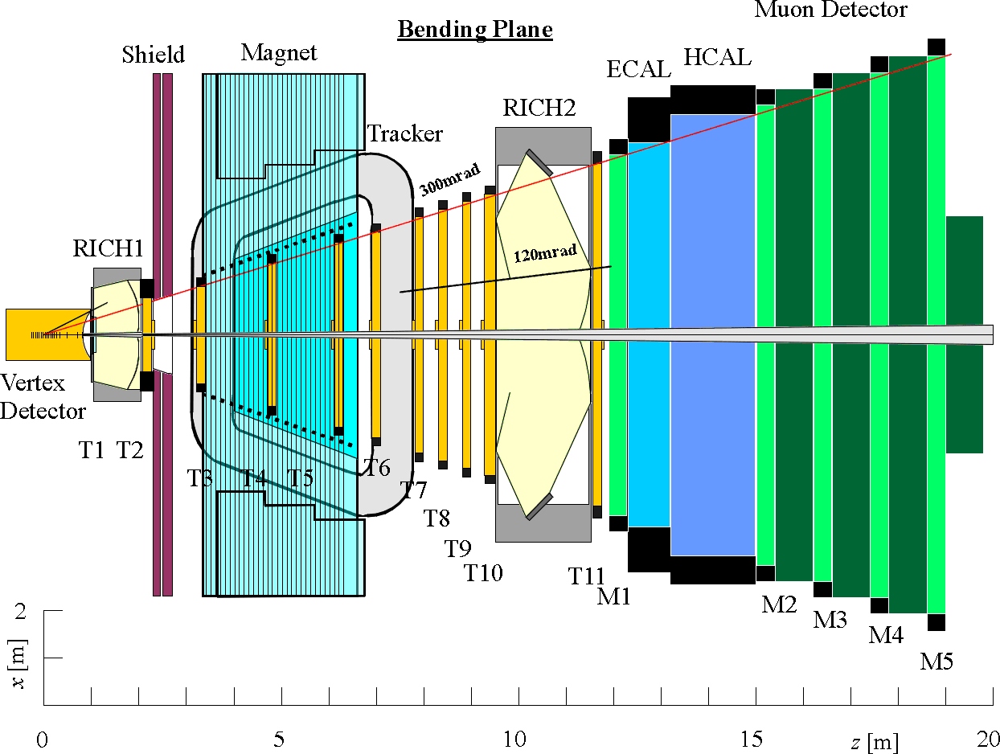
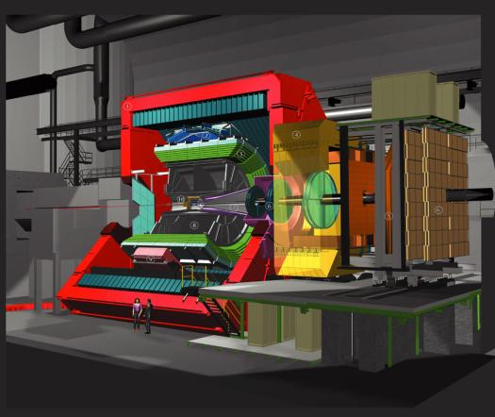
ATLAS
CMS
LHCb
ALICE

Slide 31
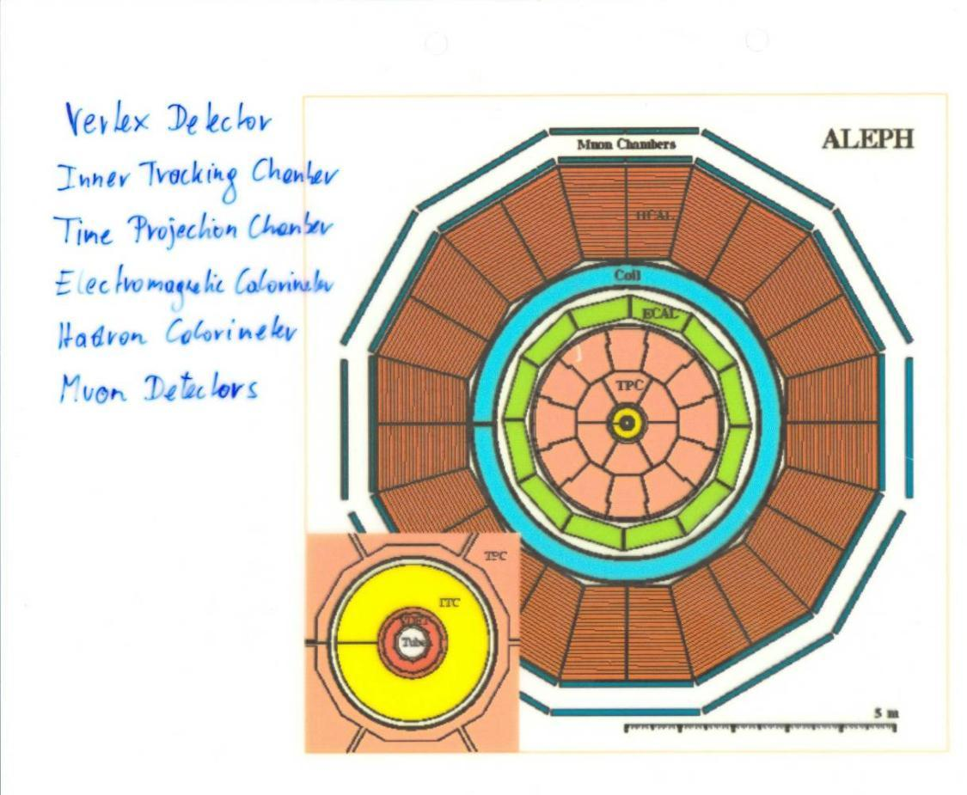

Slide 32
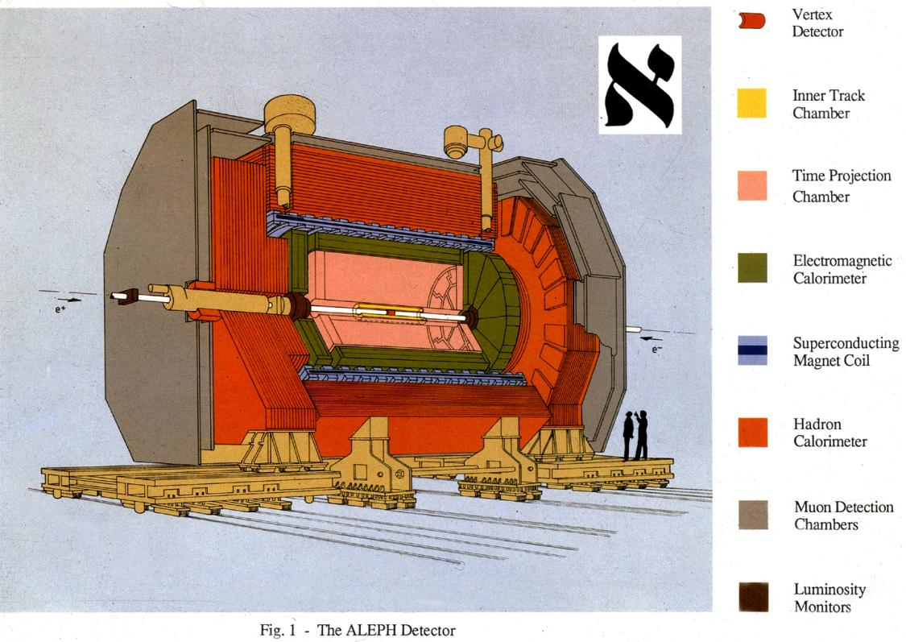

Slide 33
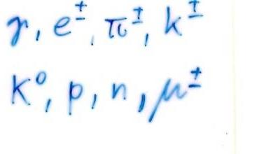
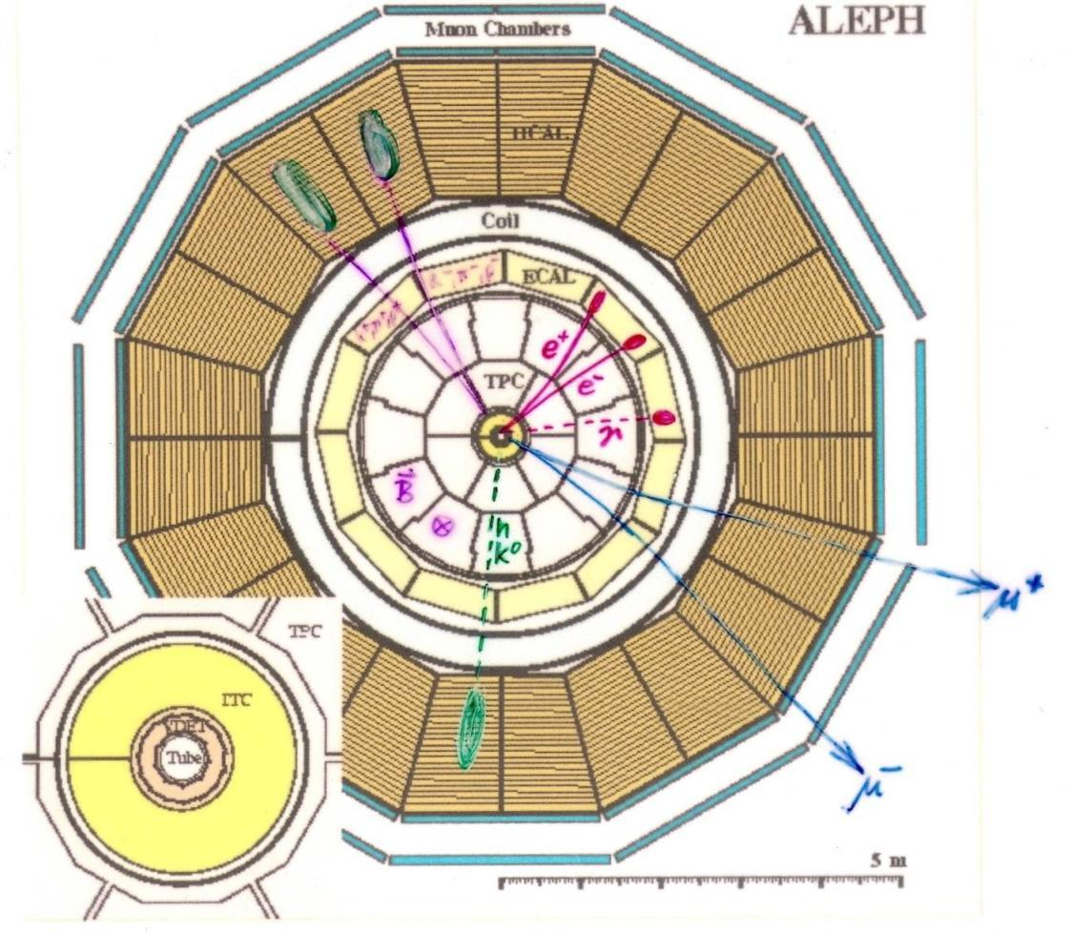

Slide 34

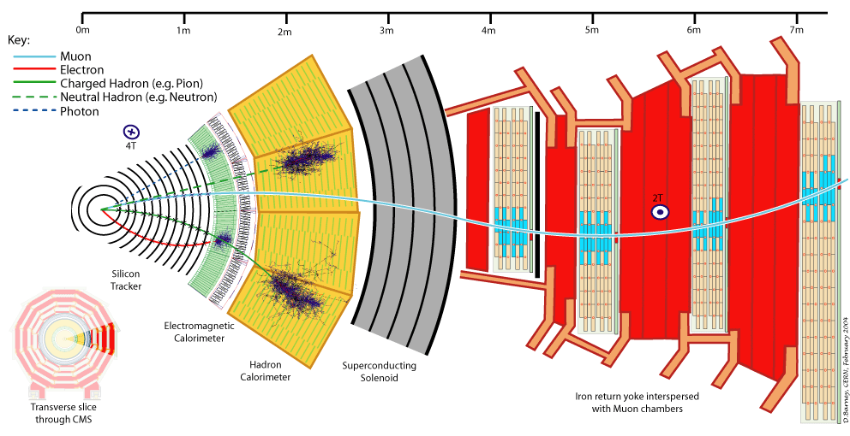

Slide 35
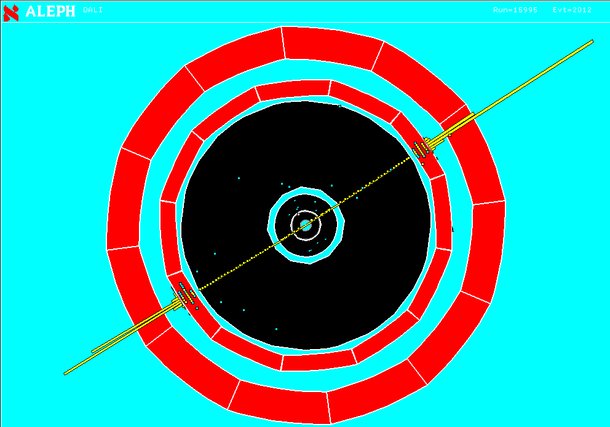
Z → e⁺ e⁻
Two high momentum charged particles depositing energy in the Electro Magnetic Calorimeter

Slide 36
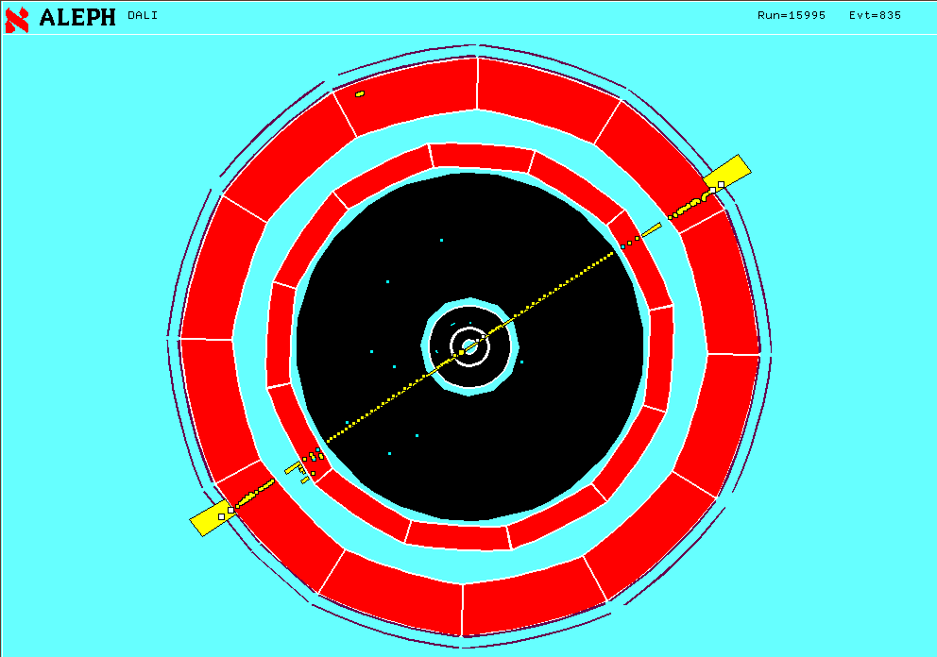
Z → μ⁺ μ⁻
Two high momentum charged particles traversing all calorimeters and leaving a signal in the muon chambers.

Slide 37
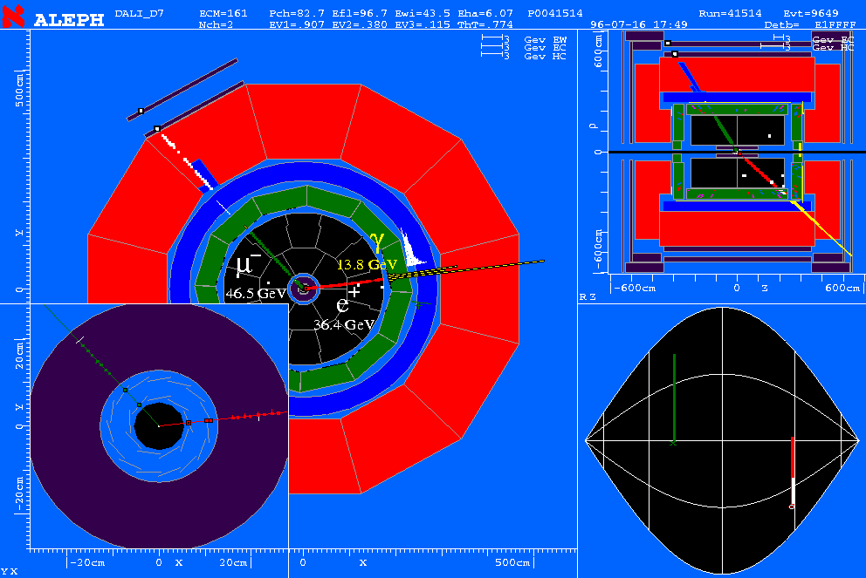
W⁺W⁻ → e+ m + n_{e}+n_{m}
Single electron, single Muon, Missing Momentum

Slide 38
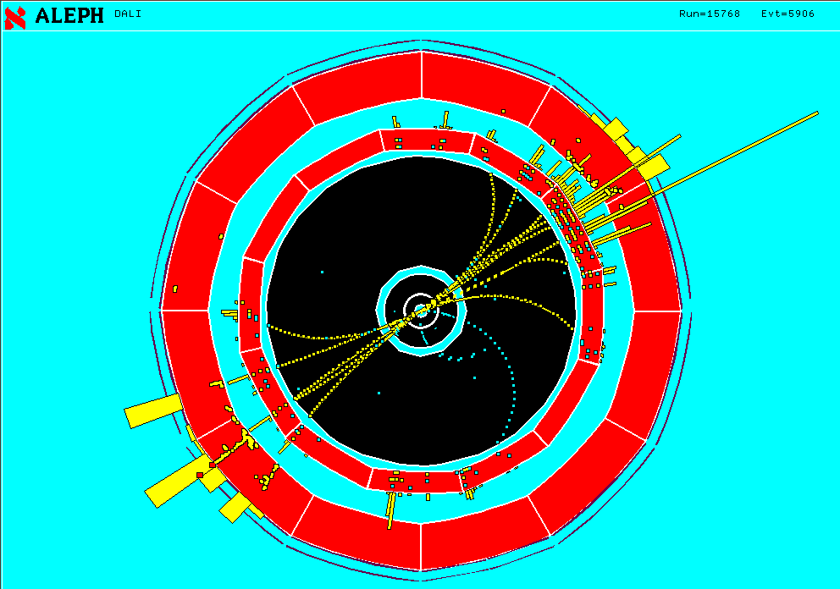
Z → q q
Two jets of particles

Slide 39
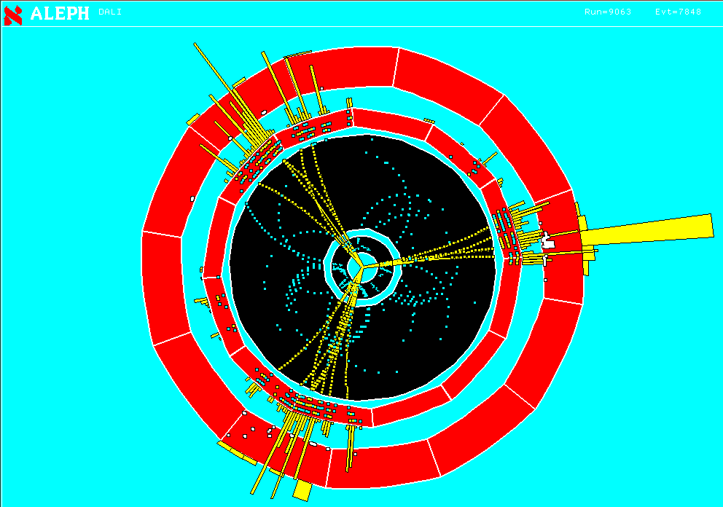
Z → q q g
Three jets of particles

Slide 40
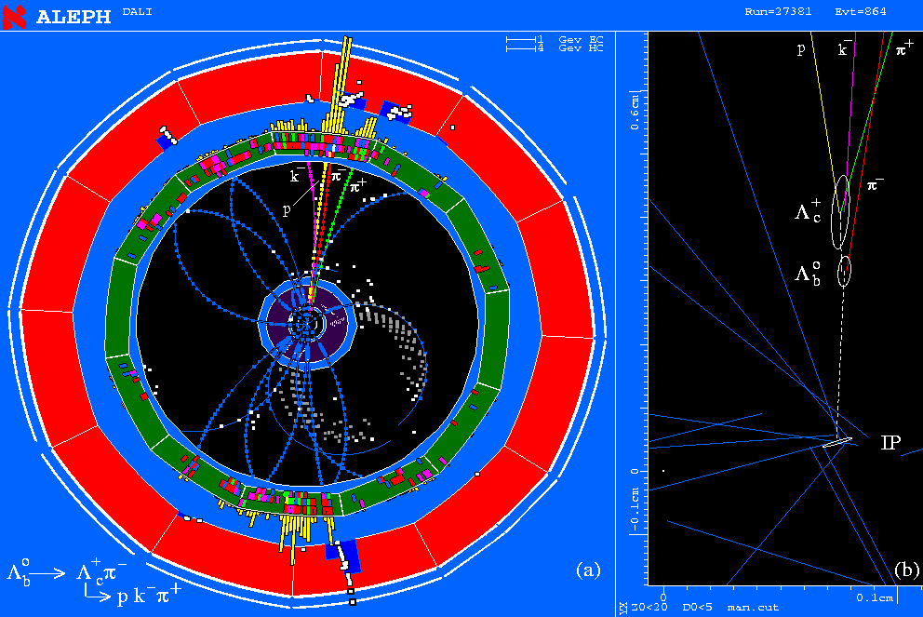
Two secondary vertices with characteristic decay particles giving invariant masses of known particles.
Bubble chamber like – a single event tells what is happening. Negligible background.

Slide 41
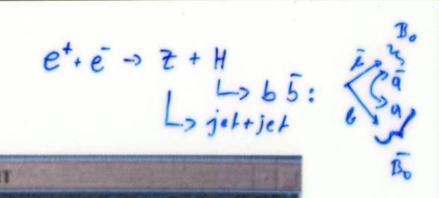
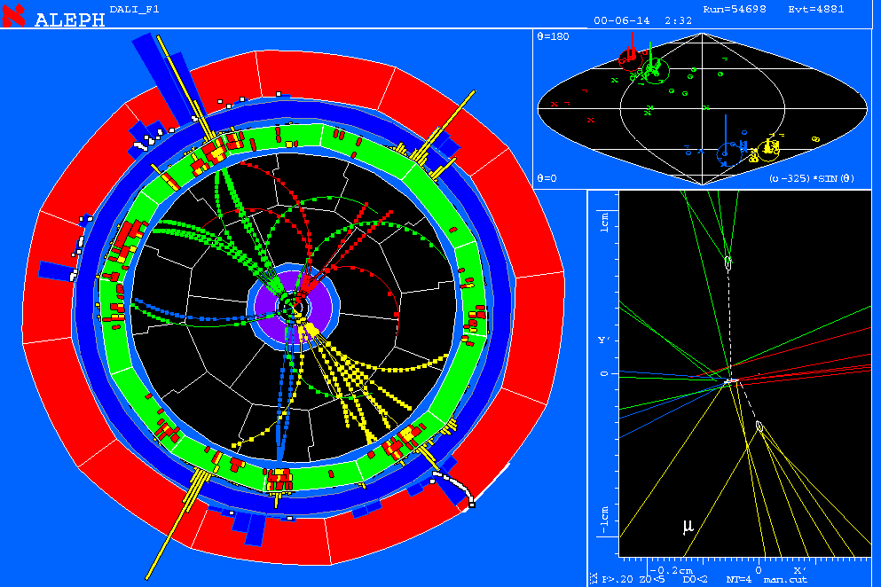
ALEPH Higgs Candidate
Undistinguishable background exists. Only statistical excess gives signature.

Slide 42
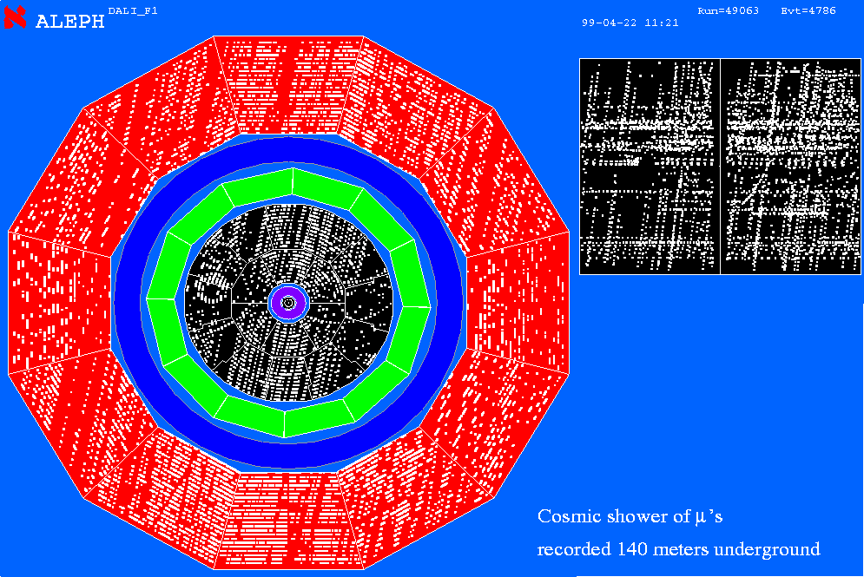
Cosmic Shower of Muons

Slide 43
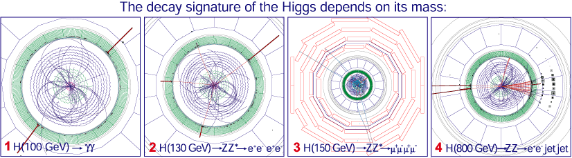
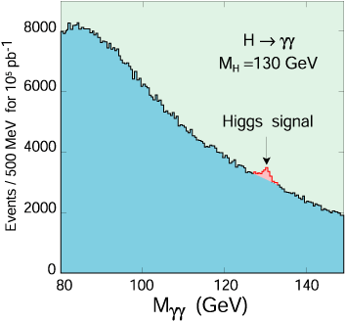
Higgs Boson at CMS
Particle seen as an excess of two photon events above the irreducible background.

Slide 44
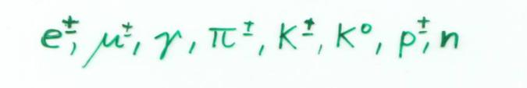
Conclusion:
Only a few of the numerous known particles have lifetimes that are long enough to leave tracks in a detector.
Most of the particles are measured though the decay products and their kinematic relations (invariant mass). Most particles are only seen as an excess over an irreducible background.
Some short lived particles (b,c –particles) reach lifetimes in the laboratory system that are sufficient to leave short tracks before decaying → identification by measurement of short tracks.
In addition to this, detectors are built to measure the
8 particles
Their difference in mass, charge and interaction is the key to their identification.

