Slide 1

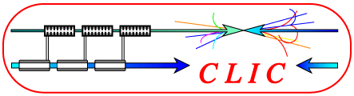

SiD Tracking Performance at 3 TeV in Presence of Beam Background
April 21, 2010
Christian Grefe
CERN, Bonn University
Notes:
1

Slide 2
Overview
Introduction
  Detector concept for CLIC
  Beam induced background
Overlaying background
Tracking efficiency
Momentum resolution
Performance of tracking algorithm
Notes:
2

Slide 3
CLIC Detector Concept
Precision instrument for e⁺e⁻ collisions
Optimized concept for 3 TeV
Detector will be operated at 500 GeV in a first stage
→ Start from existing ILC detector concepts and modify where necessary
Main differences from the detectors point of view:
  Higher Energy (more jet energy, higher density within jets, …)
  Higher beam induced background (high occupancy esp. in vertex)
  Less time between bunches (time stamping / time slicing)
  Less time between trains (power pulsing?)

Slide 4
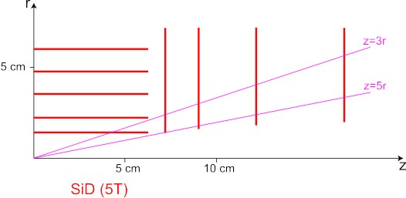
Modified SiD Tracker
Vertex and forward tracker:
  5 barrel layers and 7 disks of 20 x 20 µm² Si-pixels
  Modified layout to avoid pair background
Main Tracker:
  5 barrel layers and 4 disks of 9 cm x 25 µm Si-strip
+4.4cm
+4.8cm
+1.7cm
+1.6cm
+1.5cm
CLIC01_SiD (5T)
Forward Disk 1

Slide 5
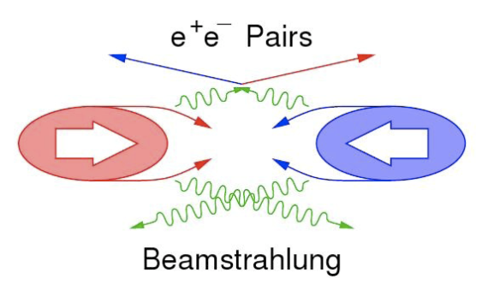
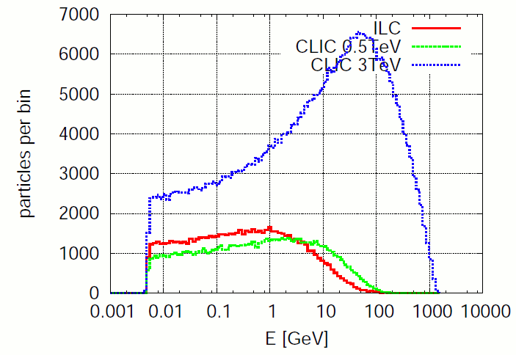
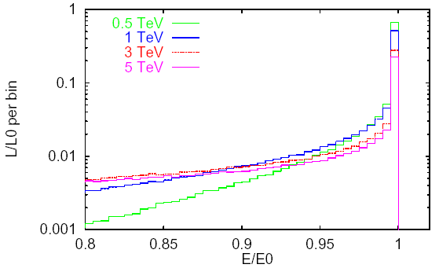
Beam Induced Background
Beamstrahlung:
  Oppositely charges bunches attract each other and create γ (ΔE/E = 29% @ 3 TeV)
Coherent pairs (3.8×10⁸ / BX)
  Very low angles, mostly disappear in the beampipe
Incoherent pairs (3.0×10⁵ / BX)
  Higher angles, need to be suppressed by solenoid field, problematic for VTX
γγ → hadrons (~3 / BX)
  “mini jets” spoiling the physics
Beamspectrum:
  Only 1/3 of luminosity in top 1% of energy
→ For now: only γγ → hadrons in sim & reco
D. Schulte

Slide 6
Overlaying LCIO Files
Implemented lcsim driver
  Define input LCIO files (no limit)
  Each LCIO can contribute different number of its events to the overlayed event
  Set which collections to merge (i.e. no need to merge calo hits for tracking studies)
  Feedback appreciated: lcsim-contrib/Grefe/overlayEvents
Procedure
  Simulate signal and background (1 BX per event) separately
  Merge desired amount of BX with signal LCIO
  Run reconstruction

Slide 7
SeedTracker Algorithm
Track finding begins by forming all possible 3 hit track seeds in the three “Seed Layers”
  Brute force approach to finding all possible track seeds
Require the presence of a hit in a “Confirmation Layer”
  Significantly reduces the number of candidate tracks to be investigated
Add hits to the track candidate using hits on the “Extension Layers”
  Discard track candidates with fewer than 7 hits (6 hits for barrel only tracks)
  If two track candidates share more than one hit, best candidate is selected
Upon each attempt to add a hit to a track candidate, a helix fit is performed and a global χ² is used to determine if the new track candidate is viable
Seed
Confirm
Extend
Richard Partridge

Slide 8
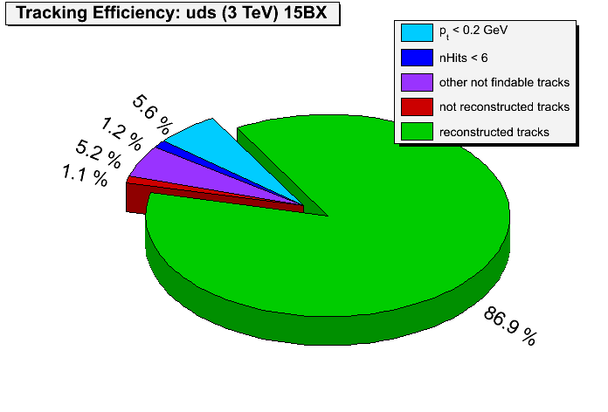
Tracking Efficiency
Strategy requirements from SiD
  At least 7 hits on the track
    Only 1 hit per layer
    Special barrel only strategy with 6 hits used to pick up low-p_{t} particles in the central region
  p_{T} > 0.2 GeV
  r - φ and s - z impact parameter cuts |d₀| < 1 cm and |z₀| < 1 cm
  χ² < 50 (χ² < 25 for 6-hit barrel only strategy)
A “findable track” fulfills these cuts
Define tracking efficiency as nReconstructed / nFindable
Only consider final state MCPs from the signal event for calculating efficiency

Slide 9
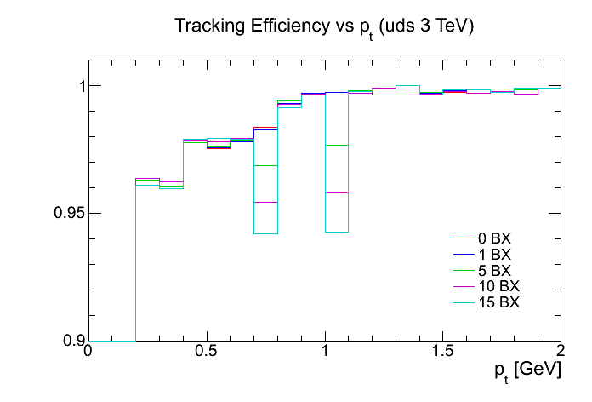
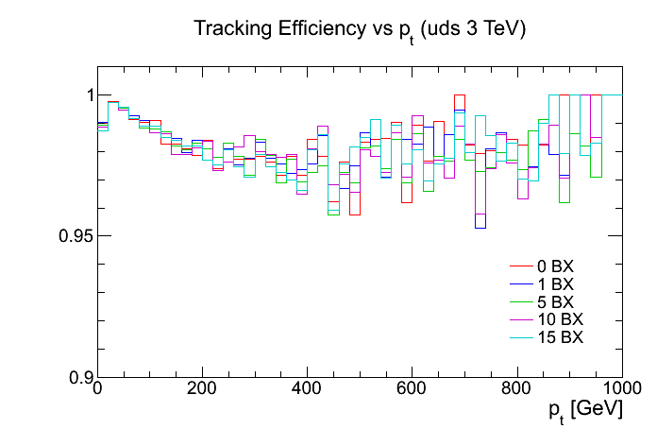
Tracking Efficiency vs. p_{t}
Cut-off by algorithm for p_{t} < 0.2 GeV
Lose some tracks for p_{t} < 1 GeV and p_{t} > 100 GeV
No difference when adding background (except for dips at 0.7 GeV and 1.0 GeV → needs to be understood)

Slide 10
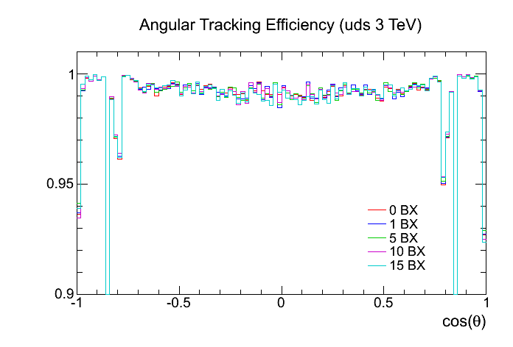
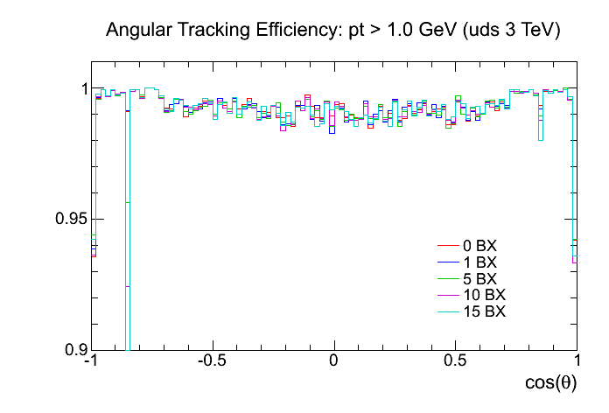
Tracking Efficiency vs. cos(θ)
Dips in efficiency at barrel-endcap-transitions for VTX and main tracker
Only low p_{t} tracks affected
Again no difference when adding background

Slide 11
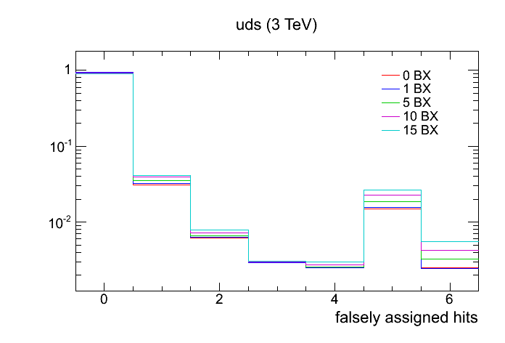
Fake Track Rate
Define MC particle contributing majority of hits to reco track as true MCP
More background leads to more confusion
  3% of reco tracks have 5 falsely assigned hits with 15 BX overlayed

Slide 12
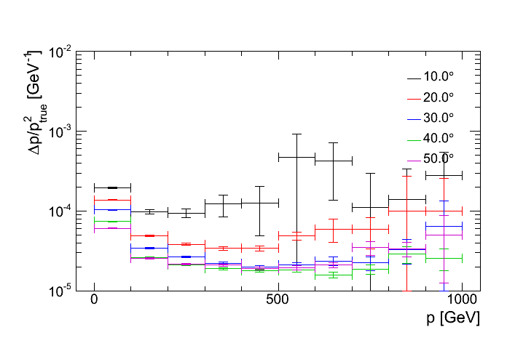
Momentum Resolution
Design goal for CLIC (and ILC): ∆p/p² ≈ 2*10⁻⁵ GeV⁻¹
  Driven by physics requirements, i.e. e⁺e⁻ → ννH⁰ → ννμ⁺μ⁻
Fulfilled for angles > 20°
Loss of resolution for high p (should be flat)

Slide 13
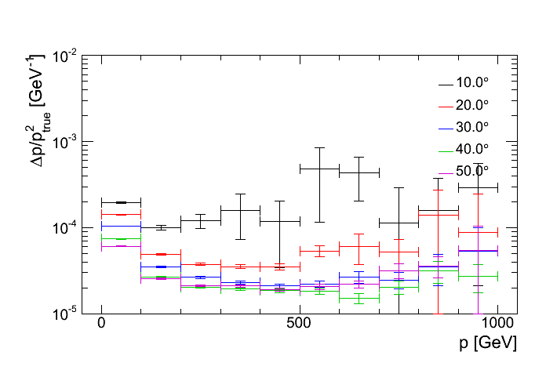
Momentum Resolution
Only marginal changes in resolution when adding background

Slide 14
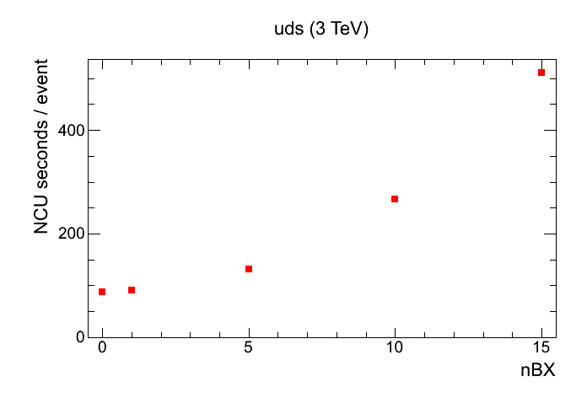
Performance of Tracking Algorithm
Computing performance does not scale when adding background

Slide 15
Conclusion & Outlook
Modifed geometry of SiD02 → CLIC01_SiD
Implemented flexible driver for overlaying LCIO files
Simulation and reconstruction for z → qq (uds) @ 3 TeV, including up to 15 BX of γγ → hadrons background:
  Tracking efficiency: OK
  Momentum resolution: OK
  Computing performance: does not scale
Future Plans:
  Overlay pair background as well
  Add more BX, see if efficiency breaks down
Need to understand high p behavior

Slide 16
Further Things ongoing
Produce efficiency plots for more channels
  Stau / tau : dense lepton “jets”
  tt : dense hadronic jets
Impact parameter resolution
  bb / HA -> bbbb

