Slide 1
Two-bunch operation for Compact Light:
sub-harmonic transverse deflector system design
and long-range transverse wakefield optimization
Xiaowei Wu, Walter Wuensch
xiaowei.wu@cern.ch
27.5.2020

Slide 2
outline
1. Introduction to Compact Light
2. Sub-harmonic transverse deflector system design
3. Long-range transverse wakefield optimization

Slide 3
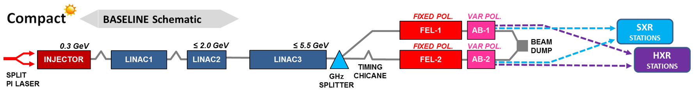
Layout of Compact Light
FEL structure
Injector
Main linac
1000 Hz soft X-ray
100 Hz hard X-ray
C-band gun&injector
X-band structure
A compact free electron laser based on X-band technology
Two-bunch operation for pump-and-probe experiment
Produce 100 Hz hard X-ray (2.0 - 16.0 keV) and 1000 Hz soft X-ray (0.25 - 2.0 keV) with same installed linac
Design project funded by European Union Horizon 2020

Slide 4
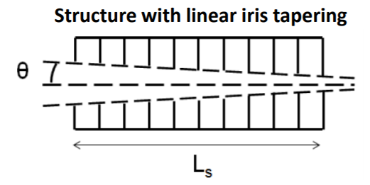
Compact Light X-band structure
108-cell 2π/3 traveling-wave structure
* Courtesy by M. Diomede
Parameter | Value
Frequency [GHz] | 11.9942
Phase advance per cell [rad] | 2π/3
Shunt impedance R [MΩ/m] | 90-131
Effective shunt Imp. R_{s} [MΩ/m] | 387
Group velocity v_{g} [%] | 4.7-1.0
P_{out}/P_{in} | 0.215
Filling time [ns] | 144
Number of cells per structure | 108
# structures per module N_{m} | 4
Module active length L_{mod} [m] | 3.6
Average iris radius <a> | 3.5
Iris radius input-output [mm] | 4.3-2.7
Structure length L_{s} [m] | 0.9
 | Rep. rate [Hz]
 | 100 | 1000
Average gradient <G> [MV/m] | 65 | 30.4
Max klystron available output power [MW] | 50 | 10
Required input power per module P_{K} [MW] | 39 | 8.5
RF pulse [µs] | 1.5 | 1.5
Av. diss. power per structure [kW] | 1 | 2.2
Peak input power per structure [MW] | 68 | 14.8
Av. Input power per structure [MW] | 44 | 9.6
Module energy gain [MeV] | 234 | 109

Slide 5
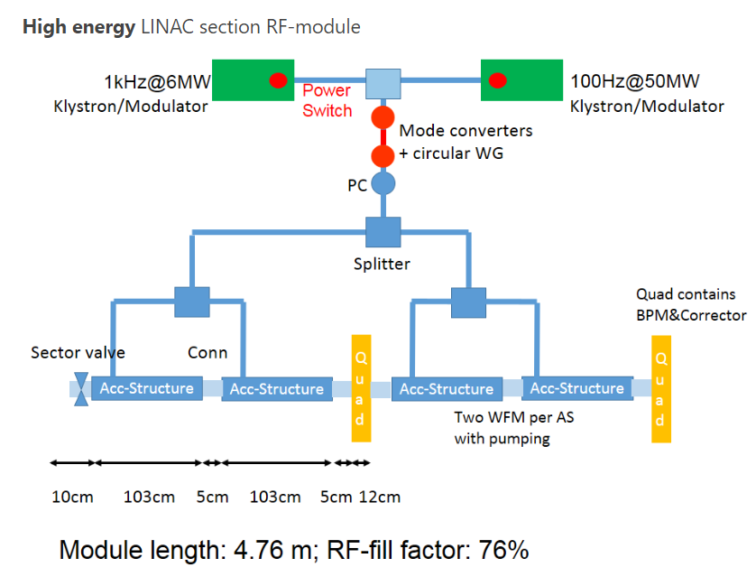
Compact Light linac module
* Courtesy by M. Aicheler
4 X-band structures in 1 rf module
Dual rf source (100 Hz and 1000 Hz)
With pulse compressor to increase the peak power
Module energy gain: 234 MeV@100 Hz
109 MeV@1000 Hz

Slide 6
Linac layout
1000 Hz soft X-ray
100 Hz hard X-ray
Main linac
main linac works at 67 deg off crest
BC1
BC2
Linac0
Linac1
Linac2
Linac3
H/S XR
3 C-band 2(4)X-band
16 X-band
8 X-band
68 X-band
1-str beween quads
2-str beween quads
2-str beween quads
4-str beween quads
100 Hz
300 MeV
1.16 GeV
1.59 GeV
5.25 GeV
hard X-ray
1000 Hz
150 MeV
0.55 GeV
0.75 GeV
2.46 GeV
soft X-ray

Slide 7
outline
1. Introduction to Compact Light
2. Sub-harmonic transverse deflector system design
3. Long-range transverse wakefield optimization

Slide 8
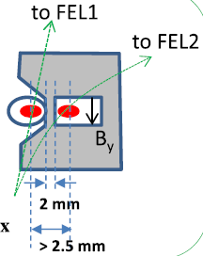
Bunch splitter before FEL structure
1000 Hz soft X-ray
100 Hz hard X-ray
Need a splitter to separate the two bunches into two FEL lines
Distance between the two bunches should be over 2.5 mm at the entrance of septum
Splitter
x=2.5 mm
y=drifting length

Slide 9
Sub-harmonic delfector and spacing between two bunches
Δt = n τ_{gun}, n = 1,3,5...
Δs = n λ_{gun}
n (C-band) | Δt | Δs
1 | 166 ps | 50 mm
3 | 500 ps | 150 mm
5 | 833 ps | 250 mm
7 | 1.16 ns | 350 mm
9 | 1.5 ns | 450 mm
n (X-band) | n (S-band)
2 | 0.5
6 | 1.5
10 | 2.5
14 | 3.5
18 | 4.5
Gun 6 GHz C-Band
E
Linac
12 GHz X-Band
E
Spacing between the two bunches should be 2, 6, 10, 14… X-band rf cycles
Sub-harmonic delfector
3GHz
S-band
E┴
Sub-harmonic delfector
2.5 mm
drifting length
* Courtesy by N. Thompson

Slide 10
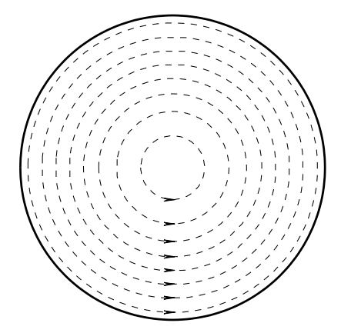
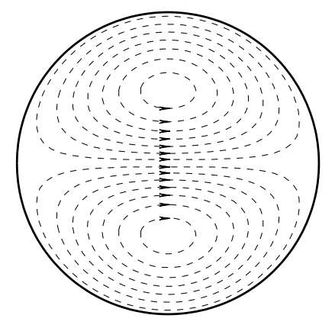
TM110 mode in transverse deflecting cavity
Transverse magnetic field of TM010 and TM110 in pillbox cavity
TM010 mode
TM110 mode
Accelerating mode
Dipole mode
Transverse kick to beam

Slide 11
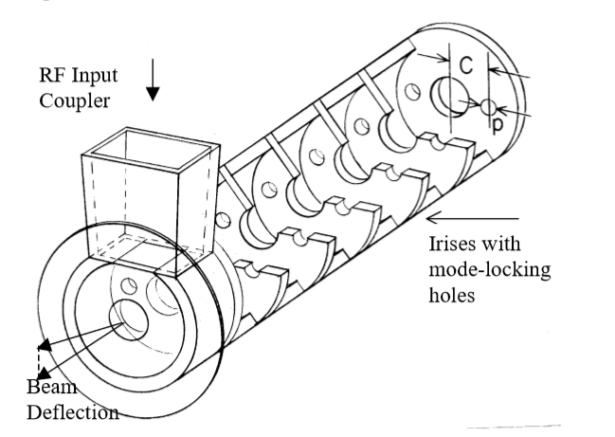
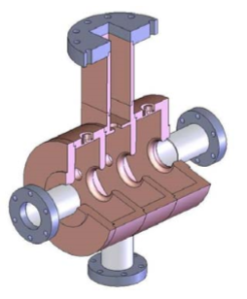
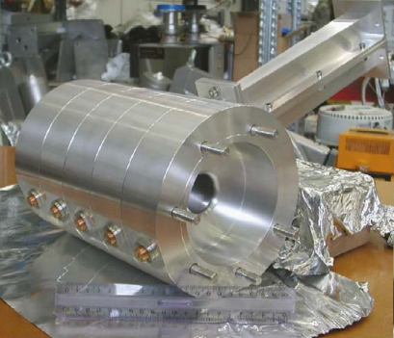
Transverse deflecting cavity (TDC) design
Traveling-wave structure
Hard X-ray mode: 5.5 GeV bunch
x=2.5 mm, y is drift length
SLAC type LOLA TDC
TM110, 2π/3 mode
Length=2.4 m
Filling time~ 300 ns
TDC
x=2.5 mm
y=drifting length
Standing-wave structure
Voltage of deflector could be reduced if we increase the drift length
Longer drift length makes standing-wave deflecting cavity possible
Three options for the transverse deflecting cavity
1. Traveling-wave structure
2. Standing-wave structure, 3-cell structures
3. Standing-wave structure, 5-cell structures
Loew, G. A., & Altenmueller, O. H. DESIGN AND APPLICATIONS OF RF DEFLECTING STRUCTURES AT SLAC. 1965
Shi, J. phD thesis. 2009
Alesini, D., et al. RF deflector design and measurements for the longitudinal and transverse phase space characterization at SPARC. Nucl. Instrum. Methods Phys. Res. A, 568(2), 488-502. 2006
Tsinghua University type 3-cell structure
INFN type 5-cell structure
Notes:
700 ns SW filling time

Slide 12
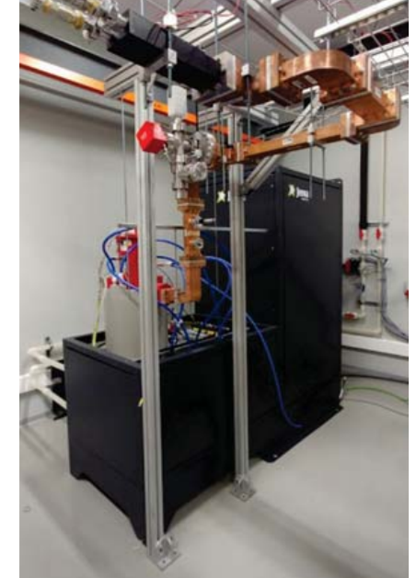
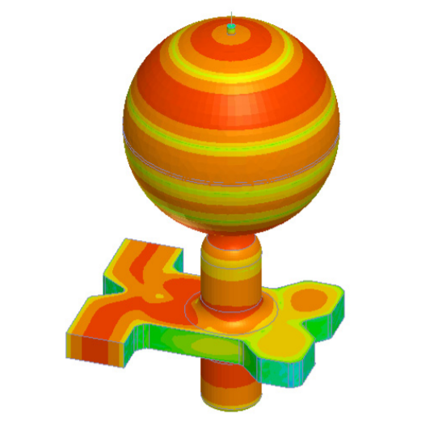
Power capability
CPI S-band Klystron (VKS8262G1):
7.5 MW, 5.0 μs, 400 Hz flat pulse
already applied in IFIC S-band test stand in Valencia
With spherical pulse compressor:
39.7 MW, 300 ns (Avg. without loss) compressed pulse
Spherical pulse compressor
frequency | 2.998 GHz
Q0 | 100000
Coupling factor | 7
Compression ratio | 15
Peak power gain | 7.15
Average power gain | 5.29
Esperante Pereira, Daniel, et al. "Construction and Commissioning of the S-Band High-Gradient RF Laboratory at IFIC." J. Phys. Conf. Ser.. Vol. 1067. 2018.

Slide 13
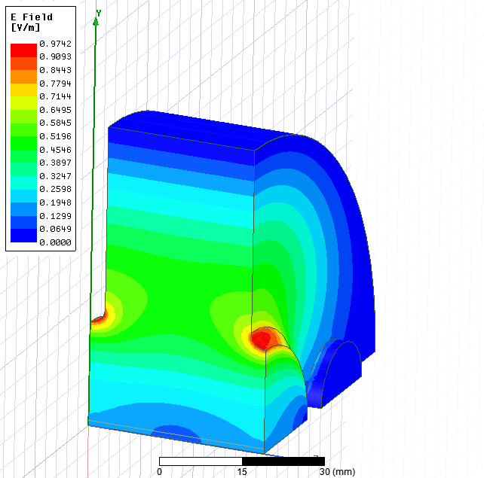
Traveling-wave transverse deflecting structure design
Increasing the drift length can reduce the length of traveling-wave structure
Work at 2π/3 mode
6 MW 4.5 μs klystron pulse
30 MW 300 ns compressed pulse
TW TDC
x=2.5 mm
y=drifting length
Freq [GHz] | 2.998
R [MΩ/m] | 20
Q | 12000
v_{g}/c [%] | 3
Drift length [m] | Deflecting voltage [MV] | Traveling wave (2π/3)
 |  | Input power [MW] | Stru. Length w/ PC [m] | Stru. Length w/o PC [m]
0.5 | 13.75 | 6 | 1.45 | 3.65
1.0 | 6.875 | 6 | 0.70 | 1.64
1.5 | 4.583 | 6 | 0.46 | 1.06
2.0 | 3.438 | 6 | 0.35 | 0.79
Notes:
1 m=111 ns

Slide 14
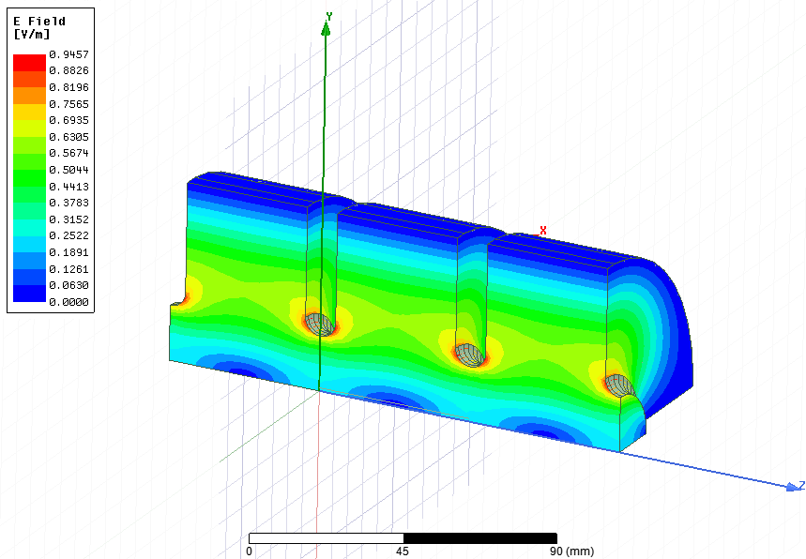
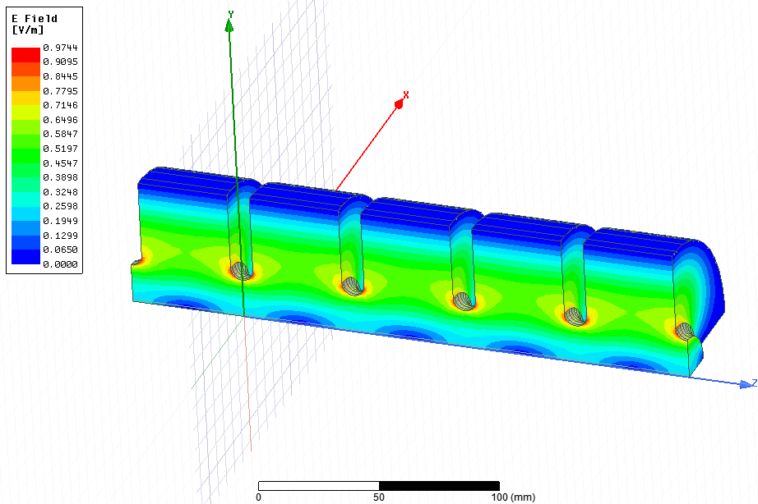
Standing-wave transverse deflecting structure design
TM110 Eigen mode results
3-cell structure
5-cell structure
R [MΩ] | Freq [MHz] | Q
3.03 | 2996 | 15337
R [MΩ] | Freq [MHz] | Q
5.02 | 2996 | 15271

Slide 15
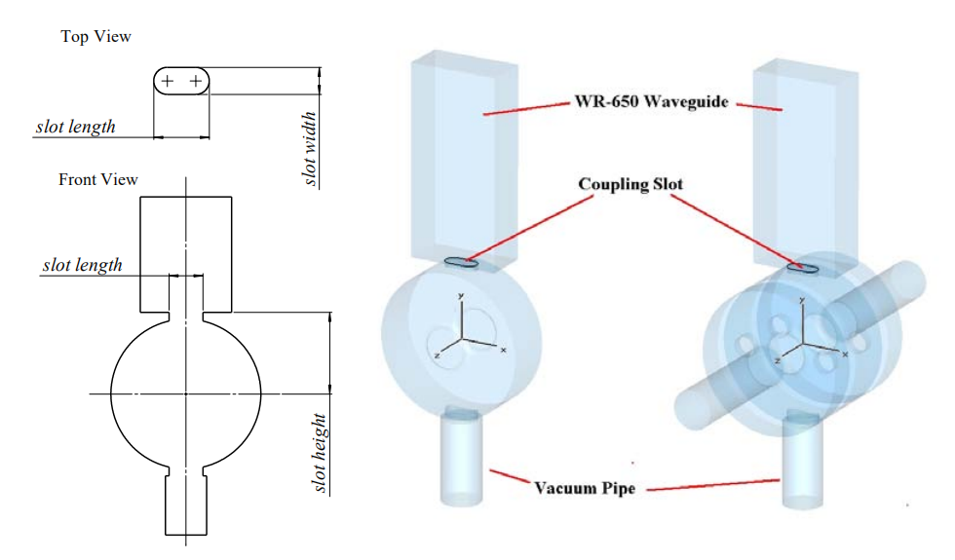
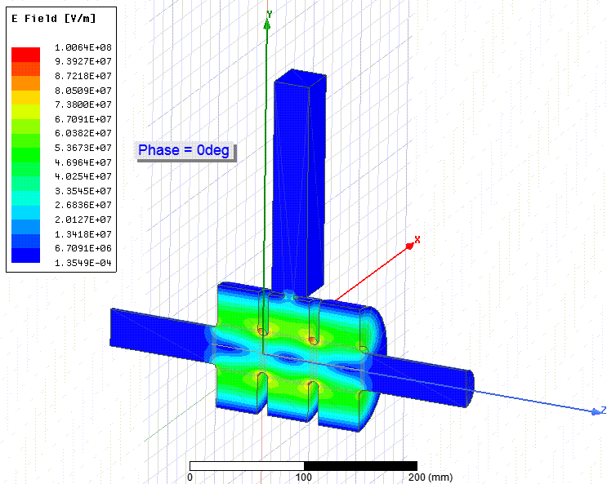
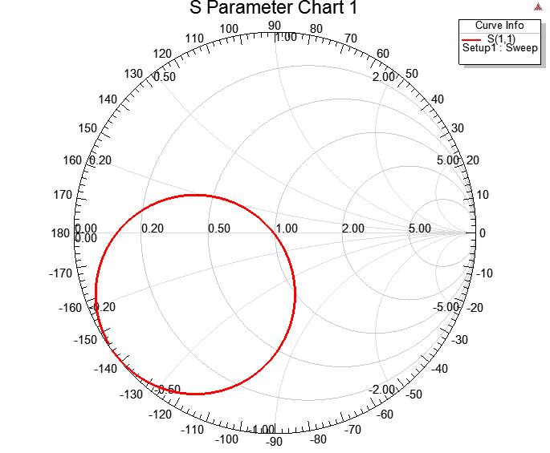
3-cell standing-wave TDC coupler design
Use race track shape coupling hole
4.14 MV deflecting voltage @ 6 MW input power
Maximum surface field around 100 MV/m
Filling time~820 ns

Slide 16
TDC System design
HXR mode: 5.5 GeV bunch
x=2.5 mm, y is drift length
Traveling-wave structure
Standing-wave structure
TDC
x=2.5 mm
y
Two options for the transverse deflecting cavity
1. Traveling-wave structure
2. Standing-wave structure
RF parameters
Power capability
2998 MHz | Traveling-wave (2π/3) | Standing-wave
Cell number | N | 3/5
Single cell length [m] | 0.033 | 0.05
Structure length [m] | N*0.033 | 0.15/0.25
Shunt impedance [MΩ/m] | 15.3 | 20
Klystron: VKS8262G1 model built by CPI
Maximum rf peak power of 7.5 MW→6 MW within loss
Pulse length of up to 5 μs
Repetition rate of 400 Hz
Pulse compressor: spherical pulse compressor
Increase the average power:
6 MW, 4.5 us →40 MW, 300 ns (Avg.)
Notes:
700 ns SW filling time

Slide 17
Drift length [m] | Deflecting voltage [MV] | Input power [MW] | Traveling-wave (2π/3) |  | Standing-wave
 |  |  | Stru. Length w/ PC [m] | Stru. Length w/o PC [m] | Stru. length [m]
1.66 | 4.14 | 6 | 0.42 | 1.06 | 0.15
Traveling-wave
Use the maximum output power (6 MW with loss) from VKS8262G1
1. Klystron, pulse compressor, 0.42 m traveling-wave structure
2. Klystron, circulator, 0.15 m standing-wave structure
30 MW
70 ns (AVG)
6 MW
0.8~1 us
PC
Klystron
TW
0.42+1.66=2.08 m
Standing-wave+Circulator
6 MW
0.7~1 us
Klystron
Cir
SW
0.15+1.66=1.81 m
Notes:
700 ns~800 ns SW filling time
50 ns 0.44 m TW filling time

Slide 18
outline
1. Introduction to Compact Light
2. Sub-harmonic transverse deflector system design
3. Long-range transverse wakefield optimization

Slide 19
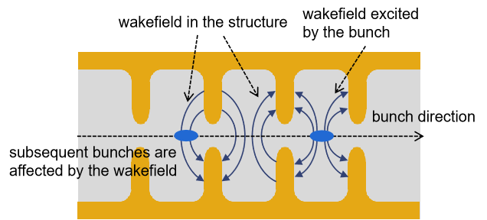
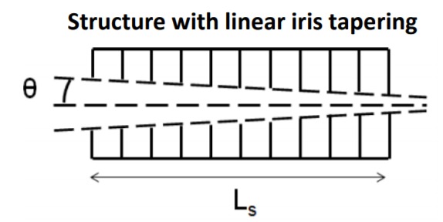
Long-range transverse wakefield problem
In the two-bunch operation, wakefield excited by the first bunch will affect the second bunch
Baseline design is cylinder tapering cavity without heavy damping part
Check the wakefield at 2nd, 6th, and 10th X-band rf cycle (sub-harmonic at S-band)

Slide 20
Long-range transverse wakefield of the Compact Light X-band structure
1. Analytical results from formula
Dipole wake:
2. Numerical results from GdfidL*
Numerical and analytical results have a good agreement
We can estimate the wake by analytical methods and then use GdfidL to verify
The long-range transverse wakefield goes down automatically ☺
X-band linac structure has a tapered iris design
Structure cells have different dipole mode frequency
Wake at 2nd rf cycle is much higher than the requirement (40 V/pC/mm/m) ☹
Wake at 6th rf cycle is a bit higher than the requirement
Wake at 10th rf cycle is around 20 V/pC/mm/m
P. B. Wilson, SLAC-PUB-4547
*The GdfidL Electromagnetic Field Simulator: bruns@gdfidl.de

Slide 21
Wakefield optimization
Detuning by using non-linear frequency distribution
Adjust the dipole mode frequency distribution by changing the coupling irises and the diameters of the cells
Optimize the wake by changing the curvature of the aperture distribution
Linear distribution (Blue) is the existing baseline design
Enhanced-bandwidth distribution (Pink) reduces the wake at 6th rf cycle
Gaussian-like distribution (Red) reduces the wake at 10th rf cycle
Baseline design’s aperture:
from 4.278 mm to 2.722 mm
Notes:
Adjust the frequency of the dipole mode by diameter of the cell
如何引出利用aperture来改变geometry？
Developed by the linear accelerator society and well applied in the linear collider people
Enhanced-bandwidth
Gaussian-like

Slide 22
Enhanced-bandwidth distribution optimization at 6th rf cycle
Cycle number (X-band) | Wt [V/pC/mm/m] | Enhanced Wt [V/pC/mm/m]
6 | 45.3 | 25.7
10 | 21.2 | 41.5
Possible for 6th rf cycle operation but delicate
GdfidL results
Notes:
-1.8

Slide 23
Gaussian-like distribution optimization at 10th rf cycle
Cycle number (X-band) | Wt [V/pC/mm/m] | Gaussian Wt [V/pC/mm/m]
6 | 45.3 | 64.5
10 | 21.2 | 1.8
Even lower wakefield at 10th rf cycle and robust
GdfidL results
Notes:
3.4

Slide 24
Long-range transverse wake at 10th rf cycle in the linear tapering design
Apply linear iris thickness distribution to the Gaussian-like aperture design
Origin design has a constant iris thickness
This could reduce the average wake around 10th rf cycle
Robust and low wakefield at 10th rf cycle

Slide 25
RF parameter comparison between two taperings
* Courtesy by M. Diomede
CompactLight | baseline design | Gaussian aperture linear iris thickness
Frequency [GHz] | 11.9942
RF pulse [µs] | 1.5
Net kly. power (w/ loss) [MW] | ≈40
Average iris radius <a> | 3.5
Iris radius a [mm] | 4.3-2.7
Iris thickness t [mm] | 2.0 | 2.0-2.24
Average gradient <G> [MV/m] | 65 MV/m (w/ margin) | 65 MV/m (no margin)
Structure length L_{s} [m] | 0.9
Shunt impedance R [MΩ/m] | 90-131 | 90-125
Effective shunt Imp. R_{s} [MΩ/m] | 387 | 378
Group velocity v_g/c [%] | 4.7-1 | 4.7-0.9
Filling time [ns] | 144 | 146
Max. Mod. Poy. Vec. - 10⁻⁶ bpp/m limit [%] | -32.7 | -29.7
No big difference on rf parameters
Apply Gaussian-like aperture and linear iris thickness distribution to the baseline design
Choose 10 X-band rf cycles as the two bunch spacing

