Slide 1
Energy Frontier
Snowmass 2020-2021
Alessandro Tricoli (BNL)
Laura Reina (FSU)
Meenakshi Narain (Brown)

Slide 2
The future of HEP
The international HEP community is planning for future projects. Several regional communities are going through processes to build vision and agree on a strategy for future projects.
All of us together have to develop an approach to how to suggest “what projects to do next”.
Final decision belongs to funding agencies. They need input from us to decide how to spend money!
Important points in providing recommendations:
  The science has to be excellent.
  The selection process has to be community wide.
  We all have to agree to the process and support the outcome.

Slide 3
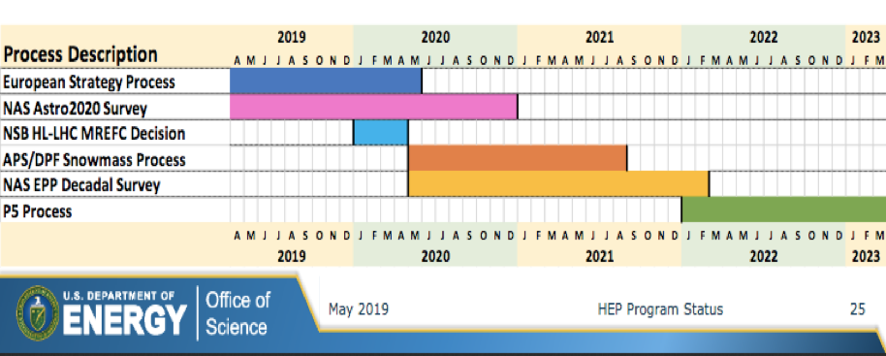
International Timeline
Snowmass Final Report: Fall 2021
NAS (National Academy of Sciences) Decadal Survey Report: end 2020 or very early 2022

Slide 4
The Snowmass Process
Why this Snowmass?
  New science and technological developments accumulated over past ~8 years.
  Beyond 2026 funding in HEP is expected to become available for “next large/medium projects”.
  New proposals have to be developed in advance.
Good proposal includes:
  Excellent physics goals.
  Technical implementation description.
  Feasibility in terms of cost and schedule.
To develop a proposal at least a year of concentrated efforts is required.
  Preparations of the new proposals have to start now.
Projects already listed in previous P5 plan and under execution are not expected to be the focus of the discussion, unless projections need updating.
Examples:
  Detector upgrades beyond HL-LHC, but we must stress that HL-LHC is a critical stepping stone to any future exp.
  FCC, ILC, CLIC, muon collider, and colliders in China.
  Various cosmic and dark matter experiments.
Joint efforts between labs and universities and in close cooperation with international community

Slide 5
The Snowmass Organisation
Snowmass Process is organized by the DPF of the APS.
Snowmass is an opportunity for the entire HEP community to come together to identify and document a vision for the future of particle physics in the U.S. and its international partners:
  It is a year and ½ process.
  10 Frontiers have been created.
  We aim for everyone's voice to be heard.
  Various Town Halls and Community planning meetings for communication and feedback.
  Various Workshops will be organized by Frontiers, bi-weekly meetings of Topics Groups.
  Letters of Interest and Contributed Papers are encouraged.

Slide 6
USA Strategic Planning Timeline
To provide timely input to the next P5 report will be required by March 2023.
U.S. Community Snowmass process with major meeting in Summer 2021.

Slide 7
Snowmass Timeline & Milestones
January 2020: Announcement of Frontier conveners and 2021 Snowmass site.
2020 APS April meeting (April 18 – 21): Town Hall meeting to communicate with the community (attendance of > 800 people).
April 2020 - July 2021: Developing proposals, workshops, interactions inside the community.
Paper contributions:
  August 31, 2020: Deadline for submission of “Letters of Interest”:
    2 pages with descriptions of proposal and citation of the relevant papers (instructions) to be eventually turned into contributed papers in preparation for the Community Planning Meeting.
  July 31, 2021: Deadline for submission of “Contributed Papers”:
    Contributed papers will be part of Snowmass Proceedings (submission instructions).
Community Planning Meeting, at FNAL: November 4-6, 2020.
July 11 - 20, 2021: Snowmass Summer Study at UW Seattle.

Slide 8
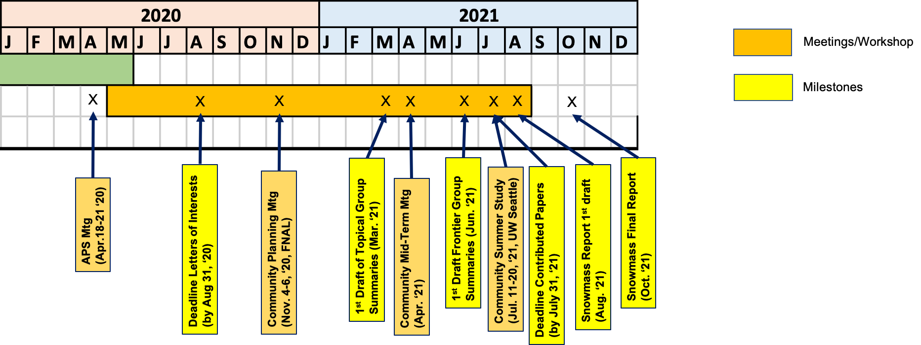
Snowmass Timeline
Several community-wide meetings with all Frontiers will be arranged leading to the Summer Study in Seattle, July 11-20, 2021.
Several milestones for contributions and reports throughout the process leading to Final Report in October 2021.

Slide 9
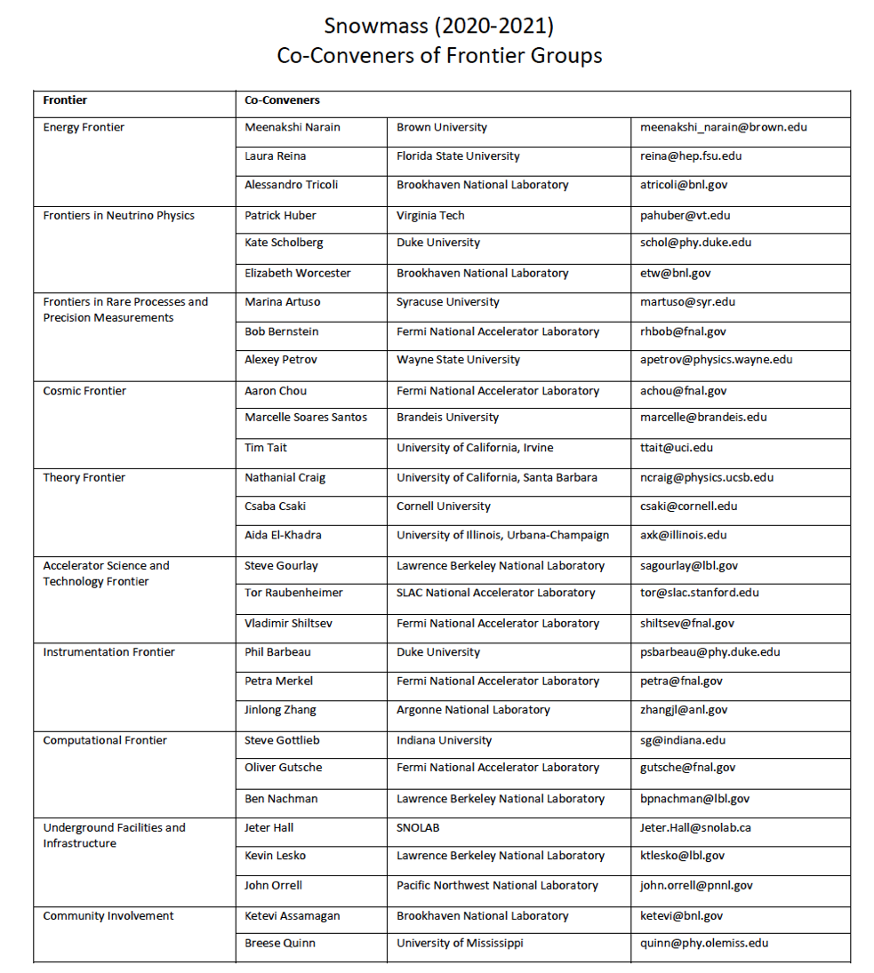
Snowmass Frontiers

Slide 10

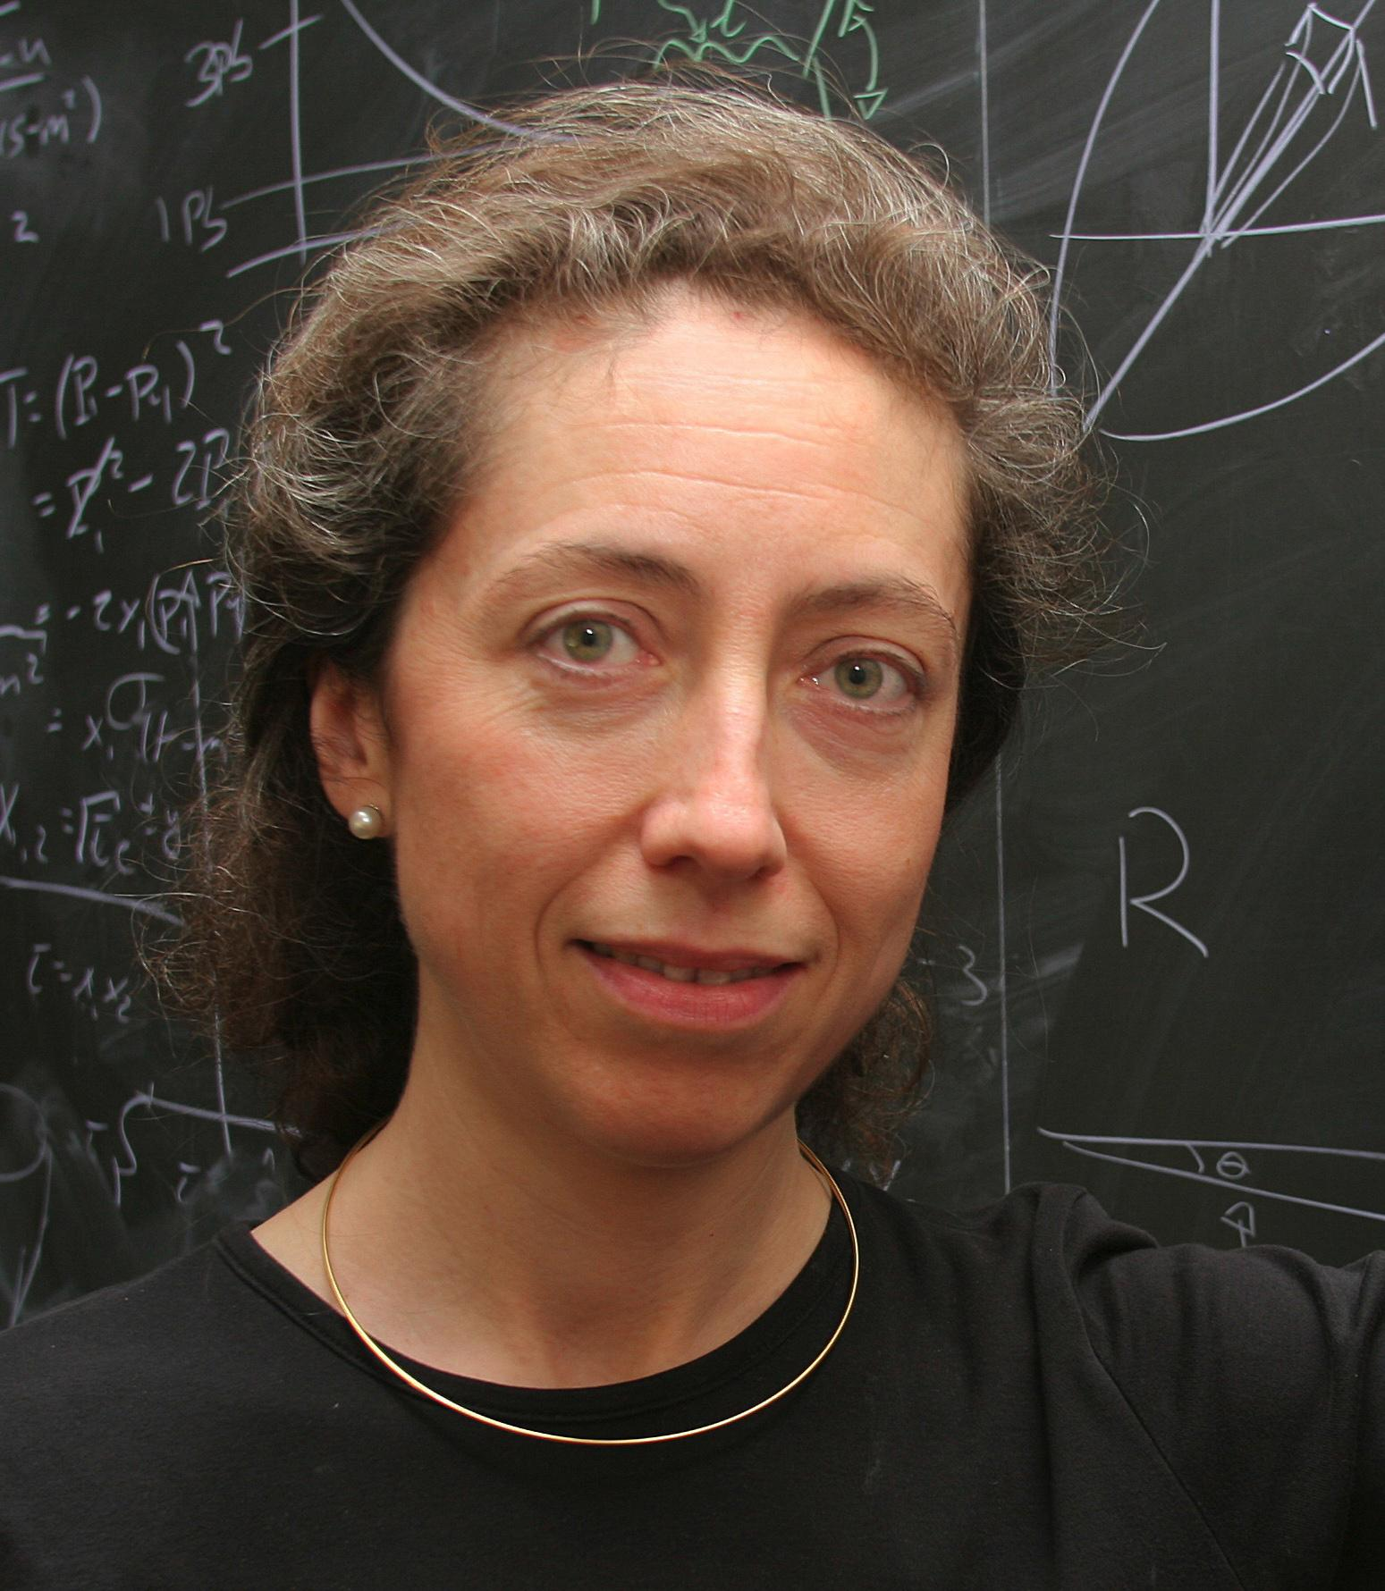
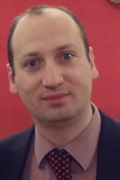
Energy Frontier
Co-Conveners:
wiki: https://snowmass21.org/energy/start
The Energy Frontier (EF) group will explore the TeV energy scale and beyond. Our sharply focused agenda includes understanding the heaviest particles of the Standard Model (SM), as well as exploring physics beyond the SM to discover new particles and interactions, including unraveling the mystery of dark matter. In this context, the EF group will carry out (and compile) detailed studies of Electroweak (EW) physics, QCD and strong interactions, and Beyond-Standard-Model (BSM) physics under different future accelerator scenarios, including lepton-lepton, hadron-hadron, and lepton-hadron colliders.
Alessandro Tricoli
(BNL)
Meenakshi Narain
(Brown U)
Laura Reina
(FSU)

Slide 11
Energy Frontier Topical Groups
Topical Group | Co-Conveners
EF01: EW Physics: Higgs Boson properties and couplings | Sally Dawson (BNL) | Andrey Korytov (U Florida) | Caterina Vernieri (SLAC)
EF02: EW Physics: Higgs Boson as a portal to new physics | Patrick Meade (Stony Brook) | Isobel Ojalvo (Princeton)
EF03: EW Physics: Heavy flavor and top quark physics | Reinhard Schwienhorst (MSU) | Doreen Wackeroth (Buffalo)
EF04: EW Physics: EW Precision Physics and constraining new physics | Alberto Belloni (Maryland) | Ayres Freitas (Pittsburgh) | Junping Tian (Tokyo)
EF05: QCD and strong interactions: Precision QCD | Michael Begel (BNL) | Stefan Hoeche (FNAL) | Michael Schmitt (Northwestern)
EF06: QCD and strong interactions: Hadronic structure and forward QCD | Huey-Wen Lin (MSU) | Pavel Nadolsky (SMU) | Christophe Royon (Kansas)
EF07: QCD and strong interactions: Heavy Ions | Yen-Jie Lee (MIT) | Swagato Mukherjee (BNL)
EF08: BSM: Model specific explorations | Jim Hirschauer (FNAL) | Elliot Lipeles (UPenn) | Nausheen Shah (Wayne State)
EF09: BSM: More general explorations | Tulika Bose (U Wisconsin-Madison) | Zhen Liu (Maryland) | Simone Griso (LBL)
EF10: BSM: Dark Matter at colliders | Caterina Doglioni (Lund) | LianTao Wang (Chicago)

Slide 12
Physics Charges of Topical Groups
Electroweak Physics
  EF01: Higgs Boson Properties and couplings
Mass, width, couplings, including Higgs self-coupling.
  EF02: Higgs Boson as a portal to new physics
Broad spectrum of BSM Higgs (2HDM, extra singlets, ...)
  EF03: Heavy flavor and top-quark physics
Top properties, top/bottom/charm production.
  EF04: EW precision physics
Precision fits of EW+Higgs+top observables (EFT, models, …)

Slide 13
Physics Charges of Topical Groups
QCD and strong interactions
  EF05: Precision QCD
QCD h.o. corrections, jets, event generators, alphas, quark masses, PDF for precision physics.
  EF06: Hadronic Structure and forward QCD
PDF fits, Generalized PDF, hadron spectroscopy.
  EF07: Heavy Ions
Impact of heavy-ion physics on EF physics (ex.:EIC physics).

Slide 14
Physics Charges of Topical Groups
BSM Physics
  EF08: Model specific explorations
SUSY, composite models, extended scalar sectors, rare top decays, …
  EF09: More general explorations
New bosons, new fermions, MET signatures, long-lived particles, EFT, ...
  EF010: Dark matter at colliders
Searches for DM particles at colliders.

Slide 15
Liaisons
One or two people will provide high-level and bi-directional communication b/w Frontiers.
They will be people with interests in both communities.
Liaisons:
  Neutrino Physics Frontier: André de Gouvêa (Northwestern)
  Rare Processes and Precision: Angelo di Canto (BNL)
  Cosmic Frontier: Caterina Doglioni (Lund)
  Theory Frontier: Laura Reina (FSU)
  Accelerator Frontier: Dmitri Denisov (BNL), Meenakshi Narain (Brown)
  Computational Frontier: Daniel Elvira (FNAL)
  Instrumentation Frontier: TBD
In addition to official Liaison we foresee unofficial ‘Link People’
  Provide a lower-level and more technical link between an EF-TG and a TG in other Frontiers.
  We expect they will naturally emerge from the community by the November workshop.
  They will be people who are embedded in both communities based on their personal interests.

Slide 16
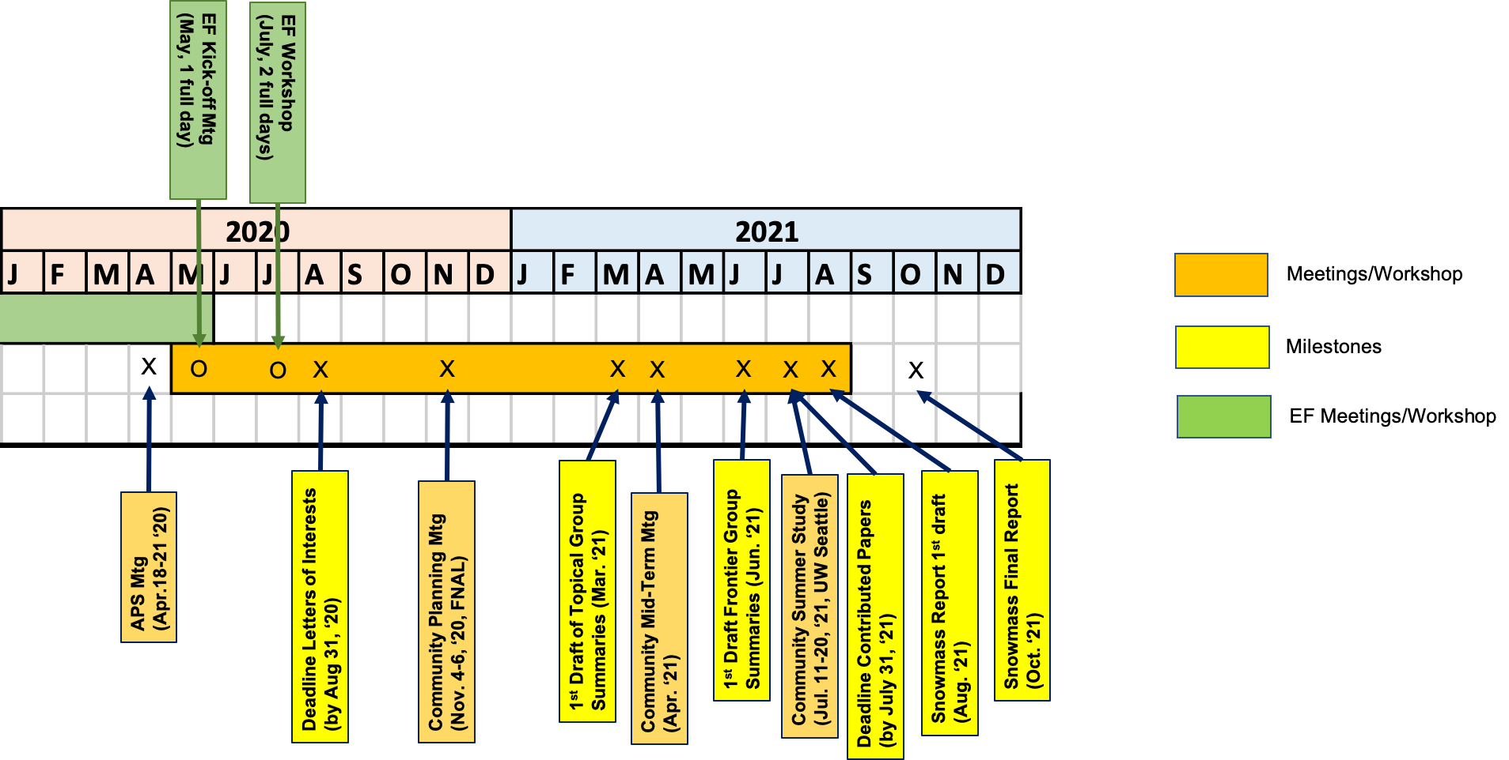
Energy Frontier Planning
Two EF community meetings to be arranged before the LoI deadline and in preparation for the Nov 4-6, 2020 Snowmass Planning Meeting:
  EF Kick-off meeting on May 21.
  EF workshop July 9-10 with common sessions with other Frontiers.
More workshops will follows

Slide 17
Future Collider Scenarios
ESG studies, comparing various options, are detailed in the briefing book:
We will expand on these studies and add other collider scenarios e.g. muon collider, Electron-Ion Collider, and other c.o.m. (if needed).
Our goal is to:
  Focus on a “set of Questions” and the “scientific merits” of the various collider options and proposals.
  Develop a global picture and a future roadmap.
  Compile existing studies [start from ESG briefing book].
  Use machine parameters as used for ESG. We will confirm with the Accelerator Frontier.
  Add new studies and information.
  For pp future colliders, HL-LHC will serve as a critical baseline. HL-LHC results may be revisited if deemed necessary.
Note: Updating existing projections with yet another simulation should be avoided, unless indications are that it will lead to significant improvements.

Slide 18
MC Production
Since Snowmass 2013, the landscape for simulations for future colliders have changed.
  Both future e+e- circular colliders (FCC-ee, CepC) and pp colliders (FCC-hh, CppC) have developed simulation and analysis frameworks, and generated MC samples for their studies.
Thus, we have a two-step plan:
  Assess the MC needs for EF (exp+th) and formulate a plan. We have formed a “Task force” for this purpose.
  Produce the “needed” MC samples by the community to carry of the necessary studies for EF.
    “needed” ⇒ some reasonable level, as well as prioritized.

Slide 19
MC Task Force
Charge of the task force:
  Assess the needs for MC samples for studies by each TG.
  Assume ILC, and CLIC studies will use their MC/framework.
  Survey existing frameworks for MC generation and analysis for circular colliders (FCC-ee, FCC-hh, CepC, CppC):
    are there existing samples generated by these collaborations which we can request to use?
    if so, can we use these samples and their framework?
  In case we have to generate a large set of MC samples ourselves, then develop a plan , addressing also the needed resources for generation, and sample storage.
  Finalize the plans by July 2020 EF Workshop.

Slide 20
MC Task Force Composition
Membership includes representatives from EW, QCD and BSM TGs as well as other people with past Snowmass experience & technical expertise.
Composition of the EF MC task force:
  member of the Snowmass 2013 team - John Stupak (Chair)
  Energy Frontier (EF) Topical Group conveners:
    EWK: Isobel Ojalvo
    QCD: Michael Schmitt
    BSM: Simone Pagan Griso
  Theorists with MC expertise: Fabio Maltoni (convener of TF07: Collider Phenomenology) & Stefan Hoeche (convener of EF05: Precision QCD)
  member of OSG for technical input & resource support: Robert Gardner (or designee)
  EF conveners

Slide 21
Upcoming EF Meetings
Kick-off Meeting: Thursday May 21, 2020 (full day).
  Review of existing studies, and plans to engage communities.
    Goal is to lay out our plans, strategy, activities, discuss the organisation of the EF group and TGs, how to communicate within the community.
    Summaries of studies that can be considered as stepping stones for TG activities (e.g. surveys of previous or international studies, e.g. ESG results, Yellow Reports etc.) as well as overviews of ideas for studies that can be carried out for Snowmass 2021.
    Present plans for and use of letters of intents and contributed papers within the EF group, and the strategy for MC production.
EF Workshop: July 9-10, 2020 (two full days)
  First opportunity for the community to present ideas, plans, and results if already available.
  Plans to have dedicated joint sessions with other Frontiers, and common session between TGs.

Slide 22
Communication - Email and Slack
Email lists: primary mode for important physics communication within TGs as well as announcements of meetings, and workshops.
Slack: informal brainstorming and discussions as well as announcements of meetings, and workshops.
  Use dedicated Slack channel for calling EF Meetings energy_frontier_meetings
  EF Slack Channels:
    Common to the entire Energy Frontier: energy_frontier_topics,
    Specifics to the individual EF Topic Groups:
      EW:
        ef01-higgs_properties, ef02-bsm_higgs, ef03-top_heavy_flavors, ef04-ewk_constraints
      QCD:
        ef05-precision_qcd, ef06-had_fwd_qcd, ef07-heavy_ions
      BSM:
        ef08-bsm_models, ef09-bsm_generic, ef10-dark_matter

Slide 23
Communication - mailing lists
Email lists for communication [archived]
  EF conveners by anyone: SNOWMASS-EF-CONVENERS@fnal.gov
    with topical group conveners by anyone: SNOWMASS-EF-TOPICAL-GP-CONVENERS@fnal.gov
    with the EF community by EF conveners: SNOWMASS-ENERGY-FRONTIER-GROUP@fnal.gov
        post all announcements relevant to EF.
        community members can contact us via this email list
    Email List for all TGs (for instructions how to join see TWiki):
      SNOWMASS-EF-01-HIGGS_PROPERTIES[at]FNAL.GOV
      SNOWMASS-EF-02-BSM_HIGGS[at]FNAL.GOV
      SNOWMASS-EF-03-TOP_HEAVY-FLAVOR[at]FNAL.GOV
      SNOWMASS-EF-04-EWK_CONSTRAINTS[at]FNAL.GOV
      SNOWMASS-EF-05-PRECISION_QCD[at]FNAL.GOV
      SNOWMASS-EF-06-HAD_FWD_QCD[at]FNAL.GOV
      SNOWMASS-EF-07-HEAVY-IONS[at]FNAL.GOV
      SNOWMASS-EF-08-BSM_MODELS[at]FNAL.GOV
      SNOWMASS-EF-09-BSM_GENERIC[at]FNAL.GOV
      SNOWMASS-EF-10-DARK_MATTER[at]FNAL.GOV

Slide 24
Useful Links
Snowmass APS / DPF webpage
Snowmass Twiki page
EF Twiki
  with instructions how to join mailing lists
  with up-to-date calendar of meetings which you can subscribe to
  other useful info...
SLACK channels
  See info here how to join
Snowmass Indico
EF indico

Slide 25
Inputs from Collaborations
We have started receiving inputs from International Collaborations
  Plans for analyses, MC samples, framework availability and how to share them with the Snowmass community, contact people etc.
  Letters of Interests
Following slides show two contributions received so far, more are expected from other collaborations
Those contributions will be made available to the whole Snowmass community soon

Slide 26

Inputs from Collaborations: ILC

Slide 27
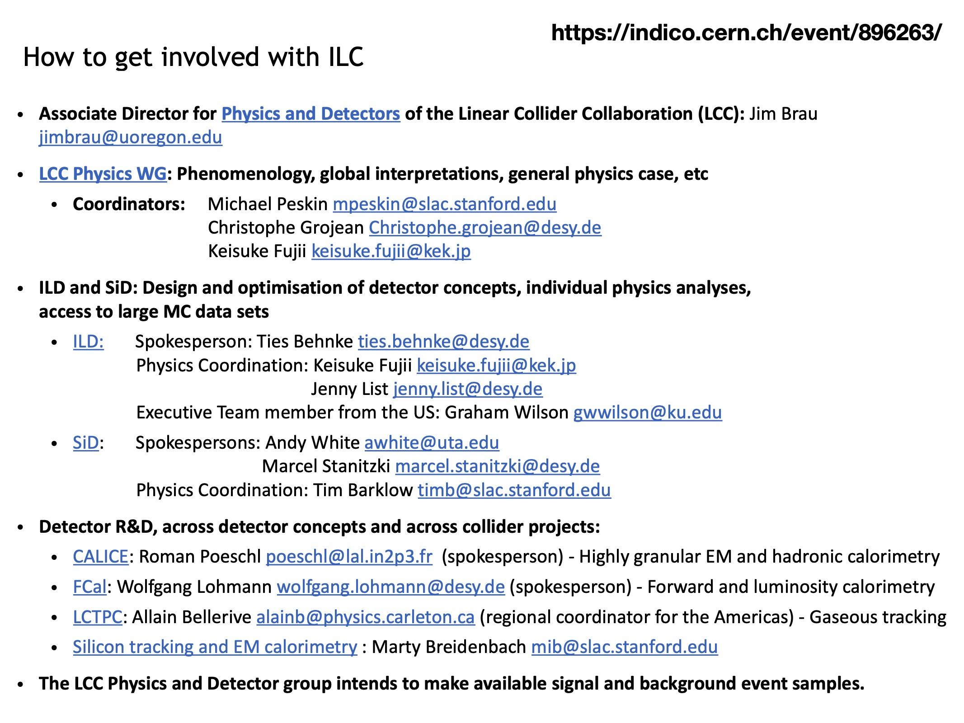
Inputs from Collaborations: ILC

Slide 28
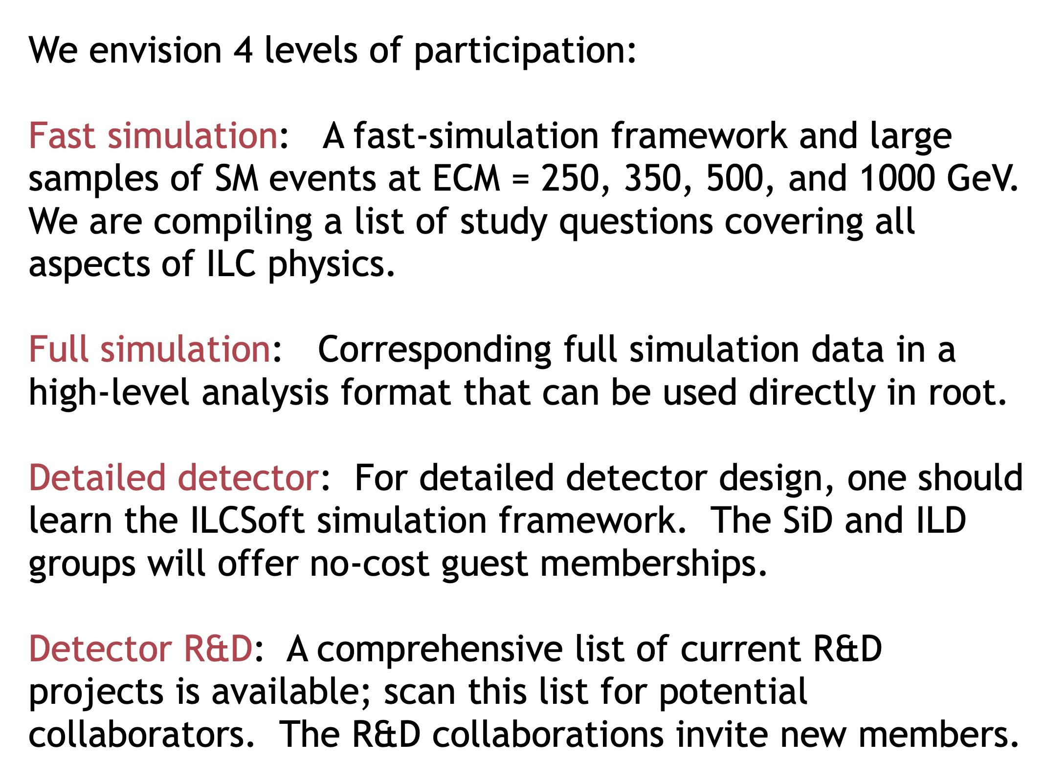
Inputs from Collaborations: ILC

Slide 29
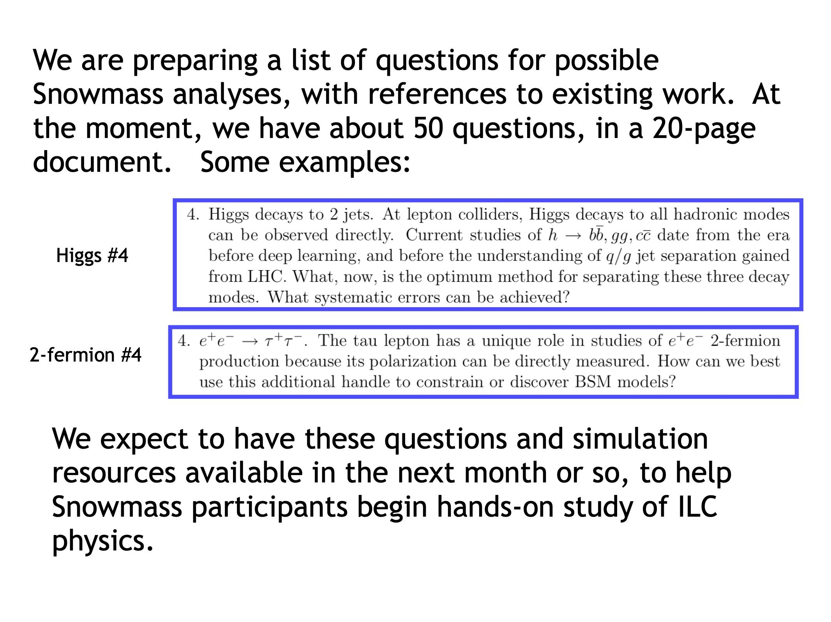
Inputs from Collaborations: ILC

Slide 30
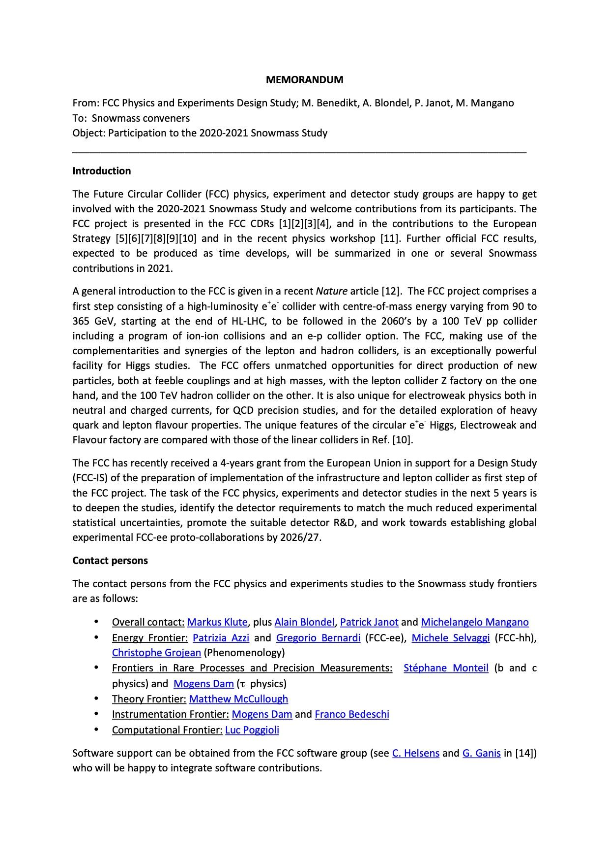
Inputs from Collaborations: FCC

Slide 31
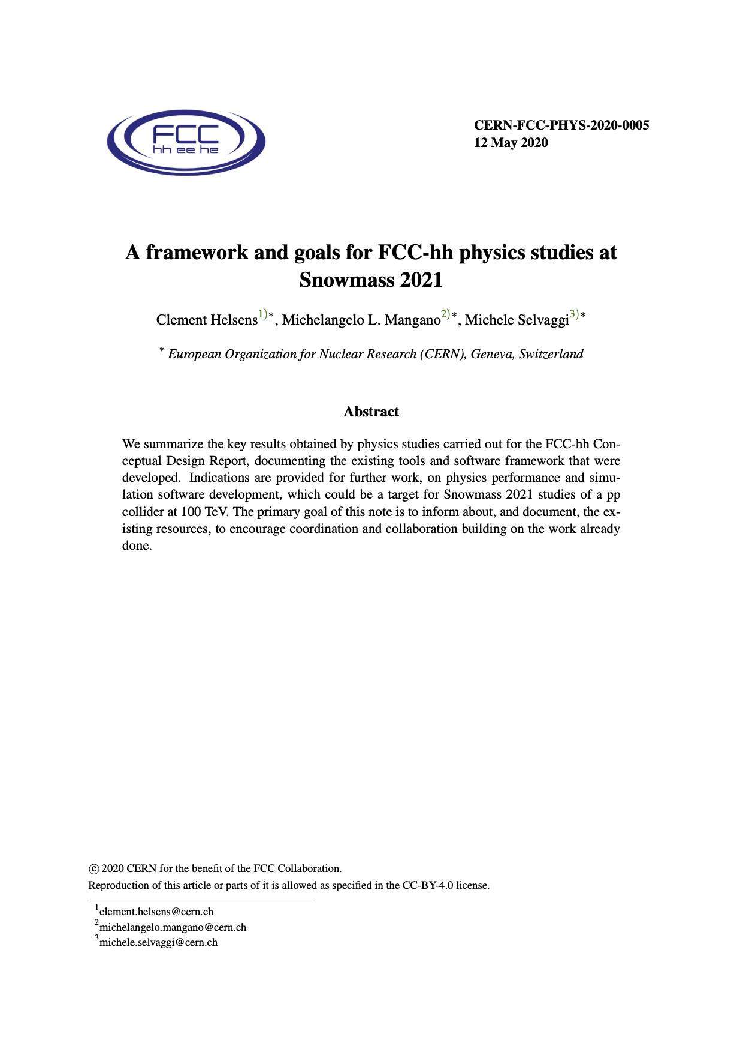
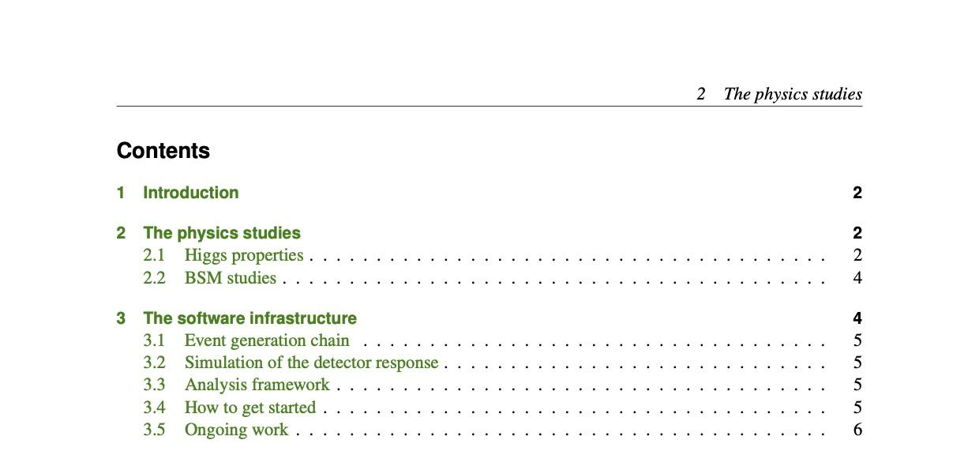
Inputs from Collaborations: FCC-hh

Slide 32
Back-up

Slide 33
“Letters of Interest” and “Contributed Papers”
Letters of Interest (LOI)
(submission period: April 1, 2020 – August 31, 2020)
“They allow Snowmass conveners to see what proposals to expect and to encourage the community to begin studying them. They will help conveners to prepare the Snowmass Planning Meeting that will take place on November 4 - 6, 2020 at Fermilab. Letters should give brief descriptions of the proposal and cite the relevant papers to study. Instructions for submitting letters are available at
https://snowmass21.org/loi.
Authors of the letters are encouraged to submit a full write-up for their work as a contributed paper.”
Very brief (two pages).
Uploaded by Authors through Snowmass 2021 Wiki.
Index of submitted LOI available on the Snowmass 2021 Wiki.
Could represent existing work (cite) or new ideas.
Will help the EF conveners plan the work of the Frontier (including liaisons with other Frontiers: avoid duplication/build synergy).
If further developed in the context of the Snowmass 2021 exercise could lead to a Contributed Paper.

Slide 34
“Letters of Interest” and “Contributed Papers”
Contributed Papers
(submission period: April 1, 2020 – July 31, 2021)
“Contributed papers will be part of the Snowmass proceedings. They may include white papers on specific scientific areas, technical articles presenting new results on relevant physics topics, and reasoned expressions of physics priorities, including those related to community involvement. These papers and discussions throughout the Snowmass process will help shape the long-term strategy of particle physics in the U.S. Contributed papers will remain part of the permanent record of Snowmass 2021. Instructions for submitting contributed papers are available at
https://snowmass21.org/submissions/”
More extensive studies.
May include white papers, scientific/technical articles, etc.
Can but do not have to be related to a given LOI.
Submitted by Authors following instructions given on Snowmass 2021 Wiki page (submit to arXiv, send email to M. Peskin with subject “Contribution to Snowmass 2021”, etc.)
Will be part of the official Snowmass 2021 records..

Slide 35
Charge of the EF MC Task Force (I)
Assess the MC needs for studies by each Energy Frontier Topical Group.
  This should include the processes, the MC generators, the accelerator configurations (c.o.m, integrated luminosity, pileup scenarios, if any), detector configurations, and number of events for each process type.
Survey existing frameworks for MC generation and analysis for future circular colliders (FCC-ee, FCC-hh, CepC, CppC, LHeC, EIC...etc...).
  Are the existing samples and framework sufficient for our studies?
  Need to request permission to use the existing samples?
Check/confirm that ILC, CLIC, Muon collider studies will use their frameworks, and no MC generation by EF group needs to be planned.
Finalize the plans and submit the recommendations by the end of June 2020 to the EF conveners.
The plan and recommendations will be presented to the EF community and discussed during the July 2020 EF Workshop.
The OSG has kindly agreed to support the MC generation for EF, and will provide both compute resources and storage on the OSG Data Federation.

Slide 36
Charge of the EF MC Task Force (II)
Develop a plan, in the event the EF group has to mount a production of a large set of samples for Standard Model backgrounds. The plan should address the following questions:
  Shall we adopt a “common framework” both for generation & analysis of the various samples, if so, which one(s)?
  Which samples are needed to be produced as a central production?
    Include detailed information about the samples (as listed in 1.a above).
    Should signal samples be produced by the proponents and only large SM background samples be produced centrally?
  What scale of CPU resources are needed for sample generation?
  What projected size of storage is required for production and long term storage of the samples?
  Recommendation on the formation and activities of the “EF Monte Carlo Production team”.

Slide 37
Interactions with Community
Input to Task Force from members of the community will be facilitated by each of the EF Topical Groups.
EF Topical group conveners will interact with the community
  to gather the needed MC requests - large samples for background and systematic studies
    Please note that for Snowmass 2013 signal samples were generated by the proponents of the studies, though this is an open question for the TF!
  to ensure that there is a (/are) group(s) which will use the samples!
  The theory co-convenors in each TG own the responsibility to provide guidance to their TG community on theory predictions and how to assess theory uncertainties.
EF Topical Group conveners will interact with the MC TF
  to provide guidance on (or negotiate?) priorities (if needed to constrain the insatiable needs of the community):
    they have the knowledge and expertise to prioritize and advise if the requests are reasonable.

Slide 38
Snowmass 2021 EF Monte Carlo Production Team
We envision that the MC production team will take charge of executing the plan developed by the “MC task force”.
This group will be formed around July and we will recruit volunteers with technical expertise from the community.
The main activities of the team are:
  Set up the technical infrastructure for the central MC production. This will also involve working with the OSG team for compute and storage resources.
  Recruit members from the community to help with the production.
  Produce the samples and make them available to the EF community.
  Provide documentation for use by the EF community for generation of signal and other smaller samples which will not be centrally produced.
  The chair of this team will help the EF conveners in any future requests for central production, if any, from the community.
  Document the efforts of this team as “snowmass contributed papers”.

Slide 39
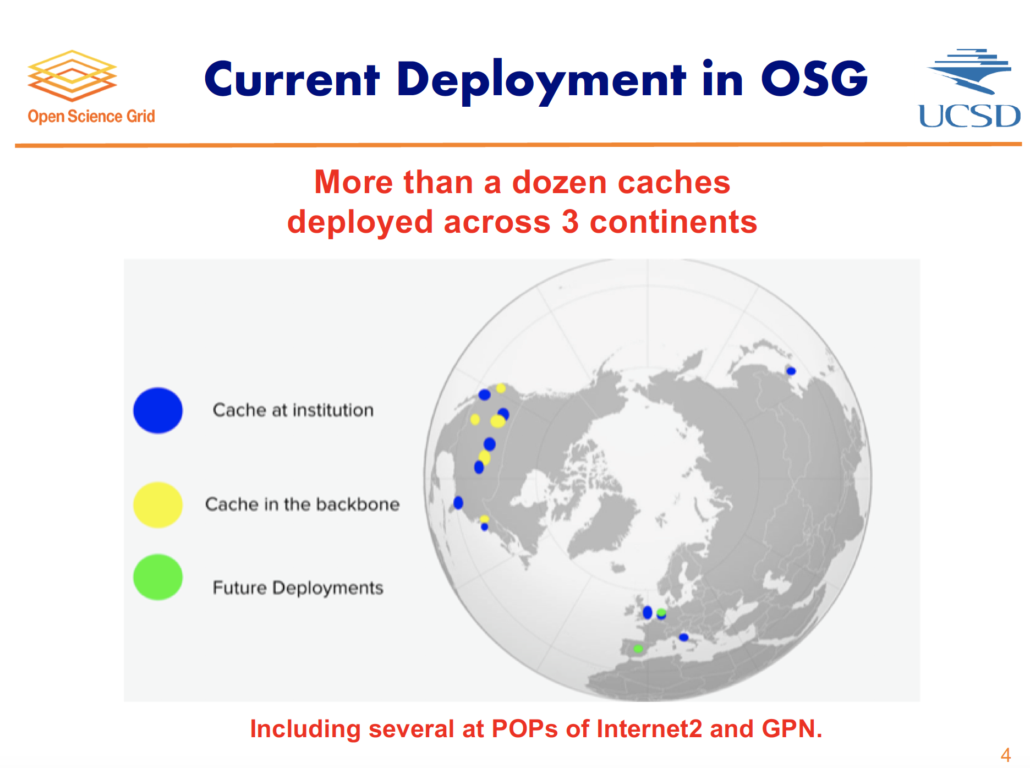

Slide 40
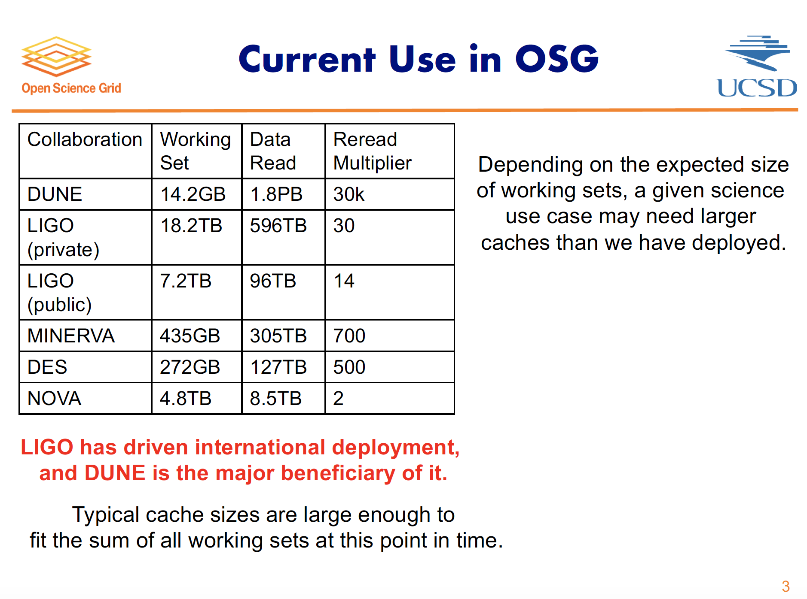

Slide 41
USA Decision Process
Groups of scientists develop proposals for future projects/experiments.
“Snowmass” is a community-wide process that discusses proposals, evaluates strong and weak points, physics reach and summarizes outcome in a written form.
  Organized by APS’s Division of Particles and Fields (DPF) – professional organization, not laboratories or funding agencies.
P5 committee (Particle Physics Projects Prioritization Panel) is formed (by NSF and DOE) consisting of ~25 scientists representing all areas of particle physics.
  The committee, within about 6-12 months, have to recommend priorities based on available funding and on the expected cost of the projects.
  Recommendations covers ~10 years time span.
HEPAP (High Energy Physics Advisory Panel) appointed by NSF/DOE reviews the proposal and provides advice to funding agencies.
NSF/DOE fund recommended projects (assuming funds are available).

Slide 42
Community Involvement
Particle physics is global: long-term strategy study done in the global context.
Europe, Japan, other countries/regions are developing plans which U.S. is monitoring closely and in many cases is active participant.
European / U.S. Process:
  European Physics Preparatory Group (PPG) ~ U.S. Snowmass
  European Strategy Group (ESG) ~ U.S. P5
European Physics Preparatory Group (PPG) 2018-2019:
  17 PPG Members, including 4 members from Americas and Asia.
  16 Conveners (8 groups), including 4 conveners from Americas and Asia.
  ESG report expected soon.
U.S. P5 2014:
  25 members, including 5 members from Europe and Asia.
U.S. Snowmass 2020-2021:
  Expected and encouraged representation of foreign institutions.

