Slide 1
Impact of COVID on 2020-2021 Low-energy ISOLDE activities
88th ISOLDE Collaboration Committee meeting
23rd of June 2020
Joachim Vollaire on behalf of EN-STI

Slide 2
Outline
Situation and organization since mid-March
Status and plans for frontends replacement finalization
Plans for the new Fast Tape Station
Nano-Laboratory construction and actinide target production
Report on TISD activities
MEDICIS update

Slide 3
Situation and organization since mid-March
Mid-March the facility was put in a “safe mode” and all activities on-site (including LS2 projects) were suspended teleworking
Remote teleworking was beneficial and productive for the majority but less relevant for colleagues doing mainly hands-on work. Important also to keep social connection with “isolated” colleagues (stay-at-home order for France).
Focus on training, documentation and technical specification for tendering process (new target vessel contract, nano-laboratory equipment….)
Continue the excellent collaboration with all ISOLDE stakeholders (standing meetings maintained and additional ones).
Ensure proper representation of ISOLDE in CERN wide committees. Very important when discussing priorities and support from technical teams.

Slide 4
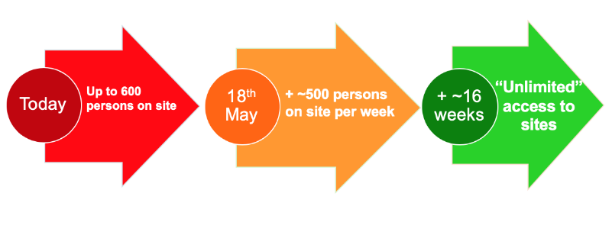

CERN plan for restart
Special LS2C 8th May
LS2 Day 12th June
End-June
For EN-STI-RBS:
Priority for frontends production
Workshop activities
Target production
MEDICIS operation
Students experiments (TISD)
End of June, ~10 people on site out of ~20 (rotation)
Phase 1
Phase 2
People with symptoms or vulnerabilities not allowed to work on site
Safe-mode and other
urgent activities
Resume gradually, starting
with LS2, accelerator and
detector upgrades, urgent
site and building work
Ramp-up to “unlimited”
access may be completed
by mid-September

Slide 5
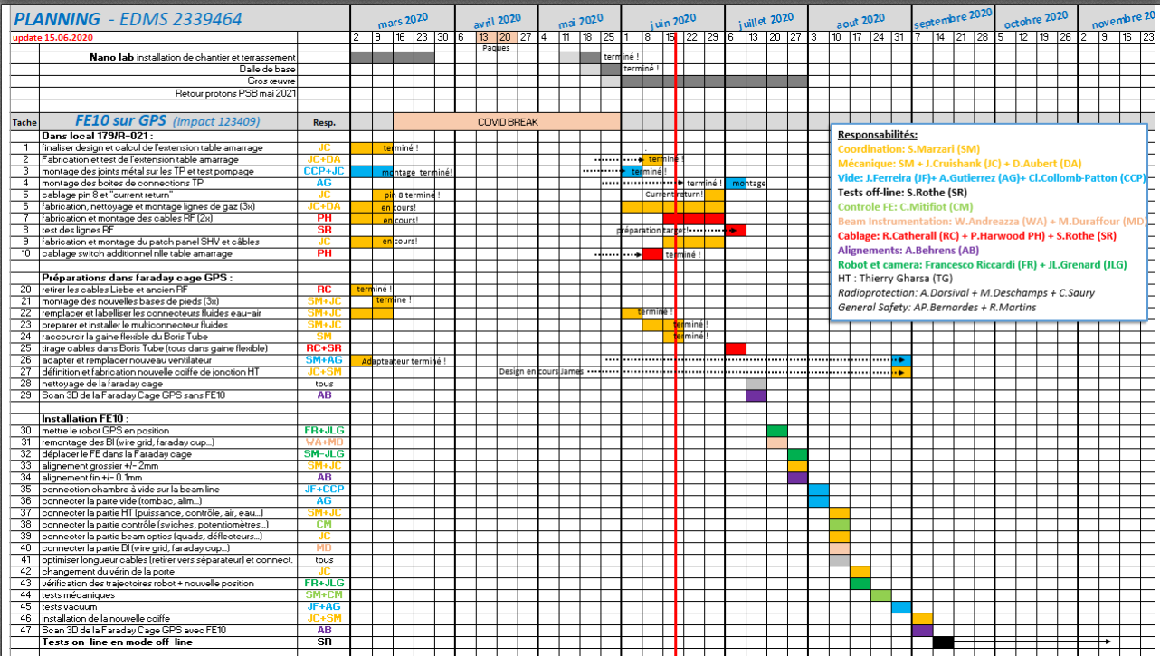
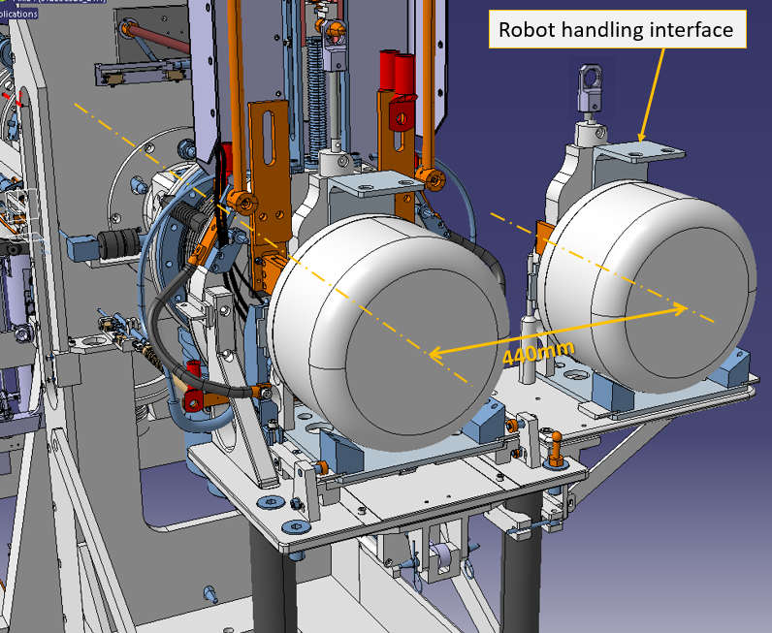
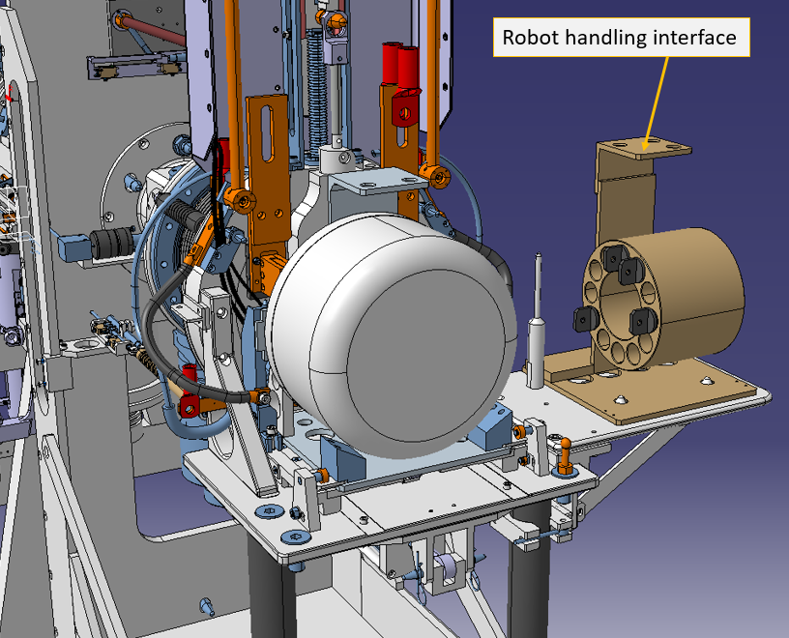
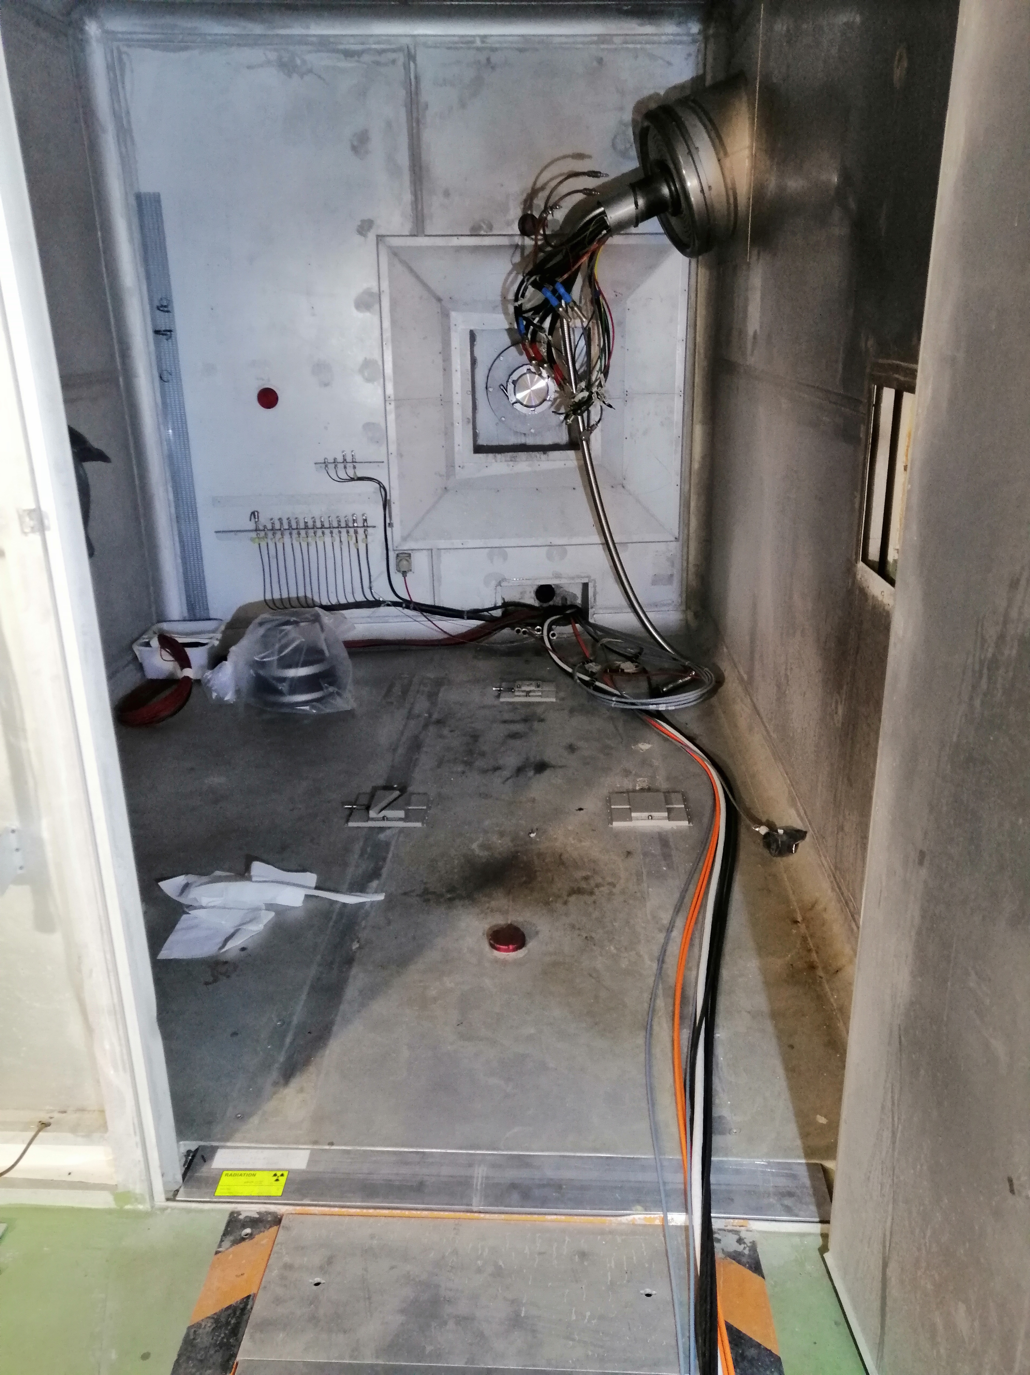
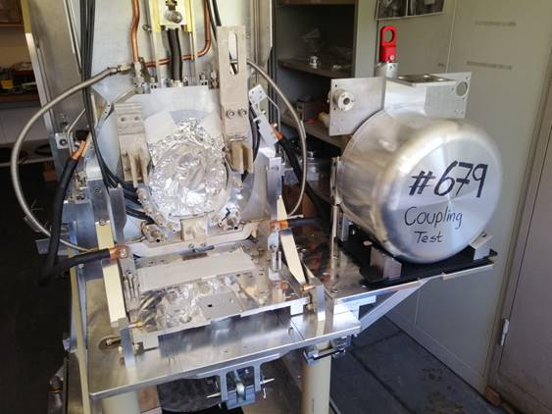
FE10 production status (installation on GPS)
FE10 in Building 179 successfully vacuum tested during the last weeks
Preparatory activities (alignment, cabling….) inside the GPS Faraday cage in view of the Frontend installation
New irradiation table
GPS Faraday Cage
FE to the target area
Stable beams

Slide 6
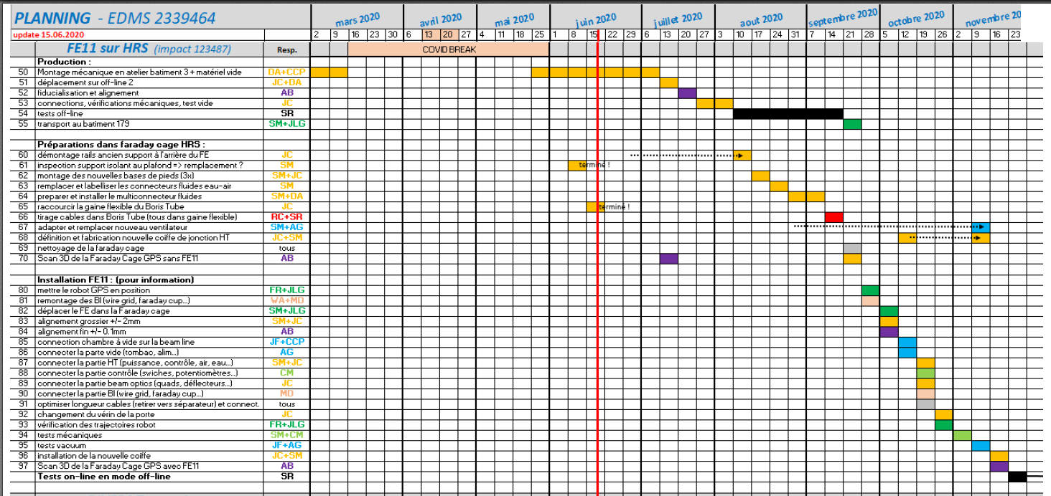
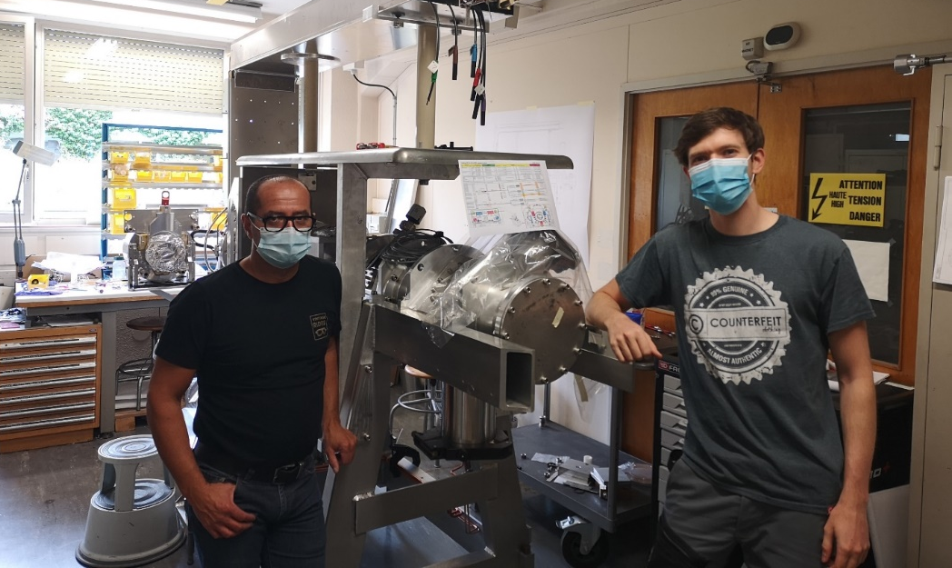
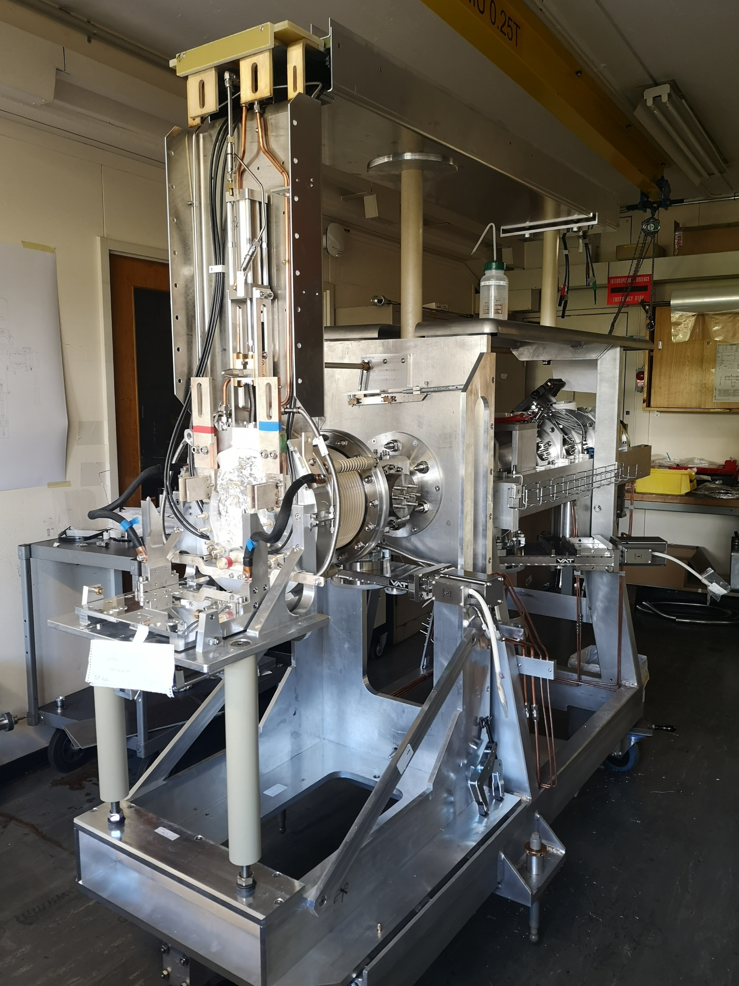
FE11 production status
Working on FE11 mechanical assembly
They smile (happy to be here !)
Stable beam testing period at offline2 starting in August
New contract for J. Cruikshank until end of Jan. 2021 (+ 6 months, exceptional circumstances)

Slide 7
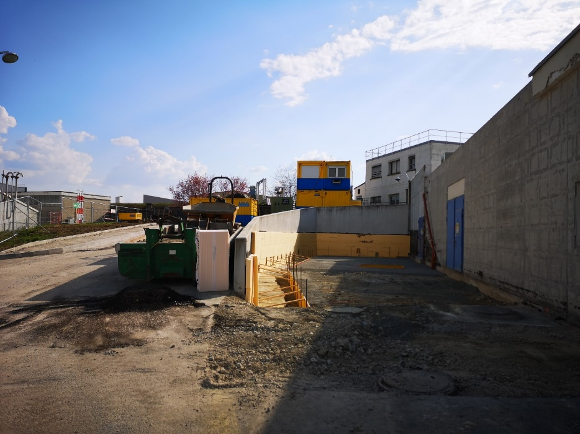
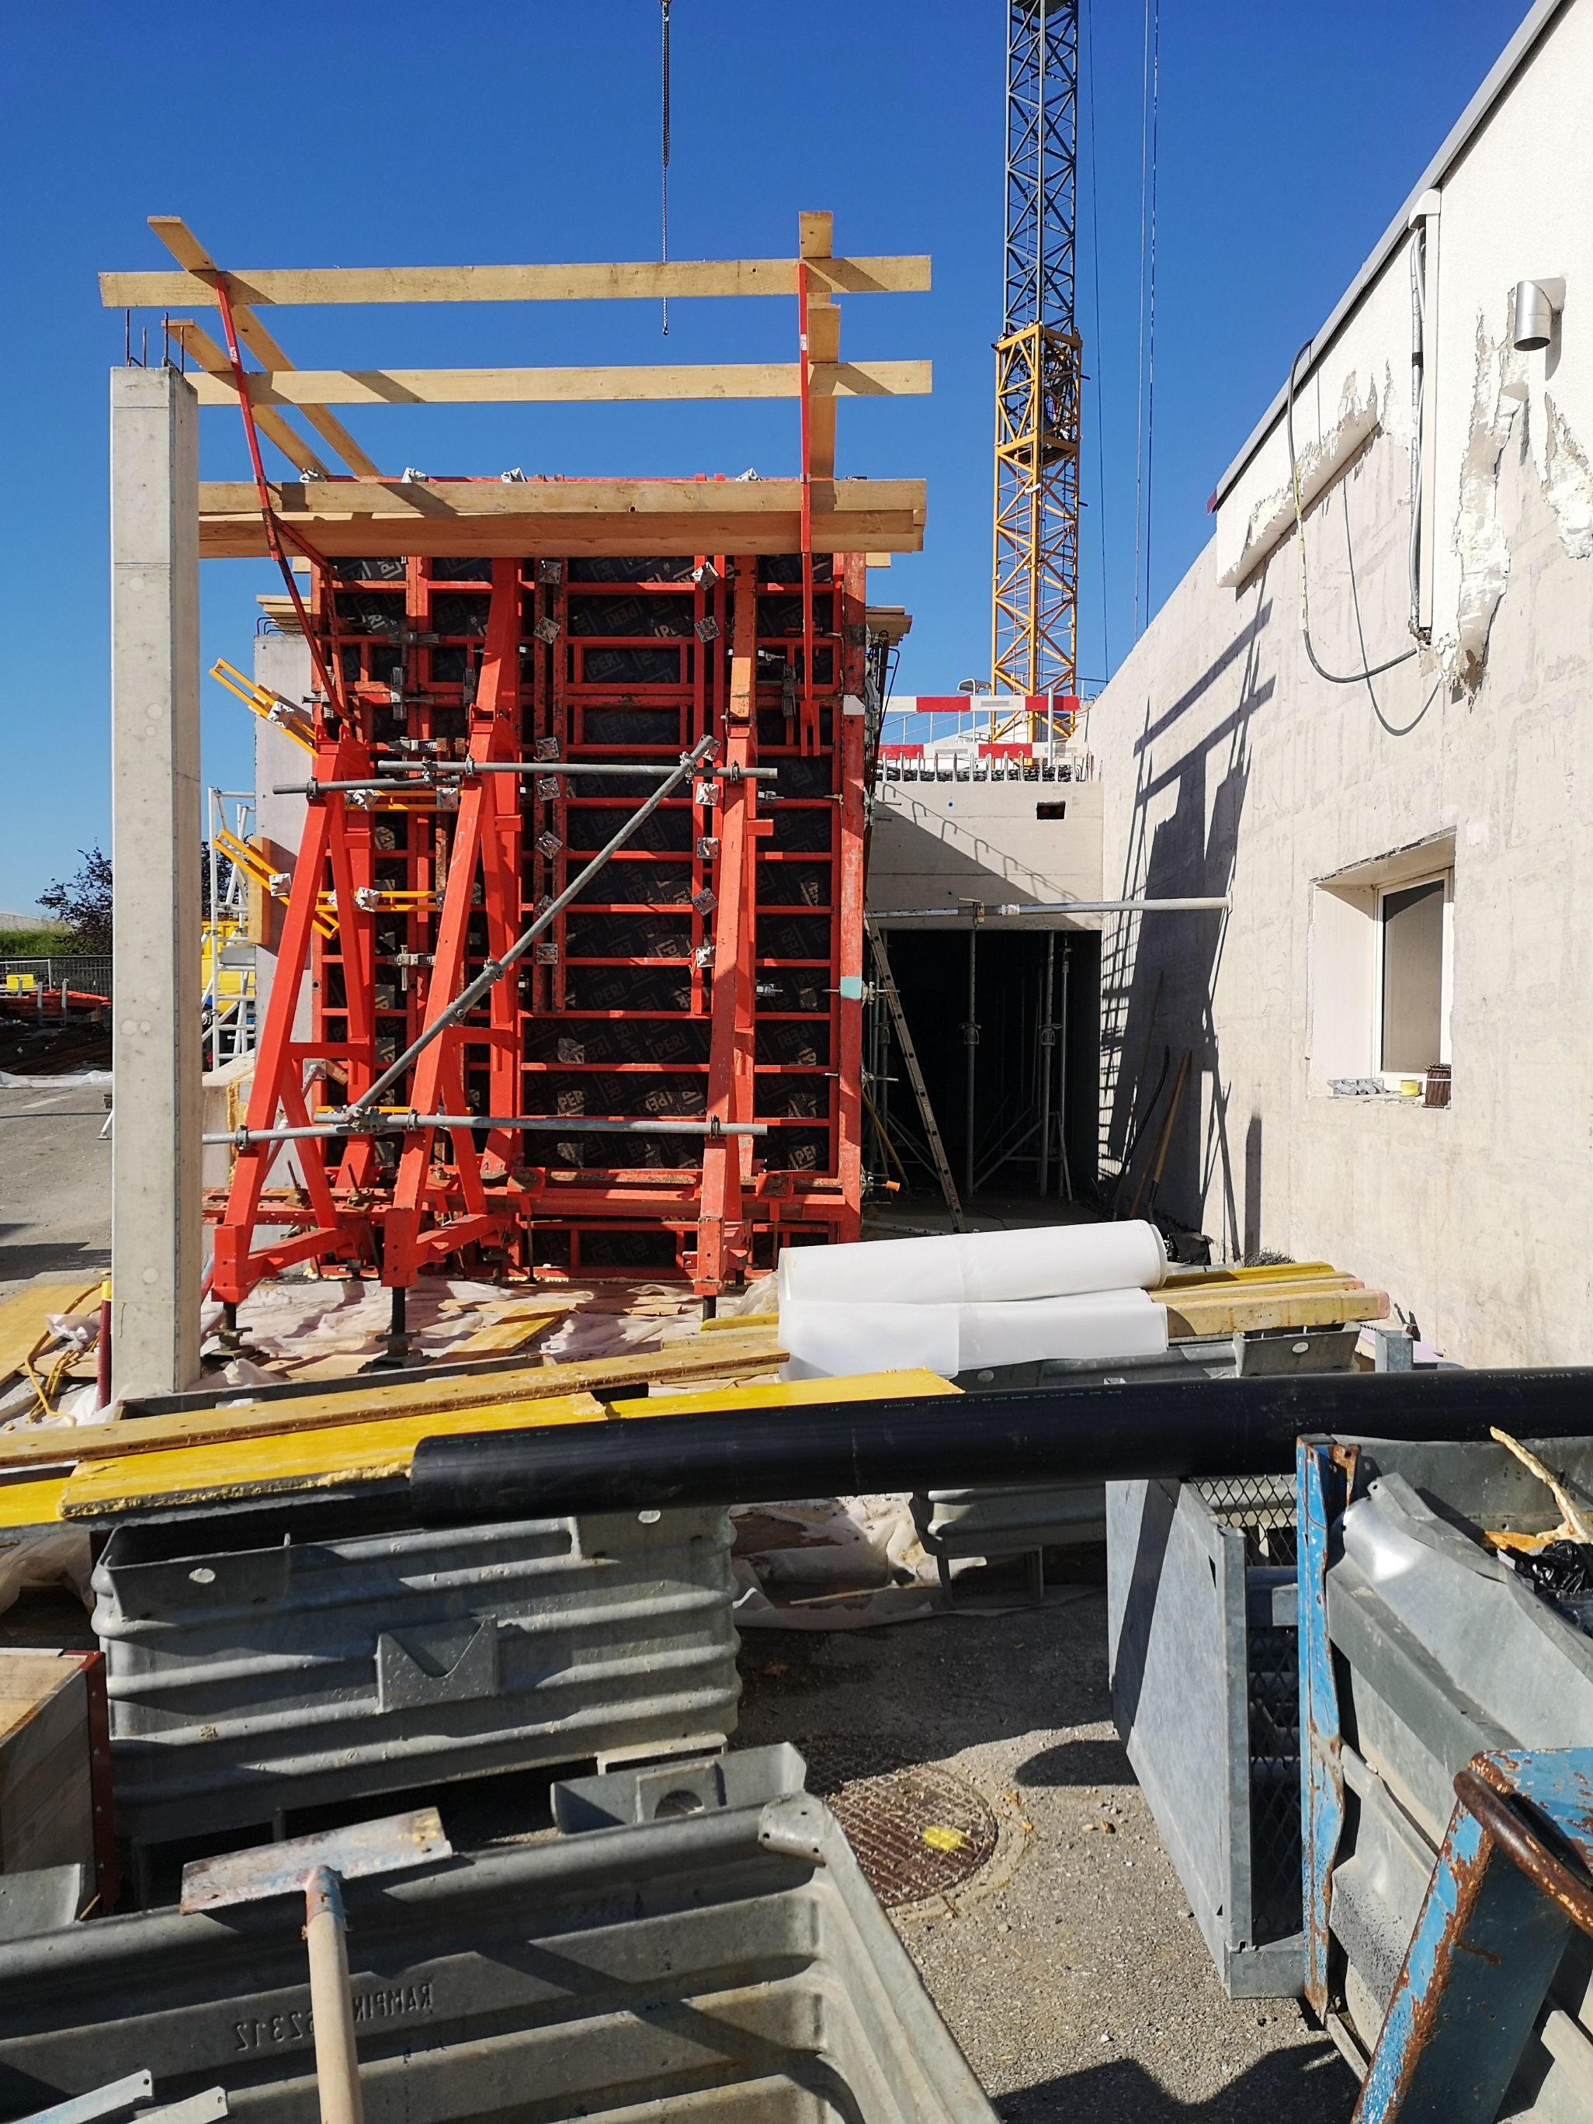
Nano-Laboratory Construction
Situation mid March
Situation mid June
Part dedicated to radioactive material storage (heavy density concrete)
Building 179
Construction could resume after a few weeks of interruption only in agreement with host state regulations and management approval

Slide 8
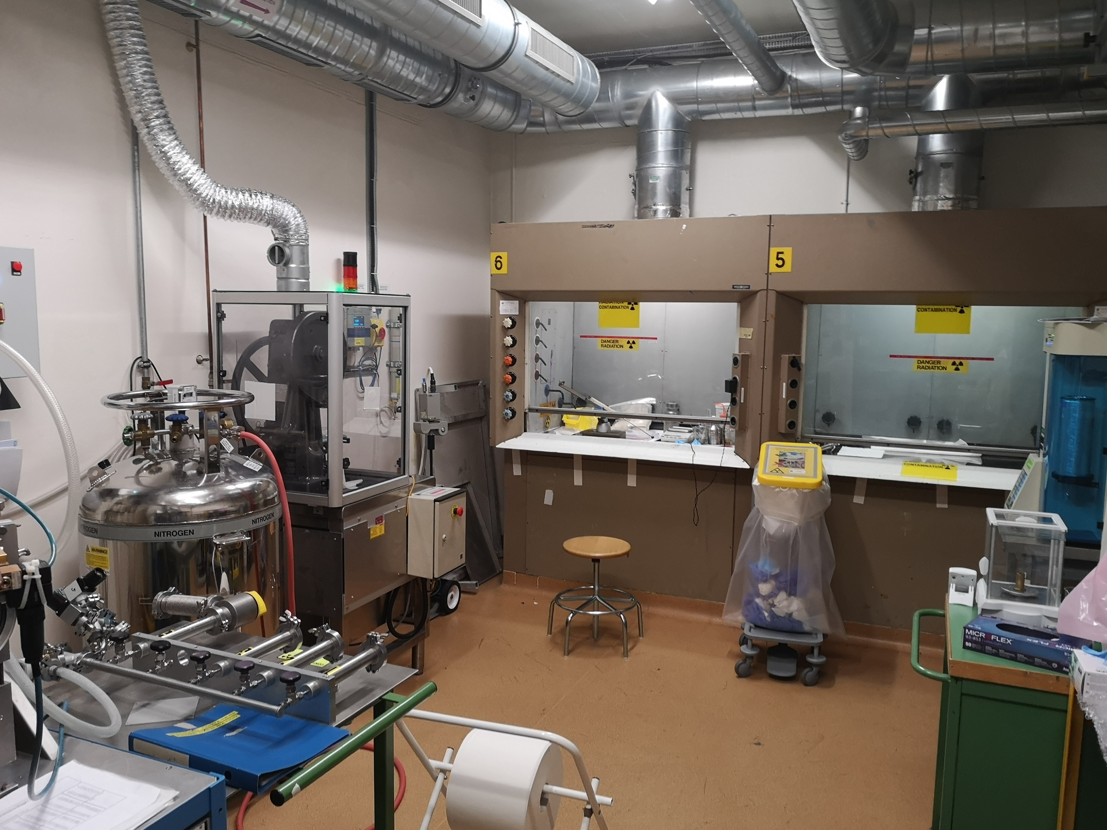
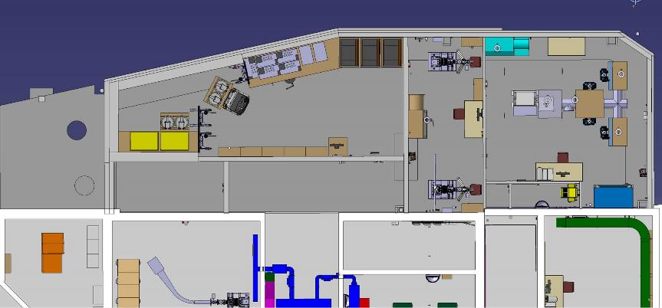
New nano-laboratory – operational constraints
Laboratory for UCx production
(no nano-material handling allowed)
No nuclear ventilation in the ISOLDE laboratories until end of May in 2021
Carburation Area
UCx pills production
Radioactive storage
Existing Building

Slide 9
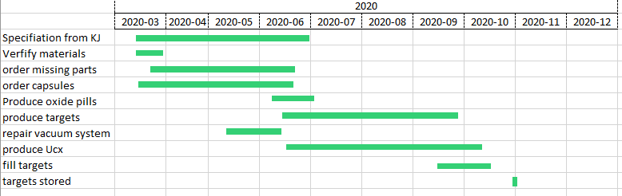
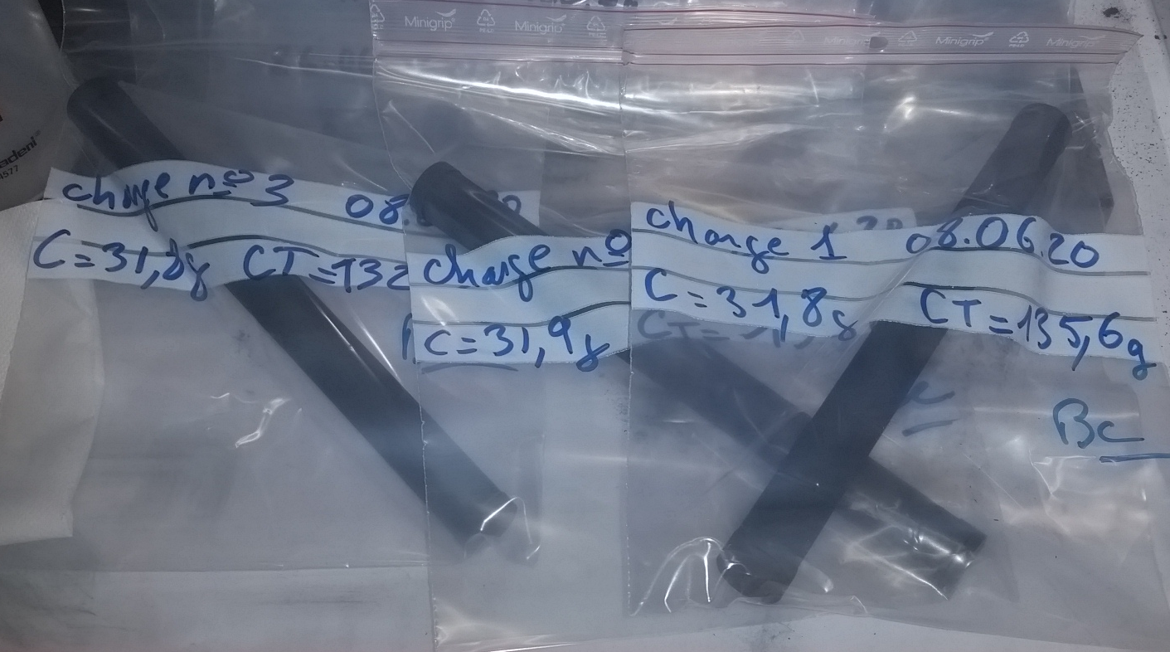
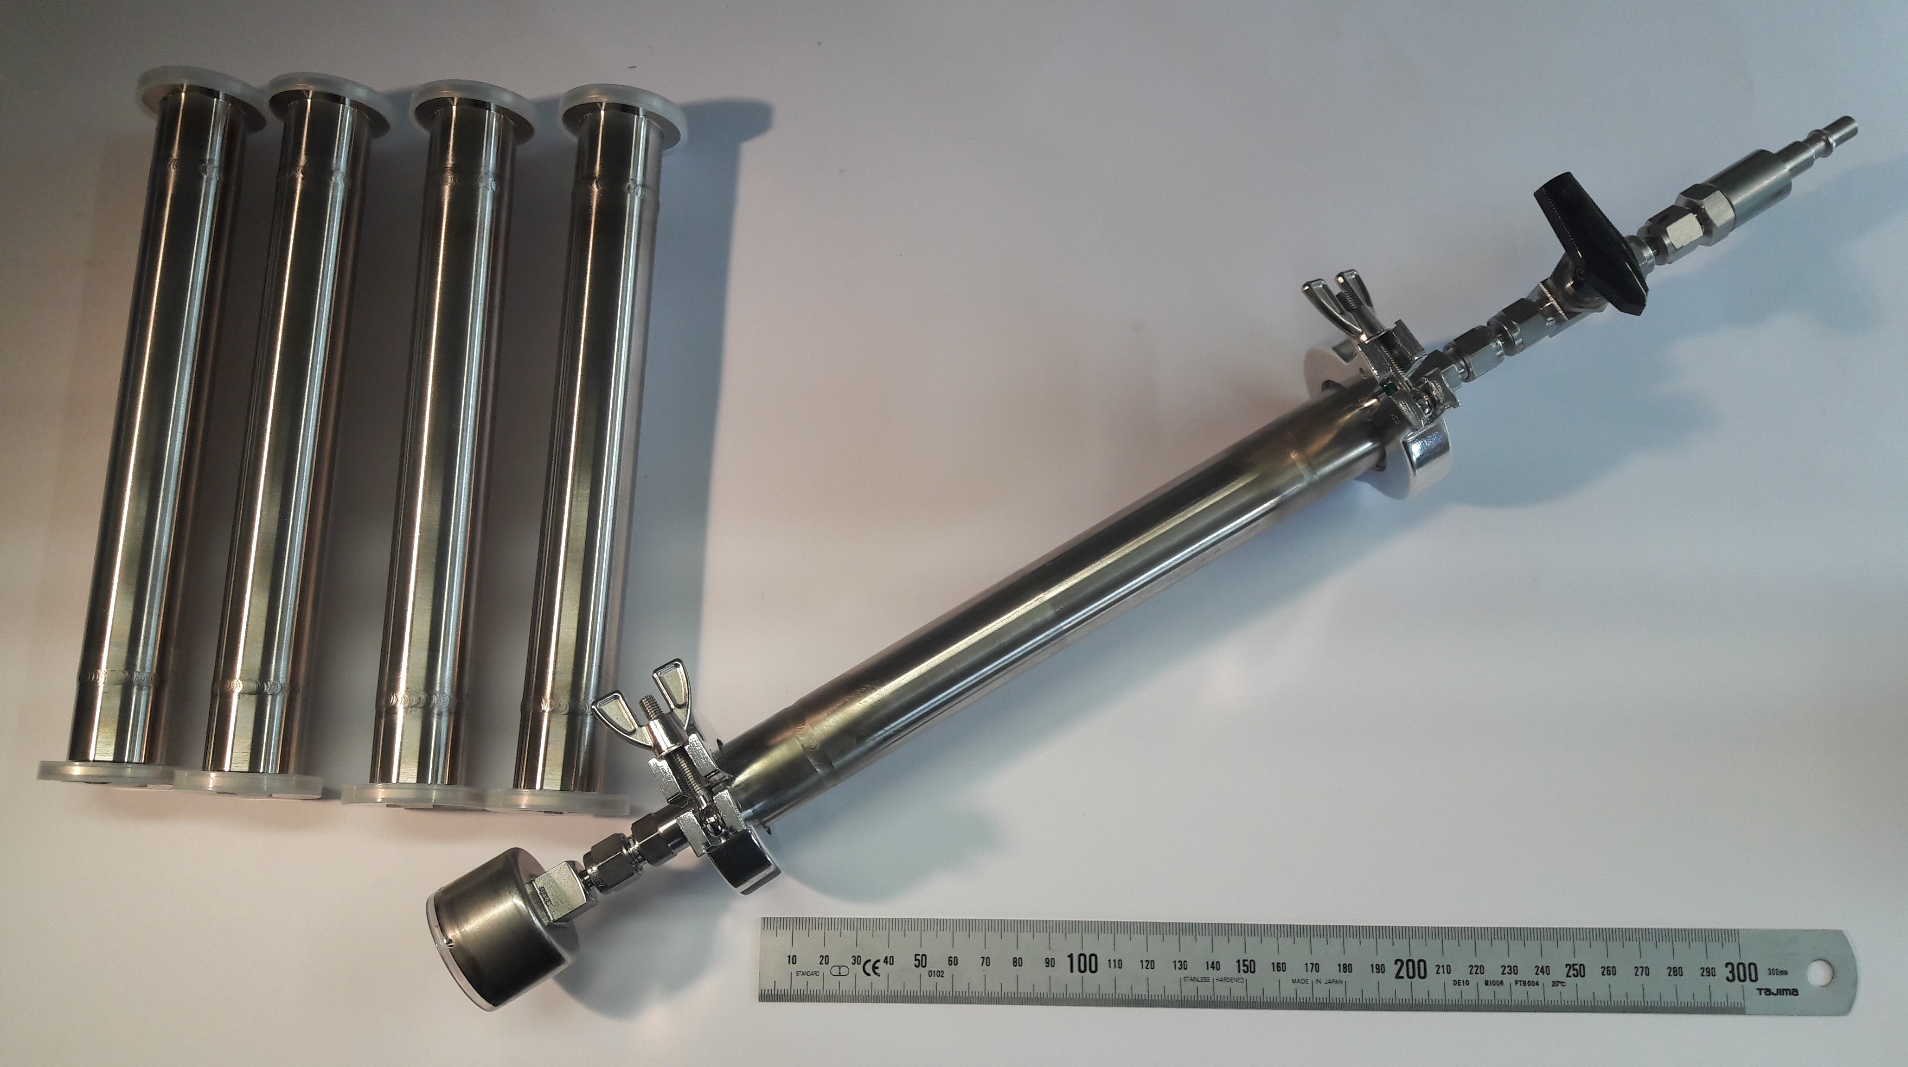
Targets for 2021 (anticipate in 2020)
UCx targets pre-production in view of nanolab ventilation cut Q1-Q2 2021
UO+C pills production ongoing
10 targets in queue
708-UC-MK1
709-UC-MK1
710-UC-MK1
711-UC-MK1
712-UC-MK1
713-UC-VD5
714-UC-VD7
715-UC-MK1
716-UC-MK1
717-UC-MK1
Production of storage container ongoing
Targets to be reused for 2021
#654-UC-MK1-W
#635-UC-MK1-Ta
#534-Sn-VD7
#619-Pb-VD
#653-UC-Ta-n
#641-UC-Ta
Also available: Targets from TISD tests
#638-UC-MK1-Re
#659-UC-VD7
#668M-UC-VD5
#637-UC-MK1-W
B. Crepieux, M. Owen, S. Rothe

Slide 10
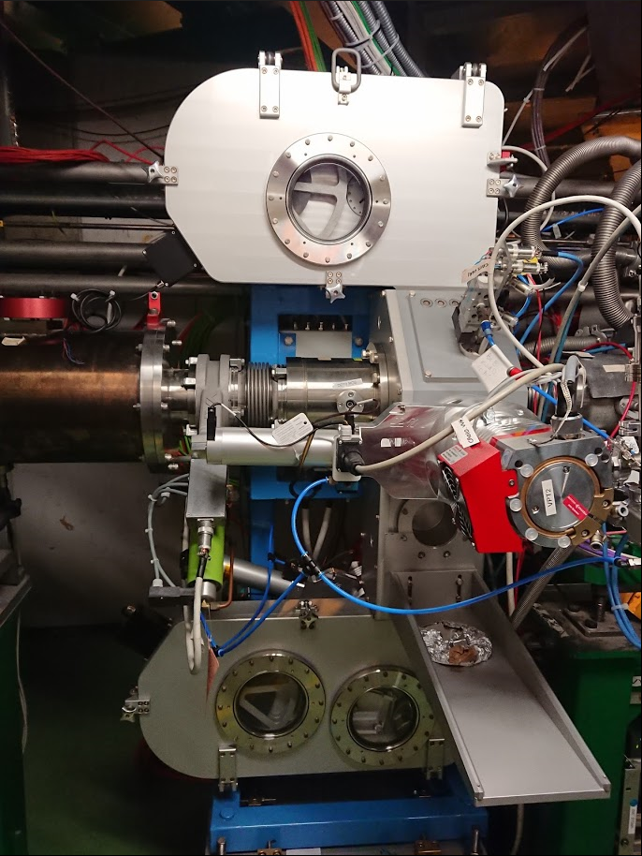
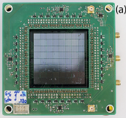
New Fast Tape Station
Low level controls to be tested/fixed EN/SMM (ongoing)
Basic high-level application / Beam instrumentation display by BE/OP (from Oct 2020)
Advanced yield measurement application via EN/STI (2021)
Detectors (4pi beta | (beta/)gamma | alpha) with strong support by EP/SME (2020|2021|2022)
Investigating SiPM electronics designed by IFIN (Bucharest, Romania)
Tapestation 2 at GLM on hold till TS1 advanced
https://doi.org/10.1016/j.nima.2019.163263
Courtesy of S. Rothe

Slide 11

Target and Ion source development 20/21
Welcome new arrivals !
Short descr. | Target # | Ion source | Target | Mass marker / available beams | Beam to | Proposed exp/ descr. | Constraints | Linked experiment/ proposal | Contact person
VADLIS Te/Cs-suppression | Tbd 1 | VADIS mod. | none | Te Cs Noble gasses | FC490 | Measure Te RILIS efficiency pump-probe Test Cs suppression | Clean FE RILIS | Collaps Te (INTC-P-561) TAS n-rich In (INTC-P-559) | BM
VADLIS Ion load | Tbd 1 | VADIS Mod. | none | Sm (contaminat tbd. Rb,Cs) Noble gasses | FC490 | Measure the RILIS efficiency vs ion load and VADLIS potentials | Clean FE RILIS | General VADLIS performance | BM
2Photon | Tbd 2 | VADIS + mirror | none | Rb (tbc.) Noble gasses | FC490 | Perform in-source 2 photon laser spectroscopy in-source | Clean FE RILIS Laser from CRIS | ~All in-source laser spectroscopy | KC
Ti efficiency 1 | Tbd 3 | Mk1-Ta | Container | Enriched Ti isotope in target container | FC490 | Measure RILIS efficiency | Clean FE RILIS | 44Ti | srr
Ti Efficiency 2 | Tbd 3 | Mk1-Ta | Container | Sample prepared from PSI w. nat.Ti | FC490 | Measure efficiency under real conditions. Measure 44Ca contamination Tansport through HIE isolde ? | Clean FE RILIS | 44Ti | srr
LIST @ GPS | Tbd 4 | PI LIST | none | Mg (tbc) Na (tbc) | FC490 | LIST commissioning | Clean FE RILIS | IS456, (P556) | RH
LIST @ HRS | Tbd 4 | PI LIST | none | Mg (tbc) Na (tbc) | FC490 | LIST commissioning | Clean FE RILIS | IS456, (P556) | RH
PI-list prep |  |  |  |  | CA0 | Verification that slotted extraction electrode tip has no effect. Back to back comparison of beam transmission through the machine Transmission, beam shape, mass resolution, (emittance) | Clean FE | IS456, (P556), LISA | RH
PI-LIST spectroscopy | Tbd 4 | PI-LIST | none | Tbd. Rb? Good from laser side, but low temperature evaporation not representative | FC490 | Perform offline hres spectroscopy | RILIS NB | IS456, (P556), LISA | RH
RILIS@Actinides | #638 | MK1-Re | UC-2018-12 | Li Sm | MED | Laser ionize actinides from UC targets (Pu, Np, …). Also check Pm, Tc | 2 weeks in NOV @ MED MELISSA | LISA | RH
Actinide Molecules VD7 | #659 | VD7 | UC-2018-05 | Standard leak | ISOLTRAP | Systematic study of beam composition : mass / target temp / level of fluorination. Probe molecular breakup using RILIS | MRTOF RILIS | LISA | srr, MA
Actinide Molecules VD5 | #668M | VD5 | UC |  | ISOLTRAP | Systematic study of beam composition : mass / target temp / level of fluorination. Probe molecular breakup using RILIS | MRTOF RILIS | LISA | srr, MA
Actinide Molecules MK1 | #637 | MK1-W | UC | Big leak 1.1E-4 RaF molecules for CRIS ? | ISOLTRAP | Systematic study of beam composition : mass / target temp / level of fluorination. Probe molecular breakup using RILIS | MRTOF RILIS | LISA RaF (INTC-P-555) | srr, MA
Mechatronics FTEC
Facility support
Y. Gracia
RILIS
Material Science FTEC
Target development
LIST
E. Reis
PhD Student Jun. FELL
Molecular Beams
Molecular
beams
M. Au
S. Rothe on behalf of TISD team

Slide 12

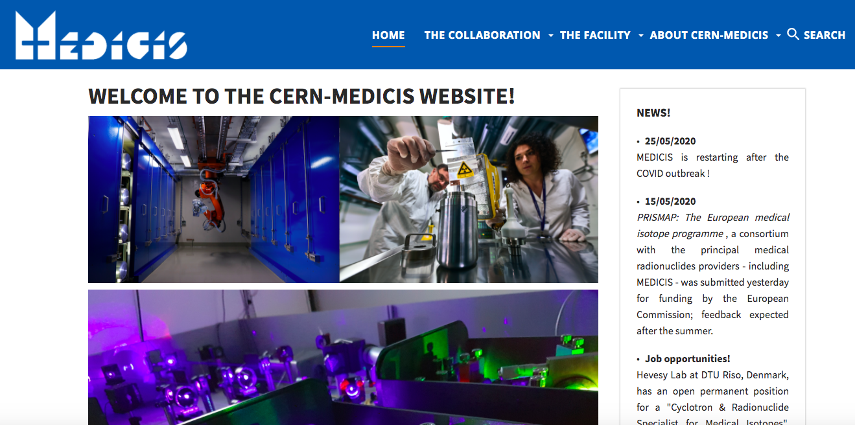
MEDICIS Status Report (02/20 to 06/20)
Technical stop completed (January and February 2020)
Successful stable beam commissioning (beginning of March)
Installation stopped and put in safe mode on 16th of March 2020 (Covid)
MEDICIS is back in operation with stable beam since 25th of May 2020
Laser alignment performed and first laser ionized beam of the year with MELISSA on 15th of June 2020!
First reception of an external radioactive source foresees for the 26th of June 2020 (Sm-153 for MED-025).
MEDICIS website is now available!
https://cern-medicis.web.cern.ch/
C. Duchemin on behalf of MEDICIS

Slide 13
Thank you for your attention!

