Slide 1




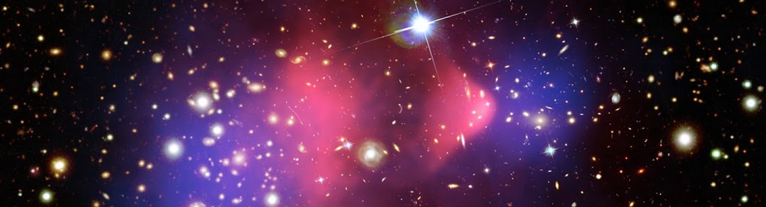

Towards a fast simulation of light detection in
LAr TPCs with deep learning techniques
Krishan Jethwa, Enrico Zammit Lonardelli,
Darren Price, Stephen Menary
ECHEP Simulation meeting
May 22nd 2020

Slide 2
Overview
Current workflows for detector simulations consume large amounts of computing power: limits events generated, simulation tuning capacity...
Is it possible to use machine learning to reduce overheads / enable more?
Very active area of research, e.g. [1--3]
We study the use of Monte Carlo generation for the DarkSide direct dark matter detection experiment as input, but this could be extended to use of calibration data or other experiments.
We explore using an autoregressive generative adversarial network (arGAN) to produce data points which follow the same distribution as those created by current simulation, but greatly reducing computing power and time required.
Our early work shows the potential for GANs to accurately replicate current Monte Carlo data with promising performance, however further iterations of our work would be required for a robust arGAN.
[1] CaloGAN: Simulating 3D high energy particle showers in multilayer electromagnetic calorimeters with generative adversarial networks, arXiv:1712.10321
[2] Image-Based Model Parameter Optimization Using Model-Assisted Generative Adversarial Networks, arXiv:1812.00879
[3] Getting High: High Fidelity Simulation of High Granularity Calorimeters with High Speed, arXiv:2005.05334

Slide 3
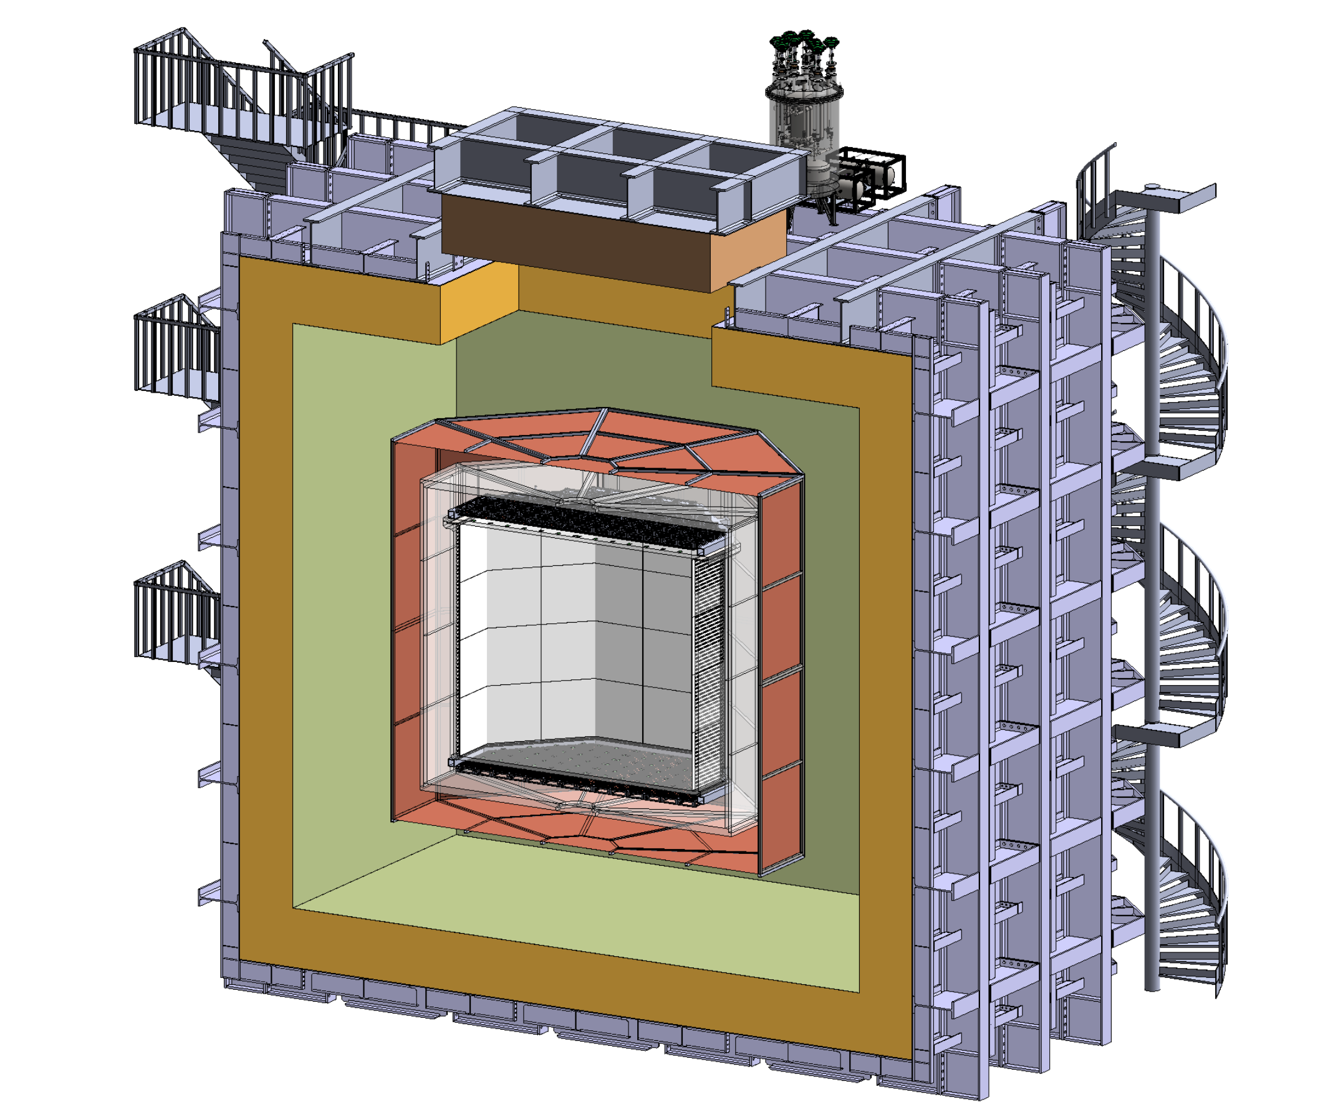
DarkSide experiment
DarkSide is a direct dark matter detection experiment due to begin taking physics data in 2023:
Primary signature: scintillation light from LAr nuclear recoil from DM interaction
Liquid Argon Time Projection Chamber
11,280 SiPMs to detect scintillation light
50t total LAr volume
Region of interest (ROI) for the WIMP search is 30 keV_{nr} to 200 keV_{nr}

Slide 4
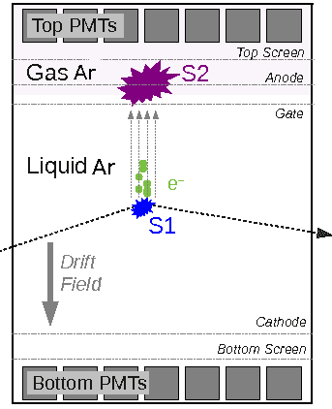
LAr TPC & Variables of Interest: S1,S2
Three key high-level observables for DM detection. First two:
S1 is first signal caused by scintillation due to excitation (7𝝁s window)
S2 signal caused by free electrons from ionisation moving to gaseous phase due to drift field (30𝝁s window)
Ratio of S2 to S1 (logarithms) is greater for background electron recoils than for DM signal
TOP SiPMs
BOTTOM SiPMs

Slide 5
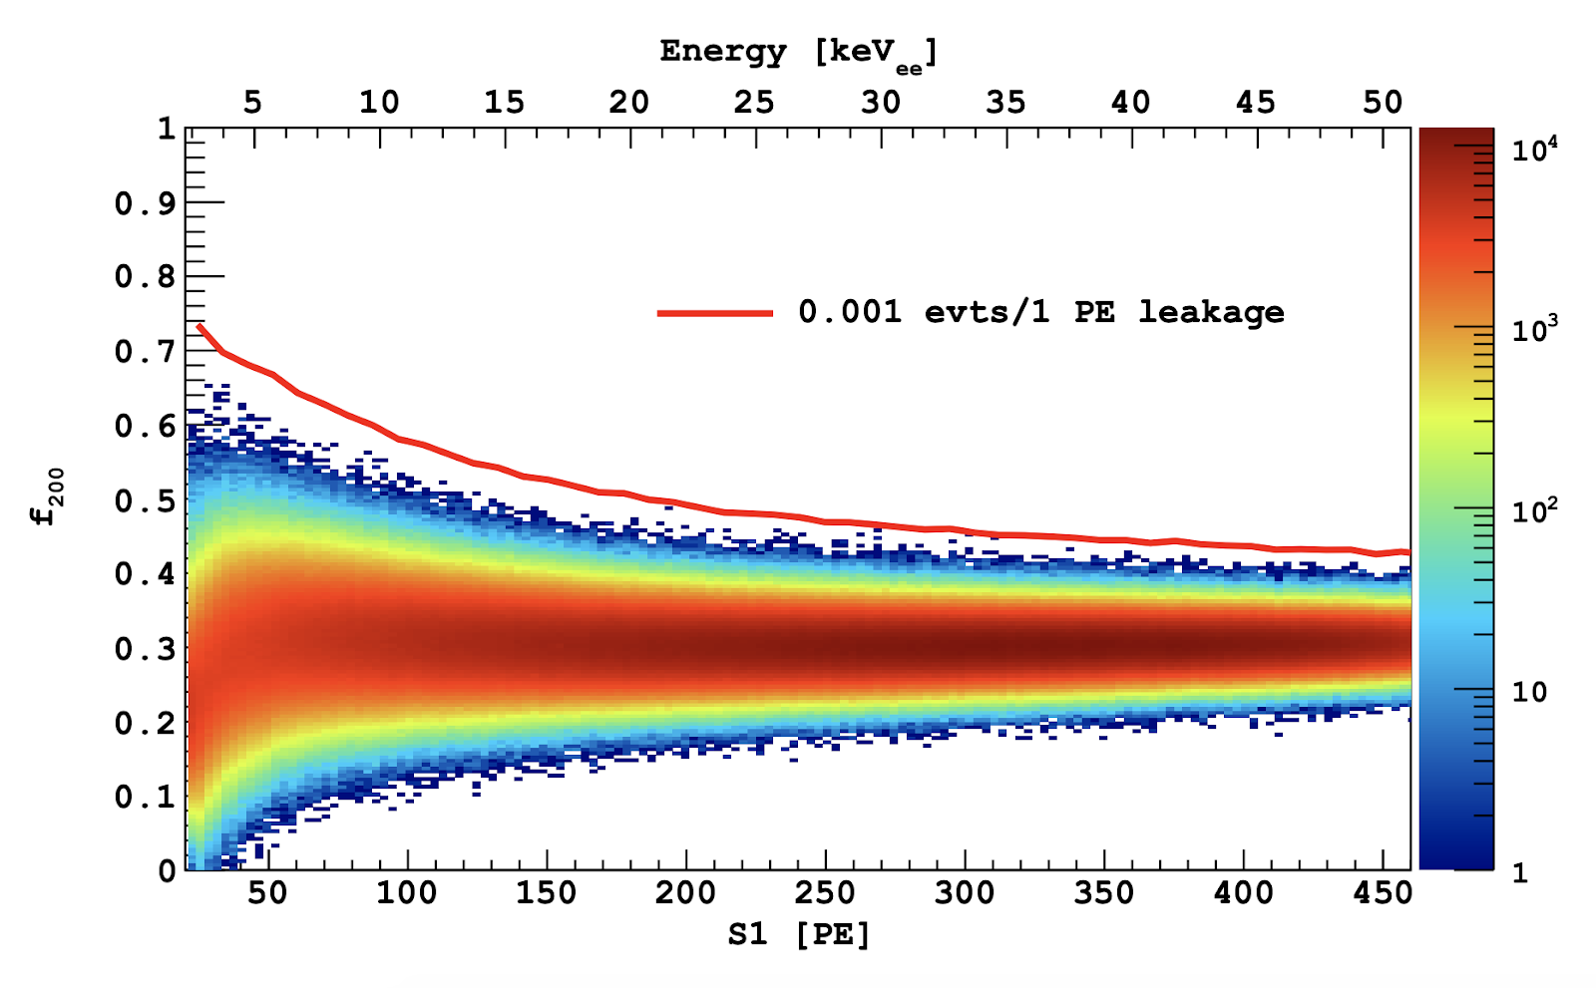
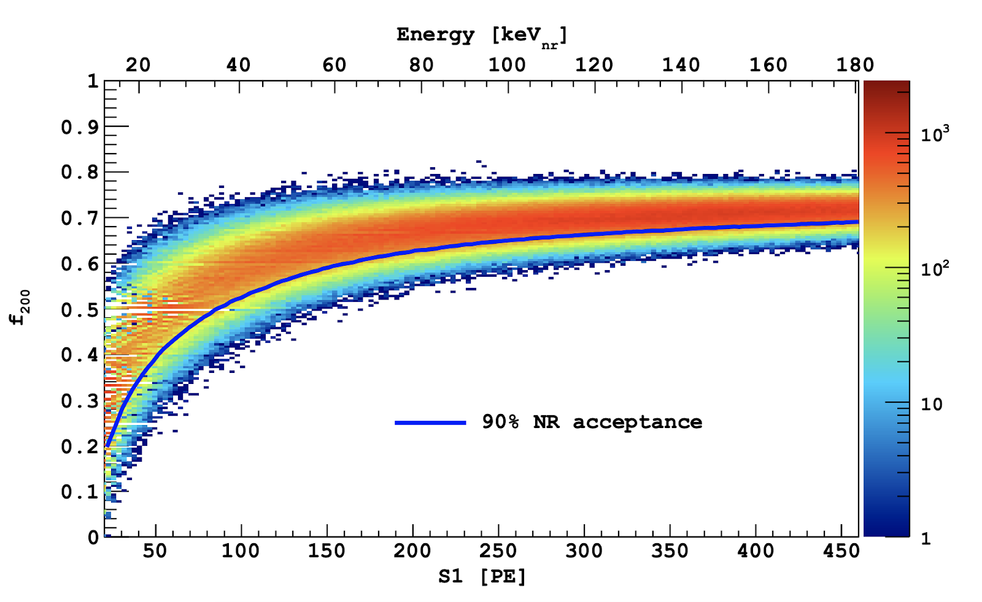
LAr TPC & Variables of Interest: f200
f₂₀₀ is the ratio of total intensity observed in first 200ns against all S1
Pulse shape discrimination uses correlations between S1 and f₂₀₀ to distinguish signal and background events
DS20k Geant4 Simulations Background
DS20k Geant4 Simulations Signal

Slide 6
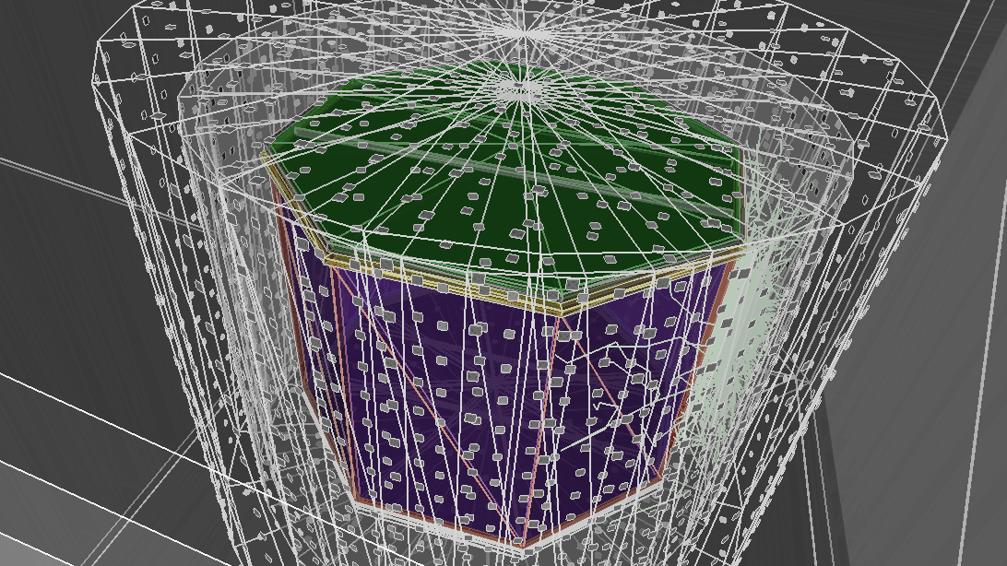
Geant4 DarkSide (G4DS)
Sample configuration used in G4DS for DarkSide
  Monte Carlo methods based on Geant4
  G4DS implementation of DarkSide in G4 providing detailed geometry descriptions, physical processes and the full optical propagation of photons produced by scintillation in liquid argon and electroluminescence in gaseous argon.

Slide 7
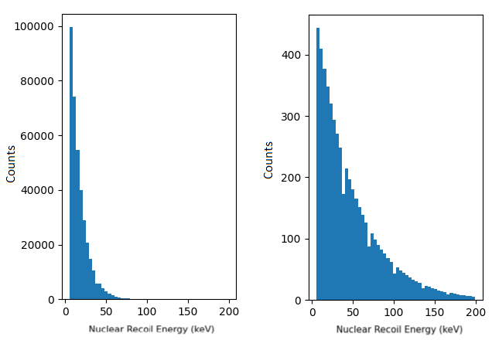
G4DS - Output
Recoil spectra for spin-independent WIMPs
G4DS simulates result of dark matter interaction within TPC
Each dark matter mass ( m_{𝝌} ) has a unique nuclear recoil spectrum
For each nuclear recoil energy, we expect unique distributions of S1, S2, and f₂₀₀
log( m_{𝝌} )=1.5
log( m_{𝝌} )=4

Slide 8
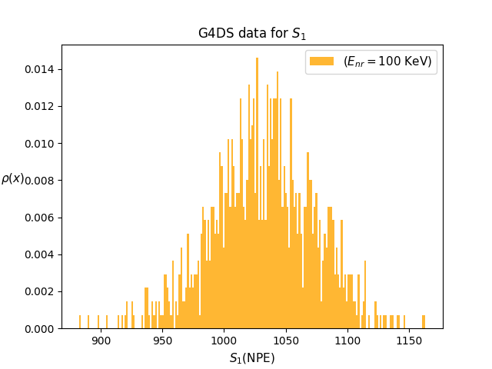
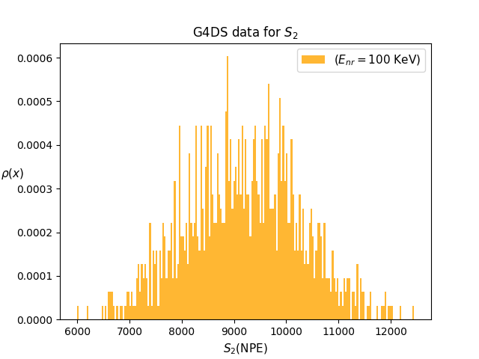
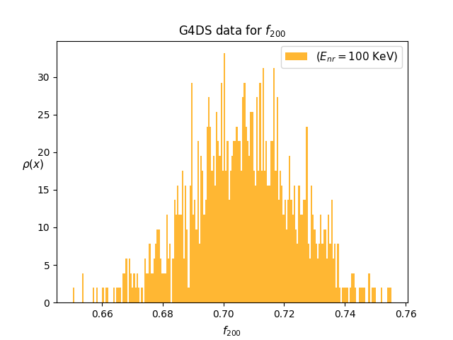
G4DS - Output
Example of S1, S2, f200 distribution for 100 keV elastic nuclear recoil (signal)
G4DS simulates result of dark matter interaction within TPC
Each dark matter mass ( m_{𝝌} ) has a unique nuclear recoil spectrum
For each nuclear recoil energy, we expect unique distributions of S1, S2, and f200

Slide 9
G4DS
Disadvantages
Very slow for tracking large number of photons (S2 >> S1)
Changing initial setup (for tuning of simulation, generation of new signal or background models) means full re-simulation
Advantages
Accurate as it is proven to model real data well
Used widely in particle physics so known to be trustworthy

Slide 10
Can we reduce time spent simulating?
Machine learning changes the focus on where processing time is spent.
Long training done once -> Run trained models very fast, many times
Machine learning is widely used for classification, however generative models have proven to be more difficult to train.
Possible generative models include generative adversarial networks (GANs) and variational autoencoders (VAEs).
GANs were investigated as they are very fast to sample, and produce a stochastic result identically to how usual MC simulation works. Furthermore, in principle they can learn to sample from the "true" underlying distribution with no approximation or smoothing, which other methods do.

Slide 11
Training Dataset
Network was trained on G4DS data from [5,235] keV in steps of 1 keV for S1, S2 and f₂₀₀.
Trained for 10,000 cycles of learning (epochs)
Desired final product:
  Input: a nuclear recoil energy
  Output: a distribution for each of these variables.

Slide 12
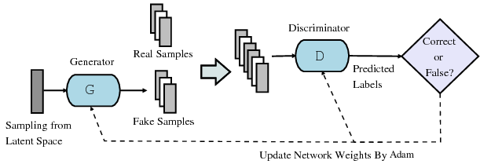
GAN
Two neural networks: Generator and discriminator.
  Generator: Attempts to create datapoints following same underlying
  distribution as G4DS.
  Discriminator: Attempts to distinguish real and generated datapoints.
Still requires G4DS simulation/ data to act as ‘real samples’

Slide 13
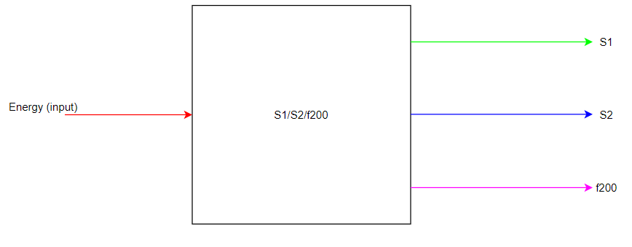
3 variables, 1 condition
Single GAN producing all three variables was initially favoured
We found that it was difficult for one GAN to accurately produce all three distributions

Slide 14
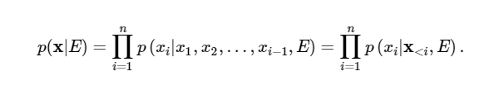
Autoregressive GAN
Uses chain rule of probability:
Break up vector of distributions into components
Conditions for the next variable are all the variables learnt previously + nuclear recoil energy

Slide 15
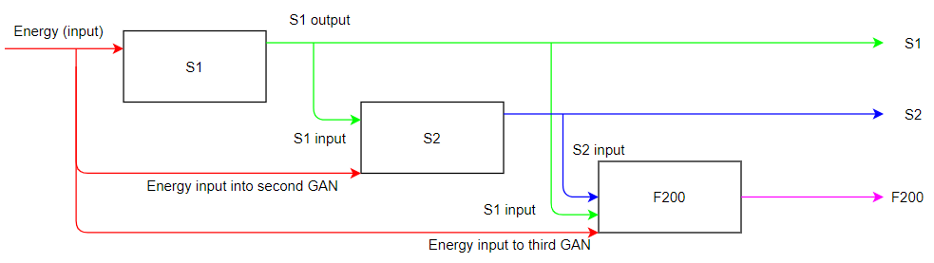
Autoregressive GAN layout
Each box is one GAN, trained separately. Each modules output is given as a condition to subsequent modules.

Slide 16
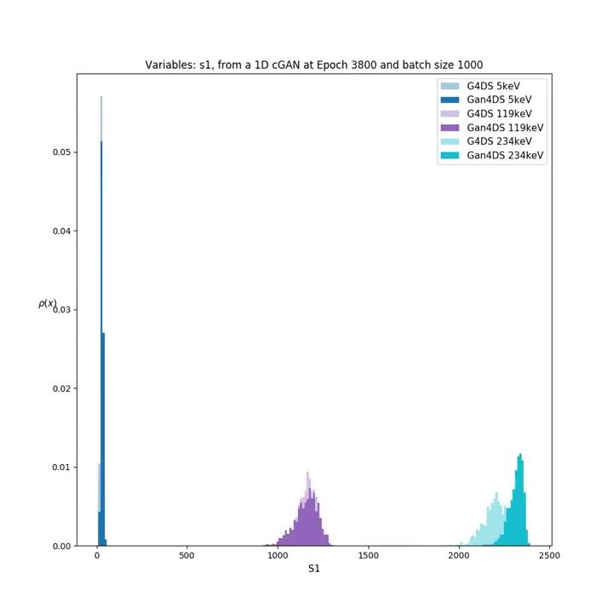
GAN4DS Training on S1 Demonstration

Slide 17
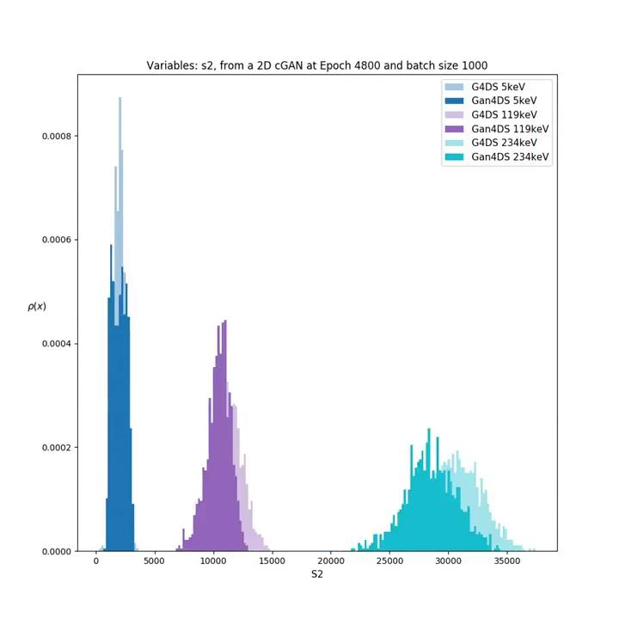
GAN4DS Training on S2 Demonstration

Slide 18
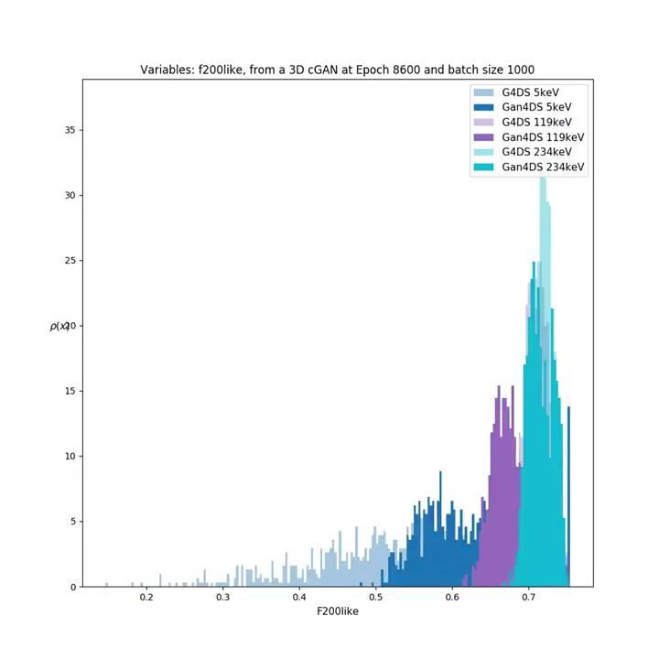
GAN4DS Training on f200 Demonstration

Slide 19
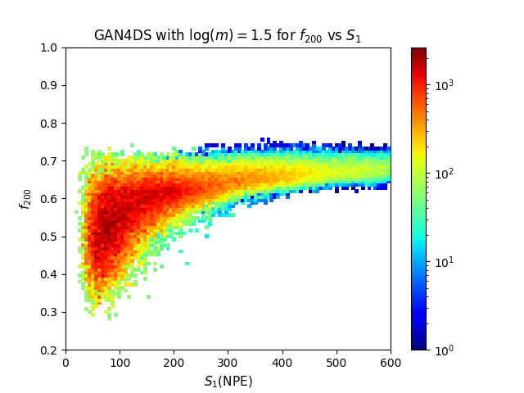
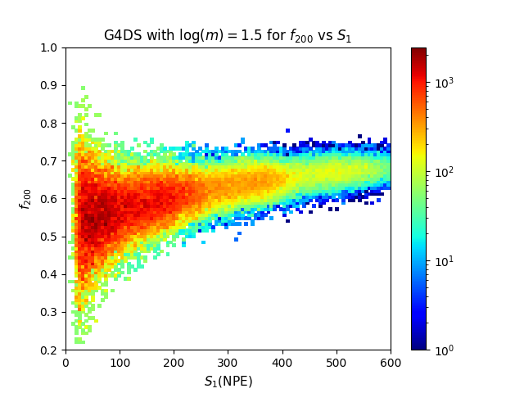
Discrimination Plots: f200 vs S1
Shape agrees with G4DS
Significant differences for lower values of S1 (correlate with lower NR energies).

Slide 20
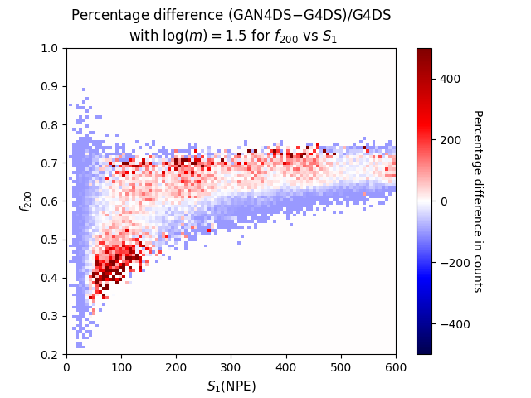
f200 vs S1 : GAN4DS - G4DS
Differences plot shows low S1 modelled more poorly than higher S1
Comparable to GAN performing worse for lower nuclear recoil energies than for higher ones
Symmetries appear for under and over estimation by the GAN of the G4DS data - A kind of offset

Slide 21
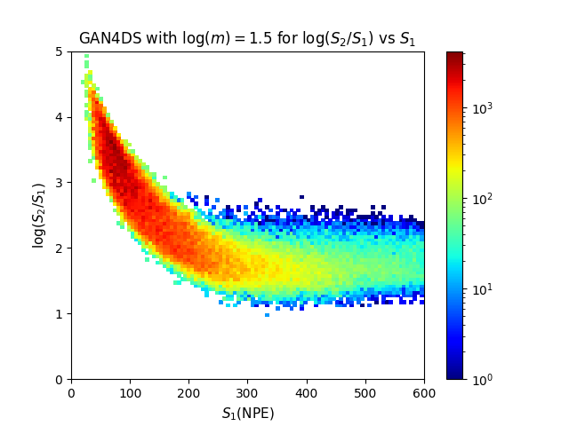
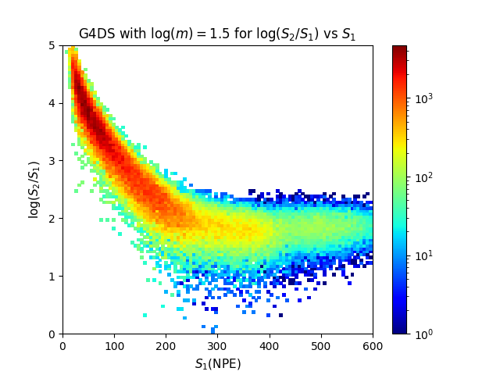
Discrimination Plots: log(S2/S1) vs S1

Slide 22
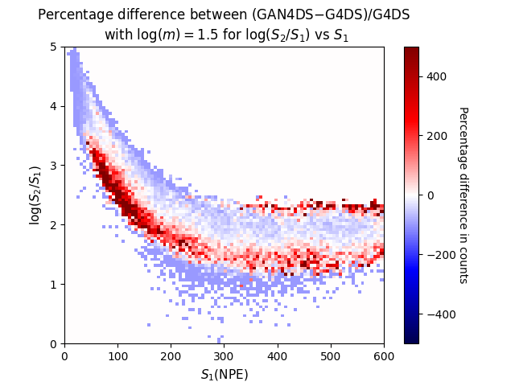
log(S2/S1) vs S1: GAN4DS - G4DS
Low S1 is modelled more poorly
Symmetry appears as before
For a given S1, the log(S2/S1) has a lower mean than expected

Slide 23
Analysis of Distributions
Wanted to be able to quantitatively compare distributions to G4DS.
Can therefore understand the flexibility of current architecture, and
understand energies it is modelling well/poorly.
Decided to use permutation test as well as the Wasserstein distance.

Slide 24
Permutation test & Wasserstein Distance
Permutation test is a frequentist test to compare two sets of data.
Null Hypothesis: Two datasets follow same underlying distribution
For two data sets, A of size n and B of size m, calculate the absolute difference between the geometric means , Z.
We then combine all data points into a single data set, and draw a permuted data sets from all permutations of the joint data set, of equal size.
For permuted data set, compute difference in mean.
p value is number of times we obtain difference in mean greater than in step 1.
Wasserstein Distance to gauge difference between distributions. It is the ‘minimum energy required to transform one distribution to the other’.

Slide 25
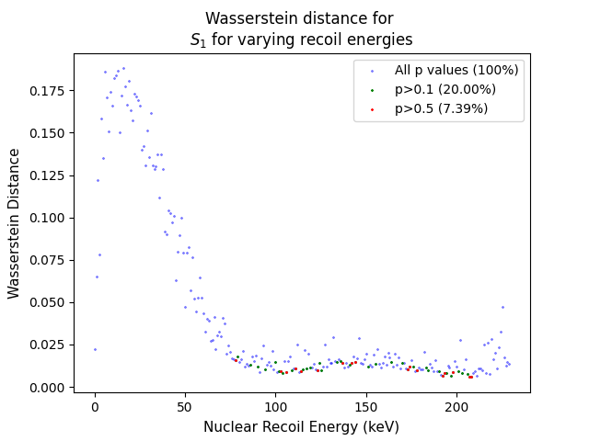
Analysis on S1 across NR energy domain
Permutation test values agree with Wasserstein distance.
Low energies are modelled significantly more poorly than higher energies
Leads to bell-shaped curve at low energies.

Slide 26
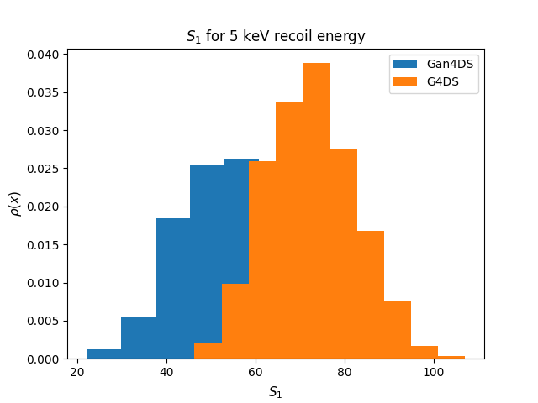
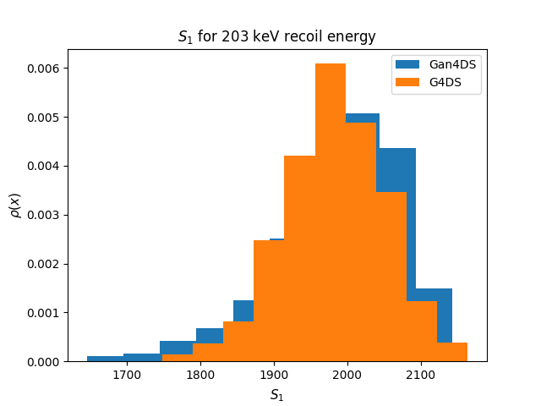
Analysis on S1 across NR energy domain
On the left, the GAN output is compared to the G4DS output for two energies.
This supports the Wasserstein distance plot, as the low energy distributions are less similar than the high energy distributions.

Slide 27
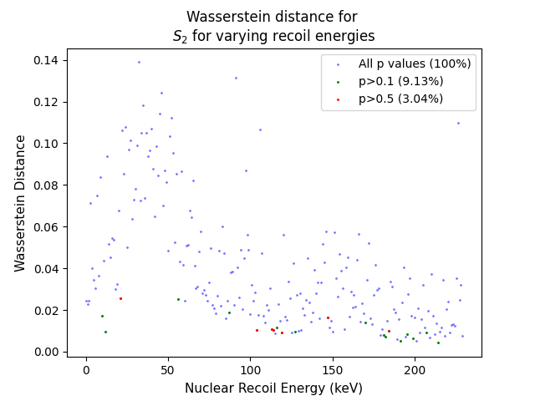
Analysis on S2 across NR energy domain
Average Wasserstein distance is lower when compared to S1.
Lower energies modelled less well than higher energies, but biases less prevalent.
GAN seems to learn when S1 datapoint is bad and accounts for it.

Slide 28
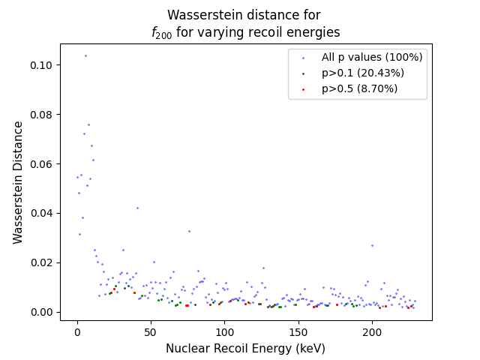
Analysis on S2 across NR energy domain
Average Wasserstein distance is lower compared to S1 and S2.
Lower energies modelled worse than higher energies, but bell curve even less prevalent compared to S1 and S2.

Slide 29
Processing Times Comparison
G4DS
GAN4DS
Training
222 hrs (∼9 days)
Generation
78 hrs (∼3 days)
1.5 mins
G4DS/GAN benchmarks each for 1000 events per NR energy, for energies [5,235] keV in steps of 1 keV
GAN trained on a NVIDIA TESLA V100 16GB memory, Intel(R) Xeon(R) CPU E5-2620 v4 @ 2.10GHz and 48 GB RAM
G4DS obtained on AMD Opteron(tm) Processor 6278 @ 2.4 GHz and 132 GB RAM

Slide 30
Next steps
The potential of GANs to reproduce fast high-level LAr DM detector outputs compared to G4 simulations demonstrated in these initial ArGAN studies
Fixes to observed discrepancies expected in near future (currently being developed)
Our developments envisaged along two streams:
Implementation enhancements — more versatile architectures:
  Patch-GAN: Different GANs for different energies
  VAEs as a possible alternative
  Wasserstein GANs as a standalone study
Particle physics applications:
  Add recoil location (r, z) as conditions (under study)
  Train for low-level outputs: #photons on SiPMs with timing information (under study)
  Future directions:
    Training against calibration data for data-driven background modelling
    Study potential use to constrain physical simulation parameters from data
Working towards broader applications building on this base architecture:
feedback on what is of interest to this community for study in coming months?

Slide 31
Backup

Slide 32
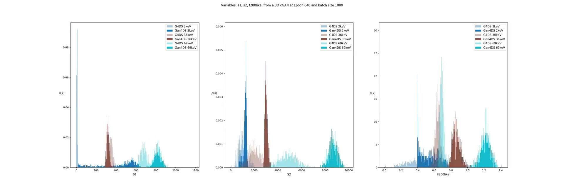
3 variables, 1 condition
Video of GAN during training shown below, very difficult for it to converge on all variables at once.

Slide 33

Tensorboard
We implemented a reusable, scalable solution in Python3 we call GAN4DS
Used Tensorboard for monitoring metrics + histograms + individual layers of the network
Interchangeable layouts to be able to test different configurations
  Layout markup language is separate to the Python implementation

Slide 34
Saving distributions
At every 100 epochs (out of total 10,000 epochs)
Calculated manhattan distance between distributions for lowest, highest and median energies
If new calculation is less than last calculation - saved weights and current model
Notes:
E

Slide 35
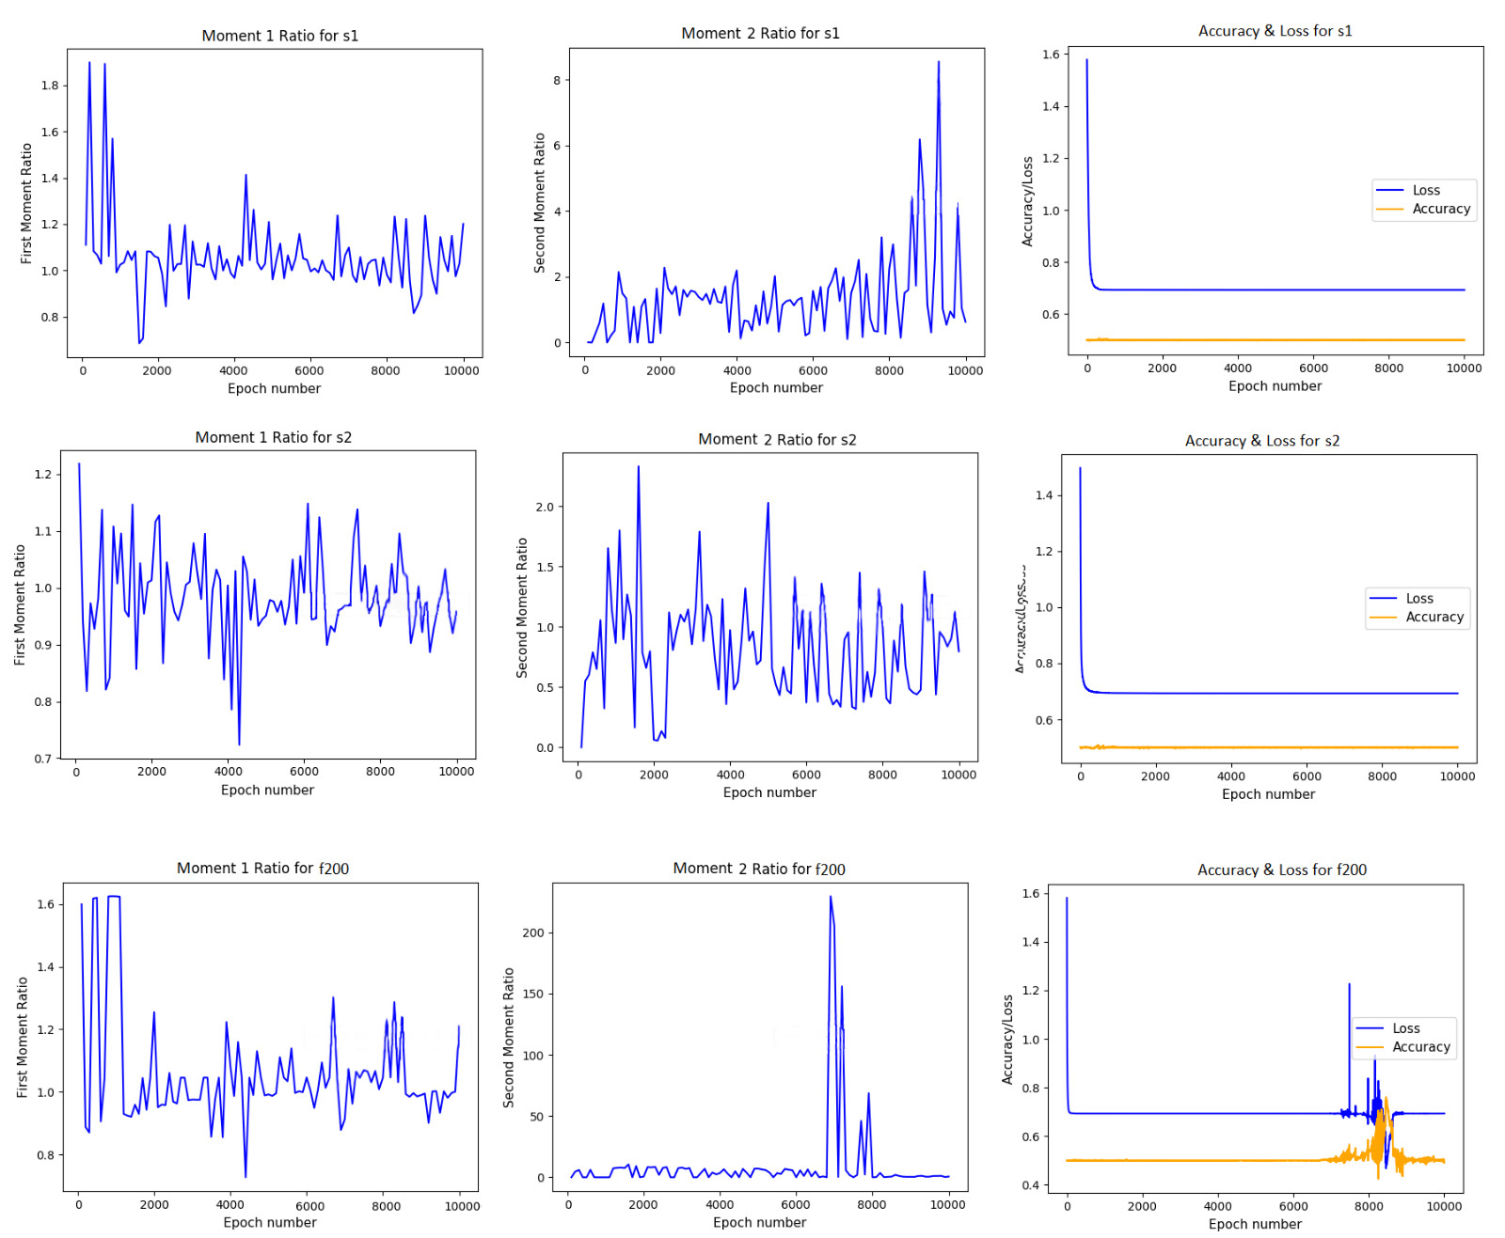
Moments
Every 100 epochs (out of total 10,000 epochs)
Moments were used to analyse the output of the GAN.
Even though loss/accuracy is constant, the generated distributions are still training - illustrating a failure mode of the GAN
Notes:
?

