Slide 1
Topic: Standard animation of device widgets
Vacuum Supervisory applications Users’ meeting
Goal: Discussions and decisions to standardize device widget animation
Approval discussion for the EDMS doc https://edms.cern.ch/document/2317395
"Device Widget Animation in Vacuum Supervisory Applications"

Slide 2





What is a device widget?: It is the representation (animated icon) of an instrument in the supervisory synoptic.
Why such document?: avoid below animations, very busy and difficult to see

Slide 3
Standard animation of device widgets in Vacuum Supervisory applications
Interlocks | Letters
Interlocked | I
Device selected
MODE | Letter
Forced Mode | F
MAIN STATUS | Body filled colour | PRIORITY
NOT REMOTE CONTROLLED | Grey | Highest Lowest
NO COMMUNICATION | Blue
CLOSED (Valve) BAD (Hardware Alarm) ERROR (all other devices) | Red
DEVICE SPECIFIC STATUS | Orange
WARNING | Yellow
OFF | White
UNDER RANGE | Dark Green
ON or OPEN or OK | Green
I
F
Order WHEN DIFFERs FROM STATUS | Letters
ON or Open order | ON/OP
OFF or Close order | OFF/CL
CL
HARDWARE Interlocks and Alarms | Arrow
Local pressure interlock for next valve
Local pressure interlock for previous valve
Local pressure interlock for both previous and next valve
External Alarm
If there is no issue and device is operated in normal conditions, widget does not show any satellite letter.

Slide 4
“The color code is wrong. Missing purple for error status and the red should be used just for the closed command. ” (Giuseppe)
Will make sense.
The drawback is current animation for error (except Valve) is Red, so it is a change with a lot of impact. Pumps and gauges in error will be PURPLE!
Decision Error color : RED/PURPLE ?
MAIN STATUS | Body filled colour | PRIORITY
NOT REMOTE CONTROLLED | Grey | Highest Lowest
NO COMMUNICATION | Blue
CLOSED (Valve) BAD (Hardware Alarm) ERROR (all other devices) | Red
DEVICE SPECIFIC STATUS | Orange
WARNING | Yellow
OFF | White
UNDER RANGE | Dark Green
ON or OPEN or OK | Green
MAIN STATUS | Body filled colour | PRIORITY
NOT REMOTE CONTROLLED | Grey | Highest Lowest
NO COMMUNICATION | Blue
ERROR | Purple
CLOSED (Valve) BAD (Hardware Alarm) | Red
DEVICE SPECIFIC STATUS | Orange
WARNING | Yellow
OFF | White
UNDER RANGE | Dark Green
ON or OPEN or OK | Green

Slide 5
“used orange color for warning and yellow for undefined position state, in the regular yellow to red scale.” (Giuseppe)
This is up to you. The device specific status is most of the case more critical than the warning
Ex: a puming group may be :
- yellow (warning) because auto-restart occurred
- orange (device specific status) because in recovering mode
Note: Some device types has no device specific status and so orange color is not relevant
Decision Warning color : YELLOW/ORANGE ?

Slide 6
“ “I”: Is it interlocked? or it gives an interlock, how it is managed? Why having on the widget? ” (Giuseppe)
Means device is interlocked (i.e. for VVR valve of pumping group the valve is interlocked when turbo not at nominal speed, it means the valve will not open with a normal open order)
Requested by Jaime for VVR valve of pumping group, extended to any other device type that may be interlocked (standardization)
Decision: Keep the “I” tag ?
“ “F”: Force mode, not clear for which command (Giuseppe)
The detail is device specific (ditto “Interlocked”) and so will be mentioned in the device type documentation that is not the scope of this document.
Requested by Jaime for VVR valve of pumping group, extended to any other device type that may be interlocked (standardization)
Decision: Keep the “F” tag ?

Slide 7
“Orange color should be: Undefined status, How the system distinguishes between blue and orange? ” (Giuseppe and Jose)
“Undefined” is misleading, i.e. currently for a valve it can means the communication with the PLC is interrupted or the position of the gate is between opened and closed.
But maybe it is not important to have different animation at the synoptic level?
The Sector valves paragraph has been removed from this document.
There is no plan to change animation of Sector valves before Run3.
The decision here will only impact pumping group valves (new control).
But better to define standards now that VVS can benefit later.
Decision: Change “Not open neither closed” by “Undefined” or “Intermediate position” or “Unknown position” ?
For valve remove ORANGE color only use BLUE ?

Slide 8
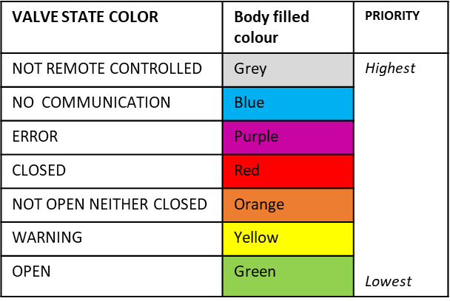
Valve p.6 “We need example of status: When do we have a yellow code? ” (Giuseppe)
Warning status meaning is device control type specific
At widget level we have only the information there is a warning.
To have details operator has to open details panel.
Decision: Remove Warning/Yellow state from widget animation ?
Exemple: Unknown position valve (orange) Interlocked, Forced, Open order

Slide 9
Pumping Group p.7 “What happen when plug-in the touch panel in local? Is it possible to have a kind of “local mode”? (Julien)
It could be implemented, currently nothing avoid sending remote order when operator locally (with touch panel) act on pumping group
Decision: Do you want a tag or an animation that report local mode at the widget level?

Slide 10
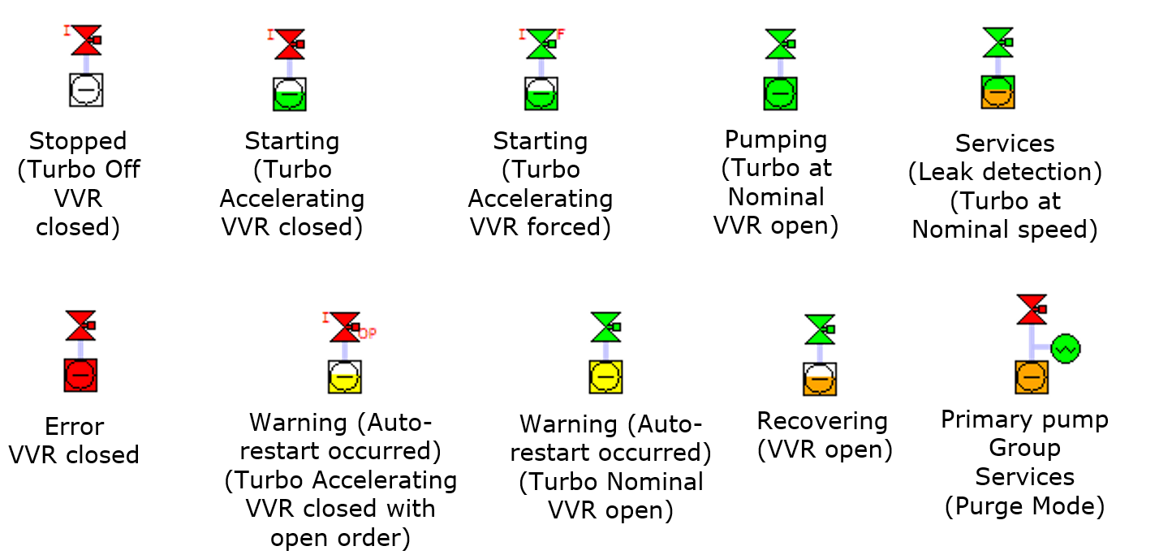
Pumping Group p.8 “This is different from the animation the new groups have? We cannot have half color . This is practically impossible to follow ” (Giuseppe)
Jaime requested different animations for all the below states. This is not possible with a single color, so the body has been split horizontally in two areas.

Slide 11

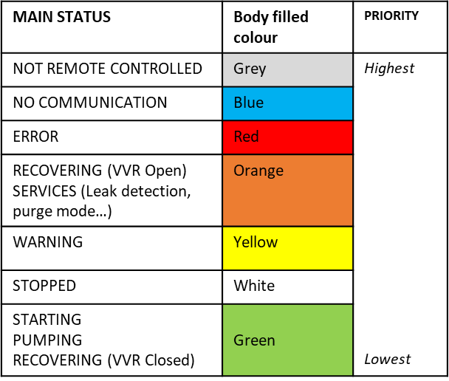
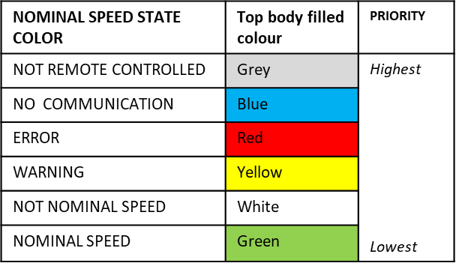
Pumping Group p.8 “The white color is wrong, this is defined as stopped. The error code should be the purple, and the not nominal speed should be orange? ” (Giuseppe)
Decision: Keep the split animation or roll back to single color (current LHC app animation)?

Slide 12
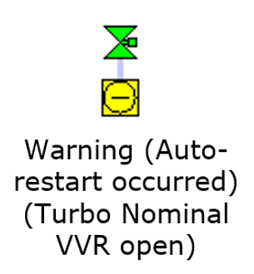
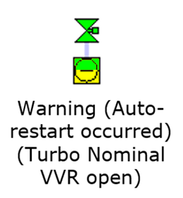
Pumping Group p.8 “Why not to have the TMP in green/yellow?” (Julien)
In document :
NOMINAL SPEED STATE COLOR | Top body filled colour | PRIORITY
NOT REMOTE CONTROLLED | Grey | Highest Lowest
NO COMMUNICATION | Blue
ERROR | Red
WARNING | Yellow
NOT NOMINAL SPEED | White
NOMINAL SPEED | Green
You mean changing to:
NOMINAL SPEED STATE COLOR | Top body filled colour | PRIORITY
NOT REMOTE CONTROLLED | Grey | Highest Lowest
NO COMMUNICATION | Blue
ERROR | Red
NOT NOMINAL SPEED | White
NOMINAL SPEED | Green
Decision: Agree with change?

Slide 13
Pumping Group p.8 “: I am surprised that the Recovering Mode (VVR open) exists → I find it very dangerous for the above VVR vacuum system” (Eric)
This document is not a functional specification for pumping group.
This mode is only for Insulation Vacuum pumping group.
Recovering
(VVR open)

Slide 14
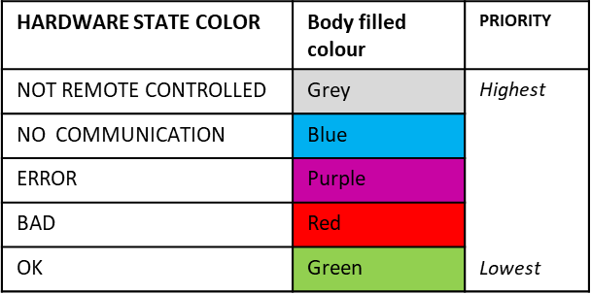
Hardware Alarm Group p.9 “Again, yellow is warning, Orange for specific status, Error for purple, I do not know why Red is BAD and what does it means, but makes no sense.” (Giuseppe)
There is no warning status for Hardware Alarm, so I remove the warning row from the table.
There is no specific status for this device type, so no ORANGE (actually most of the device types have no specific status)
BAD means alarm is raised, (the output signal of the alarm is low) if not RED what should be the color?

Slide 15
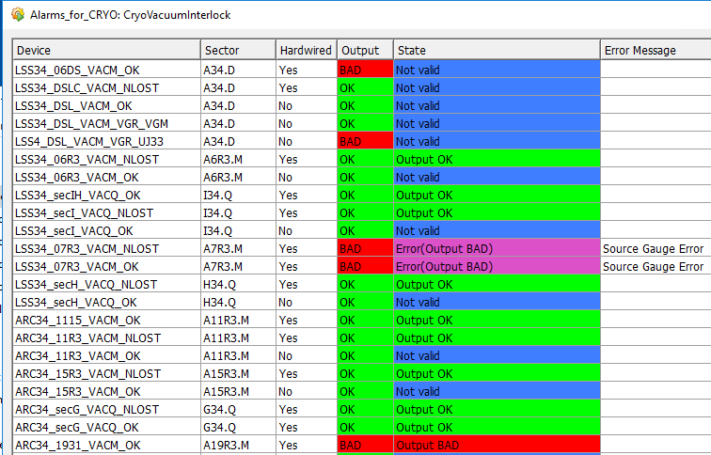
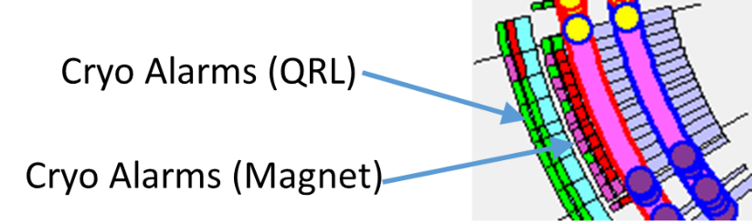
Hardware Alarm Group p.10 “If you cannot change the color code of “Output” column at least the “State” one has to respect the global color” (Giuseppe)
The output column is new, it reports the output binary level (low level -> BAD -> RED or high level -> OK -> Green)
The state is not binary in addition to OK or BAD it has NOT REMOTE CONTROLLED, NO COMMUNICATION, ERROR.
Color of state in the table is same as color of the alarm rectangle in the main panel.

Slide 16
Controller relay alarm p.10 “To be reviewed as said based on a global color code and not based on an equipment”(Giuseppe)
The arrow follow the global color code.
MAIN STATUS | Body filled colour | PRIORITY
NOT REMOTE CONTROLLED | Grey | Highest Lowest
NO COMMUNICATION | Blue
ERROR | Purple
CLOSED (Valve) BAD (Hardware Alarm) | Red
DEVICE SPECIFIC STATUS | Orange
WARNING | Yellow
OFF | White
UNDER RANGE | Dark Green
ON or OPEN or OK | Green

