Slide 1
PHIN outlook towards a CLIC Drive Beam photo injector
PHIN original specifications and plans
CLIC Drive Beam Injector parameters
Can PHIN be used to study the photo injector option
for CLIC
Conclusions

Slide 2
Original PHIN specification
Parameter | Nominal value | Unit
Beam Energy | 5.4 | MeV
Pulse Length | 1.54 / 140 | μs / ns
Beam current | 3.5 | A
Bunch charge | 2.33 | nC
Number of bunches | 2310
Total charge per pulse | 5.4 | μC
Bunch spacing | 0.666 | ns
Emittance | 14 | mm mrad
Repetition rate | 5 | Hz
Charge variation shot to shot | 2 | %
Charge flatness on flat top | 0.25 | %
The above parameters have been essentially achieved with PHIN
RF-gun: 3 GHz, 85 MV/m nominal, 30 MW power (19 MW beam)

Slide 3
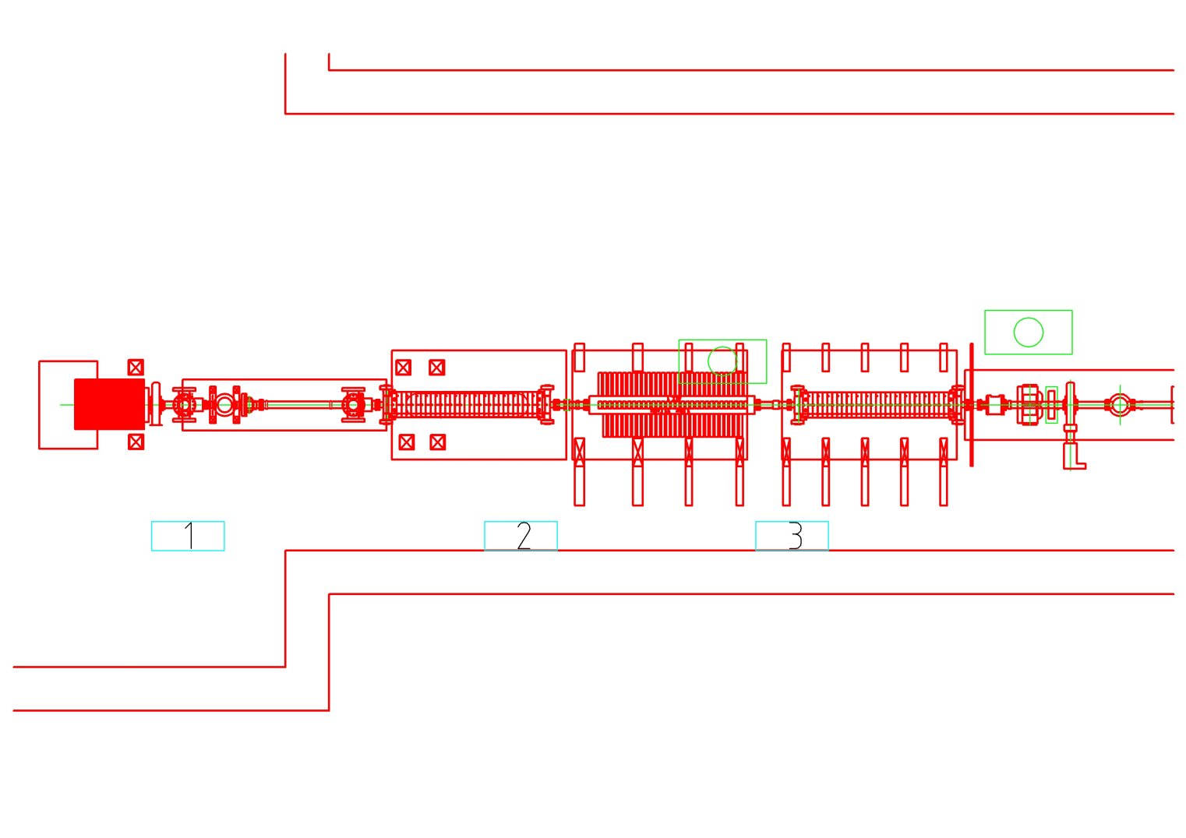
PHIN in CTF3
Implementation in CTF3 has been studied and is feasible
However, does not seem to be the right thing to do at this moments
(Impact on schedule, stability, availability, current)
Probably more useful to use PHIN for R&D towards CLIC

Slide 4
CLIC Drive Beam injector
Parameter | Nominal value | Unit
Beam Energy | 50 | MeV
Pulse Length | 140.3 / 243.7 | μs / ns
Beam current | 4.2 | A
Bunch charge | 8.4 | nC
Number of bunches | 70128
Total charge per pulse | 590 | μC
Bunch spacing | 1.992 | ns
Emittance at 50 MeV | 100 | mm mrad
Repetition rate | 100 | Hz
Energy spread at 50 Mev | 1 | % FWHM
Bunch length at 50 MeV | 4 | mm rms
Charge variation shot to shot | 0.1 | %
Charge flatness on flat top | 0.1 | %
Allowed satellite charge | < 7 | %
Allowed switching time | 5 | ns

Slide 5
CLIC Drive Beam injector
Baseline: Thermionic gun with 500 MHz sub harmonic bunching and bunch compressor, 1 GHz acceleration
Advantages of a photo injector for the CLIC DB
Time structure already defined by the laser
Satellite free phase coding, less loses
No bunching system needed and less bunch compression later on
Smaller emittance (< 10 μm in theory, < 40 μm from PHIN extrapolation )
{thermionic gun is specified for < 100 μm }
(FEL community: Emittance: ~ sqrt(Q[nC]) independent of technology)
Disadvantges:
Need to operate a high power laser and ‘frequent’ cathode changes

Slide 6
Critical parameters and tests
Very long bunch train, long pulse rf system and laser
High total charge, cathode limitations and lifetime
High average power, rf-gun cooling, laser elements (crystals)
New bunch spacing, which frequency for the rf-gun
Vacuum limitations, cathode lifetime
Demanding stability, laser and rf system
Laser power, peak and average, repetition rate and frequency

Slide 7
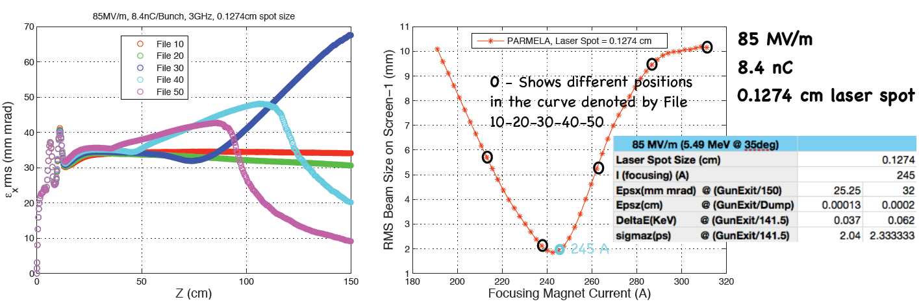
8.4 nC in PHIN
85 MV/m
It seems we can work with 8.4 nC bunches in PHIN
Upgrade focusing ?
Öznur Mete

Slide 8
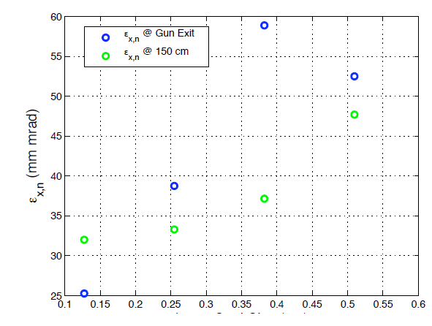
8.4 nC in PHIN
85 MV/m
Laser spot size (cm)
Reasonable emittances can be expected,
improvement by laser pulse shaping can be expected
Next steps for simulations: lower gradient, change frequency
Öznur Mete

Slide 9
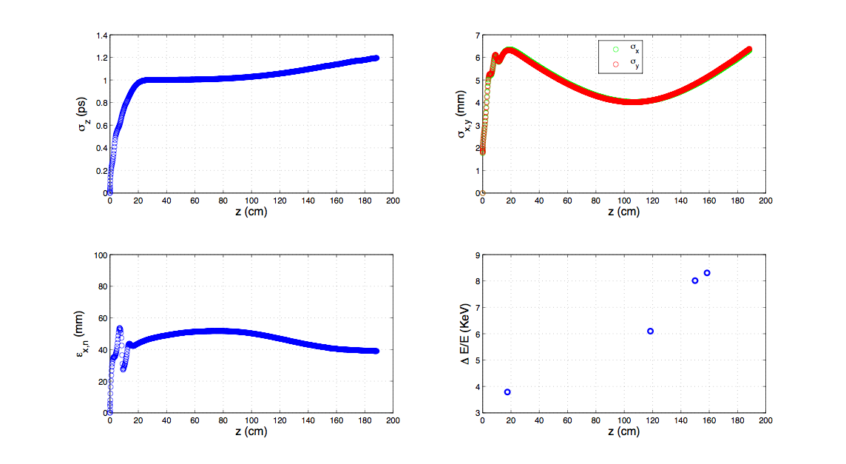
8.4 nC in PHIN
40 MV/m
Preliminary results: Energy 2.5 MeV
Öznur Mete

Slide 10
What has to be shown, what can be done
8.4 nC single bunch quality in CLIC type RF-gun, realistic gradient
Stability of full laser pulse with correct, peak and average power
Power handling of the rf-gun
Rf-system design
Cathode lifetime under ‘realistic conditions’
Eventually nominal CLIC drive beam
Possible in PHIN with laser power upgrade
Needs PHIN laser upgrade, new oscillator and additional amplifier
Need long pulse klystron, new rfgun, look at DESY
RF-gun design needed, rest has to be done anyway for CLIC DB,
See if higher bunch repetition frequency and DC-gun can do that
Full set up needed but can demonstrate everything of course

Slide 11
Possible strategy
Simulation study to optimize the CLIC DB photo injector
Design study of rf-gun, frequency, beam loading, cooling
Continue working with PHIN and try to produce nominal bunch charge
Upgrade PHIN laser to study high peak and average power, compare stability
Continue cathode development to access lifetime data relevant for CLIC
Design rf system needed for CLIC DB photo injector, as well needed for thermionic gun
Eventually build realistic photo injector
2013

Slide 12
Conclusions
Photo injector is an attractive option for CLIC DB
Difficult to demonstrate challenging parameters without building the full injector
Some problems can be studied with simulations, PHIN and the PHIN-laser
Needs beam time for PHIN and development time for the laser
Should try to make use of other facilities (LAL, PITZ, Flash)
Can we think of a DB injector test facility which allows to test both options, when do we select the solution for CLIC

