Slide 1
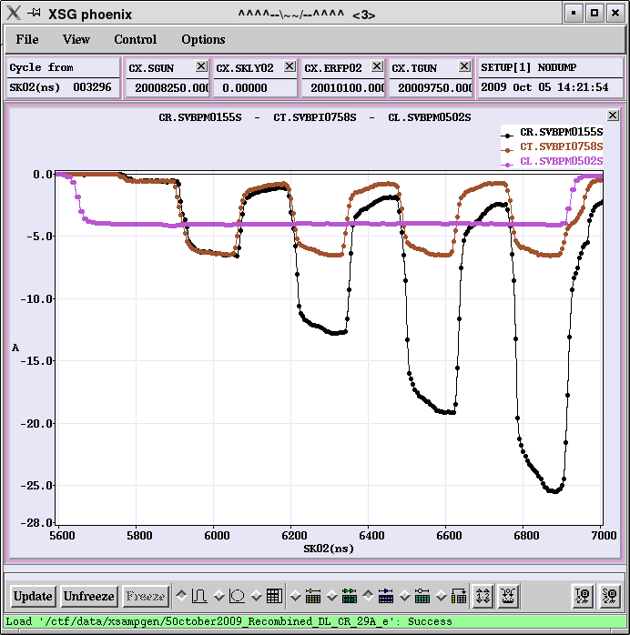
Status of CTF3 Feasibility Studies
Experimental program in 2010, 2011
Introduction
CTF3 present status
(the good news and the bad news)
Future program 2010/11
Conclusion
Current from
Linac
Current after
Delay Loop
Current in the ring

Slide 2
CLIC feasibility issues @ CTF3
SYSTEMS |  | Critical parameters | Relevant Facilities Common with ILC in red
Structures | Main Beam Acceleration Structures: Demonstrate high-power operation of nominal CLIC structures with damping features at the design gradient, with design pulse length and breakdown rate | Average loaded gradient 100 MV/m total/flat-top pulse length 240/160 ns breakdown probability/pulse < 3·10-7 /m average a/λ > 0.11 Long range wakefield <6V/(pC*m*mm ) | CTF2&3 (2005-2010) Test Stand (2009-10) SLAC/NLCTA SLAC/ASTA KEK/NEXTEF
 | RF Power production structures: Demonstrate high-power operation of nominal PETS with damping features at the design power, with design pulse length, breakdown rate and on/off capability | Generated power 132 MW total/flat-top pulse length 240/160 ns breakdown probability/pulse < 1·10-7 /m Wakefield < 9 V/(pC*m*mm ) On/Off/adjust capability | CTF3 (2005-2010) CTF3/TBTS (2008-10) CTF3/TBL (2009-10) SLAC/ASTA
Two Beam | Two Beam Acceleration and module integration: Demonstrate two-beam acceleration and operation in a prototype module equipped with all critical subsystems | Two Beam Acceleration at nominal parameters as given above for individual components Pulse shape accuracy < 0.1% | CTF2&3/TBTS (2004-10)
Drive Beam | Drive Beam Production - Beam generation and combination - phase and energy matching - Potential feedbacks | 100 A peak current- 590 μC total charge 12 GHz bunch repetition frequency, 1 mm rms bunch length 0.2 degrees phase stability at 12 GHz 7.5 10⁻⁴ intensity stability | CTF3 (2005-2010) CTF3/TBL (2009-10) Simulations X-FEL LCLS
 | RF power generation by Drive Beam - Rf power extraction - Beam stability | 90% extraction efficiency Large momentum spread | CTF3/TBL Simulations
Beam Physics | Generation and Preservation of Low Emittances Damping Rings, RTML and Main Linacs | Emittances(nm): H= 600, V=5 Absolute blow-up(nm): H=160, V=15 | ATF, SLS, NSLSII Simulations LCLS, SCSS
Stabilization | Main Linac and BDS Stabilization | Main Linac : 1 nm vert. above 1 Hz; BDS: 0.15 to 1 nm above 4 Hz depending on final doublet girder implementation | CESRTA ATF2
Operation and reliability | Operation and Machine Protection Staging of commissioning and construction Machine protection with high beam power | drive beam power of 72 MW @ 2.4 GeV main beam power of 13 MW @ 1.5 TeV MTBF, MTTR | CTF3 Simulations
Detector | Conditions for the experiments Detector design and shielding compatible with short bunch interval and breakdown generated by beam beam effects during collisions at high energy | Time stamping: 0.5 nsec bunch interval Beam-Beam background: 3.8 10⁸ coherent/1e5 incoherent e+/e- pairs, Hadrons, High muon flux | Simulations

Slide 3
CTF3 base line programme
CTF3 – R&D Issues - where
recombination
x 4
recombination x 2
bunch length
control
bunch
compression
fully loaded
acceleration
PETS
on-off
structures
12 GHz
two-beam
acceleration
phase-coding
R1.1 – structures
R1.2 – DB generation
R1.3 – PETS on-off
R 2.1 – structure materials
R 2.2 – DB decelerator
R 2.3 – CLIC sub-unit
Deceleration
stability
structures
30 GHz
R.Corsini

Slide 4
Drive Beam generation

Slide 5
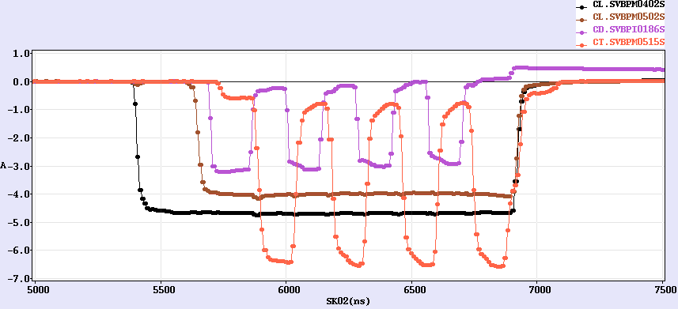
Delay loop status
DL
CR
7A
factor 2 combination re-established after 2 years
current about doubled, up to ~7 A (~0.5 A in satellites)
current stability 0.22% => details in
Simona Bettoni Wed 15:00
Current in the Delay Loop
Current after Delay Loop
Current from Linac

Slide 6
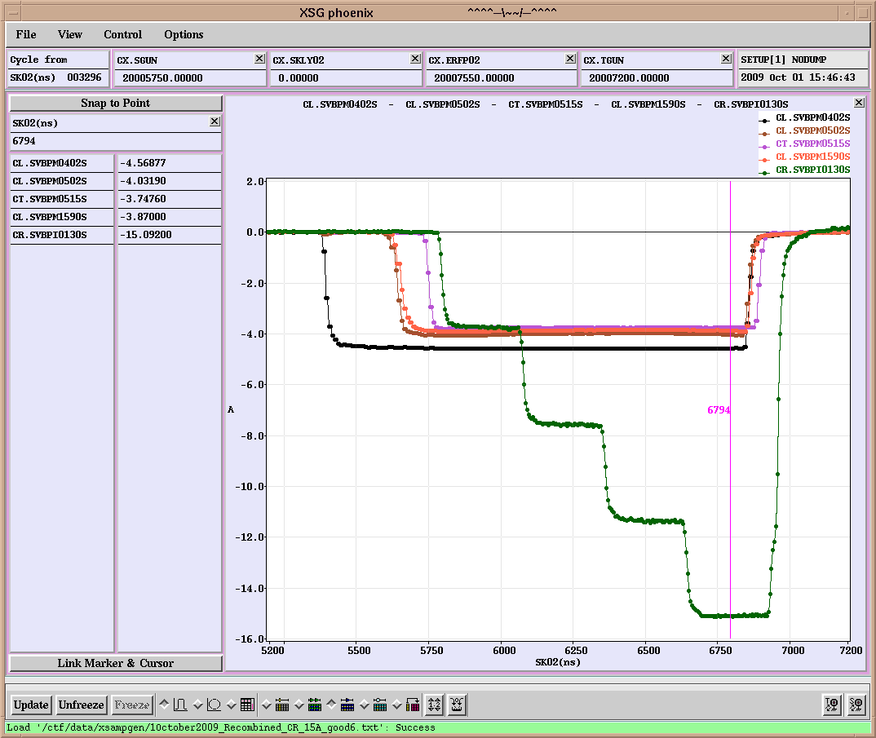
Combiner ring status
routinely factor 4 combination achieved with 15 A, 280 ns (without DL)
current stability 0.25%
CR
15 A
280 ns
280 ns
Current from Linac
1st turn of 1st pulse
2nd turn of 1st pulse and
1st turn of 2nd pulse
3rd turn of 1st pulse,
2nd turn of 2nd pulse,
1st turn of 3rd pulse
Current in the ring
All 4 pulses

Slide 7
Factor 8 combination (DL+CR)
~28 A combined achieved, nominal 140 ns pulse
current stability 1%
DL
CR
30A
Current from
Linac
Current after
Delay Loop
Current in the ring

Slide 8
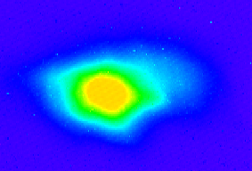
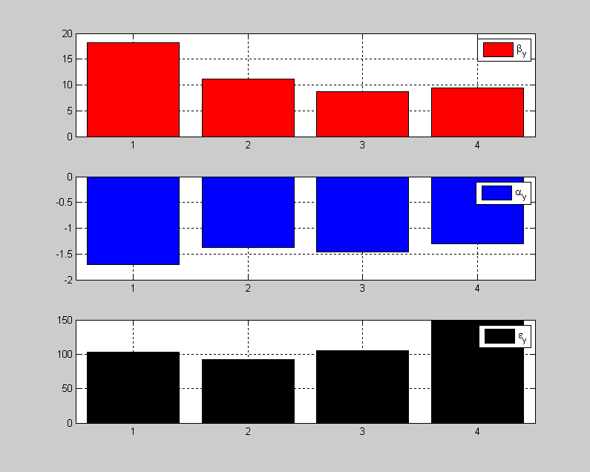
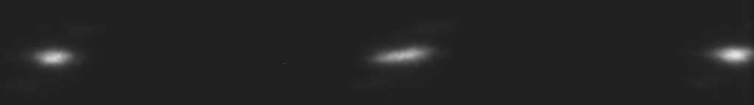
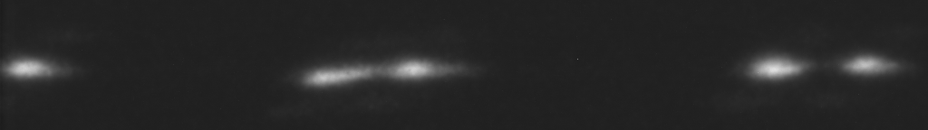
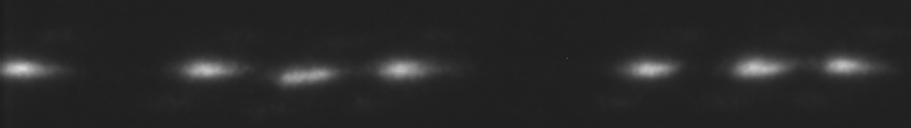
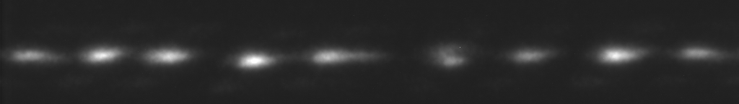
Recombination studies
emittance measurement (vertical plane)
combined 4x beam < 150 π mm mrad
streak camera measurements
orbit closure well controlled
combination to be optimized
dispersion/isochronicity
more from
666 ps initial bunch spacing
Turn 1
from
DL
Turn 2
Turn 3
Turn 4
Simona Bettoni Wed 15:00
Anne Dabrowski Thu 9:00
83 ps final bunch spacing

Slide 9
DB scheme - status
quite close to all requirements already at the end of 2009
Parameter | Unit | CLIC nominal | Present state | Objective mid 2011 | Objective 2013
I initial | A | 4.2 | 5
I final | A | 100 | 28 | 30
Q_{b} | nC | 8.4 | 4 (2.3 nom.)
Emittance, norm rms | π mm mrad | ≤ 150 | ≤ 100 (end of linac) ≤ 150 (y, comb. beam) | ≤ 150 (comb. beam)
Bunch length | mm | ≤ 1 | ≤ 1 (comb. beam)
E | MeV | 2400 | 120 |  | 150
T_{pulse} initial | μs | 140 | 1.4
T_{pulse} final | ns | 240 | 140 (240) | 140 (240) | 140 (240)
Beam Load. Eff. | % | 97 | 95
Deceleration | % | 90 | - | 30 | 50 or more
Phase stability @ 12 GHz | degrees | 0.2 | - | 0.5 ? | 0.2
Intensity stability |  | 7.510⁻⁴ to few 10⁻⁵ | 2 10⁻³ (comb.4) | 2 10⁻³ (comb.8) | ≤ 1 10⁻³ (comb.8)

Slide 10
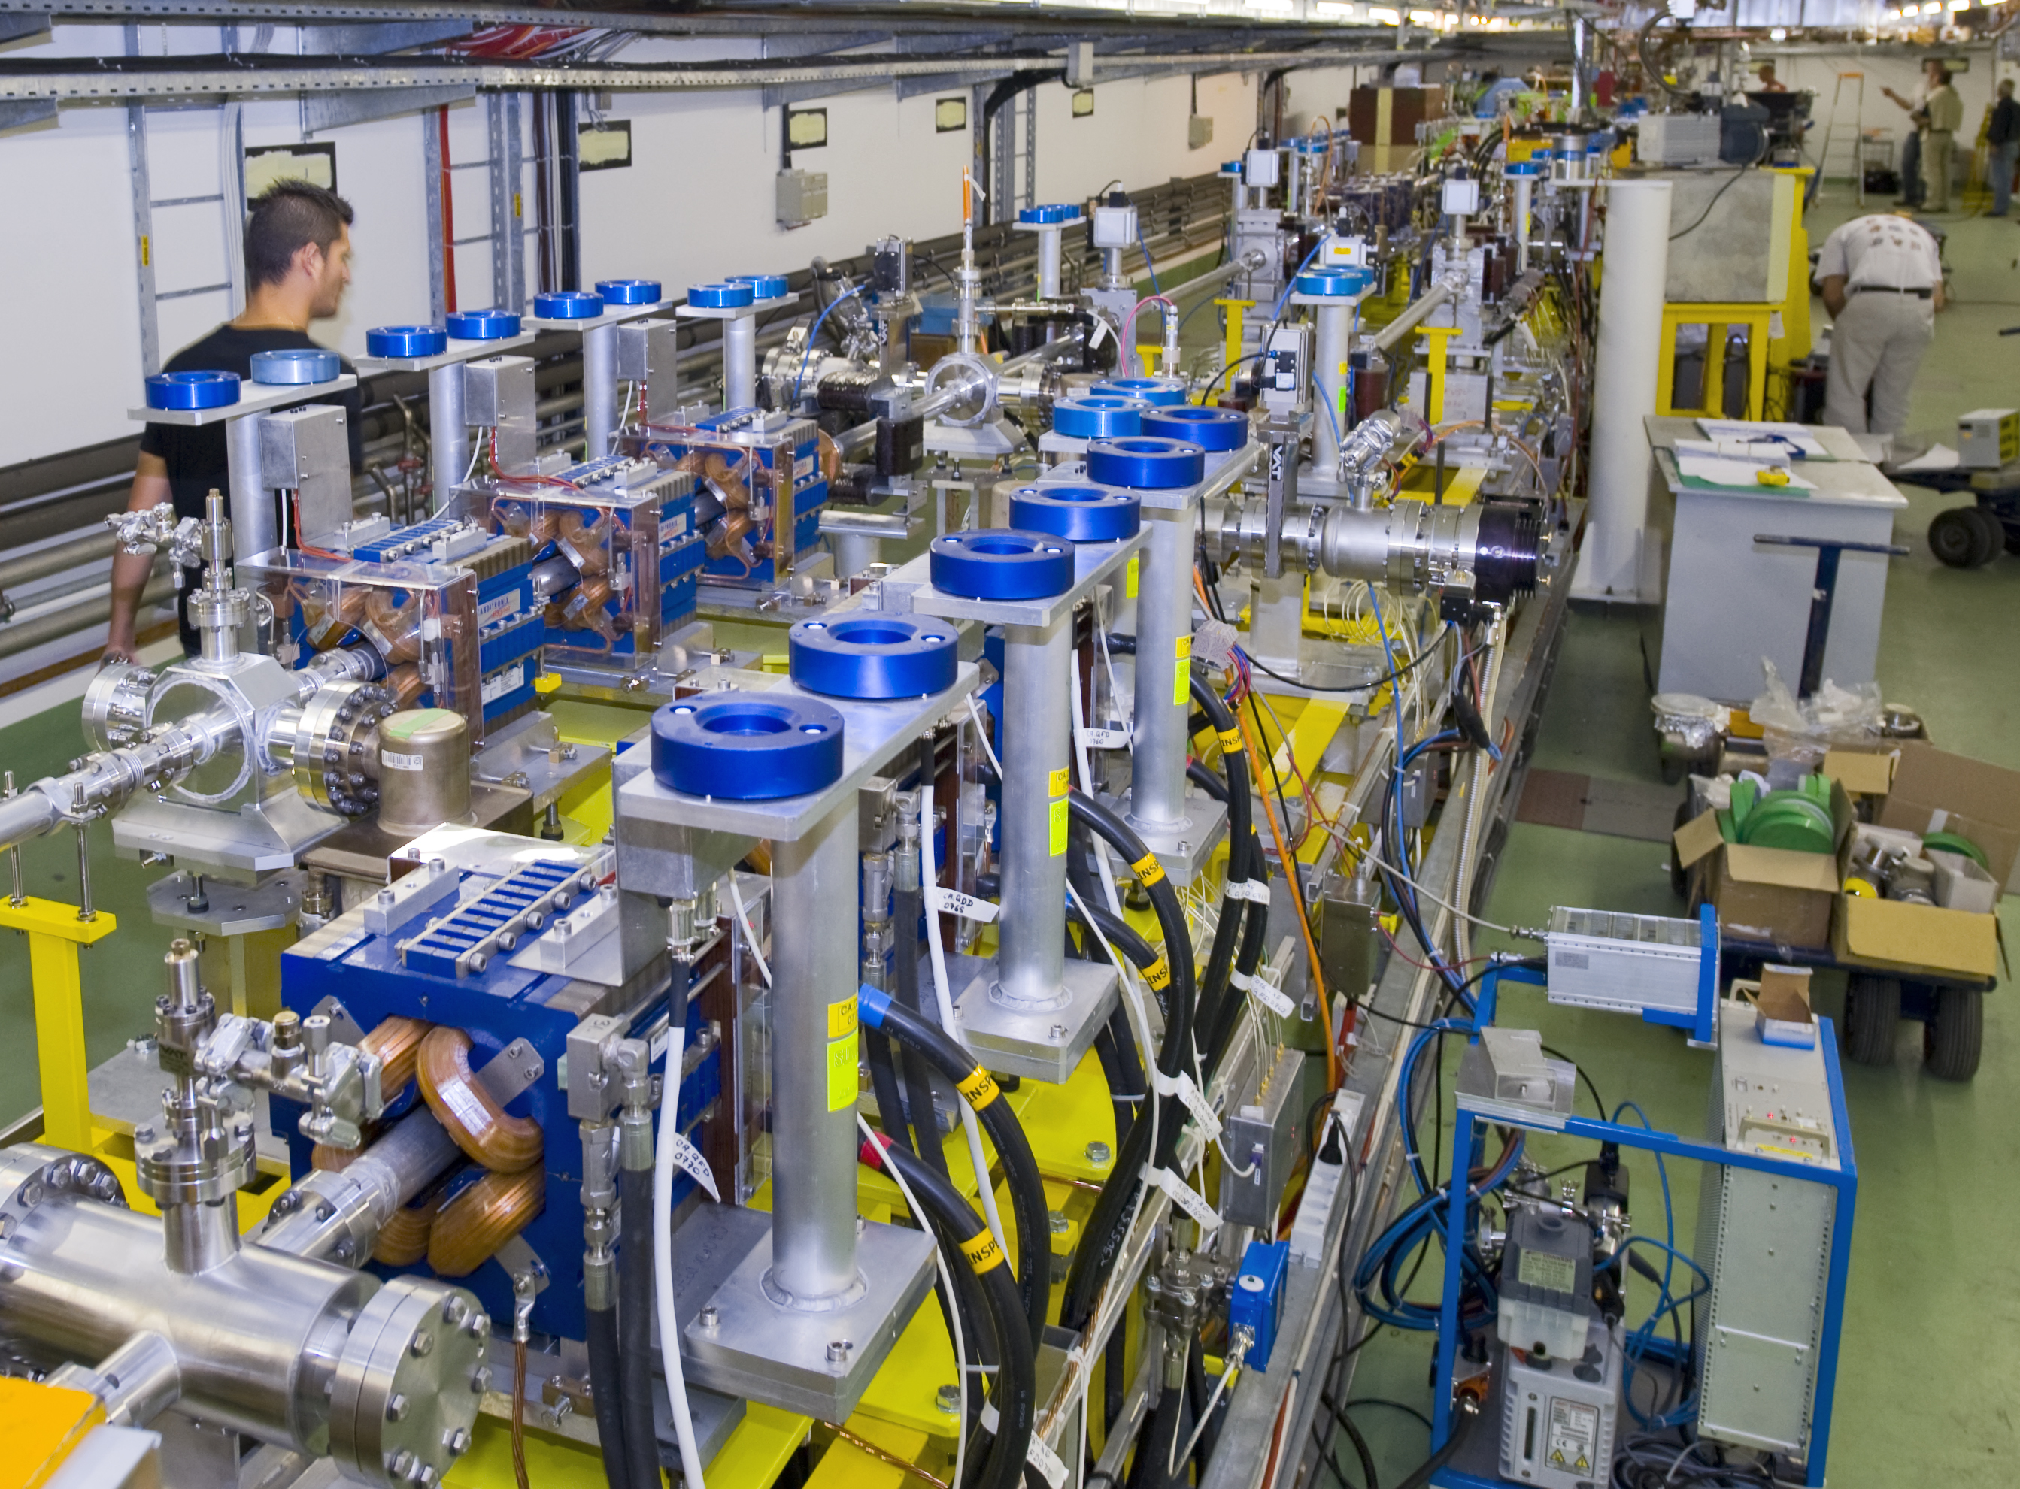

TBTS – Two beam test stand
talk by Roger Ruber this morning
Allessandro Capelletti Wed 16:00
Germana Riddone Thu 16:00
Combined beam of Combiner Ring extracted
(up to 15A/28A), transported to CLEX
used for power production in TBTS and TBL
TBTS: Line for Two-beam acceleration studies
both Drive Beam and Probe Beam to the end
Optics and first breakdown kick measurements
170 MW (peak) RF power reached in
PETS power production structure
total pulse length ~200 ns
=> reached nominal CLIC power (135 MW)
acceleration structure TD24 is installed now

Slide 11
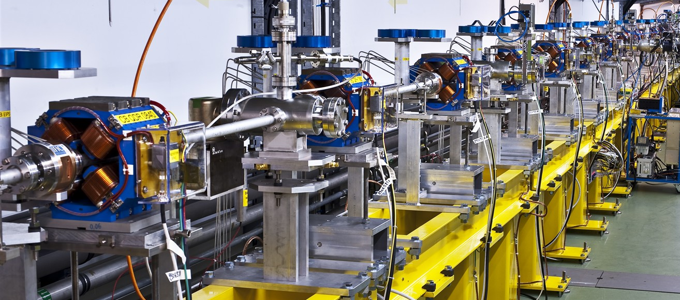
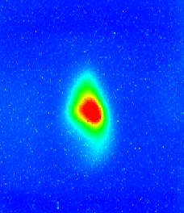

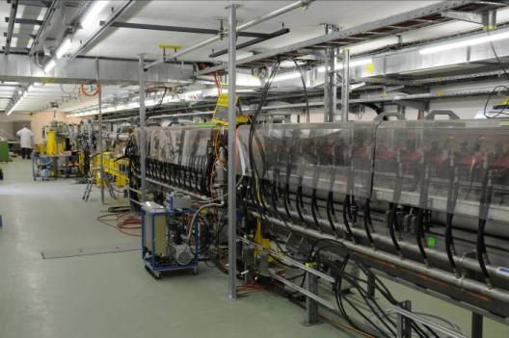
TBL - Test Beam Line / Califes
TBL: Line for deceleration studies
Installation of beam line with all magnets
and BPMs finished, 1st PETS prototype
installed (2-3 more this year)
Beam transported to the end
10A beam generated 20 MW RF
power in the PETS structure,
follows expectation
Erik Adli Wed 16:30
Fernando Toral Thu 12:00
Steffen Doebert Thu 14:00
Califes: Probe beam photo-injector
Laser performs well, nominal bunch charge reached, accelerated to 140 MeV
Beam transported to the end with ~100% transmission, reliable beam to TBTS
Detailed optics studies
Wilfrid Farabolini Thu 9:30

Slide 12
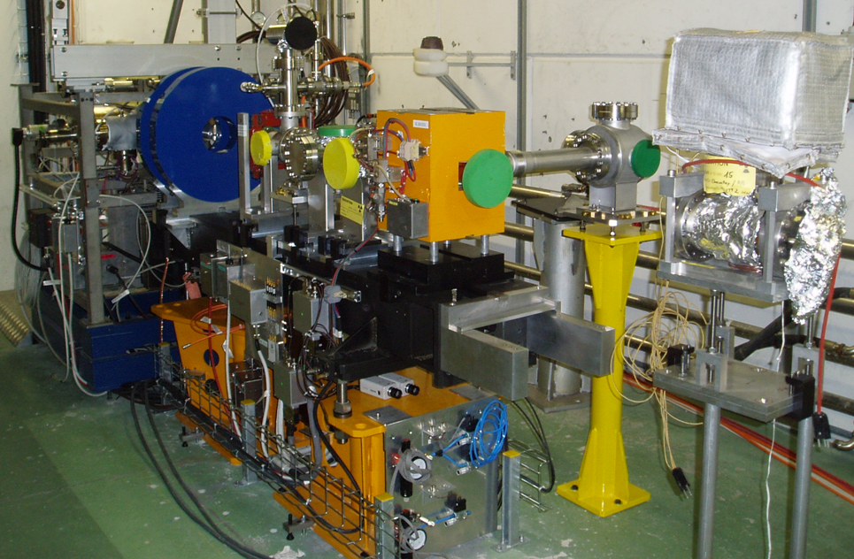
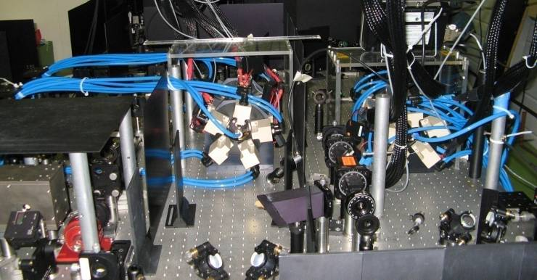
PHIN / Laser status
PHIN: Drive beam photoinjector test
shown up to 2.5 nC, above nominal!
also 2.3 nC for long train reached
Beam energy ~ 5-6 MeV
Emittance measured ~7 π mm mrad
Very good agreement with simulations
Öznur Mete Thu 11:00
Steffen Doebert Thu 11:20
Laser: (for Califes and PHIN)
all PHIN main parameters fulfilled !!!
0.8% beam current stability
(without feedback on the laser)
long term studies (cathode response, …)
to be done
Laser phase coding to be demonstrated
this year
Marta Csatari Thu 10:00

Slide 13
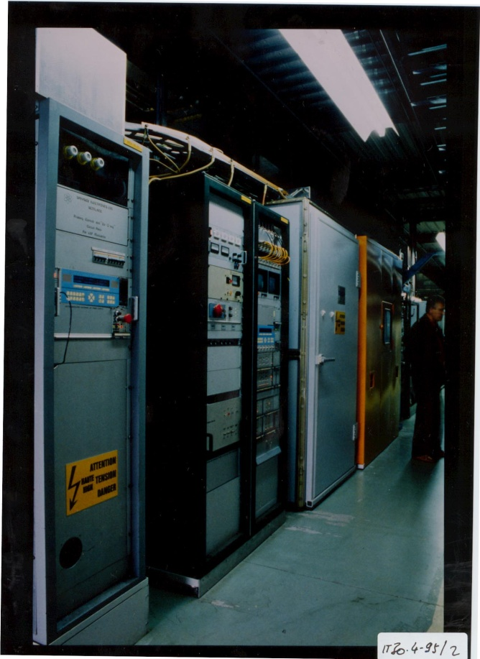
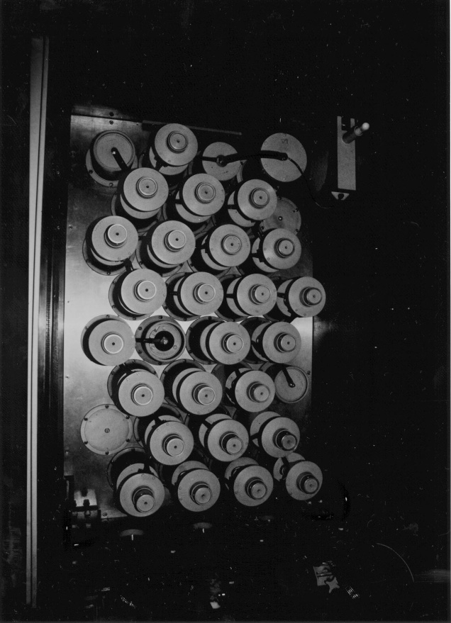
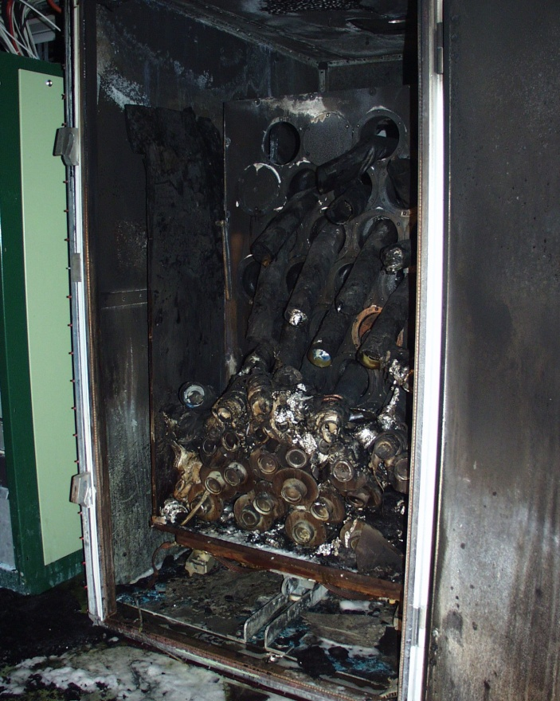
Fire in MKS13 Faraday Cage
Thu 4 Mar, lunch time …
Faraday Cage
Modulator in Gallery
Pulse Forming Network
in Faraday Cage
Pulse Forming Network
after fire

Slide 14
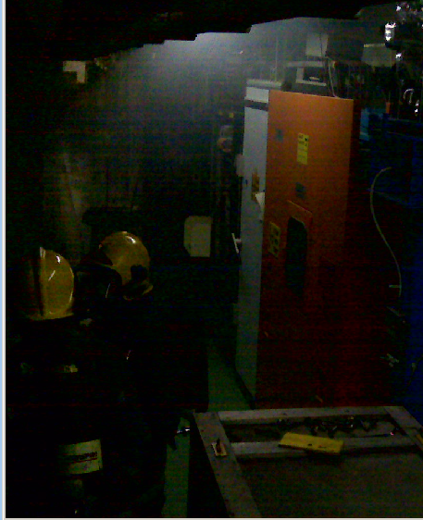
Events and actions
Modulator turned on around 12h00
Smoke alarm level 3 at fire service 12h33
Fire Service in place at 12h42
Smoke from MKS 13
General emergency stop activated
All electricity (including MKS13) cut
apart from lift and smoke extraction system
CO₂ , powder, then water and
eventually foam applied => corrosive!!!
Fire extinguished around 16h00
Building access refused to everyone
apart from fire service and safety commission
Cleaning company BELFOR contacted for swab testing to check contamination of zone
Safety commission enquiry started
Surveillance camera image

Slide 15
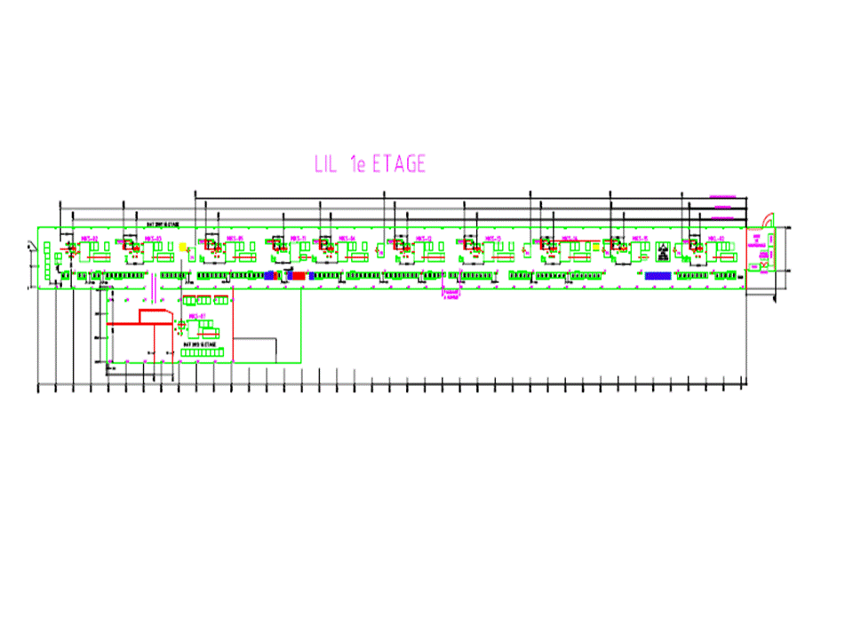
Clean up
Gallery partitioned
initially into 2 zones
(clean up area + “clean area”)
Clean up of contaminated area estimated > 4 weeks
New swab test on equipment in “clean area”
contamination of ventilation ducts
Clean up scheduled for 6 weeks
cleaning finished 27 April (most of it even before)
All electrical systems locked off
gallery classified as non controlled area (cleaning firm didn’t need film badges) => no beam or RF possible
Contaminated area from MKS12

Slide 16
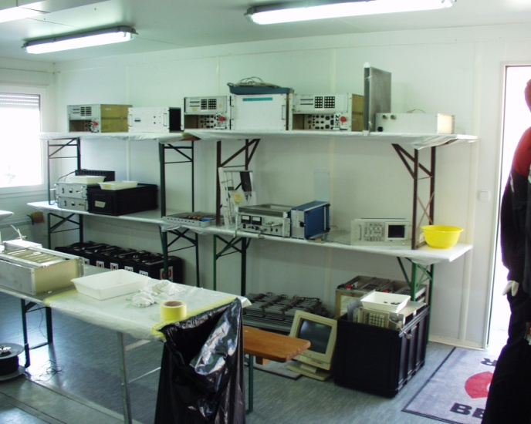
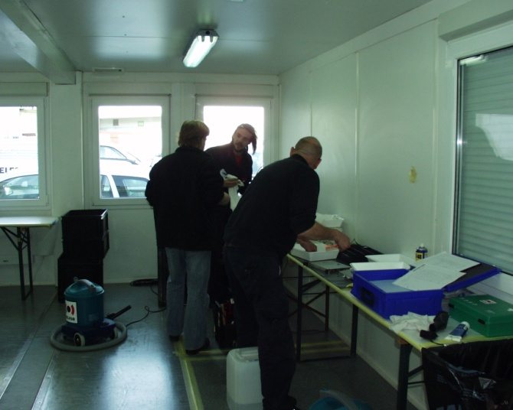
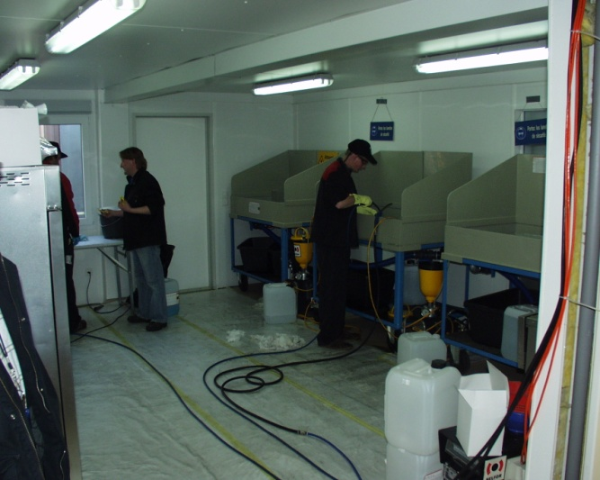
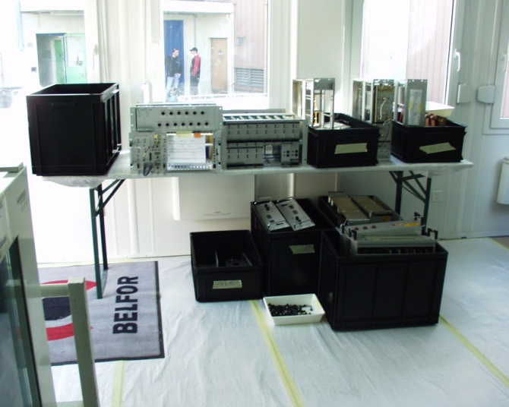
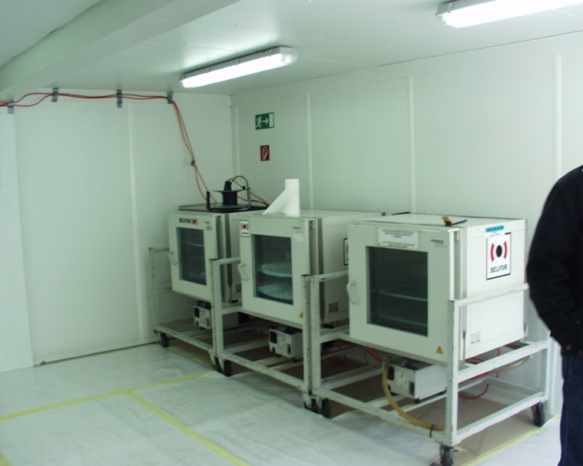
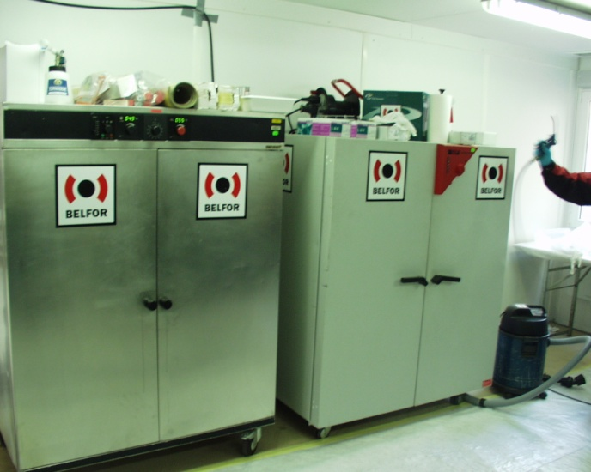
Cleaning procedure
Components from each rack
dismounted and identified
Dust removal from sub
components
Chemical cleaning
Cleaned components waiting for reinstallation in gallery
Vacuum ovens for 2nd stage
Ovens for drying after
chemical cleaning

Slide 17
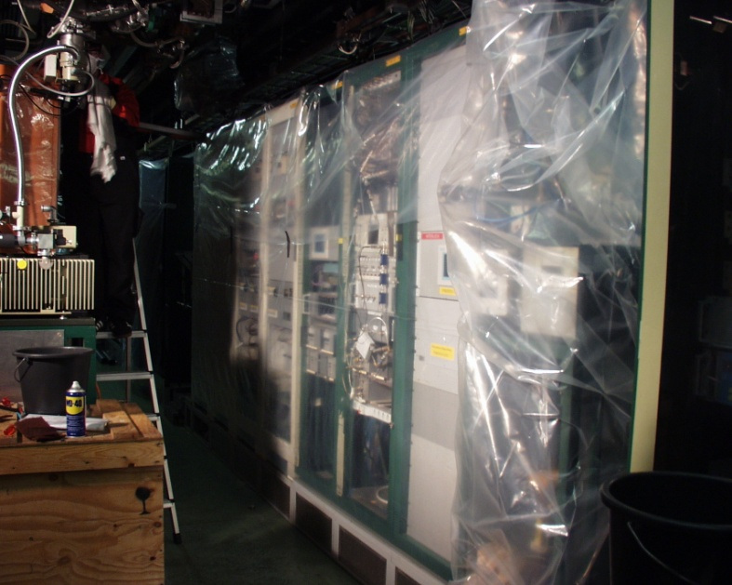
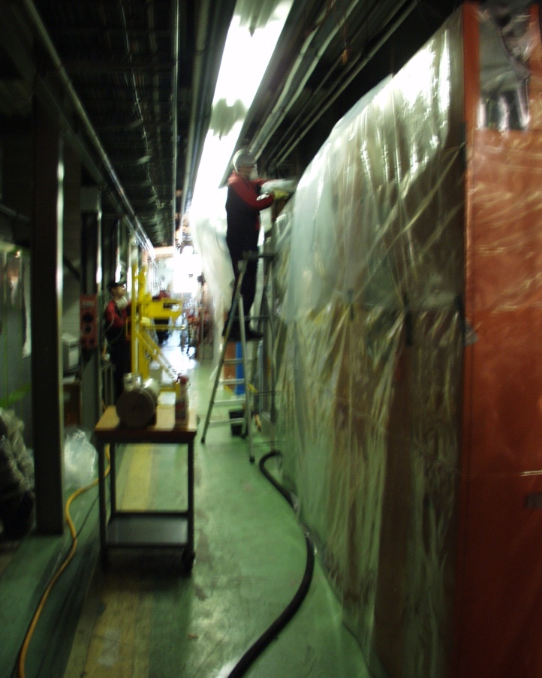
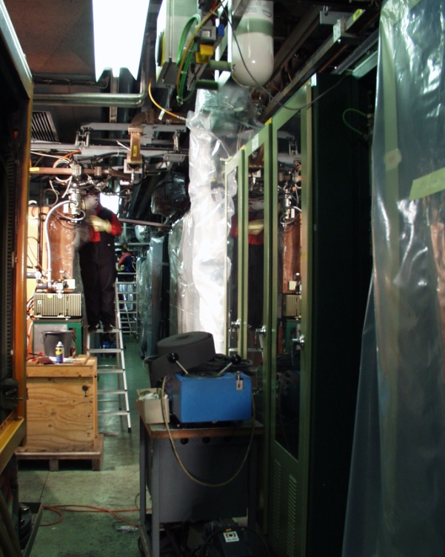
Some images from gallery

Slide 18
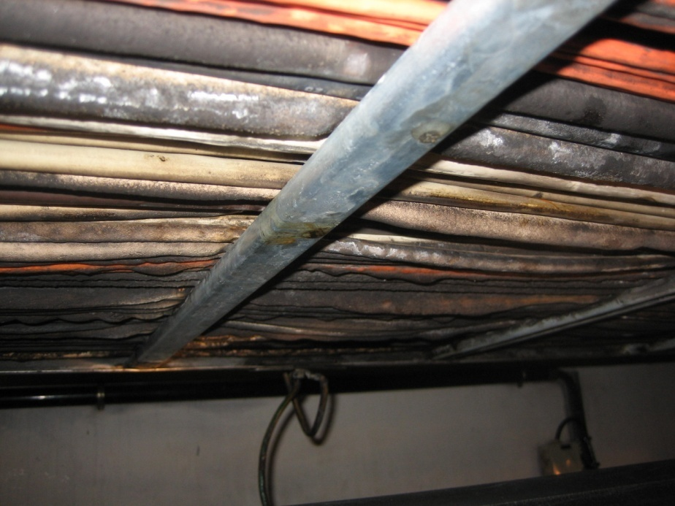
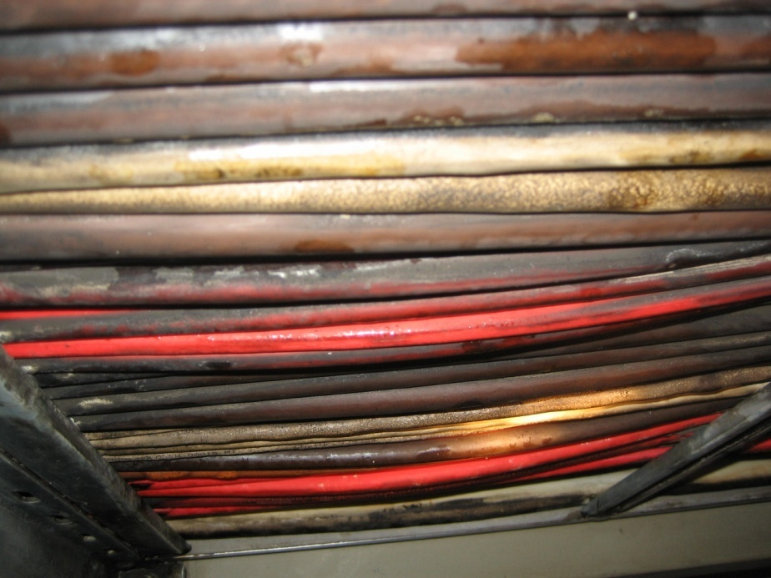
Damaged cables
>300 cables and ~40 HV vacuum cables in front of PFN damaged
All cables will be repaired – 4 ½ weeks estimated => until 26 May
  complete replacement (vacuum)
  replace damaged section with connectors at both ends
consequence:
  all power still disconnected in the klystron gallery => until 20 May
  vacuum pumps off in Delay Loop, Combiner Ring + part of linac
problem: testing of connections => bumpy start-up?

Slide 19
Restart planning
Meeting on Wednesday 24th March with groups and departments who have equipment in the area to define an action plan for recovery after the clean up
meeting yesterday about detailed planning
Fire detection system gets repaired this week
=> fire detection tests after re-establishing general power
visual inspection by equipment experts
gradually power on the equipments when powering possible
=> hardware + controls tests
modify klystrons for increased safety
restart klystron interlock system for access => safety chain tests
3-4 weeks after end of cable repair
=> restart RF mid june

Slide 20
Fire Consequences
17 weeks delay with respect to nominal program
(42 weeks not including stops)
=> >40% of the time lost!
klystron MKS13 not available, acc. structures are removed
=> lower energy than before => complete new machine setup
repair of MKS13 man-power limited
difficult start-up with additional HW checks
=> only less than half of useful beam time this year
=> compromises on the program 2010 have to be made
plan to have minimum winter shutdown and continue operation early in 2011
=> the items planned for up to end 2010 extend to mid 2011

Slide 21
DB generation – mid 2011
Bunch train recombination
  Consolidate results, routine operation, stability of fully combined beam
Transverse rms emittance
  Complete TL2, TL2’, TBTS commissioning – full transport to CLEX
  < 100 π mm mrad after ring, combined beam
  < 150 π mm mrad in CLEX, combined beam
Bunch length control to < 1 mm rms (combined beam)
  Measurement campaign with different meas. systems
  (RF defl.& screen, fast streak-camera, RF monitors)
  R₅₆ tuning experiments in Frascati chicane and TL2
Beam current stability: improve slow variations, obtain ~0.2 % for combined beam
  Full measurement campaign
  (find correlations, jitter sources)
  Gun pulse flatness, “slow” feedback
  Improve overall klystron stability (at least up to best performing klystrons)
  Slow RF feedback (temp. in pulse compressors)
Alexandra Andersson Wed 17:25
Alexey Dubrovskiy Wed 17:45

Slide 22
RF structures – mid 2011
PETS TBTS
  Initial configuration with variable power splitter & phase shifter
  Fast fall-back solution: recirculation with no active elements
  (maximum power to accelerating structure)
  Goal: nominal power / pulse length inside PETS with recirculation
  (135 MW, 250 ns total pulse length, 170 ns flat-top)
  Breakdown rate measurements
  (at high BD rate - extrapolation to lower rates)
  Operation w/out recirculation – may have different breakdown rate…
  Test of new PETS on-off scheme (components and concept)
Acc. structure in TBTS
  TD24, initial conditioning in the shadow of PETS operation
  Goal: nominal power / pulse length delivered to structure
  (65 MW, 250 ns total pulse length, 170 ns flat-top)

Slide 23
Two beam issues – mid 2011
  TBTS
    Two-Beam test – 100 MV/m, consistency between power & beam energy gain
    Drive beam, deceleration, power produced
    Probe beam, power delivered to accelerating structure, energy gain
    Beam Loading compensation experiment - by varying fast phase switches – check control of RF pulse shape with probe beam acceleration
    Measurement of breakdown kicks
    Measurement of effect of beam loading on breakdown rate
  TBL
    Measurement of deceleration / produced power
    Goal: deceleration by 30% (need 8 PETS installed)
    Measurement of energy spectrum
    Optics, steering algorithm studies

Slide 24
CTF3 beam-loading experiment
model for beam-loading compensation by Oleksiy Kononenko
phase coding / Full PETS Bunch Response Calculations
applied to CLIC reduced voltage spread from 6% to 0.25%
CTF3 case under study
 | CTF3 | CLIC
Delay loop | x2 | x2
Combiner Ring #1 | x4 | x3
Combiner Ring #2 | - | x4
Bunch Frequency | 1.5 GHz | 2 GHz
# of Bunches | 1-226 | 312
Bunch Charge | Total charge 19 nC | 0.6 nC
Energy | 177 MeV | 2.424 GeV
Energy spread | 2% (from CALIFES) | 0.134% (from damping ring)
PETS length | 1 m | 0.213 m
Voltage Spread ≈ 0.25 %
CLIC
optimized

Slide 25
Other issues – mid 2011
CALIFES
  Fully reach nominal parameters (total charge)
  Bunch length measurements (RF defl. & screen)
PHIN
  2010: complete measurement program
  2011: test of phase coding with beam
Other
  First measurements of phase stability (PETS output, RF pickups…)
  Operation at 5 Hz (or more)
  Control of beam losses
  Coherent Diffraction Radiation (RHUL collaboration)
  …
Andrea Ghigo Thu 11:40
Giulio Morpurgo Thu 14:30
Pavel Karataev Wed 17:00

Slide 26
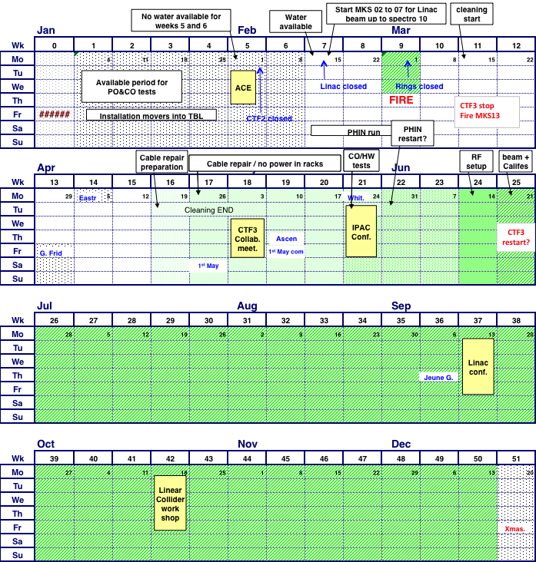
Schedule 2010 (updated)
Optics improvements (DL dispersion)
Full transport to CLEX
Bunch length control (first tests)
TBTS initial PETS tests
CALIFES setup
new setup when MKS13 available?
1
2
PETS conditioned to nominal power/pulse length
TBL PETS tests
Accelerating structure conditioned to nominal power/pulse length
  Two-Beam test
  power & energy gain, 100MV/m
3
1
3
4
  TBL studies
  (limited)
PETS breakdown rate measurements???
2
  Measurement of breakdown kicks
  Beam Loading compensation experiment
5
1
2
3
    Measurement of effect of beam loading on breakdown rate
6
4
5
6
7
Test of new PETS on-off scheme
8
  TBL studies 30% deceleration ?
    Stability studies & improvements
    PETS no recirculation
    Phase stability
    Operation at 5 Hz (or more)
    Control of beam losses
    Coherent Diffraction Radiation …
  1st TBL PETS installation
  PHIN possible
  <-------->
4
5
6
  2nd TBL PETS installation
  6 weeks PHIN
  phase-coding
  Laser preparation
7
7
8
8

Slide 27
Conclusion
Drive Beam generation very well covered
  full bunch train combination 2x4 shown (DL+CR)
  started to address performance and stability
Fire has caused considerable delay
recovery ongoing
next major steps:
  two beam acceleration tests in TBTS
  drive beam deceleration in TBL
  increase beam stability => easier routine operation
CTF3 evolution beyond 2012
Many THANKS to all collaborators!
Roberto Corsini Thu 16:00

Slide 28
Reserve

Slide 29
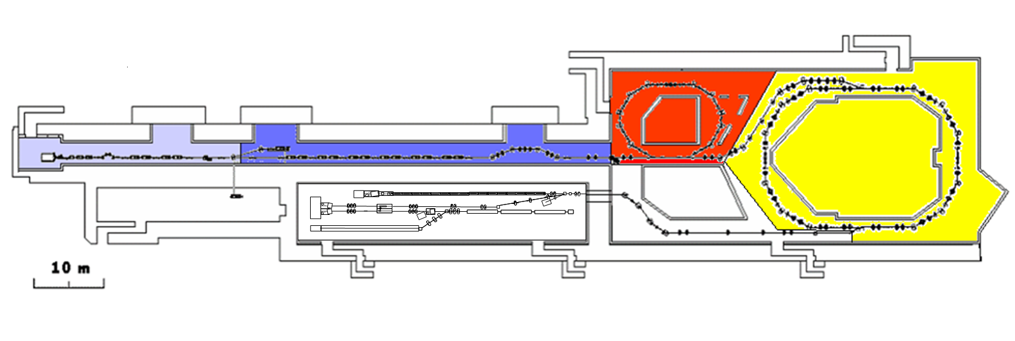
CTF 3 – CLIC Test Facility
demonstrate CLIC RF power source Drive Beam generation
(fully loaded acceleration, bunch frequency multiplication 8x)
Test CLIC accelerating structures
Test power production structures (PETS)aaaa
.
Delay Loop
42m
Combiner Ring – 84m
RF deflector
TL1
Injector
Linac
3.5A – 1.2µs
150 MeV
Laser
Test Beam Line - TBL
28A
140ns
150 MeV
TBTS
Califes
TL2
TBL
CLEX
Two Beam Test Stand - TBTS
Probe Beam - CALIFES

Slide 30
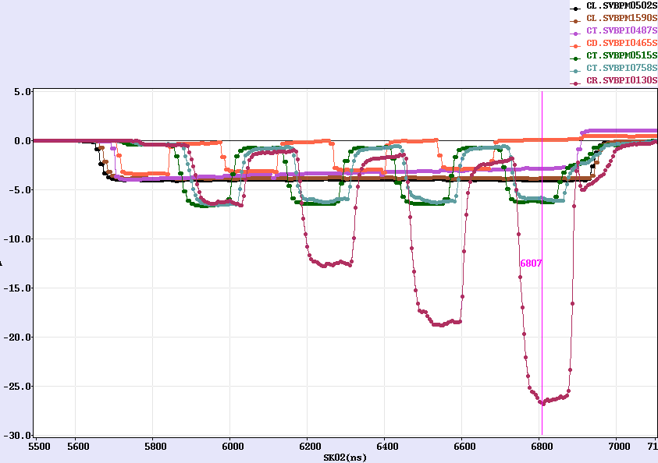
Factor 8 combination (DL+CR)
Current from
Linac
Current after
Delay Loop
Current in the ring

Slide 31
Roberto’s comments
before the fire
CTF3 2010 outlook
Drive Beam Generation
  Bunch train recombination 2 x 4 in DL and CR (from 3.5 to 28 A)
  Transverse rms emittance < 150 π mm mrad (combined beam)
  Bunch length control to < 1 mm rms (combined beam)
  Beam current stability ~ 0.1 % for combined beam
Drive Beam Power Production & Two Beam Acceleration
  20.8 A beam-powered test of a single PETS (without recirculation) in the TBTS
    135 MW (with 28 A potentially available in CLEX, the peak power can reach 240 MW)
    140 ns total pulse length
    A measured breakdown rate in the range of 10-4 or lower
    Operation of a few hundred hours at 1 Hz
  7.4(10) A beam-powered test of a single PETS with ext. recirculation in TBTS
    135 (81) MW circulating power or 65 (65) MW available for accelerating testing
    250 ns total pulse length, 100 (170) ns flattish-top
    A measured breakdown rate in the range of 10-4 or lower
    Operation of a few hundred hours at 5 Hz
    On/off/adjust will be demonstrated using the external reflection/recirculation system mounted on one of the PETS in TBL.
  TBTS
    Improved measurements of power and energy loss.
    Breakdown transverse kick measurements.
    Probe Beam energy gain and beam loading tests.
  TBL
    The current schedule is to have 8 PETS installed as well as a spectrometer dump for energy spectrum studies, toward the summer 2010. This will allow to verify transport of a beam with up to 30% of the energy extracted.
Will be OK, possibly somewhat reduced performance…
Overall reasonable goals, but difficult to have a few hundred hours, and 5 Hz
TBTS studies and especially TBL results can happen only quite late in 2010…

Slide 32
State of the art today
ongoing Drive Beam generation demonstration in CTF3.
  Full beam loading (95% transfer), high current (up to 5A) in DBA
  Sub-Harmonic bunching, phase coding (7% satellites)
  Bunch train recombination factor 2 in Delay Loop (up to ~7 A)
  Bunch train recombination factor 4 in Combiner Ring (3.8 to 15 A)
  Recombination 2x4 DL/CR achieved ~ 28 A
  Isochronous operation of ring, α_{p} < 10⁻⁴
  Transverse rms emittance 100 π mm mrad (end of linac only)
  150 π mm mrad (vert., 4x combination)
  Bunch length control to < 1 mm rms (end of linac only)
  Control of ring length to better than 0.5 mm
  Beam current stability ~ 0.15% end-of-linac, ~0.25% combiner ring

Slide 33
To be addressed …
Dispersion / isochronicity in DL/CR
Full bunch length manipulations in TL2 after combination
(we see from RF that the form factor is close to 1)
full beam (28 A) to users (new TL2/CLEX BPM readout)
RF power production in CLEX
Two-beam operation in TBTS (relevant CLIC sub-unit)
(we started with CCC operator supervision)
Deceleration stability
Loss management, machine protection system
Satellite bunches
Photo injector option
…

Slide 34
2009 CTF3 experimental program
Goals
30 GHz: One structure test (TM02) + breakdown studies
PHIN Beam characterization, reach ½ of nominal bunch charge
CALIFES Beam characterization, beam to TBTS (most likely still reduced current)
Delay Loop Back in operation, retrieve combination x 2 (~ 7 A)
Combiner Ring Final optics checks, isochronicity, put together with DL (> 24 A)
TL2 Complete commissioning (tail clipper), bunch length control, > 20 A to users
TBTS PETS to nominal power/pulse length (15 A, recirculation)
Beam commissioning of probe beam line
First accelerating structure tests (one structure ? – CLIC G)
Two-beam studies (deceleration/acceleration), initial breakdown kicks studies
TBL PETS validation (100 MW, need > 20 A), beam line studies (2-3 PETS ?)
Others CDR studies in CRM, beam dynamics benchmarking, stability studies, control of beam losses…

Slide 35
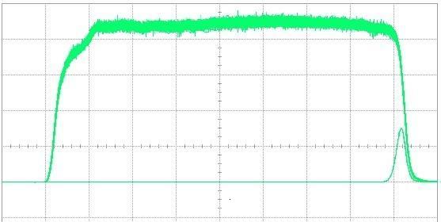
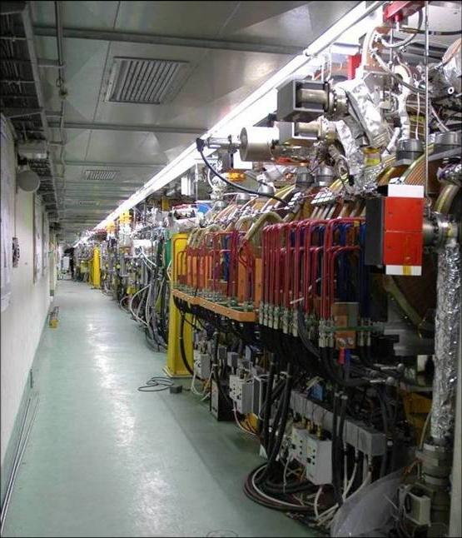
Full beam-loading acceleration in CTF3
high current routine operation demonstrated
RF pulse at structure input
1.5 µs beam pulse
RF pulse at structure output
analog signal
Measured RF-to-beam efficiency 95.3%
Theory 96%
(~ 4 % ohmic losses)
MKS03
MKS05
MKS06
MKS07
Spectrometer
4
Spectrometer
10

Slide 36
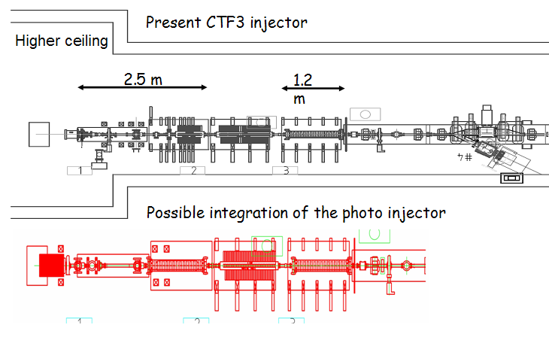
PHIN Photo-injector
Smaller transverse emittance, shorter bunches, no energy tails, no satellites
Bunch charge lower than present injector
shown up to 2.5 nC, above nominal!, also 2.3 nC for long train reached
Beam energy ~ 5-6 MeV
Emittance measured ~7 π mm mrad
Very good agreement with simulations
started to measure laser/beam stability:
better than requirements
Laser
size: x=0.74mm
E-beam
size: x=1.53mm
δ=0.15mm
δ=0.35mm

Slide 37
Laser system status
fulfilled PHIN photo injector requirements
micro bunches repetition rate | ns | 0.667
Synch to external rf @ 1.5GHz | ps | <1
micro bunch width (FWHH) | ps | <10
micro bunch energy (@ cathode) | nJ | 370
laser pointing stability std | mm | 0.5
setup significantly improved (beam path, optical crystal,…)
For PHIN all laser main target parameters fulfilled !!!
0.8% beam current stability (without feedback on the laser)
long term studies (cathode response, …) to be done
Laser phase coding to be demonstrated this year
  Booster amplifier needed (~ June)

