Slide 1

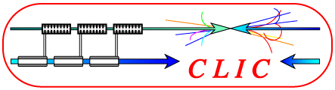
Results of beam based RF power production in CTF3
Alessandro Cappelletti for CTF3 collaboration
5th May 2010

Slide 2
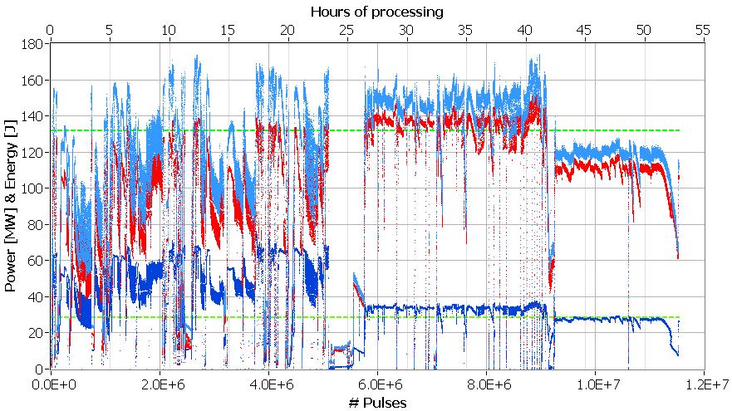
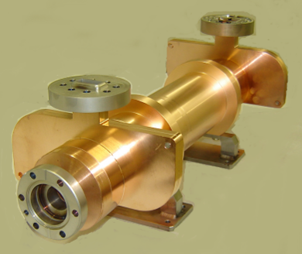
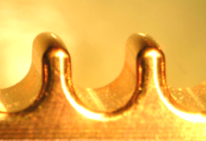
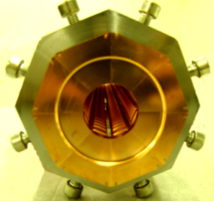
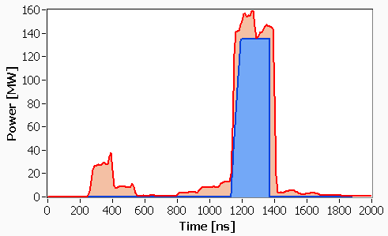
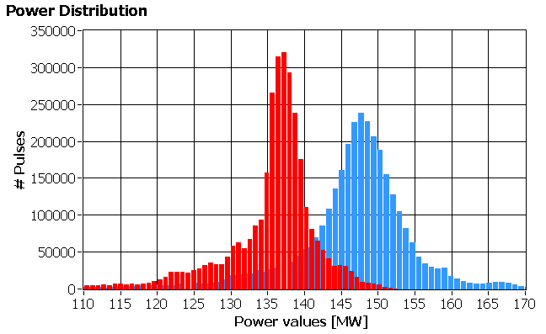
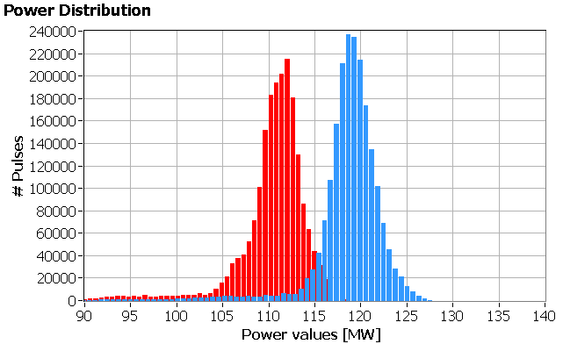
Hours
PETS RF high power tests in ASTA (SLAC).
Peak power
CLIC target
Average power
Energy
CLIC target
20.11.09
RF pulse in ASTA, SLAC.
Present breakdown rate ~2x10⁻⁶
(CLIC target - 1x10⁻⁷/pulse/m)
#pulses
CLIC target
Mean av. =137
Mean peak = 147.6
Mean av. =112
Mean peak = 118.6
CLIC target

Slide 3
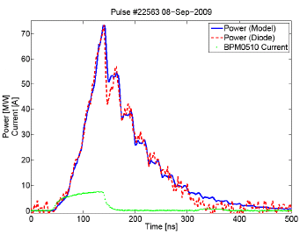
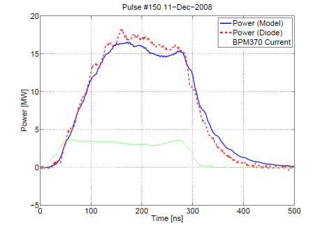
PETS high power production at CERN (TBTS)
Different scenarios of the drive beam generation in the CTF3
In order to demonstrate the nominal CLIC power level and pulse length, it was decided to implement a different PETS configuration – PETS with external re-circulation.
#1
CTF3
DL
CR
Round trip efficiency: 75%
Round trip delay: 22 ns
To the Load
DBA
CTF2
CLEX
TBTS
<30A
Variable
phase shifter
Variable Splitter
(coupling: 0→1)
#2
PETS output
Drive
beam
PETS input
14 A
#3
For the fixed parameters of re-circulation (loop delay, coupling, ohmic efficiency and RF phase error) and given pulse shape of the current, the generated RF pulse can be reconstructed/predicted rather well:
4 A
To compensate for the lack of current, the active TBTS PETS length was significantly increased: from the original 0.215 m to 1 m.
Full re-circulation
50% re-circulation
Coupling = 1
Δφ = 0
Coupling = 0.7
Δφ = 17⁰
Operation mode | #1 | #2 | #3 | CLIC
Current, A | <30 | 14 | 4 | 101
Pulse length, ns | 140 | <240 | <1200 | 240
Bunch Frequency, GHz | 12 | 12 | 3 | 12
PETS power (12 GHz), MW | <280 | 61 | 5 | 135

Slide 4
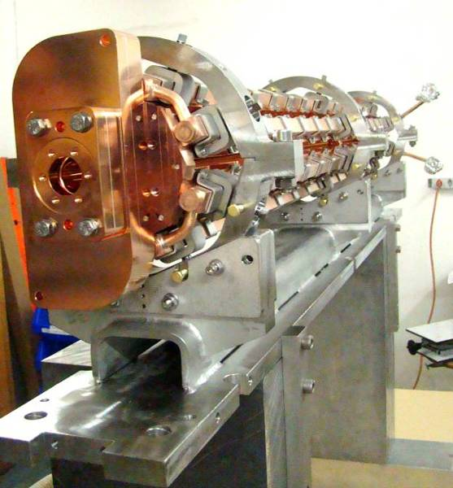
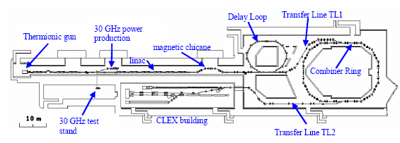
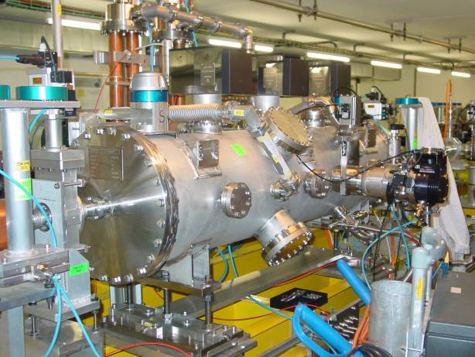
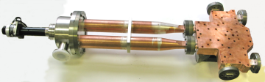
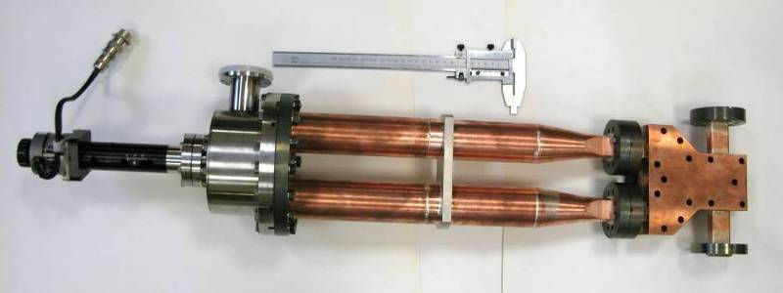
PETS high power production at CERN (TBTS)
Two Beam Test Stand (TBTS)
Fully equipped 1 m long TBTS PETS
Variable high power RF power splitter
Drive beam
Variable high power RF phase shifter
PETS tank with re-circulation RF circuit installed in TBTS test area (October 2008)

Slide 5
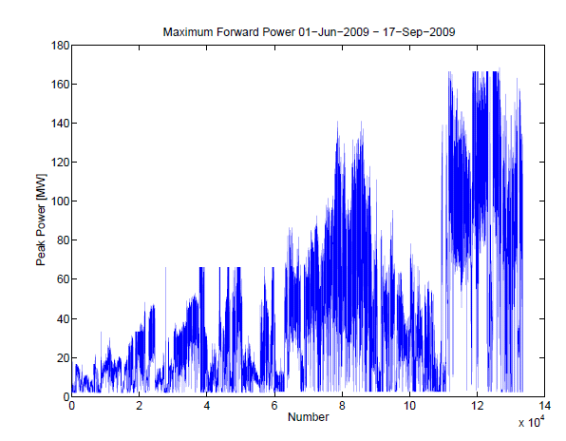
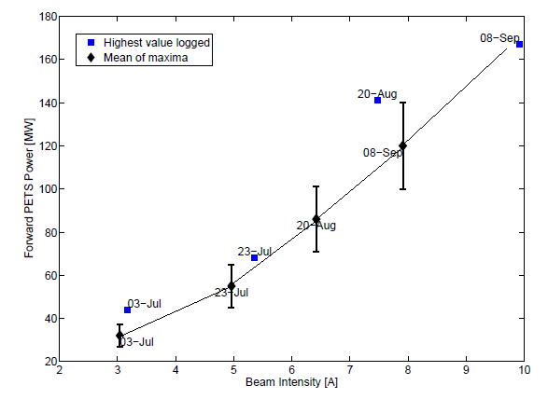
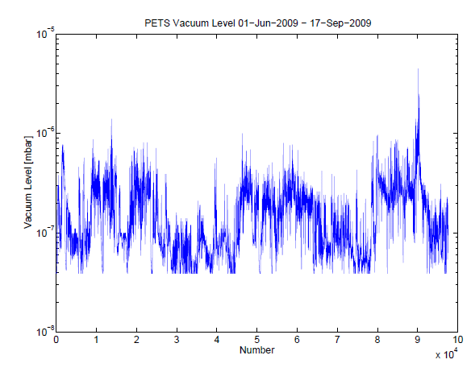
June-September 2009 PETS TBTS processing history
In total, 60 hours (~2x10⁵ pulses) of the RF power production in the PETS was accumulated. The peak RF power in full recirculation regime was gradually increased from 20MW to ~ 180 MW.

Slide 6
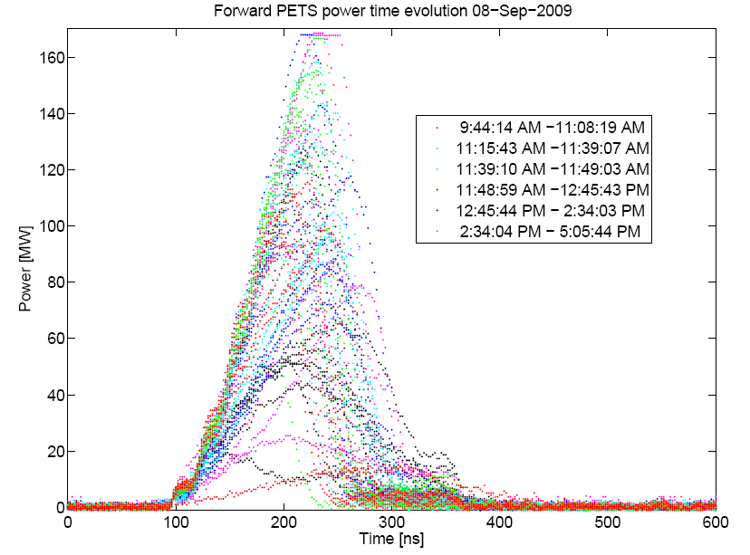
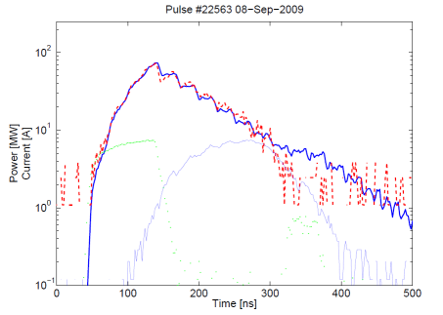
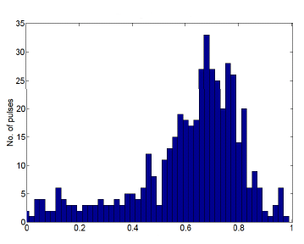
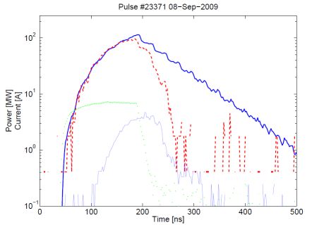
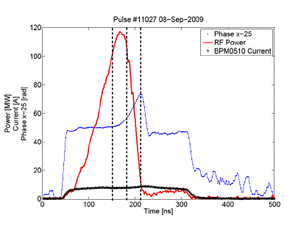
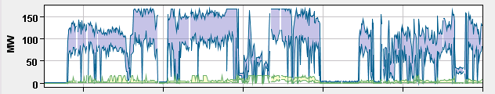
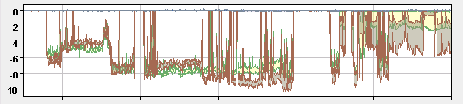
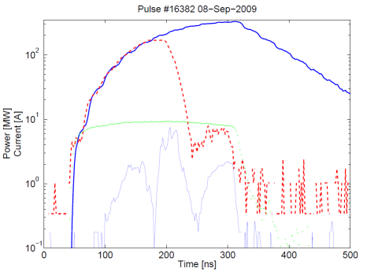
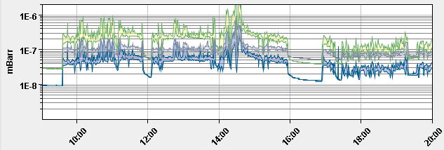
One day at TBTS. 08.09.2009
Pulse shortening (full re-circulation)
Pulse shortening statistics
T_{DB} =100 ns
P _{peak} = 73 MW
Number of pulses
(W _{expected} – W _{measured})/ W _{expected}
Pulse shortening and RF phase
T_{DB} =150 ns
P _{peak} = 110 MW
measured
expected
current
reflected
The processing strategy was rather aggressive. However, in most of the cases the pulse shortening followed the recirculation parameters transient modification (phase and amplitude) and thus the power production was normally quenched (no missing energy).
T_{DB} =260 ns
P _{peak} = 170 MW

Slide 7
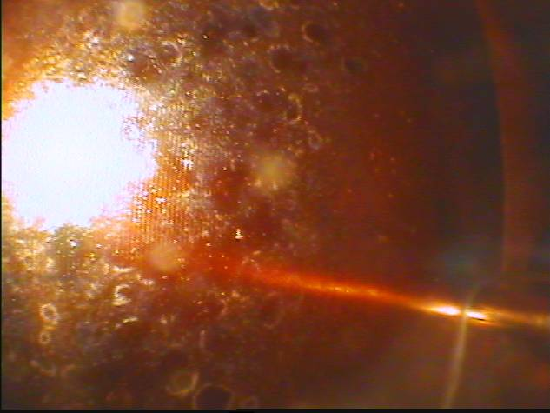
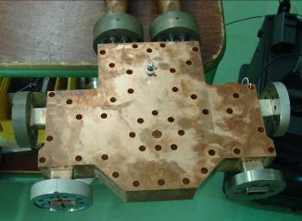
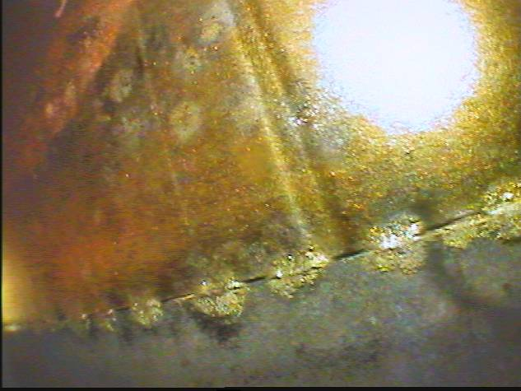
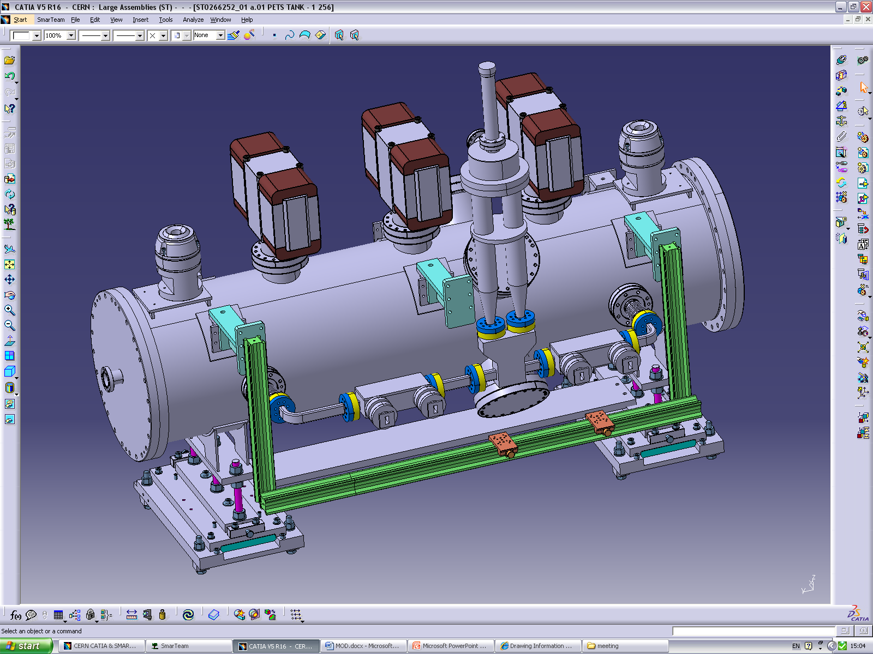
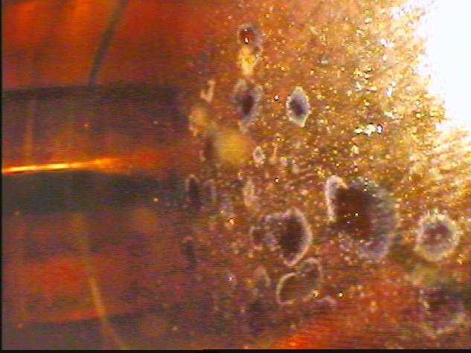
The detailed analysis of the signals gave us a strong indication that in most of the cases the breakdown activity was associated with feedback loop and not the PETS itself.
We have opened attenuator and found multiple traces of breakdowns inside the attenuator splitter.
It was decided to completely remove the attenuator and to continue the next run in a full re-circulation mode using a phase shifter for the power level modulation.

Slide 8
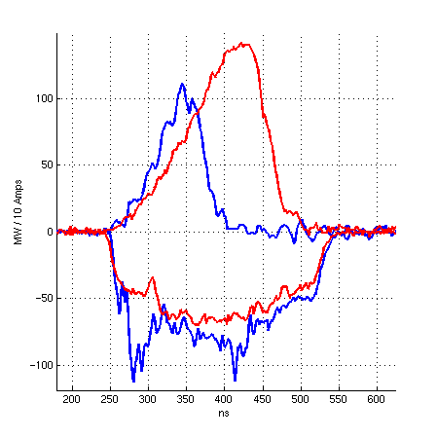
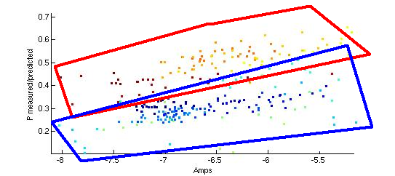
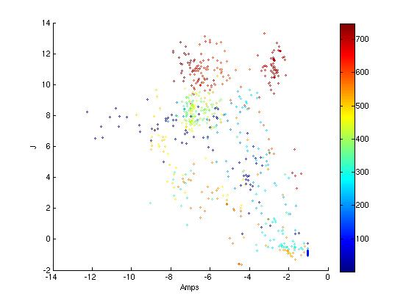
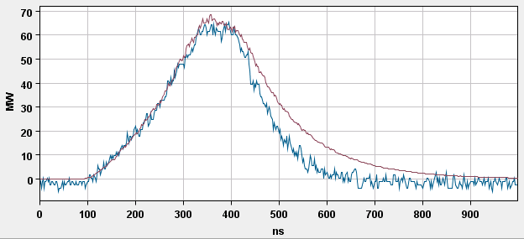
October-December 2009 PETS TBTS processing history
Since 02.11.2009 the phase shifter has being kept at the same position, which corresponds to the full recirculation. In total there were about 75k pulses at 1.2 Hz, which is ~25 beam-hours (25 SLAC’s minutes)
RF pulse envelopes with pulse shortening at the different stages of processing
3 weeks later
beginning
3 weeks later
beginning
T the end of processing period the system behavior at the peak power levels ~60/70 MW was rather stable
Pulse energy, J
02.11 21.11
predicted
Each point is an average value over 100 pulses
measured

Slide 9
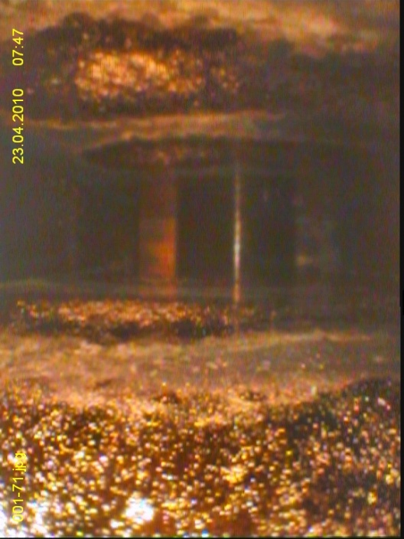
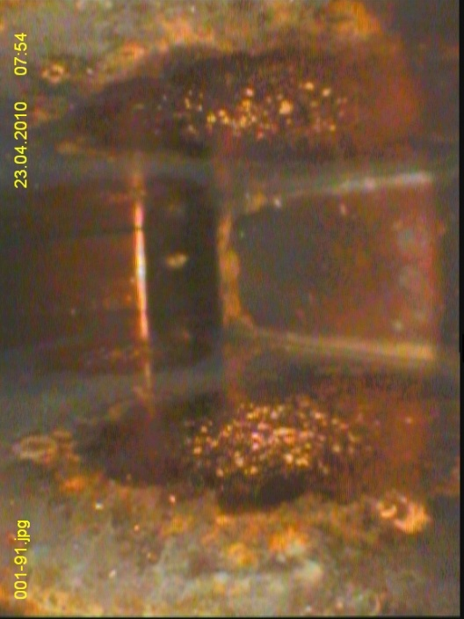
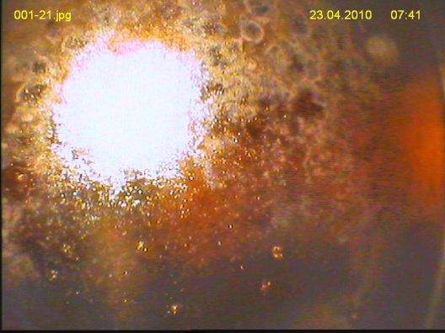
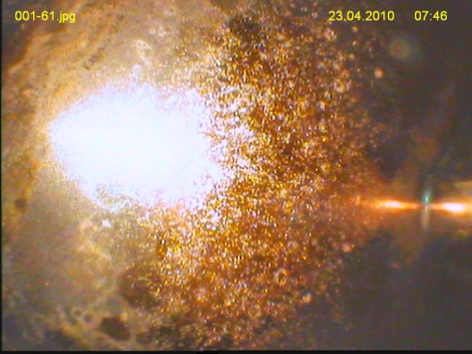
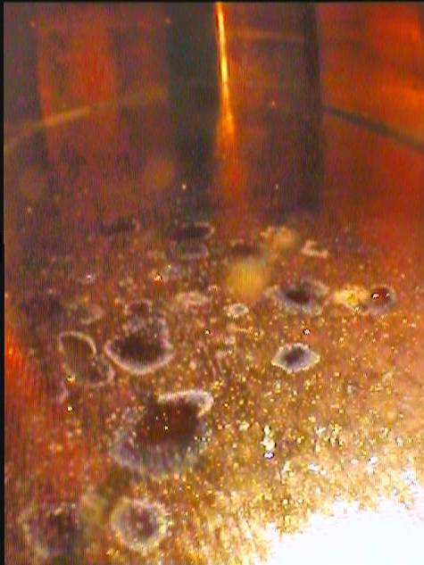
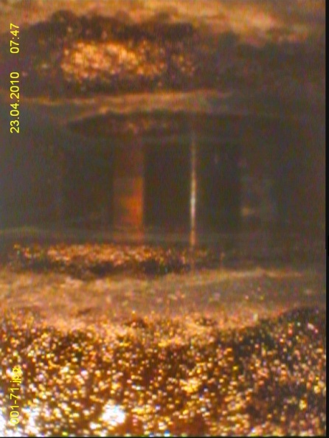
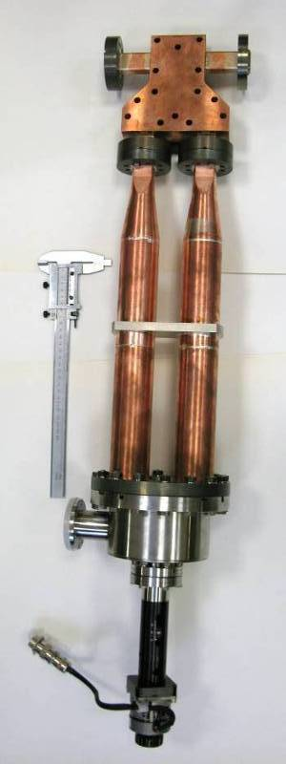
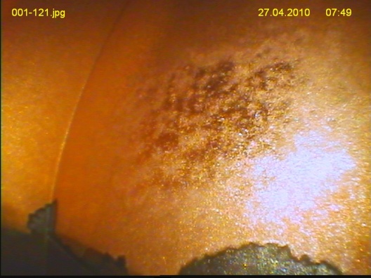
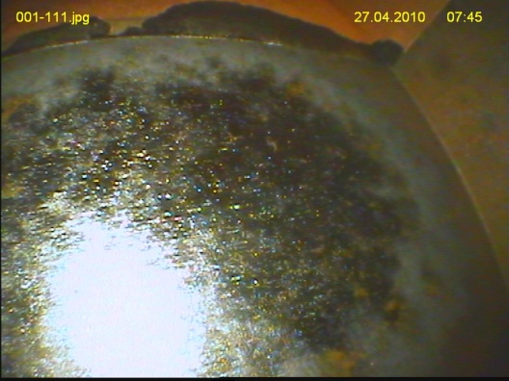
3dB hybrid
Phase shifter autopsy:
1. The hybrid of the phase shifter showed much stronger damages than that of attenuator.
2. The surface looks melted rather than having “dirty” spots.
3. The breakdown spots nicely show the standing wave pattern.
4. In the mode converter, the breakdown erosion was found mostly at/close to the input flange.
(Note: for the same input power phase shifter was exposed to `~40% more electric filed than attenuator)
~λ/2
Attenuator
Phase shifter
Mode converter

Slide 10
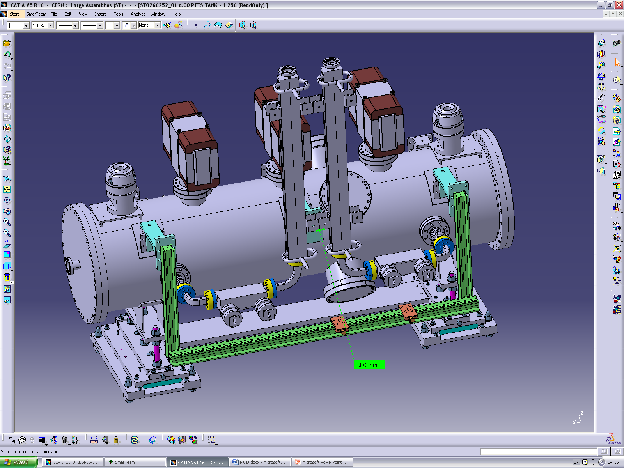
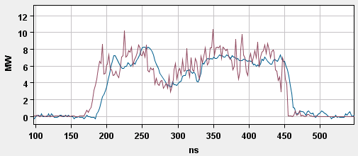
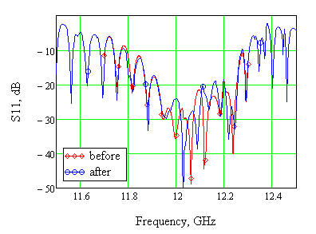
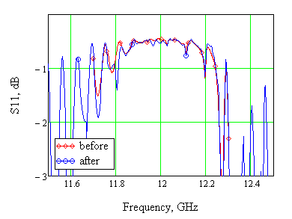
December 2009 PETS TBTS calibration test (no recirculation)
predicted
measured
TBTS PETS low RF power measurements before and after processing

Slide 11
TBTS PETS 2009 processing summary
During June - December 2009 about 100 hours (~3.5x10⁵ pulses) of the RF power production in the PETS were accumulated in total.
The processing was mostly done in free mode, when the PETS was trying to digest any drive beam current available at the moment.
Each breakdown was followed with fast RF power production quench which was protecting the system. Therefore aggressive processing strategy was adopted and frequent breakdowns were allowed.
Finally, up to 180 MW peak RF power in breakdown mode and ~70 MW with in a rather stable operation were achieved.
The power produced was in very good agreement with simulations.
The RF signal analysis indicated that in most of the cases breakdown activity was associated with feedback loop and not the PETS itself. Latest visual inspection of the attenuator’s and phase shifter’s hybrid bodies showed serious breakdown damages and confirmed that these devices were limiting the performance.

Slide 12
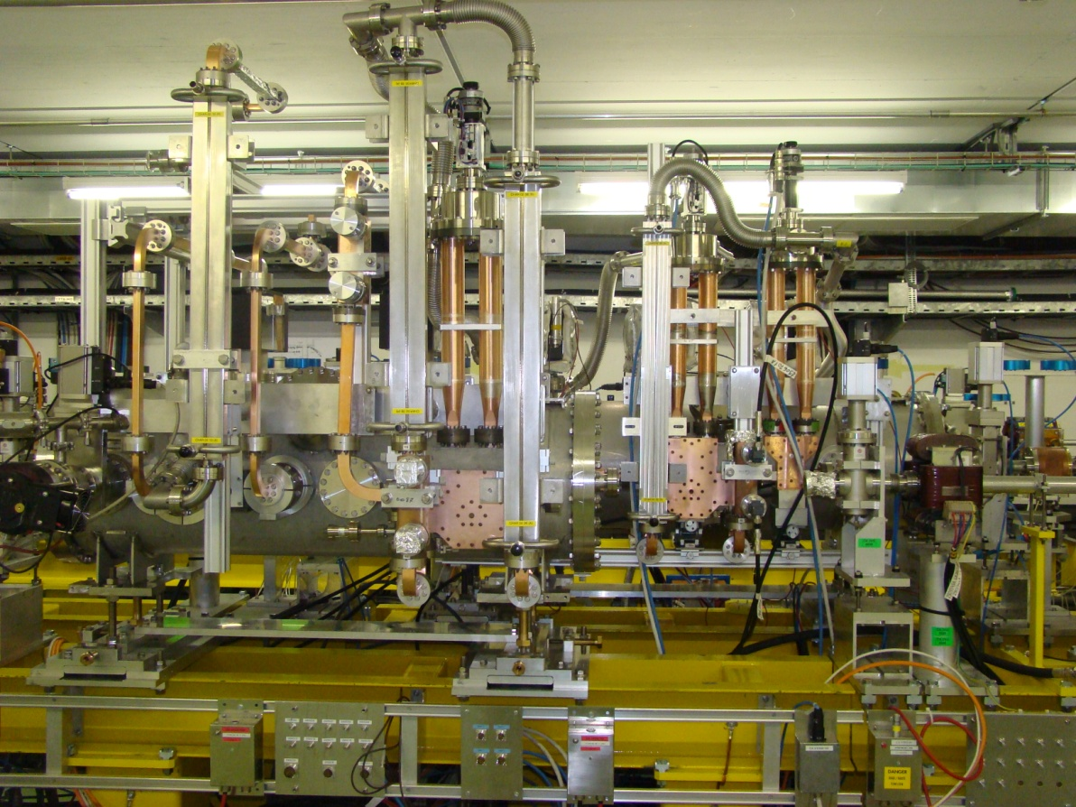


Current TBTS hardware status and actions taken since beginning 2010
1. The brand new waveguide components made by GYCOM (Russia) went through the complete cleaning procedure:
- Chemical
- Hydrogen firing
- Vacuum firing
and were installed back into the PETS re-circulation loop
2. The TD24 accelerating structure tank was installed into TBTS area. Ready for the 2-beam operation.
The brand new components
Accelerating structure tank
PETS tank
In the case, if problem with attenuator and phase shifter will continue, we have prepared back-up solution with a fixed 3dB splitter.
The operation will start with fixed 50% RF power split and tuned in-phase recirculation length.
Recirculation loop tuned to its resonance
fixed 3dB splitter

Slide 13

0.8m TBL PETS, beam driven power production
About 15 MW RF power was produced with a 10A beam according to predictions. No pulse shortening or other breakdown activities were observed.

