Slide 1
CTF3 stability, TWTs and Gun
Alexandra Andersson, CERN

Slide 2
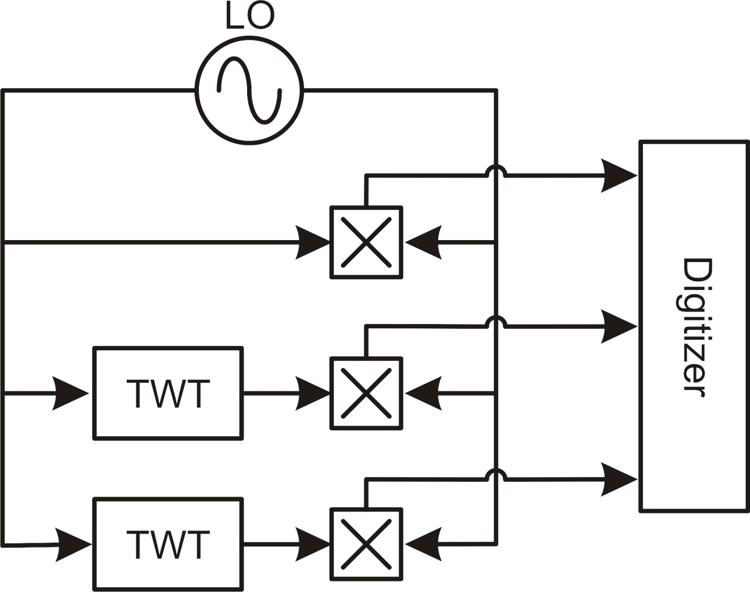
TWTs -- Measurement Setup

Slide 3
Pulse-to-pulse stability
The pulse-to-pulse difference in average value of the flat-top of the RF pulse from the TWTs was around 1‰ in amplitude and 0.1° in phase. The distributions were roughly Gaussian.

Slide 4
Long term stability
The two TWTs drift together in phase
There was almost no drift at all on the third channel, mixing LO with itself
Probably some temperature effect

Slide 5
Quality of the flat-top TWT1
≈1.2°
≈6‰
≈2.5‰

Slide 6
Quality of the flat-top TWT2
≈8‰
≈3.5°
≈2.5‰

Slide 7
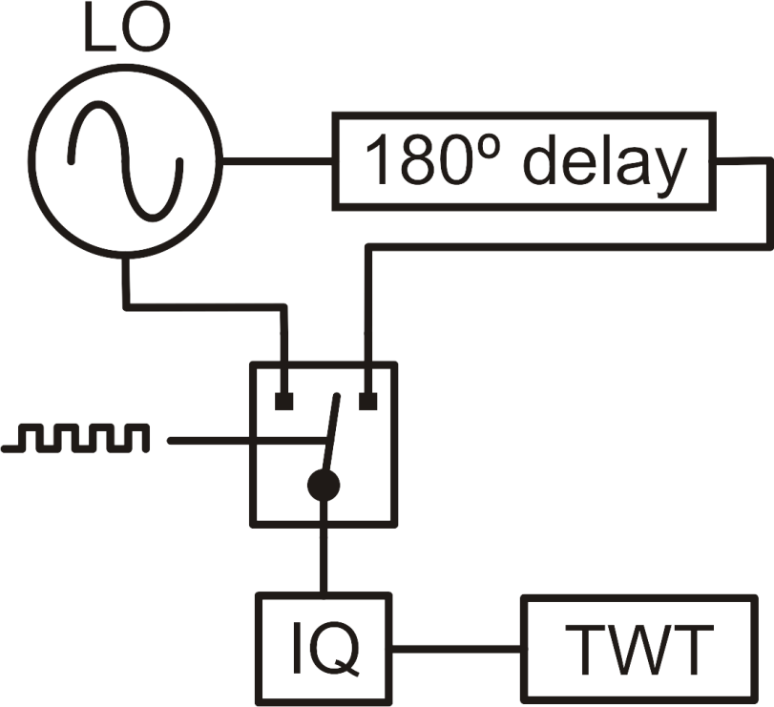
TWT phase flip programming
Currently the IQ modulation input remains unused
On the drive to the TWT we observe disturbances of ≈6°, lasting some 40ns, after each phase flip
Some attempts where made to cure this by modifying the signal path
Some amplitude difference was observed on the TWT output, but not on the drive
As these effects are constant pulse-to-pulse, one could attempt to run a slow feedback via the IQ, which was foreseen for this purpose

Slide 8
Gun current stability
At the moment, not much is known about this due to a lack of availability of measurements on the gun deck
Some elements will shortly be added to the gun setup in order to address this issue
Further, devices have been added to shape the current pulse exiting the gun, i.e. the possibility to add modulation on top of the pulse

Slide 9
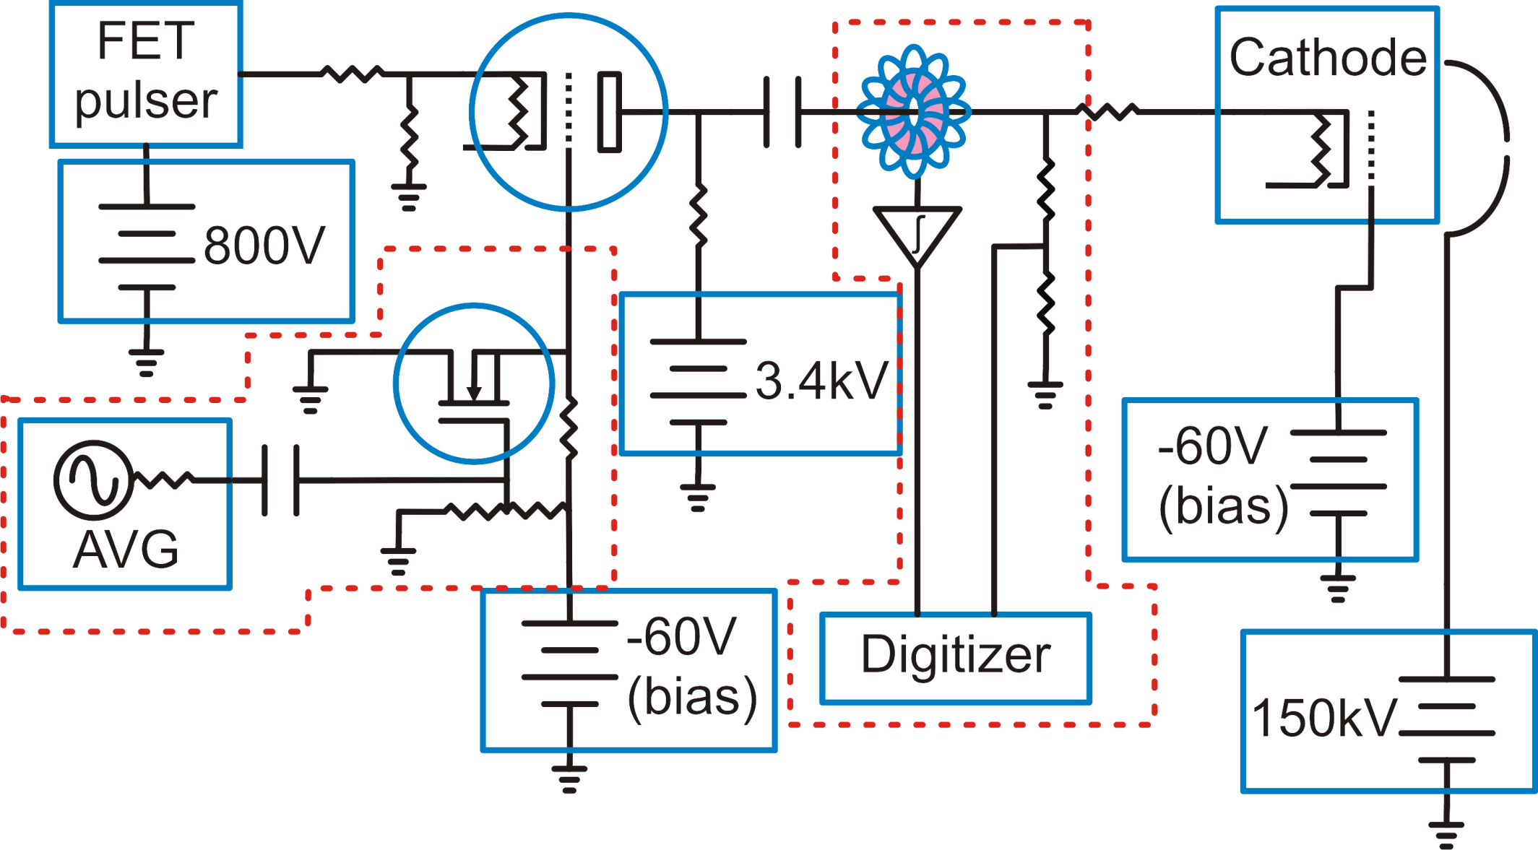
Gun pulser - upgrade

Slide 10
Gun pulser - upgrade
Current modulation:
±5% modulation, 10kHz - 50 MHz bandwidth
Looking into boosting modulation strength to ±10%
Can be used with gun current measurements, or potentially some BPM further downstream to correct the beam current in the linac.
Current measurements:
One resister divider on the gun connector
One dI/dt current pickup coil followed by integrator
Two measurements since the cathode is a rather non-linear device, thus knowing both current and voltage values could be useful.
So far, only tests in the lab has been performed

Slide 11
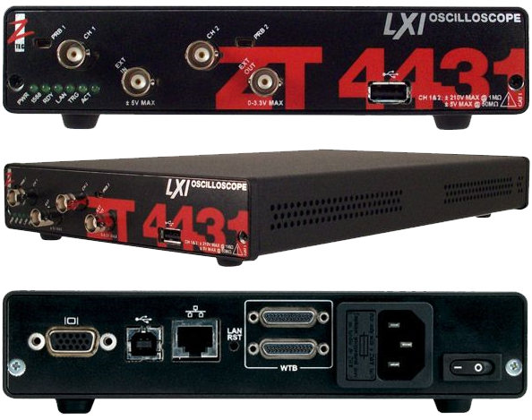
Digitizer
2 Channels
13-bit vertical resolution
250MS/s or 500MS/s interleaved
250MHz Analog bandwidth
0.5‰ resolution at full bandwidth
Ethernet connection
Should be adequate for all the measurements we might wish to do on gun deck.

Slide 12
Conclusions
Measurements of TWT indicate that they have decent stability.
There is a slow phase drift that is probably due to temperature
Gun will be equipped to have stability measurements done
A modulation input has been upgraded to allow for an arbitrary modulating waveform

