Slide 1
CTF3 collaboration technical meeting
CLIC Two-beam Module Program in CTF3
G. Riddone, 06.05.2010
(contributions from Two-beam module team and several collaborators: CEA/Saclay, Dubna/JINR, HIP, CIEMAT, LAPP, Pakistan, UnM, UPPSALA, IFIC Valencia, SLAC, Fermilab)

Slide 2
Content
Introduction to module
CLIC feasibility issues and motivation
Phases towards the CLEX modules
  TBTS
  Prototype modules in the lab (Modules-LAB)
  Prototype modules in CLEX (Modules-CLEX)
Conclusions

Slide 3
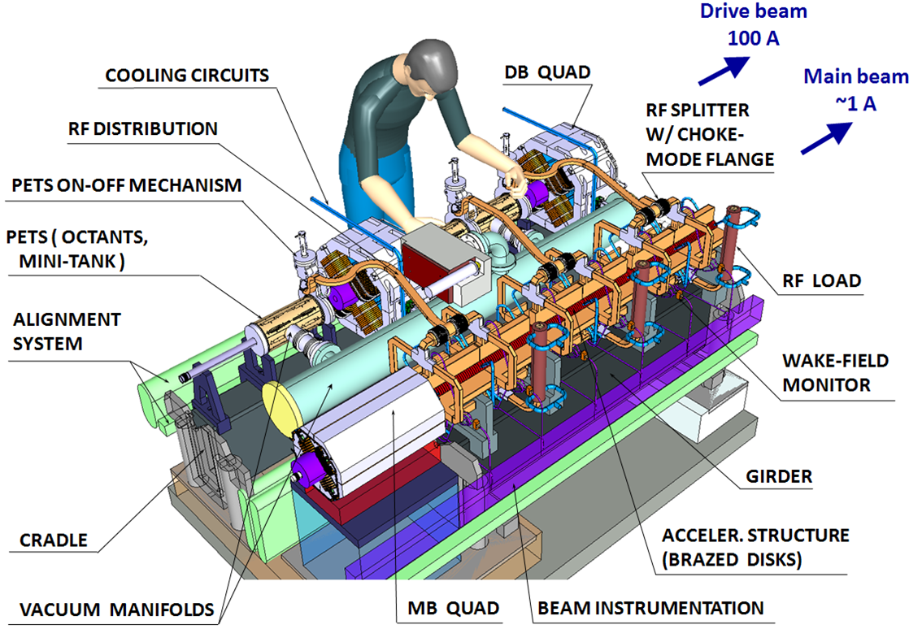
CLIC two-beam module
PETS
-6.5 MV/m, 136 MW
ACCELERATING STRUCTURE
+100 MV/m, 64 MW
NUMBER OF
CLIC MODULES
20924
ACCELERATING
STRUCTURES - 142812
QUADRUPOLES:
Main Beam – 3992
Drive Beam – 41848
PETS - 71406

Slide 4
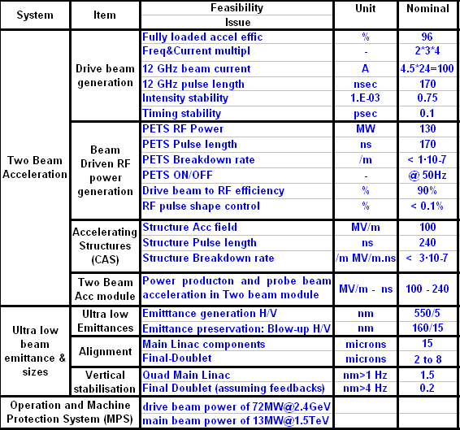
CLIC feasibility issues
Demonstration of novel scheme of two beam acceleration in compact modules integrating all technical systems for RF production, beam measurement and acceleration including alignment, stabilisation and vacuum at their nominal parameters.

Slide 5
Steps towards two-beam acceleration modules
Demonstration of the two-beam acceleration with one PETS and one accelerating structure at nominal parameters in CLEX
Two-beam test stand (PETS and ac. structures)
Demonstration of the two-beam module design. This implies the assembly and integration of all components and technical systems, such as RF, magnet, vacuum, alignment and stabilization, in the very compact 2-m long two-beam module
Prototype modules in LAB
Demonstration of the two-beam acceleration with two-beam modules in CLEX
Address other feasibility issues in an integrated approach
  Industrialization and mass production study
Prototype modules in CLEX

Slide 6
Two-beam modules - Strategy
Stand-alone tests
TBTS
RF structures
Pre-alignment
Stabilisation
Vacuum
CLIC PROTOTYPE MODULES
CLIC Modules (LAB)
(as much as possible close to CLIC modules)
4 modules: 2010-2011
CLIC Modules (CLEX)
(Eucard – NCLinac –WP9.2/9.3)
(to be adapted to test infrastructures)
3 modules: 2010-2012

Slide 7
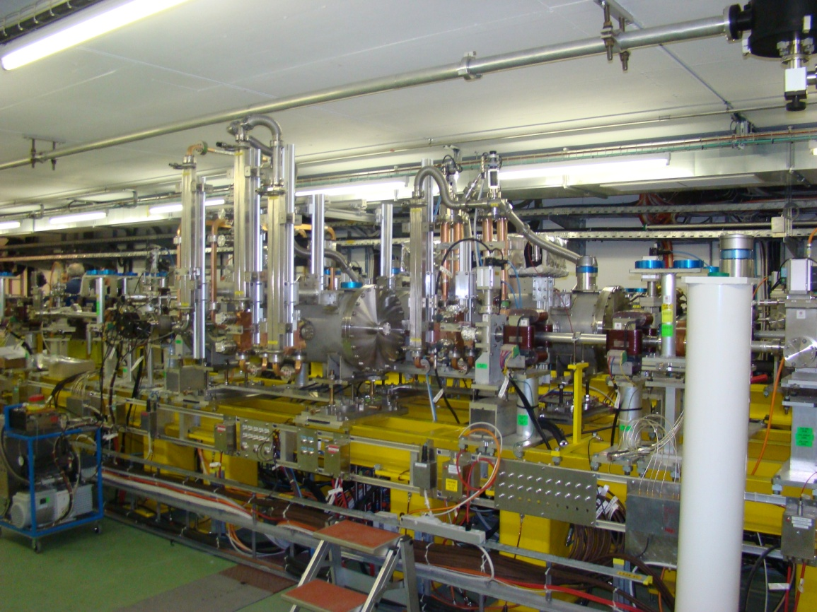
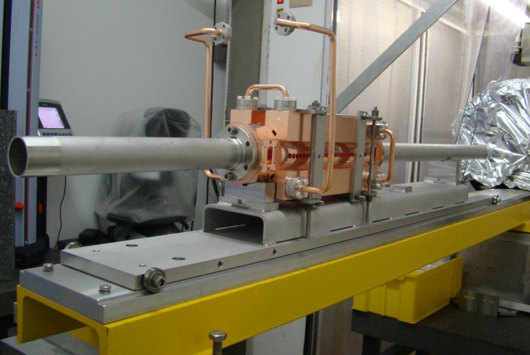
TBTS – Phase 2
NOW: phase 2.1
FUTURE
Phase 2.2: two accelerating structures TD24 with WFM (CEA)
The accelerating structures are currently under procurement (aim: ready to be installed by Q4, 2010)
AS
(TD24)
PETS

Slide 8
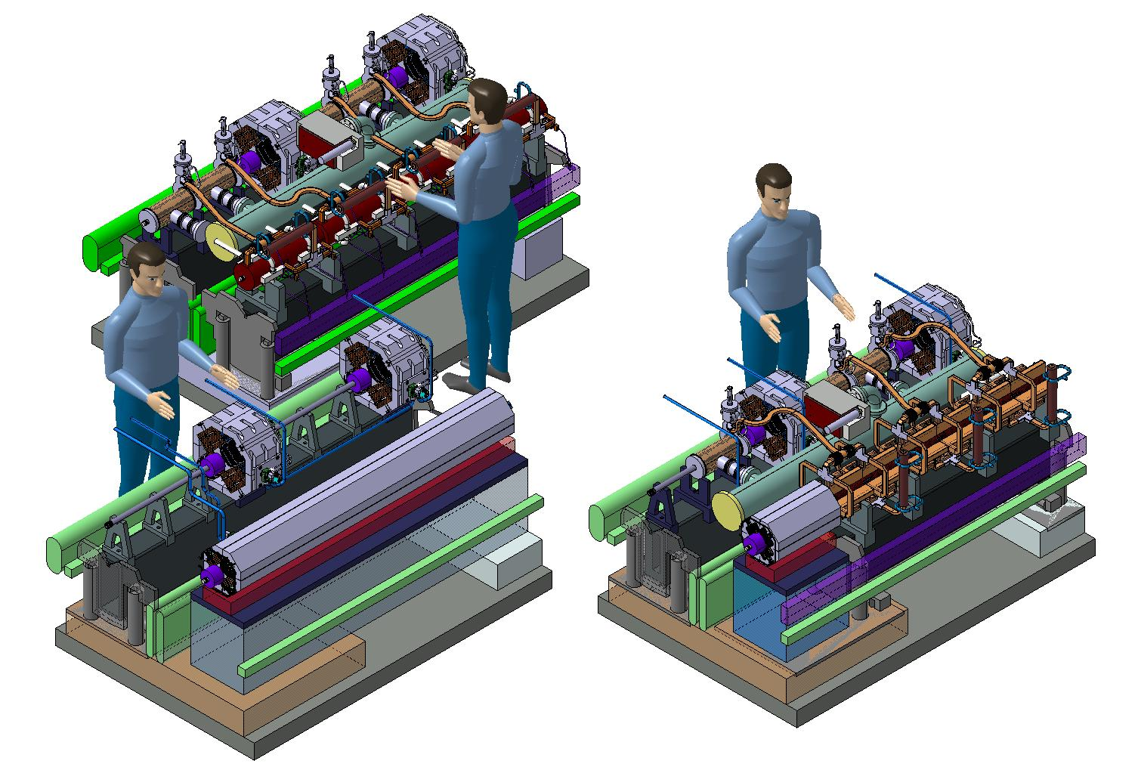
CLIC module types
A. Samoshkin
Type 0
(only RF structures)
The test module types 0-1-4 are representative of all module types
Type 4
(1 long MB Q)
Type 1
(1 short MB Q)

Slide 9
Modules-LAB: objectives
Integration of all technical systems (dummy RF structures and quadrupoles can be used – real dead weight and interfaces to other systems)
  Assembly of RF structures with all features
Validation of different types of girders and movers
Pre-alignment of girders/quadrupoles in the module environment, including fiducialisation
Full metrology of the module components
Stabilization of main beam quad in the module environment
Validation of interconnections under different simulated thermal loads
Vibration study of all systems and identification of vibration sources
Measurement of resonant frequencies (both in lab and in the tunnel/underground area)
Simulation of several thermal cycles: measurements of thermal transients (e.g. how long it takes to achieve a new equilibrium state), fiducialisation verification
Transport of the module and verification of alignment

Slide 10
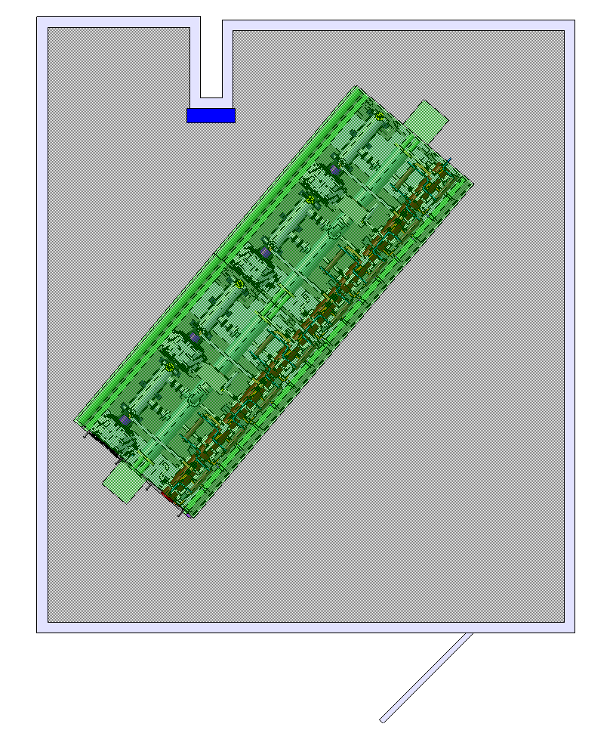
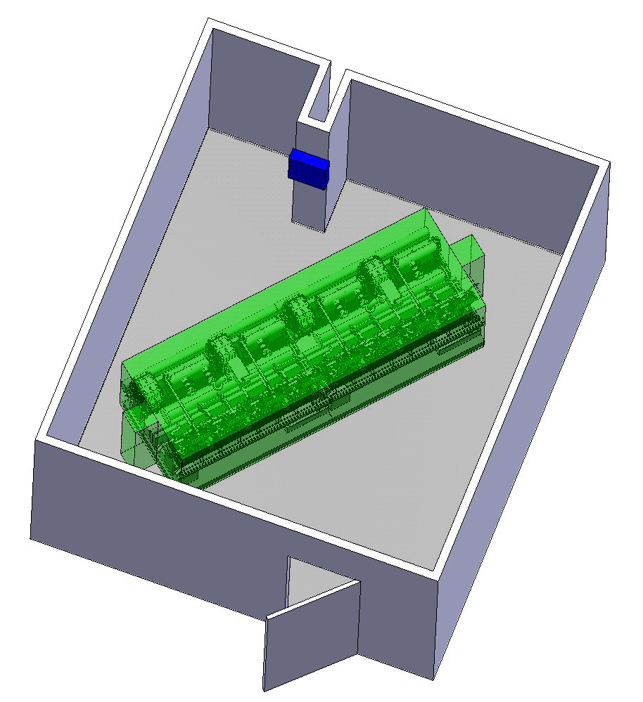
Modules-LAB
Installation of first two modules in the building 162

Slide 11
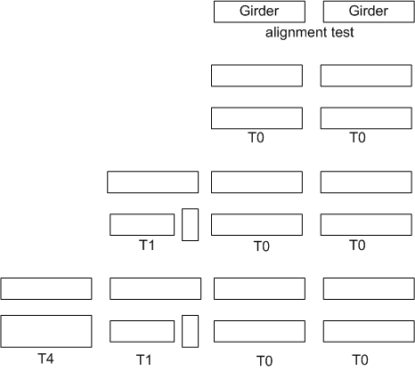
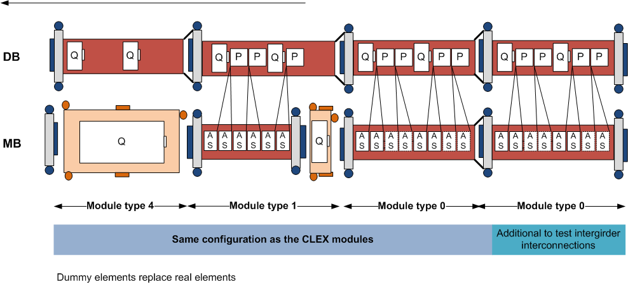
Modules-LAB
2010
Pre-alignment validation with dummy elements
Interconnections - pumping (static conditions)
Repositioning
Measurements of resonant frequencies
Phase 1
Phase 2
Transport and thermal cycles
Measurements of resonant frequencies
Phase 3
Stabilization (Q) and pre-alignment compatibility
Vibration study of all system and vibration sources

Slide 12
Modules-CLEX: objectives
Two-beam acceleration in compact modules integrating all technical systems for RF production, beam measurement and acceleration including alignment, stabilisation and vacuum at their nominal parameters.
Accelerating structure alignment on girder using probe beam
Wakefield monitor (WFM) performance in low and high power conditions, and after a breakdown
Investigation of the breakdown effect on the beam
Alignment and stabilization systems in a dynamic accelerator environment
RF network phase stability especially independent alignment of linacs
Vacuum system performance, both static and dynamics with rf
Cooling system, especially dynamics due to beam loss and power flow changes
Validation of assembly, transport, activation, maintenance etc.

Slide 13
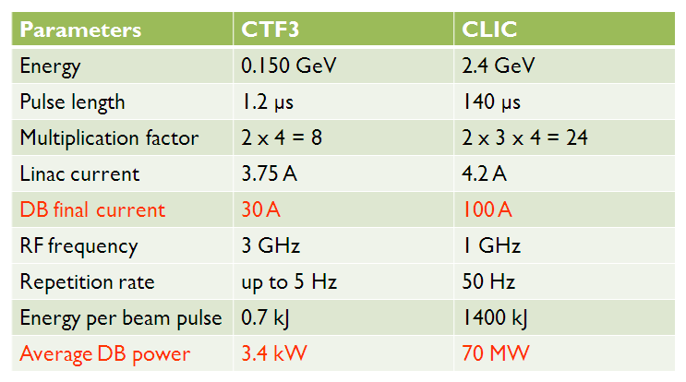
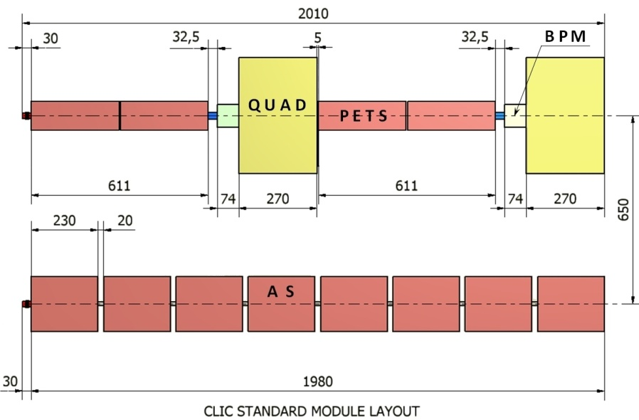
From CLIC module to CLEX module
CLIC module type 0
(1PETS feeding 2 AS)
CLEX module type 0
Double length PETS
PETS
PETS
(1PETS feeding 2 AS)

Slide 14
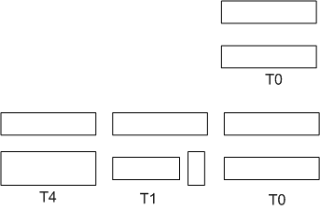
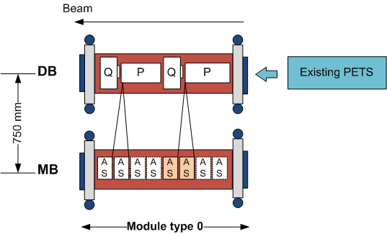
Module-CLEX: Phase 3
Phase 3 foresees the installation and testing of 1 module type 0: AS equipped with WFM (5 um accuracy / few WFM in the 1st powered AS)
3.1 / Nominal power and pulse length for 1 PETS and 2 AS
Recirculation
12 A and 240 ns
3.2 / No modifications on the module type 0 HW
No Recirculation
Current increase from 12 A to 19.2 A
Pulse length reduced from 240 ns to 140 ns

Slide 15
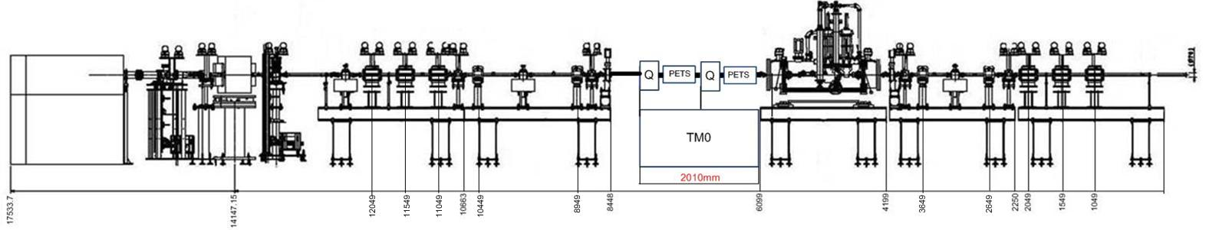
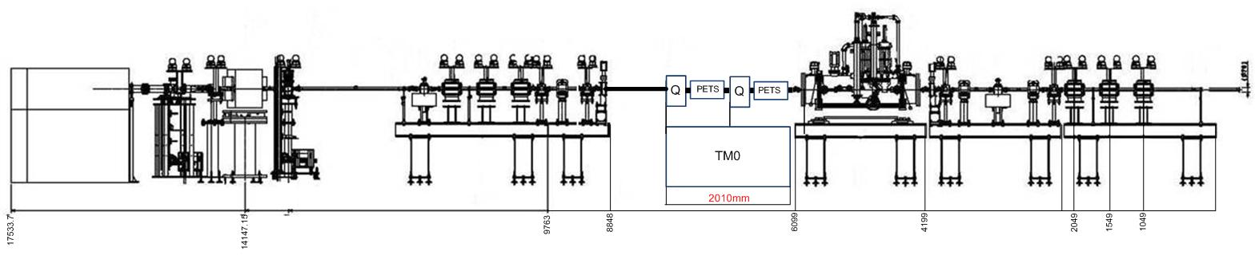
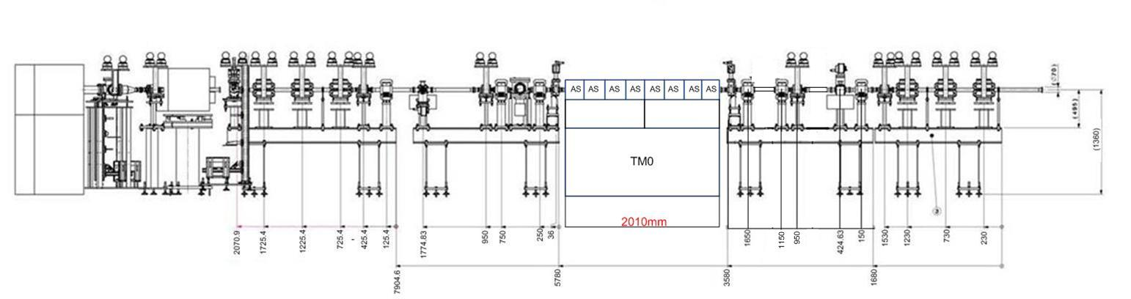
Module-CLEX/ Phase 3: type 0 module installation
15
DRIVE BEAM LINE (opt.1)
A. Solodko
DRIVE BEAM LINE (opt.2)
PROBE BEAM LINE

Slide 16
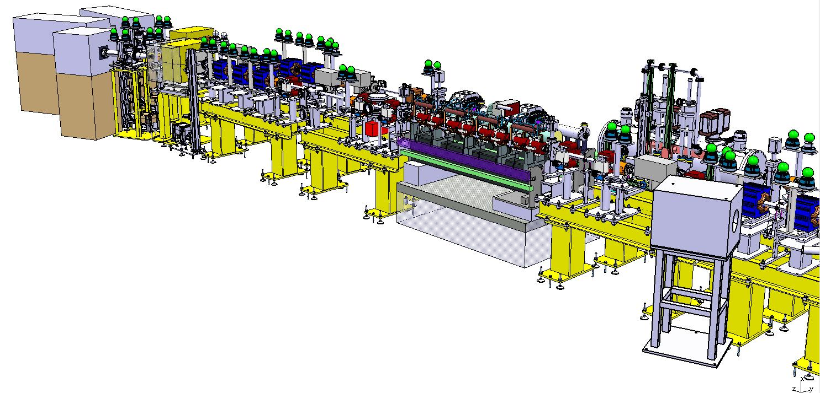
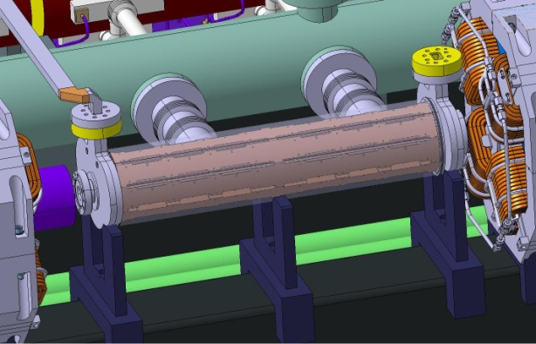
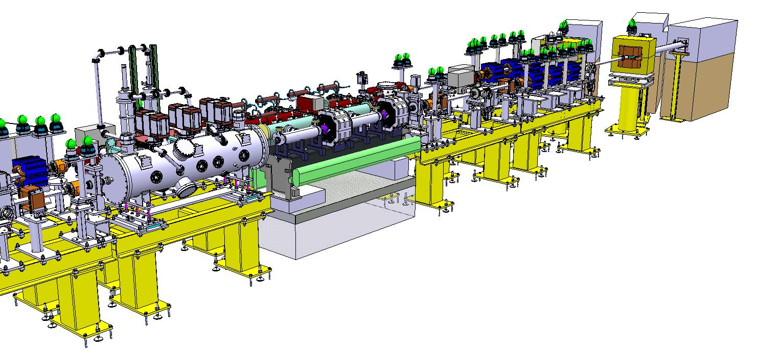
CLEX/Phase 3: module integration
16
A. Solodko
Double length PETS
Test Module type 0 integration into CLEX

Slide 17
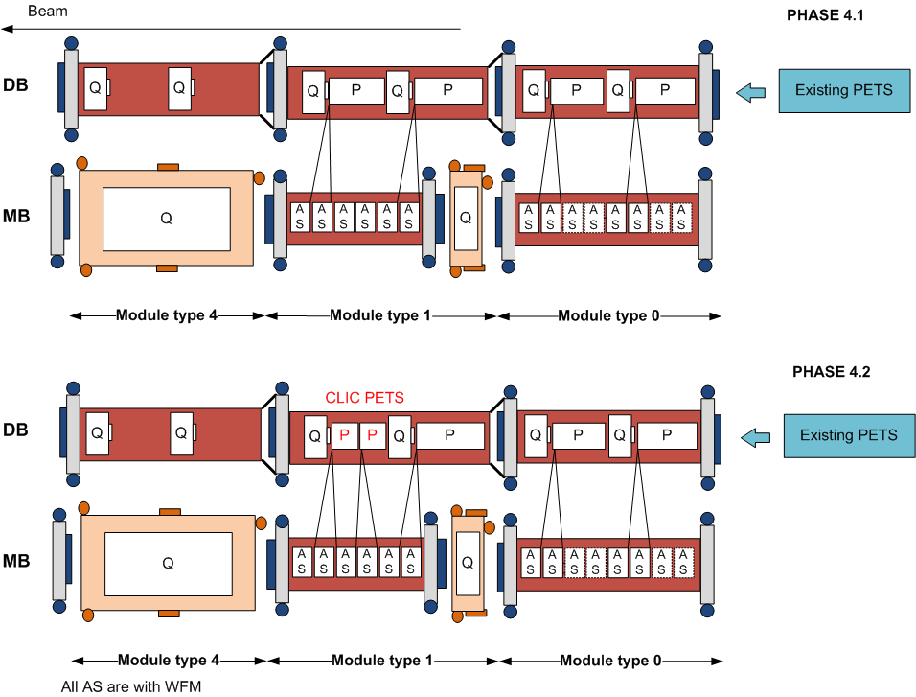
Modules-CLEX: Phase 4
No modifications on the module type 0
Addition of new modules - type 1 and 4
Increase of current from 19.2 A to 22 A
Modification on the module type 1
(2 CLIC PETS)
Needed klystrons and PC

Slide 18
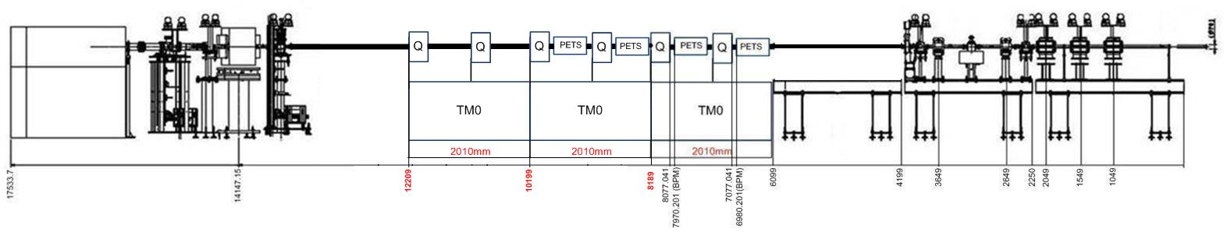
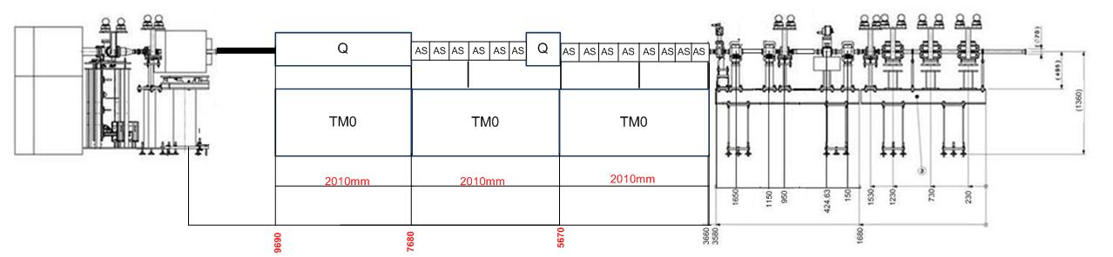
Phase 4: module installation
18
A. Solodko
DRIVE BEAM LINE
PROBE BEAM LINE

Slide 19
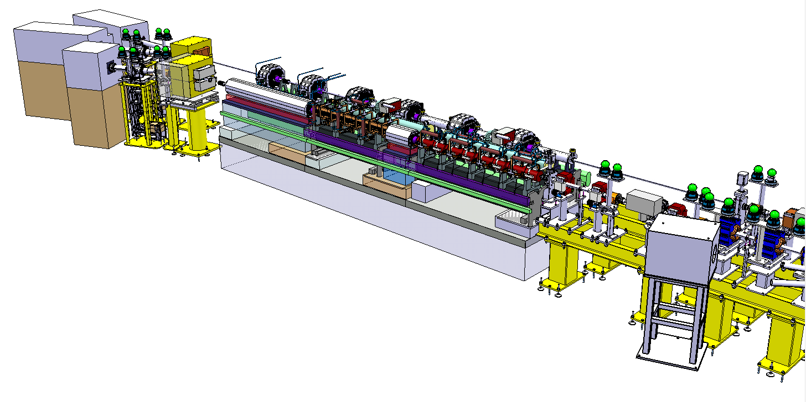
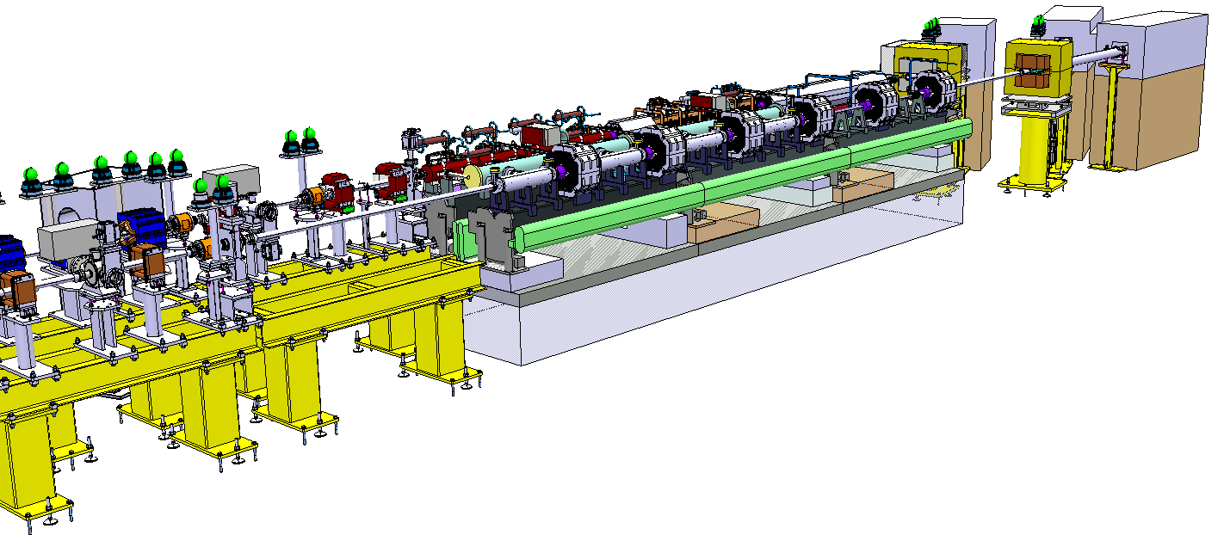
Phase 4: module integration
19
A. Solodko
3 Modules integration into CLEX

Slide 20
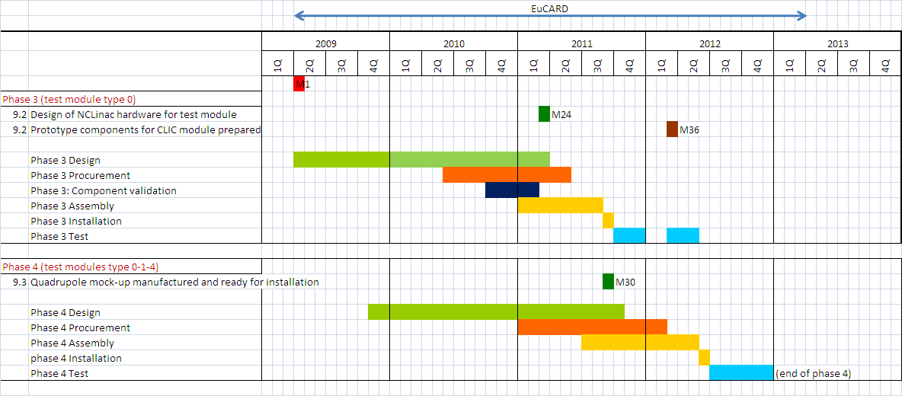
Proposed schedule

Slide 21
Conclusions
Two-beam acceleration module is one of the feasibility issues
We have established a program to address this issue, through different steps:
  TBTS
  Lab (4 modules from 2010)
  CLEX (3 modules from 2011) [also part of EuCARD – WP9.2 (G. Riddone /WP9.3 (A. Jeremie)) ➔ compact modules integrating all technical systems for RF production, beam measurement and acceleration
Procurement of key components for Modules-LAB under way (girders, Q, RF structures)
Prototype module design was frozen in Q1 2010 – a lot of work and limited resources: contribution from several collaborators is essential ➔ Type 0 by end of 2010

