Slide 1
Radiation Integrals in MADX
Tobias Persson and Leon van Riesen-Haupt
Thanks to: Helmut Burkhardt, John Jowett

Slide 2
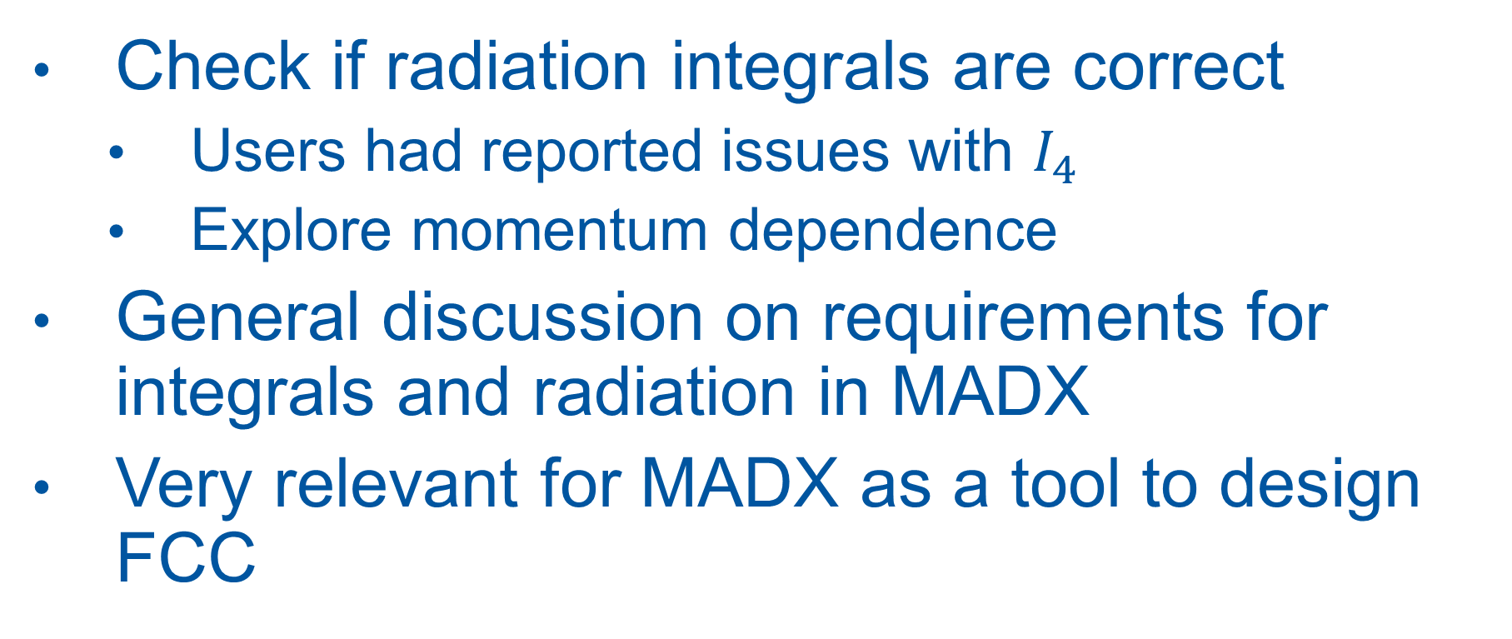
Goals and Motivation
Check if radiation integrals are correct
Users had reported issues with $I_{4}$
Explore momentum dependence
General discussion on requirements for integrals and radiation in MADX
Very relevant for MADX as a tool to design FCC

Slide 3
Reliability of Integrals
Checked integrals for well studied lattices (on momentum)
LEP: MADX vs python from twiss
FCC-ee: MADX vs python vs SAD
All showed good agreement
Closer study of script from users
Could not reproduce problem they were experiencing
After consulting with users, they were using version 5.02.00
Integrals last updated in 5.02.03 (2014)
“Standard” radiation integrals reliable in MADX

Slide 4
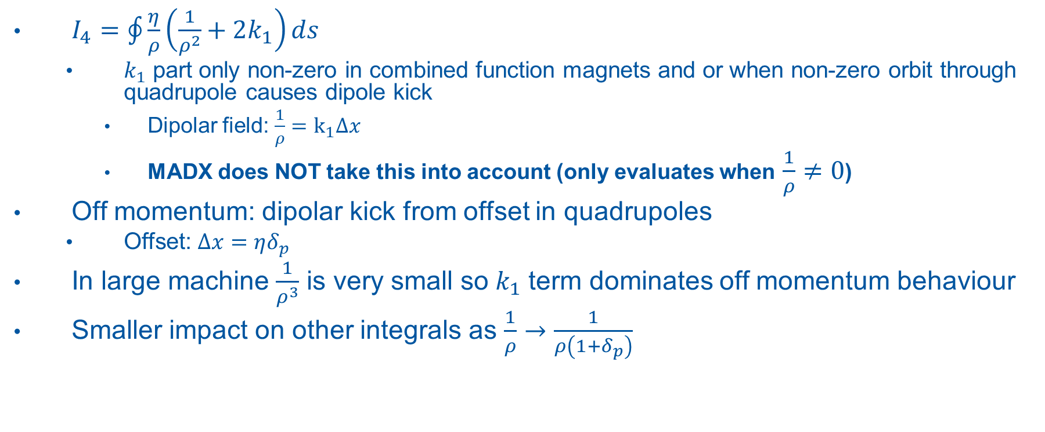
Off Momentum
$I_{4}=\oint{\frac{η}{ρ}\left(\frac{1}{ρ^{2}}+2k_{1}\right)ds}$
$k_{1}$ part only non-zero in combined function magnets and or when non-zero orbit through quadrupole causes dipole kick
Dipolar field: $\frac{1}{ρ}=k_{1}Δx$
MADX does NOT take this into account (only evaluates when $\frac{1}{ρ}≠0$)
Off momentum: dipolar kick from offset in quadrupoles
Offset: $Δx=ηδ_{p}$
In large machine $\frac{1}{ρ^{3}}$ is very small so$k_{1}$ term dominates off momentum behaviour
Smaller impact on other integrals as $\frac{1}{ρ}→\frac{1}{ρ\left(1+δ_{p}\right)}$

Slide 5
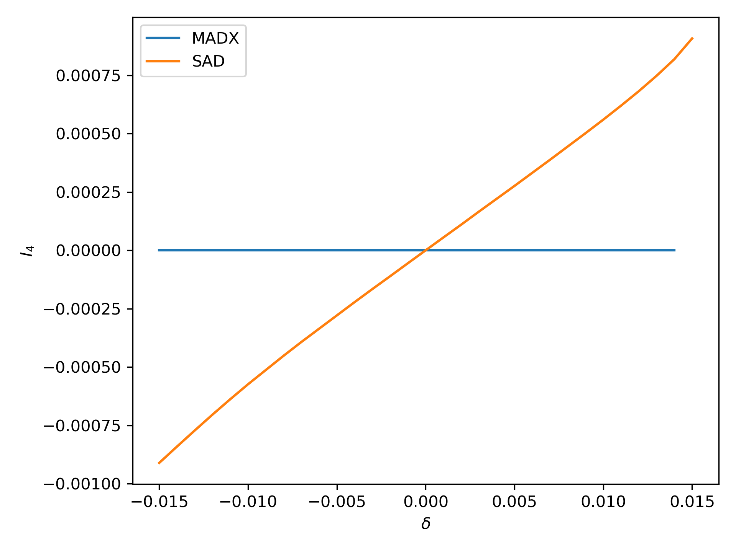

Off Momentum $I_{4}$ MADX vs SAD

Slide 6
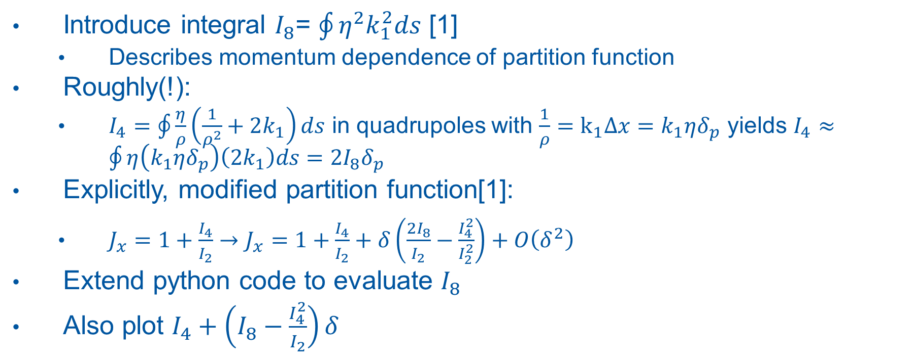

$I_{8}$ Integral
Introduce integral $I_{8}$= $\oint{η^{2}k_{1}^{2}ds}$ [1]
Describes momentum dependence of partition function
Roughly(!):
$I_{4}=\oint{\frac{η}{ρ}\left(\frac{1}{ρ^{2}}+2k_{1}\right)ds}$ in quadrupoles with $\frac{1}{ρ}=k_{1}Δx=k_{1}ηδ_{p}$ yields $I_{4}≈\oint{η\left(k_{1}ηδ_{p}\right)\left(2k_{1}\right)ds=2I_{8}δ_{p}}$
Explicitly, modified partition function[1]:
$J_{x}=1+\frac{I_{4}}{I_{2}}→J_{x}=1+\frac{I_{4}}{I_{2}}+δ\left(\frac{2I_{8}}{I_{2}}−\frac{I_{4}^{2}}{I_{2}^{2}}\right)+O\left(δ^{2}\right)$
Extend python code to evaluate $I_{8}$
Also plot $I_{4}+\left(I_{8}−\frac{I_{4}^{2}}{I_{2}}\right)δ$
[1] J. Jowett SLAC-PUB-4033

Slide 7
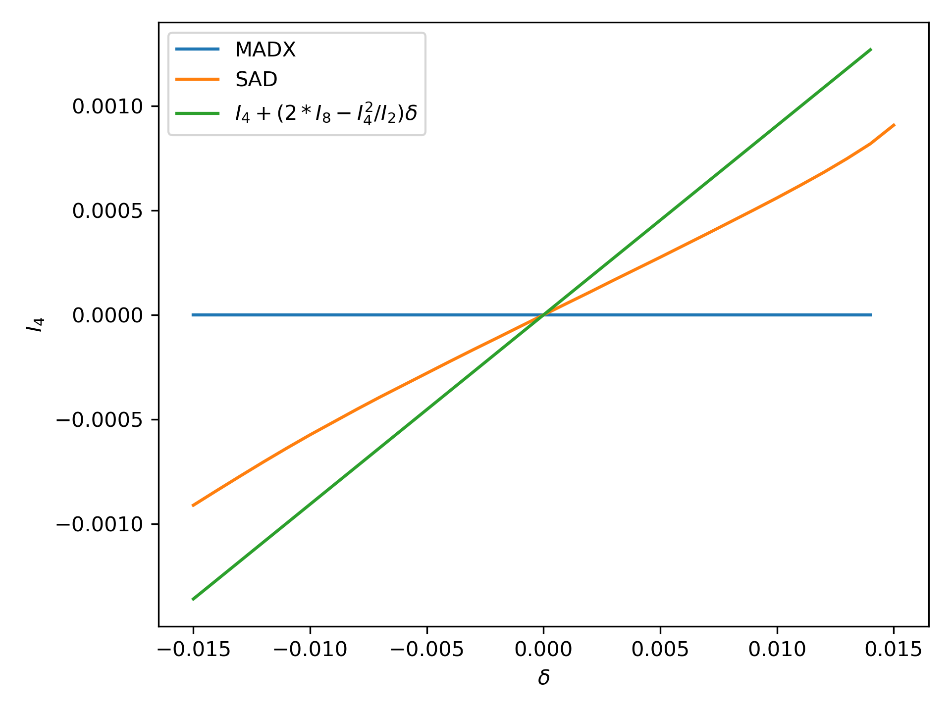

Including $I_{8}$

Slide 8
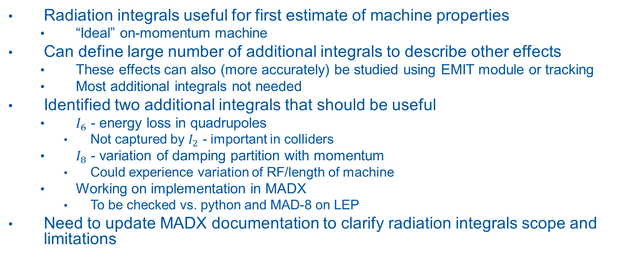
Discussion
Radiation integrals useful for first estimate of machine properties
“Ideal” on-momentum machine
Can define large number of additional integrals to describe other effects
These effects can also (more accurately) be studied using EMIT module or tracking
Most additional integrals not needed
Identified two additional integrals that should be useful
$I_{6}$ - energy loss in quadrupoles
Not captured by $I_{2}$ - important in colliders
$I_{8}$ - variation of damping partition with momentum
Could experience variation of RF/length of machine
Working on implementation in MADX
To be checked vs. python and MAD-8 on LEP
Need to update MADX documentation to clarify radiation integrals scope and limitations

