Slide 1


Beam spot at EAR1
with capture collimator
Laurent Tassan-Got

Slide 2
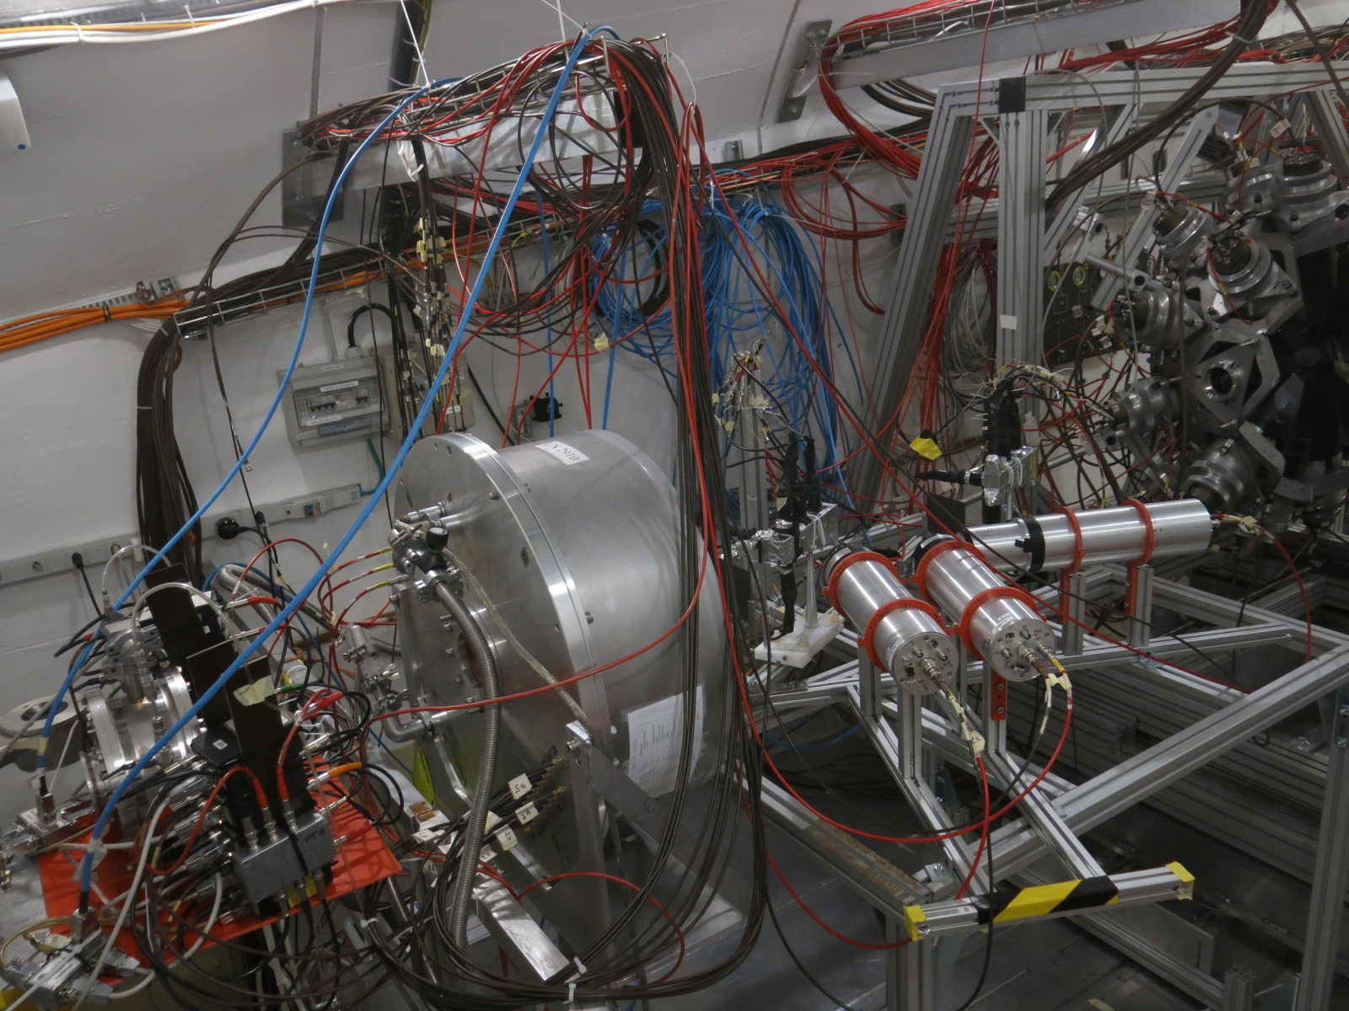
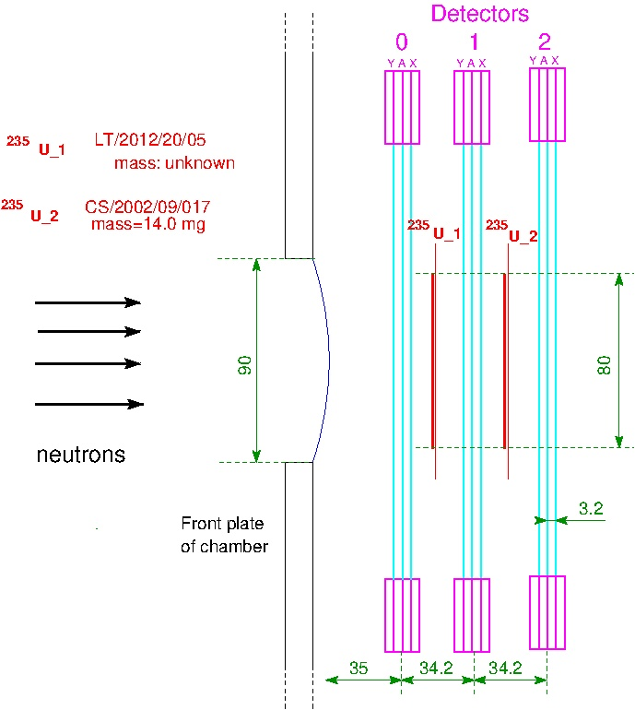
PPAC chamber in PRT experiment
2 x ²³⁵U samples
Localisation of emitting point on sample from line joining the crossing points on detectors on each side of the sample (coincidence method)

Slide 3
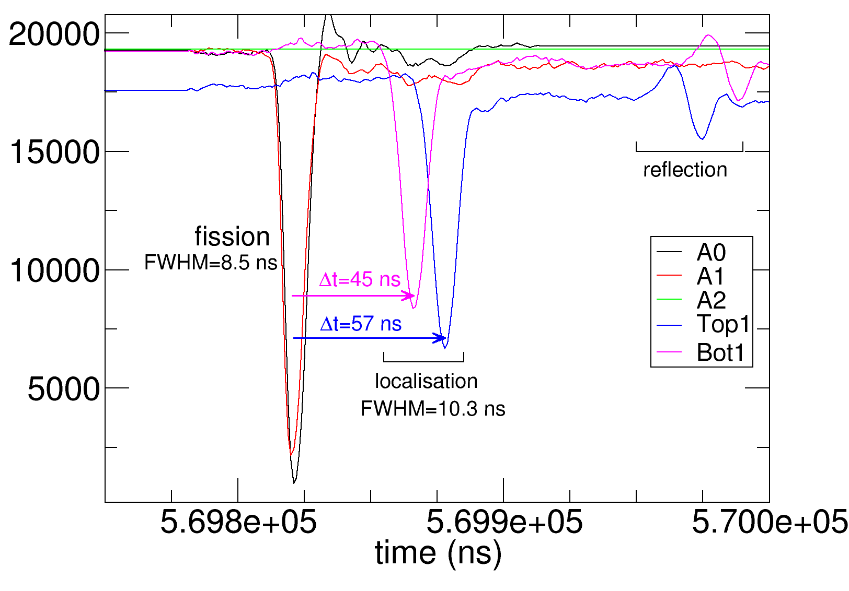
Localisation
Localisation of each fission fragment in PPAC by delay line
Emitting point on sample reconstructed from the line joining the crossing points on PPACs
Accuracy ~1.5mm. At high energy (>10 MeV) the linear momentum transfer slightly blurs the reconstruction

Slide 4
Mapping of the beam spot
All energies
300 MeV < E < 1 GeV
Circular spot well observed + neutron background covering the sample disk size (8cm diameter)

Slide 5
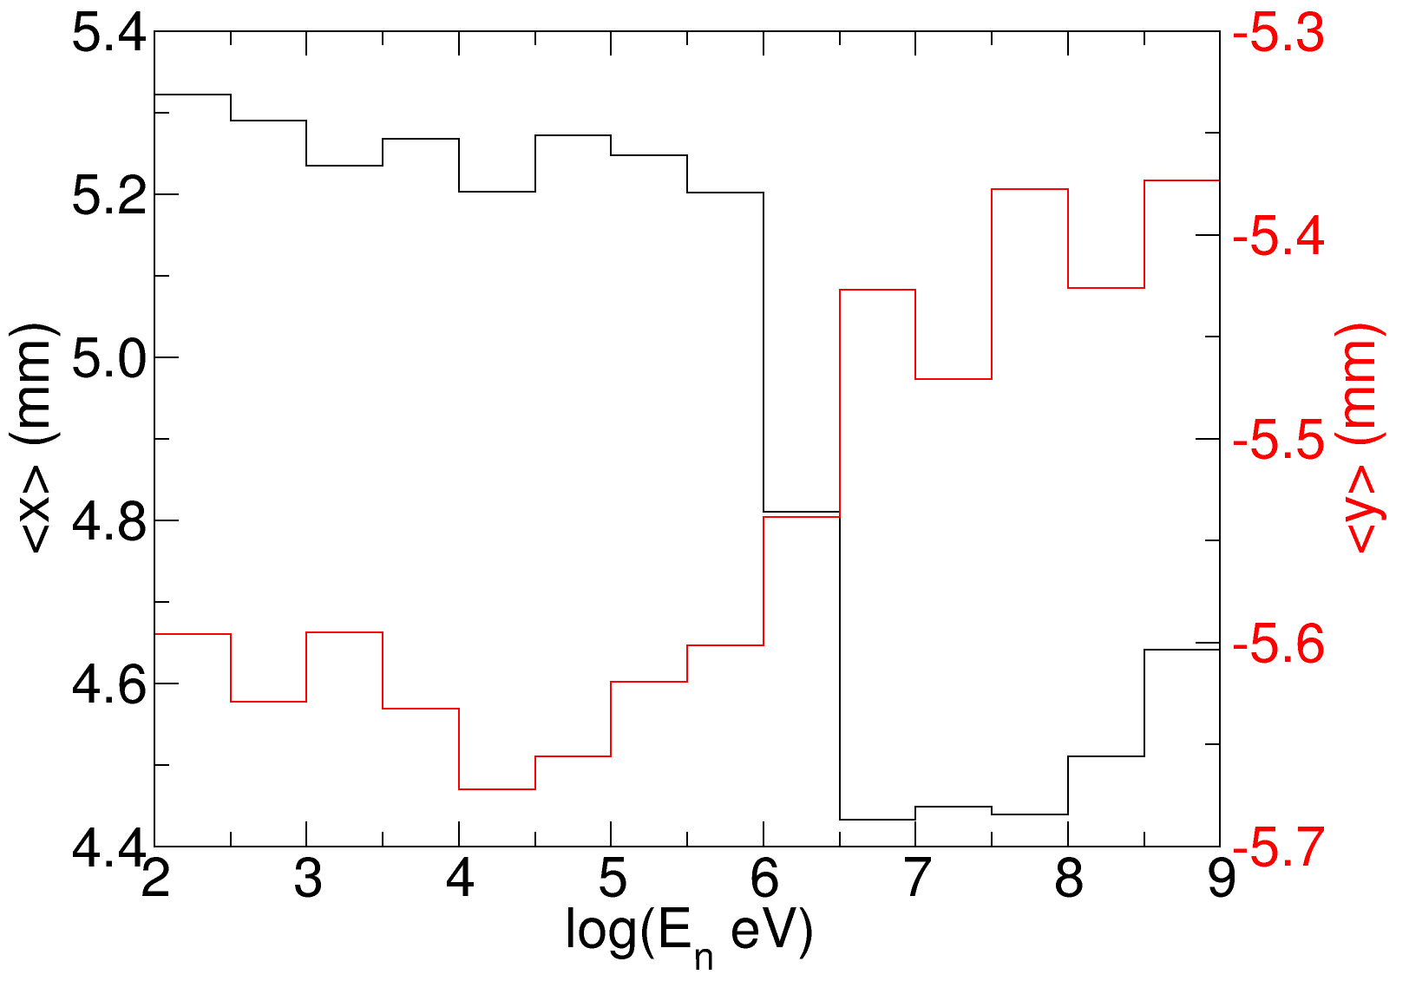
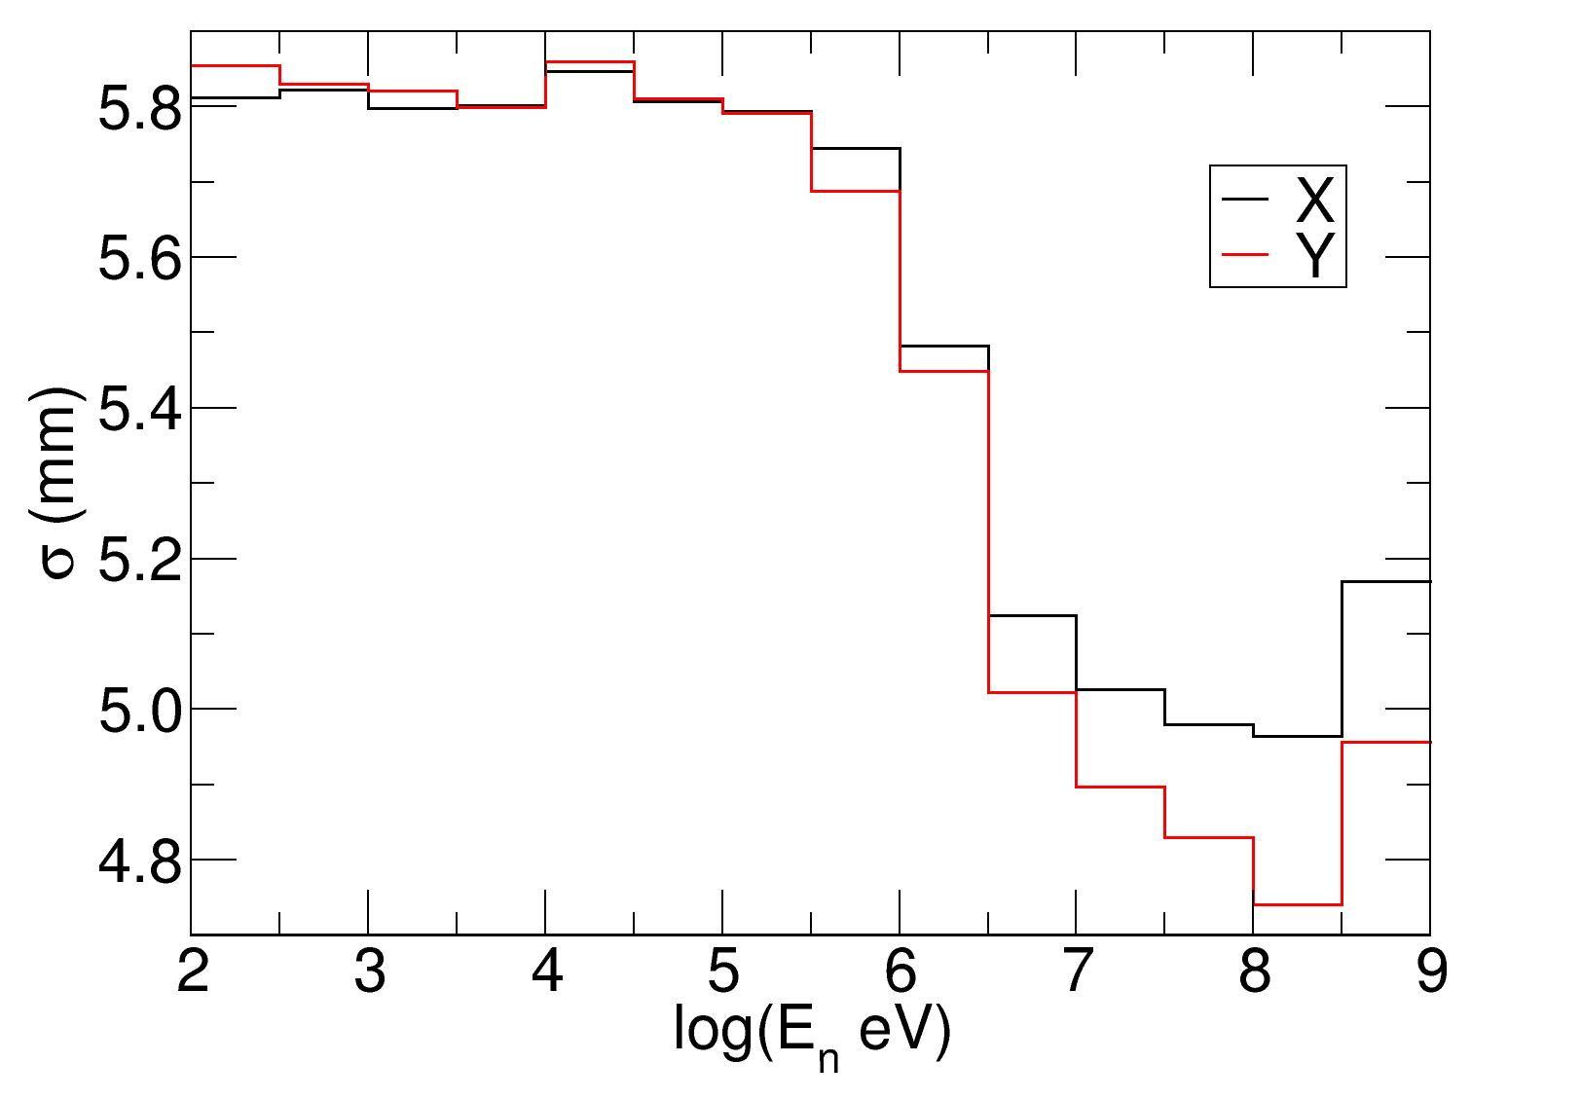
1st and 2nd moments of beam spot
Mean position
Standard deviation
Transition between 1 and 3 MeV visible in 1st and 2nd moments
Horizontal shift by 0.75 mm in the transition

Slide 6
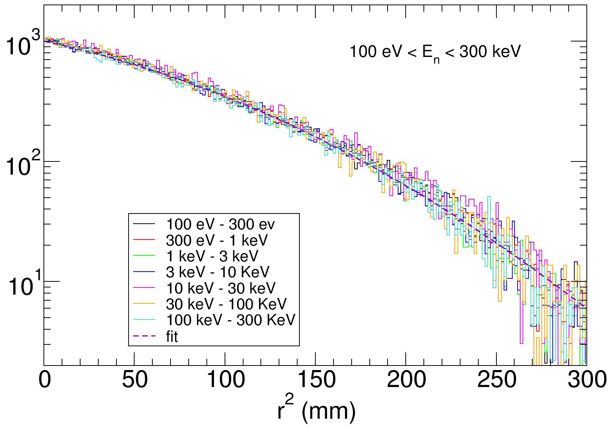
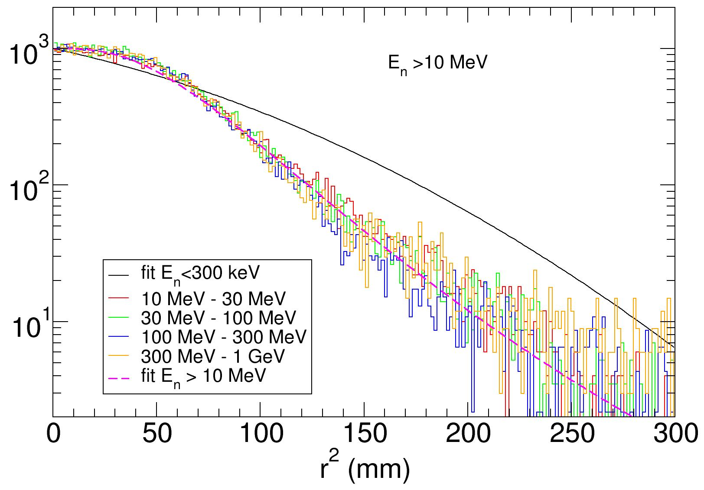
Intensity radial distribution
Low energy
High energy
Distribution is not gaussian
Fitted by :
Flat plateau at the center
Fitted by :
$N\left(r^{2}\right){dr}^{2}=p_{0}exp\left(−\frac{p_{1}r^{8}}{{\left(1+p_{2}r^{2}\right)}^{3.9}}\right){dr}^{2}$
$N\left(r^{2}\right){dr}^{2}=p_{0}exp\left(−p_{1}r^{2}−p_{2}r^{4}\right){dr}^{2}$
(1)
(2)
p₁=0.007333
p₂=3.25 10⁻⁵
p₁=4.7574 10⁻⁷
p₂=0.01373

Slide 7
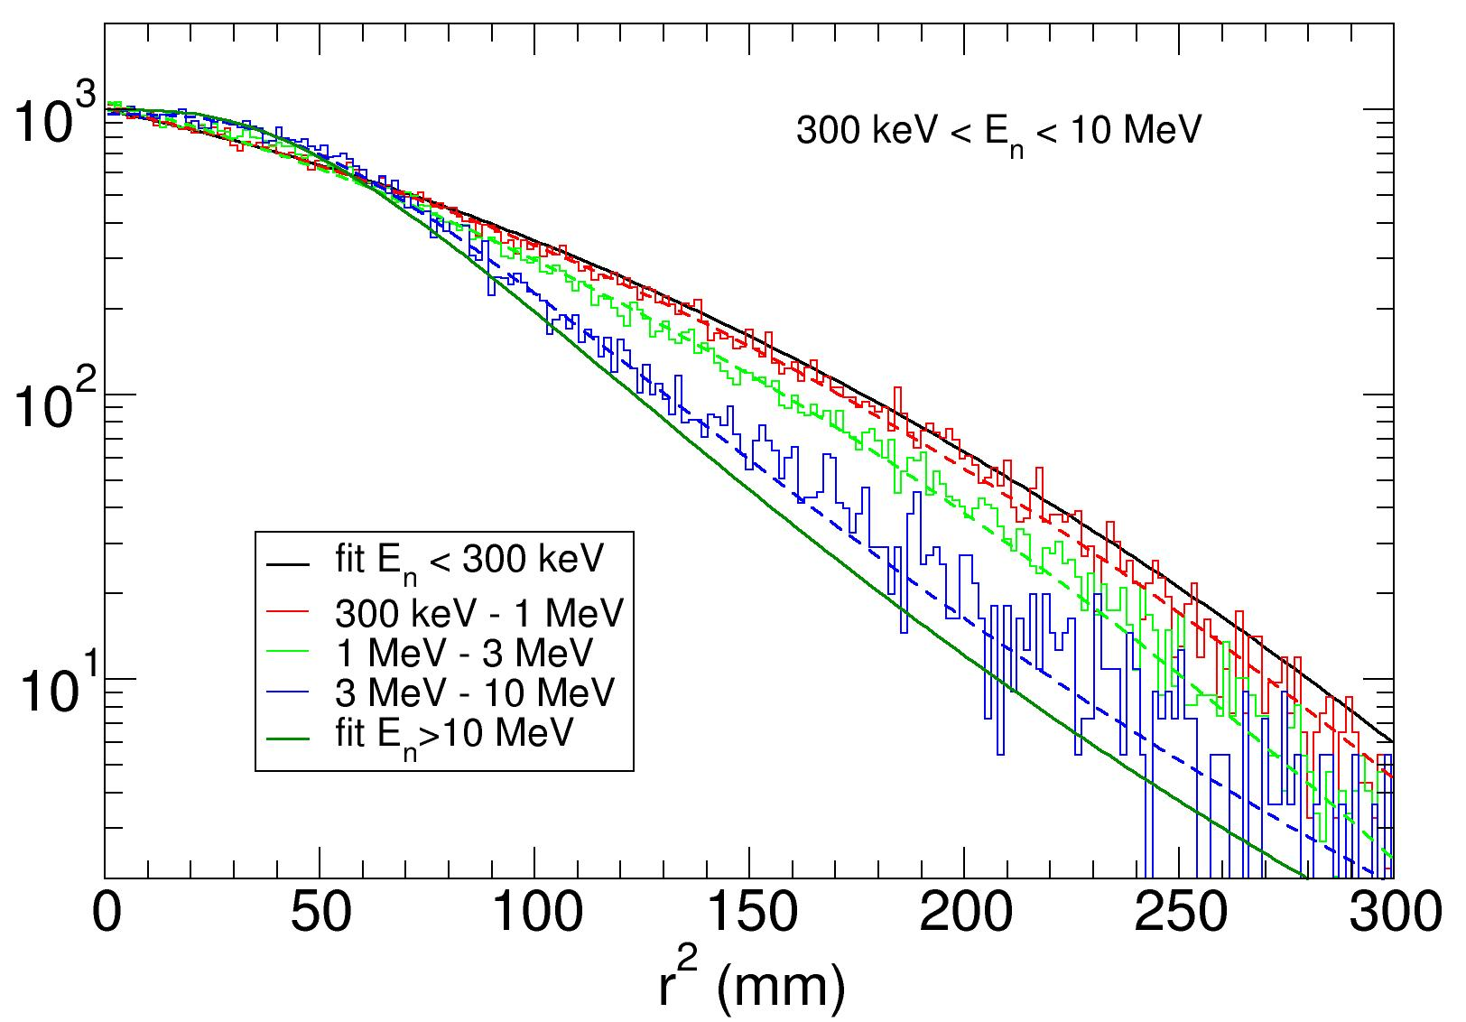
Radial distribution in transition range
0.3-1 Mev (1) p₁=0.007558, p₂=3.51 10⁻⁵
1-3 MeV (1) p₁=0.00900, p₂=3.817 10⁻⁵
3-10 MeV (2) p₁=3.614 10⁻⁷, p₂=0.01281

Slide 8
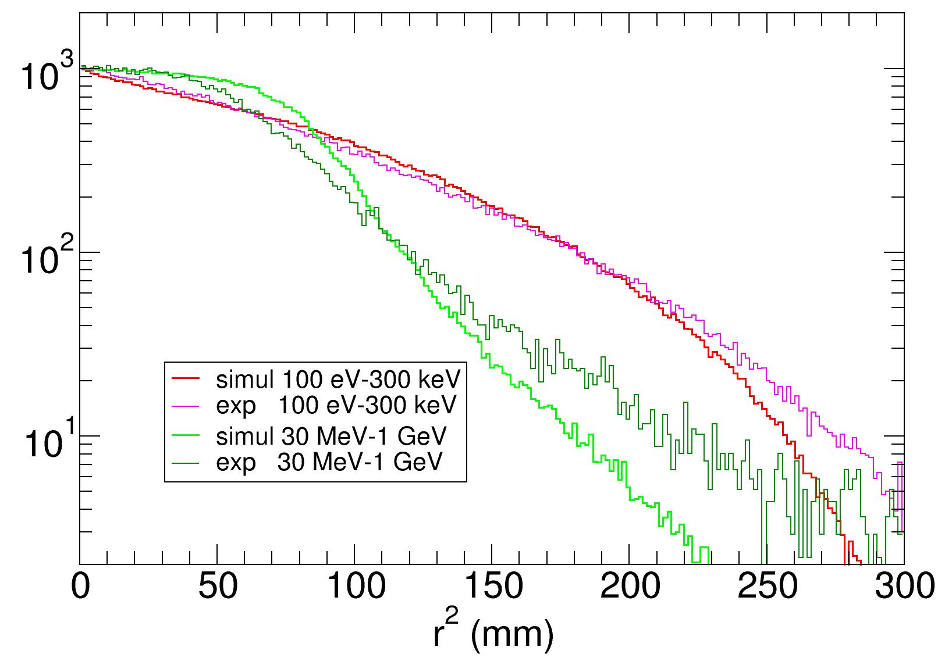
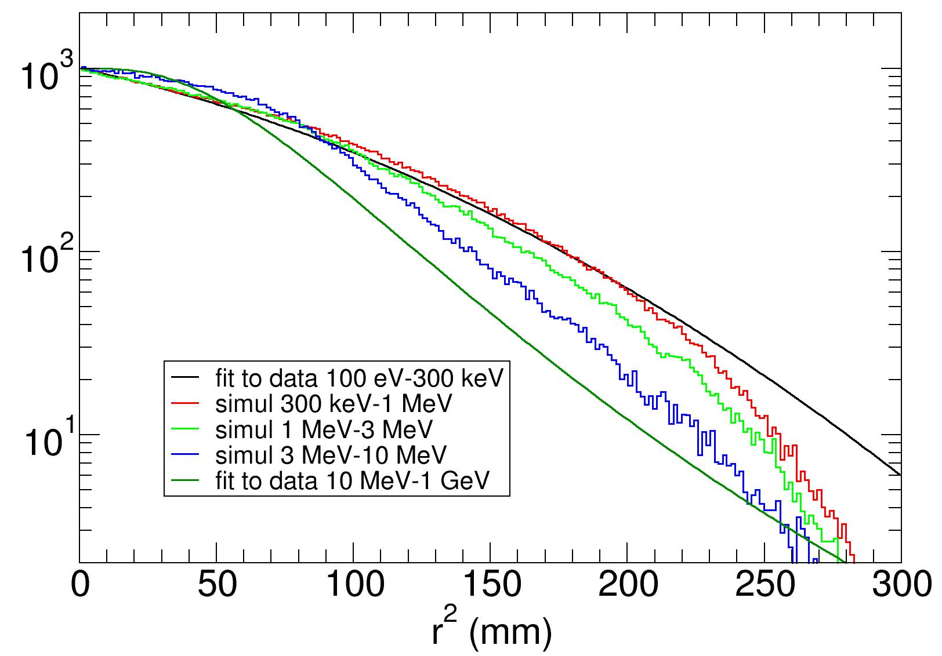
Comparison to simulations
simulation=Fluka+geometrical transport
Low and high energy
Transition range
Good agreement for the shape of radial distribution
Flat central plateau at high energy satisfactorily reproduced
Good agreement for the energy dependence

Slide 9
Conclusion
Accurate measurement of the beam profile at EAR1 with the capture collimator
The profile is not gaussian and a flat central plateau shows up above 3 MeV
Fits are provided so that the beam interception factor can be accurately at any energy
Simulations well reproduce the shapes of the distributions and their energy dependence

Slide 10
Backup

Slide 11
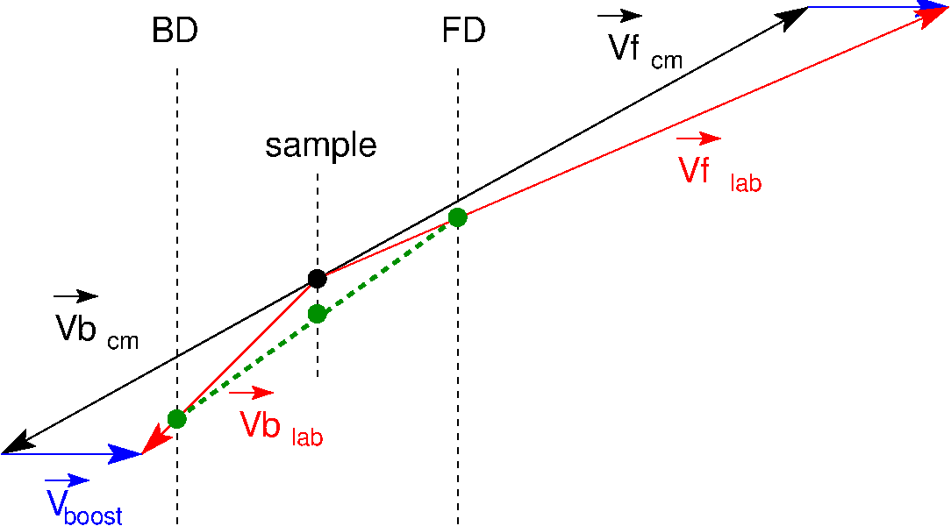
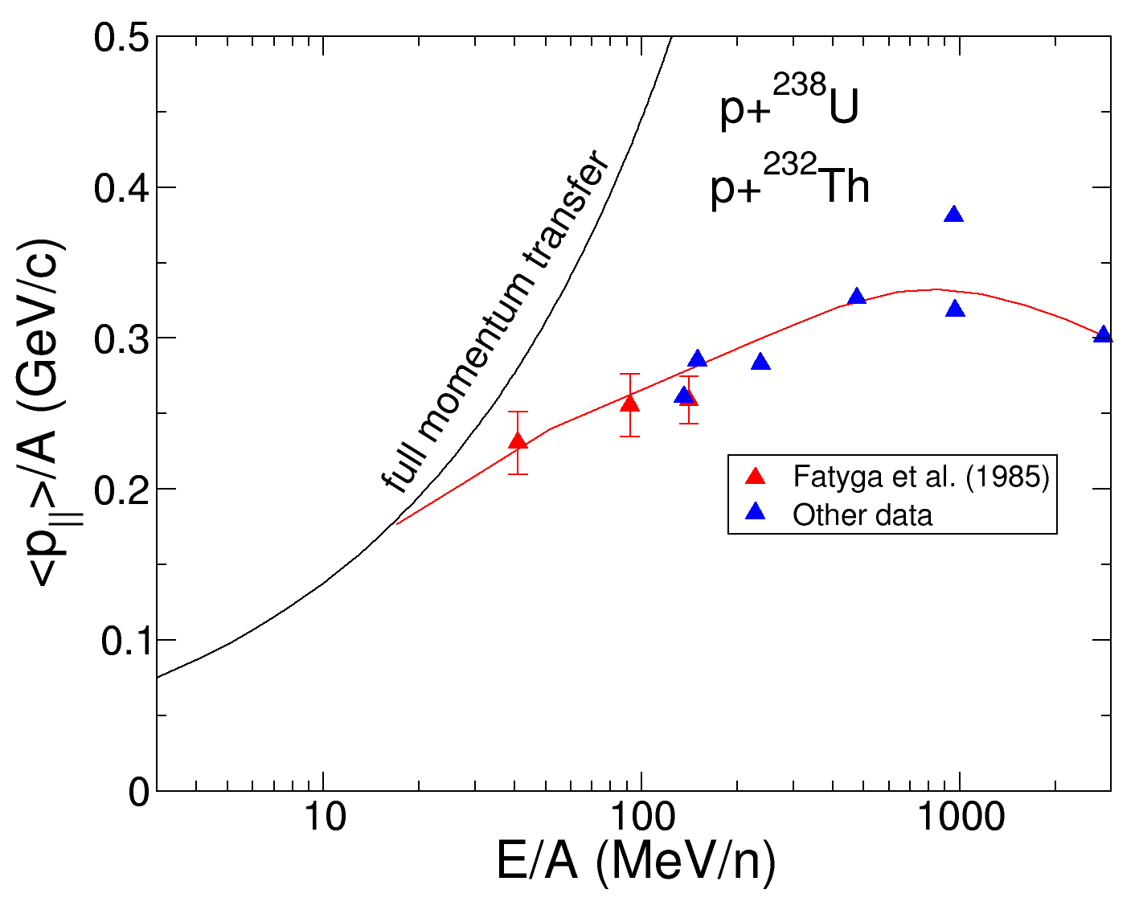
Trajectory reconstruction with boost
The reconstructed point (green dot) deviates from the emitting point (black dot) due to the linear momentum transfer
The effect is limited due to limited angle (no effect at 0°)
The linear momentum transfer levels off at high energy beyond 30 MeV

Slide 12
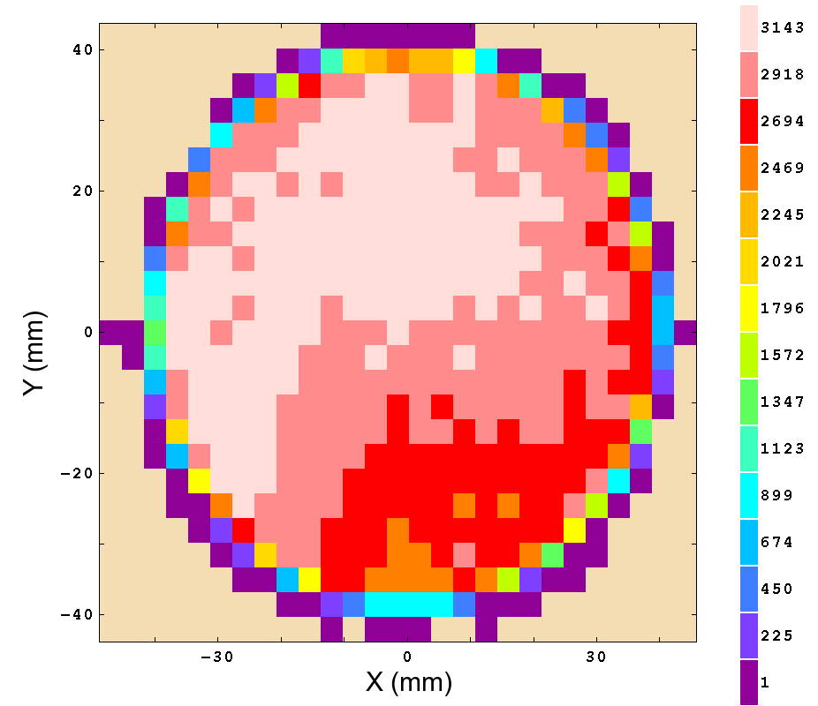
Mapping of α activity

