Slide 1





⁷⁹Se(n,ɣ) measurement
proposal
V. Babiano, J. Balibrea-Correa, L. Caballero, F. Calviño, A. Casanovas, C. Domingo-Pardo,
R. Dressler, C. Guerrero, S. Heinitz, U. Kösterk, I. Ladarescu, J. Lerendegui-Marco,
E. A. Maugeri, D. Schumann, J. L. Taín, A. Tarifeño-Saldivia,
and the n_TOF Collaboration
n_TOF Collaboration Meeting, CERN, 9th-10th June 2020

Slide 2
Outline
Motivations: s-process and nuclear waste
Status of the data and evaluations
Sample
Experimental set-up and EARs: combined proposal
Counting rate estimates and expected accuracy
Summary and outlook

Slide 3
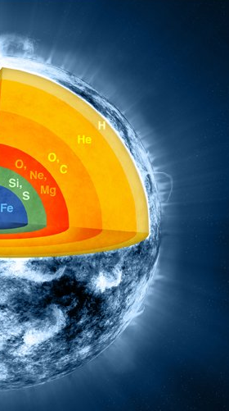

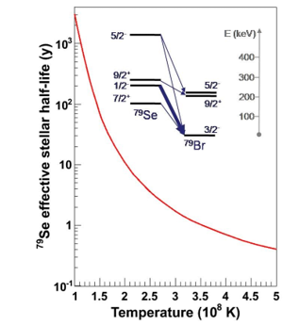
Motivation (I): s-process
s-process nucleosynthesis around A = 80
Se-79(n,ɣ) + s-only Kr-80 abundance well characterized
⁸⁰Kr
⁸¹Kr
⁸²Kr
11 a
⁷⁹Br
⁸⁰Br
⁸¹Br
⁸²Br
17 m
35 h
⁷⁶Se
⁷⁷Se
⁷⁸Se
⁷⁹Se
⁸⁰Se
⁸¹Se
⁷⁹Se
3x10⁵y
18 m
⁷⁵As
⁷⁶As
Se-79(n,ɣ): key measurement
s-process stellar site thermometer
26 h

Slide 4
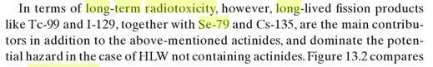
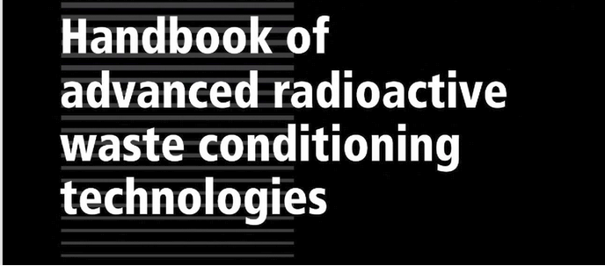
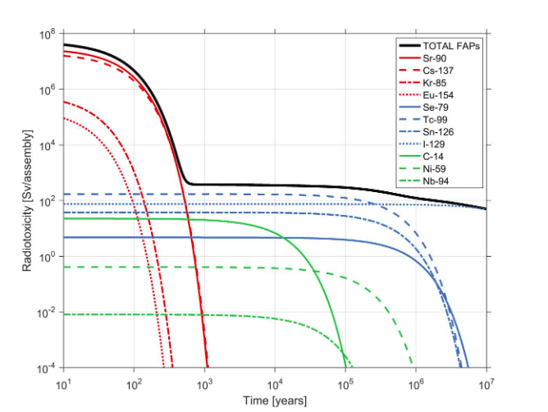
Motivation (II): nuclear waste
Se-79 is one of the main contributors to the
long-term radiotoxicity among fission products
Se-79(n,ɣ): relevant for nuclear waste disposal and transmutation
Se-79

Slide 5
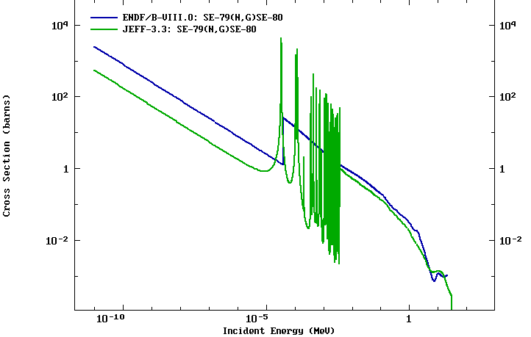
Status of the ⁷⁹Se(n,ɣ) data
EXPERIMENTAL DATA
First measurement of this cross section at thermal, RRR and URR
No data available in EXFOR:
MACS via activation not possible
(Se-80 stable)
EVALUATIONS
JEFF-3.3: TALYS Calculation → Provides Resonance parameters
ENDF/B- VIII.0: Systematics for the thermal point + 1/v dependence & OM for the URR
Thermal
URR
RRR
Additional calculations by
A. Mengoni in Back-up
Se-79(n,ɣ): challenging measurement but high impact.
No data available → High accuracy is not mandatory.

Slide 6
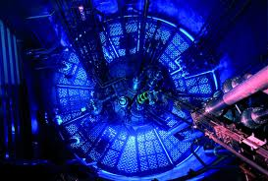
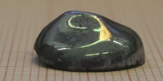
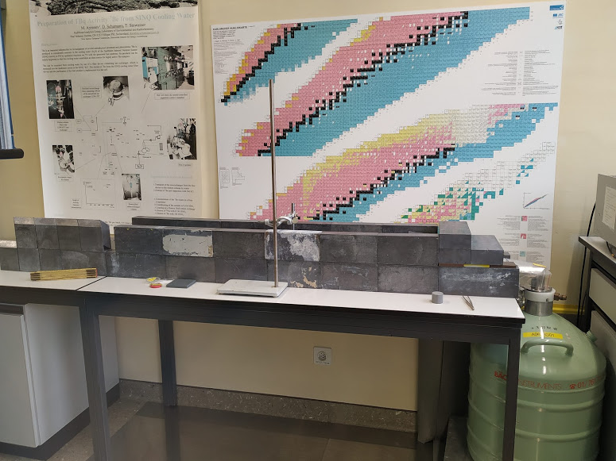
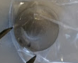
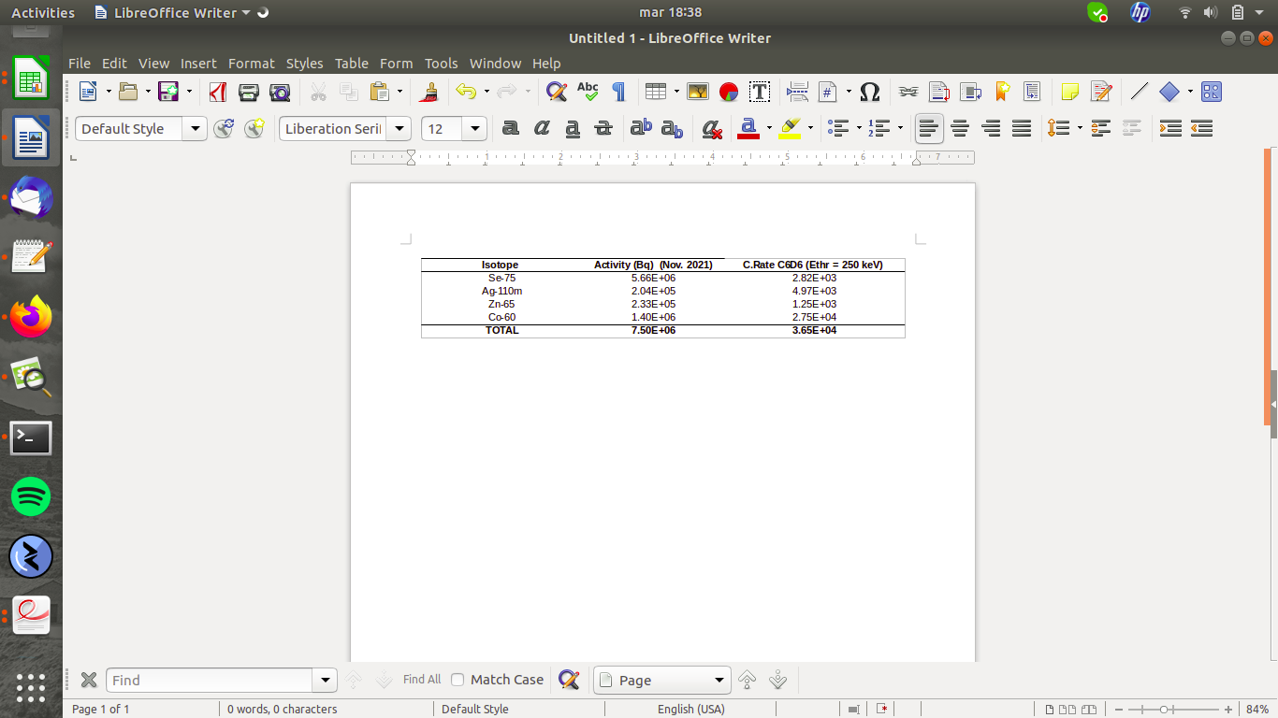
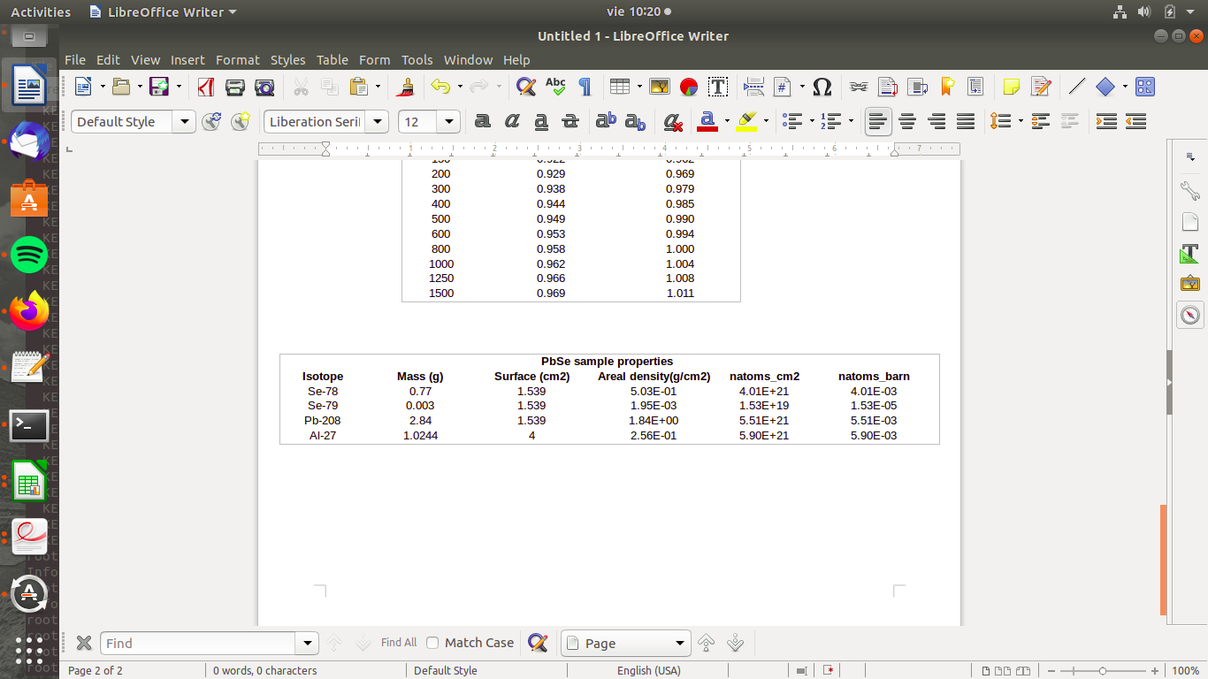
⁷⁹Se Sample
HPGe
Measuring table
PbSe alloy to avoid low melting point of pure Se
Se-78(n,ɣ) @ ILL
0.5 mm thick 6N Al casing (laser-welded)
Gamma activity characterization @ PSI
Sample properties

Slide 7
Detectors and EARs: pros & cons
Se-79(n,ɣ): EAR1 o EAR2?
Small mass (3 mg Se-79 + 2.84 g Pb + 0.77 g Se-78)
Radioactive sample
Measurement at EAR2 seems the best idea to achieve good statistics in the URR and optimize capture/activity.
RF EAR2: uncertain to resolve resonances in the keV range (& disentangle 78Se contribution)
Performance of C6D6 and i-TED at “new” EAR2 is still uncertain: to be commissioned
Feasibility of (n,ɣ) up to hundreds of keV @ EAR1 well known
Measurement at EAR1 required for validation/cross check in the RRR
Se-79(n,ɣ): i-TED and/or C6D6?
Large contribution of neutron scattering in Pb, Se-78 and Se-79 → Case for i-TED
i-TED has shown good performance @ EAR1 (commissioning 2018)
i-TED allows to extract spectroscopic information of the Se-79(n,ɣ) cascade
C6D6 better performance at high CR → Better suited for EAR2
Combined proposal:
i-TED (+ C6D6?) @ EAR1 & C6D6 @ EAR2
Similar previous measurements:
Tm-171(n,ɣ) @ EAR1 and EAR2
Cm-244/246(n,ɣ)

Slide 8
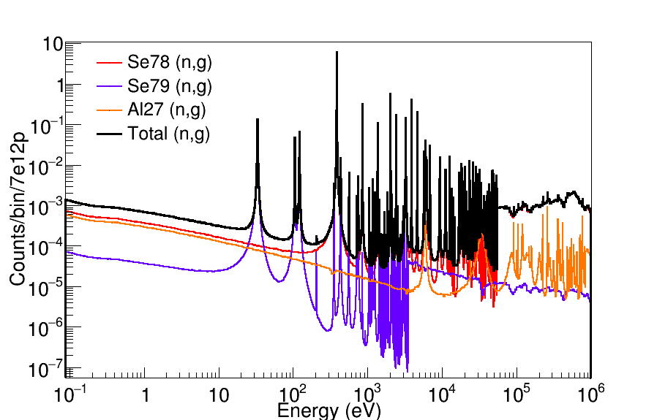
⁷⁹Se(n,ɣ): Counting rate estimates
COUNTING RATES: Ingredients
Cross sections from JEFF-3.3
Evaluated Flux EAR1/2 phase 3
BIF = 0.4
(n,ɣ) efficiency from MC assuming Au-197 cascade
Ethr = 200 keV
for C6D6 & i-TED (coinc.)
Se-79 sample @ EAR1

Slide 9
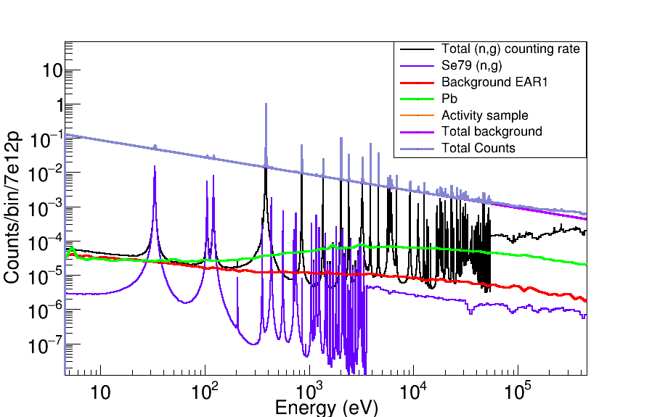
⁷⁹Se(n,ɣ) @ EAR1 with i-TED
Empty and Lead from experimental C6D6 data.
i-TED: Scaled assuming than (n,ɣ)/background can improve a factor 5(*).
Activity counting rate via MC simulations of the sample contaminants.
i-TED: Energy cuts -50% of the activity
PHWT may improve the capture to background ratio
(*) backup
Total count rate dominated by sample activity background: to be fitted and 1/v subtracted such as in previous measurements on highly active samples: Tm-171, Tl-204, ....

Slide 10
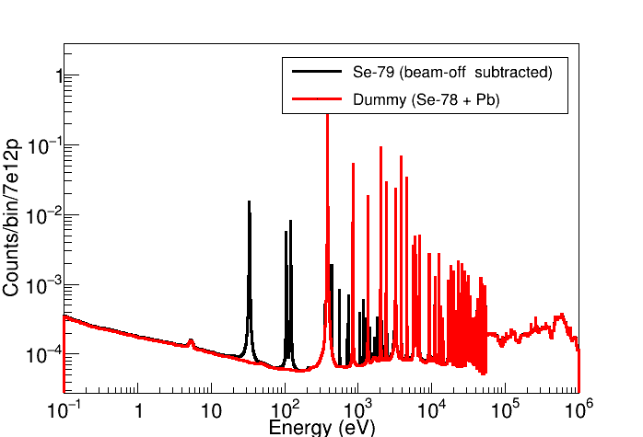
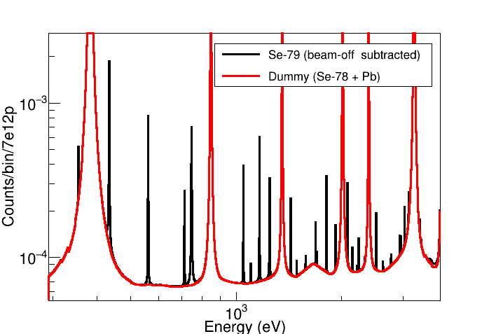
⁷⁹Se(n,ɣ) @ EAR1: expected results
Theoretical estimation: After 1/v activity subtracted → Total counts vs “dummy”
ASTROPHYSICS: keV-to-100keV region is the most important one.
High-resolution of EAR1 is required here to resolve 79Se capture levels between Se-78 resonances
Strength and level density of Se-79 may change (BASED IN TALYS)

Slide 11
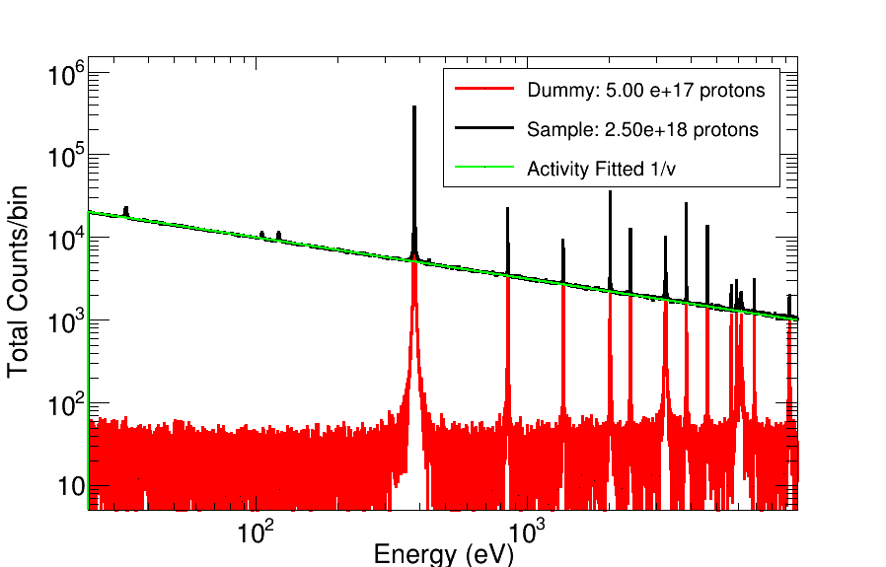
⁷⁹Se(n,ɣ) @ EAR1 i-TED: statistics
STATISTICS IN EAR1 FOR
MC RESAMPLING
PbSe sample:
2.5e18 protons
Dummy:
0.5e18 protons
Dummy = Pb + Se-78 + Al + empty
Activity (beam-off + sample-in)
Sample = Dummy + Activity + Se-79
MC simulation of the experiment: Realistic counts and statistical uncertainties
i-TED: reduction of activity background in 40% and the dummy in a factor ~5 relative to capture (wrt to C6D6)

Slide 12
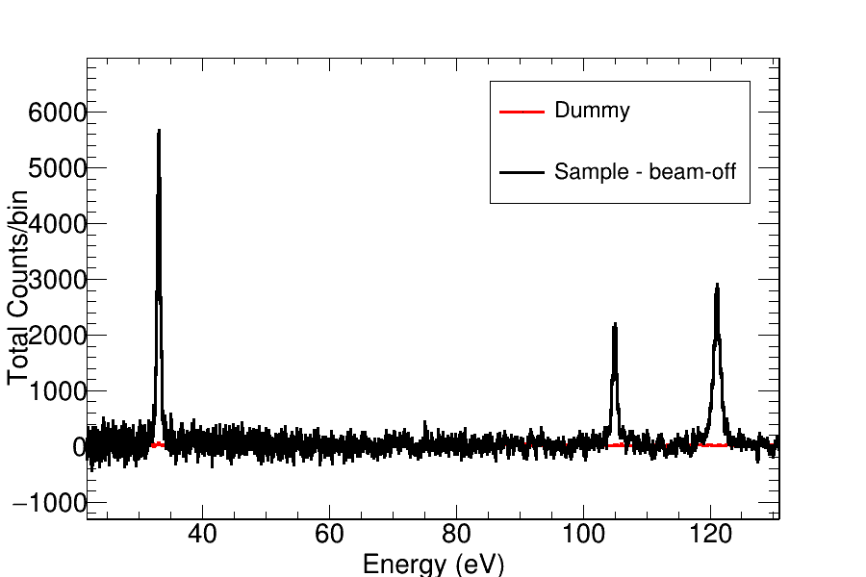
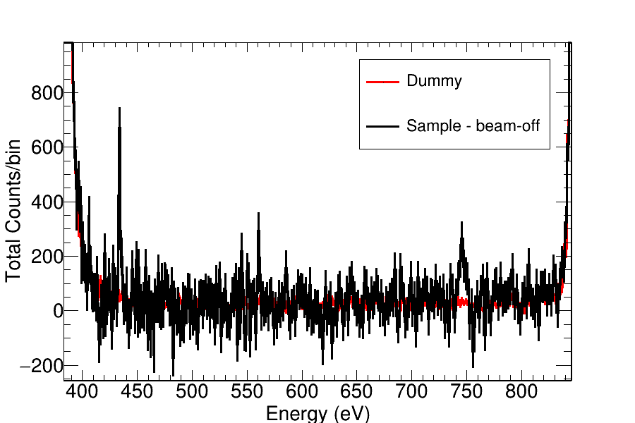
⁷⁹Se(n,ɣ) @ EAR1 i-TED: RRR
EAR1 → High energy resolution
RF @EAR1 negligible below 1 keV
Se-79 @ EAR1: RRR (strongest resonances) of Se-79 below 1 keV with high resolution
URR: complementary measurement at EAR2 up to 100 keV

Slide 13
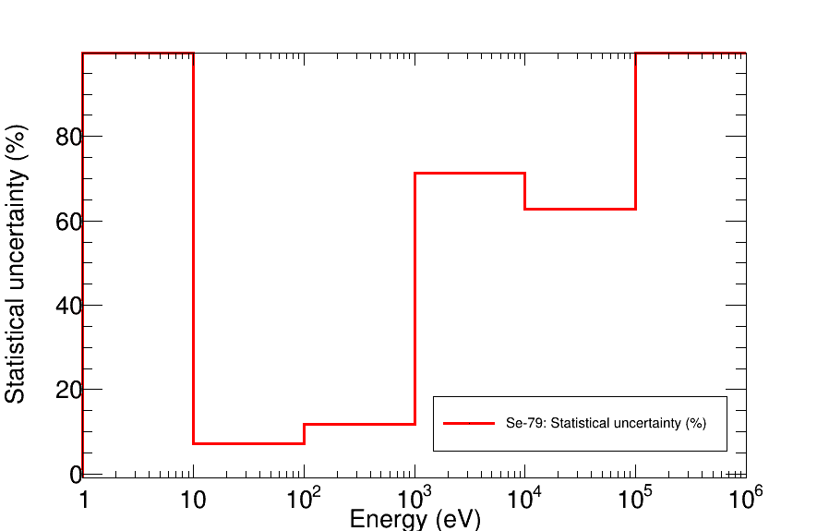
⁷⁹Se(n,ɣ) @ EAR1 i-TED: uncertainty
Statistical uncertainties in the Se-79(n,ɣ) yield (1 bpd)
RRR; Uncertainty < 15% up to 1 keV
URR and thermal: Motivation for EAR2
AIM OF EAR1
URR→ EAR2
Aim of i-TED in EAR1 :RRR
PROTON REQUEST Se-79 @ EAR1
3.5 10¹⁸ protons
2.5 Se-79 sample +
0.5 dummy (Se-78 + Pb) +
0.5 backgrounds/normalization)

Slide 14
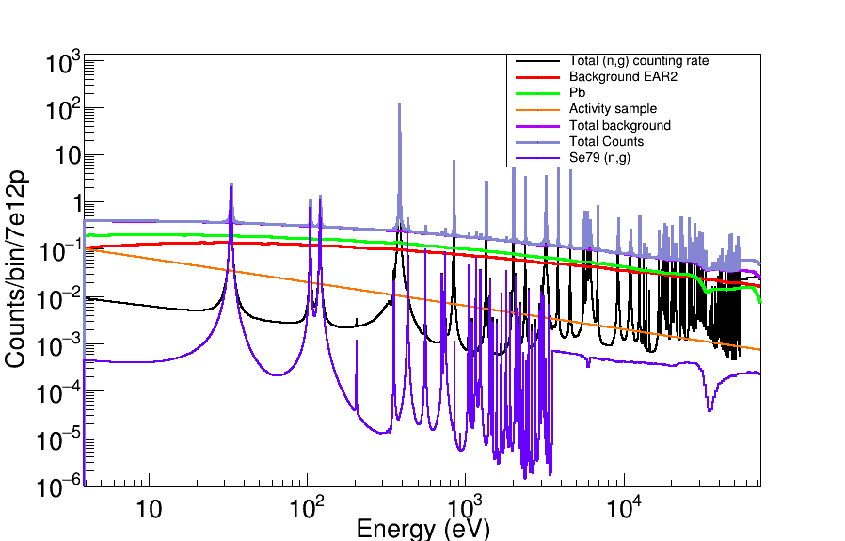
⁷⁹Se(n,ɣ) @ EAR2 with C6D6
Empty and Lead experimental data with C6D6 @ EAR2
Activity counting rate calculated with MC simulations of the sample contaminants.
PHWT not applied:
It may improve the capture to background ratio
Activity background does not dominate like in EAR1
Overall (n,ɣ)/background better than in EAR1

Slide 15
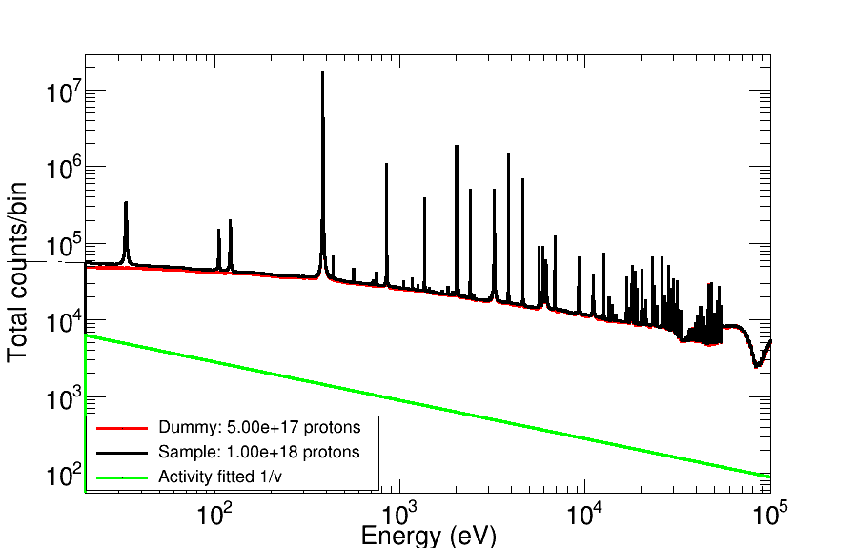
⁷⁹Se(n,ɣ) @ EAR2 with C6D6
STATISTICS IN EAR2
FOR MC RESAMPLING
PbSe sample:
1.0e18 protons
Dummy:
0.5e18 protons
Dummy = Pb + Se-78 + Al + empty
Activity (beam-off + sample-in)
Sample = Dummy + Activity + Se-79
MC simulation of the experiment: Realistic counts and statistical uncertainties

Slide 16
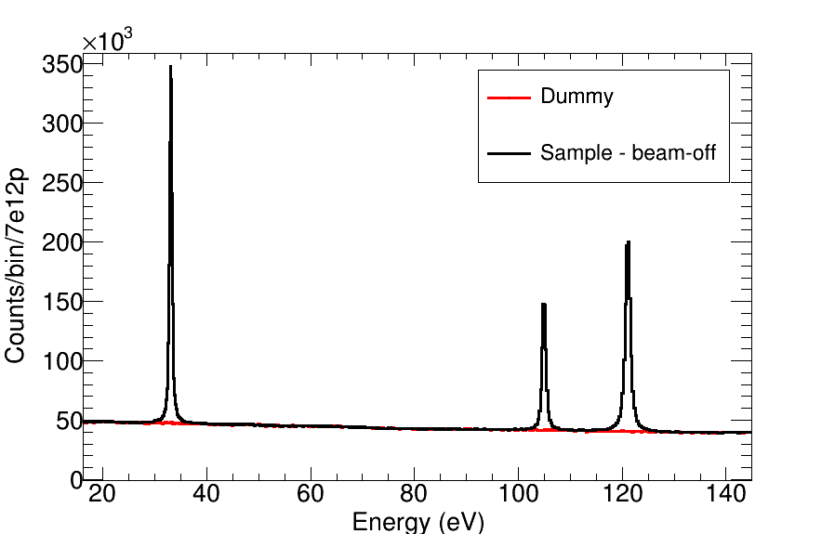
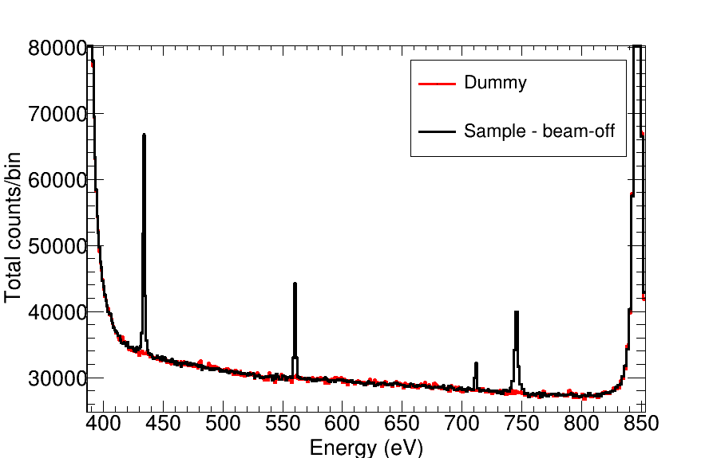
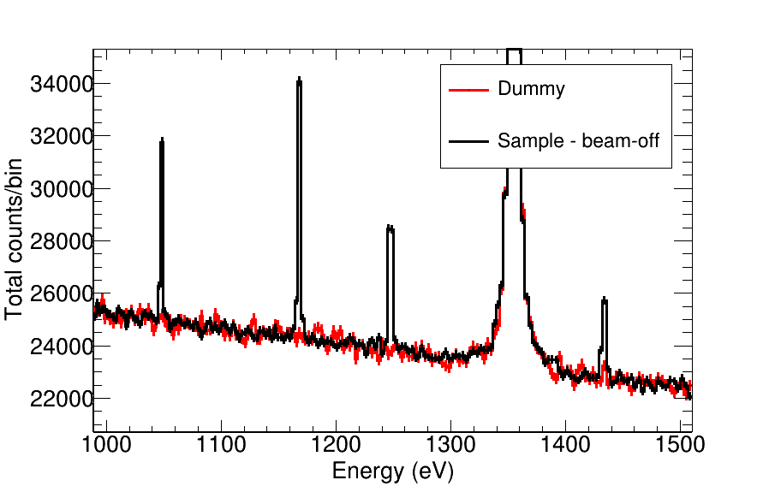
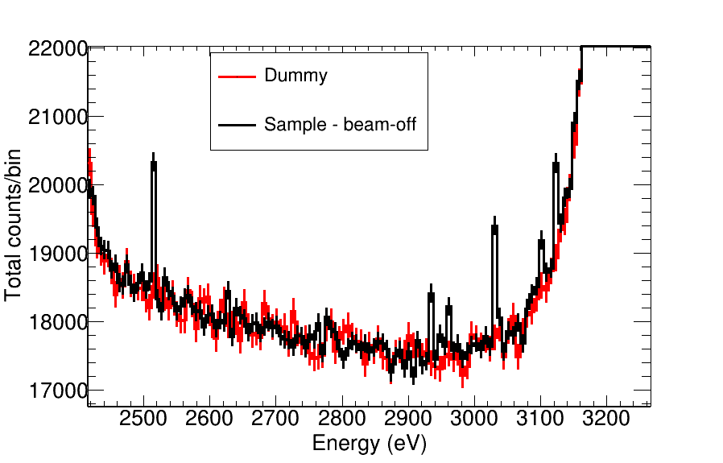
⁷⁹Se(n,ɣ) @ EAR2 C6D6: RRR
Very good statistics in the resolved resonances of Se-79 below 1 keV
GOAL: Validation/normalization with EAR1 data
RF @EAR2 NOT INCLUDED:
Impact RF from target #2 (Back-up slides)
Improvement with Target #3 expected

Slide 17
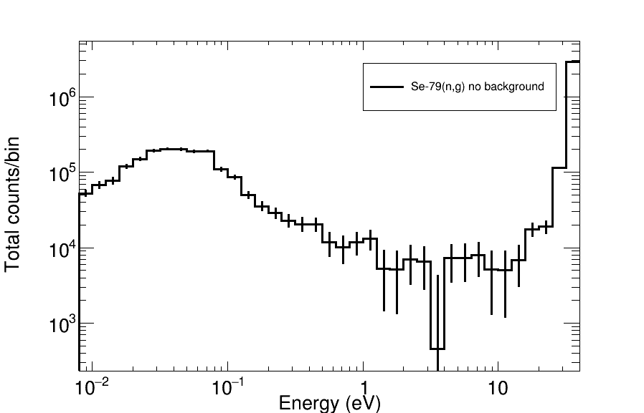
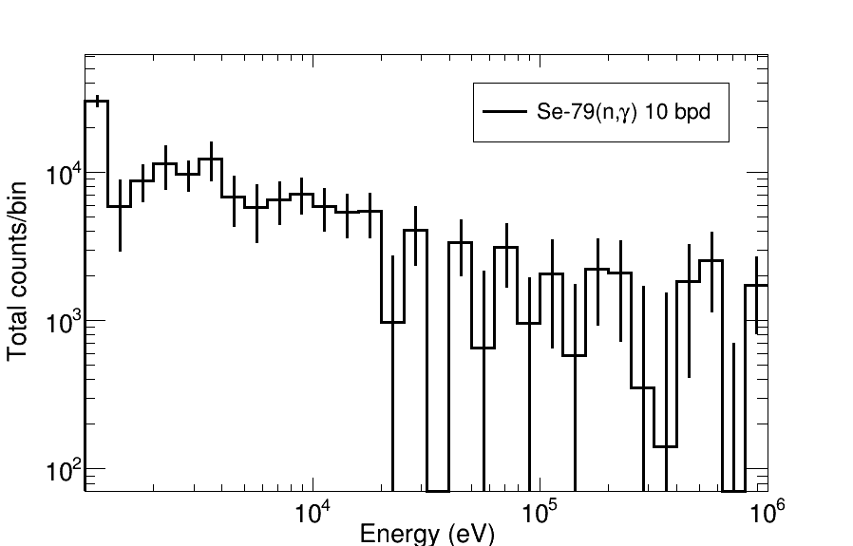
⁷⁹Se(n,ɣ) @ EAR2 C6D6: Thermal & URR
THERMAL
URR
Thermal point: large deviation between evaluations and other calculations
Measurement @ EAR2 required for this point
URR: Very relevant for the stellar capture rates (MACS)
Feasible @ EAR2 with 5-10 bpd

Slide 18
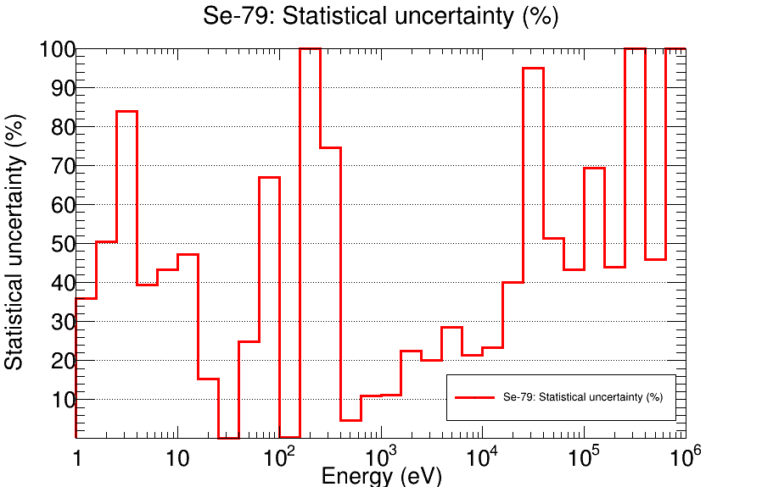
⁷⁹Se(n,ɣ) @ EAR2 C6D6: uncertainty
Statistical uncertainties in the Se-79(n,ɣ) yield (5 bpd)
Very small < 1% in the resonances below 200 eV
Between 5 and 10% in the
500-2 keV range (RRR)
URR: 20-25% up to 2-20 keV
URR: Larger than 40% above 30 keV
AIM OF EAR2

Slide 19
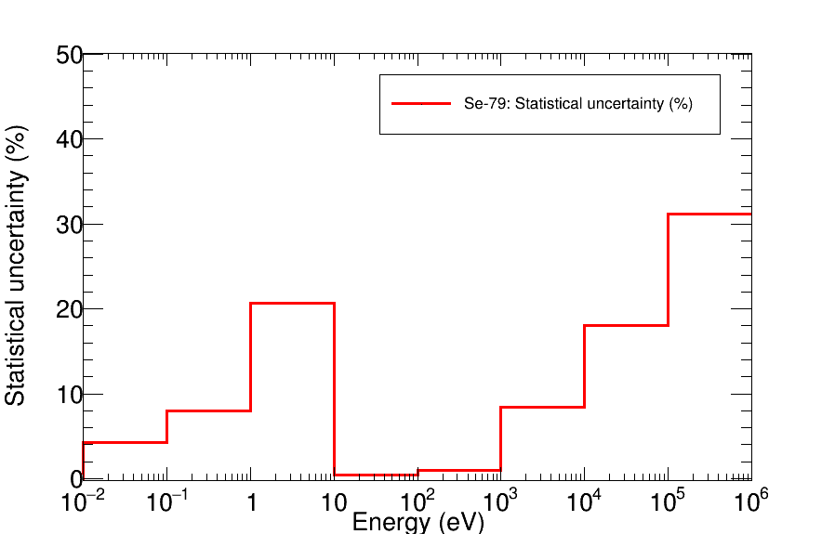
⁷⁹Se(n,ɣ) @ EAR2 C6D6: uncertainty
Statistical uncertainties in the Se-79(n,ɣ) yield (1 bpd)
Integral cross section URR (useful for MACS) with statistical unc. < 20 % up to 100 keV
Measurement at EAR2 provides also the thermal point: 5% unc. (Integral 10-100 meV))
URR
Thermal
PROTON REQUEST Se-79 @ EAR2
2.0 10¹⁸ protons
1.0 Se-79 sample +
0.5 dummy (Se-78 + Pb) +
0.5 backgrounds/normalization)

Slide 20
Summary
Motivation for Se-79(n,g):
Key s-process branching point isotope: Constrain thermal conditions of massive stars
One of the largest contributions to the long-term radiotoxicity among FP in the nuclear waste
Goal of the proposal:
First measurement of this cross section at thermal, RRR and URR
Get the most comprehensive knowledge of Se-79(n,g) in the 3 energy regions.
Se-79 sample ready and characterized @ PSI
Realistic counting rate estimates of Se-79(n,g) @ EAR1 and EAR2:
Realistic efficiencies from MC simulations
Evaluated cross sections JEFF-3.3 (TALYS for Se-79)
Impact of statistical uncertainties in background subtraction and RF
A combined proposal would be ideal for a successful measurement of this key isotope
Se-79(n,ɣ) @ EAR1 with C6D6 and/or i-TED: RRR with high resolution and validation
3.5 10¹⁸ protons (2.5 sample + 0.5 dummy + 0.5 backgrounds normalization)
Se-79(n,ɣ) @ EAR2 with C6D6: good statistics for the URR and thermal point
2.0 10¹⁸ protons (1.0 sample + 0.5 dummy + 0.5 backgrounds normalization)

Slide 21
Outlook
Possible sample improvement:
Under discussion with PSI’s colleagues: Chemical purification of the PbSe sample to reduce the sample activity and make a Se Oxide sample. →Specially relevant for the measurement @ EAR1
i-TED development & characterization:
Results of the i-TED 5.3 prototype look promising and proof the good perfomance in EAR1
(V. Babiano’s talk)
Optimization of the position reconstruction & imaging algorithms to improve background suppression capabilities: Machine learning looks promising
(J. Balibrea & J. Lerendegui’s talks)
On-going tests @ IFIC-lab to characterize the CRT and the counting rate limit.
Before measurement: i-TED 4 pi commissioning in EAR1 and EAR2 during target commissioning
(Cesar’s talk)
Proposal timeline:
Presentation to INTC in November
Measurement: End 2021, early 2022 → ERC Project ends May 2022

Slide 22
^{BACK-UP SLIDES}

Slide 23
⁷⁹Se(n,ɣ)
Cross section calculations
(A. Mengoni)

Slide 24
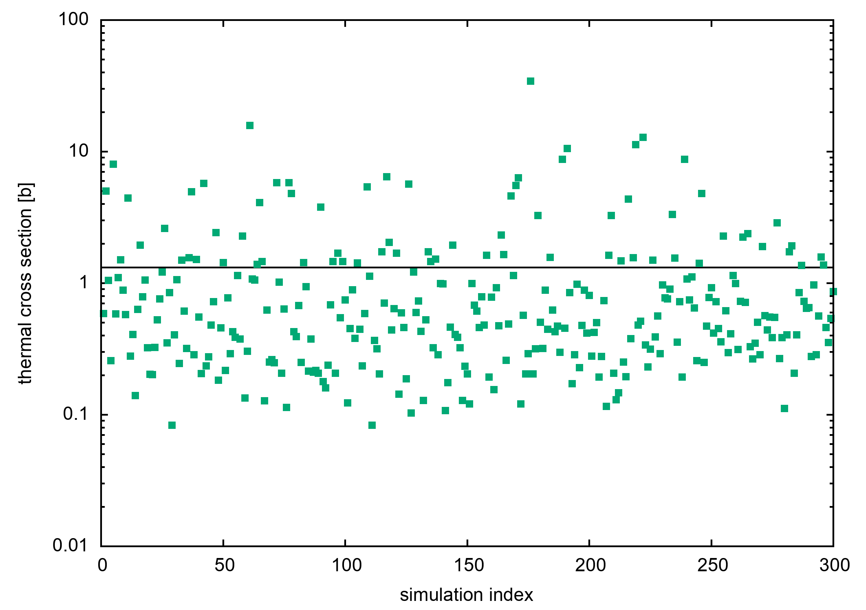
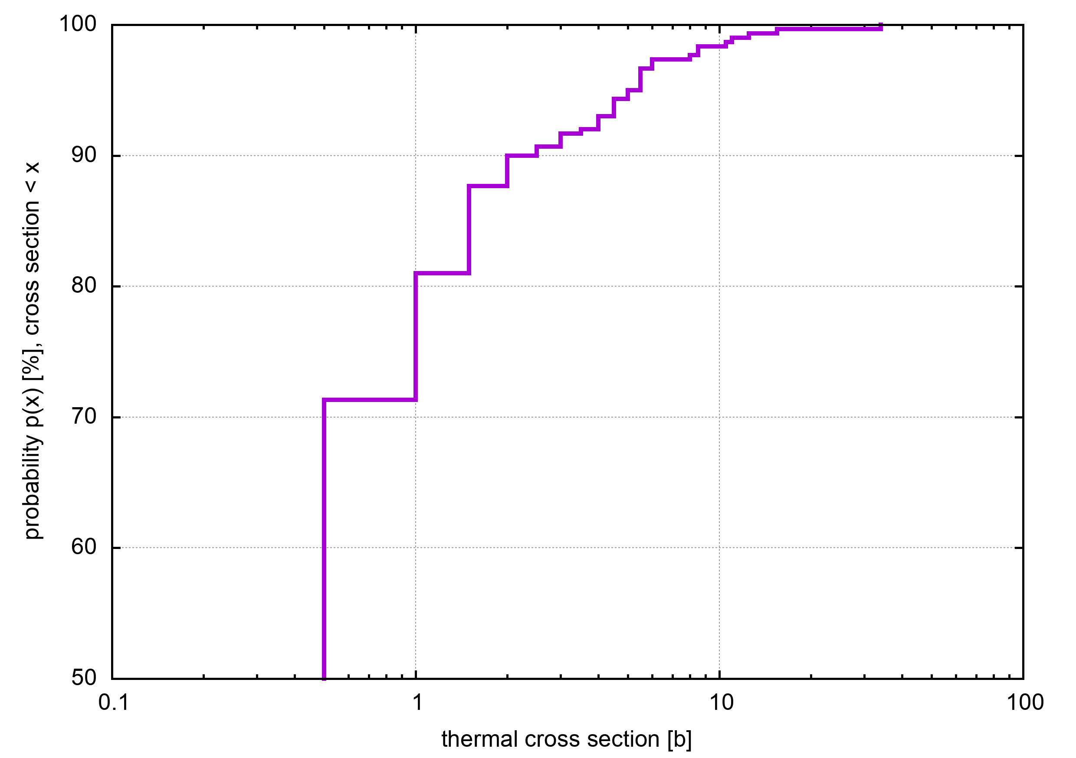
Thermal value: ENDF, JEFF and TALYS
A. Mengoni’s calculations:
300 sets of resonance using average parameters in TALYS:
<D0> = 56.8 eV
S0 = 0.98 x 10ˆ{-4}
<Gamma_g(0)> = 0.078 (+-10%)
CALCULATED THERMAL XS
PROBABILITY SIGMA_TH
JEFF-3.3 (TENDL 2019)
uses <Gamma_g(0)> = 0.100 meV
Calculation at thermal shows remarkable differences with evaluations
Calculation: P(sigma_th <1b)= 80% + P (sigma_th <10 b) = 98%
sigma_th = 50 b In ENDF/B-VIII.0
sigma_th = 11.8 b in TENDL-2019

Slide 25
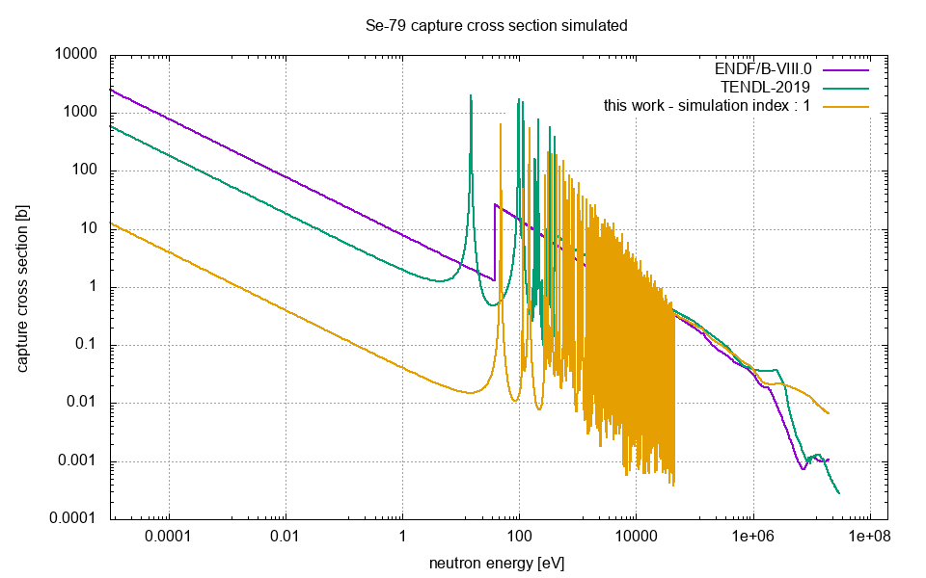
RRR and URR: ENDF, JEFF and TALYS
A. Mengoni’s calculations:
300 sets of resonance using average parameters in TALYS:
<D0> = 56.8 eV
S0 = 0.98 x 10ˆ{-4}
<Gamma_g(0)> = 0.078 (+-10%)
JEFF-3.3 (TENDL 2019)
uses <Gamma_g(0)> = 0.100 meV
Calculation RRR: some realizations are compatible to JEFF-3.3 (used for the estimates). In some cases the strength of resonances is smaller
Calculation URR: Above 55 keV, TALYS Statistical model

Slide 26
⁷⁹Se(n,ɣ) @ EAR1:
i-TED imaging capabilities

Slide 27
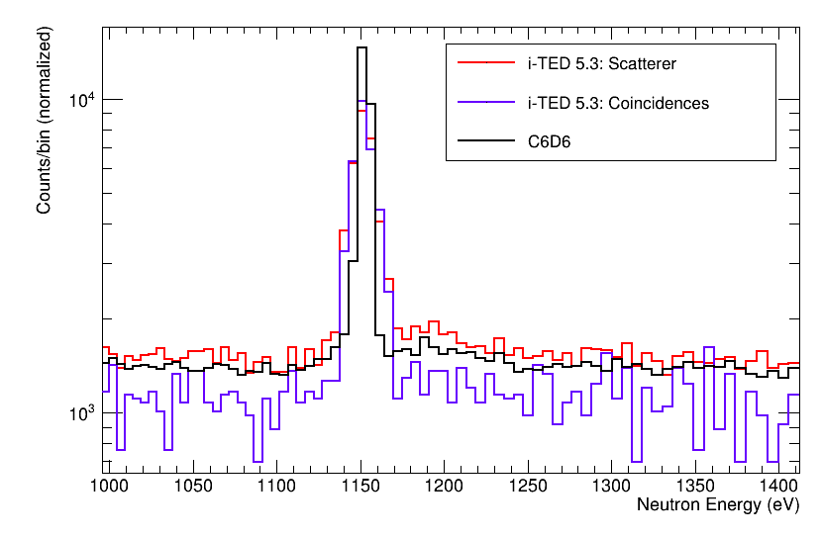
i-TED5.3 vs C6D6 @ EAR1: Fe-56(n,g)
Spectra normalized to integral
(1140-1160 keV)
Resonance is wider in i-TED due to non-perfect trigger timing correction
NORMALIZATION TO 1.15 KeV Resoannce to proof gain in (n,g) background in the keV range

Slide 28
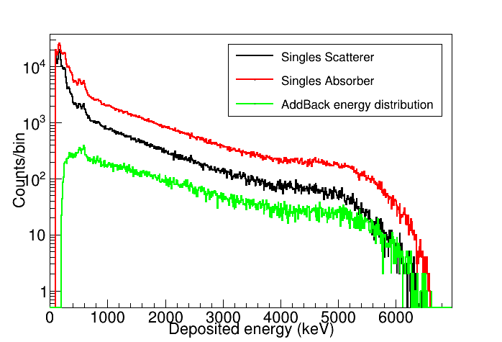
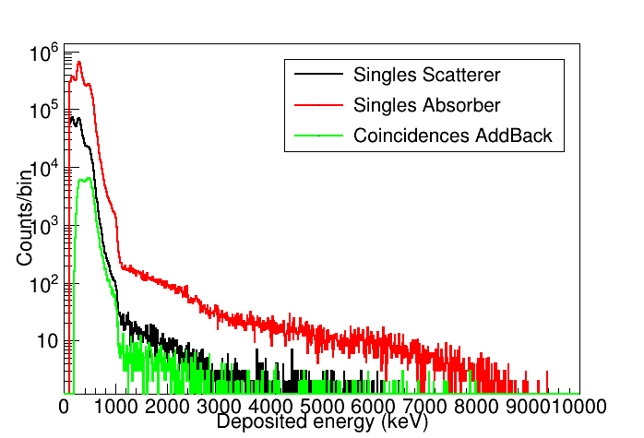
i-TED Spectra : singles & add-back
Det #2
D = 50 mm
(n,g) and background
Au-197(n,g)
Background EAR1

Slide 29
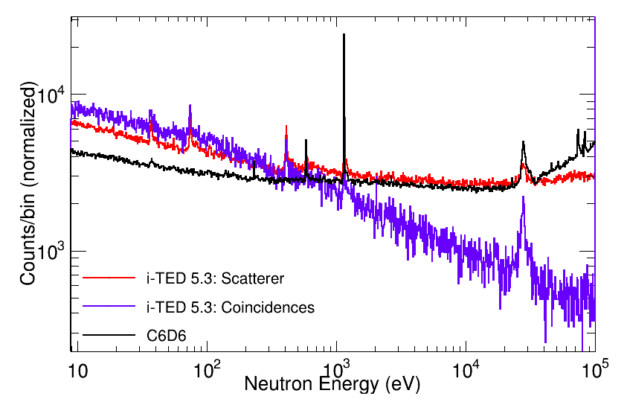
i-TED: Experimental bckg suppression
i-TED 5.3 (n,ɣ)/background gain vs C6D6: Scatterer-Absorber coincidences
Scatterer alone very similar counting rate that C6D6 but:
Higher resolution
Spectroscopic
Fe-56(n,ɣ)
Before imaging: i-TED improves (n,ɣ)/background ratio in the keV range after coincidences between absorber-scatterer
x4

Slide 30


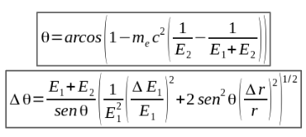
Background suppression i-TED
i-TED CONCEPT
captured neutron
γ
TED
γ
n-beam
1
scattered neutron
E₁ r₁ t₁
𝛾-ray source
E₂ r₂ t₂
Compton
scattering
2
COMPTON IMAGING
WITH I-TED

Slide 31
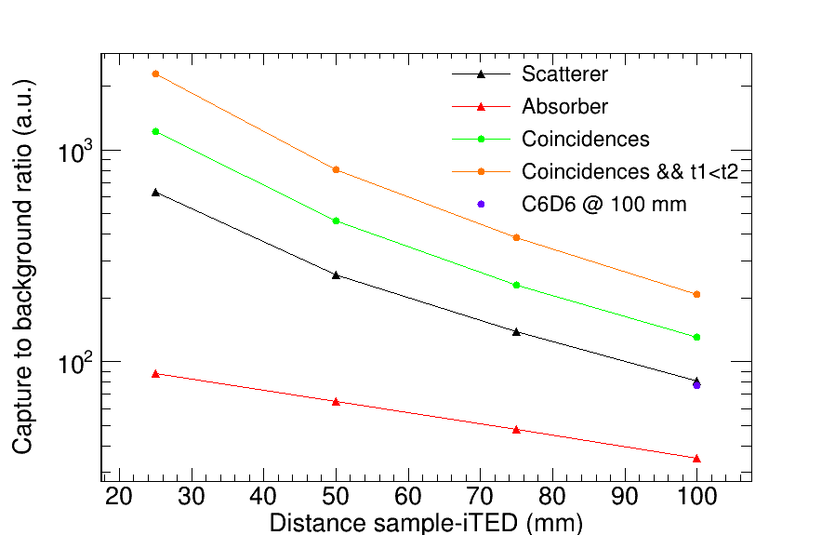
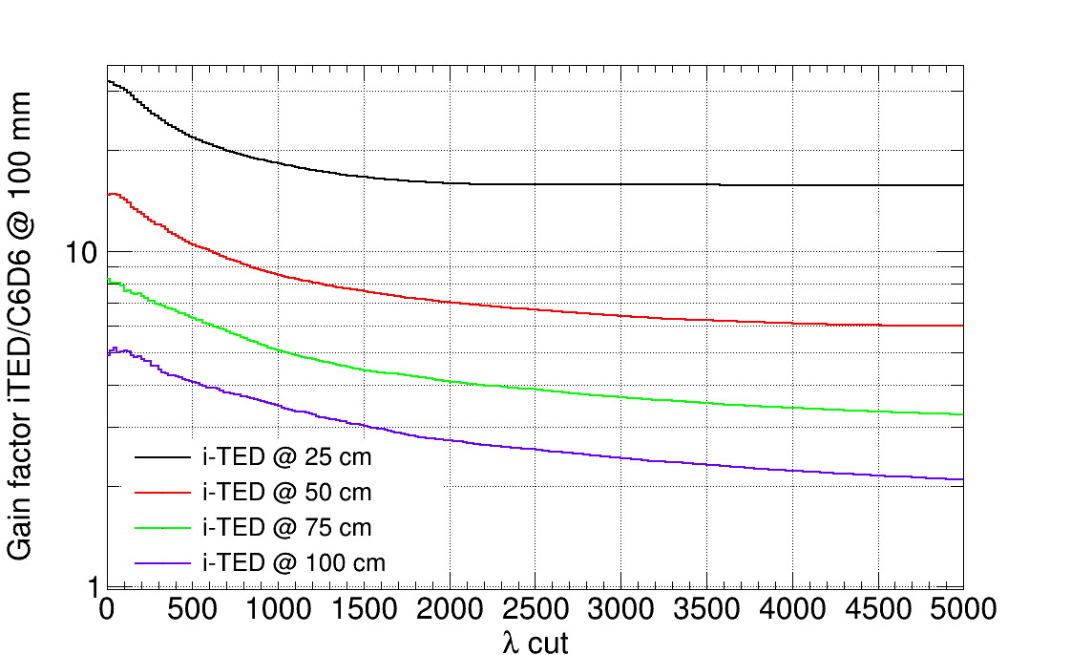
Background suppression i-TED
MC :C6D6 & i-TED to capture & background
Imaging capabilities of i-TED
Best gain factors (n,ɣ)/bckg
ratio wrt to C6D6
Values with no imaging cut
Coincidences and time resolution make a factor
2-3 in (n,ɣ)/background gain
Feasible (n,ɣ)/background gain:
Factor 5-10 depending of the sample-i-TED distance
Optimization of the background rejection capabilities still on-going

Slide 32
⁷⁹Se(n,ɣ) @ EAR1:
i-TED vs C6D6

Slide 33
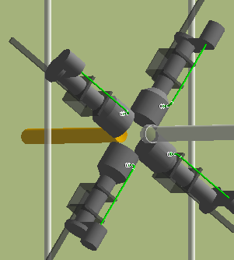
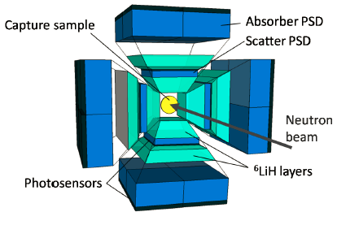
Detectors and EARs: summary
L-type C6D6
detectors
DETECTOR EAR |  | EAR1 |  | EAR2
C6D6 |  | Higher efficiency, Worse background rejection (large neutron scattering) |  | Better Performance @ high CR More statistics Activity not an issue
I-TED |  | ~ 5-10 x Better (n,ɣ)/background in the keV range. C. Rate is not an issue. |  | Performance in EAR2 is still uncertain, probably too high CR
i-TED 4pi
Combined proposal:
i-TED (+ C6D6?) @ EAR1 & C6D6 @ EAR2

Slide 34
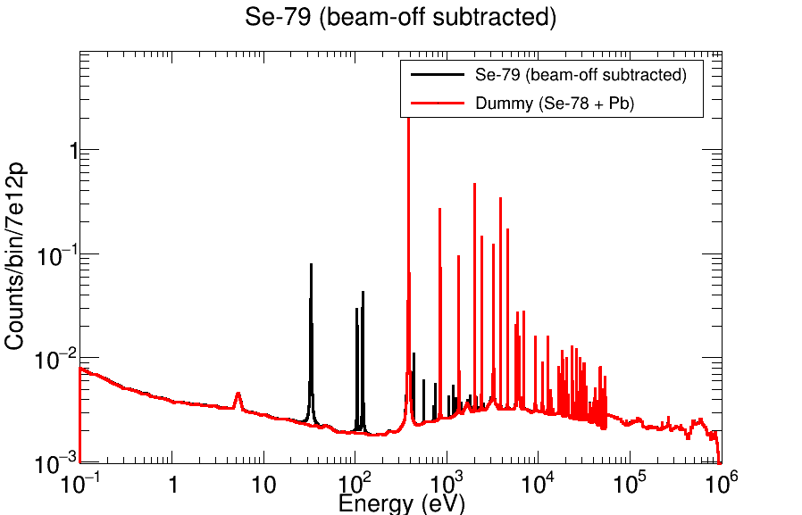
⁷⁹Se(n,ɣ) @ EAR1: i-TED vs C6D6
i-TED
C6D6
Theoretical estimation: After 1/v activity subtracted → Total counts vs “dummy” sample
i-TED: improved Se-79(n,ɣ)/background above 100 eV
Background due to Se-78(n,n) and Se-79(n,n) not included and also suppressed with i-TED

Slide 35
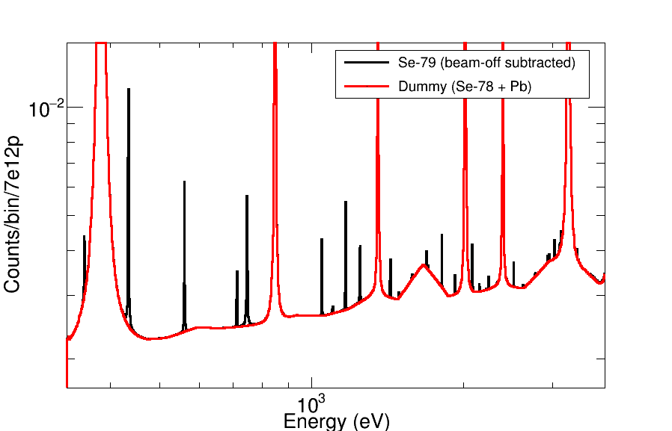
⁷⁹Se(n,ɣ) @ EAR1: i-TED vs C6D6
i-TED
C6D6
Theoretical estimation: After 1/v activity subtracted → Total counts vs “dummy” sample
Reduction of the background in i-TED seems critical to observe Se-79 resonances, Strength and level density may change (BASED IN TALYS)

Slide 36
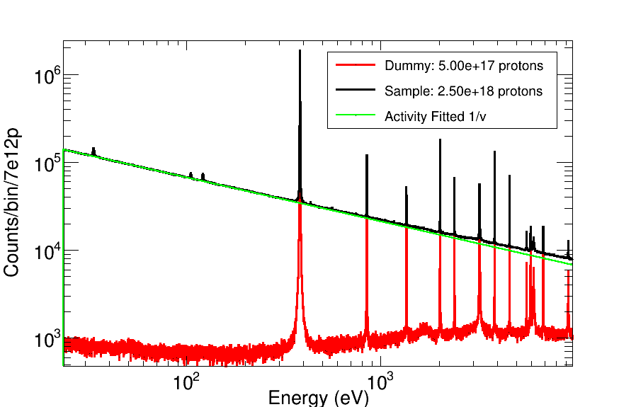
⁷⁹Se(n,ɣ) @ EAR1 i-TED vs C6D6
PbSe sample: 2.5e18 protons
Dummy: 0.5e18 protons
i-TED
C6D6
MC simulation of the experiment: Realistic counts and statistical uncertainties
i-TED vs C6D6: reduction of activity background in 50% and the dummy in a factor ~5 relative to capture

Slide 37
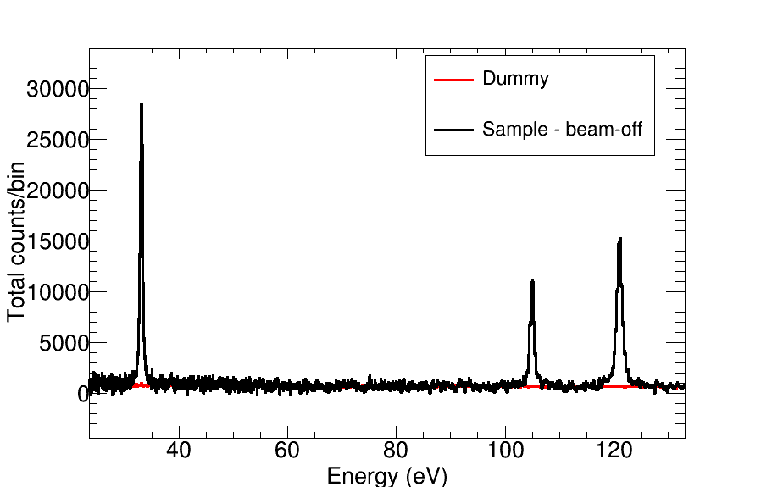
⁷⁹Se(n,ɣ) @ EAR1 i-TED vs C6D6: RRR
PbSe sample: 2.5e18 protons
Dummy: 0.5e18 protons
i-TED
C6D6
Largest resonances of Se-79 below 200 eV clearly observed

Slide 38
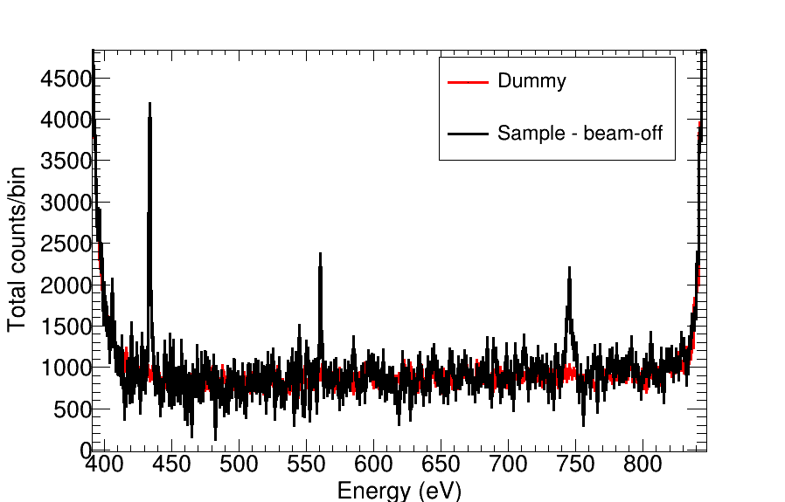
⁷⁹Se(n,ɣ) @ EAR1 i-TED vs C6D6: RRR
PbSe sample: 2.5e18 protons
Dummy: 0.5e18 protons
i-TED
C6D6
Possible to measure @ EAR1 the RRR below 1-2 keV
URR: complementary measurement at EAR2

Slide 39
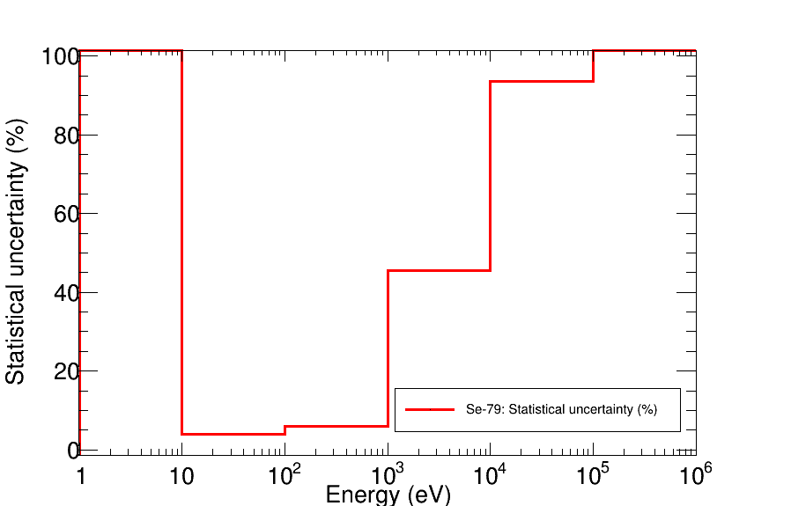
⁷⁹Se(n,ɣ) @ EAR1: uncertainty
PbSe sample: 2.5e18 protons
Dummy: 0.5e18 protons
i-TED
Statistical uncertainties in the Se-79(n,ɣ) integral yield (1 bpd)
Below 15% up to 1 keV (both setups)
At higher energies: Uncertainty 50-70%. Very challenging to extract any cross section
i-TED provides better uncertainty in above 10 keV→ better Se-79(n,ɣ)/ background
C6D6

Slide 40
⁷⁹Se(n,ɣ) @ n_TOF:
Including RF

Slide 41
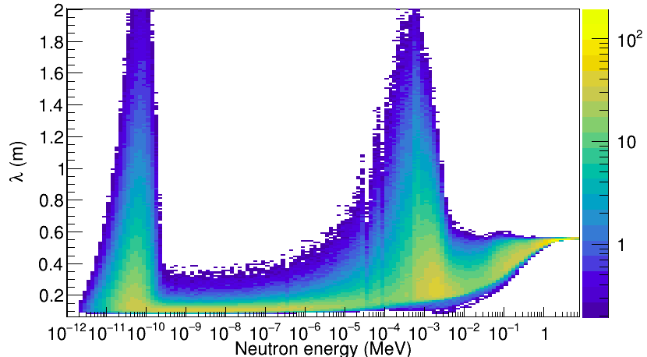
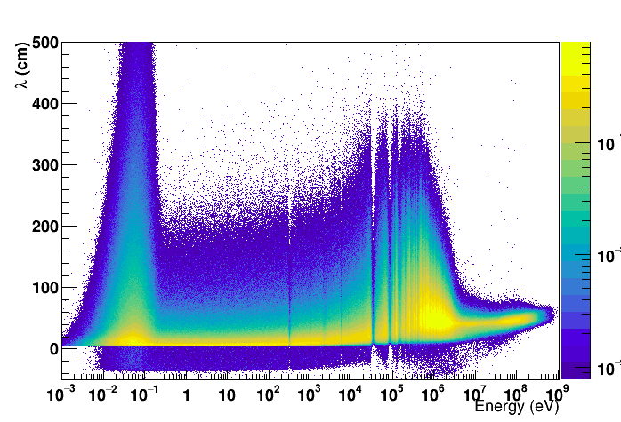
Resolution Function
RF EAR1
RF EAR2
Neutron Energy (GeV)
For a given real neutron Energy (En):
L(En) = L0 + λ(En) → Flight path distribution
TOF (En) = TOF(L(En)) → TOF distribution
E’(En) = E’(TOF(En)) →Exp. Energy distribution

Slide 42

⁷⁹Se(n,ɣ): Resolution Function
Shift resonance energy + broadening + asymmetry (low energy tail)

Slide 43

⁷⁹Se(n,ɣ) @ EAR1 i-TED: Impact RF
MC simulation Experiment
PbSe sample: 2.5e18 protons
Dummy: 0.5e18 protons
NO RF
WITH RF
Resolution function at EAR1 not sizable below 1 keV
Target #3 should not worsen the RF @ EAR1

Slide 44

⁷⁹Se(n,ɣ) @ EAR1 i-TED: Impact RF
MC simulation Experiment
PbSe sample: 2.5e18 protons
Dummy: 0.5e18 protons
NO RF
WITH RF
Resolution function at EAR1 negligible below 1 keV
Target #3 should not worsen the RF @ EAR1

Slide 45

⁷⁹Se(n,ɣ) @ EAR2 C6D6: Impact RF
MC simulation Experiment
PbSe sample: 1e18 protons
Dummy: 0.5e18 protons
NO RF
WITH RF
Measurement at EAR2 can observe resonances up to 1 keV even with current RF
Target #3 should improve the RF @ EAR2

Slide 46

⁷⁹Se(n,ɣ) @ EAR2 C6D6: Impact RF
MC simulation Experiment
PbSe sample: 1e18 protons
Dummy: 0.5e18 protons
NO RF
WITH RF
Challenging to analyze individual Se-79 resonances @ EAR2 above 1 keV
Target #3 should improve the RF @ EAR2

