Slide 1




⁹⁴Nb(n,ɣ) proposal
V. Babiano, J. Balibrea-Correa, L. Caballero, D. Calvo, C. Domingo-Pardo, I. Ladarescu, J. Lerendegui-Marco,
J.L. Taín (IFIC)
C. Guerrero, J.M.Quesada (US)
F. Calviño, A. Casanovas, A. Tarifeño-Saldivia (UPC)
D. Cano-Ott, V. Alcayne, E. Mendoza (CIEMAT)
E. A. Maugeri, D. Schumann (PSI)
U. Köster, S. Heinitz
Sergio Cristallo (INFN-Bologna)
n_TOF Collaboration Meeting, CERN, 11th June 2020

Slide 2
Outline
Motivation
Astrophysical.
Nuclear waste.
State of art for ⁹⁴Nb(n,ɣ).
Samples and experimental setup
Samples and detectors.
Threshold and efficiency.
Expected counting rate
Level of the different components.
Monte Carlo experiment
Feasibility of RRR and URR.
Possible (future) activation measurement in NEAR
Summary and conclusions

Slide 3
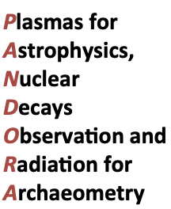
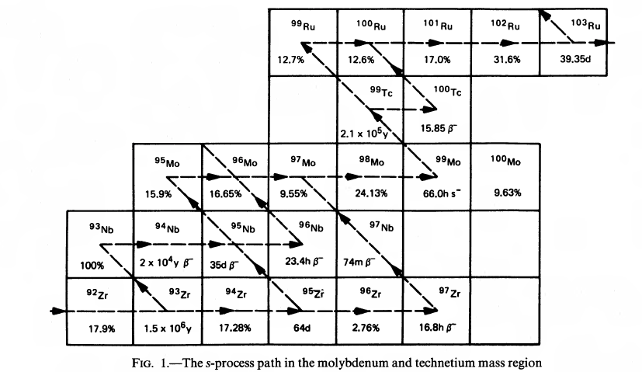

Astrophysical motivation
⁹⁴Mo
9.1%
Interesting astrophysical case:
Anomalies on Mo isotopes found in presolar grains.
Earth and planetary science letters, Vol473, 215-226 (2017) 94
Very Preliminary calculations from Sergio Cristallo (Many thanks!):
Increased the MACS by 2 (482 mb reference) @ at 30 keV → +14% ⁹⁴Mo/⁹⁶Mo ratio.
Isotope of interest for β-decays in plasmas for stellerar nucleosynthesis (PANDORA -INFN)
EPJ Web of Conferences 227, 010 (2020)
Better constrain the contributions from the s-process and the p-process to the proton-rich ⁹⁴Mo.

Slide 4
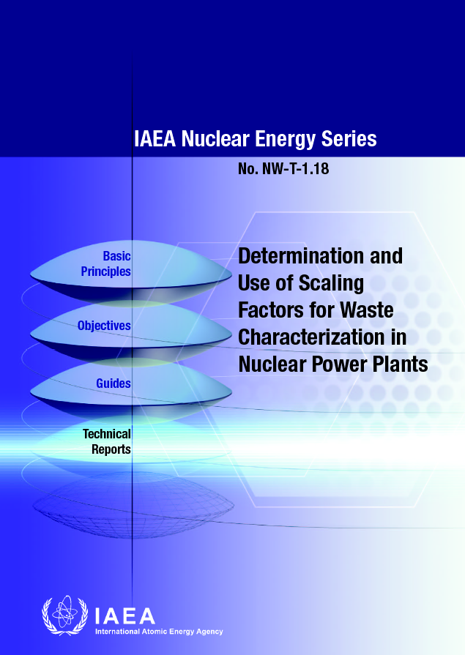
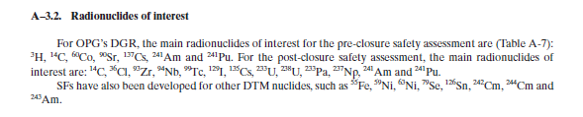
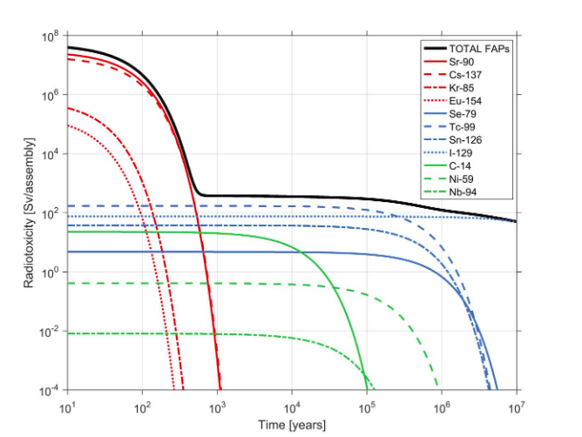
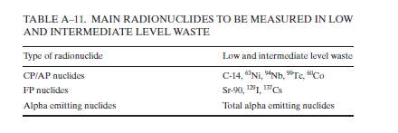
Nuclear Energy motivation
⁹⁴Nb isotope is present in low and intermediate nuclear waste:
Activation of Zr present in different components of the reactor.
Applied Radiation and Isotopes 66 (2008) 24–27
One of the major contribution to radiotoxicity (No actinides).
⁹⁴Nb

Slide 5
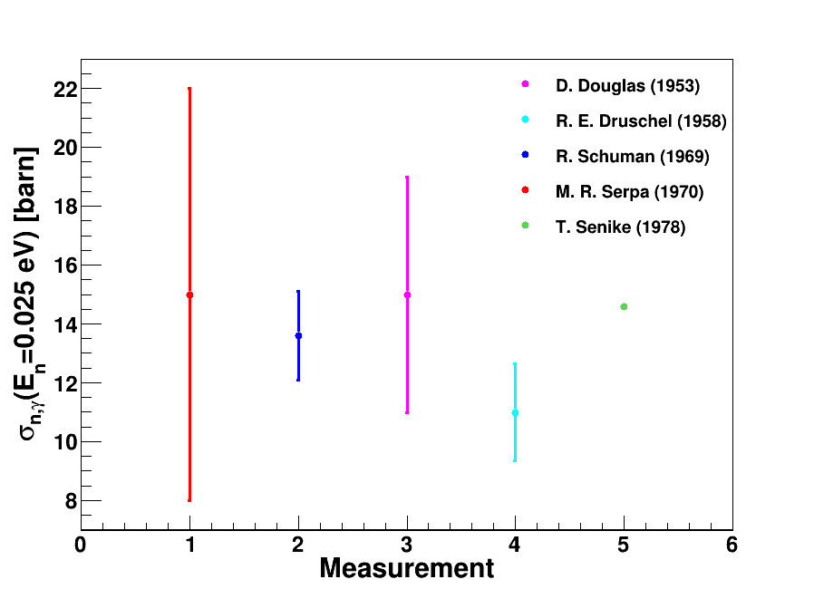
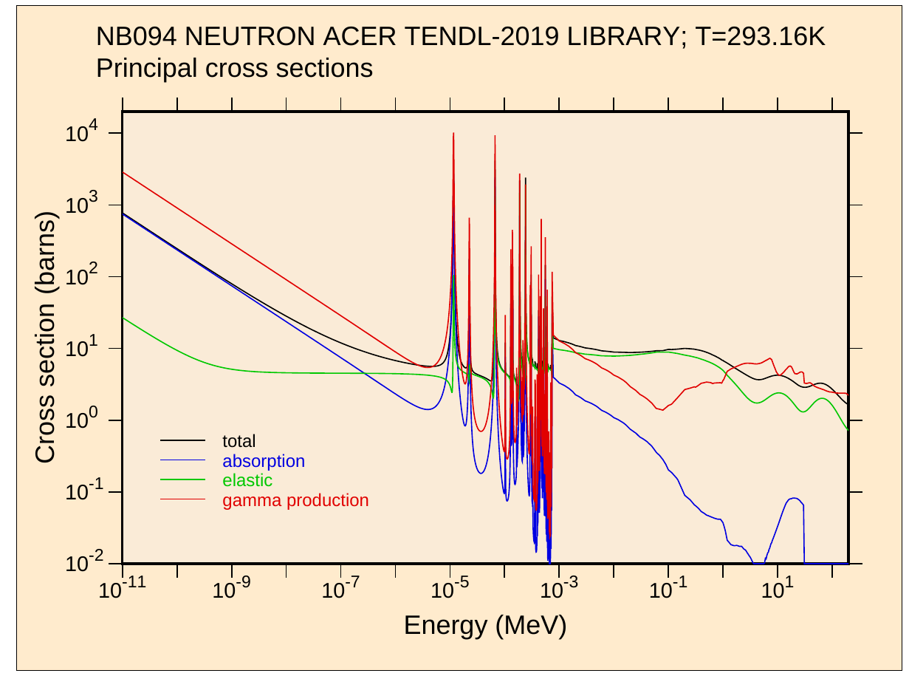
State of art: ⁹⁴Nb (n,ɣ) measurements
Experimental data in the thermal point agree within uncertainties.
No experimental data available for the Resolved Resonance Region (!).
No data available for the Unresolved Resonance region.
Estimation of Resolved /Unresolved Resonance Region based on TENDL-2019

Slide 6
State of art: ⁹⁴Nb (n,ɣ) measurements
Experimental data in the thermal point agree within uncertainties.
No experimental data available for the Resolved Resonance Region (!).
No data available for the Unresolved Resonance region.
Estimation of Resolved /Unresolved Resonance Region based on TENDL-2019
GOAL: Measure RRR as high in neutron energy as possible.

Slide 7


Available samples and Experimental setup
Sample | A(⁹⁴Nb+⁶⁰Co)[Mbq] | N(⁹⁴Nb) [10¹⁸] | ns(⁹⁴Nb)[barn⁻¹·10⁻⁶] | N(⁹³Nb) [10²⁰] | ns(⁹³Nb) [barn⁻¹·10⁻⁴]
foil (5) 15x18 mm² | 5.39+(1.026) | 4.97813 | 1.84375 | 8.81 | 3.26404
foil (6) 8x36 mm² | 8.92 | 8.23838 | 3.05125 | 16.00 | 5.92593
wire (2) | 4.85 | 4.47939 |  | 9.39
wire (3) | 5.16 | 4.47939 |  | 10.30
⁹⁴Nb samples already produced:
Irradiated together with ⁷⁹Se sample in ILL.
Hyper-pure ⁹³Nb raw material.
All the samples were characterized at PSI in December 2019:
Exhaustive analysis carried out.
Foil (6) and (5) have better shape for ToF measurement. Wire (2) and (3) require “reshape”.
(5)
Considered the high activity of the samples (and the expected 94Nb capture yield):
Experimental setup:
EAR 2.
4 C₆D₆/ C₆D₆+SiPM
Assumptions in CR estimations:
BIF=0.25 (EAR2)
1000 bin per decade
Efficiency (n,ɣ)/A (MC)
Cross section from TENDL-2019
J.balibrea
D. Meeting 2020
D. Cano-Ott
C. Meeting 2020
(6)

Slide 8
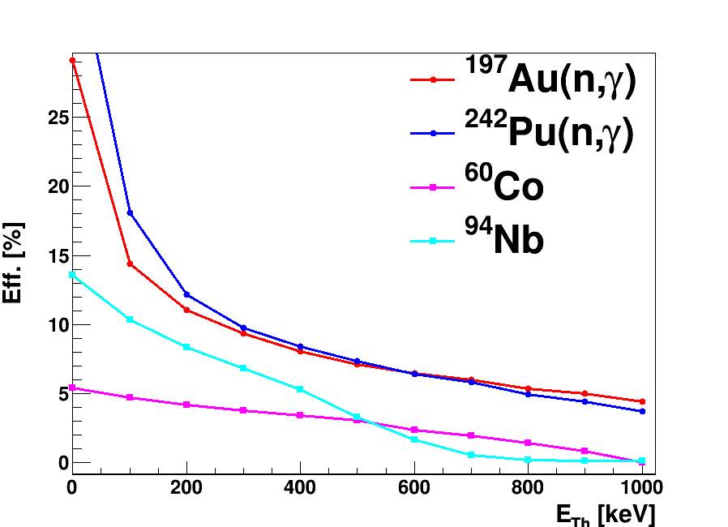
Detection efficiency and background suppression
Monte Carlo simulation for 4 C₆D₆ at a reasonable distance (10 cm).
Cascade detection efficiencies calculated for:
¹⁹⁷Au(n,ɣ)
²⁴²Pu(n,ɣ)
⁶⁰Co (1100-1300 keV)
⁹⁴Nb (700-900 keV)
A reasonable trade off between (n,ɣ) efficiency and background suppression is 500 keV.
Low detection efficiency can be compensated by weighting technique.

Slide 9
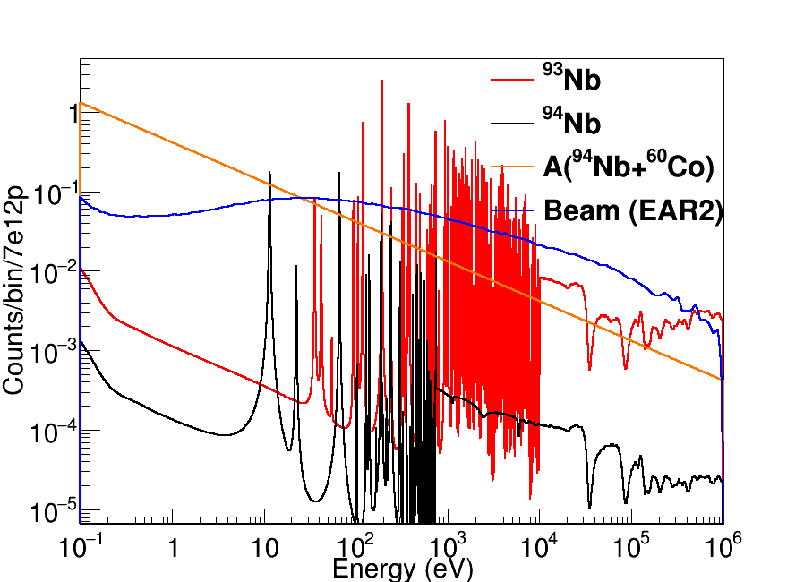
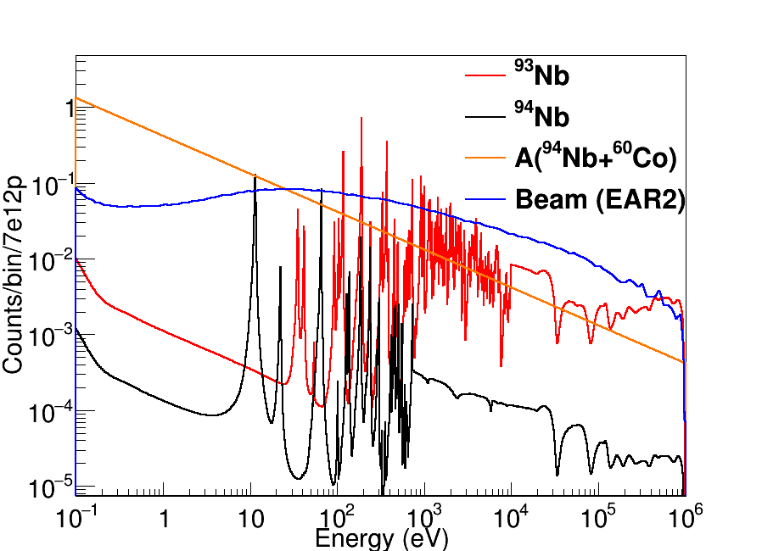
Counting rate for ⁹⁴Nb foil in EAR2
Foil (6) Without RF
Foil (6) with RF
Included the Resolution Function (Phase III) to check the neutron energy limit resolving resonances:
Resolution function Phase III is the worst scenario → In 2021 the expected RF should be better.
The true yield will lie between the ideal case and RF (Phase III) scenario.
C₆D₆+SiPM development would help to reduce the level of beam background.
J.balibrea D. Meeting 2020
D. Cano-Ott C. Meeting 2020

Slide 10
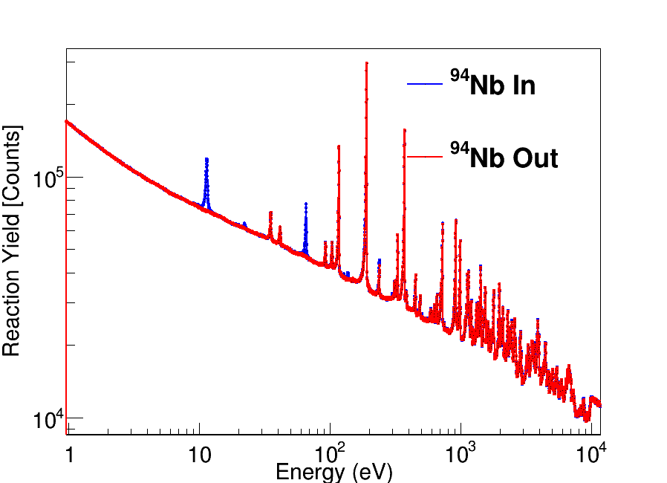
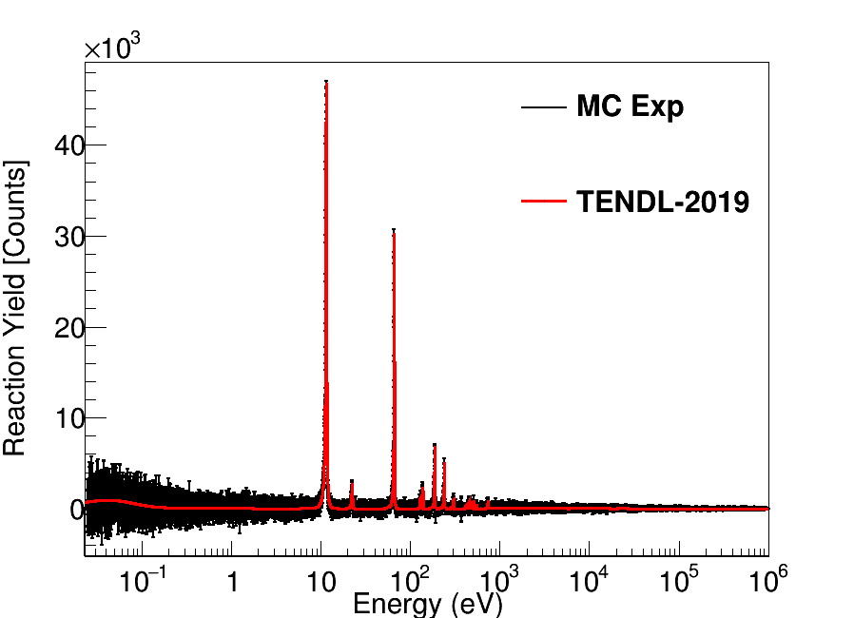
Monte Carlo experiment for ⁹⁴Nb foil (6)
⁹⁴Nb(n,ɣ)
Resampling Monte Carlo experiment to consistently account for feasibility and uncertainties:
Resampling from individual proton pulses.
2.5·10¹⁸ p for isotope under study.
0.5·10¹⁸ p for background estimation.
Background subtraction:
Regular background subtraction applied for RRR measurement feasibility.
Expected Statistical uncertainty (Conservative).

Slide 11
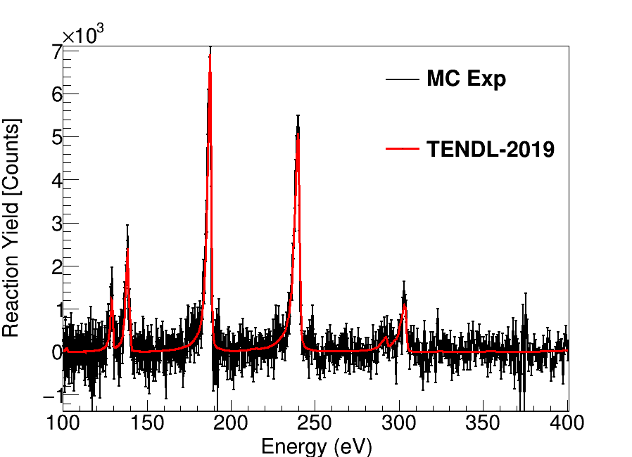
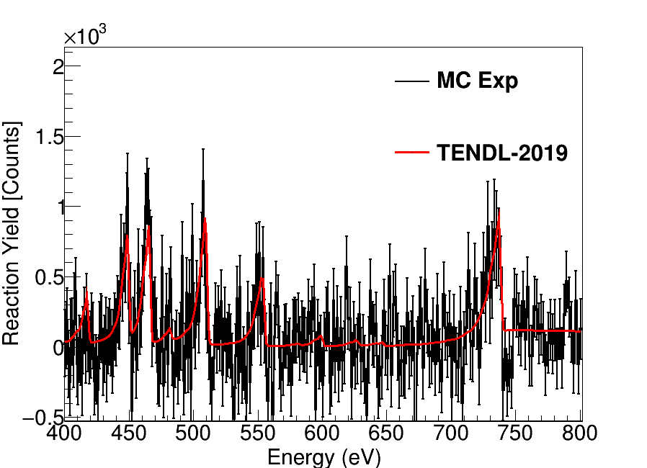
Background subtraction in the RRR
⁹⁴Nb(n,ɣ)
⁹⁴Nb(n,ɣ)
Remarks:
For neutron energies below 400 eV the individual TENDL resonances are detectable by the background subtraction.
For neutron energies above 400 eV the individual TENDL resonances are difficult to detect.
Remember yield including the Resolution function (Phase III) is the worst scenario!

Slide 12
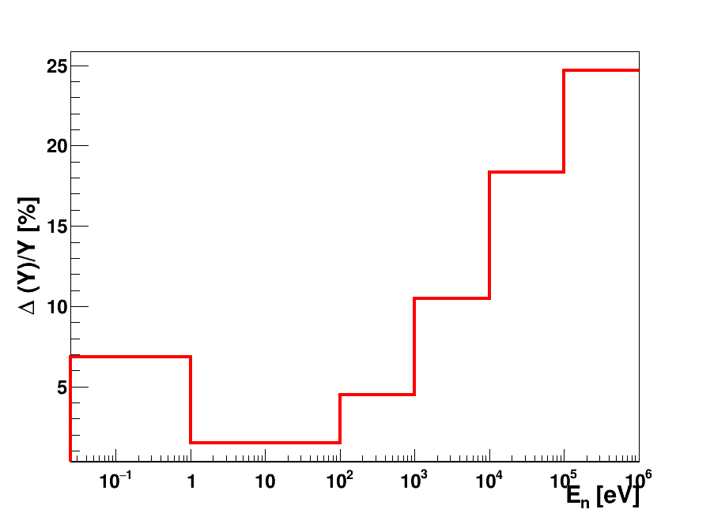
Expected statistical uncertainty
⁹⁴Nb(n,ɣ)
RRR
URR
Thermal
cross
check
Goal of the measurement
Statistical uncertainty check:
Cross check of cross section at thermal energies: Low statistical uncertainty.
Goal of the measurement: Cross section measurement would be feasible up to < 1keV (RF).
Unresolved Resonance Region: Complicated background subtraction, still not imposible.

Slide 13
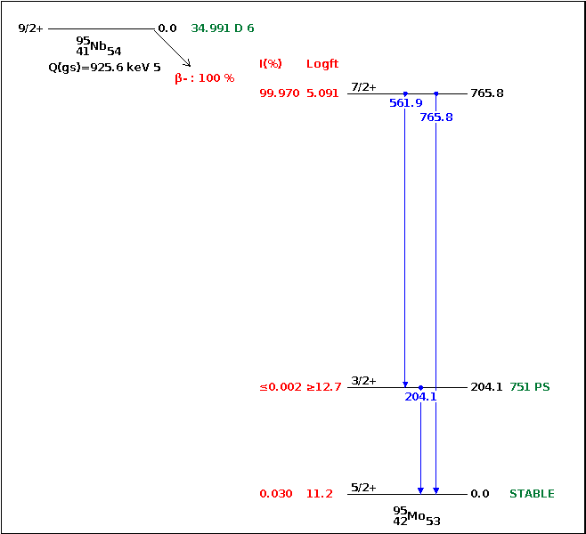
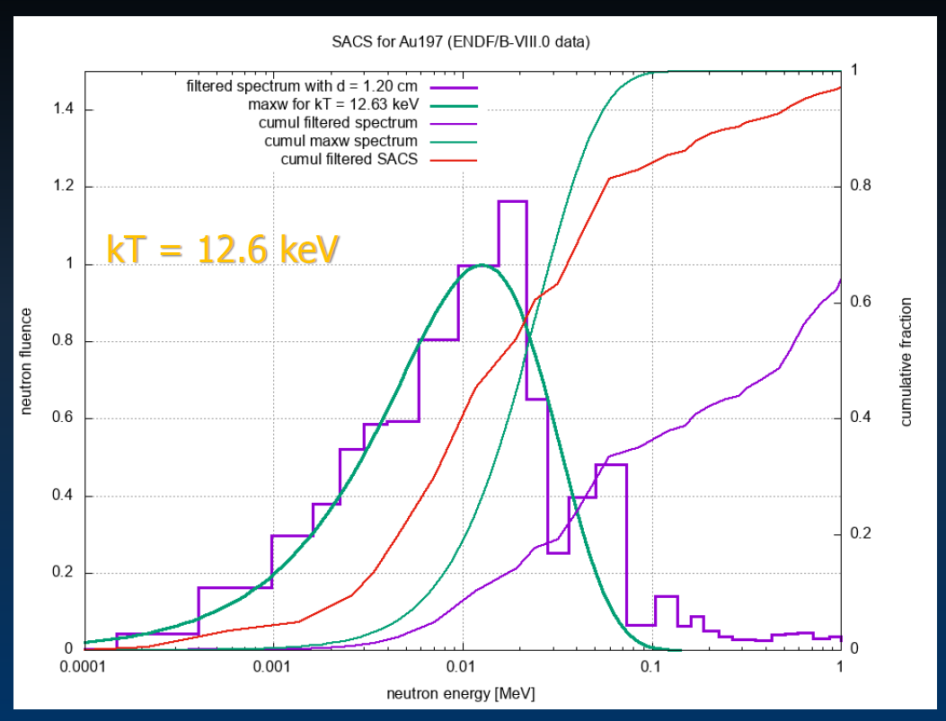
Possible activation measurement in NEAR
Unfavourable signal to background ratio for URR.
Complicated background subtraction for the Unresolved Resonance Region.
Activation measurement for NEAR station?
Flux shaping in the NEAR for MACs or “high” energy flux?
Four samples available with different shapes.
Isotope candidate for NEAR station:
“Short” half life: ~35 d.
“High” energy ɣ lines (562,766 keV).
A.Mengoni (Coll. Meeting 2019)

Slide 14
Summary & Outlook
⁹⁴Nb(n,ɣ) is an interesting measurement:
Contributions from the s-process and the p-process to ⁹⁴Mo/ Isotope of interest for β-decays in plasmas .
In addition, this is one of the isotopes present in the nuclear waste.
Only a few experimental measurements of this isotope
No experimental data exist yet in the RRR/URR.
⁹⁴Nb samples already produced -> 2 of them with rectangular shape suitable for ToF:
⁹³Nb/⁹⁴Nb~1/100.
Activity ~ 6-8 Mbq, “high” energy ɣ lines in the decay.
High counting rate due to the high intrinsic activity of the sample:
Feasible for EAR 2: RRR sure, complicated background subtraction for URR.
High detection threshold in the detectors for optimal S/B tradeoff (compensated by weighting technique).
Reasonable statistics for RRR using:
2.5·10¹⁸ protons for isotope under study.
0.5·10¹⁸ protons for background estimation.
RF will determine the “high” neutron energy limit resolving resonances.
New development C₆D₆+SiPM could help to improve situation with the signal/background ratio.
Possible isotope candidate for NEAR station → “Short” half life, “high” ɣ lines in the decay.

Slide 15
Thank you very much for your kind attention!

Slide 16
Backup

Slide 17
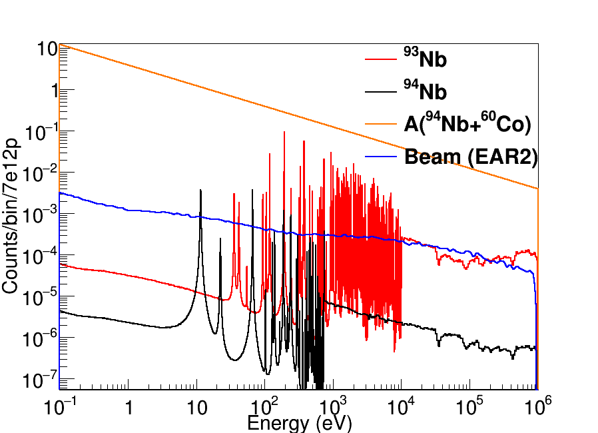
Experimental area 1
EAR2
EAR1

Slide 18
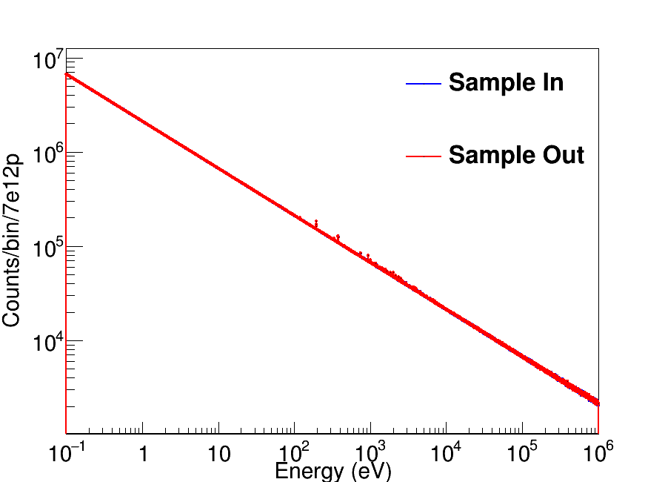
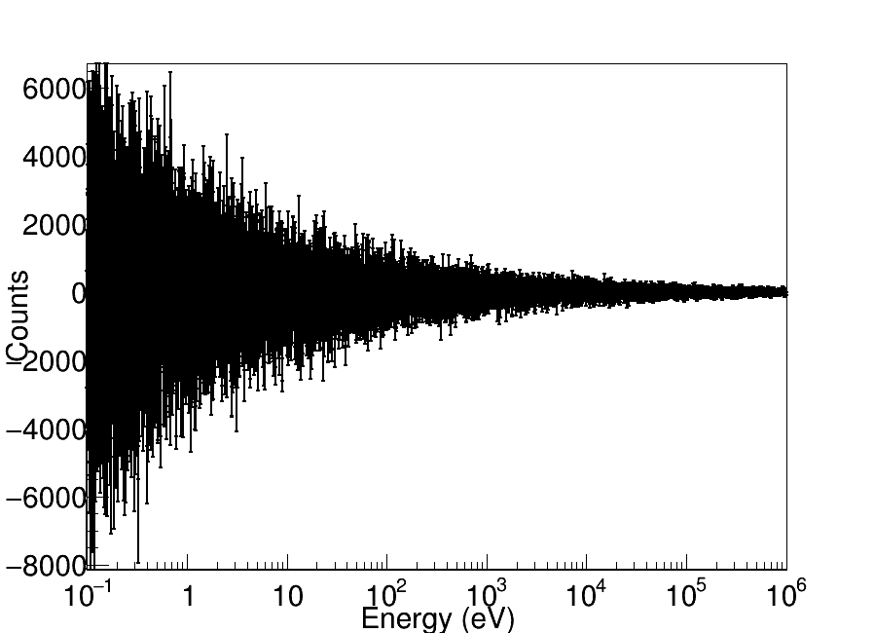
Experimental area 1

Slide 19
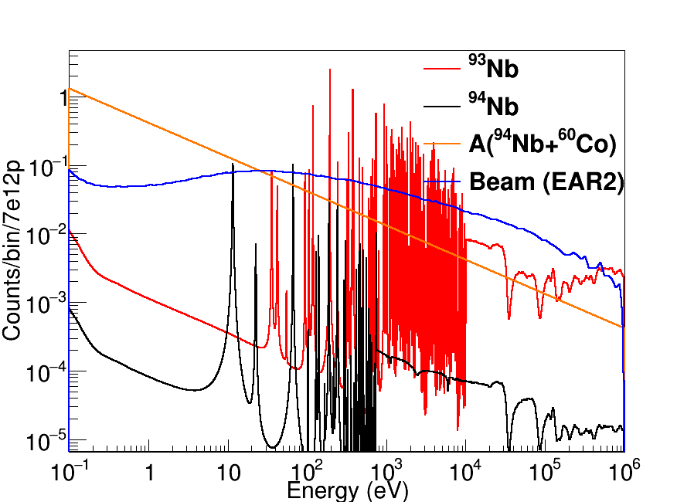
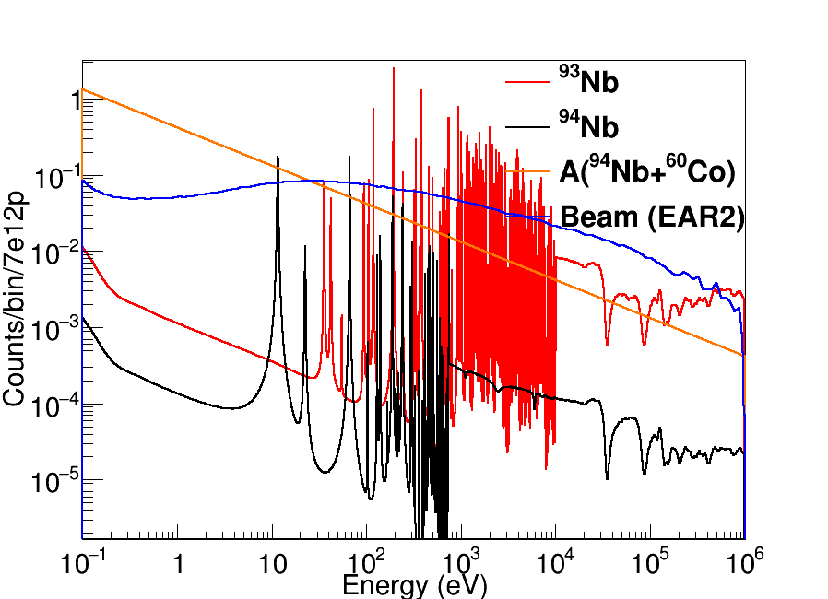
Counting rate for ⁹⁴Nb foils in EAR2
Foil (5)
Foil (6)
Threshold used in the detectors to reduce counting rate from samples activity: 500 keV
Raw detection efficiency (n,ɣ) ~8% (No pulse weight technique applied)
Raw detection efficiency Activity ~4%

