Slide 1
Neutron capture on ⁵⁰Cr and ⁵³Cr for criticality safety applications
C. Guerrero¹, V. Alcayne², V. Babiano³, J. Balibrea³, L. Caballero³, O. Cabellos⁴, F. Calviño⁵, D. Cano-Ott², R. Capote⁶, A. Casanovas⁵, M.A. Cortés¹, S. Cristallo⁷, C. Domingo-Pardo³, B. Fernández¹, E. González², I. Ladarescu³, J. Lerendegui-Marco³, N. Liu⁸, T. Martínez², E. Mendoza², M.A Millán¹, T. Rodríguez¹, J.M. Quesada¹, A. Tarifeño⁵
¹Universidad de Sevilla (USE), Sevilla, Spain
²CIEMAT, Madrid, Spain
³Instituto de Física Corpuscular (IFIC-CSIC), Valencia, Spain
⁴Universidad Politécnica de Madrid (UPM), Madrid, Spain
⁵Universidad Politécnica de Cataluña (UPC), Barcelona, Spain
⁶International Atomic Energy Agency (IAEA), Viena, Austria
⁷INFN Sezione Perugia, Perugia, Italy
⁸Carnegie Institution for Science, Washington, USA

Slide 2

Motivation
“Sensitivity of selected benchmarks to Cr-53 and Cr-50 capture”, by A. Trkov, O. Cabellos and R. Capote (2018)
Chromium is, after iron, the major element in stainless steel (SS).
Criticality benchmarks can test different components of SS.
A large part of the uncertainty in SS capture seems to be driven by Cr.
Some benchmarks highly sensitive to Cr (as a component of SS) indicate a need for much higher capture in Cr for both Pu and U fueled critical assemblies.
Capture in natural Cr driven by ⁵⁰Cr (4,3%) and especially in odd ⁵³Cr (9,5%).
Capture in ⁵⁰Cr and ⁵³Cr included in the NEA HPRL in 2018:
The contradictions present in the current libraries and experiments need to be resolved thanks to new measurements and evaluation.
Accuracy of 8-10% requested between 1 and 100 keV.
Cr cross sections interest in astrophysics? (same energy range)
Isotopic ratios have been measured in O-rich grains. Expert in grains N. Liu (Carnegie Institution Washinton, USA) and S. Cristallo will be involved aiming at looking further into the role of Cr(n,γ), the effect of the new measurements, and the need (or not) to measure ⁵²Cr and ⁵⁴Cr in a new proposal.

Slide 3
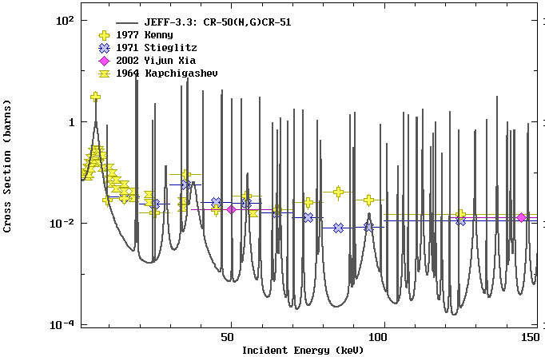
Neutron capture on ⁵⁰Cr (EXFOR & evaluations)
Evaluations are not so different between each other, but:
Resonance integral in evaluations is 60% lower than ANR (Mughabghab:2006)
<σ>_{30keV} in evaluations is 29% lower than Bao et al. (based on 3 experiments)

Slide 4
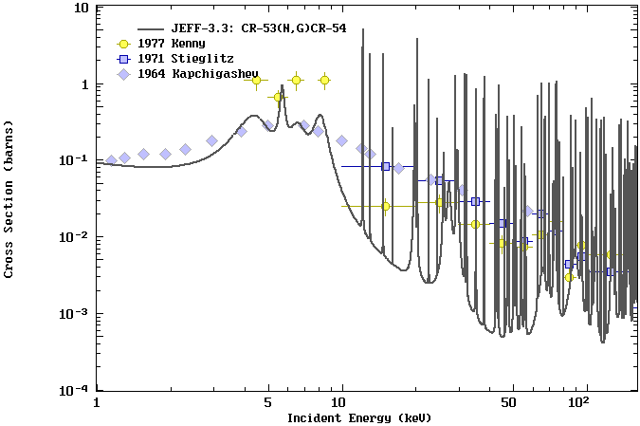
Neutron capture on ⁵³Cr (EXFOR & evaluations)
Selected criticality benchmarks with large amounts of Cr show large criticality changes of the order of 1000 pcm due to 30% change in ⁵³Cr capture in the region from 1 keV up to 100 keV.
Evaluations are discrepant by 30%
Resonance integral in evaluations is 50% lower than ANR (Mughabghab:2006)
<σ>_{30keV} in evaluations is 87% lower than Bao et al. (based on 2 experiments)
Recent ENDF evaluation by Leal based on unpublished data from Guber contradicts the increase suggested above.

Slide 5
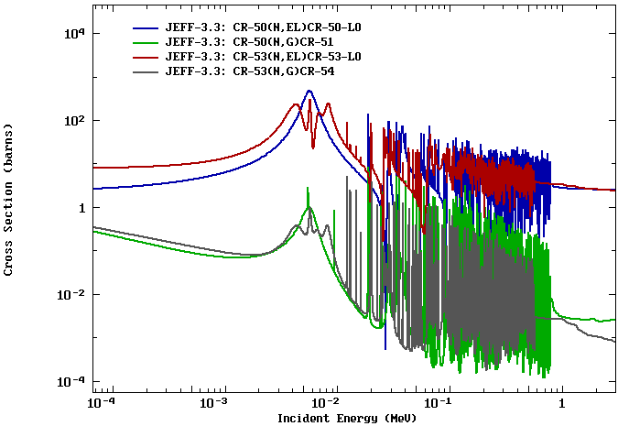
Proposed experiment
TARGETS
⁵⁰Cr & ⁵³Cr are estable
Commercially available:
- ⁵⁰Cr: 6,5 €/mg
- ⁵³Cr: 15 €/mg
- 97% enrichments
- In stock
→ for once, not an issue
σ_{n}~10³σ_{γ}
ROI (1-100 keV)
FACILITY
RoI: 1-100 keV
Dominated by resonances
E_{n} resolution needed
→ n_TOF-EAR1
DETECTION SYSTEM
Scattering dominates over capture
→ C₆D₆ detectors (i-TED? s-TED?)

Slide 6
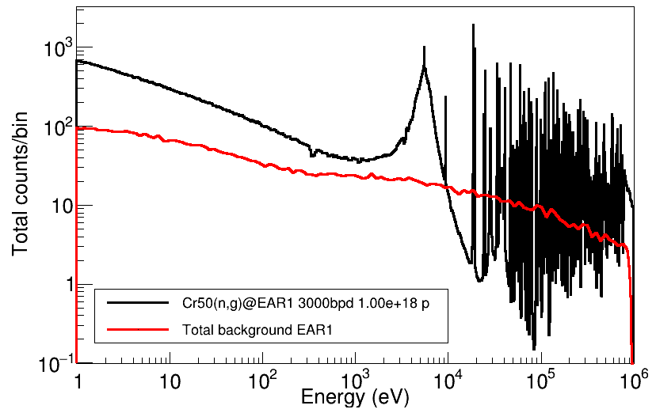
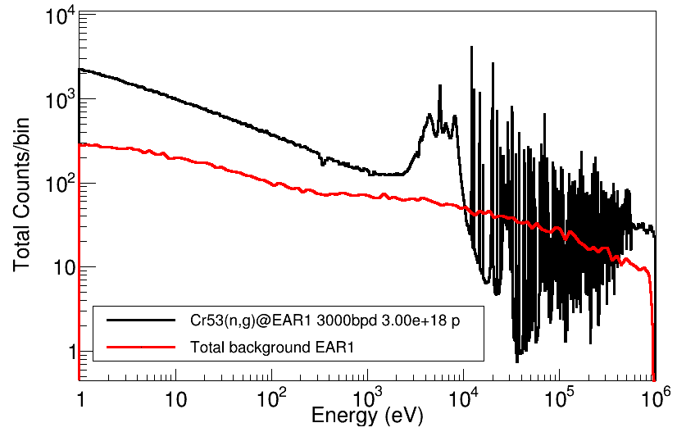
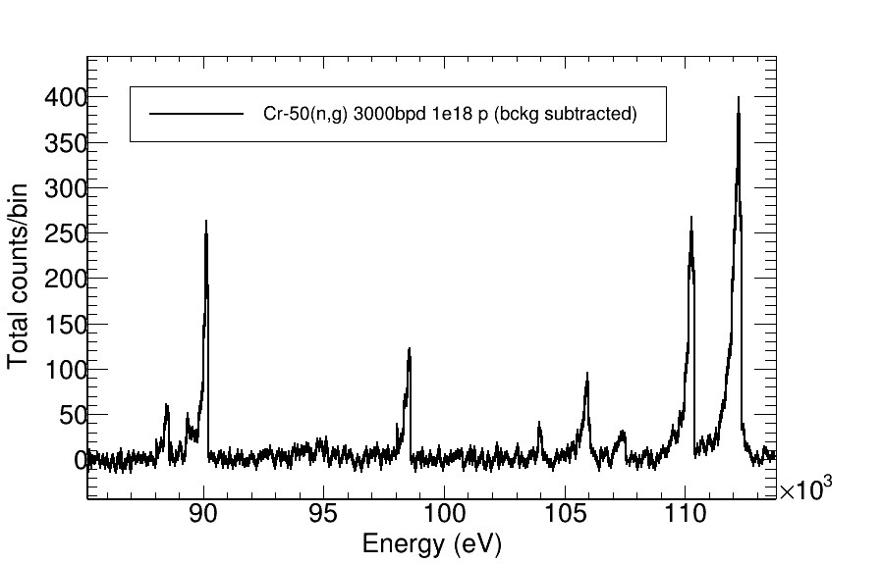
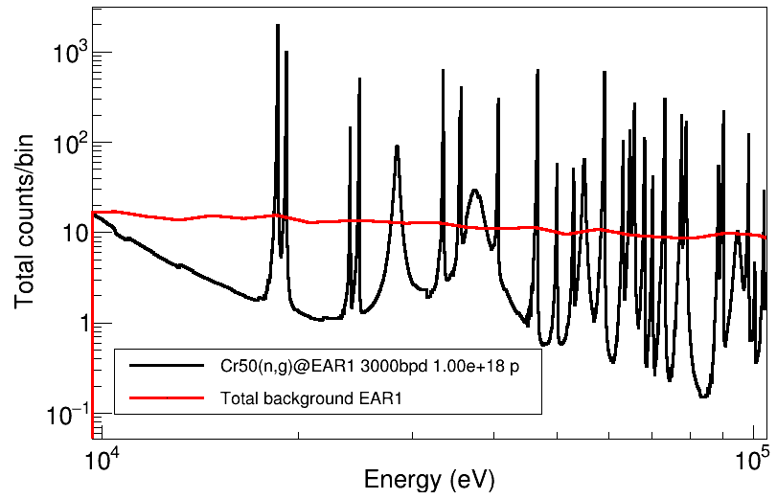
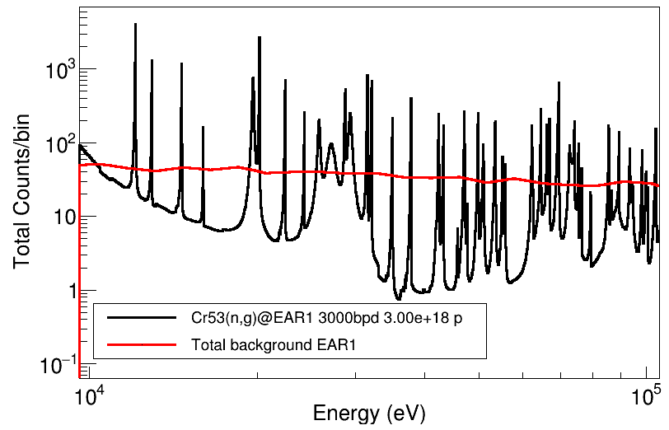
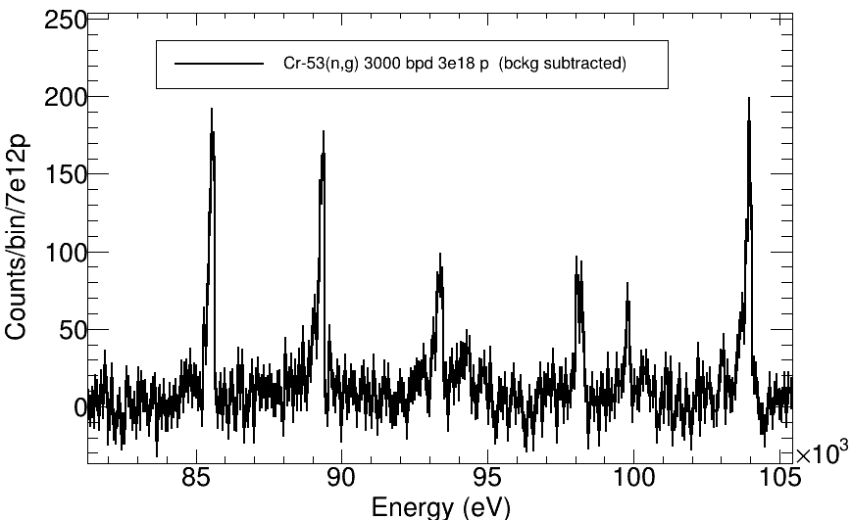
⁵⁰Cr & ⁵³Cr @EAR1 with C₆D₆ (1g 2cm diam.)
Calculations including RF @3000 bpd: 1x10¹⁸ for ⁵⁰Cr and 3x10¹⁸ for ⁵³Cr

Slide 7
Summary and beam time request
The NEA HPRL features ⁵⁰Cr and ⁵³Cr in relation with nuclear technology (neutron absorption in stainless steel)
Current uncertainty ~35%
→ 8-10% (1-100 keV) required for criticality benchmarks
BEAM TIME REQUEST:
- 1 g metallic targets @EAR1 with C₆D₆
- 3000 bpd needed
- 1 g targets, for now (mass of the targets depends on budget*)
- evaluations, hence beam time estimates, uncertain by ~35%
- Assuming common background and normalization measurements
Request is
~1x10¹⁸ pot for ⁵⁰Cr
~3x10¹⁸ for ⁵³Cr Overall ~4,5x10¹⁸
~0.5x10¹⁸ for ^{nat}Cr
*Budget availability to be definitive within 2020

