Slide 1
The First LHC Results
CERN Summer Student Lectures
Tom LeCompte/Argonne National Laboratory

Slide 2

Before We Start
STOP ME if I go too fast or you have questions!!
I know I talk too fast, so please interrupt me – my goal is not to cover as much
material as possible: it’s to uncover as much material as possible

Slide 3
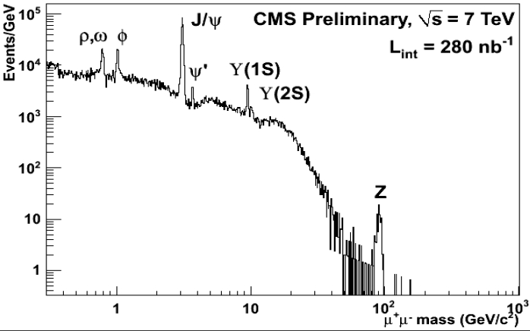
The Challenge
1960s
1970s
1980s
In the last 4 months, the LHC has “rediscovered” several decades worth of physics.

Slide 4
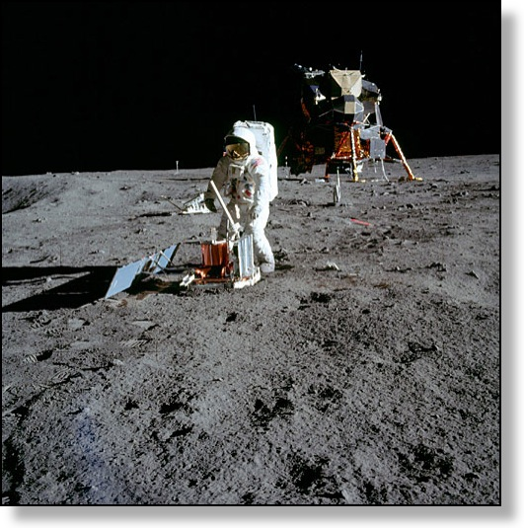

LHC Status – Where We Are Today
Today, the LHC has delivered a few hundred inverse nanobarns, out of a target of 30 fb⁻¹.
This is typical of large accelerators – having the luminosity increase over time means that most of the data comes late in the run.
To put these numbers in perspective, if the ultimate target is putting a man on the moon (380,000 km), we’ve made it about as far as low earth orbit.
Just as we learned a lot in the early days of the space program, we’re learning a lot now.
I hope to show you some of what we have learned during this talk.

Slide 5
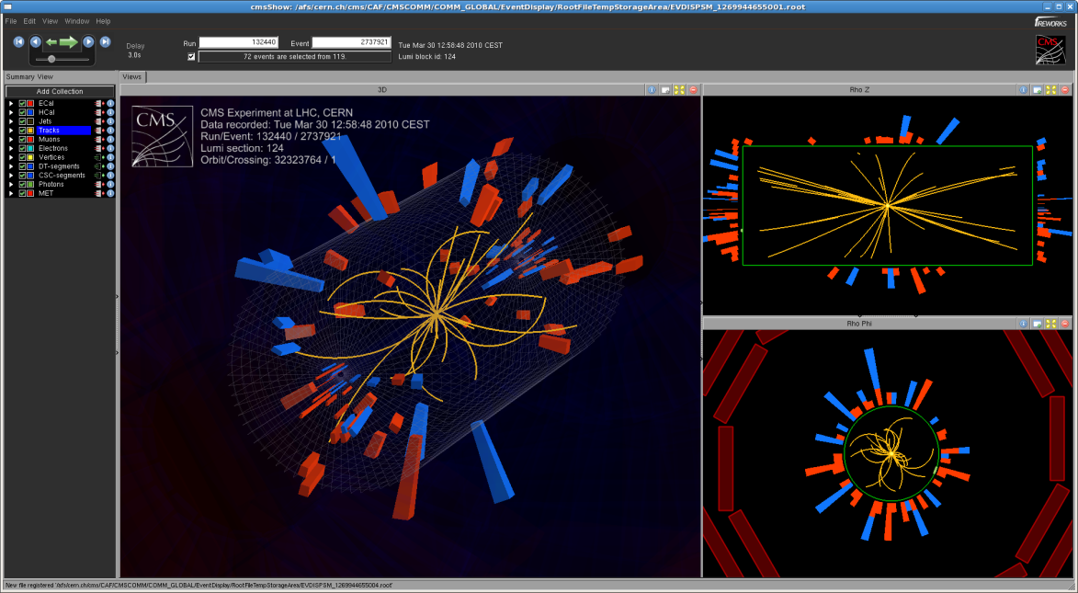
Let’s Start Simply
How many charged particles are produced in a typical collision?
  What could be simpler?
“A typical collision” is an illuminating phrase
  Most of the events we are interested in (Higgs, top, supersymmetry, etc…) are not typical events
    Indeed, they are very rare!
    One in 500,000 events has a top quark in it
  We often call these events “minimum bias” events
    What happens when nothing else happens.
CMS

Slide 6
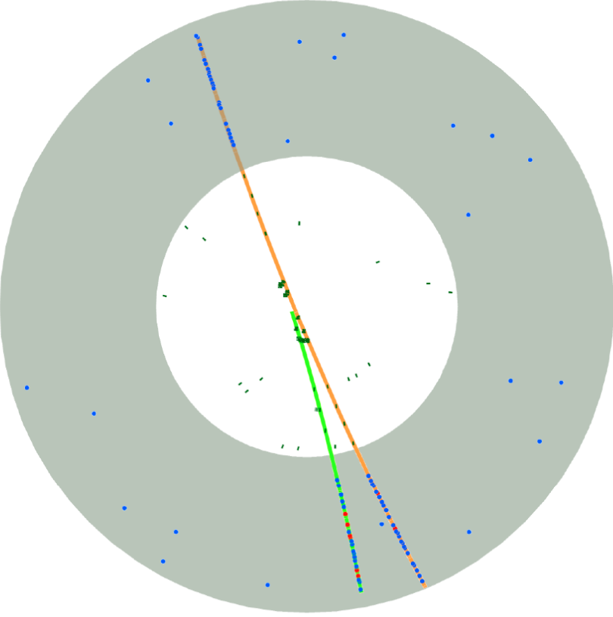
Counting Tracks
This looks straightforward
A charged particle makes a track in the tracking detector, so to count particles, we count tracks
One, two, three.
1
3
2
Except…
ATLAS

Slide 7
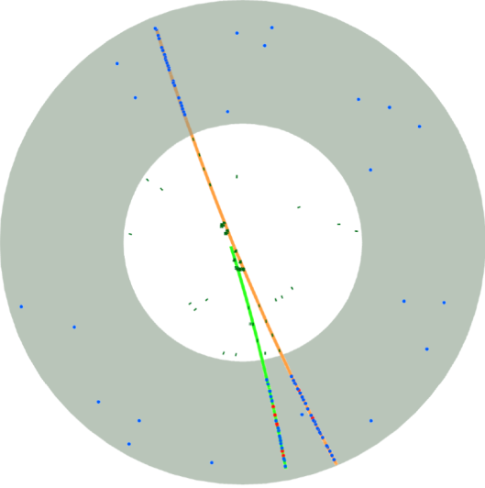
This event isn’t even a collision
Cosmic Ray muon enters from above (track #1)
1
Cosmic Ray interacts and knocks
off an electron (making track #2)
3
2
Cosmic Ray muon exits (track #3)
ATLAS

Slide 8
First Order of Business
Our first order of business is to ensure that we really had a collision
Two general techniques
  Activity: require that there be some minimum amount of activity in the jet.
  The problem is that “almost empty” events become easy to misidentify
  Timing: require that the event be consistent with the collision time.
  The problem is that you can still have fake events that happen accidentally at the right time.
Because we have two techniques, we can play one off the other.
Note that they make tend to mistakes in opposite directions – the first method can be too restrictive, and the second not restrictive enough.

Slide 9
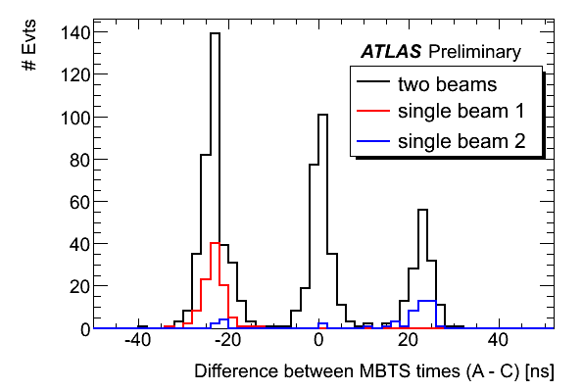
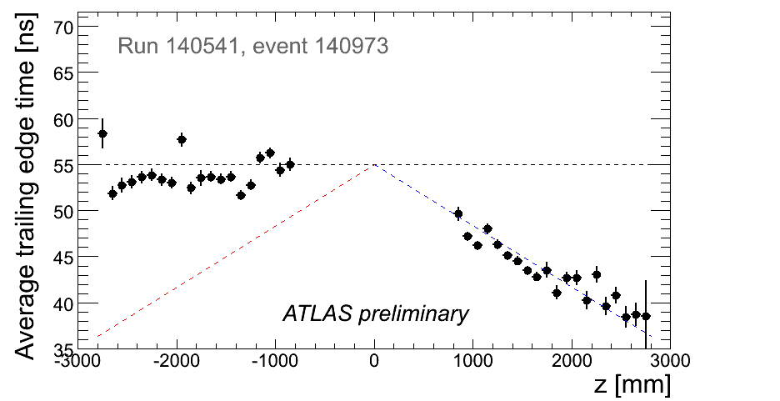
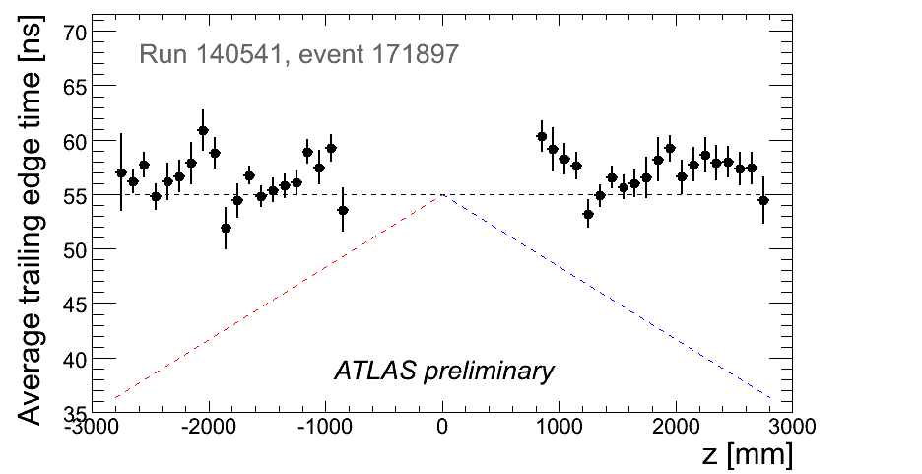
Timing evidence for collisions
Timing with the trigger scintillators
mounted on the endcaps.
Beam-gas in the ATLAS Tracker
tracks moving towards the left.
Collisions in the ATLAS Tracker
tracks moving outwards.
ATLAS

Slide 10
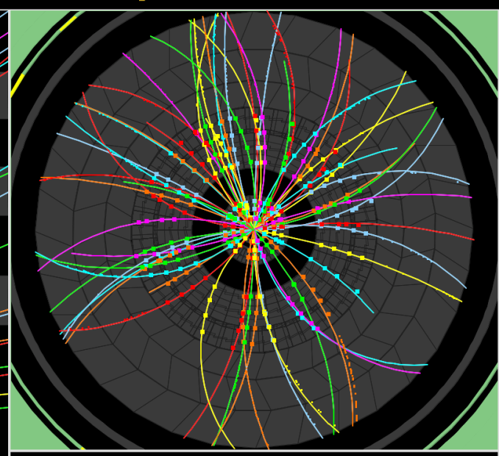
The other side of the coin
ATLAS
This event seems to have a large number of tracks.

Slide 11

The other side of the coin
ATLAS
This event seems to have a large number of tracks.
That’s because we have two collisions at the same time, on top of each other.
We need to identify these events and remove them.

Slide 12
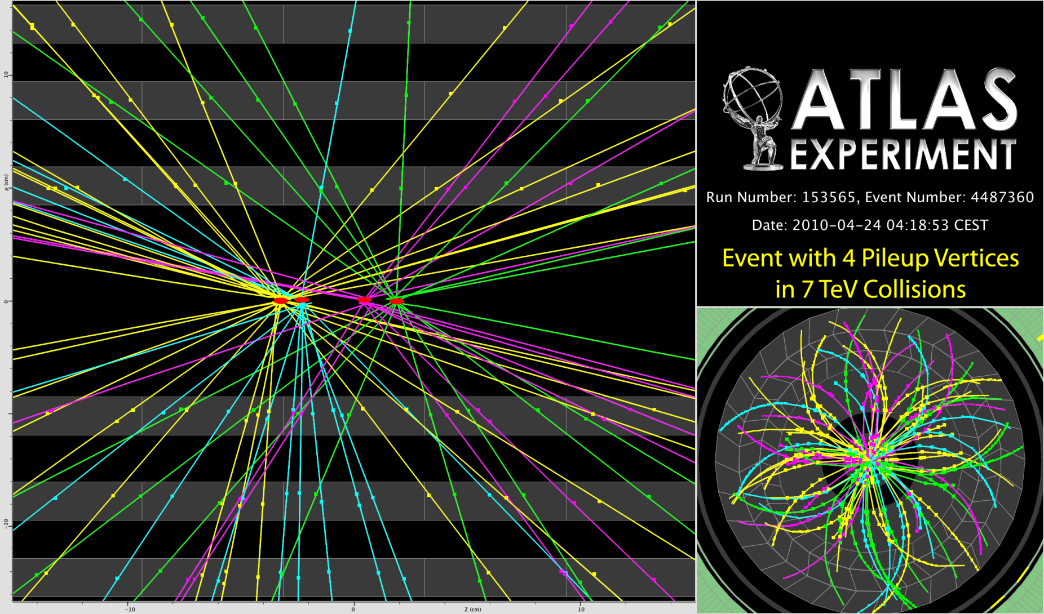
Sometimes We Get Even More
ATLAS
So, some care needs to be taken that we select events with exactly one collision – not 0, 2 or even 4.

Slide 13
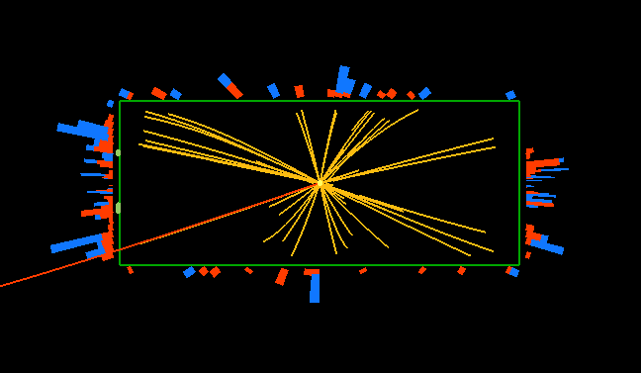
Next on Our List: The Counting of Tracks
Sometimes, counting tracks
is easy:
CMS
36
ALICE
7

Slide 14
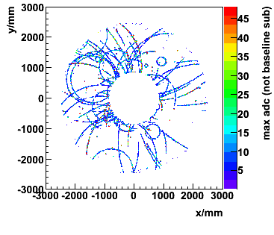
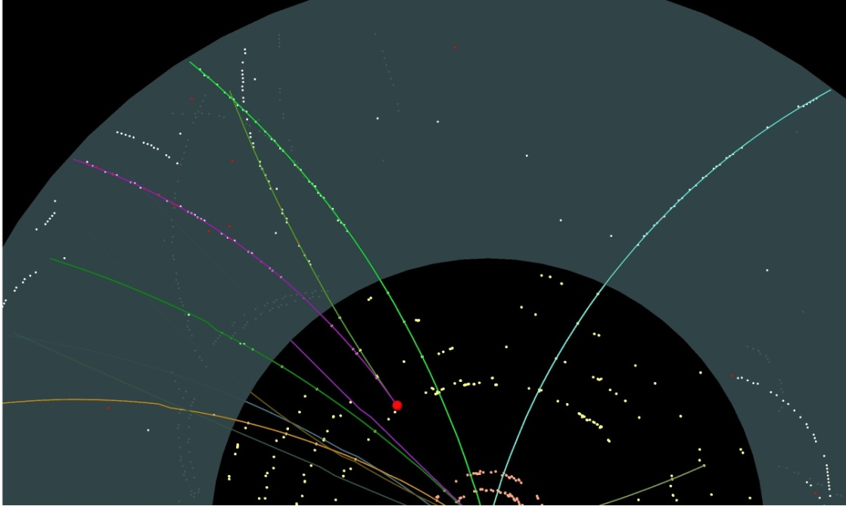
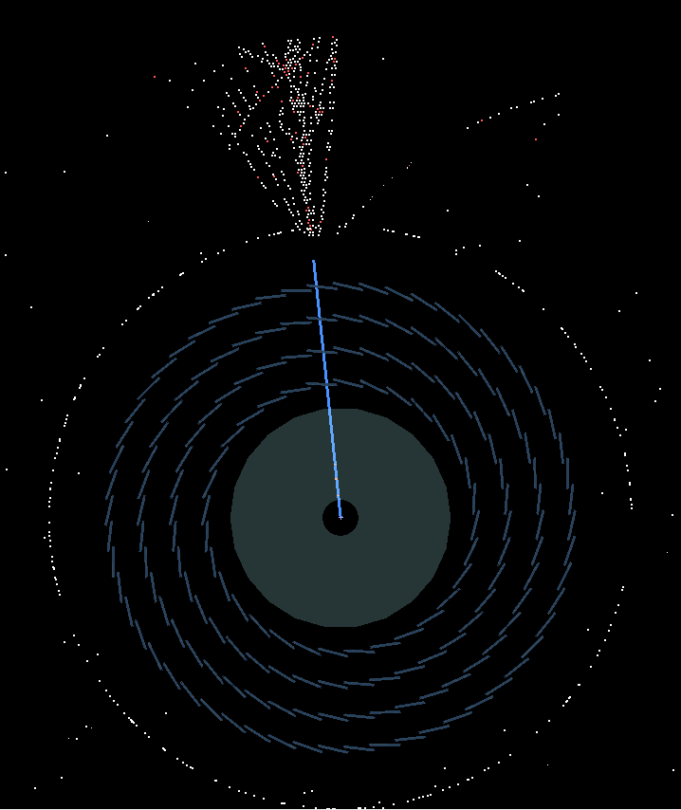
Counting Tracks II
ALICE
Sometimes it’s not so easy – interaction with the detector material can cause tracks to be created or destroyed inside the detector
It’s critical to understand exactly how much material is in the tracking volume and where it is located.
ATLAS
ATLAS

Slide 15
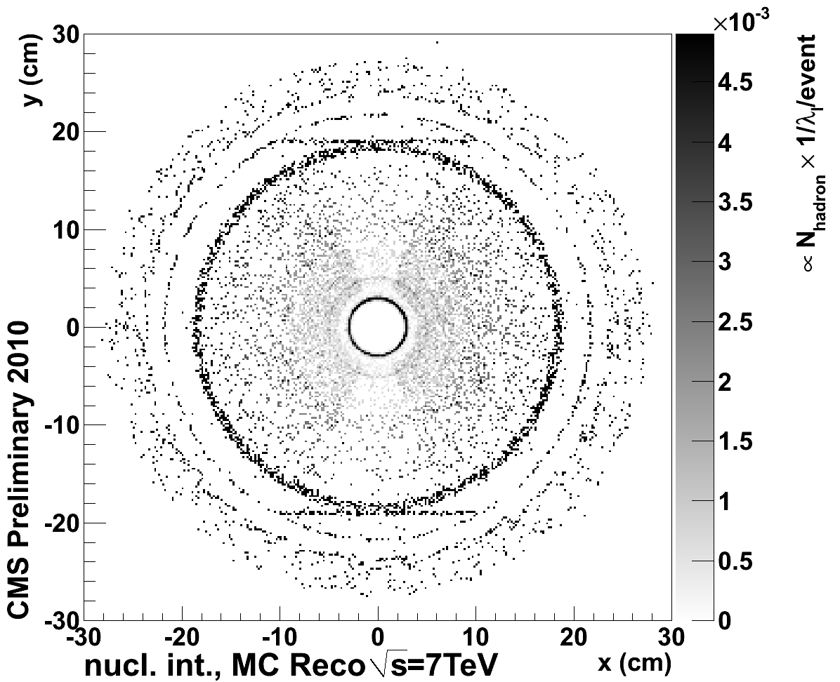
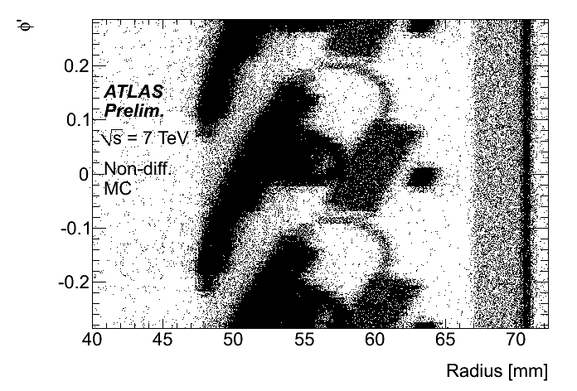
Location of Interactions in the Detectors
CMS
Expected
ATLAS

Slide 16
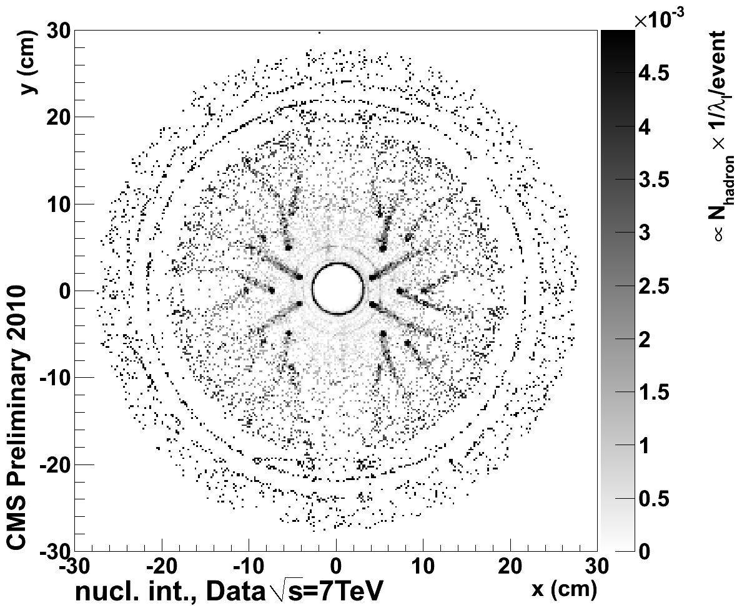
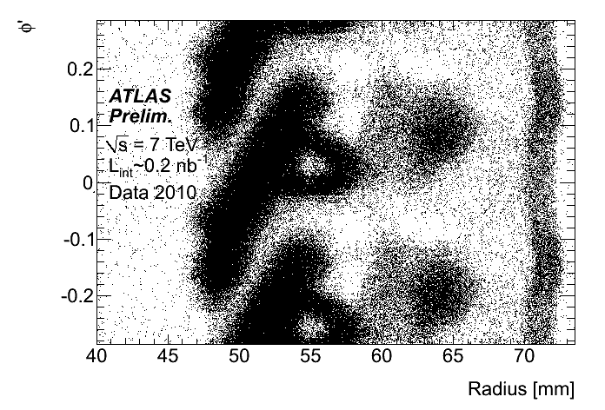
Location of Interactions in the Detectors
CMS
CMS
Expected
Actual
ATLAS
ATLAS

Slide 17
The Chain of Reasoning
The material in the tracker doesn’t just measure tracks – it also destroys and creates them.
If I knew how much material I had, I could calculate this effect and correct for it.
I can infer how much material is there by looking at distributions of where these secondary-interactions occur
  It doesn’t even have to be from the same event sample; the detector is the same in all my event samples
This is just one of many such checks that can be done.

Slide 18
A Second Check
A K-short is a meson that travels several centimeters before decaying to two charged pions.
A quickly-decaying K_{s} will have its daughter pions traverse more material
A long-lived K_{s} will have its daughter pions traverse less material
These pions lose energy as they traverse the material
If I have properly corrected for this, the reconstructed mass of the K_{s} will be independent of the K_{s} flight distance. If I have not (i.e. I have more or less material than I think), I will see the reconstructed mass depend on flight distance.

Slide 19
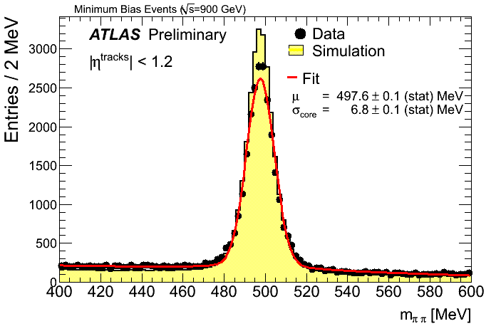
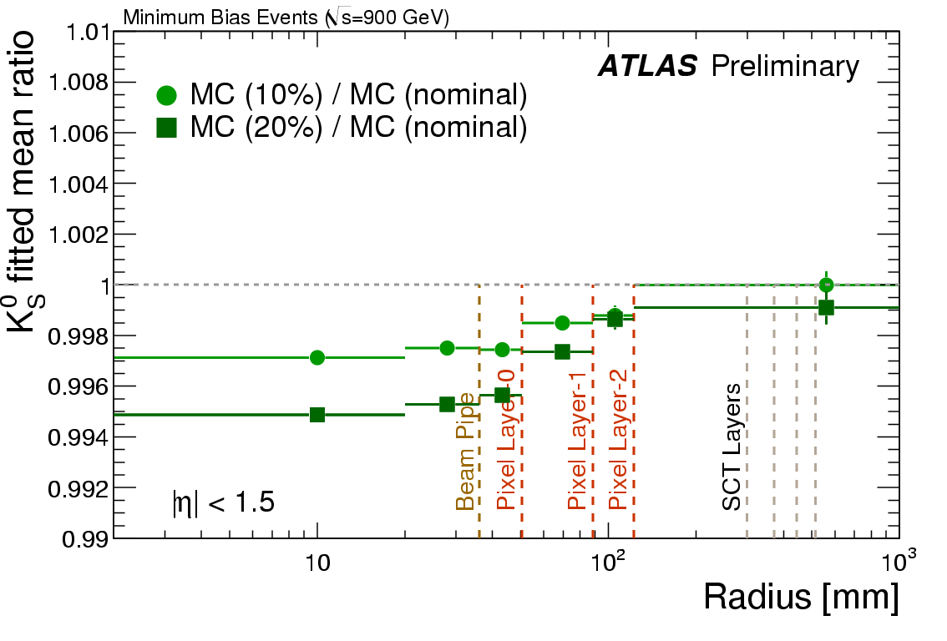
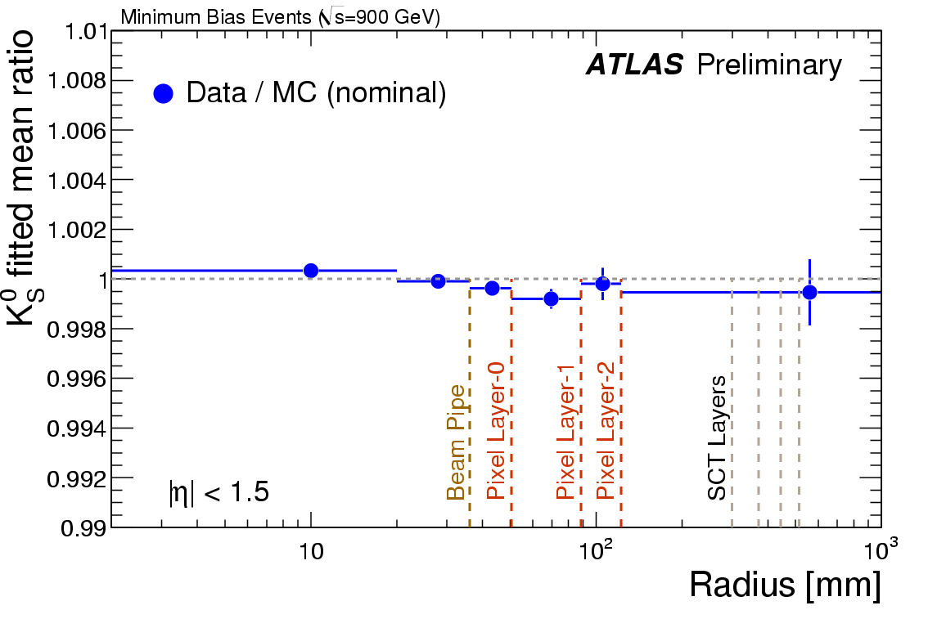
Results
Reconstructed mass
Assuming 10/20% too much material
Had the material been misestimated by 20% - or even 10% - we could tell that from the data.
Since we don’t see such an effect, we know that any mis-estimation must be smaller than that.

Slide 20
Summary on Material
It’s important to understand the amount of material in your detector
  Interactions with the material both destroy and create tracks
  You need to know how much material you have to correct for this
This is not simple, because there’s a difference between
  What you wanted to build
  What you think you built
  What you actually built
  What you said you built
    (when defining the material geometry in the simulation)

Slide 21
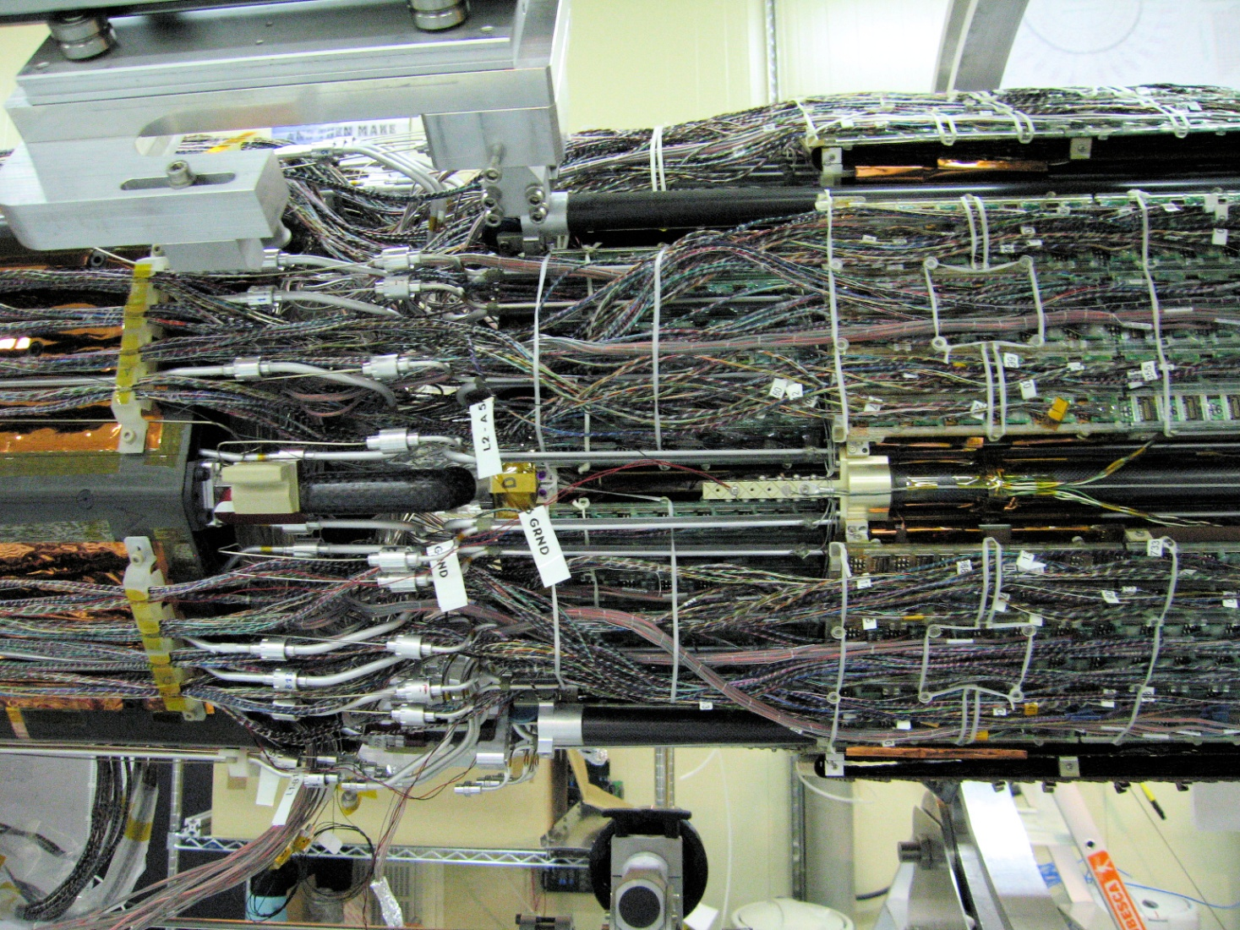
Why This Is Not An Easy Task
This is part of the ATLAS detector (one of the pixel patch panels).
This is typical of what experiments look like on the inside.
You can see how modeling this by simple geometrical shapes is likely to
introduce inaccuracies.

Slide 22
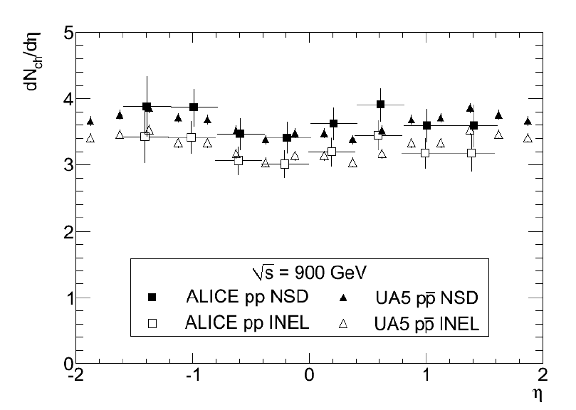
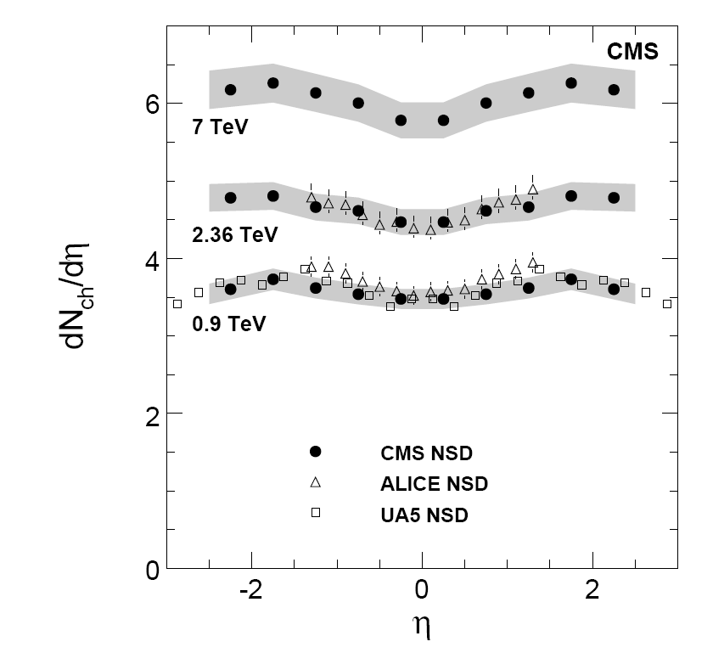
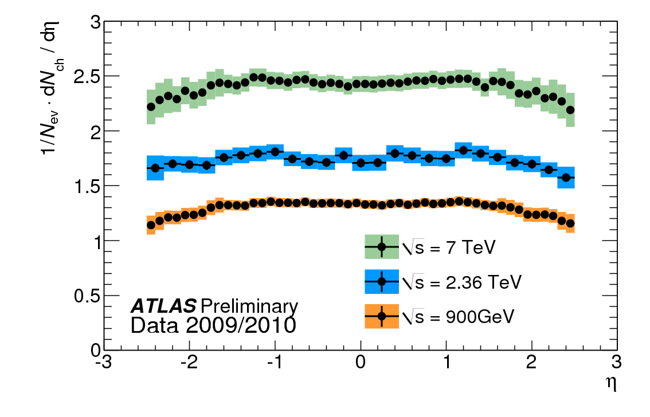
Results
ALICE, CMS and ATLAS have all measured the multiplicity (we used to call this “counting”) of charged particles produced at the LHC.
In fact, they have counted the particles produced in separate bins (in this case, of angle)
ALICE
ATLAS
CMS

Slide 23
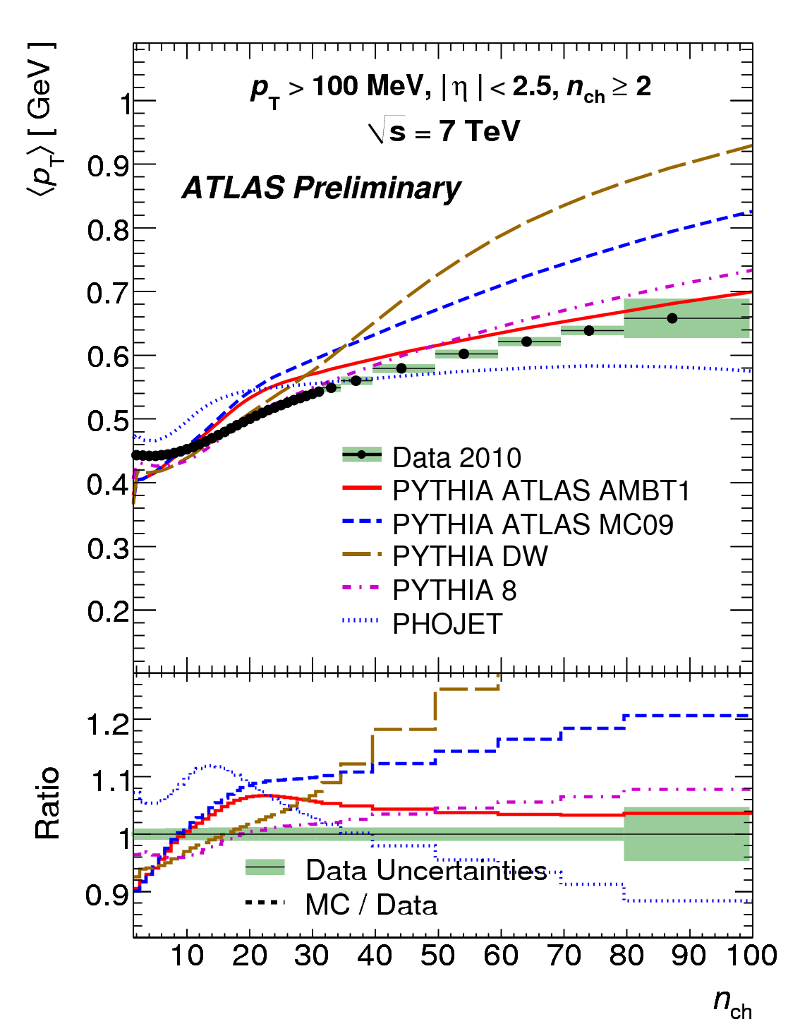
So, What Have We Learned From All This?
It turns out our theory of strong interactions, QCD, says very little about the details of these events
  Calculations are so difficult that they can safely be called “impossible”
We need to develop models
The data tells us where particular models do well, and where they need improvement
Dozens of plots like this one are used to “tune” these models so they can provide a better description of nature.

Slide 24
A Part of Science that Is Seldom Discussed in School
How do you know when you are ready to publish your results?
There is always one more check you can do, one more opportunity to reduce the uncertainties, and there is usually a chance to wait for more data
For this measurement
  The first experiment to publish had an 8% uncertainty
  The second experiment to publish had a 4% uncertainty
  The third experiment to publish had a 3% uncertainty
There is a natural trade-off between speed and precision
  Where is the optimal point?
Of course, there is no single right answer to this – but you might want to think about the question in your free time.

Slide 25
Part Two
J/ψ Production at the LHC

Slide 26
An Introduction To Charmonium
3.8 GeV
threshold
Charmonium is a bound state
of a charmed quark and
antiquark, much like a hydrogen
atom is a bound state of
a proton and an electron.
In fact, the spectrum looks a lot
like that for a hydrogen atom.
³S₁
ψ(2S) or ψ’
³P₂
χ₂
³P₁
χ₁
Mass
³P₀
χ₀
J/ψ
Only the most important
(experimentally) states
are shown. Many more
with different quantum
numbers exist.
³S₁
3 GeV

Slide 27
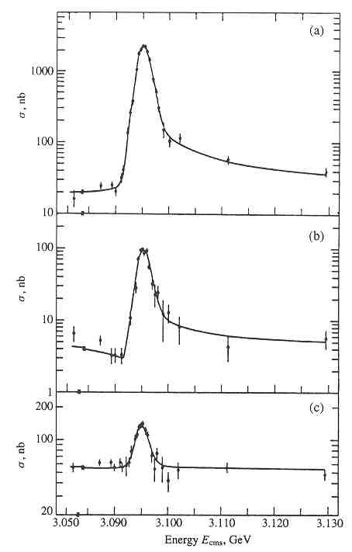
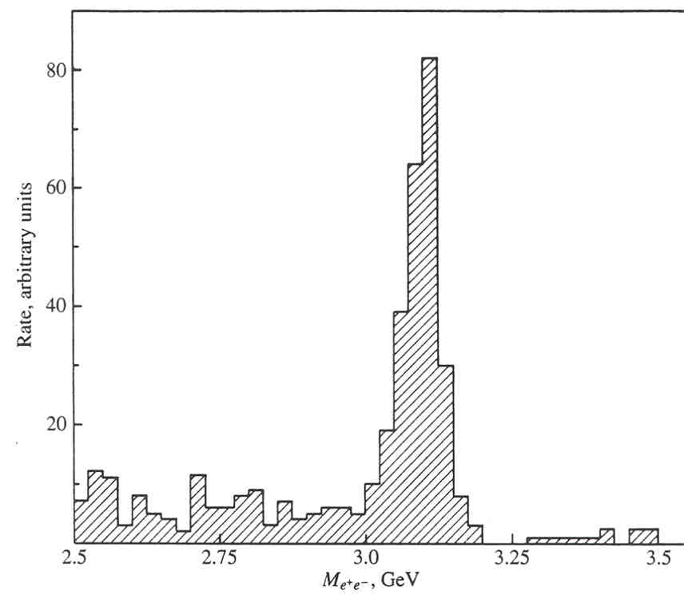
Discovery of the J/ψ
October, 1974
Near simultaneous discovery
  Ting et al. at BNL AGS
  Richter et al. at SLAC SPEAR
Quarks were no longer mathematical objects, but particles that moved in a potential
This work got the 1976 Nobel prize in physics
p + Be→ e⁺e⁻ + X at AGS
The decay into two electrons or two muons 6% of the time makes this particle very accessible experimentally.
e⁺e⁻ annihilation at SPEAR

Slide 28
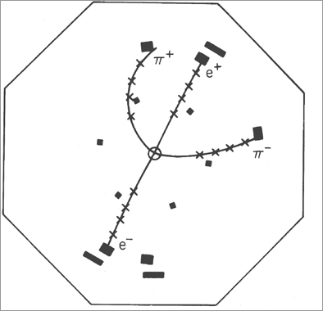
Aside: Why ψ?
Decay is:
ψ(2S) → J/ψ + π⁺ + π⁻
Followed by J/ψ → e⁺e⁻
It’s very convenient to
have the particle name
itself!
Mark I (SPEAR) Event Display

Slide 29
Why is J/ψ Production At Colliders Interesting?
Here’s what we know about it:

Slide 30
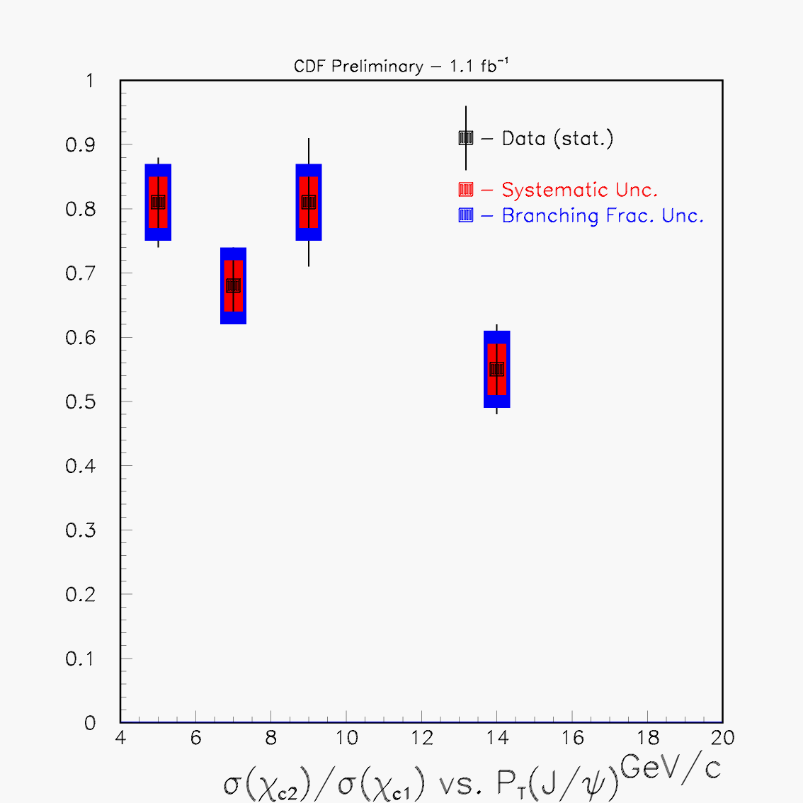
Why is J/ψ Production At Colliders Interesting?
Color Singlet
(could be even higher)
Here’s what we know about it:
That was more than a little unfair of me.
We know that it is initiated by gluons.
We have several theoretical models
  No model can successfully explain all the observations (one comparison is shown to the right)
Scale by Hadronic
Partial Widths
Color Evaporation
(spin counting)
Since we need to develop a better model, we need to provide as much experimental input as we can to the developers of these models.
σ(χ₁)=σ(χ₂)

Slide 31
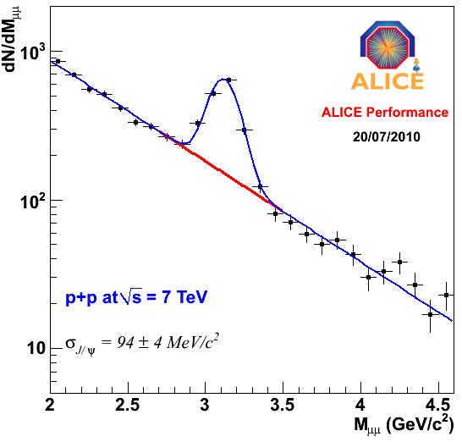
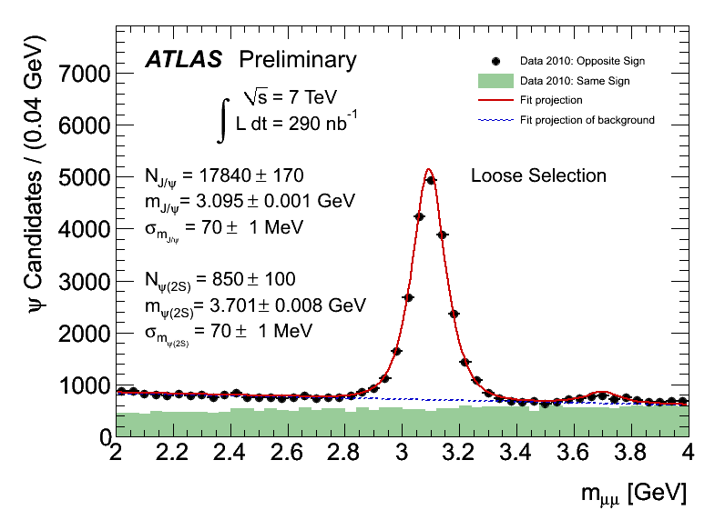
All Four Experiments See The J/ψ
ALICE
ATLAS
LHCb
CMS

Slide 32
Are These Results Consistent?
Comparing raw numbers of events is unhelpful
  The amount of data can be different
  The geometric acceptance can be different
  The detector efficiency can be different…
To address this, the concept of a “cross-section” was introduced.
  This is a number that corrects for all of this: it should be the same for all LHC experiments
  It’s related to the probability of a collision producing a given final state
  It’s expressed in units of area

Slide 33

Why Area?
Think of it like a dartboard
  Each possible final state corresponds to a region on the dartboard.
If we expressed it as a pure probability – given an interaction, how often do you produce X – we need a well defined denominator
It’s not that easy to distinguish between a non-interaction and an interaction where almost nothing happens. This avoids this problem.
The units are in “barns”, where the total cross-section for pp interactions is about a tenth of a barn.

Slide 34
Elements of a Cross-Section
How many signal events you see.
The cross-section you want to measure
Acceptance (A) and efficiency (ε) – how often a produced particle is detected and reconstructed
Integrated luminosity: How much
beam you have collected
Note that this has the right properties
And that it has the right dimensions (luminosity is in inverse (nano)-barns)

Slide 35
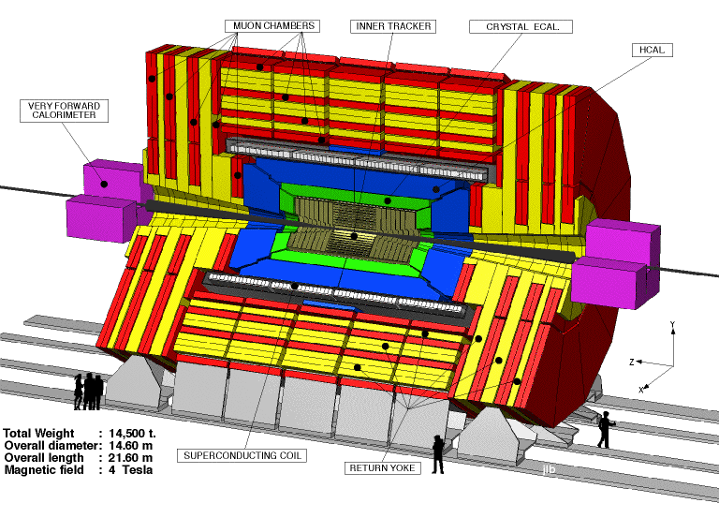
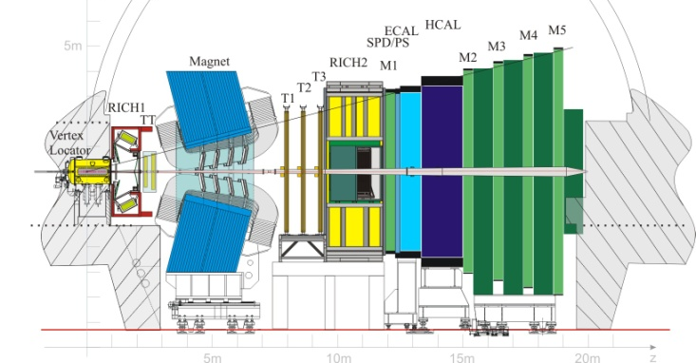
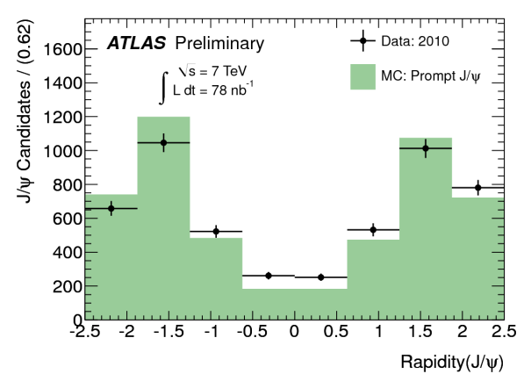
Elements of a Cross-Section II
We can simply read N off the mass plots
Acceptance and efficiency varies a lot between
the central detectors (ATLAS and CMS) and LHCb
CMS is central
LHCb is forward
Most reconstructable J/ψ’s are forward. That’s why LHCb looks like it does: it’s acceptance is 5x ATLAS’ and 3.5x CMS’.

Slide 36
That Leaves Luminosity
Past experiments used a clever trick:
  There is a relationship between elastic scattering and the total cross-section.
  We will use this too – but not for some years
    Not all the detectors have been installed
We need to go to first principles: the
luminosity equation:
  f (revolution frequency) : known
  E (beam energy): known
  n_{b} (number of bunches): known
  N₁, N₂ (protons per bunch): measurable via beam current
  Normalized Emittance (ε) and β* : in principle, known – these are machine design parameters
It’s better to measure this. Note that their product is essentially
the overlap area – indeed, it has dimensions of area/energy.

Slide 37
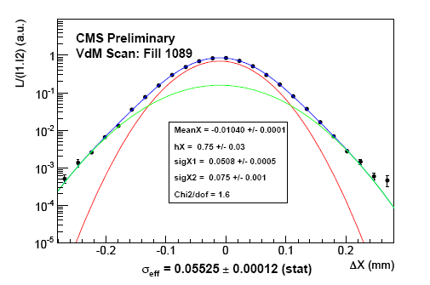
Determining the Overlap Area
We use a technique called van der Meer scans.
The two beams are moved with respect to each other, and the interaction rates measured as this happens.
  The individual bunch profiles can then be inferred
CMS
ATLAS
After this exercise, the total uncertainty is dominated by how well we can measure the beam current, and is about 11%.

Slide 38
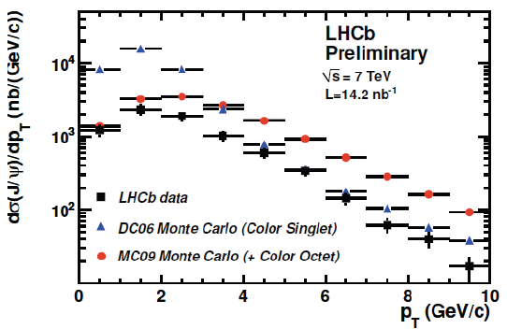
J/ψ Results
ATLAS | 250 nb
CMS | 290 nb
LHCb | 300 nb
Disclaimer: I had to do some calculations of my own – going beyond what the experiments have made public - to allow a direct comparison. Don’t take these exact values too seriously.
The accuracy of these numbers is good to about 20-25% *
LHCb
And of course, this result can be expressed in graphical format over the range of J/ψ momenta.
(all 3 experiments do this)

Slide 39
Why This Is Particularly Remarkable
None of the models predicted a cross-section this small
All three experiments produced this result for last week’s conference (without talking to each other, of course)
All three experiments were confident enough in their results to show them at the biggest conference of the year, even though they disagreed (rather spectacularly) with expectations.
This is how science is supposed to work –
but it’s not easy!

Slide 40
Special Bonus Topic
It turns out that ~10% of the J/ψ’s are from decays of b-quarks.
We can identify them because they travel a measurable distance (~mm) before they decay
The LHC experiment is seeing unequivocal evidence for bottom quark production.
μ⁺
p(ψ)
μ⁺
LHCb
p(B)
θ
R_{xy}
Decay Point
L_{xy}
Production Point

Slide 41
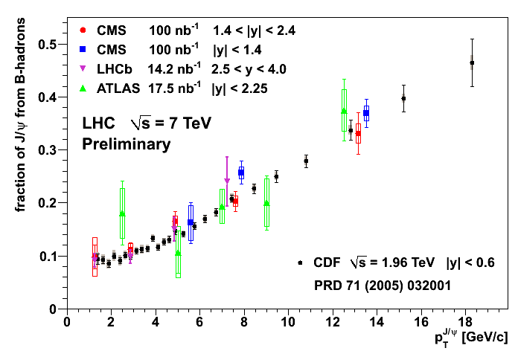

Again, the experiments agree…
This is actually rather mysterious
  There is no obvious reason why the LHC and Tevatron
  results should be identical.
  I can (and did) argue that J/ψ production is poorly
  understood. But bottom production was thought to be
  better.
Welcome to “real science”!

Slide 42
Part III
W, Z and Top

Slide 43
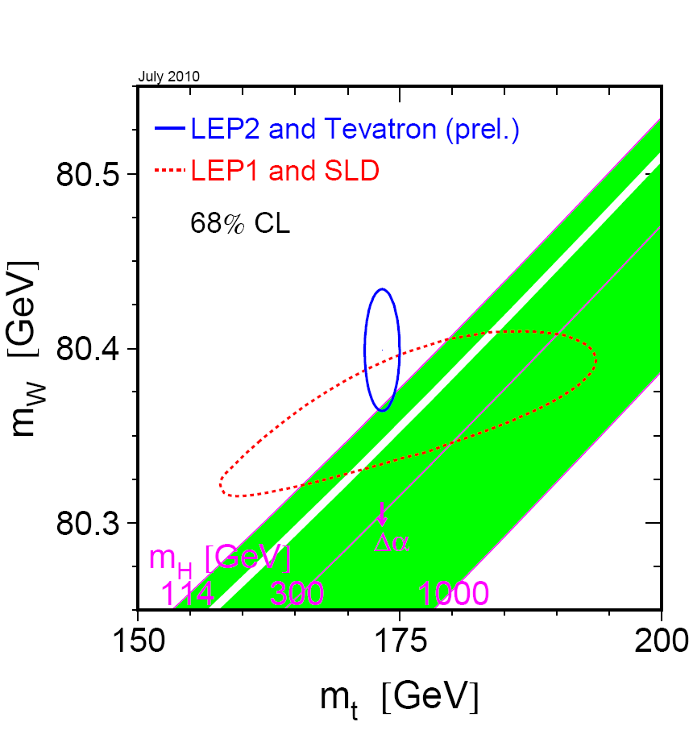
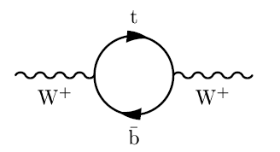
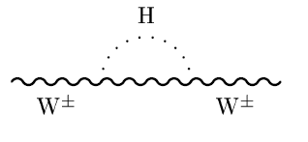
Why is This Important?
Measuring the top and the W tells you something about the Higgs boson.
  Useful particularly if you don’t have any Higgs bosons to look at!
In a sense, the W and the Z are the closest thing we can get to the Higgs field:
  The Higgs boson is only ¼ of the Higgs mechanism
  The remainder are “hiding” “inside” the W’s and Z’s
Many of the things we will ultimately search for have signatures very much like W, Z and/or top
  Practice makes perfect

Slide 44
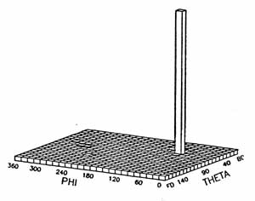
The W Boson in Pictures
From the first observations (UA1/UA2)
This is a UA2 event
Each 11% of the time.
D0
Missing E_{T} (neutrino)
Gives two jets –
like millions of other events
Electron momentum

Slide 45
What is “Missing Transverse Energy (E_{T})”
We know momentum is conserved.
An apparent imbalance of momentum can be due to an escaping neutrino
  Calculated by adding up all the other momenta and reversing the sign
We work only in the xy (transverse) plane
  Many particles escape unmeasured down the beampipe
Missing E_{T} is not just present in W’s: its’ common in many new theories (like supersymmetry)
  Again, the W lets us “practice”
Same event as before
Missing E_{T}
Momentum of the “underlying event”
Electron momentum

Slide 46
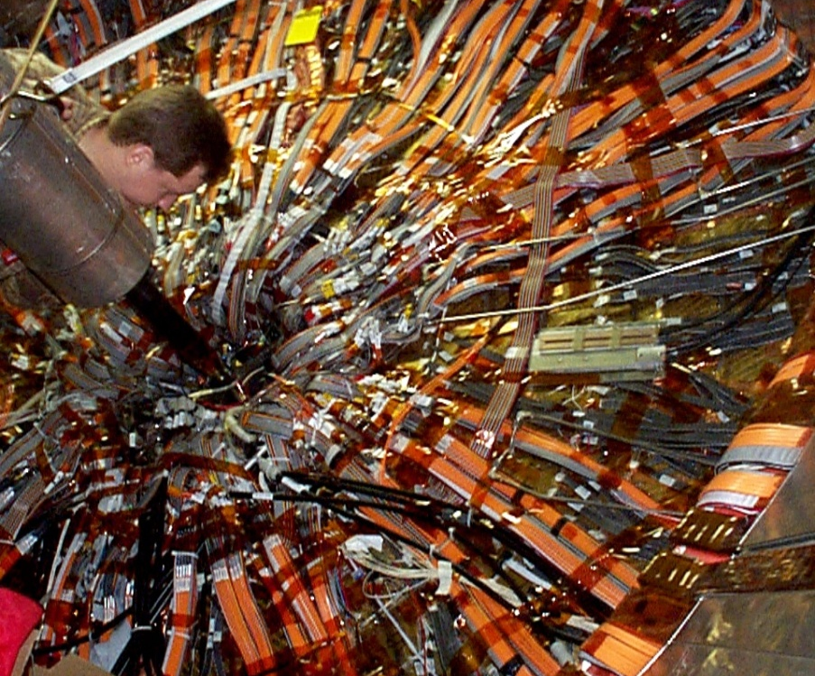
Hermiticity
A fancy way of saying “holes are bad”
Particles escape down holes and cracks, and generate missing E_{T}
  “Real missing E_{T}, because it truly is missing
  “Fake missing E_{T}” in the sense that it wasn’t what you were looking for
    Difference between an undetected and an undetectable particle
Holes, gaps and cracks are necessary
  Minimum of two holes (for the beam)
  Cables need to come out somewhere
  Cooling and cryogens need to go in
    If they go in, they have to come out
CDF

Slide 47
Improving Missing ET
To keep particles from escaping, one can:
  Make the holes smaller
    There’s a limit to this
  Make the detector longer
    The hole is the same size, but subtends a smaller angle
    Works, but eventually you run out of space, money or both.
    ATLAS and CMS are both about as long as we can make them.

Slide 48
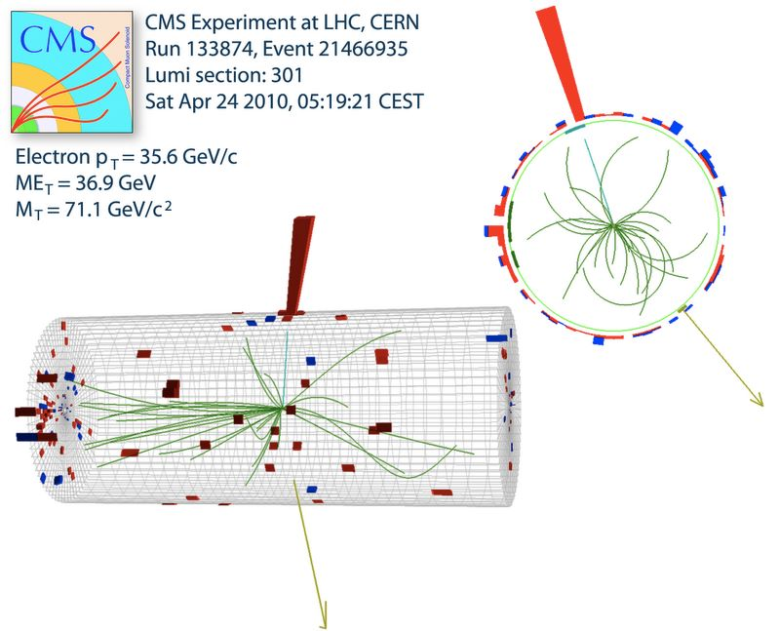
One LHC W (from CMS)
Electron momentum
Missing E_{T} (neutrino)

Slide 49
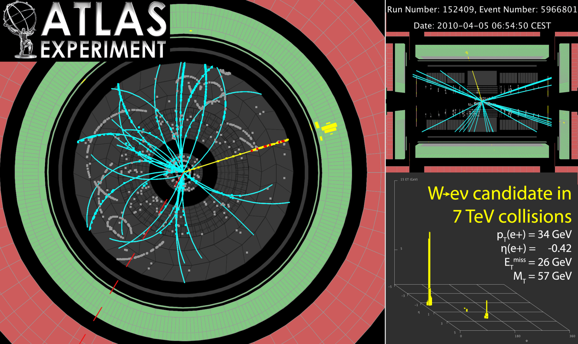
And One From ATLAS

Slide 50
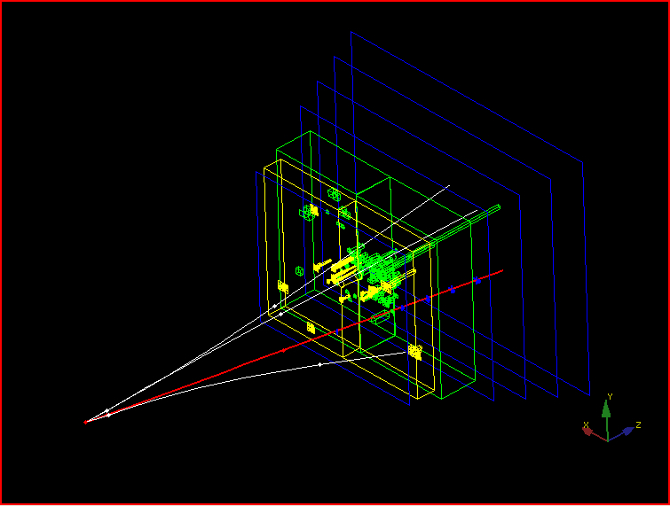
And One from LHCb
Even though their detector is optimized for B-physics, the LHC produces the
same kinds of events as seen everywhere else.

Slide 51
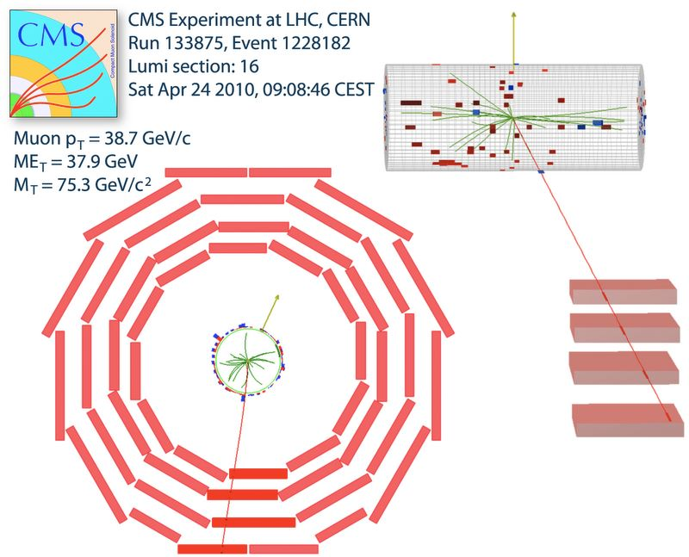
We See Ws in the Muon Channel as Well

Slide 52
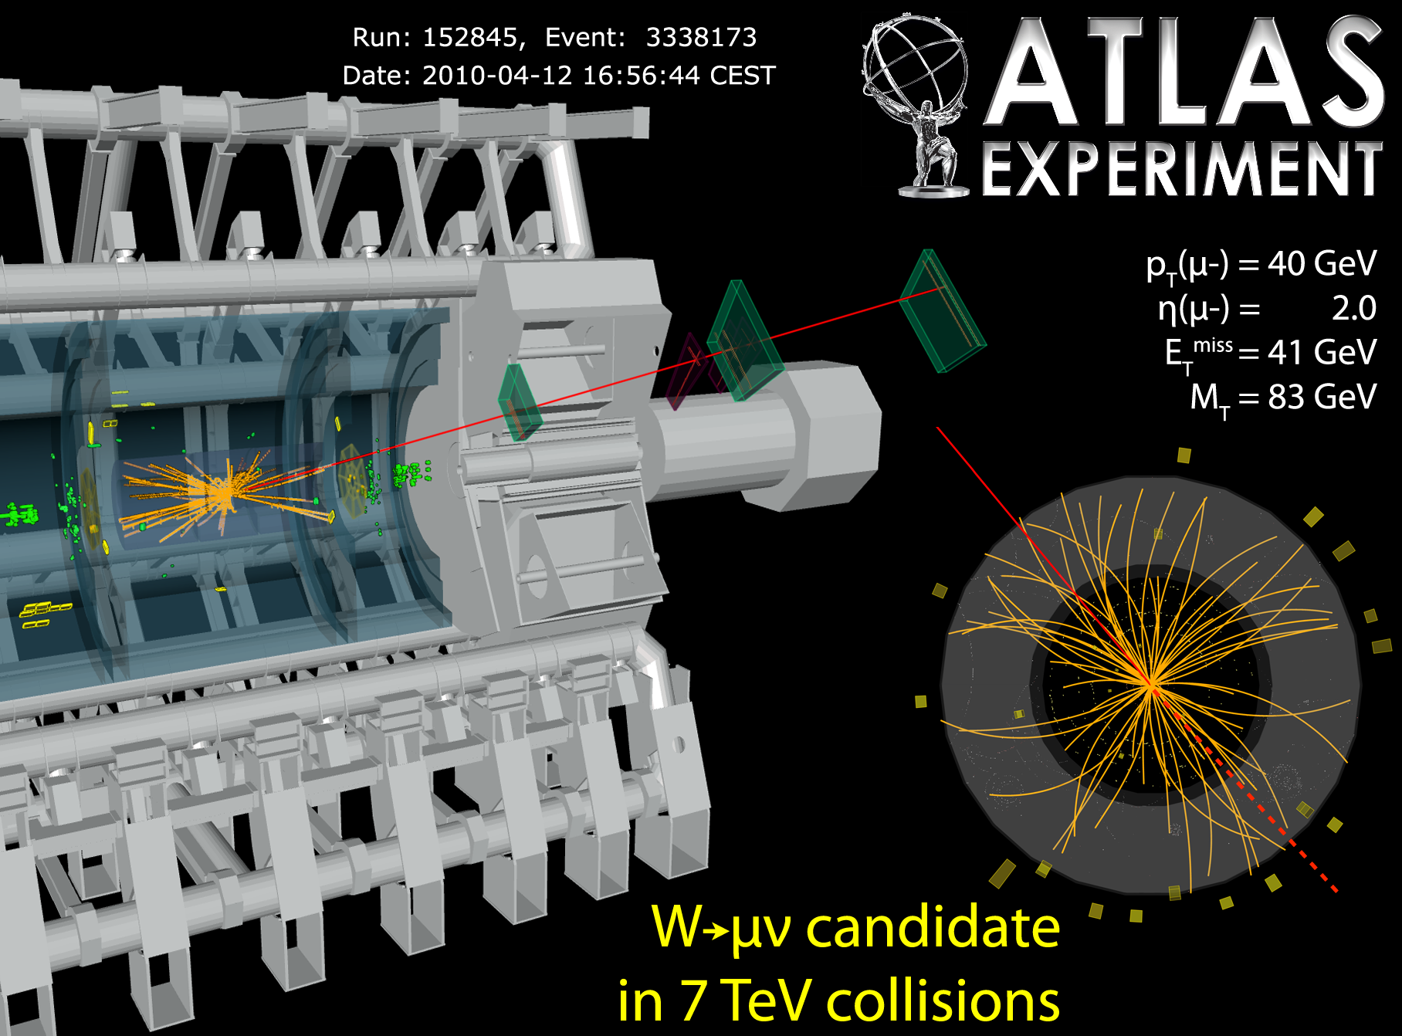
And at ATLAS

Slide 53
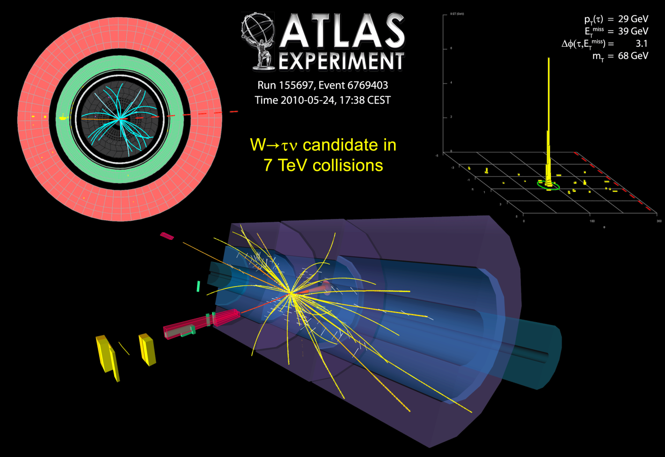
And Maybe even Taus
This channel has substantially more background, so
it’s difficult to tell event-by-event if this is a real tau or background.

Slide 54
The First LHC Results – Part II
CERN Summer Student Lectures
Tom LeCompte/Argonne National Laboratory

Slide 55
Reminder from Yesterday:
STOP ME if I go too fast or you have questions!!
I know I talk too fast, so please interrupt me – my goal is not to cover as much
material as possible: it’s to uncover as much material as possible

Slide 56
Part III
W, Z and Top

Slide 57
Why is This Important?
Measuring the top and the W tells you something about the Higgs boson.
  Useful particularly if you don’t have any Higgs bosons to look at!
In a sense, the W and the Z are the closest thing we can get to the Higgs field:
  The Higgs boson is only ¼ of the Higgs mechanism
  The remainder are “hiding” “inside” the W’s and Z’s
Many of the things we will ultimately search for have signatures very much like W, Z and/or top
  Practice makes perfect

Slide 58
The W Boson in Pictures
From the first observations (UA1/UA2)
This is a UA2 event
Each 11% of the time.
D0
Missing E_{T} (neutrino)
Gives two jets –
like millions of other events
Electron momentum

Slide 59
One LHC W (from CMS)
Electron momentum
Missing E_{T} (neutrino)

Slide 60
We See Ws in the Muon Channel as Well

Slide 61
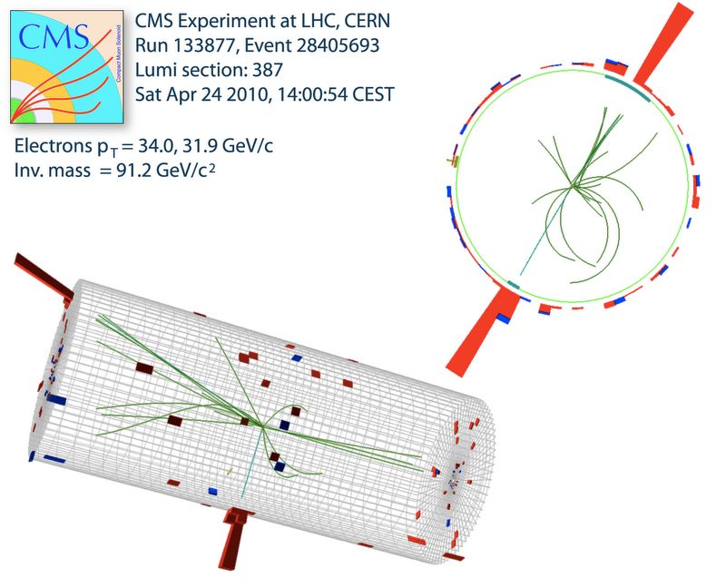
And the W’s Heavier Neutral Brother, the Z

Slide 62

And at ATLAS

Slide 63

In The Dimuon Channel

Slide 64

And at ATLAS

Slide 65








Today There Are Hundreds of W and Z Events

Slide 66



Questions To Ask
Why is the W so broad and the Z so narrow?
  The undetected neutrino: we need to infer its momentum from the Missing E_{T}
That has physical consequences (missing p_{z}) and instrumental effects (fake missing E_{T})
  It’s remarkable that the W mass is known to better than a part per thousand!
Do the experiments agree with each other?
  By now you know this needs to be converted into a cross-section to compare
  And yes, the cross-sections agree
  (indeed, they agree better with each other than with theoretical expectations)
ATLAS
225 nb⁻¹

Slide 67
Questions To Ask (II)
Why do you see so many more W’s?
  The branching fraction of a W to leptons is 11%
  The branching fraction of a Z to leptons is 3.3%
  So we produce ~3x as many W’s and Z’s, not the ~10x you might think
OK, but why are the branching fractions so different?
  An excellent question, and it is related to how the electromagnetic force and the weak force are unified.

Slide 68


The Top Quark
The heaviest particle known
  It used to be “as heavy as a gold nucleus”, but now it’s closer to ytterbium
It decays almost immediately
  Half a yoctosecond after production
  Can only be detected by its decay products
The W daughters also decay right away
  We characterize the events by how the two W’s decay (left)
  The best modes are
    Dileptons (green) – both W’s decay to an μ or m
    Lepton + jets (cyan) – one W decays to an e or μ and the other to a quark-antiquark pair, which gives two jets.

Slide 69

Let’s Look at Some Candidate Events
A CMS event, consistent with
both W’s decaying to a muon
plus a neutrino

Slide 70

Looking Closer at this Event
Top quarks decay to bottom quarks + W bosons.
  Hadrons containing bottom quarks can travel ~mm distances before decaying.
  About half the time, we can detect this. (called “b-tagging”)
Two of these jets seem to contain a long-lived particle.
  Consistent with a bottom particle (see next slides)
This is highly unusual for background events
y [cm]
x [cm]

Slide 71
Reminder from Yesterday
~10% of the J/ψ’s are from decays of b-quarks.
We identified them because they travel a measurable distance (~mm) before they decay
We will use this same fact to identify which jets contain b-quarks
μ⁺
p(ψ)
μ⁺
LHCb
p(B)
θ
R_{xy}
Decay Point
L_{xy}
Production Point

Slide 72


The Idea Behind B-tagging
b’s can be identified by the presence of a set of tracks consistent with the decay of long-lived particle (e.g. a b)
Alternatively, b’s can be identified by the presence of a set of tracks inconsistent with coming from the primary vertex

Slide 73

An ATLAS Event
This event has one W decay to e+ν and the other to μ+ν
  Highly unusual for a background event
Also one jet is b-tagged
  Also highly unusual for a background event

Slide 74

And in Other Channels
This is a lepton+jets candidate
Consistent with one W decaying to e+ν and the other to a quark-antiquark pair (which then become jets)

Slide 75

And from CMS
This is also a lepton+jets candidate
Consistent with one W decaying to e+ν and the other to a quark-antiquark pair (which then become jets)

Slide 76



Where Are The Experiments Now?
ATLAS and CMS each have a handful of events
  Some events look a lot like top and not so much like background
  Some events look a lot like background and not so much like top
The experiments are looking carefully at every candidate
  Someday we will have thousands. Today every event has a name
To say that we see more events than can be explained by an upward statistical fluctuation of the background will take some time
  The LHC is producing more data all the time

Slide 77
Backgrounds?
Yesterday, you asked “what about backgrounds”
In general, there are two things you can do:
  Calculate the backgrounds
  Measure the backgrounds
If you choose to calculate the background, you simulate many (tens or hundreds of millions) of background events and see how many pass your selection
  Disadvantage: how do you know the simulation is correct?
If you chose to measure the background, you look in regions where you expect relatively little signal and extrapolate into your signal region
  Disadvantage: how do you know the extrapolation is correct?
You can also adopt a hybrid approach
  Use measurements to validate what the simulation is telling you

Slide 78
The “ABDC” Method
Take two independent variables
Divide your data as shown
Then we know
  N(A)/N(B) = N(C)/N(D)
  N(A)/N(C) = N(B)/N(D)
  This is what independence means.
If my signal is in region D, the background is given by:
  N(D) = N(B) x N(C)/N(A)
A
B
Variable Two
C
D
Variable One

Slide 79

ABCD in Real Life
CMS
This shows one application at CMS: in the top search
It also illustrates one of the problems with data-driven backgrounds: region C doesn’t contain as many events as one would like

Slide 80
Top Quark Status
Both ATLAS and CMS are seeing a handful (the expected number) of top quark candidates
These are obviously very complicated final states
  If you want to reconstruct top quarks, you need to reconstruct electrons, muons, jets, jets with b’s, and missing transverse energy
  These are the same objects that we need to reconstruct for new physics searches
  This is good practice
    Yes, I’ve said this before – it doesn’t make it any less true
For example, one signature for supersymmetry is a one or more leptons, jets and missing transverse energy
  Sound familiar?
  In fact, top is a background to these searches

Slide 81

A Small Part of One SUSY Study
There are five different kinds of backgrounds
  Top is one of them!
Today, all we have to go is simulation
  We can do some limited validation on data
With more data, some or all of the individual components can eventually be measured
While this isn’t a SUSY talk, there are two things you can get from this plot:
  The experiments are looking
  The experiments haven’t found anything yet.

Slide 82
Part IV
Are Quarks Elementary?
And How Could We Tell?

Slide 83

Dalton’s Atomic Theory
All matter is composed of tiny atoms
  These atoms are indivisible and indestructible
    Much like a cafeteria meatball
  All atoms of a given element are identical
  Explains the “law of definite proportions”
  The first “particle theory”
    Atoms are particles of matter
This was a major scientific accomplishment.
Now we’re going to kill it.

Slide 84

Making the Case Against Dalton’s Theory
This picture is impossible under the Dalton view.
Understanding why gives us some insight into what’s going on here.

Slide 85


Atomic Spectra
Atoms have different configurations with different amounts of energy
Transitions between these energy levels give light at energies characteristic of the given element
Different elements have different atomic spectra (which is what colors fireworks)

Slide 86
Why this is bad for Mr. Dalton
Atoms show different energy levels for different configurations
  If atoms are indivisible have no substructure, how can they have different configurations?
    There is nothing to configure!
Heavier atoms show more complex spectra
  A sign that they are made out of “more parts” than lighter atoms
  Today, we know that the parts that are moving around and creating these energy levels are electrons

Slide 87

Mr. Dalton’s Next Problem
Why on earth should different elements show similar chemical properties?

Slide 88
Why There is a Periodic Table: The Modern View
Chemistry is driven by the electronic structure of atoms
  Atoms with similar structure have similar chemistry
    Example: sodium and potassium both have a single outer electron that’s very active – this electron drives their chemical properties
  It’s the fact that atoms have substructure – they are not indivisible – that gives us the organization of the periodic table
In principle, the structure of the periodic table gives us information about the atomic structure
  In practice, this is easier done with hindsight than foresight

Slide 89


A Second Periodic Table
The 9 lightest spin-0 particles
The 8 lightest spin-1/2 particles
It looks like another periodic table is showing up for elementary particles. Pretty soon, people got the idea to look for particles where there were gaps in the patterns. Again and again, they found them.
Remember: a good theory is predictive.

Slide 90


More particles, More patterns
It’s getting hard to see how so many patterns could be forming accidentally.
These patterns aren’t random. They are representation of the same underlying symmetry.

Slide 91

One Last Bit Of Evidence
Just as atoms and nuclei have energy levels, so do “particles”
  These energy levels are typically 100’s of MeV apart
  Nuclear energy levels are MeV apart
  Atomic energy levels are eV apart
  Conclusion: particles have substructure
  Their constituents are bound together a hundred times tighter than nuclei are (again, suggests structure) and a hundred million times tighter than atoms are
We see “periodic tables” and energy levels because hadrons are made up of smaller particles (quarks).

Slide 92

The “Standard Model”
Everything we know about can be made up of particles in this table
A good theory is predictive:
  Two quarks and one lepton were successfully predicted from this table
The quarks and leptons line up in nice columns

Slide 93

How Atoms Emit Light
Found on the internet

Slide 94


The Idea: Draw a Parallel between Atoms and Quarks
Put a lot of energy into an atom
The atom transitions to an excited state
The atom emits a photon and returns to its ground state
We see a line spectrum
Put a lot of energy into a quark
The quark transitions to an excited state
  Only if such a state exists of course!
The excited quark (q*) emits a gluon and returns to its ground state.
What would we see?

Slide 95

What We Might See
Lines in atomic spectra correspond to bumps in the jet-jet mass plot
  One jet is the emitted gluon
  The other is the recoil quark
  (With atoms, the recoil is small)
The experimental question is whether this distribution is smooth or whether it has bumps
The background (black) is huge – it’s like trying to measure atomic spectra at noon outside rather than in a dark room.

Slide 96

The Sort Of Events We Are Looking For

Slide 97

And One From ATLAS

Slide 98


What Do The Data Look Like?
Both CMS and ATLAS see the same thing – smooth, with no sign of bumps.

Slide 99
Summary of Q* Search
The previous limit was from CDF at the Tevatron: m(q*) > 870 GeV
  This is a statement of the form “We don’t see anything – but if there were an excited quark lighter than 870 GeV, we would have seen it.”
Now there are LHC limits
  CMS: m(q*) > 590 GeV
  ATLAS: m(q*) > 1.29 TeV
Still no major discovery, but the LHC is starting to move beyond what existed before
  We’ll keep looking.
Note: if you have an observation, every experiment needs to see the same thing. (We discussed this in the
context of cross sections. For a limit, that’s not true:
the experiments’ sensitivities can be different.

Slide 100
Summary
I hope I managed to show you some of the excitement and challenges of experimental HEP
Feedback is welcome – there is always a tradeoff between number of topics covered and their depth
The LHC is a discovery machine, and now – only four months after the first 7 TeV collisions – we are starting to become sensitive to new TeV-scale physics
Thanks for your attention, and thanks to ALICE, ATLAS, CMS and LHCb for producing such nice results.

